Slide 1
IoT Smart Home Dashboard
Sushma Mainampati
Emp. ID: 108915821

Slide 2
Introduction
The IoT Smart Home Dashboard is a Java-based console application designed for managing smart home devices through a comprehensive command-line interface. Built with Java 21 and AWS DynamoDB Local, this application provides device control, user management, energy monitoring, and automation features.

Slide 3
Architecture
PRESENTATION LAYER Console Interface (CLI) Smart Home Dashboard
SERVICE LAYER
 | Smart Home Service (Core Logic) | Timer Service (Automation) | Calendar Service (Events) | Energy Service (Analytics)
DOMAIN LAYER
 | Customer Entity (User Data) | Gadget Entity (IoT Device) | Device Permission Entity (Access Control) | Smart Alert Entity (Notify)
INFRASTRUCTURE LAYER AWS DynamoDB

Slide 4
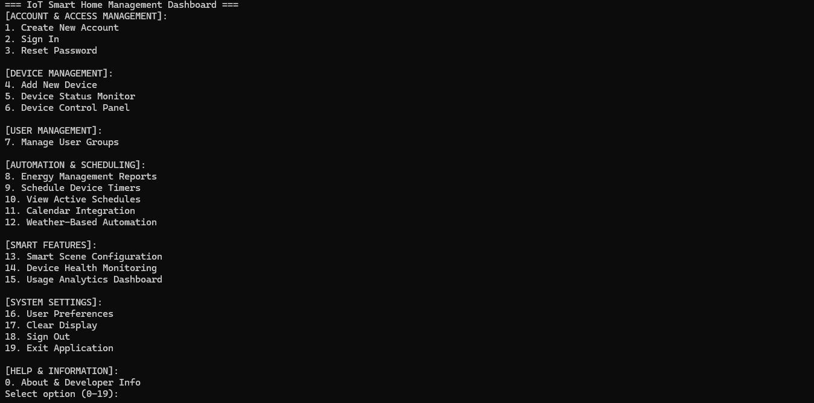
IoT Smart Home Dashboard - Menu
Account & Access Management:
Password strength is enforced with a minimum length of 8 characters, requiring at least one capital letter, one lowercase letter, one special character, and one number. Sensitive data is secured through Bcrypt encryption.

Slide 5
IoT Smart Home Dashboard - Menu
Device Management:
Application offers the user to add new devices and individually monitor or control each device's ON/OFF state.

Slide 6
IoT Smart Home Dashboard - Menu
Manage User Groups:
The application enables users to add or remove members and assign precise, device-specific controls to them.

Slide 7
IoT Smart Home Dashboard - Menu
Automation and Scheduling:
This application offers comprehensive device management, including:
Energy Monitoring: Track individual device and total system energy consumption.
Scheduling: Create, manage, and view device operational schedules.
Smart Automation: Automate device states based on calendar events and weather conditions.

Slide 8
IoT Smart Home Dashboard - Menu
Smart Features:
For enhanced control, users can group devices and manage their ON/OFF states collectively. The application further offers simulated performance reports and comprehensive usage details for all connected devices.

Slide 9
IoT Smart Home Dashboard - Menu
System Settings:
The application offers essential user controls:
Account Management: Edit profile and change password.
Interface Reset: Clear screen to wipe previous operations.
Session Control: Securely sign out or exit the application.

Slide 10
Solid Principles – SRP
Single Responsibility Principle
CustomerService: Only handles user authentication/management
GadgetService: Only handles device validation/creation
TimerService: Only handles scheduling operations
EnergyManagementService: Only handles energy calculations

Slide 11
Solid Principles – OCP
Open/Closed Principle
Add Device: New device types added without modifying existing code
Smart Scenes: New scenes added via extension, not modification
Alert System: TimeBasedAlert, EnergyUsageAlert extend base Alert class

Slide 12
Solid Principles – LSP
Liskov Substitution Principle
Alert System: All Alert subclasses are substitutable in menu operations
Menu 13: Alert.getAlertId() works for both TimeBasedAlert and EnergyUsageAlert
Polymorphic usage maintains expected behavior across menu functions

Slide 13
Solid Principles – ISP
Interface Segregation Principle
SmartHomeService: Large class serving multiple menu options

Slide 14
Solid Principles – DIP
Dependency Inversion Principle:
Direct Dependencies: SmartHomeService directly instantiates other services

Slide 15
Design Patterns – Singleton Pattern
Singleton Pattern:
Ensures single instance for shared scheduling and monitoring resources
TimerService, AlertService, CalendarEventService

Slide 16
Design Patterns – Factory Pattern
Factory Pattern:
Handles complex object creation with validation for 14+ device types
Customer creation, Device creation

Slide 17
Design Patterns – Command Pattern
Command Pattern:
Encapsulates operations, supports undo/redo, enables macro commands
Device control, Scene execution, System operations

Slide 18
Design Patterns – Observer Pattern
Observer Pattern:
Decouples event producers from consumers, enables real-time updates
Status monitoring, Timer events, Calendar automation

Slide 19
Design Patterns – Strategy Pattern
Strategy Pattern:
Supports multiple algorithms, easy to add new strategies
Authentication strategies, Energy pricing, Weather responses, Analytics

Slide 20
Design Patterns – Template Method
Template Method Pattern:
Defines skeleton of algorithm, specific steps implemented by subclasses
Schedule display, Health reports, Settings, Shutdown

Slide 21
Design Patterns – Composite Pattern
Composite Pattern:
Handles hierarchical structures uniformly
User Groups with nested permissions

Slide 22
Design Patterns – Repository Pattern
Repository Pattern:
Abstracts data access, centralizes database operations
All Database Operations: CustomerService acts as repository

Slide 23
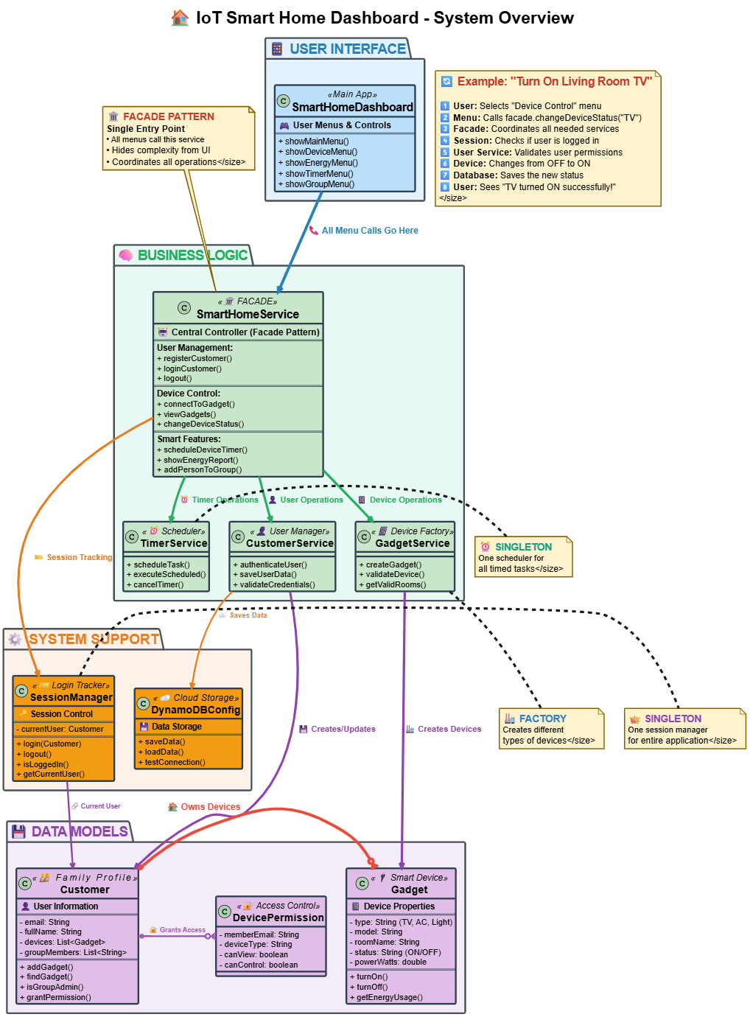

Slide 24
Thank you

