Slide 1
Finding Open Data

Slide 2
Finding Open Data
First, go to the ATLAS Open Data website,
https://opendata.atlas.cern/

Slide 3
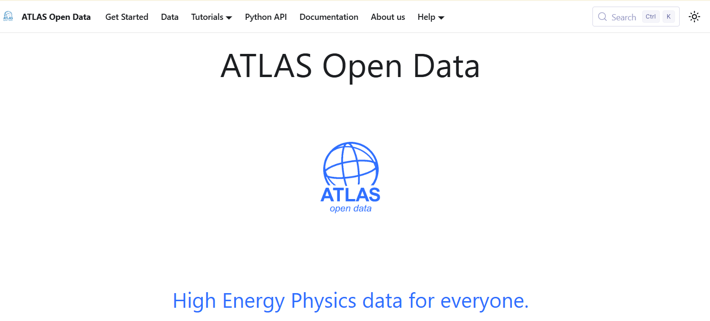
Finding Open Data
We will click “data” to explore the data collections.
You should also explore the “Documentation” tab

Slide 4
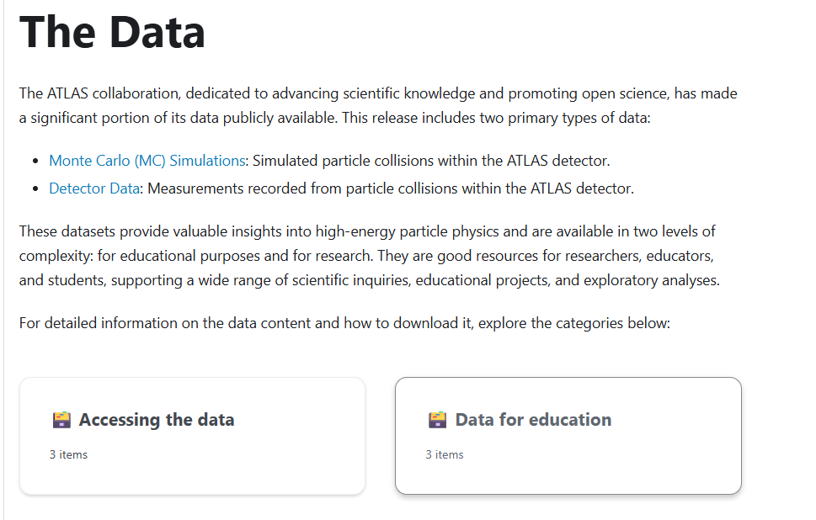
Finding Open Data
Read through the information linked here.
Then click on Data for Education

Slide 5
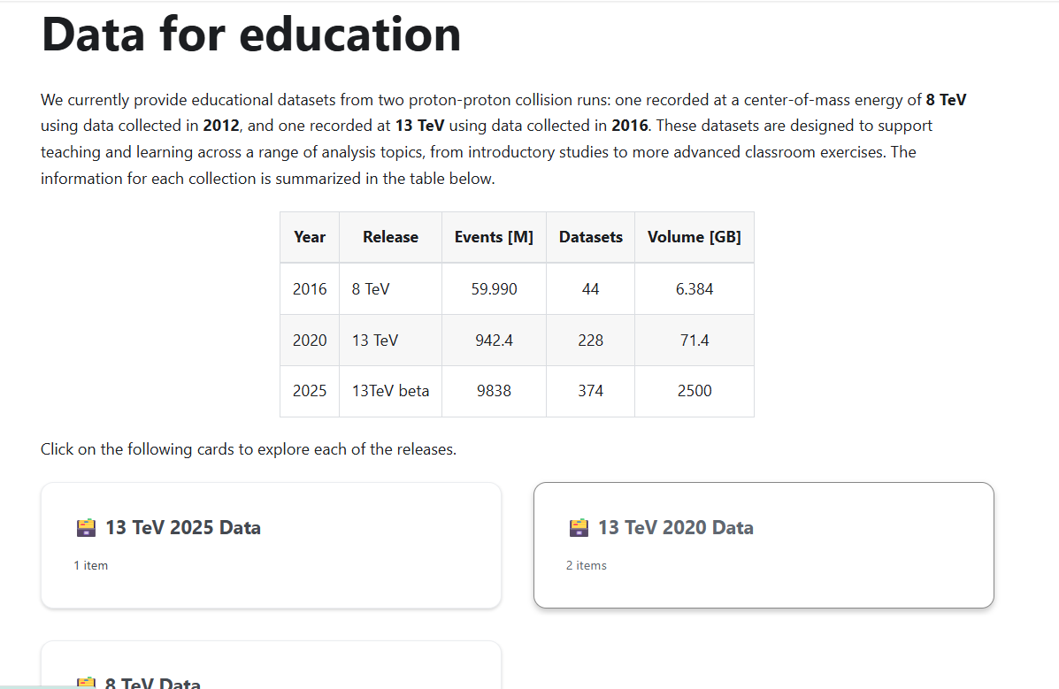
Finding Open Data
We will initially be using the 2020 data.
If you want to you can explore other data sets when conducting your own research in Phase 3

Slide 6
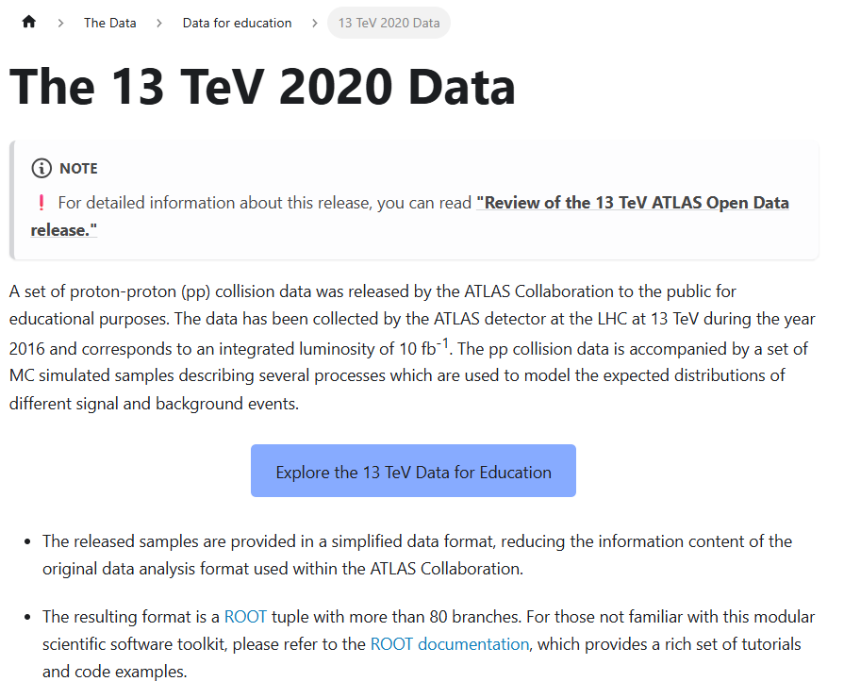
Finding Open Data
Read down through this page. Some parts might be confusing, but you will gradually develop familiarity with the notation and the contents of the files.
You will likely revisit it and the documentation tab a few times to read about the different types of analysis you can do and to find the numbers/names of datafiles for those analyses.
When you’re ready, click the blue button to navigate to the files themselves.

Slide 7
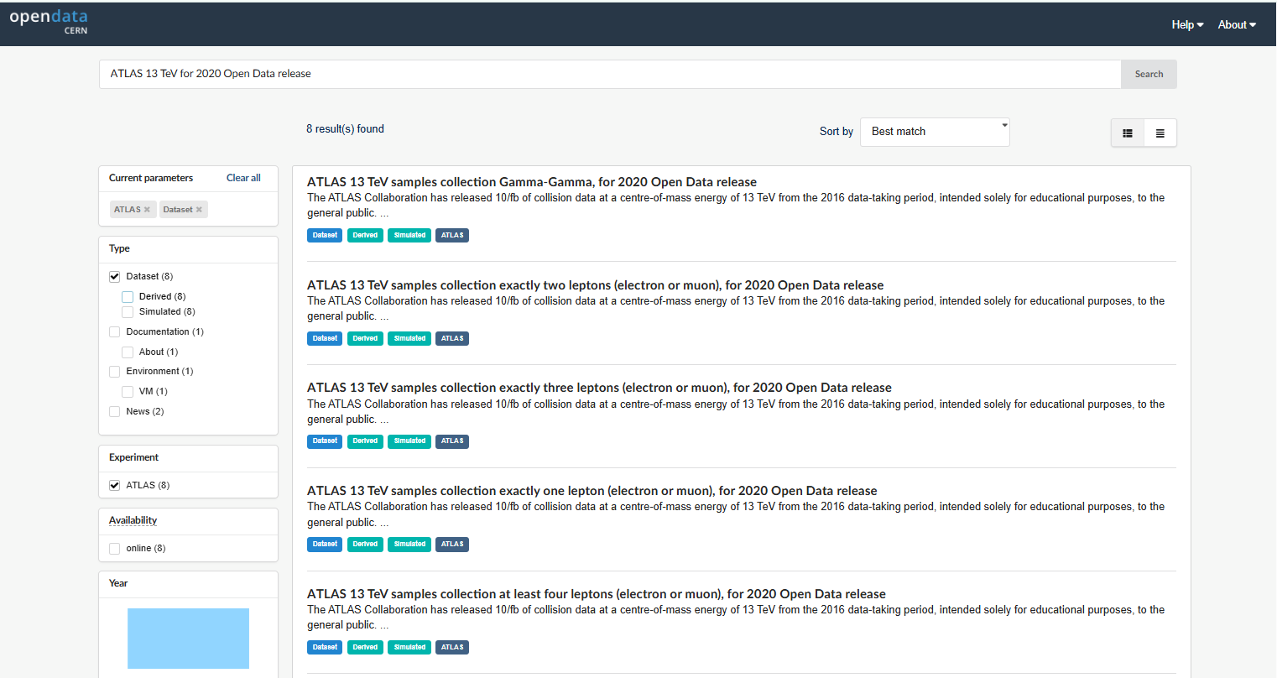
Finding Open Data
You can use filters to narrow your search. E.g. if you want Monte Carlo simulated data you can select “simulated”
Then you can click on a row to look at it in detail.

Slide 8
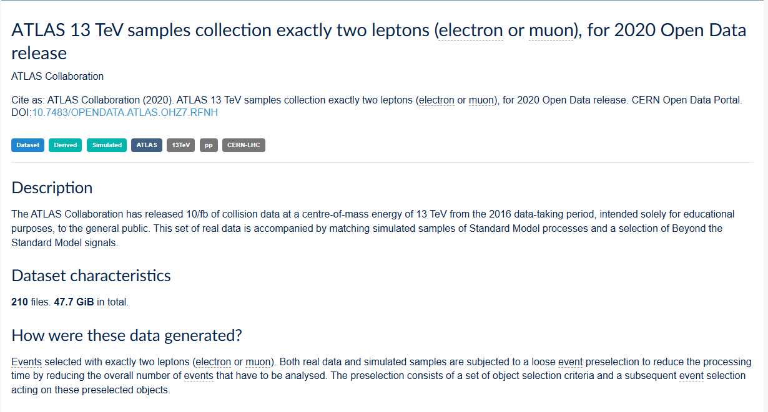
Finding Open Data
These DOI links are unique identifiers that can be used to reference the data you used.

Slide 9
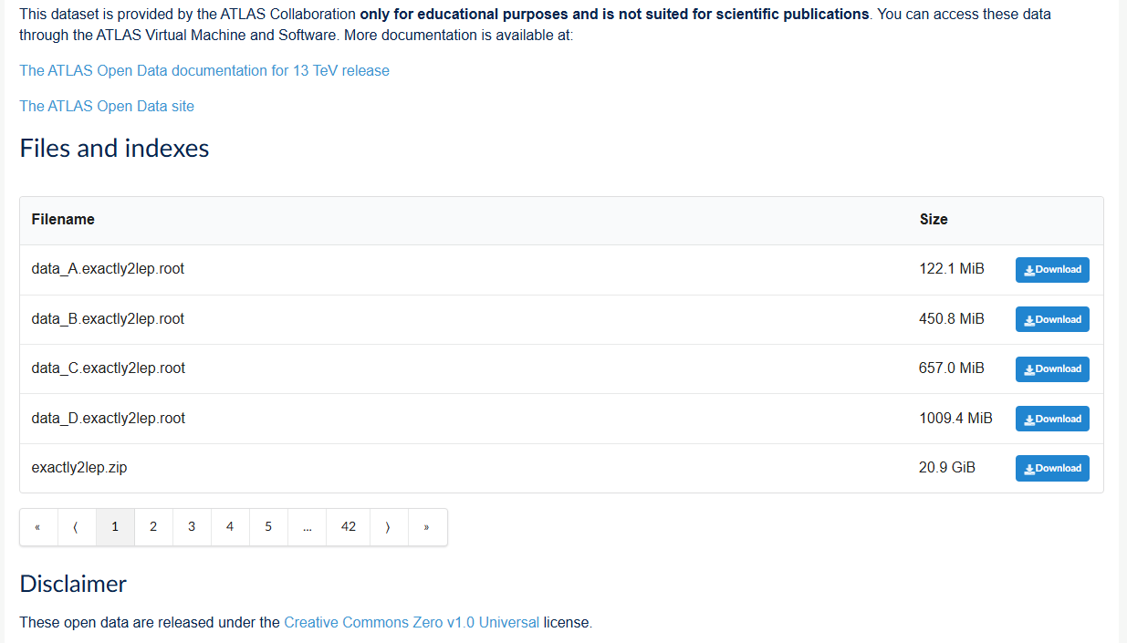
Finding Open Data
It is possible to download the files and work with them locally, but as they are very large this is inefficient. It also doesn’t work well with the Monty server.
There are links to the documentation
Sometimes there are a lot of files!

Slide 10
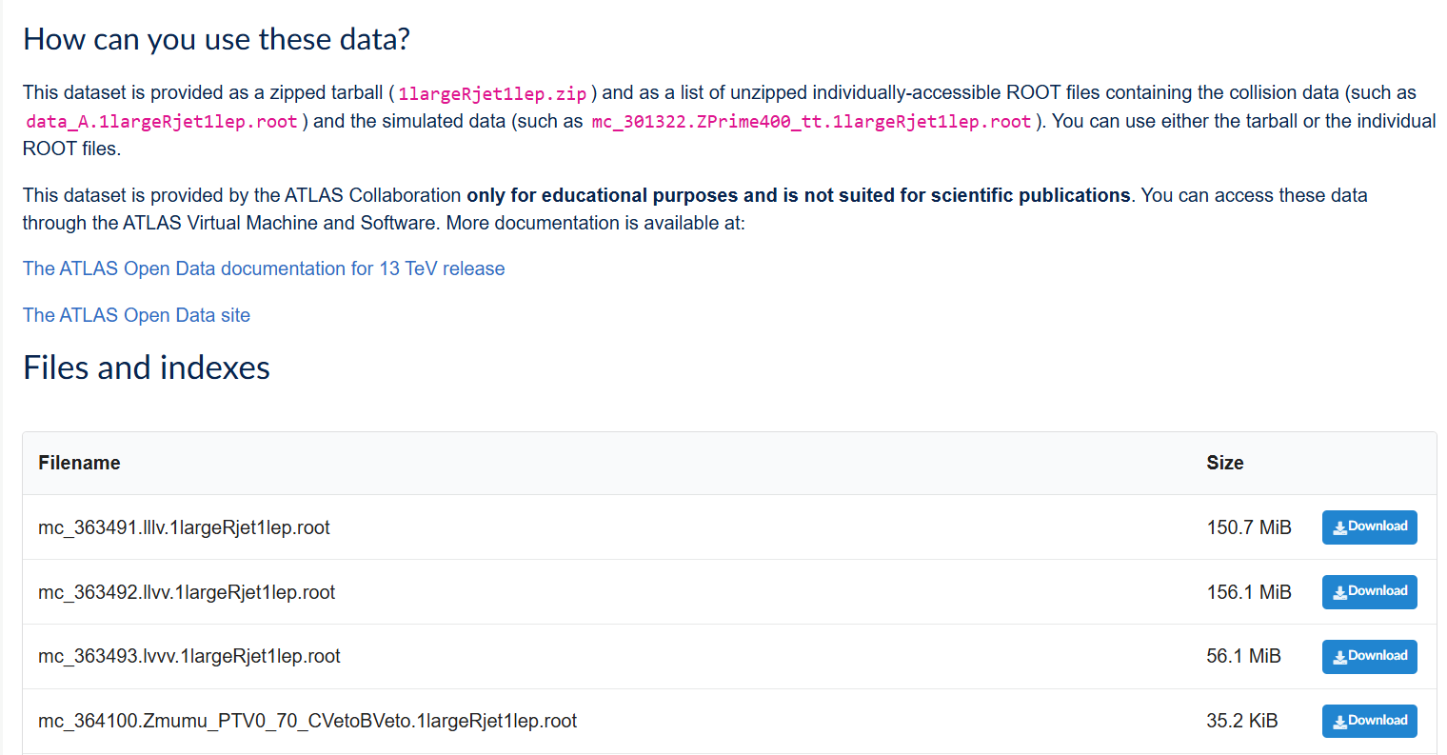
Finding Open Data
This is the dataset identifier.
This is the skim.
The dataset and skim are used in the atom.get_urls() as shown in Book 3 and in AccessingRootFiles:
e.g. atom.get_urls(363491, skim”1largeRjet1lep”)

Slide 11
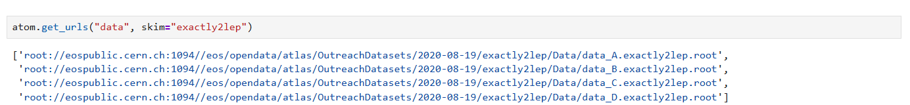
Finding Open Data
This is the skim.
This is the dataset identifier.
When using the “data” dataset, we have to use quotes as it is a string, not an integer (number)
When we use the atom.get_urls() attribute we can see the data_A, data_B, data_C and data_D results, as expected.

Slide 12
Finding Open Data
So, to access the data we choose the first (and only!) result in the list ([0]) and use the syntax below (see more in the “AccessingRootFiles” notebook):
So we can see it is worth having a look to check how many files there are!
To access data in a particular file, you can work your way down the list:
events_using_atom = uproot.open(atom.get_urls("data", skim="exactly2lep")[0]) – gives data_A
events_using_atom = uproot.open(atom.get_urls("data", skim="exactly2lep")[1]) – gives data_B
events_using_atom = uproot.open(atom.get_urls("data", skim="exactly2lep")[2]) – gives data_C
events_using_atom = uproot.open(atom.get_urls("data", skim="exactly2lep")[3]) - gives data_D
Then:
sel_atom_events = events_using_atom['mini'].arrays(["lep_n", "lep_charge", "lep_type", "lep_pt", "lep_eta", "lep_phi", "lep_E"])
Alternatively, if you know for sure that you want all the data there are a few different ways to combine the files. This is one way:
urls = atom.get_urls("data", skim="exactly2lep")
urls_with_tree = [f"{url}:mini" for url in urls]
all_events = uproot.concatenate(urls_with_tree, expressions = ["lep_n", "lep_charge", "lep_type", "lep_pt", "lep_eta", "lep_phi", "lep_E"])

