Slide 1
MAKE MILLIONS OF DOLLARS USING THIS OLD POKER TRICK
Tim Weber, Patrice Gobat, Lionel Gulich, Jan Speckien
Supervisors: Dr. Olivia Woolley, Dr. Lloyd Sanders
Modeling and Simulation of Social Systems with MATLAB

Slide 2
Motivation
Texas Holdem‘ Poker:
2 Privat cards | 5 public cards
Flop, Turn, River
best 5 cards -> Score
Strategy
Passive/ Agressive
Blind
Poker hand ranking chart [1]
Modeling and Simulation of Social Systems with MATLAB
Notes:
Objective of the game is go win all the money (Chips)
Game consists of multiple Rounds called Hands
different stages: Flop 3 public/ Turn 1 pub /River 1 pub |
Before and after stage of a hand all players can bet chips on their victory into a pot, the winner wins the pot

Slide 3
Generic model
Poker | Simulation
Bet and Blind vary | Bet = Blind = 1
Check, call, raise, re-raise | Bet, No bet
Strategy | Risk factor r [0,1]
Cards and odds | Card value/ score
Replacement of cards
Private cards -> Card value =rand [0,1]
Adjustment of card score
Good cards usually stay good
Bad cards usually stay bad
For each player individually
Pot odds
Modeling and Simulation of Social Systems with MATLAB

Slide 4
Generic model
Active vs. passive strategy
Fixing bet and blind to const.=1
Simplifying check, call, raise, re-raise to bet or no bet
Simplification of strategy to one variable r
Replacement of cards
Private cards -> Cardvalue =rand [0,1]
Flop adjust
Good cards usually stay good
Bad cards usually stay bad
For each player individually
Modeling and Simulation of Social Systems with MATLAB
Notes:
Replacement of cards in order to simplyfy code and shorten computaional time
vs. Real poker same cards for everyone

Slide 5
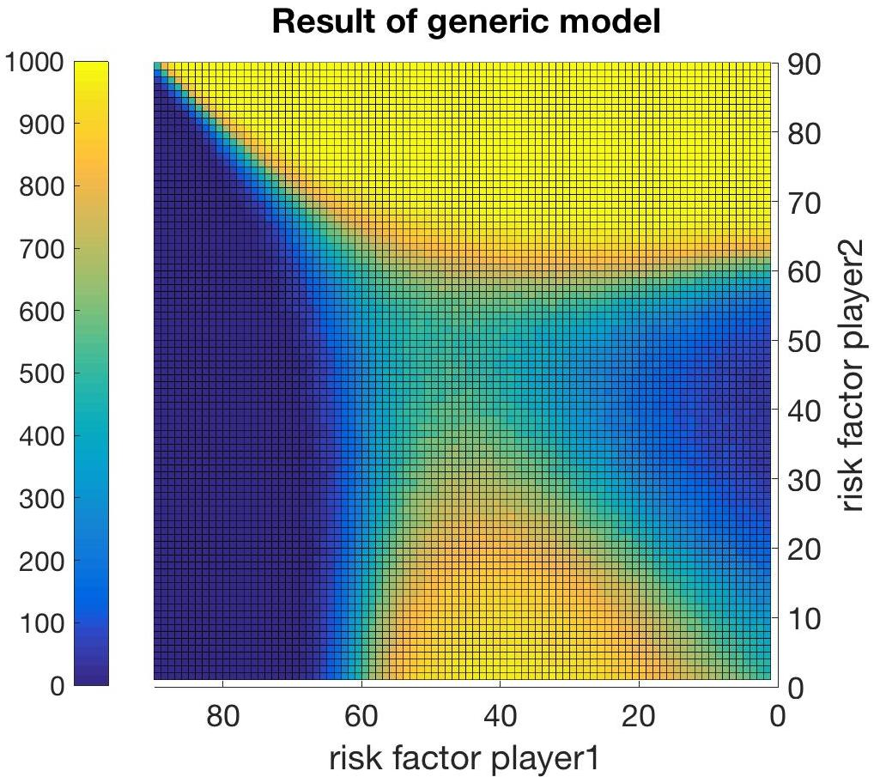
Results and interpretation of Generic Model
A very passive strategy (r > 0.63) is only successful against even more passive players
An aggressive strategy ( r < 0.5) performed better against more aggressive players
Transition period in-between
Change of successful Strategy occurs
Modeling and Simulation of Social Systems with MATLAB

Slide 6
Learning models overview
Iteration model
evaluate own former performance
adapt own risk factor
Win: stay
Loss: diminish ris factor
Drop out: increase risk factor
Count and Gauge model
evaluate opponents behaviour to find opponents risk factor
count amount of unforced initial plays
Threshold model
evaluate showdown to find opponents risk factor
set opponents card value as threshold for his risk factor
Find own optimal risk factor from previous simulation results
Modeling and Simulating Social Systems with MATLAB
Notes:
Overview of learning methods implemented

Slide 7
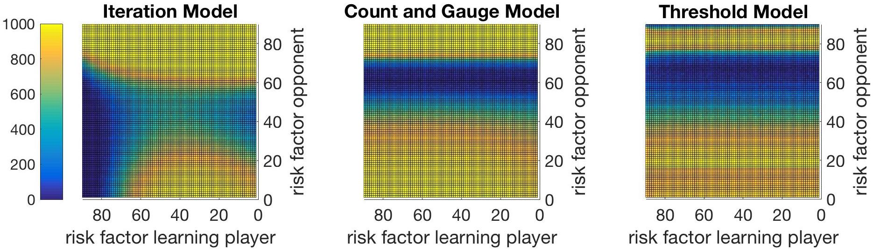
Learning models comparison
Iteration model
Count and Gauge model
Threshold model
# games won | 𝜇 | 647.55 | 690.6369 | 605.77
 | 𝜎 | 335.5068 | 313.1811 | 301.3260
# hands played | 𝜇 | 110020 | 709.35 | 1565
Modeling and Simulating Social Systems with MATLAB

Slide 8
Outlook
Optimised capital-bet-ratio
Player’s options ’’check’’ and ‘’bluff’’
Increasing bet over time
Varying bet sizes
More than two players
Real cards
Modeling and Simulation of Social Systems with MATLAB
Notes:
Replacement of cards in order to simplyfy code and shorten computaional time
vs. Real poker same cards for everyone

Slide 9
End of presentation
Sources: [1] Poker hand ranking sheet. http://www. pokerbonus.com/how-to-play-poker/ poker-hands/poker-hand-ranking/ poker-hand-ranking-chart/, accessed on 15. December 2016.
Modeling and Simulation of Social Systems with MATLAB

