Slide 1
MAKE MILLIONS OF DOLLARS USING THIS OLD POKER TRICK
Tim Weber, Patrice Gobat, Lionel Gulich, Jan Speckien
Supervisors: Dr. Olivia Woolley, Dr. Lloyd Sanders
Modeling and Simulation of Social Systems with MATLAB

Slide 2
Motivation
Texas Holdem‘ Poker:
2 Privat cards | 5 public cards
Flop, Turn, River
best 5 cards -> Score
Strategy
Passive/ Agressive
Blind
Poker hand ranking chart [1]
Modeling and Simulation of Social Systems with MATLAB
Notes:
Objective of the game is go win all the money (Chips)
Game consists of multiple Rounds called Hands
different stages: Flop 3 public/ Turn 1 pub /River 1 pub |
Before and after stage of a hand all players can bet chips on their victory into a pot, the winner wins the pot

Slide 3
Generic model
Poker | Simulation
Bet and Blind vary | Bet = Blind = 1
Check, call, raise, re-raise | Bet, No bet
Strategy | Risk factor r [0,1]
Cards and odds | Card value/ score
Replacement of cards
Private cards -> Card value =rand [0,1]
Adjustment of card score
Good cards usually stay good
Bad cards usually stay bad
For each player individually
Pot odds
Modeling and Simulation of Social Systems with MATLAB

Slide 4
Generic model
Active vs. passive strategy
Fixing bet and blind to const.=1
Simplifying check, call, raise, re-raise to bet or no bet
Simplification of strategy to one variable r
Replacement of cards
Private cards -> Cardvalue =rand [0,1]
Flop adjust
Good cards usually stay good
Bad cards usually stay bad
For each player individually
Modeling and Simulation of Social Systems with MATLAB
Notes:
Replacement of cards in order to simplyfy code and shorten computaional time
vs. Real poker same cards for everyone

Slide 5
Outlook
Optimised capital-bet-ratio
Player’s options ’’check’’ and ‘’bluff’’
Increasing bet over time
Varying bet sizes
More than two players
Real cards
Modeling and Simulation of Social Systems with MATLAB
Notes:
Replacement of cards in order to simplyfy code and shorten computaional time
vs. Real poker same cards for everyone

Slide 6
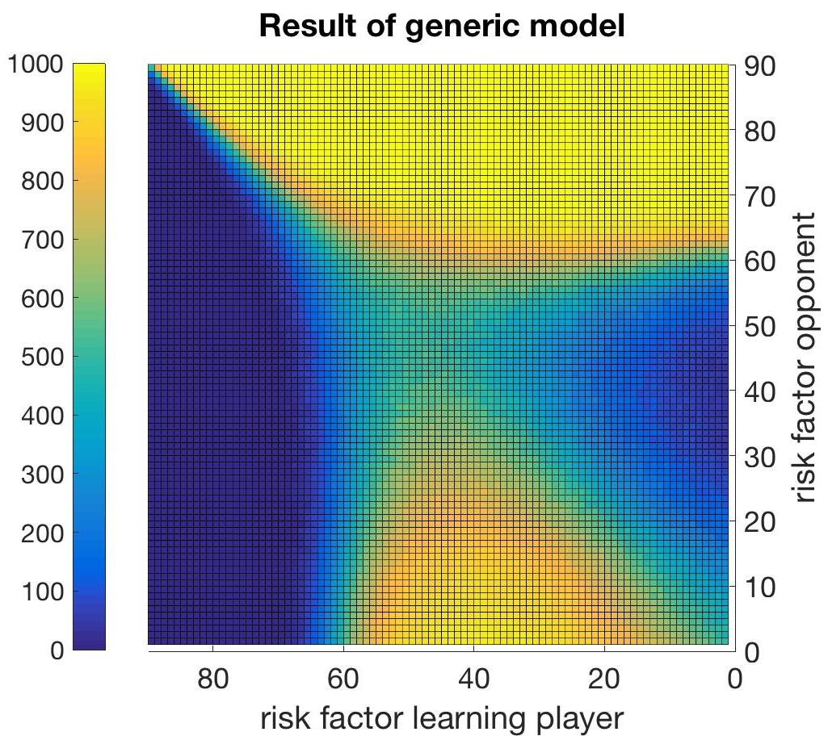
Modeling and Simulation of Social Systems with MATLAB

Slide 7
End of presentation
Sources: [1] Poker hand ranking sheet. http://www. pokerbonus.com/how-to-play-poker/ poker-hands/poker-hand-ranking/ poker-hand-ranking-chart/, accessed on 15. December 2016.
Modeling and Simulation of Social Systems with MATLAB

