Slide 1


Scalability in Practice: a Highly scalable Website
SE124 (2021 Fall)
Yubin Xia
IPADS, Shanghai Jiao Tong University
https://www.sjtu.edu.cn

Slide 2




Scalable websites are everywhere
High request rate
  100 billions of requests daily
Massive data
  Facebook has more than 1 billion of images uploaded weekly, Baidu stores tens of billions of web pages

Slide 3
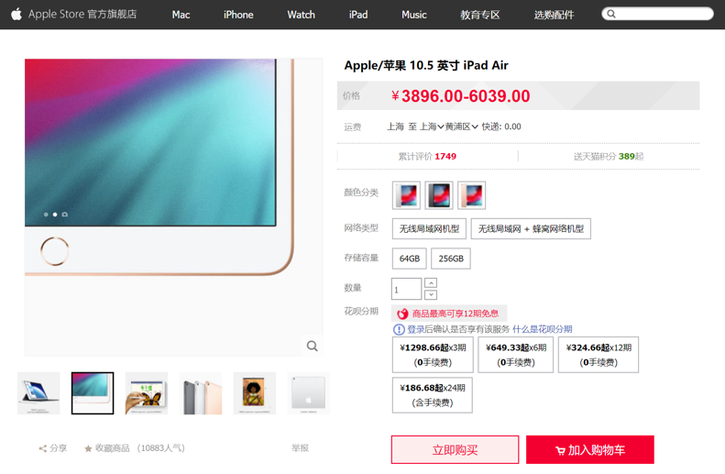
Different systems to support different types of data
Database
File system
Key-value store

Slide 4

Each click needs thousands of servers to cooperate
Caching server
Caching server
…
Caching server
Caching
Caching
Caching
Distributed caching
Database server
Database server
CDN
Users
Application #1
generate the page
Database
user, price
…
Database
user, price
Application server
Distributed database
Internet
Load
Balance
Application #2
add the order
File server
File server
File server
File:
image
File:
image
…
File:
image
Application server
…
…
Message queue
Distributed file system

Slide 5
How to build Taobao on a single machine (in old days)?
Operating system:
  Linux (in OS class)
Serving the requests: web server
  Apache, Nginx (in ICS)
Serving the data: file system & DB
  MySQL & inode file system (in CSE)
Displaying the page: HTML
  PHP (in Web class)
LAMP = Linux + Apache + MySQL + PHP

Slide 6

Using one server to build Taobao
https://www.taobao.com
Internet
Application
generate the web page
File:
image
Database:
user, price
Server
Notes:
// todo: refine

Slide 7
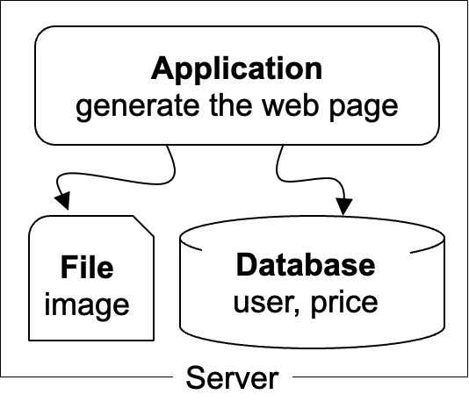
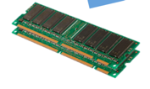
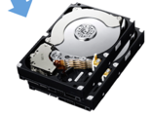
The architecture of LAMP cannot scale!
https://www.taobao.com
Internet
The disk & memory of one server cannot store massive amount of data
  DRAM: 64 – 256 GB
  HDD: 2 – 40 TB
  Facebook has more than 1 billion of images uploaded weekly, Baidu stores tens of billions of web pages
File:
image
Database:
user, price
DRAM
HDD

Slide 8
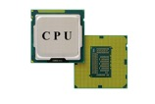
The architecture of LAMP cannot scale!
https://www.taobao.com
Internet
Application uses the CPU for processing, while a single CPU can hardly scale due to the end of Moore’s law & Dennard scaling
  Moore’s law: the number of transistors in a dense integrated circuit (IC) doubles about every two years.
  Dennard scaling: as transistors get smaller, their power density stays constant
Application
generate the web page

Slide 9

Step #1 for scalability: disaggregating application & data
Scale
Application: handles the application logic
  Can be scaled with more CPUs
Database: requires reading/writing disk & cache
  Can be scaled with faster disk & larger memory
File system: store large bulk of data
  E.g., images, videos
  Can be scaled with faster disk
Application
generate the web page
Application server
Local area network
File server
Database server
Scale
Scale
File:
image
Database
user, price
Database
user, price
Notes:
// TODO: add figure

Slide 10
Step #2 Avoid the slow data accesses? Caching
Observation: most requests are accessing a small portion of the data
Caching system with a single node:
  E.g., page cache
  Drawbacks: limited DRAM capacity
Distributed caching server
  Benefits: huge DRAM capacity, e.g., deploy many caching servers
Application
generate the web page
Application server
Local area network
Caching server
Caching server
Caching
Caching
File server
Database server
File:
image
Database
user, price

Slide 11
Case study of distributed cache server: Memcached
Distributed caching server
  Benefits: huge DRAM capacity
Memcached server
  Store all the cached data in memory
  Can scale out to use multiple servers
Memcached clients
  Check whether server has cached data
  On cache miss, fallback to database/file
Question:
  How to find which server has cached the data?
Application
generate the web page
Net
Comm
Memached API
S0: 10.0.0.100
S1: 10.0.0.101
Routing
Application server
Local area network
Caching server#0:
10.0.0.100
Caching server#1:
10.0.0.101
Caching
Memached
Caching
Memached

Slide 12
Case study of distributed cache server: Memcached
Naïve method, hashing:
  address = key / #server
Problem:
  What if we add a new server?
  Suppose that we add server from 3->4
  Then there would be 75% miss!
Solution: consistent hashing
  Suppose that we add server from 3->4
  It will only incur 25% miss
How to find the data?
Consistent hashing

Slide 13
Step #3 for scalability: more servers
Internet
For stateless application servers
  E.g., web servers
  We can add more servers for scaling its performance
What is stateless?
  The server only executes the logic that only relies on input data but no long-term state
Benefits:
  Better fault-tolerance
  Better elasticity
Application
generate the web page
Application
generate the web page
Application
generate the web page
Application server #N
Application server #N
Application server #N
Local area network
Caching server
Caching server
Caching
Caching
File server
Database server
File:
image
Database
user, price

Slide 14
Step #3 for scalability: How to do the load balance?
  Load balance: how to route the user quests to the application servers?
  Leverage the network layer
  use HTTP redirection,
  use reverse proxy,
  …
  Load balance algorithms
  round-robin
  random
  hashing
  …
Internet
Load balancer
Application
generate the web page
Application
generate the web page
Application
generate the web page
Application server #N
Application server #N
Application server #N

Slide 15
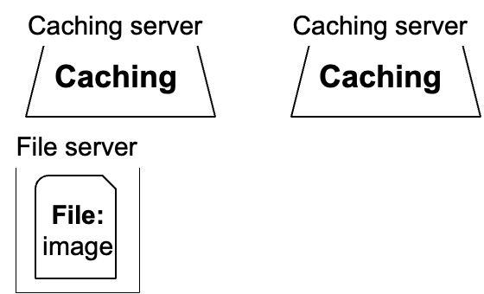
Step #4 for scalability: scaling database
#1. Separate the database for read/write
  E.g., use primary-backup replication
  The primary servers the writes and backup only serves reads
#2. Separate a single table on multiple databases
  e.g., a bank has reported that a single table has 100,000,000 rows
  However, split a table on multiple machines complex consistency management
Application
generate the web page
Application
generate the web page
Application
generate the web page
Application server #N
Application server #N
Application server #N
Local area network
Write
Read
Database server
Database server
Database
user, price
Database
user, price

Slide 16
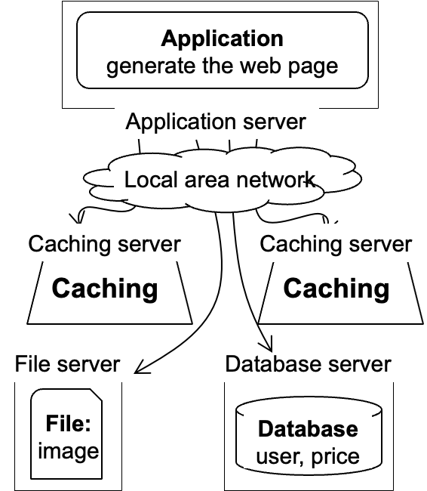
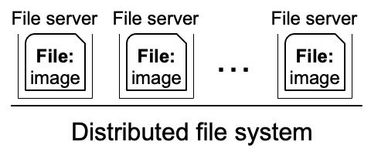
Step #5 for scalability: using distributed file system
Using multiple database in principle makes the database distributed
We can use a similar approach to make the file system distributed !
Well-known distributed file system
  NFS (Network file system)
  GFS (Google file system)
  HDFS
Application
generate the web page
Application server
Local area network

Slide 17
Step #6 for scalability: using CDN
Goal: return the results to user as soon as possible
  Why? Amazon has reported that 100ms latency increase will cause 1% financial loss
Core idea: caching (again)
  E.g., CDN (content delivery network) caches the content at the network providers, which is closer
  to users
  Challenge: how to do it without users’ awareness?
CDN
Users
Application
generate the web page
Internet
Application server
…

Slide 18


Step #7 for scalability: separate different applications
Use dedicated servers for different applications
  E.g., micro-services
Application #1
Alipay
Internet
Application server
Application #2
Taobao
Application server

Slide 19
How different applications communicate? MQ or DB
Message queue (MQ): applications send the message the queue, and the queue can buffer the message (somewhere between RPC and database)
  E.g., Apache Kafka
Or, applications can directly use the databases, caching (e.g. KV) or file system to communicate with shared data
Internet
Application #1
Alipay
Application #2
Taobao
Application server
Application server
Local area network
Caching server
Message queue
Caching
Database server
File server
Database
user, price
File:
image

Slide 20


How to handle complex requests?
Example: after the website become larger, handling requests is not only displaying a (static) web page
Alipay (支付宝)
  E.g., fraud detection
Taobao
  Hot list (热榜)
  Dynamic product ads (千人千面)
  Recommendation (you might also like)
  …
Hot lists
Customized ads

Slide 21
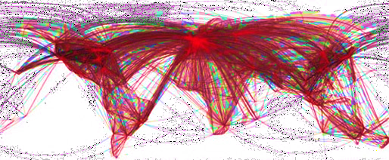

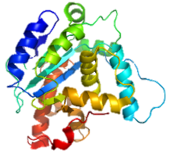
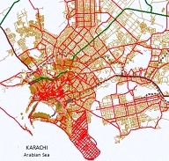
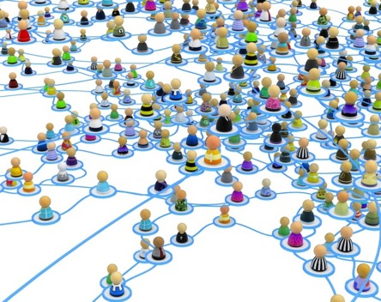


Use distributed computing frameworks for complex queries
General batch processing systems
  MapReduce, Spark, etc.
Graph processing systems
  GraphLab, Pregel, etc.
Machine learning systems
  Tensorflow, pytorch, etc.

Slide 22
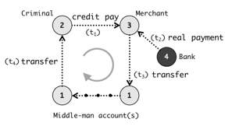

Step #7: separated applications + distributed computing
Example
  Use general batch processing system to generate hot list
  Use graph system to detect credit card fraud
  Each framework is powered by massive machines
Alipay detects frauds w/ graph systems
Application #1
Alipay
Graph processing
e.g., GraphLab
Application server
Internet
Generate hot lists
Application #2
Taobao
Batch processing
e.g., MapReduce
Application server

Slide 23
A scalable website: overall picture
We have not covered all the parts
  E.g., container
  Yet most of them are orthogonal to the scalability concepts in this class
Caching server
Caching server
Caching server
…
Caching
Caching
Caching
Distributed caching
Database server
Database server
CDN
Users
Application #1
generate the page
Database
user, price
…
Database
user, price
Application server
Distributed database
Internet
Load
Balance
Application #2
add the order
File server
File server
File server
File:
image
File:
image
…
File:
image
Application server
…
…
Message queue
Distributed file system

Slide 24
Recall: we have talked about distributed system
But what is a distributed system?

Slide 25
A scalable website: powered by distributed systems!
Distributed system: a collection of independent/autonomous connected through a communication network working together hosts to perform a service
Caching server
Caching server
Caching server
…
Caching
Caching
Caching
Distributed caching
Database server
Database server
CDN
Users
Application #1
generate the page
Database
user, price
…
Database
user, price
Application server
Distributed database
Internet
Load
Balance
Application #2
add the order
File server
File server
File server
File:
image
File:
image
…
File:
image
Application server
…
…
Message queue
Distributed file system

Slide 26
Modern scalable website/distributed systems are large
Powered by large-scale datacenter

Slide 27
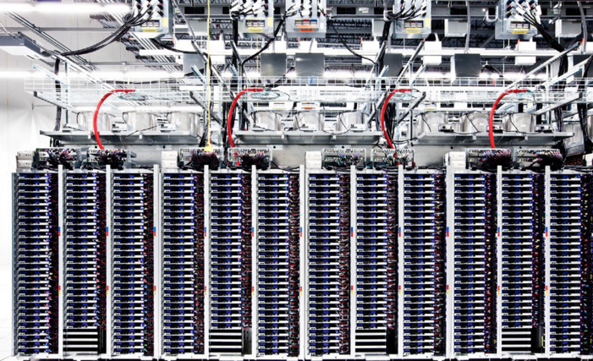
Scalable websites are powered by modern datacenters
Large server and storage farms
  CPUs: > 20,000,000 cores
  Disk capacity: > 1,000,000 GB
Caching server
Caching server
…
Caching server
Caching
Caching
Caching
Distributed caching
Database server
Database server
CDN
Users
Application #1
generate the page
Database
user, price
…
Database
user, price
Application server
Distributed database
Internet
Load
Balance
Application #2
add the order
File server
File server
File server
File:
image
File:
image
…
File:
image
Application server
…
…
Distributed file system

Slide 28
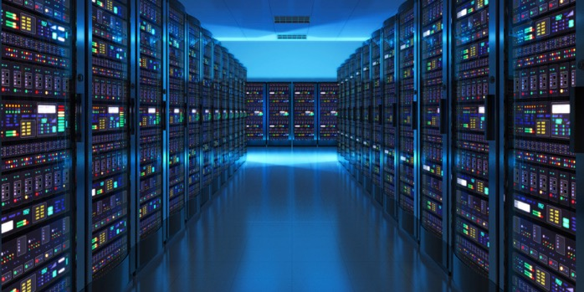
Datacenters that power the scalable website
Large-scale distributed systems: 10K – 100K servers
  Each rack: 40 servers
  Network: 10Gbps – 100Gbps in rack
  10-100 MW of power
Source: “The Datacenter as a Computer --- An Introduction to the Design of Warehouse-Scale Machines”

Slide 29
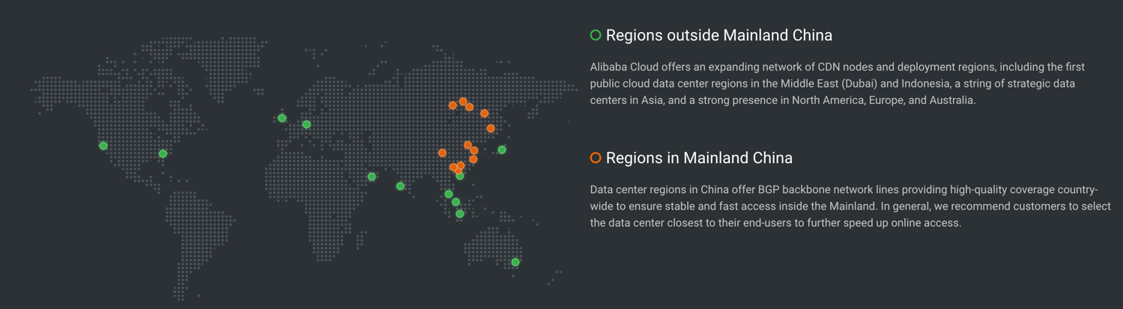
Geo-replicated datacenters
The locations of Alibaba datacenters
Source: https://www.alibabacloud.com/zh/global-locations

Slide 30
Design large-scale distributed system is challenging
Fault is common, how to handle it?

Slide 31
Fault is common: fault, error, failure
Fault can be latent or active
  if active, get wrong data or control signals
Error is the results of active fault
  e.g. violation of assertion or invariant of spec
  discovery of errors is ad hoc (formal specification?)
Failure happens if an error is not detected and masked
  not producing the intended result at an interface

Slide 32
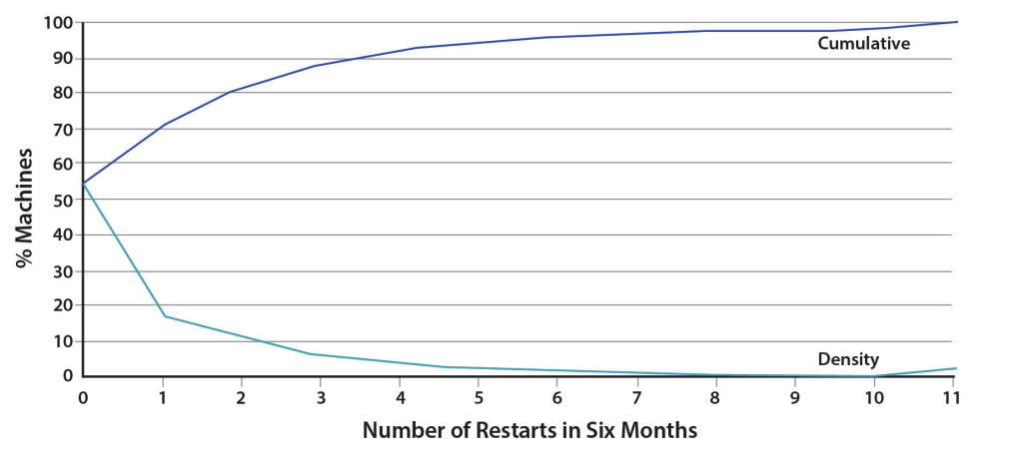
Fault is common
, especially in large distributed systems
Why faults are common especially in distributed systems? Scale!
  “Suppose a cluster has ultra-reliable server nodes with a stellar mean time between failures (MTBF) of 30 years (10,000 days)—a cluster of 10,000 servers will see an average of one server failure per day. ”
Source: The Datacenter as a Computer
-- An Introduction to the Design of Warehouse-Scale Machines

Slide 33
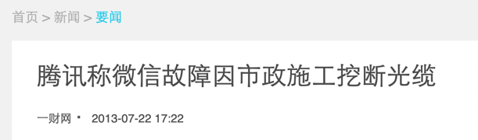

Fault is common
especially in large distributed systems
What are the causes?
Why faults are common especially in distributed systems? Scale!
  “Suppose a cluster has ultra-reliable server nodes with a stellar mean time between failures (MTBF) of 30 years (10,000 days)—a cluster of 10,000 servers will see an average of one server failure per day. ”
Causes:
  Operation error (human, configuration, etc.)
  Software error (e.g., bug)
  Hardware error
  Power outage
  Natural disaster
Source: The Datacenter as a Computer
-- An Introduction to the Design of Warehouse-Scale Machines

Slide 34
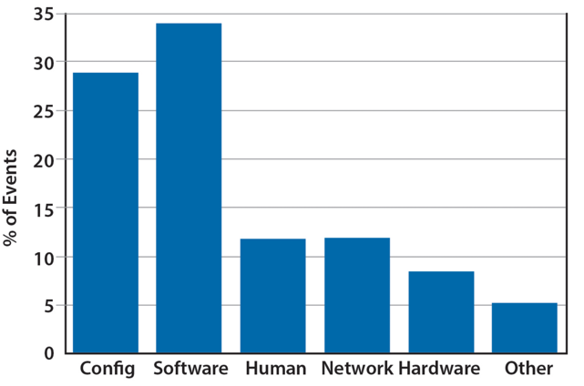
Fault is common
especially in large distributed systems
What are the causes?
Why faults are common especially in distributed systems? Scale!
  “Suppose a cluster has ultra-reliable server nodes with a stellar mean time between failures (MTBF) of 30 years (10,000 days)—a cluster of 10,000 servers will see an average of one server failure per day. ”
Causes:
  Operation error (human, configuration, etc.)
  Software error (e.g., bug)
  Hardware error
  Power outage
  Natural disaster
Source: The Datacenter as a Computer
-- An Introduction to the Design of Warehouse-Scale Machines

Slide 35
Faults and partial failures
On a single computer, it either works or it doesn’t
But in a distributed system, some parts of the system can be broken in some unpredictable way
  Such failure is partial (aka., grey failure)
Since most other parts of the system are OK, we want the system still working!
Notes:
画一个big picture

Slide 36

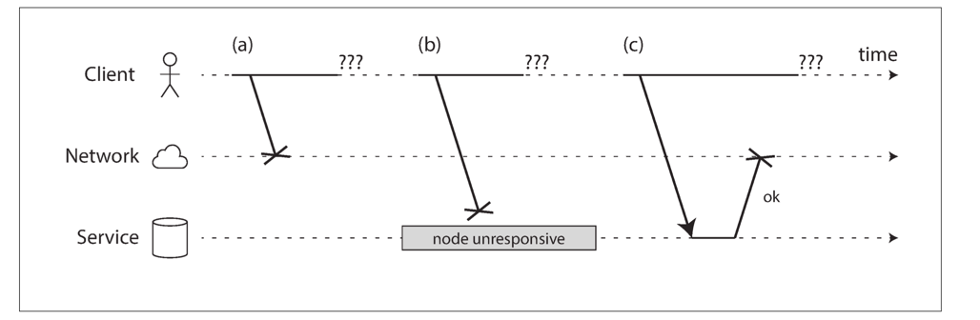
Faults and partial failures
Example: unreliable network
  A client (e.g., Smartphone),
  through network (5G, Wifi),
  sends requests to the service (e.g., Taobao).
  The client gets: “网络竟然奔溃了”, how can a network break?
Notes:
画一个big picture

Slide 37
Example: unreliable network
A user sends a request but the server does not reply, possible reasons:
1. Your request may have been lost (e.g., someone unplugged a network cable).
2. Your request may be waiting in a queue and will be delivered later (e.g., the network or the recipient is overloaded).
3. The remote node may have failed (e.g., it crashed or it was powered down).
Notes:
+ 淘宝的联系

Slide 38

Example: unreliable network
A user sends a request but the server does not reply, possible reasons:
4. The remote node may have temporarily stopped responding (e.g., it is experiencing a long garbage collection pause)
5. The remote node may have processed your request, but the response has been lost on the network (e.g., a network switch has been misconfigured).
6. The remote node may have processed your request, but the response has been delayed and will be delivered later (e.g., the network or your own machine is overloaded).

Slide 39
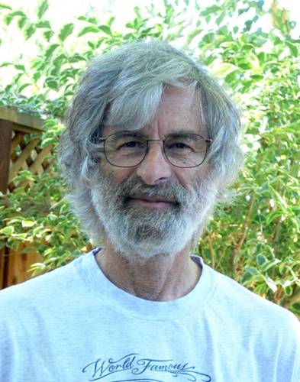
You know you have a distributed system when the crash of a computer you’ve never heard of stops you from getting any work done.
- Leslie Lamport
Lamport received the 2013 Turing Award for "fundamental contributions to the theory and practice of distributed and concurrent systems, notably the invention of concepts such as causality and logical clocks, safety and liveness, replicated state machines, and sequential consistency" in 2014.

Slide 40
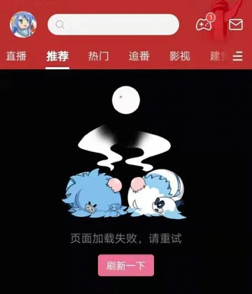
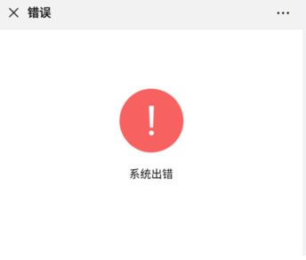
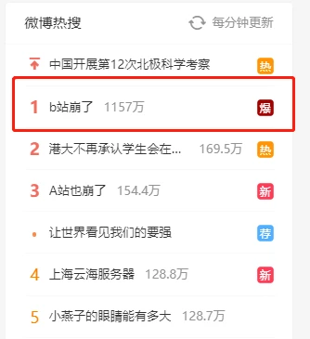


Notes:
宕机的例子，比如微信？

Slide 41


Availability and reliability
Availability: A measure of the time that a system was usable, as a fraction of the time that it was intended to be usable (x nines), corresponding downtime:
  e.g. 3-nines -> 8 hour/year
  e.g. 5-nines -> 5 min/year
  e.g. 7-nines -> 3 sec/year
Metrics to measure reliability
  MTTF: mean time to failure
  MTTR: mean time to repair
  MTBF: mean time between failure
  MTBF = MTTF + MTTR

Slide 42




Large-scale systems can be highly available
Example#1: Internet, the BGP (Broder Gateway Protocol) is highly available
Example#2: WeChat, Taobao & Baidu rarely (but not never) become outage

Slide 43
Achieving high availability: handling failures
Redundancy
  E.g., replicas: identical multiple copies
Example: replicated file servers
  As long as one copy survives, the application is available
Application
generate the web page
Application server
Local area network
File server
File server
File server
File:
image
File:
image
File:
image
Identical copies

Slide 44
Achieving high availability: handling failures
Redundancy
  E.g., replicas: identical multiple copies
Example: replicated file servers
  As long as one copy survives, the application is available
Challenge: consistency
Application
generate the web page
Application server
Local area network
File server
File server
File server
File:
image
File:
image
File:
image

Slide 45
Achieving high availability: handling failures
Redundancy
  E.g., replicas: identical multiple copies
Example: replicated file servers
  As long as one copy survives, the application is available
Challenge: consistency
Application put file A to one server
Application
generate the web page
Application server
1
Local area network
File server
File server
File server
File:
image
File:
image
File:
image

Slide 46
Achieving high availability: handling failures
Redundancy
  E.g., replicas: identical multiple copies
Example: replicated file servers
  As long as one copy survives, the application is available
Challenge: consistency
Application put file A to one server
The server crashed
Application
generate the web page
Application server
Local area network
2
File server
File server
File server
File:
image
File:
image
File:
image

Slide 47
Achieving high availability: handling failures
Redundancy
  E.g., replicas: identical multiple copies
Example: replicated file servers
  As long as one copy survives, the application is available
Challenge: consistency
Application put file A to one server
The server crashed
What happens when read A again?
Application
generate the web page
Application server
Local area network
3
File server
File server
File server
File:
image
File:
image
File:
image

Slide 48

Achieving high availability: handling failures
Redundancy
  E.g., replicas: identical multiple copies
Techniques:
  RAID (Redundant Array of Inexpensive Disks)
  Primary-backup replication
  Replicated state machine
  …

Slide 49
Achieving high availability: handling failures via retry
Restart or reconstruct
  Monitoring and catching errors
  Restart or reconstruct the system (sub-system)
  E.g., restart the stateless application server is ok
What about consistency?
  Stateless applications does not have consistency issue
  Some applications, like Google search, can even tolerate occasional inconsistency
    Can you notice the inconsistency of search results?

Slide 50
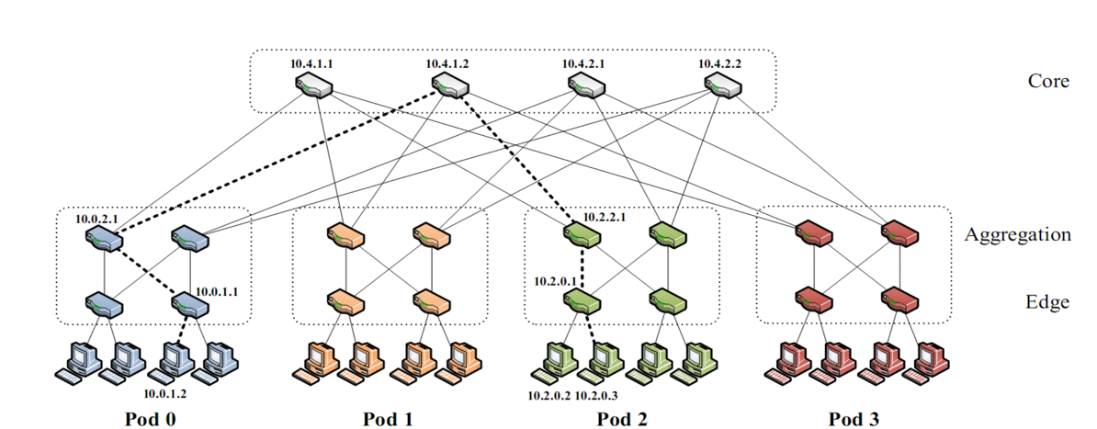
Another common fault: network partition
A network partition refers to network decomposition into relatively independent subnets
  Can happen when a switch is being upgraded in a datacenter
For example, suppose the datacenter adopts a fat-tree topology
Source: https://www.cs.cornell.edu/courses/cs5413/2017sp/lectures/16-datacenter-topologies2.pdf

Slide 51
Another common fault: network partition
A network partition refers to network decomposition into relatively independent subnets
  Can happen when a switch is being upgraded in a datacenter
For example, suppose the datacenter adopts a fat-tree topology
Source: https://www.cs.cornell.edu/courses/cs5413/2017sp/lectures/16-datacenter-topologies2.pdf

Slide 52
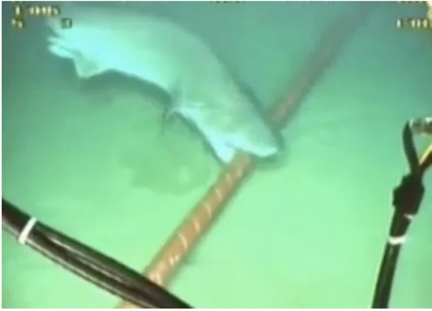
Another common fault: network partition
A network partition refers to network decomposition into relatively independent subnets
  Can happen when a switch is being upgraded in a datacenter
  Can even happen when being attacked by sharks
Source: https://slate.com/technology/2014/08/shark-attacks-threaten-google-s-undersea-internet-cables-video.html

Slide 53
Another common fault: network partition
A network partition refers to network decomposition into relatively independent subnets
  Can happen when a switch is being upgraded in a datacenter
  Can even happen when being attacked by sharks
Network partition is usually a reality
  You can never count on the network connectivity

Slide 54
The CAP theorem
  Consistency, Availability & Partition tolerance

Slide 55
CAP: an example
Amazon has two zones: US and Euro
  All US users connect to the US zone
  All Euro users connect to the Euro zone
Define Availability and Consistency
  C: all users see the actual number of items
  Not-C: users see 1 item left, but actually is 0
  A: all users can buy items at any time (if there are some)
  Not-A: users might get "cannot buy now, please wait and retry"

Slide 56
The CAP theorem: 2 out of 3
It is impossible for a distributed computer system to simultaneously provide all three of the following guarantees
  Consistency (all nodes see the same data at the same time)
  Availability (a guarantee that every request receives a response about whether it succeeded or failed)
  Partition tolerance (the system continues to operate despite arbitrary message loss or failure of part of the system)
v₀
v₀
v₀
v₀
v₁
v₀
v₁
v₀
v₁
v₀
S₁
S₂
S₁
S₂
S₁
S₂
S₁
S₂
S₁
S₂
S₁
S₂
A=v₁
done
A=?
1. A=v₀
C
C
C
C
C
C
2. Not available

Slide 57


Partition Tolerance
"P" is usually a reality
  You can never count on the network connectivity
AP: sacrifice C
  If you have one book but sell it to two customers
  Maybe just an apology and a small gift coupon
CP: sacrifice A
  If you are selling train ticket but cannot deliver
  Customer may sue you
  But the user can fail to buy the ticket, e.g., 12306 during spring festival in the last few years

Slide 58
CAP: not a Binary Decision
Example: a CP system does not mean no "A" at all during network partition
  If the Euro zone and US zone are disconnected, the US zone can still keep available
  Only the Euro zone is not available
  When the network connects again, apply US zone data to Euro zone for consistency

Slide 59
Summary
A scalable website is built upon large distributed systems
Building large-scale distributed systems is non-trivial
  Partial failure
    E.g., machine faults, network faults, timing faults
    CAP theorem: cannot guarantee ideal properties (e.g., consistency) in face of these faults

