Slide 1


iNode-based File System
SE124 (2021 Fall)
Yubin Xia
IPADS, Shanghai Jiao Tong University
https://www.sjtu.edu.cn

Slide 2
Large-scale websites are built from distributed systems
While distributed systems are built from components on a single node
  File system runtimes, etc.
Caching server
Caching server
Caching server
…
Caching
Caching
Caching
Distributed caching
Database server
Database server
CDN
Users
Application #1
generate the page
Database
user, price
…
Database
user, price
Application server
Distributed database
Internet
Load
Balance
Application #2
add the order
File server
File server
File server
File:
image
File:
image
…
File:
image
Application server
…
…
Message queue
Distributed file system

Slide 3
Large-scale websites are built from distributed systems
While distributed systems are built from components on a single node
  File system runtimes, etc.
Caching server
Caching server
Caching server
…
Caching
Caching
Caching
Distributed caching
Database server
Database server
CDN
Users
Application #1
generate the page
Database
user, price
…
Database
user, price
Application server
Distributed database
Internet
Load
Balance
Application #2
add the order
File server
File server
File server
File:
image
File:
image
…
File:
image
Application server
…
…
Message queue
Distributed file system

Slide 4
iNode-based File System

Slide 5

What is a file?
Storage as files
A file has two key properties
  It is durable & has a name
  It is a high-level version of the memory abstraction
System layer implements files using modules from hardware layer
  Divide-and-conquer strategy
  Makes use of several hidden layers of machine-oriented names (addresses), one on another, to implement files
  Maps user-friendly names to these files

Slide 6
The Big Picture
User
App-1
App-2
App-3
OPEN("a.txt", "rw")
READ(…)
WRITE(…)
…
File System
Kernel
Disk Driver
READ(block-addr, buf)
WRITE(block-addr, buf)
Hardware
Memory
Disk
(4TB = 2³⁰ 4KB blocks)

Slide 7
Abstraction: API of UNIX File System
OPEN, READ, WRITE, APPEND, SEEK, CLOSE
FSYNC
STAT, CHMOD, CHOWN
RENAME, LINK, UNLINK, SYMLINK
MKDIR, CHDIR, CHROOT
MOUNT, UNMOUNT
….

Slide 8
A Naive File System
Each file occupies one continuous range of blocks
  Use block index as file name, e.g., 107, 113
  Every file write will either append or reallocate
What are the problems?
101
102
103
104
105
106
107
108
109
110
111
112
113
114
115
116
117
118
119
120

Slide 9
inode: 7 software layers

Slide 10
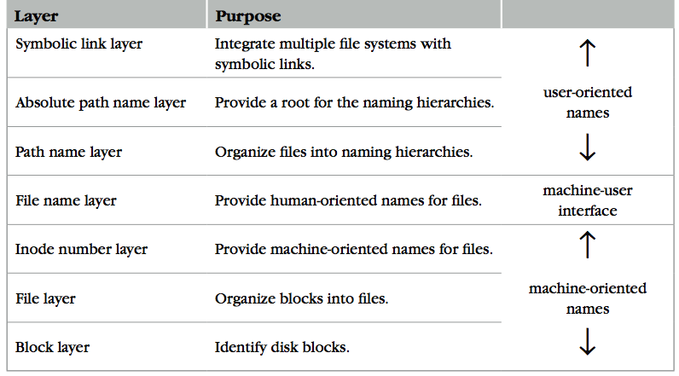
The Naming Layers of the UNIX FS (version 6)
Notes:
TODO: redraw

Slide 11

L1: Block Layer
Block num
Disk
Block
Mapping: block number -> block data
How to know the size of block?
  How to know which block is free?
  These metadata will also be stored on the same disk
  Super block!
procedure BLOCK_NUMBER_TO_BLOCK(integer b)-> block
return devices[b]

Slide 12
Super Block
Block num
Disk
Block
One superblock per file system
  Kernel reads superblock when mount the FS
Superblock contains:
  Size of the blocks
  Number of free blocks
  A list of free blocks
  Other metadata of the file system (including inode info)
0
1
…
n - 1
Boot
block
Super
block

Slide 13
L1: Block Layer
Block num
Disk
Block
Block size: a trade-off
  Neither too small or too big
Question
  What will happen if the block size is too small? What if too big?
  How to efficiently track free blocks?

Slide 14
L1: Block Layer
Block num
Disk
Block
Block size: a trade-off
  Neither too small or too big
Question
  What will happen if the block size is too small? What if too big?
  How to efficiently track free blocks?
Use a bitmap
File blocks
0
1
…
n - 1
Boot
block
Super
block
Bitmap for free blocks

Slide 15
L2: File Layer
File
(inode)
Block num
Disk
Block
File requirements
  Store items that are larger than one block
  May grow or shrink over time
  A file is a linear array of bytes of arbitrary length
  Record which blocks belong to each file
inode (index node)
  A container for metadata about the file
struct inode
integer block_nums[N]
integer size

Slide 16
inode for Larger Files
File
(inode)
Block num
Disk
Block
block
indirect block
double indirect block
triple indirect block
Data
Data
Data
Data
an inode
Data
Data
Notes:
with a 512 byte block size, and 4 byte block pointers, each indirect block can consist of 128 (512 / 4) pointers.
For one double indirect block: (128*128*512) / (1024*1024)

Slide 17
L2: File Layer
File
(inode)
Block num
Disk
Block
Given an inode, can map a block index number (of a file) to a block number (of a disk)
  Index number: e.g., the 3rd block of a file is number 78
procedure INODE_TO_BLOCK(integer offset, inode i)-> block
o <- offset / BLOCKSIZE
b – INDEX_TO_BLOCK_NUMBER(i,o)
return BLOCK_NUMBER_TO_BLOCK(b)
procedure INDEX_TO_BLOCK_NUMBER(inode i, integer index)-> integer
return i.block_nums[index]

Slide 18
L3: inode Number Layer
Inode num
File
(inode)
Block num
Disk
Block
Mapping: inode number -> inode
inode table: at a fixed location on storage
  inode number is the index of inode table
  Track which inode number are in use, e.g. free list, a field in inode
procedure INODE_NUMBER_TO_INODE(integer num)-> inode
return inode_table[num]
0
1
…
n - 1
Boot
block
Super
block
Bitmap for free blocks
Inode table

Slide 19
Put Layers so far Together
Inode num
File
(inode)
Block num
Disk
Block
procedure INODE_NUMBER_TO_BLOCK(integer offset, integer inode_number)-> block
inode i = INODE_NUMBER_TO_INODE(inode_number)
o <- offset / BLOCKSIZE
b <- INDEX_TO_BLOCK_NUMBER(i,o)
return BLOCK_NUMBER_TO_BLOCK(b)
inode number is sufficient to operate a file. However,
  inode numbers are convenient names only for computer
  inode numbers change on different storage device
A file needs a more user-friendly name!

Slide 20
L4: File Name Layer
File
name
Inode num
File
(inode)
Block num
Disk
Block
File name
  Hide metadata of file management
  Files and I/O devices
Mapping
  Mapping table is saved in directory
  Default context: current working directory
    Context reference is an inode number
    The current working directory is also a file
  Max length of a file name is 14 bytes in UNIX version 6 (what does it mean?)
struct inode
integer block_nums[N]
integer size
integer type
Overview of inode content
File name | inode num
helloworld.txt | 12
cse2021.md | 73
procedure name_to_inode(string filename, integer dir)-> integer
return LOOKUP(dir, filename)

Slide 21
LOOKUP in a Directory
File
name
Inode num
File
(inode)
Block num
Disk
Block
procedure LOOKUP(string filename, integer dir)-> integer
block b
inode i = INODE_NUMBER_TO_INODE(dir)
if i.type != DIRECTORY then return FAIURE
for offset from 0 to i.size – 1 do
b <- INODE_NUMBER_TO_BLOCK(offset, dir)
if STRING_MATCH(filename, b) then
return INODE_NUMBER(filename, b)
offset <- offset + BLOCKSIZSE
return FAILURE
Overview of inode content
Name comparing method: STRING_MATCH
  LOOKUP(”cse2021", dir) will return 73
Next problem:
  What if there are too many files?
File name | inode num
helloworld.txt | 12
cse2021.md | 73

Slide 22
L5: Path Name Layer
File
name
Inode num
File
(inode)
Block num
Disk
Block
Path name
Hierarchy of directories and files
  Structured naming: E.g. "projects/paper"
Context: the working directory dir
procedure PATH_TO_INODE_NUMBER(string path, integer dir)-> integer
if PLAIN_NAME(path)return NAME_TO_INODE_NUMBER(path,dir)
else
dir <- LOOKUP(FIRST(path), dir)
path <- REST(path)
return PATH_TO_INODE_NUMBER(path,dir)

Slide 23
Links
File
name
Inode num
File
(inode)
Block num
Disk
Block
Path name
LINK: create shortcut for long names
  LINK("Mail/inbox/new-assignment", "assignment")
  Turns strict hierarchy into a directed graph
    Users cannot create links to directories -> acyclic graph
  Different filenames, same inode number
UNLINK
  Remove the binding of filename to inode number
  If UNLINK last binding, put inode/blocks to a free-list
    A reference counter is needed

Slide 24
Links
File
name
Inode num
File
(inode)
Block num
Disk
Block
Path name
Reference count
  An inode can bind multiple file names
  +1 when LINK, -1 when UNLINK
  A file will be deleted when reference count is 0
  No cycle allowed
    Except for '.' and '..'
    Naming current and parent
    directory with no need to
    know their names
struct inode
integer block_nums[N]
integer size
integer type
integer refcnt

Slide 25

No Cycle for LINK
File
name
Inode num
File
(inode)
Block num
Disk
Block
Path name
x
x
x
a
a
a
25:1
25:2
25:1
b
c
b
c
b
/a/b is a directory
The refcnt of a is 1
a's inode num is 25
LINK ("/a/b/c", a")
Cause a cycle!
Refcnt of a is 2
UNLINK ("/a")
Refcnt of a is 1, so the inode 25 is not deleted
Now inode 25 is dis-connected from graph
No one can get it!
Think:
Why deleting a directory requires
to delete all the files in it first?

Slide 26
Renaming - 1
File
name
Inode num
File
(inode)
Block num
Disk
Block
Path name
1 UNLINK(to_name)
2 LINK(from_name, to_name)
3 UNLINK(frome_name)
Text edit usually save editing file in a temp file
  Edit in .a.txt.swp, then rename .a.txt.swp to a.txt
What if the computer fails between 1 & 2?
  The file to_name will be lost, which will surprise the user
  Need atomic action (in later lectures)

Slide 27
Renaming - 2
File
name
Inode num
File
(inode)
Block num
Disk
Block
Path name
1 LINK(from_name, to_name)
2 UNLINK(frome_name)
Weaker specification without atomic actions
  1. Changes the inode number in for to_name to the inode number of from_name
  2. Removes the directory entry for from_name
If fails between 1 & 2
  Must increase reference count of from_name's inode on recovery
If to_name already exists
  It will always exist even if the machine fails between 1 & 2

Slide 28
L6: Absolute Path
Name Layer
Absolute path
File
name
Inode num
File
(inode)
Block num
Disk
Block
Path name
HOME directory
  Every user has a default working directory (HOME) after login
  Problem: no sharing of files between users
Introducing the root directory
  A universal context for all users
  A well-known name: '/'
  Both '/.' and '/..' are linked to '/'
procedure GENERATEPATH_TO_INODE_NUMBER(string path)-> integer
if path[0] = “/” return PATH_TO_INODE_NUMBER(path,1)
else return PATH_TO_INODE_NUMBER(path, wd)

Slide 29
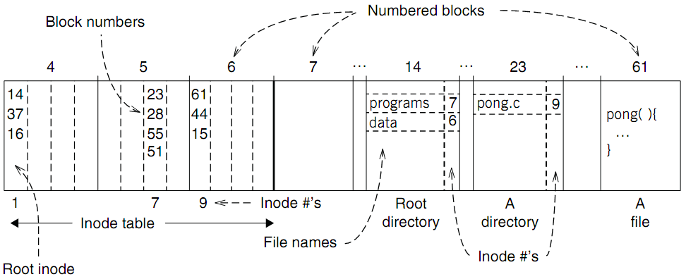
An Example: Find Blocks of "/programs/pong.c"

Slide 30
An Example: Find Blocks of "/programs/pong.c"
'/' root directory: inode is 1

Slide 31
An Example: Find Blocks of "/programs/pong.c"
Find the first directory in '/' by block number

Slide 32
An Example: Find Blocks of "/programs/pong.c"
Find '/programs' by comparing name

Slide 33
An Example: Find Blocks of "/programs/pong.c"
Find '/programs' inode by its inode number 7

Slide 34
An Example: Find Blocks of "/programs/pong.c"
Find the first file in '/programs/'

Slide 35
An Example: Find Blocks of "/programs/pong.c"
Find '/programs/pong.c' by comparing its name

Slide 36
An Example: Find Blocks of "/programs/pong.c"
Find inode of '/programs/pong.c' by the inode number 9

Slide 37
An Example: Find Blocks of "/programs/pong.c"
Find block number of '/programs/pong.c'

Slide 38
An Example: Find Blocks of "/programs/pong.c"
Find data of block 61 by its block number
  And data of block 44 & 15

Slide 39
Directly Dump a Directory
$ ls -ai temp
7536909 . 7530417 .. 7536939 a 7536940 b 7536941 c 7536942 d
$ echo “obase=16;7536909;7530417;7536939;7536940;7536941;7536942" | bc
73010D 72E7B1 73012B 73012C 73012D 73012E
$ sudo /sbin/debugfs /dev/sda1
debugfs 1.43.4 (31-Jan-2017)
debugfs: dump temp temp.out
debugfs: quit
$ xxd temp.out
0000000: 0d01 7300 0c00 0102 2e00 0000 b1e7 7200 ..s...........r.
0000010: 0c00 0202 2e2e 0000 2b01 7300 0c00 0101 ........+.s.....
0000020: 6100 0000 2c01 7300 0c00 0101 6200 0000 a...,.s.....b...
0000030: 2d01 7300 0c00 0101 6300 0000 2e01 7300 -.s.....c.....s.
0000040: c40f 0101 6400 0000 0000 0000 0000 0000 ....d...........
0000050: ...

Slide 40
Directly Dump a Directory
struct ext4_dir_entry {
uint32_t inode_number;
uint16_t dir_entry_length;
uint8_t file_name_length;
uint8_t file_type;
char name[EXT4_NAME_LEN];
}
0d01 7300 0c00 0102 2e00 0000
b1e7 7200 0c00 0202 2e2e 0000
2b01 7300 0c00 0101 6100 0000
2c01 7300 0c00 0101 6200 0000
2d01 7300 0c00 0101 6300 0000
2e01 7300 c40f 0101 6400 0000
File Type
0x0: Unknown
0x1: Regular file
0x2: Directory
0x3: Character device file
0x4: Block device file
0x5: FIFO
0x6: Socket
0x7: Symbolic link
0d01 7300 0c00 0102 2e00 0000
0d01 7300: inode number
0c00: entry length is 12 bytes
01: file name length is 1 byte
01: file type is regular file
2e00 0000: file name (2e -> ".")

Slide 41
L7: Symbolic
Link Layer
Symbolic link
Absolute path
File
name
Inode num
File
(inode)
Block num
Disk
Block
Path name
Name files on other disks
  Inode is different on other disks
  Supports to attach new disks to the name space
Two options
  Make inodes unique across all disks (not good)
  Create synonyms for the files on the other disks
Introducing layer 7: soft link (symbolic link)
  SYMLINK
  Add another type of inode

Slide 42
Directly Dump a Symbolic Link
$ ln -s "/tmp/abc" s-link
$ ls –l s-link
7536945 lrwxrwxrwx 1 xiayubin 8 Sep 20 08:01 s-link -> /tmp/abc
$ readlink s-link
/tmp/abc
$ cat s-link
cat: slink: No such file or directory
$ echo "hello, world" > /tmp/abc
$ cat s-link
hello, world
What does "8" means?
File size

Slide 43
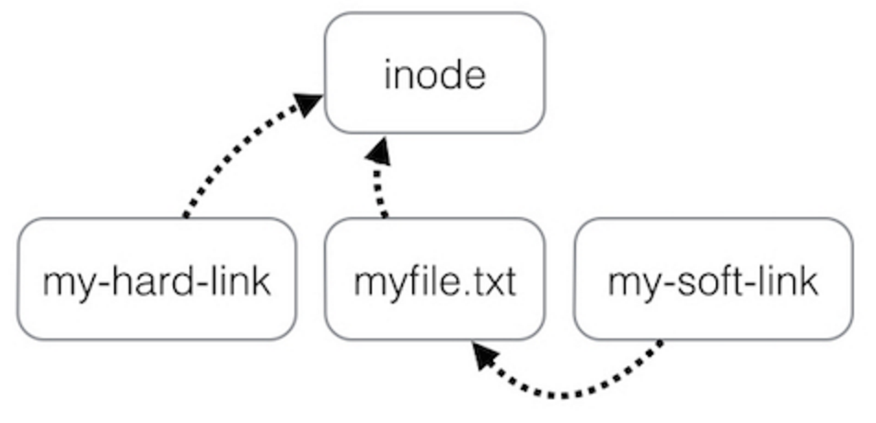
Two Types of Links (Synonyms)
By inode number
By inode number
By file name

Slide 44
Sidebar: Notice the Context Change
Another interesting behavior of soft link
  There is a directory: "/Scholarly/programs/www"
  The root directory contains a soft link
    "/CSE-web" -> "/Scholarly/programs/www"
  Run following commands
    cd CSE-web
    cd ..
  What is the current directory? Why?
    ".." is resolved in a new default context: by bash, not file system

Slide 45
Sidebar: Notice the Context Change
The bash tries to be "human-friendly"
  When you cd /into/a/symlink/, the shell remembers the old location (in $OLDPWD) and will use that directory when you cd .. under the assumption that you want to return to the directory you were just in
If you want to use the real .., then you must also use "cd -P .."
The -P option says to use the physical directory
structure instead of following symbolic links (see
also the -P option to the set builtin command);
the -L option forces symbolic links to be followed.
$ cd
$ cd a/b/symlink
$ cd -P ..
$ pwd -P
/home/sarnold
$

Slide 46
Summary of File System's 7 Layers
File name is not part of a file
  Name is not a part of an inode
  Name is data of a directory, and metadata of a file system
  One inode can have several names (hard links)
Hard links are equal
  If a file has two names, both are links (instead of "a link and a name")
Directory size is small
  Only mapping from name to inode number
  The term "folder" is somewhat misleading

