Slide 1


File System API
SE124 (2021 Fall)
IPADS, Shanghai Jiao Tong University
https://www.sjtu.edu.cn

Slide 2
iNode-based File System

Slide 3
Review: Large-scale websites on distributed systems
While distributed systems are built from components on a single node
  File system runtimes, etc.
Caching server
Caching server
Caching server
…
Caching
Caching
Caching
Distributed caching
Database server
Database server
CDN
Users
Application #1
generate the page
Database
user, price
…
Database
user, price
Application server
Distributed database
Internet
Load
Balance
Application #2
add the order
File server
File server
File server
File:
image
File:
image
…
File:
image
Application server
…
…
Message queue
Distributed file system

Slide 4
Review: Large-scale websites on distributed systems
While distributed systems are built from components on a single node
  File system runtimes, etc.
Caching server
Caching server
Caching server
…
Caching
Caching
Caching
Distributed caching
Database server
Database server
CDN
Users
Application #1
generate the page
Database
user, price
…
Database
user, price
Application server
Distributed database
Internet
Load
Balance
Application #2
add the order
File server
File server
File server
File:
image
File:
image
…
File:
image
Application server
…
…
Message queue
Distributed file system

Slide 5
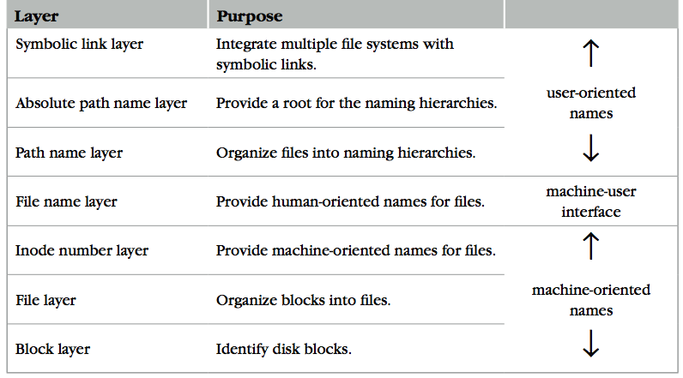
Review: The Naming Layers of the UNIX FS (version 6)
Notes:
TODO: redraw

Slide 6
Hard Link of a File
$ touch a.txt
$ ls -il
40975357 -rw-r--r-- 1 xiayubin wheel 0 9 26 08:15 a.txt
$ ln a.txt a.ln
$ ls -il
total 0
40975357 -rw-r--r-- 2 xiayubin wheel 0 9 26 08:15 a.ln
40975357 -rw-r--r-- 2 xiayubin wheel 0 9 26 08:15 a.txt
$ echo hello > a.txt
$ ls -il
total 16
40975357 -rw-r--r-- 2 xiayubin wheel 6 9 26 08:17 a.ln
40975357 -rw-r--r-- 2 xiayubin wheel 6 9 26 08:17 a.txt
What does "2" means?
Reference count
What does "6" means?
Size

Slide 7
L7:
Symbolic Link Layer
Symbolic link
Absolute path
File
name
Inode num
File
(inode)
Block num
Disk
Block
Path name
Name files on other disks
  The inode name space is different on other disks
  Support to attach new disks to the name space
Two options
  Make inodes unique across all disks (not good)
  Create synonyms for the files on the other disks
Introducing layer 7: soft link (symbolic link)
  SYMLINK
  Add another type of inode
struct inode
integer block_nums[N]
integer size
integer type

Slide 8
Directly Dump a Symbolic Link
$ ln -s "/tmp/abc" s-link
$ ls –l s-link
7536945 lrwxrwxrwx 1 xiayubin 8 Sep 20 08:01 s-link -> /tmp/abc
$ readlink s-link
/tmp/abc
$ cat s-link
cat: slink: No such file or directory
$ echo "hello, world" > /tmp/abc
$ cat s-link
hello, world
What does "8" means?
File size

Slide 9
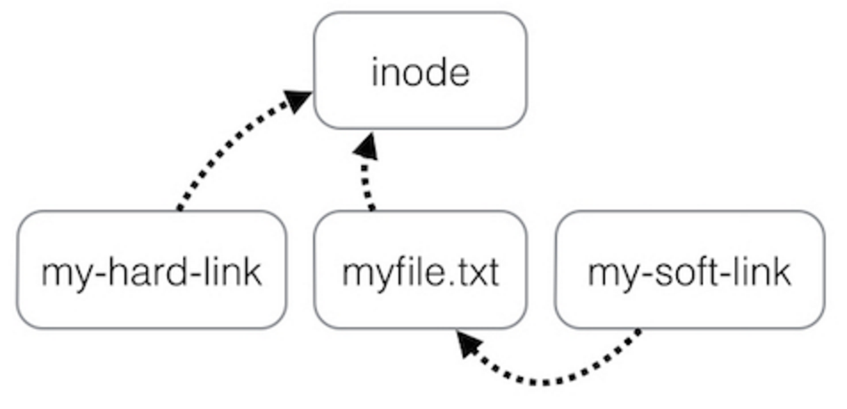
Two Types of Links (Synonyms)
By inode number
By inode number
By file name

Slide 10
Sidebar: Notice the Context Change
Another interesting behavior of soft link
  There is a directory: "/Scholarly/programs/www"
  The root directory contains a soft link
    "/CSE-web" -> "/Scholarly/programs/www"
  Run following commands
    cd CSE-web
    cd ..
  What is the current directory? Why?
    ".." is resolved in a new default context: by bash, not file system

Slide 11
Sidebar: Notice the Context Change
The bash tries to be "human-friendly"
  When you cd /into/a/symlink/, the shell remembers the old location (in $OLDPWD) and will use that directory when you cd .. under the assumption that you want to return to the directory you were just in
If you want to use the real .., then you must also use "cd -P .."
The -P option says to use the physical directory
structure instead of following symbolic links (see
also the -P option to the set builtin command);
the -L option forces symbolic links to be followed.
$ cd
$ cd a/b/symlink
$ cd -P ..
$ pwd -P
/home/sarnold
$

Slide 12
Summary of File System's 7 Layers
File name is not part of a file
  Name is not a part of an inode
  Name is data of a directory, and metadata of a file system
  One inode can have several names (hard links)
Hard links are equal
  If a file has two names, both are links (instead of "a link and a name")
Directory size is small
  Only mapping from name to inode number
  The term "folder" is somewhat misleading

Slide 13
Implementing the file system API

Slide 14
Implementing the File System API
API
  CHDIR, MKDIR
  CREAT, LINK, UNLINK, RENAME
  SYMLINK
  MOUNT, UNMOUNT
  OPEN, READ, WRITE, APPEND, CLOSE
  SYNC
Implemented as system calls to user applications
  Kernel has many sets of function pointers implementing the API
  Each set is specific to a FS (chose at mount point)

Slide 15
Sidebar: open() vs. fopen()
Difference between open() and fopen()?
  open() returns an fd; fopen() return a FILE*
  open() is a system call of OS; fopen() is an API of libc
Questions
  Which one can be used on both Windows and Linux?
  Which one has better performance?
    fopen() provides you with buffering IO that may turn out to be a lot faster than what you're doing with open()
Notes:
What is the difference between FILE* and fd? Fopen and open?

Slide 16
File Meta-data
Owner ID
  User ID and group ID that own this inode (can be changed by chown)
Types of permission
  Owner, group, other
  Read, write, execute
Time stamps
  Last access (by READ)
  Last modification (by WRITE)
  Last change of inode (by LINK)
struct inode
integer block_nums[N]
integer size
integer type
integer refcnt
integer userid
integer groupid
integer mode
integer atime
integer mtime
integer ctime
Notes:
There are three more mode bits: setuid, setgid, stick_bit

Slide 17
OPEN a File
Check user's permission
Update last access time
Return a short name for a file
  File descriptor (fd)
  fd is used by READ, WRITE, CLOSE, etc.

Slide 18
File Descriptor
Each process starts with three default open files
  Standard in(stdin): fd = 0, standard out(stdout): fd = 1, standard error(stderr): fd = 2
Can also use fd to name opened devices
  Keyboard, display, etc.
  Allow a designer not to worry about input/output
    Just read from fd 0 and write to fd 1
Each process has its own fd name space
Notes:
What is the different between fd and inode?
More details on device as a file

Slide 19
Why File Descriptor?
Other options
  Option-1: OS returns an inode pointer
  Option-2: OS returns all the block numbers of the file
Reasons and considerations
  Security: user can never access kernel's data structure
  Non-bypassability: all file operations are done by the kernel
  (aka., complete mediation)

Slide 20
File Cursor
File cursor
  Keep track of operation position within a file
  Can be changed by the SEEK operation
Case-1: Sharing file cursor
  Parent passes its fd to its child
    In UNIX, child inherits all open fds from its parent
  Allow parent and child to share an output file
Case-2: Not sharing file cursor
  Two processes open the same file
Cursor

Slide 21
fd_table & file_table
One file_table for the whole system
  Records information for opened files
  inode num, file cursor, ref_count of opening processes
  Children can share the cursor with their parent
One fd_table for each process
  Records mapping of fd to index of the file_table

Slide 22
File Cursor Sharing
Note: this refcnt is not the refcnt of inode!
fd_table
file_table
fd
index
index
inode num
file cursor
refcnt
Process A
3
115
115
23
128
1
116
23
240
2
fd
index
Process B
3
116
...
fd
index
C is B's child
3
116
Process A, B and C all open just one file with inode number 23
Process A and B open the same file, not share file cursor
Process B and C share the file cursor

Slide 23
OPEN Implementation
procedure OPEN(string filename, integer flags, integer mod)-> integer
0 inode_number <- PATH_TO_INODE_NUMBER(filename, wd)
if inode_number = FAILURE and flags = O_CREATE then // Create the file?
inode_number <- CREATE(filename, mode) // Yes, create it.
if inode_number = FAILURE then
return FAILURE
inode <- INODE_NUMBER_TO_INODE(inode_number)
if PERMITTED(inode, flags) then // Does this user have the required permissions?
file_index <- INSERT(file_table, inode_number)
fd <- FIND_UNUSED_ENTRY(fd_table) // Find entry in file descriptor table
fd_table[fd] <- file_index // Record file index for file descriptor
return fd // Return fd
else return FAILURE // No, return a failure

Slide 24
READ Implementation
procedure READ(integer fd, character[] &buf, integer n)-> integer
0 file_index <- fd_table[fd]
cursor <- file_table[fd].cursor
inode <- INODE_NUMBER_TO_INODE(file_table[file_index].inode_number)
m <- MINIMUM(inode.size – cursor, n)
atime of inode <- now()
if m = 0 then return END_OF_FILE
for i from 0 to m – 1 do
b <- INODE_NUMBER_TO_BLOCK(i,inode_number)
COPY(b, buf, MINIMUM(m-i, BLOCKSIZE)
i <- i + MINIMUM(m – i, BLOCKSIZE)
file_table[file_index].cursor <- cursor + m
return m

Slide 25
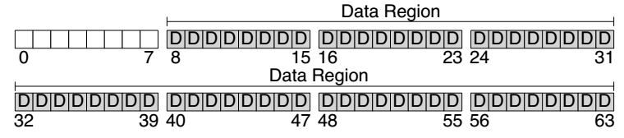
Disk Layout of a Simple File System

Slide 26
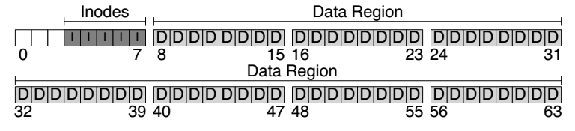
At the Head of a Disk Partition
S
i
d
i: inode free block bitmap
d: data free block bitmap
S: super-block
  How many inodes: 80
  How many data blocks: 56
  Where the inode table begins: block 3
  …
  A magic number to identify the file system type
The super-block is used when
the file system is mounted

Slide 27
Questions
How many read and write in a OPEN?
How many read and write in a READ?
How many read and write in a CREATION?

Slide 28
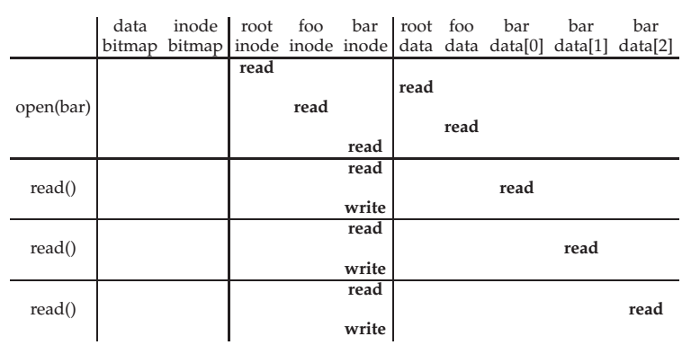
File Open & Read Timeline
open("/foo/bar", O_RDONLY)
Why "write" on bar inode in a read operation? Why no "write" on foo inodes?

Slide 29
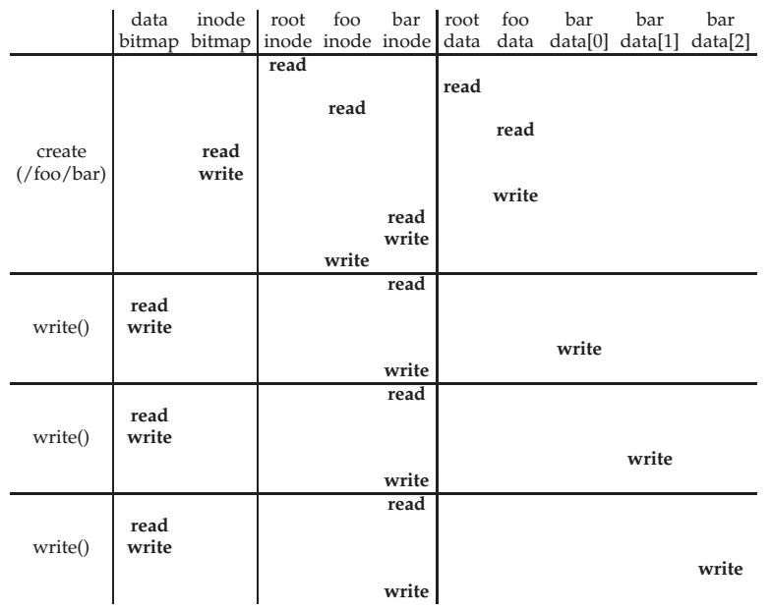
File Creation Timeline

Slide 30
WRITE, APPEND & CLOSE
WRITE is similar to READ
  Allocate new block if necessary
  Update inode's size and mtime
APPEND
  Similar to write, directly write to the end of the file
CLOSE
  Free the entry in the fd_table
  Decrease the reference counter in file table
  Free the entry in file table if counter is 0
Failures in the middle may cause inconsistency!

Slide 31
Questions
When writing, which order is preferred?
  Allocate new blocks, write new data, update size
  Allocate new blocks, update size, write new data
  Update size, allocate new blocks, write new data

Slide 32
SYNC
Block cache
  Cache of recently used disk blocks
  Read from disk if cache miss
  Delay the writes for batching
  Improve performance
  Problem: may cause inconsistency if fail before write
SYNC
  Ensure all changes to a file have been written to the storage device

Slide 33
Delete after OPEN but before CLOSE
One process has OPENed a file
Another process delete the file
  By removing the last name pointing to the file
  The reference counter is now 0
The inode is not freed until the first process calls CLOSE
  On Windows, it may forbid to delete an opened file

Slide 34
Other file systems (not inode)

Slide 35
Other Choices instead of inode
Method-1: use continue blocks
  Re-allocate if the file expands
  E.g., data in memory
  Why not?
Method-2: use a linked list
  Each block links to its next block
  Use special one as EOF (End of File)
  E.g., FAT32
  Why not?
How to integrate different FS?
  vnode (will discuss later)
  Interface is similar with inode

Slide 36
FAT (File Allocation Table) File System
File is a collection of disk blocks
FAT is a linked list 1-1 with blocks
File Number is index of root
of block list for the file
File offset (o = < B, x > )
Follow list to get block #
Unused blocks ⬄ FAT free list
FAT
Disk Blocks
file number
0:
0:
31:
File 31, Block 0
File 31, Block 1
free
File 31, Block 2
N-1:
N-1:
memory

Slide 37
FAT Properties
File is a collection of disk blocks
FAT is a linked list 1-1 with blocks
File Number is index of root
of block list for the file
File offset (o = < B, x > )
Follow list to get block #
Unused blocks ⬄ FAT free list
Ex: file_write(31, < 3, y >)
  Grab blocks from free list
  Linking them into file
FAT
Disk Blocks
file number
0:
0:
31:
File 31, Block 0
File 31, Block 1
File 31, Block 3
free
File 31, Block 2
N-1:
N-1:
memory

Slide 38
FAT File System
File allocation table (FAT)
  Organize files as linked lists
No inode
  File metadata: name & size
  Metadata are saved in dirs

Slide 39
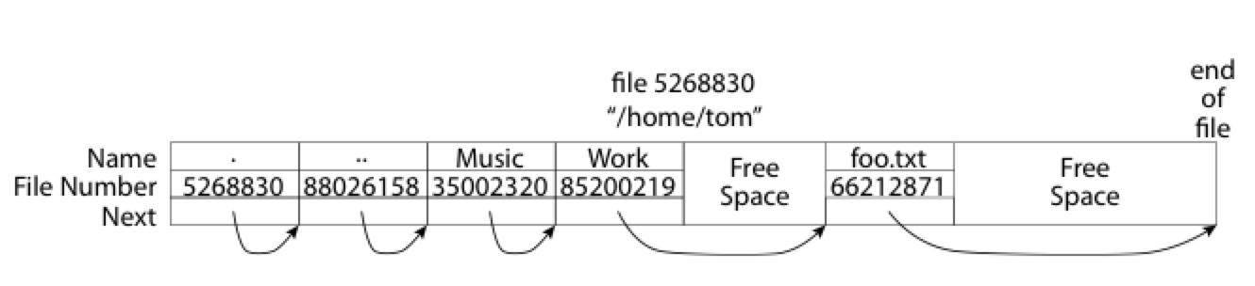
What about the Directory in FAT?
Directory: essentially a file containing <file_name: file_number> mappings
  Free space for new entries
  File attributes (metadata) are kept in directory
  Each directory is a linked list of entries
Question: Where to find root directory ( "/" )?
  Root dir at sector 0

Slide 40
Question: inode vs. FAT
What are the differences between inode and FAT?
Support hard link? Soft link?

Slide 41
How to interact with the device ? e.g., HDD, SSD

Slide 42
Review: The Big Picture so Far
User
App-1
App-2
App-3
OPEN("a.txt", "rw")
READ(…)
WRITE(…)
…
File System
Kernel
Disk Driver
READ(block-addr, buf)
WRITE(block-addr, buf)
Hardware
Memory
Disk
(4TB = 2³⁰ 4KB blocks)

Slide 43
A Canonical Device
Registers
Status
Address
Data
Command
Interface
Micro-controller (CPU)
Memory (DRAM or SRAM or both)
Other Hardware-specific Chips
Internals

Slide 44
A Canonical Protocol
while(STATUS == BUSY)
; //wait until device is not busy
Write data to DATA register and address to ADDRESS register
Write command to COMMAND register
(Doing so starts the device and executes the command )
while(STATUS == BUSY)
; //wait until device is done with your request

Slide 45
A Canonical Protocol
while(STATUS == BUSY)
; //wait until device is not busy
Write data to DATA register and address to ADDRESS register
Write command to COMMAND register
(Doing so starts the device and executes the command )
while(STATUS == BUSY)
; //wait until device is done with your request
Polling: CPU waits until the device is ready to receive a command by repeatedly reading the status register

Slide 46
A Canonical Protocol
while(STATUS == BUSY)
; //wait until device is not busy
Write data to DATA register and address to ADDRESS register
Write command to COMMAND register
(Doing so starts the device and executes the command )
while(STATUS == BUSY)
; //wait until device is done with your request
If this were a disk, then multiple writes would need to take place to transfer a disk block (say 512 Bytes) to the device
When the main CPU is involved with the data movement (as in this example protocol), we refer to it as programmed I/O (PIO)

Slide 47
A Canonical Protocol
while(STATUS == BUSY)
; //wait until device is not busy
Write data to DATA register and address to ADDRESS register
Write command to COMMAND register
(Doing so starts the device and executes the command )
while(STATUS == BUSY)
; //wait until device is done with your request
OS writes a command to the command register
Doing so implicitly lets the device know that both the data is present and that it should begin working on the command

Slide 48
A Canonical Protocol
while(STATUS == BUSY)
; //wait until device is not busy
Write data to DATA register and address to ADDRESS register
Write command to COMMAND register
(Doing so starts the device and executes the command )
while(STATUS == BUSY)
; //wait until device is done with your request
OS waits for the device to finish by again polling it in a loop, waiting to see if it is finished
It may then get an error code to indicate success or failure

Slide 49
A Canonical Protocol
while(STATUS == BUSY)
; //wait until device is not busy
Write data to DATA register and address to ADDRESS register
Write command to COMMAND register
(Doing so starts the device and executes the command )
while(STATUS == BUSY)
; //wait until device is done with your request
Problem: polling wastes too much CPU
Solution: using interrupt

Slide 50
Lowering CPU Overhead With Interrupts
Instead of polling, the OS can issue a request, put the calling process to sleep, and context switch to another task
When the device finishes, it will raise a hardware interrupt
The CPU jumps into the OS at a pre-determined interrupt service routine (ISR) or more simply an interrupt handler
The handler is just a piece of OS code that will finish the request
  For example, by reading data and perhaps an error code from the device, and wake the process waiting for the I/O, which can then proceed as desired

Slide 51
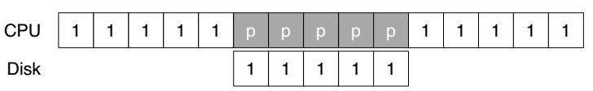
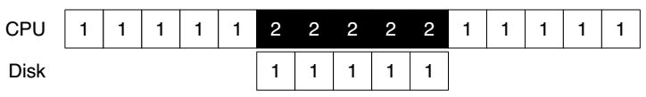
Lowering CPU Overhead With Interrupts
CPU runs thread 1
CPU is polling without doing anything
Using Polling
CPU can run thread 2
Using Interrupt

Slide 52
Example of Interrupt: Keyboard
When user depresses a key, keyboard SENDs a message to the processor containing the key value
As the processor is not ready, its bus interface:
  copies the data into a temporary register,
  acknowledges the keyboard,
  SENDs an interrupt signal to the processor
The processor handles the interrupt in the next cycle
  SENDs the value over the bus to memory module
Only suitable for slow device

Slide 53
Problem of Interrupt: Livelock
Using interrupts arises in networks
  When a huge stream of incoming packets each generate an interrupt it is possible for the OS to livelock
  Livelock: the CPU only processes interrupts and never allows a user-level process to run and actually service the requests
Hybrid solution: interrupt + polling
  Default using interrupts
  When an interrupt happens, handle it and polling for a while to solve subsequence requests
  If no further request or time-out, fall back to interrupt again
  Used in Linux network driver with the name NAPI (New API)

Slide 54
Interrupt Coalescing for Optimization
A device which needs to raise an interrupt first waits for a bit before delivering the interrupt to the CPU
While waiting, other requests may soon complete, and thus multiple interrupts can be merged into a single interrupt delivery, thus lowering the overhead of interrupt processing
Note: waiting too long will increase the latency of a request, this is a common trade-off in systems

Slide 55
DMA, PIO, MMIO:
More efficient data movement

Slide 56
DMA for Disk Device
DMA (Direct Memory Access)
  A processor SENDs a request to a disk controller to READ a block of data
  Including the address of a buffer in memory
The disk SENDs the data directly to memory
  Incrementing the memory address appropriately

Slide 57
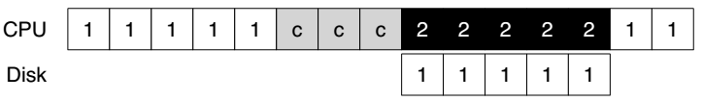
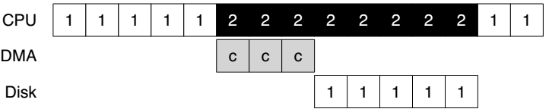
DMA for Disk Device
'c' is for copy
Without DMA
With DMA

Slide 58
DMA for Disk Device
Benefits of DMA
  Relieve the CPU's load to execute other program
  Reduce one transfer (original two)
  Take better advantage of long message if the bus supports
  Amortize the overhead of the bus protocol

Slide 59
Methods of Device Interaction
Method-1: PIO through I/O instructions
  On x86, IN and OUT instructions
  Must be executed in privileged mode (kernel mode)
Method-2: Memory-mapped I/O
  Using LOAD and STORE
  Can also be executed in unprivileged mode (user mode)

Slide 60
I/O Instructions
Example: send data to a device by OUT instruction
  out %eax, 0x120
  Specify a register with data (%eax)
  Specific an I/O Port which names the device (0x120)
    I/O port: another name space, not physical memory space
Privileged instructions
  Only the OS can directly communicate with devices

Slide 61
Memory Mapped I/O
Use LOAD and STORE instructions to address the register and buffer of the I/O modules
  Just like access memory
  Address is overloaded name with location info
Provide a uniform interface to bus modules
  MMU translates virtual address to physical address
    Physical address is system bus address
  I/O modules translate bus address to register address internally

Slide 62
Memory Mapped I/O
Processor
Virtual address
MMU
Physical address (System bus address)
Internally translate
to register address
Memory
Disk
Keyboard

Slide 63
NOTE: Volatile Address if using MMIO
void main(void)
{
void *pdev = (void *) 0x40400000;
size_t size = (1024*1024);
int *base;
volatile int *pcid, cid;
base = mmap(pdev, size, PROT_READ|PROT_WRITE,
MAP_ANONYMOUS|MAP_PRIVATE, -1, 0);
if (base == MAP_FAILED) errx(1, "mmap failure");
pcid = (int *) (((void *) base) + 0xf0704);
cid = *pcid;
printf(“cid = %d\n", cid);
cid = *pcid;
printf(“cid = %d\n", cid);
munmap(base, size);
}
If no volatile is used, the compiler will think
the two printf() are redundant and will
eliminate the second memory load operation

Slide 64
Sidebar: Another Volatile Example
#include <stdio.h>
void main()
{
int i = 10;
int a = i;
printf("i= %d\n",a);
// Change value of i
__asm {
mov dword ptr [ebp-4], 20h
}
int b = i;
printf("i= %d\n",b);
}
Is volatile needed here?
Notes:
Yes. The compiler does not know [ebp-4] is the address of i.

Slide 65
Summary: the Big Picture of File System
While distributed systems are built from components on a single node
  File system runtimes, etc
Caching server
Caching server
Caching server
…
Caching
Caching
Caching
Distributed caching
Database server
Database server
CDN
Users
Application #1
generate the page
Database
user, price
…
Database
user, price
Application server
Distributed database
Internet
Load
Balance
Application #2
add the order
File server
File server
File server
File:
image
File:
image
…
File:
image
Application server
…
…
Message queue
Distributed file system

Slide 66

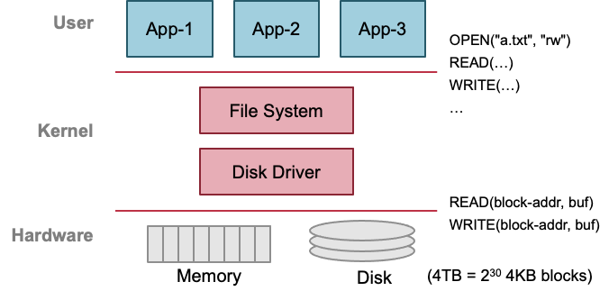
Summary: the Big Picture of File System
Storage as files
Caching server
Caching server
…
Caching server
Caching
Caching
Caching
Distributed caching
Database server
Database server
CDN
Users
Application #1
generate the page
Database
user, price
…
Database
user, price
Application server
Distributed database
Internet
Load
Balance
Application #2
add the order
File server
File server
File server
File:
image
File:
image
…
File:
image
Application server
…
…
Message queue
Distributed file system

Slide 67
Next lecture
Towards a distributed file system

Slide 68
Rename between different directories
$ ls -il dir1
40978804 -rw-r--r-- 1 xiayubin wheel 6 9 26 08:50 from.txt
$ ls –il dir2
40978827 -rw-r--r-- 1 xiayubin wheel 7 9 26 08:51 to.txt
$ mv dir1/from.txt dir2/to.txt
$ ls dir1
$ ls dir2
40978804 -rw-r--r-- 1 xiayubin wheel 6 9 26 08:50 to.txt

Slide 69
Renaming
1 UNLINK(to.txt)
2 LINK(from.txt, to.txt)
3 UNLINK(from.txt)
1 LINK(from.txt, to.txt)
2 UNLINK(from.txt)
If to.txt exists and fails between 1 & 2
  The file to.txt will be lost,
  which will surprise the user
If to.txt exists and fails between 1 & 2
  It will always exist even if the machine fails between 1 & 2
  Must increase reference count of from.txt's inode on recovery

