Slide 1


Remote Procedure Call
SE124 (2021 Fall)
IPADS, Shanghai Jiao Tong University
https://www.sjtu.edu.cn
Credits: Rong Chen@IPADS

Slide 2
Distributed system that support large-scale websites
Large-scale websites are composed of different distributed systems
  Request processing, data storage
Caching server
Caching server
Caching server
…
Caching
Caching
Caching
Distributed caching
Database server
Database server
CDN
Users
Application #1
generate the page
Database
user, price
…
Database
user, price
Application server
Distributed database
Internet
Load
Balance
Application #2
add the order
File server
File server
File server
File:
image
File:
image
…
File:
image
Application server
…
…
Message queue
Distributed file system

Slide 3
Example: extend a single-node filesystem to a distributed one
Large-scale websites are composed of different distributed systems
  Request processing, data storage
  How each system communicates?
Caching server
Caching server
Caching server
…
Caching
Caching
Caching
Distributed caching
Database server
Database server
CDN
Users
Application #1
generate the page
Database
user, price
…
Database
user, price
Application server
Distributed database
Internet
Load
Balance
Application #2
add the order
File server
File server
File server
File:
image
File:
image
…
File:
image
Application server
…
…
Message queue
Distributed file system

Slide 4
Remote Procedure Call (RPC)
“Remote procedure calls (RPC) appear to be a useful paradigm.”
— Birrel & Nelson, 1984
Andrew Birrell, Bruce Nelson, “Implementing Remote Procedure Calls”. ACM Transactions on Computer Systems (TOCS), 2(1), 1984

Slide 5
Problems with the Sockets API
The sockets interface forces a read/write mechanism
  Read(), Write(), sendmsg(), etc
Programming is often easier with a functional interface
  To make distributed computing look more like centralized computing
  Goal of RPC:
  It should appear to be the programmer that a normal call is taking place

Slide 6


RPC: Remote Procedure Call
Allow a procedure to execute in another address space without coding the details for the remote interaction
RPC History
  Idea goes back in 1976
  Sun's RPC: first popular implementation on Unix
    Used as the basis for NFS
  Many modern RPC frameworks: gRPC, bRPC, etc.
RMI (Remote Method Invocation)
  Object-oriented version of RPC, e.g. in Java

Slide 7
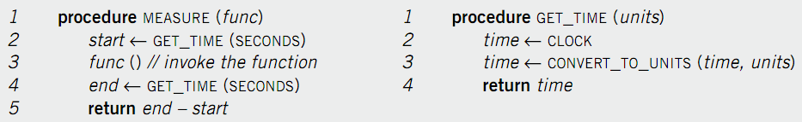
Example of RPC
The implementation of GET_TIME.
Suppose we want to measure the execution time of func()
Assumption:
  Only the server has the implementation of GET_TIME
How can the client call server’s GET_TIME?

Slide 8

Call GET_TIME in a single machine case
GET_TIME
func()
GET_TIME
Client

Slide 9
Single-machine call vs. distributed call（RPC）
Call(get_time)
GET_TIME
func()
Client
Call(get_time)
GET_TIME
Server

Slide 10
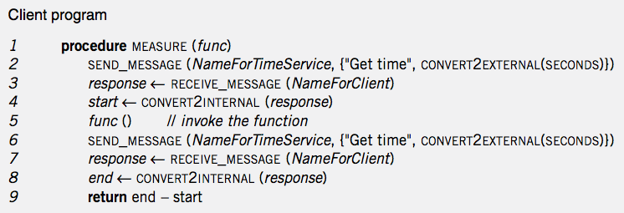
Handwritten code: client
Call(get_time)
Local
func()
Client
Call(get_time)
RPC

Slide 11
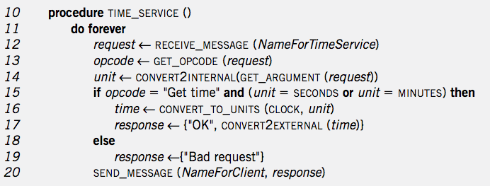
Handwritten code: server
GET_TIME
TIME_SERVICE
Client
Server

Slide 12
RPC simplifies the implementation of remote calls
Abstracts away the common parts with stub
Provided in
RPC’s stub

Slide 13
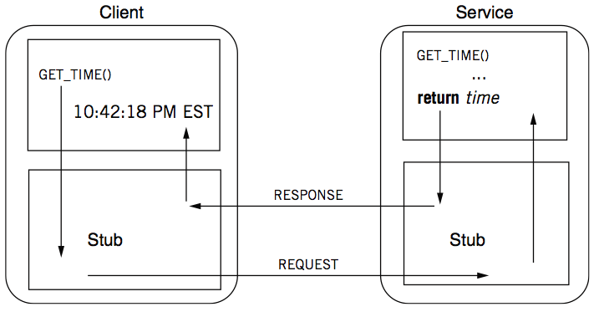
RPC: a complete calling process

Slide 14
RPC stub
Client stub
  Put the arguments into a request
  Send the request to server
  Wait for a response
Service stub
  Wait for a message
  Get the parameters from the request
  Call the procedure (e.g. GET_TIME)
  Put the result into a response
  Send the response to the client
Stub: hide communication details from up-level code, so that up-level code does not change.

Slide 15
Client Program using RPC
procedure MEASURE (func)
start <- GET_TIME(SECONDS)
func()
end <- GET_TIME(SECONDS)
return end - start
Note: this code is not changed compare
to single-machine case
This is the stub of client
procedure GET_TIME (units)
SEND_MESSAGE(ServerName, {"Get time", CONVERT2EXTERNAL(units)})
response <- RECEIVE_MESSAGE(ClientName)
if GET_RETCODE(response) != "OK"
HANDLE_ERROR(response)
else
return CONVERT2INTERNAL(GET_ARGUMENT(response))

Slide 16
Server Program using RPC
procedure GET_TIME (units)
time <- CLOCK
time <- CONVERT_TO_UNITS(time, units)
return time
Note: this code is not changed
This is the stub of server
procedure TIME_SERVICE ()
do forever
request <- RECEIVE_MESSAGE(ServerName)
opcode <- GET_OPCODE(request)
arg <- CONVERT2INTERNAL(GET_ARGUMENT(request))
if opcode = "Get time" and (arg = SECONDS or arg = MINUTES) then
retval <- GET_TIME(arg)
response <- {"OK", CONVERT2EXTERNAL(retval)}
else
response <- {"Bad request"}
SEND_MESSAGE(ClientName, response)

Slide 17
Question: what is inside a message?
procedure GET_TIME (units)
SEND_MESSAGE(ServerName, {"Get time", CONVERT2EXTERNAL(units)})
response <- RECEIVE_MESSAGE(ClientName)
if GET_RETCODE(response) != "OK"
HANDLE_ERROR(response)
else
return CONVERT2INTERNAL(GET_ARGUMENT(response))
procedure TIME_SERVICE ()
do forever
request <- RECEIVE_MESSAGE(ServerName)
opcode <- GET_OPCODE(request)
arg <- CONVERT2INTERNAL(GET_ARGUMENT(request))
if opcode = "Get time" and (arg = SECONDS or arg = MINUTES) then
retval <- GET_TIME(arg)
response <- {"OK", CONVERT2EXTERNAL(retval)}
else
response <- {"Bad request"}
SEND_MESSAGE(ClientName, response)

Slide 18
Question: what is inside a message?
A message may contain:
  Service ID (e.g., function ID)
  Service parameter (e.g., function parameter)
  Using marshal / unmarshal

Slide 19
RPC Request message
RPC request:
  Xid
  call/reply
  rpc version
  program #
  program version
  procedure #
  auth stuff
  arguments
X is short for "transaction"
Client reply dispatch uses xid
Client remembers the xid of each call
Server dispatch uses prog#, proc#

Slide 20
RPC reply message
RPC reply:
  Xid
  call/reply
  accepted? (Yes, or No due to bad RPC version, auth failure, etc.)
  auth stuff
  success? (Yes, or No due to bad prog/proc #, etc.)
  results

Slide 21
Binding: find the server
Can implement with other network name services
  E.g., 192.168.10.233:8888 + function ID
Example: gRPC
gRPC client
grpc::CreateChannel("localhost:50051",
grpc::InsecureChannelCredentials());
binding
gRPC server
std::stringserver_address("0.0.0.0:50051");
...
... AddListeningPort(server_address, ...);

Slide 22
How to pass the data between
client & server?

Slide 23
Parameter passing
Pass by value?
  Easy: just copy data to network message
Pass by reference?
  Makes no sense without shared memory
Process
  Client converts data structure into pointerless representation
  Client transmits data to the server
  Server reconstructs structure with local pointers

Slide 24
Parameter passing is challenging
Distributed systems have incompatibility problem
  Does not exist on a single machine
For example, remote machine may have different:
  byte ordering,
  sizes of integers and other types,
  floating point representations,
  character sets,
  alignment requirements
  etc.
Represent 0x89abcdef
Big endian, e.g., Power processor
89
AB
CD
EF
0
1
2
3
Little endian, e.g., X86
EF
CD
AB
89
0
1
2
3

Slide 25
Parameter passing is more challenging
Application is changing over time
  What would happen if a server upgrades while the client is intact?
  E.g., server upgrades and adds a priority field to its message, what would happen if the client does not change?
Server (new) expects requests as:
  Xid
  call/reply
  rpc version
  rpc priority
  program #
  program version
  procedure #
  auth stuff
  arguments
While the client (old) sends:
  Xid
  call/reply
  rpc version
  program #
  program version
  procedure #
  auth stuff
  arguments

Slide 26
Parameter passing is more challenging
Application is changing over time
  What would happen if a server upgrades while the client is intact?
  E.g., server upgrades and adds a priority field to its message, what would happen if the client does not change?
Evolvability: we should built systems that are easy to adapt to changes!
  Backward compatibility: newer code can read data that was written by older code
  Forward compatibility: older code can read that was written by newer code
Notes:
例子：手机

Slide 27



Representing data: encoding
Need standard encoding to enable communication between heterogeneous systems & different versions of software
  Sun’s RPC uses XDR (eXternal Data Representation)
  ASN.1 (ISO Abstract Syntax Notation)
  JSON
  Google Protocol Buffers
  W3C XML Schema Language

Slide 28


Why not usign language-specific formats?
Many programming language come with built-in support for encoding of its in-memory object
  Java’s java.io.Serializable
  Python’s pickle
Drawbacks:
  The encoding is tied to a particular programming language
    E.g., it’s challenging to use a Java client to call a C++ server
  No versioning -> no forward and backward compatibility

Slide 29
Standardized encoding: JSON, XML & etc.
Independent to a specific programming language
Textual formats:
  JSON
  XML
  CSV
Logic client request format
  Xid
  call/reply
  rpc version
  program #
  program version
  procedure #
  auth stuff
  arguments
JSON representation
{ “xid” : 12, ”call”: true,
“rpc_version”: 73,
...
}

Slide 30
Standardized encoding: JSON, XML & etc.
Independent to a specific programming language
Textual formats:
  JSON
  XML
  CSV
Benefits:
  Human-readable: easy to debug

Slide 31
Standardized encoding: JSON, XML & etc.
Independent to a specific programming language
Textual formats:
  JSON
  XML
  CSV
Drawbacks:
  1. Ambiguity around encoding of numbers
How may bytes
should I use to store
the number?
JSON representation
{ “xid” : 12, ”call”: true,
“rpc_version”: 73,
...
}

Slide 32
Standardized encoding: JSON, XML & etc
Independent to a specific programming language
Textual formats:
  JSON
  XML
  CSV
Drawbacks:
  Ambiguity around encoding of numbers
  How to support binary strings?
    People have to re-encode the string as Base64, etc.

Slide 33
Standardized encoding: JSON, XML & etc
Independent to a specific programming language
Textual formats:
  JSON
  XML
  CSV
Drawbacks:
  Ambiguity around encoding of numbers
  How to support binary strings?
  3. Verbose: use more bytes to store the data. E.g., <xx> </xx> in XML

Slide 34
Binary formats
Encode the data using binary encoding
  Pros: more compact & fast to parse, store
  Cons: less human-readable
    Not a problem when the data is only used internally
    E.g., RPC message metadata
Typical example: Thrift & Protocol Buffers
{ "userName": "Martin", "favoriteNumber": 1337, "interests": ["daydreaming", "hacking"] }
JSON representation takes 81B in total (w/o spaces)
Binary formats can reduce it to 34B or even less

Slide 35
Binary formats: schema
Both Thrift and Protocol Buffers require a schema for any data that is encoded
  Benefits: no need to encode things such as userName in the encoded data
Thrift interface definition language (IDL)
Protocol Buffers IDL
struct Person {
1: required string userName,
2: optional i64 favoriteNumber,
3: optional list<string> interests
}
message Person {
required string user_name = 1;
optional int64 favorite_number = 2;
repeated string interests = 3;
}
{ "userName": "Martin", "favoriteNumber": 1337, "interests": ["daydreaming", "hacking"] }
JSON representation takes 81B in total (w/o spaces)
Notes:
Int64 remove the ambiguity of JSON formats

Slide 36
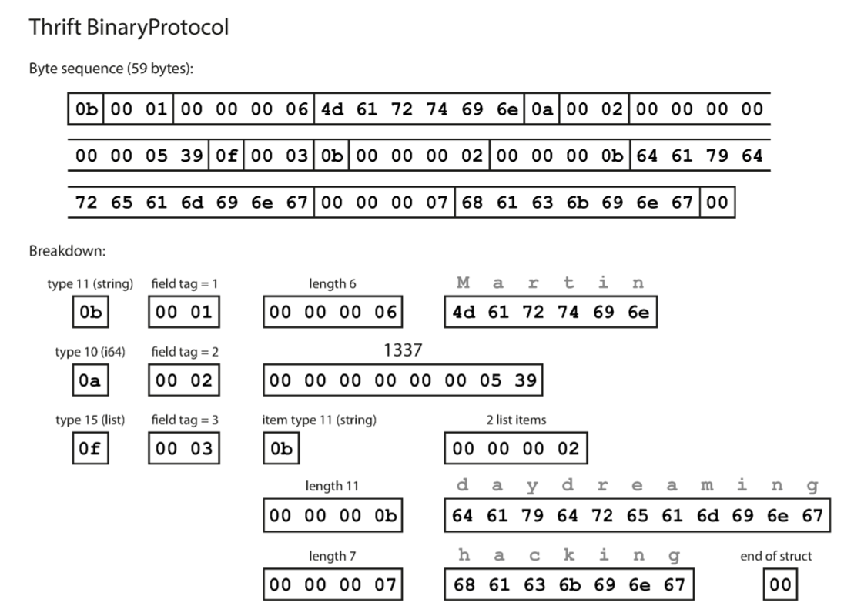
The BinaryProtocol of Thrift
Each field has:
  Type annotation (1B)
  Type field (1B)
  A length indication (optional, required for string, list, etc.)
  Data (like json)
For each type, the protocol assumes an internal encoding
  E.g., little endian
Total 59B
  no field names (userName, favoriteNumber, interests)

Slide 37
Being more compact: Thrift CompactProtocol
Techniques:
  Packing field type & field tag in 1B
  Variable-length integer
    Top-bit of each byte indicates whether there are more bytes
1
2

Slide 38
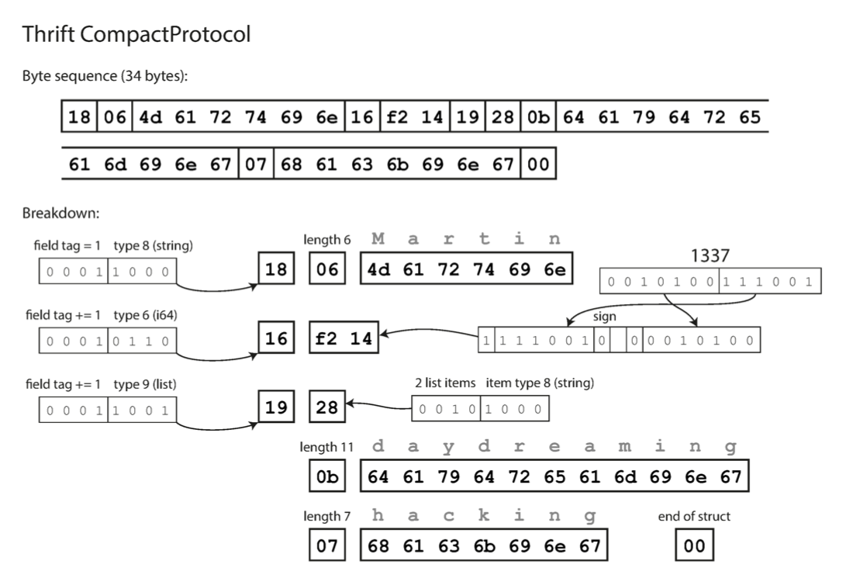
Being more compact: Thrift CompactProtocol
Techniques:
  Packing field type & field tag in 1B
  Variable-length integer
    Top-bit of each byte indicates whether there are more bytes
Now only consumes 34B

Slide 39
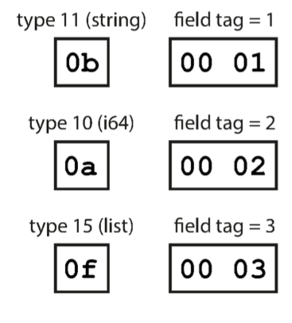
Schema simplifies supporting compatibility
Key observation: we only need to keep the field tags & field type compatible
Forward compatible: if new schema preserves the presentation of old schema, then new code can trivially decode the data encoded with old schema
Backward compatible: old code can simply skip fields with unknown field tag

Slide 40
Short summary of parameter passing in RPC
Passing data using RPC is non-trivial, should ensure
  Correctness
  Compact
  Evolvable
Encoding/decode
  Convert an object into an array of bytes with enough annotation so that the decode procedure can convert it back into an object
  Also known as Marshal / Unmarshal in RPC
  With other names, e.g., serialization

Slide 41
Automatic stub generation
Generate stubs from an interface specification
  Tool to look at argument and return types
  Generate marshal and unmarshal code
  Generate stub procedures
Benefits:
  Saves programming (thus less error)
  Ensures agreement on argument types
    E.g., consistent function ID

Slide 42
Transport protocol of RPC
Stubs also include implementations of sending/receiving messages
  TCP or UDP, which one to use?
  What about new networking features, e.g., RDMA?
Hide the transport protocol from the user
  Benefits: e.g., transparent migrate to a more advanced network
Most support several
  Allow programmer (or end user) to choose at runtime

Slide 43
Short summary: program distributed systems w/ RPC
RPC simplifies programming w/ an interface similar to local function call
RPC uses stubs to avoid handling argument encoding/decoding and send/receiving messages, etc.
  Ensure correctness & efficiency
Remain challenges of RPC：
  How to handle failure?
    As we have mentioned in lecture02, failure is common especially in large-scale distributed systems!

Slide 44
When RPC meets failure

Slide 45
When RPC meets failures
Local procedure calls do not fail (most of the time)
  If that happens, the entire process usually dies
RPC may meet many different failures
  Parameter error -> just return
  Server crash -> how the client copes with it？

Slide 46
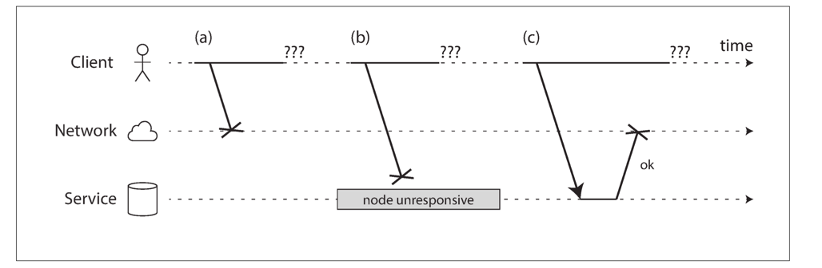
When RPC meets failures
RPC could fail in a partial failure way
  Like what we have presented in lecture 02
A client uses RPC to call a function at a service through the network
  The client does not get any reply
  What could possibly happen?

Slide 47
When RPC meets failures
A user sends an RPC but the server does not reply, possible reasons:
1. Request may have been lost (e.g., someone unplugged a network cable).
2. Request may be waiting in a queue and will be delivered later (e.g., the network or the recipient is overloaded).
3. The remote node may have failed (e.g., it crashed or it was powered down).

Slide 48
When RPC meets failures
A user sends an RPC but the server does not reply, possible reasons:
4. The remote node may have temporarily stopped responding (e.g., it is experiencing a long garbage collection pause)
5. The remote node may have executed the function, but the response has been lost on the network (e.g., a network switch has been misconfigured).
6. The remote node may have executed the function, but the response has been delayed and will be delivered later (e.g., the network or your own machine is overloaded).

Slide 49
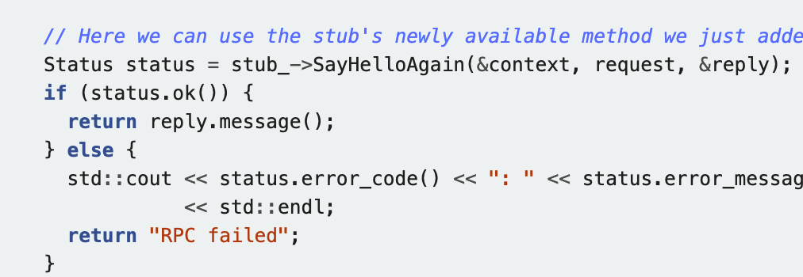
When RPC meets failures
The transparency of RPC breaks here:
  Applications should be prepared to deal with RPC failure
  E.g., gRPC will return a status for application to check

Slide 50
When RPC meets failures
Semantics of remote procedure calls
  Local procedure call: Exactly once
A remote procedure call may be called:
  0 time: server crashed or serve process died before executing server code
  1 time: everything worked well, as expected
  1 or more: excess latency or lost reply from server and client retransmission

Slide 51
RPC semantic
Most RPC systems will offer either:
  At-least-once semantics
  At-most-once semantics
Simple retransmission leads to "at-least-once"
Birrell’s RPC semantics :
  server says OK: executed once
  server says CRASH: zero or one times
much easier than exactly once, more useful than at-least-once

Slide 52
RPC semantic
Understand application:
  Idempotent: may be run any number of times without harm
  Non-idempotent: those with side-effects (e.g., call i++ at the server)
When at-least-once is ever OK?
  if no side effects (e.g., read-only operation)
  if app has its own plan for detecting duplication

Slide 53



What is idempotence?
“Idempotence means that multiple invocations of some work are identical to exactly one invocation.”
——Pat Helland
Sweeping the floor is idempotent
Pressing the elevator button is idempotent
Saving money is non-idempotent

Slide 54
Idempotence in RPC
RPC client
RPC server
Call(server, “ReadTime”);
ReadTime() {
return current_time;
}
Succ
C0
Failure & retry
Succ
C1
Server
ReadTime
ReadTime
ReadTime
Time

Slide 55
Idempotence in RPC
RPC client
RPC server
Expect ReadTime is called twice
Actually called 3 times
Is it ok? Why?
Call(server, “ReadTime”);
ReadTime() {
return current_time;
}
Succ
C0
Failure & retry
Succ
C1
Server
ReadTime
ReadTime
ReadTime
Time

Slide 56

Idempotence in RPC
RPC client
RPC server
Call(server, “Like”);
Like() {
counter++;
}
Succ
C0
Failure & retry
Succ
C1
Server
Like
Like
Like
counter=1
counter=2
counter=3
Time

Slide 57

Idempotence in RPC
RPC client
RPC server
Expect Like is called twice
Actually called 3 times
Is it ok? Why?
What about something like Vote?
Call(server, “Like”);
Like() {
counter++;
}
Succ
C0
Failure & retry
Succ
C1
Server
Like
Like
Like
counter=1
counter=2
counter=3
Time

Slide 58
RPC semantic
Understand application:
  Idempotent: may be run any number of times without harm
  Non-idempotent: those with side-effects (e.g., call i++ at the server)
When at-least-once is OK?
  If no side effect (e.g., read-only operation, ReadTime)
  If app has its own plan for detecting duplication
    E.g., record how many times a counter has been added

Slide 59
Ideal RPC Semantics: exactly-once
Like single-machine function call
Implement exactly-once semantics:
  Server remembers the requests it has seen and replies to executed RPCs (across reboots)
  Detect duplicates, requests need unique IDs (XIDs)

Slide 60
Idempotence in RPC
RPC client
RPC server
Call(server, “Like”);
Like(xid) {
if not see xid {
counter++;
}
}
Succ
C0
C0:#1
Failure & retry
Succ
C1
C1:#1
C1:#1
Server
Like
Like
Like
counter=1
counter=2
counter=2
Time

Slide 61
Ideal RPC Semantics: exactly-once
Like single-machine function call
Implement exactly-once semantics:
  Server remember the requests it has seen and replies to executed RPCs (across reboots)
  Detect duplicates, reqs need unique IDs (XIDs)
Assumption: failures are eventually repaired, and client retries forever
  How to correctly recover from failure? See next lectures

Slide 62
Put it all together: RPC system components
1. Standards for wire format of RPC message and data types
2. Library of routines to marshal / unmarshal data
3. Stub generator, or RPC compiler, to produce "stubs"
  For client: marshal arguments, call, wait, unmarshal reply
  For server: unmarshal arguments, call real function, marshal reply

Slide 63
Put it all together: RPC system components
4. Server framework:
  Dispatch each call message to correct server stub
  Recall each called functions ,if provide at-most-once semantic or exactly-once semantic
5. Client framework:
  Give each reply to correct waiting thread / callback
  Retry if timeout or server cache
6. Binding: how does client find the right server?

Slide 64
Next course
Distributed file system

