Slide 1


Batch Processing Systems
SE124 (2021 Fall)
Yubin Xia
IPADS, Shanghai Jiao Tong University
https://www.sjtu.edu.cn
Credits: Rong Chen@IPADS

Slide 2
Scalable websites overview
Scalable websites powered by distributed systems
  For request handling, data storage
Caching server
Caching server
Caching server
…
Caching
Caching
Caching
Distributed caching
Database server
Database server
CDN
Users
Application #1
generate the page
Database
user, price
…
Database
user, price
Application server
Distributed database
Internet
Load
Balance
Application #2
add the order
File server
File server
File server
File:
image
File:
image
…
File:
image
Application server
…
…
Message queue
Distributed file system

Slide 3
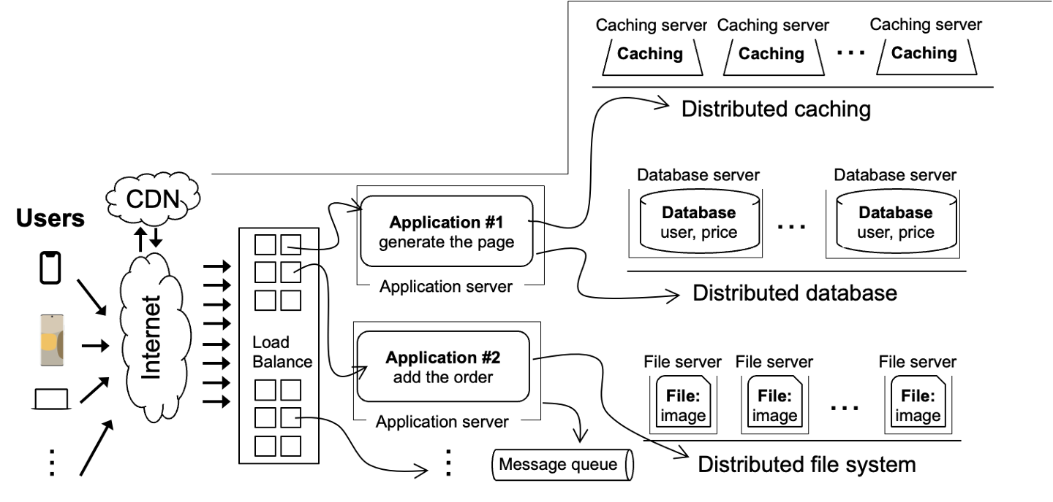
Scalable websites overview
Scalable websites powered by distributed systems
  For request handling, data storage
Application #1
generate the page
requests
results
Application server

Slide 4

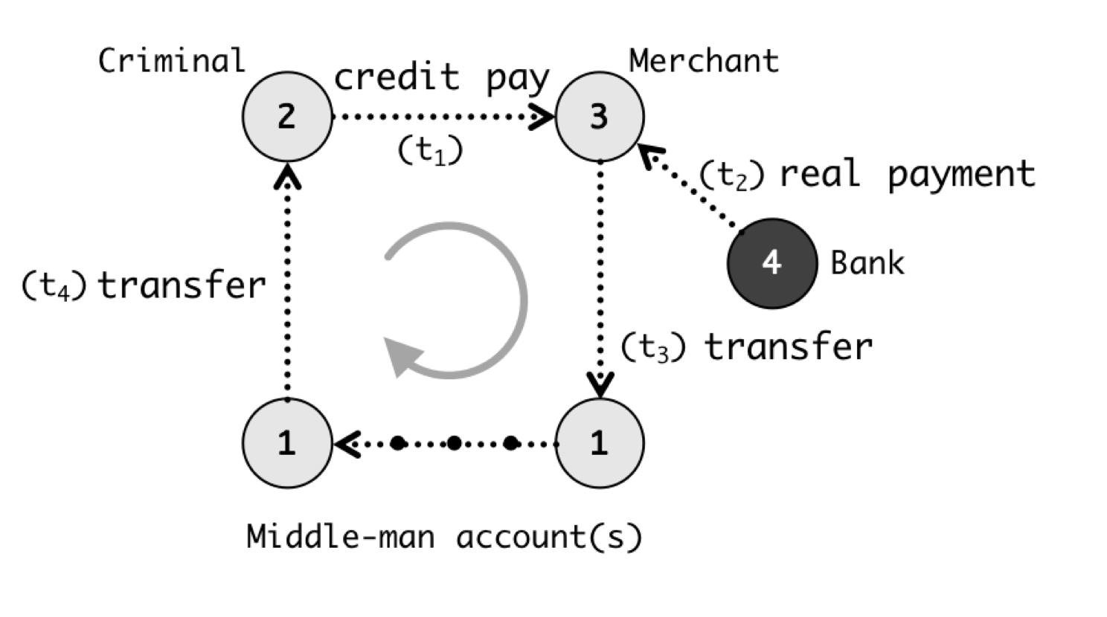

How does application server handle requests?
For simple web page
  Application server’s framework (PHP) is sufficient
Complex queries are processed by powerful distributed computing frameworks
  Fraud detection -> Graph processing system
  Hot lists -> MapReduce
Online vs. offline
  Online: compute the requests based on requests
  Offline: return the pre-computed results
Render the page
Alipay detects frauds w/ graph systems
Generate hot lists

Slide 5
How does application server handle requests?
For simple web page
  Application server’s framework (PHP) is sufficient
Complex queries are processed by powerful distributed computing frameworks
  Fraud detection -> Graph processing system
  Hot lists -> MapReduce
Online vs. offline
  Online: compute triggered by the user requests
  Offline: return the pre-computed results
Render the page
Alipay detects frauds w/ graph systems
Generate hot lists

Slide 6
Batch Processing

Slide 7


Batch processing systems
A batch processing system takes a large amount of input data
  Computing takes a while（from minutes~ days）, and thus offline
  run periodically （e.g., generate hot lists every day ）
  Key performance metric: throughput
Examples:
  Spark
  MapReduce
  Hadoop
  etc.

Slide 8
Why need specialized system for batch processing?
Assumption: our web server records every requests in a log file
  E.g., using nginx log format, a log record looks like this:
216.58.210.78 - - [27/Feb/2015:17:55:11 +0000]
"GET /css/typography.css HTTP/1.1" 200 3377 "http://martin.kleppmann.com/"
"Mozilla/5.0 (Macintosh; Intel Mac OS X 10_9_5) AppleWebKit/537.36 (KHTML, like Gecko) Chrome/40.0.2214.115 Safari/537.36"
Abstract format: $remote_addr - $remote_user [$time_local] "$request" $status $body_bytes_sent
"$http_referer" "$http_user_agent"
  Question (simple log analysis): how to find top five popular pages?

Slide 9
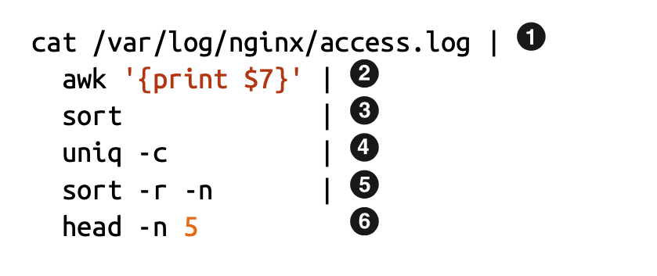
Can we use command line tools for this?
216.58.210.78 - - [27/Feb/2015:17:55:11 +0000]
"GET /css/typography.css HTTP/1.1" 200 3377 "http://martin.kleppmann.com/"
"Mozilla/5.0 (Macintosh; Intel Mac OS X 10_9_5) AppleWebKit/537.36 (KHTML, like Gecko) Chrome/40.0.2214.115 Safari/537.36"
Find top five most popular pages w/ command line tools

Slide 10
Use command line tools for batch processing
Find top five most popular pages
1
Read log file
4
Aggregate, with a counter for each line
Filter the line，pick the 7th token,
i.e., /css/typography.css
Sort again (using the counter)
2
5
3
Sort so that the same requests come together
6
Print 1-5 items

Slide 11
Does batch processing with command line tools scale?
Command line tools are mostly single-threaded, and single-machine
  : scalability is restricted by the disk capacity
  ～ : restricted by single-thread computing power
  ～ : also restricted by the machine’s DRAM capacity
1
2
6
2
6

Slide 12


Why distributed computing?
Multiprocessor system don’t scale enough
Disney’s Cars 2 required 11.5 hours to render each frame (average)
  some took 90 hours
  12,500 cores on Dell render blades
  ~152,640 frames = 1,755,360 hours = 200ys for a single core

Slide 13
Why distributed computing?
Multiprocessor system don’t scale enough
Disney’s Cars 2 required 11.5 hours to render each frame (average)
  some took 90 hours
  12,500 cores on Dell render blades
  ~152,640 frames = 1,755,360 hours = 200ys for a single core
Google
  Approximately 1 billion queries per day
  Index > 25 billion web pages
  Hundreds of thousands of servers

Slide 14
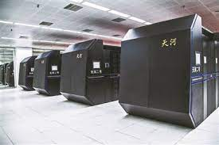
Distributed computing
Cluster computing
  Hundreds or thousands of PCs connected by high-speed LANs
  Example: supercomputer, datacenter
Grid computing
  Hundreds of supercomputers connected by high-speed network
Etc
Tianhe supercomputer has 16,000 nodes in total
Goal: 1000 nodes potentially give 1000X speedup

Slide 15
Accelerate batch processing with distributed computing
Distributed computing
  Split data into equal-size chunks
  Each process can work on a chunk parallelly
Why equal-size?
  Assume each process has nearly identical computing power

Slide 16
Accelerate batch processing with distributed computing
Distributed computing
  Split data into equal-size chunks
  Each process can work on a chunk parallelly
Most significant challenge: identify concurrency
  It should be noted that not all tasks can be parallelized
  E.g., dependencies
4
depends on
3

Slide 17
Other challenges
Communicating between two machines
can be simple, e.g., with RPC
But, what about 10000 machines?
Sending data to/from nodes
Coordinating among nodes
Recovering from node failure
Optimizing for locality

Slide 18
Other challenges
Sending data to/from nodes
Coordinating among nodes
Recovering from node failure
Optimizing for locality
When can we collect computing results from all the computing nodes?

Slide 19
Other challenges
Sending data to/from nodes
Coordinating among nodes
Recovering from node failure
Optimizing for locality
Failure is common,
especially at large-scale

Slide 20
Other challenges
Sending data to/from nodes
Coordinating among nodes
Recovering from node failure
Optimizing for locality
Transferring data over network is usually much slower than local data access

Slide 21
Other challenges
Sending data to/from nodes
Coordinating among nodes
Recovering from node failure
Optimizing for locality
Same for
all problems

Slide 22
MapReduce: Simplified Data Processing on Large Clusters

Slide 23
MapReduce: a distributed batch processing system
Created by Google (OSDI’04)
  Jeffrey Dean and Sanjay Ghemawat
Inspired by LISP (function language)
  Map (function, set of values)
    Applies function to each value in the set
  Reduce (function, set of values)
    Combines all the values using a function (e.g., +)
      (map #‘length’ (() (a) (a b) (a b c))) → (0 1 2 3)
      (reduce #‘+’ (1 2 3 4 5)) → 15

Slide 24
MapReduce Programming Model
Allows user to process huge amounts of data on thousands of nodes
Framework for data-parallel computing
  Programmers get simple API
Users don’t have to worry about handling:
  parallelization
  data distribution
  load balancing
  fault tolerance

Slide 25

MapReduce Programming Model
Functionality
Parallelization
Data Distribution
Fault Tolerance
user
Load Balance

Slide 26
MapReduce Programming Model
Functionality
Two Primitive:
Map (input)
Parallelization
Data Distribution
MapReduce
Runtime
Reduce (key, values)
Fault Tolerance
user
Load Balance

Slide 27
MapReduce Programming Model
E.g., to find the most
popular keywords (热词)
Two Primitive:
Map (input)
for each word in input
emit (word, 1)
Word Count
Functionality
MapReduce
Runtime
Reduce (key, values)
int sum = 0;
for each value in values
sum += value;
emit (word, sum)
user

Slide 28
MapReduce Programming Interface
Map: (input shard) → intermediate (k/v pairs)
  Partition the input data into M “shards”
  Group all intermediate values associated with the same key
  Pass them to the Reduce function
Reduce: intermediate (k/v pairs) → (results)
  Partition the key space into R “pieces” using a Partition function
    E.g., hash(key) mod R
  Accept a key & a set of values
  Merge these values to form result of the key

Slide 29
MapReduce Execution Flow
Map
Grab the relevant data from the source
User function gets called for each chunk of input
Map Worker
Reduce Worker
Reduce
Aggregate the results
User function gets called for each unique key

Slide 30
MapReduce Execution Flow
Map
Grab the relevant data from the source
User function gets called for each chunk of input
Partition
Identify which Reducers will handle which keys
Map partitions data to target Reducers
Map Worker
Reduce Worker
Sort
Fetch the relevant partition data from all mappers
Sort by keys
Reduce
Aggregate the results
User function gets called for each unique key

Slide 31
MapReduce: The Complete Picture
Client
Master
assign
tasks
Shard 0
Map
Worker
IF
Shard 1
Shard 2
Reduce
Worker
Output
File 1
M items
Shard 3
Map
Worker
IF
R items
...
Reduce
Worker
Output
File 2
Shard M-2
Shard M-1
Map
Worker
IF
Input
Files
Map Workers
Intermediate Files
Reduce Workers
Output
Files
Notes:
具体到实现，以文件作为input

Slide 32
MapReduce: The Complete Picture
Step1: split input files into chunks (shards)
  Typically, 64MB
Shard 0
Shard 1
Shard 2
Shard 3
...
Shard M-1
Input Files
Divided into M shards

Slide 33
MapReduce: The Complete Picture
Step2: fork processes
Start up many copies of the program on cluster
  1 master: scheduler & coordinator
  Lots of workers
Idle workers are assigned either
  Map tasks (each works on a shard)
  Reduce tasks (each works on intermediate files)
Client
remote
fork
Master
...
Map
Worker
..
Map
Worker
Reduce
Worker
..
Reduce
Worker

Slide 34
MapReduce: The Complete Picture
Step3: map task
  Reads contents of the input shard assigned to it
  Parses key/value pairs out of the input data
  Passes each pair to a user-defined Map function
    Produces intermediate key/value pairs
    These are buffered in memory
read
Map
Worker
Shard 2

Slide 35
MapReduce: The Complete Picture
Step4: create intermediate files
  Intermediate k/v pairs buffered in memory and periodically written to the local disk
    Partitioned into R regions by a Partition function
  Notifies master when complete
    Passes location of intermediate data to the master
    Master forwards locations to the Reduce worker
Intermediate File
read
Map
Worker
local
write
partition 1
Shard 2
partition 2
partition R-1

Slide 36
MapReduce: The Complete Picture
Step4a: partitioning
  Map data will be processed by reduce workers
    The user’s Reduce function will be called once
    per unique key
  Sort all the (key, value) data by keys
  Partition function: decides which of R reduce workers will work on which key
    Default function: hash(key) mod R
    Map worker partitions the data by keys
  Each reduce worker will read their partition from every map worker

Slide 37
MapReduce: The Complete Picture
Step5: sorting intermediate data
  Notified by master about the location of intermediate files for its partition
  Uses RPCs to read the data from the local disks of map workers
  Sorts the data by the intermediate keys
  All occurrences of the same key are grouped
local
write
remote
read
Map
Worker
IF
Reduce
Worker
Map
Worker
local
write
IF
remote
read
Reduce
Worker
Notes:
XD： 为什么mapreduce需要sort key？加速reduce worker的merge key过程

Slide 38
MapReduce: The Complete Picture
Step6: reduce task
  Groups data with a unique intermediate key
  User’s Reduce function is given the key and the set of intermediate values for that key
    <key, (value1, value2, ...)>
  The output is appended to an output file
Intermediate file
Intermediate file
remote
read
Reduce
Worker
write
Output
File 1
Intermediate file

Slide 39
MapReduce: The Complete Picture
Step7: return to user
  When all map and reduce tasks have completed
  Master wakes up the user program
  The MapReduce call in the user program returns, and the program can resume execution
    Output of MapReduce is available in R output files

Slide 40
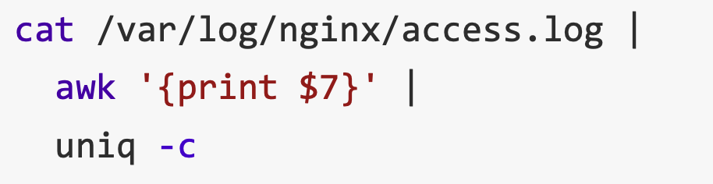
MapReduce example：Word count
Word Count: Count # occurrences of each word in a collection of documents
A simplified process of our previous log analysis example
1
2
4

Slide 41
MapReduce example：Word count
Word Count: Count # occurrences of each word in a collection of documents
Map:
  Parse data and emit each word with a count (1)
Reduce:
  Sort: sort by keys (words)
  Reduce: sum together counts each key (words)
map (String key, String value)
  for each word w in value
  EmitIntermediate (w, “1”);
Reduce (String key, Iterator values)
  int result = 0;
  for each v in values
    result += ParseInt (v);
  emit (AsString (result));

Slide 42
MapReduce example：Word count
After Map
After Sort
After Reduce
Input file
[Intermediate]
[In-memory]
It will be seen that this mere painstaking burrower and grub-worm of a poor devil of a Sub-Sub appears to have gone through the long Vaticans and streetstalls of the earth, picking up whatever random allusions to whales he could anyways find in any book whatsoever, sacred or profane. Therefore you must not, in every case at least, take the higgledy-piggledy whale statements, however authentic, in these extracts, for veritable gospel cetology. Far from it. As touching the ancient authors generally, as well as the poets here appearing, these extracts are solely valuable or entertaining, as affording a glancing bird's eye view of what has been promiscuously …
...
it 1
will 1
be 1
seen 1
that 1
this 1
mere 1
painstaking 1
burrower 1
and 1
grub-worm 1
of 1
a 1
poor 1
devil 1
of 1
a 1
sub-sub 1
…
...
a 1
a 1
aback 1
aback 1
abaft 1
abaft 1
abandon 1
abandon 1
abandon 1
abandoned 1
abandoned 1
abandoned 1
abandoned 1
abandoned 1
abandoned 1
abandoned 1
abased 1
abased 1
…
a 4736
aback 2
abaft 2
abandon 3
abandoned 7
abased 2
abasement 1
abashed 2
abate 1
abated 3
abatement 1
abating 2
abbreviate 1
abbreviation 1
abeam 1
abed 2
abednego 1
abel 1
abhorred 3
...
Map
Reduce

Slide 43
Other examples of MapReduce
Distributed grep
  Search for words in lots of documents
  Map: emit a line if it matches a given pattern
  Reduce: just output the intermediate data
Count URL access frequency
  Find the frequency of each URL in web logs
  Map: process logs of web page access;
  output <URL, 1>
  Reduce: add all values for the same URL

Slide 44
Other examples of MapReduce
Inverted index
  Find what documents contain a specific word
  Map: parse document, emit <word, doc-ID>
  Reduce: sort the doc-ID for each word, and output <word, list(doc-ID)>
Reverse web-link graph
  Find where page links come from
  Map: output <target, source> for each link to target in a page source
  Reduce: concatenate all source for each target, output <target, list(source)>

Slide 45
Other examples of MapReduce
Google used MapReduce to support distributed computing
  Large-scale machine learning jobs
  Large-scale graph analytic jobs
  Etc.

Slide 46
Recall, common challenges of Distributed Computing
Sending data to/from nodes
Coordinating among nodes
Recovering from node failure
Optimizing for locality
How does MapReduce handle these challenges?
  1 & 2 are simple because the framework can hide the communication & coordination from the applications
Same for
all problems

Slide 47
Fault tolerance of MapReduce
Machine failures are common in datacenters
  A MapReduce job can possibly run on thousands of machines
MapReduce simplifies fault tolerance due to the following two choices:
  Programming model simplifies fault recovery
    e.g., no side-effect: a map or a reduce can simply re-execute the computation to recover from failures
  Builds on a reliable service (i.e., GFS)

Slide 48
Fault tolerance of MapReduce
Worker failure
  Master pings each worker periodically via heartbeat
  If no response is received within a certain time (timeout), the worker is marked as failed
  Map or reduce tasks given to this worker are reset back to the initial state and rescheduled for other worker (re-execution)
  Robust: lost 1,600 of 1,800 machines once, but finished fine

Slide 49
Fault tolerance of MapReduce
Master failure
  Master’s state is persisted to GFS
  Recover master from GFS and continue
For each mapper & reduce
  Executing state: idle, in-progress or completed
  Locations of intermediate files
The state is checkpointed to GFS for fault tolerance
  Yet, master is unlikely to fail, since there is only one!

Slide 50
Fault tolerance of MapReduce
Skipping Bad Records
  Map/Reduce functions sometimes fail for particular inputs
  Best solution is to debug & fix, but not always possible
  On segmentation fault:
    Send UDP packet to master from signal handler
    Include sequence number of record being processed
  If master sees two failures for same record:
    Next worker is told to skip the record
Effect: Can work around bugs in third-party libraries

Slide 51
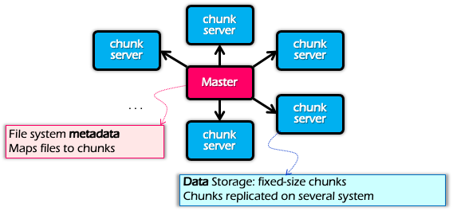
Locality
Problem: the bandwidth of datacenter network (at that time) is scarce
  If a Map worker reads all the data from the network, it would be slow
Google: Input and Output files are on GFS
  Google File System (SOSP’03), see lecture 0x
  Each chunk is replicated on multiple servers (3)
A review of GFS architecture

Slide 52
Locality
Problem: the bandwidth of datacenter network (at that time) is scarce
  If Map worker reads all the data from the network, it would be slow
Google: Input and Output files are on GFS
  Google File System (SOSP’03), see lecture 0x
  Each chunk is replicated on multiple servers (3)
MapReduce runs on GFS chunkservers
  Collocate computation and storage
Master tries to schedule map worker on one of the nodes that has a copy of the input chunk it needs

Slide 53
Refinement: redundant execution
Some workers can be slower than others, aka, stragglers
  Other jobs consuming resources on machine
  Bad disks with soft errors transfer data slowly
  Weird things: processor caches disabled ☹
Near end of phase, MapReduce spawn backup copies of tasks
  Whichever one finishes first “wins” ☺
  Dramatically shortens job completion time:“significantly reduces the time to complete large MapReduce operations ”(check the paper)

Slide 54
Question
Compare save intermediate results on mapper’s local disk with reducer’s local disk

Slide 55
Question
Compare save intermediate results on mapper’s local disk with reducer’s local disk
Mapper-side:
  Pre-aggregation → save network resource
  Map task failure → no partial data
  Reduce task failure → just pull data again
Reducer-side:
  Pipeline → overlap the transfer time
Paper: Tyson Condie et al, MapReduce Online, NSDI, 2010

Slide 56
Summary of MapReduce
Get a lot of data from input files
Map
  Parse & extract items of interest
Partition & Sort
Reduce
  Aggregate results
Write results to output files

Slide 57
Summary of MapReduce
The user does not need to care concurrency, fault-tolerant, data transfer, etc.
Reduce the user code burden and quality:
  Sort: only needs 50 LoC
  Indexing: reduce the code lines from 3800 LoC to 700LoC

Slide 58
MapReduce cannot address all the issues
MapReduce was used to process webpage data collected by Google’s crawlers
  It would extract the links and metadata needed to search the pages
  Determine the site’s PageRank
The process took around eight hours
  Results were moved to search servers
  This was done continuously
Web
crawlers
MapReduce
Migrate to
search server
~8 hours!

Slide 59
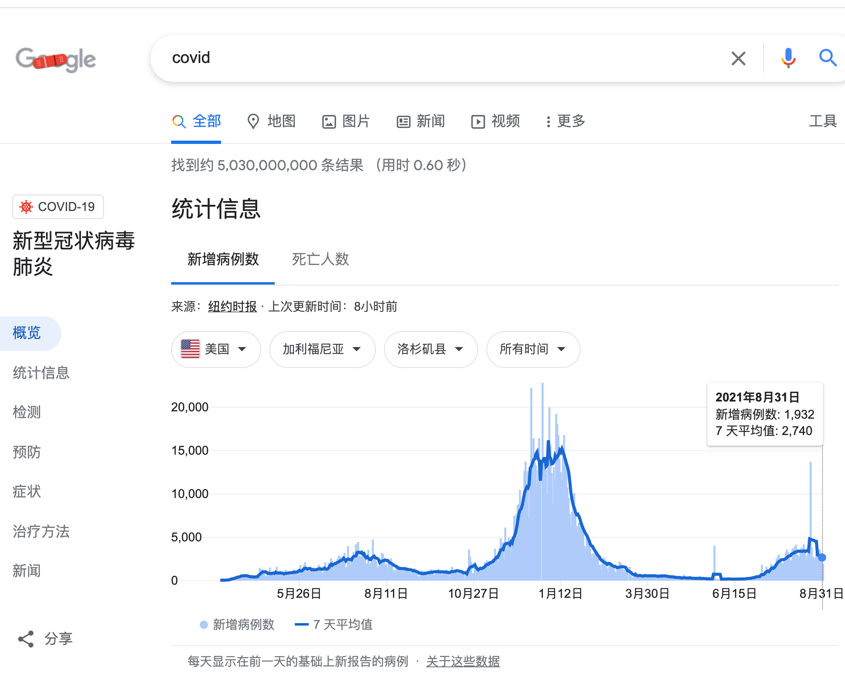
MapReduce cannot address all the issues
Web has become more dynamic
  An 8+ hour delay is a lot for some sites
Goal: refresh certain pages within seconds
MapReduce
  Batch-oriented
  Not suited for near-real-time processes
  Cannot start a new phase util previous completed
  Not optimized for specific tasks (e.g., Graph)

Slide 60




MapReduce cannot address all the issues
Time
Graph
Graph analytics frameworks
MapReduce
Machine
Learning
…
Machine learning
frameworks
Caffeine
Search
Engine
Google’s new search
engine

Slide 61
Restrictiveness of MapReduce Programming Model
Question
  How can we use MapReduce to implement “find the five most popular pages”?
Hint:
  We can chain multiple MapReduce tasks together

Slide 62
Restrictiveness of MapReduce Programming Model
Question#2:
  Is chaining multiple MapReduce tasks a good solution?
    E.g., programming is not easy
    Fault tolerance of multiple map-reduce tasks is not supported, should be handled by the users

Slide 63
MapReduce is not optimized for multiple-sages execution
MapReduce runtime is not optimized for iteration
  Persistent I/O (e.g., GFS)
. . .
Awk
sort
Time
Data
Data
Map
Reduce
Map
Reduce
Data
Data
Data
Map
Reduce
Map
Reduce
Startup Penalty
Disk Penalty
Startup Penalty
Disk Penalty
Data
Data
Map
Reduce
Data
Data
Data
Map
Reduce
Map
Reduce
Data

Slide 64
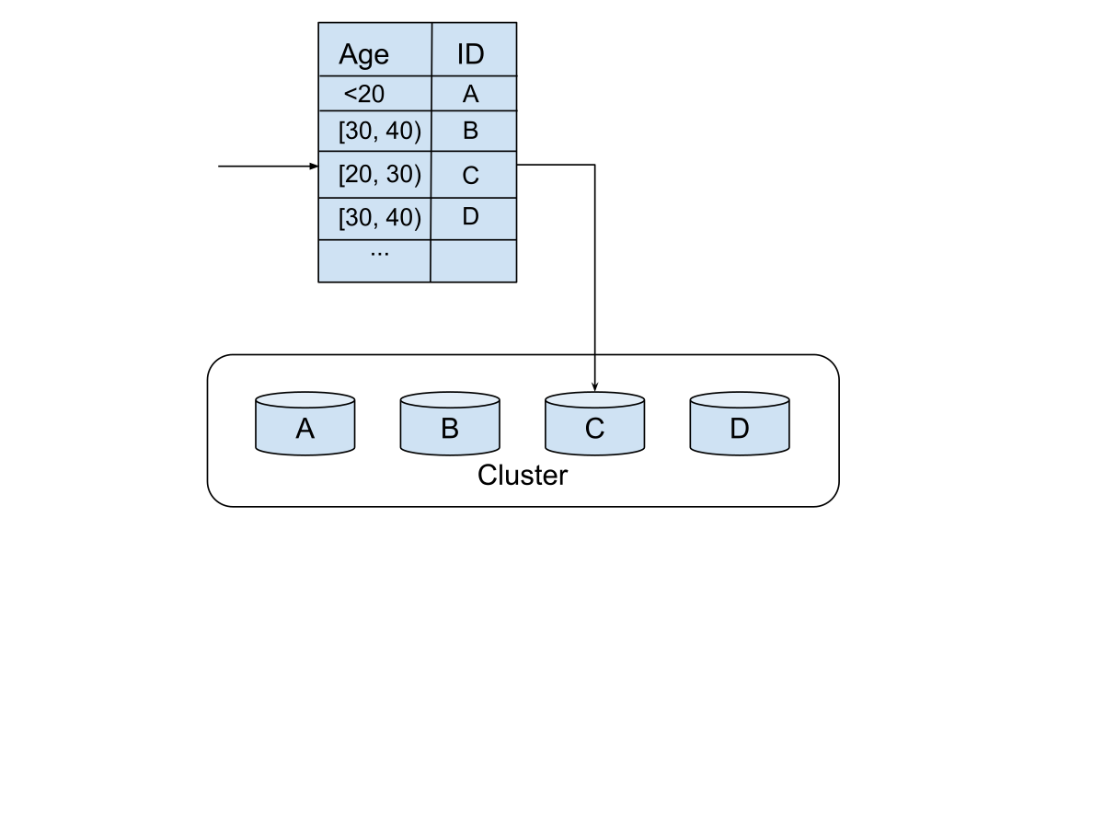
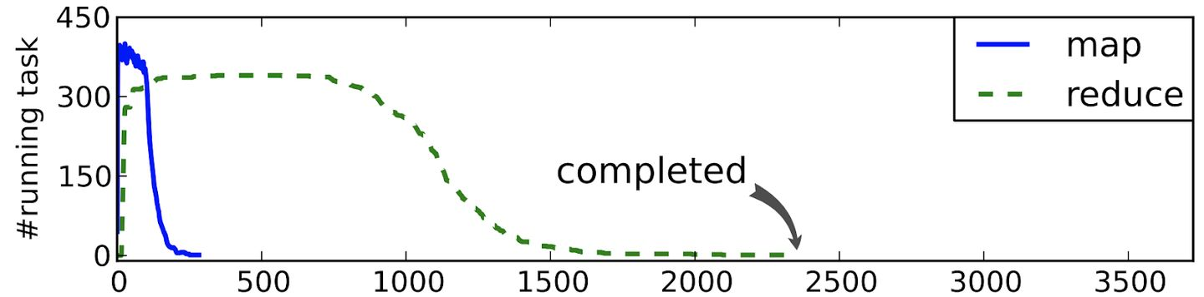
Sharding is critical
Example: Weibo’s user data
  Sharding by age?
  Most users in [20,30)
  Node-C becomes the straggler
  How to shard may depend on the application semantics

Slide 65
Dryad: Distributed Data-Parallel Programs from Sequential Building Blocks

Slide 66
Dryad
Created by Microsoft (EuroSys’07)
  Authors: Michael Isard, Andrew Birrell, et al.
Similar goals as MapReduce
  A general-purpose distributed execution engine for coarse-grain data-parallel applications
  Focus on throughput, not latency
  Automatic management of scheduling, distribution, and fault tolerance

Slide 67
Programming model of Dryad
Computations are expressed as a graph
  Vertices are computations
  Edges are communication channels
  Each vertex has several input and output edges
A
A
B
B
B
B
C
D
AS=A^n
B
B
A
A
A
A
A
BS=B^n
AS>=BS
AS>>BS
A>=C || A>=D

Slide 68
Dryad uses a dataflow graph
Why?
  Many programs can be represented as a distributed dataflow graph
Dryad Job = Directed Acyclic Graph (DAG)
Outputs
Processing
Vertices
Channels
(file, pipe, memory)
Inputs

Slide 69
Dryad uses a dataflow graph
Dryad Job = Directed Acyclic Graph (DAG)
Back to our log analysis example
…
unique
sort
awk
Inputs

Slide 70
The runtime of Dryad
Vertices (V) run arbitrary app code, exchange data through
TCP pipes etc., and communicate with JM to report status
Job Schedule
Data Plane
Files FIFO Network
V
V
V
JM
NS
D
D
D
Control Plane

Slide 71
The runtime of Dryad
Job Manager (JM) consults name server (NS) to discover available nodes, and maintains job graph and schedules vertices
Job Schedule
Data Plane
Files FIFO Network
V
V
V
JM
NS
D
D
D
Control Plane
71

Slide 72
The runtime of Dryad
Daemon process (D) executes vertices
Job Schedule
Data Plane
Files FIFO Network
V
V
V
JM
NS
D
D
D
Control Plane

Slide 73
Scheduling in JM
General scheduling rules
  Vertex can run anywhere once all its inputs are ready
    Prefer executing a vertex near its inputs (locality)
Fault tolerance
  Vertex fails → run it again
  Vertex’s inputs are gone → run upstream vertices again (recursively)
  Vertex is slow → run another copy elsewhere and use output from whichever finishes first
What if the vertex execution is non-idempotent？

Slide 74
Advantages of Dryad
Big jobs more efficient with Dryad
  MapReduce: big job runs multiple (>=1) stages
    Reducers of each stage with regard to distributed storage (GFS)
    Output of reduce → 2 network copies + 3 disk writes
  Dryad: each job is represented with a DAG
    Intermediate vertices write to local file
Dryad provides more flexible operations

Slide 75
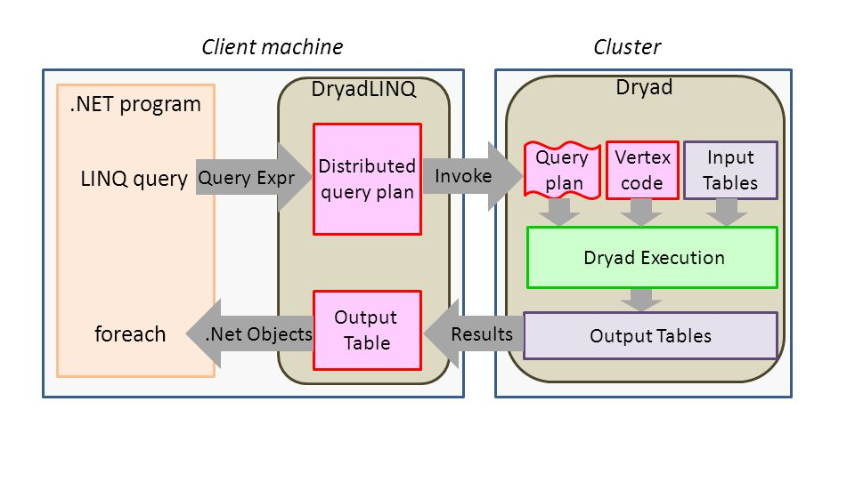
DryadLINQ: Dryad + LINQ (SQL like)
More friendly to traditional data programmers: use LINQ (SQL-like language)

Slide 76
Summary
Dryad lets developers easily create large-scale distributed apps without requiring them to master any concurrency techniques beyond being able to draw a graph of the data dependencies of their algorithms. -- Michael Isard
Sacrifice some architectural simplicity compared with MapReduce system design
Provide more flexible abstract to developers expressing their code as a DAG

Slide 77
Next lecture
Graph analytics frameworks

