Slide 1


Single-node key-value store/storage
SE124 (2021 Fall)
IPADS, Shanghai Jiao Tong University
https://www.sjtu.edu.cn
Credits: Niv Dayan， JiFei@IPADS

Slide 2

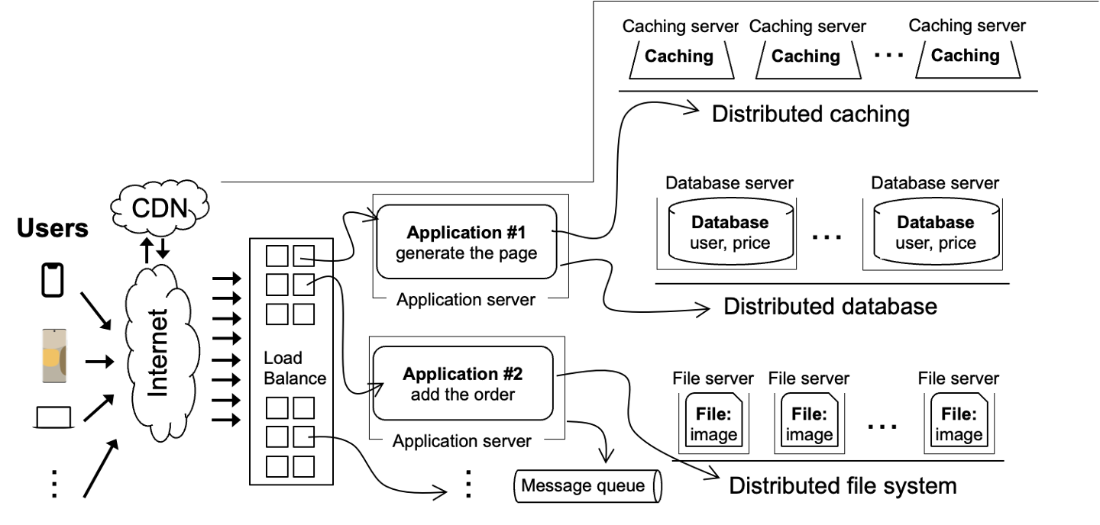

Review: scalable websites
Scalable websites powered by distributed systems
  For request handling, data storage
Caffeine
Application #1
generate the page
Computed results
Request
Results
Application server

Slide 3
Review: scalable websites
Scalable websites powered by distributed systems
  For request handling, data storage
Caching server
Caching server
Caching server
…
Caching
Caching
Caching
Distributed caching
Database server
Database server
CDN
Users
Application #1
generate the page
Database
user, price
…
Database
user, price
Application server
Distributed database
Internet
Load
Balance
Application #2
add the order
File server
File server
File server
File:
image
File:
image
…
File:
image
Application server
…
…
Message queue
Distributed file system

Slide 4

Different storage systems to support different type of data
Database
File system
Key-value store

Slide 5



Key-value storage: simple yet widely used
Storage layout:
  Each data (Value) is opaque to the underlying storage/database
  Indexed by a key (K), which itself is also a data (e.g., int, string)
  Stored on disk (tolerate failure & support a large capacity)
Interface
  Get(K) -> V, Scan(K,N)
  Update(K,V), Insert(K,V), Delete(K,V)
  The K and V can be arbitrary byte-sequence (e.g., JSON)

Slide 6
Key-value storage is similar to file system
Storage layout:
  Key → File name
  Value → All the file content
  So we can store each K,V as a file ☺
Interface
  Get(K) -> V is similar to OPEN(…) + READ(…)
  Insert(K,V) -> is similar to CREATE(…) + WRITE(…)
  Etc.

Slide 7
Why not implement the key-value storage as file system?

Slide 8
Treating File System as Key-Value storage is inefficient
Redundant system call caused by mismatch interface
  Example
    E.g., Get(K,V) needs OPEN(…) + READ(…)
    Ideally, we want to query the data in one system call or even 0
Space amplification
  File data are stored in fixed-sized blocks (e.g., 512B – 4096B)
  The value in key-value store can be small (e.g., 8B)
Idea: using one or few file to store key-value store data
  Reduced OPEN calls
  Different key-values can pack into the same disk block
Notes:
// TODO: directory has maximum file entry supported?

Slide 9
Building Key-value Storage on File System
Why builds upon the file system?
  We still system to manage disk hardware
“All problems in computer science can be solved by another level of indirection” -- often attributed to Butler Lampson, who attributes it to David Wheeler
Key-value Store
Key-value files
File system

Slide 10
A naïve Key-Value Storage (KVS)
Suppose we store all the KV in a single file in the following format:
Key
Value
123456，'{"name":"London","attractions":["Big Ben","London Eye"]}’
42，'{"name":"San Francisco","attractions":["Golden Gate Bridge"]}’
...

Slide 11
Update(K,V) in the naïve KVS
Suppose we store all the KV in a single file in the following format:
Key
Value
123456，'{"name":"London","attractions":["Big Ben","London Eye"]}’
42，'{"name":"San Francisco","attractions":["Golden Gate Bridge"]}’
...
We use a simple update rule:
  Directly append update to the end of the file
procedure UPDATE(integer fd, character[] &key, character[] &value)

Slide 12
Update(K,V) in the naïve KVS
Suppose we store all the KV in a single file in the following format:
Key
Value
123456，'{"name":"London","attractions":["Big Ben","London Eye"]}’
42，'{"name":"San Francisco","attractions":["Golden Gate Bridge"]}’
...
We use a simple update rule:
  Directly append update to the end of the file
  Benefits: update the file is efficient, if there are many updates, because disks are good at sequential writes
  Overwrite the original content introduce slow random accesses

Slide 13
Insert(K,V) in the naïve KVS
Suppose we store all the KV in a single file in the following format:
Key
Value
123456，'{"name":"London","attractions":["Big Ben","London Eye"]}’
42，'{"name":"San Francisco","attractions":["Golden Gate Bridge"]}’
...
Insert is the same as update
  Question: what about deletion?
    Append a NULL entry and later garbage collected (will talk later)
Notes:
Append a null record at the end of the file

Slide 14
BTW: File format of naïve KVS & log file
The file format is some kind of log file
  We called Log-structured file: an append-only sequence of records
Widely used in computer systems in various scenarios
  E.g., ensure consistency under failure, etc
  We will see more examples in later lectures

Slide 15
Why care about disk speed?

Slide 16
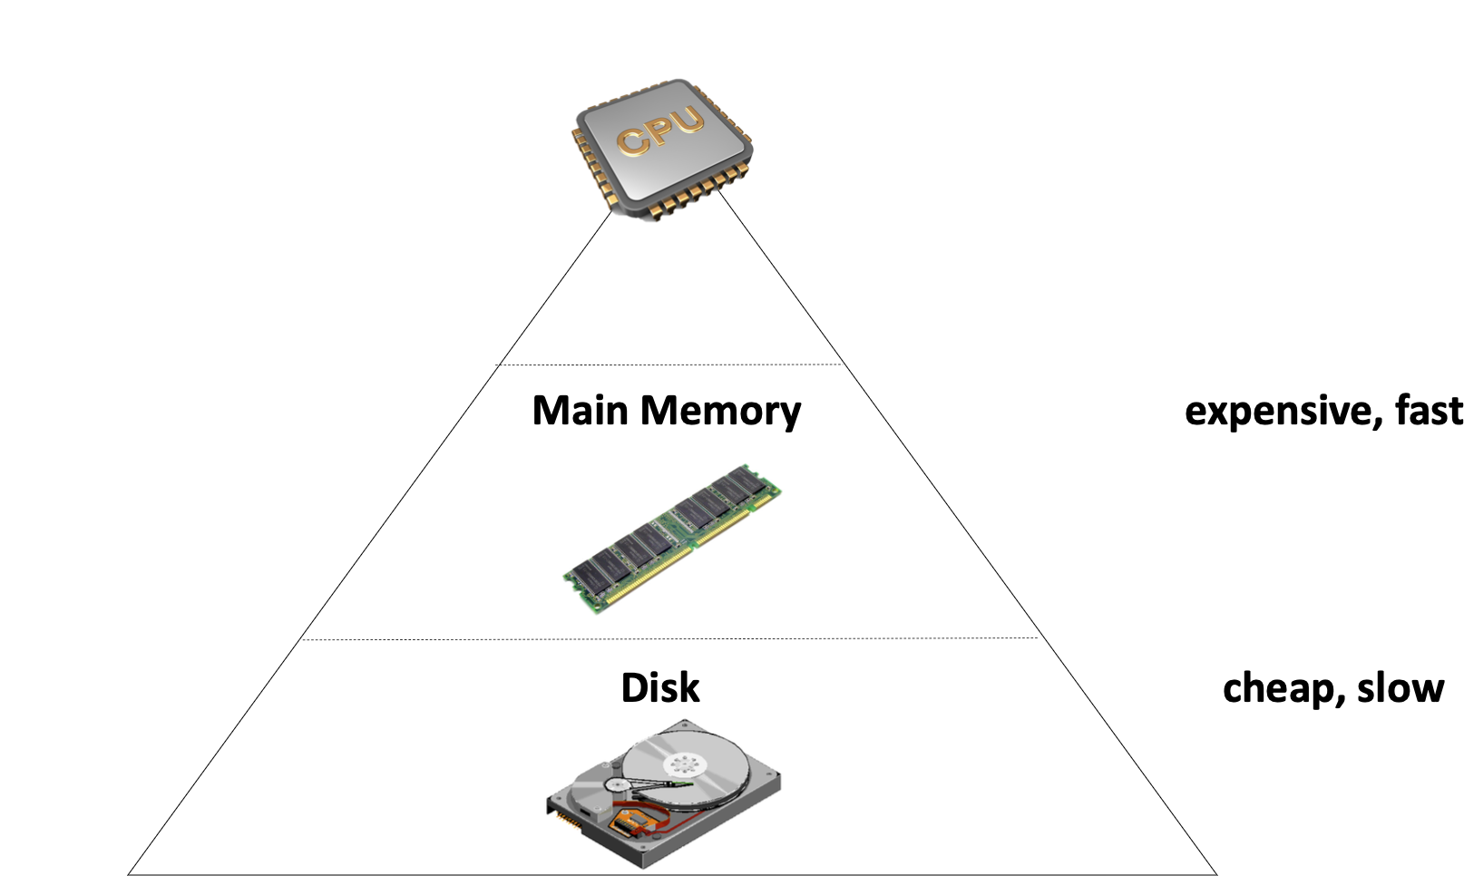
Storage Hierarchy
Fast device (e.g., Main Memory)
  Fast, but capacity is limited
  Expensive
  Volatile
Disk has huge capacity
  Cheap & slow
  Non-volatile

Slide 17
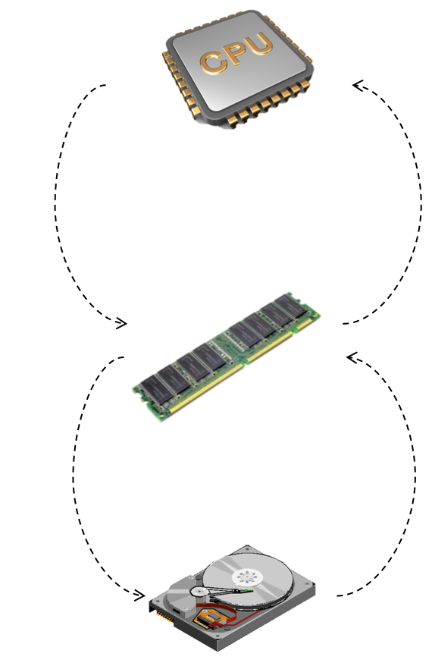
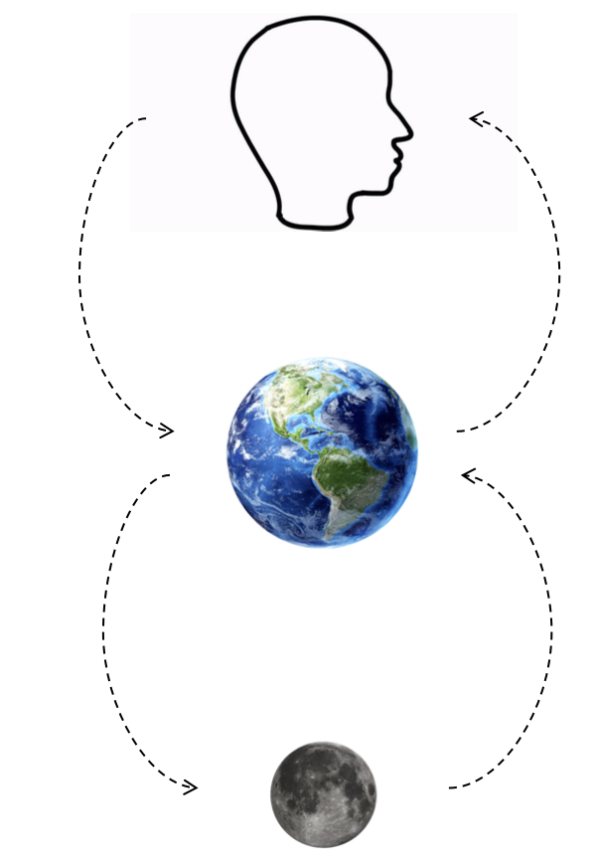
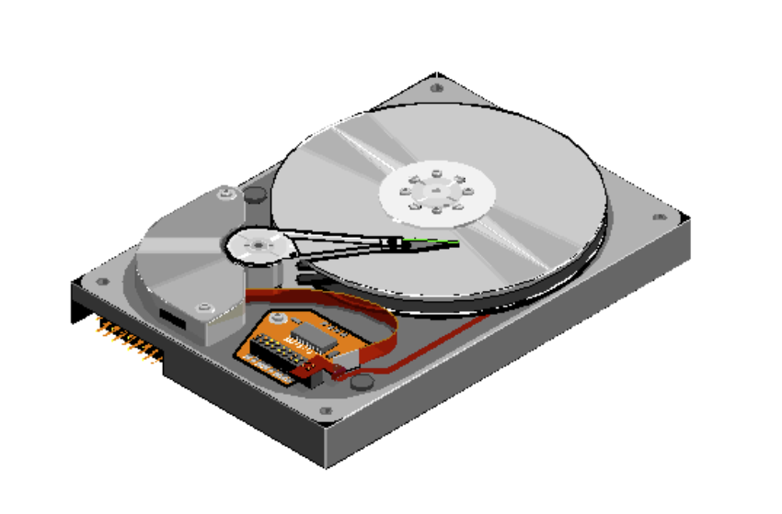
Storage Hierarchy: asymmetric performance of disk
CPU <-> Memory
  ~= 100ns
Memory <-> Disk
  ~= 10ms
Why disk is slow at random access?
  Random: move disk header
  Sequential: disk just spins
Disk Header

Slide 18
Updates work Well, What about Get(K,V)?
Suppose we store all the KV in a single file in the following format:
Key
Value
123456 '{"name":"London","attractions":["Big Ben","London Eye"]}’
42 '{"name":"San Francisco","attractions":["Golden Gate Bridge"]}’
...
Get is much tricky to implement
  We need to iterate the file line by line starting at the end of file, and then finds the first line whose key matches K
  Terrible performance! Complexity: O(n)

Slide 19
Accelerate Get with index
Index
  An additional structure that is derived from the primary data (e.g., log file)
  Can be added/removed without affecting the primary data
    Only affects the performance of interface (e.g., Get)
Example:
  B+Tree, HashTable, etc
  Question: how do you implement the lookup in the Lab1? Can we accelerate it with index?

Slide 20
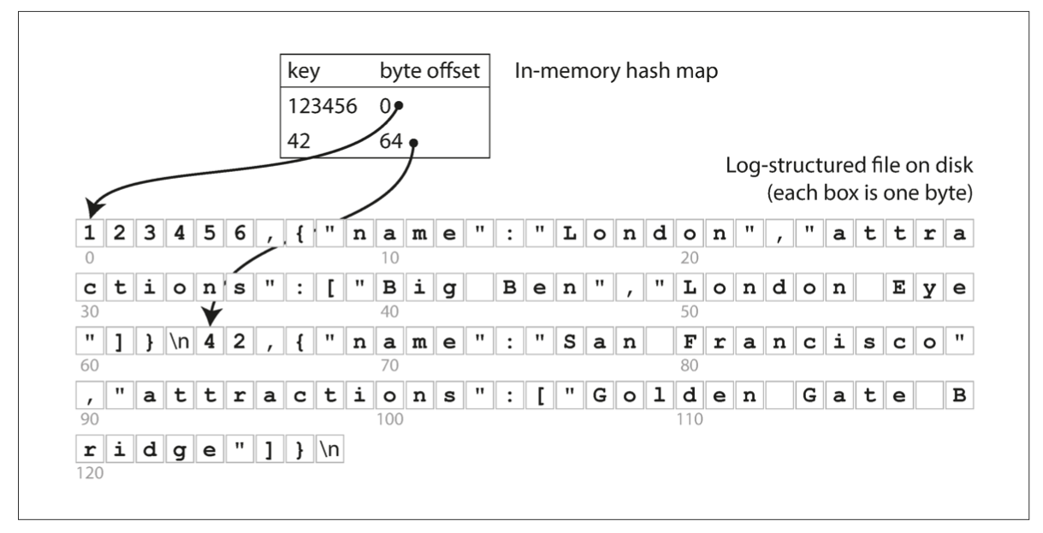
In-memory Hash Index
The simplest possible indexing strategy
  Keep an in-memory hash map that map key -> byte offset in the log file

Slide 21

Hash index & log-structured data file
The simplest possible indexing strategy
  Keep an in-memory hash map that map key -> byte offset in the log file
A viable solution
  Adopted by commercial systems， e.g., Bitcask in riakKV
Benefits
  High-performance of reads/writes
Restrictions
  Index must fit into the RAM
  Only good at: when workloads have many updates but not insertions
    Too many insertions will exhaust the RAM
Notes:
// 讲下

Slide 22
How to prevent a file from growing forever?
Log-structured data file makes updates fast
  Only append to the file
However, we will eventually run out of disk space
  Since many duplicate records in the log file, we should have space to store more records

Slide 23
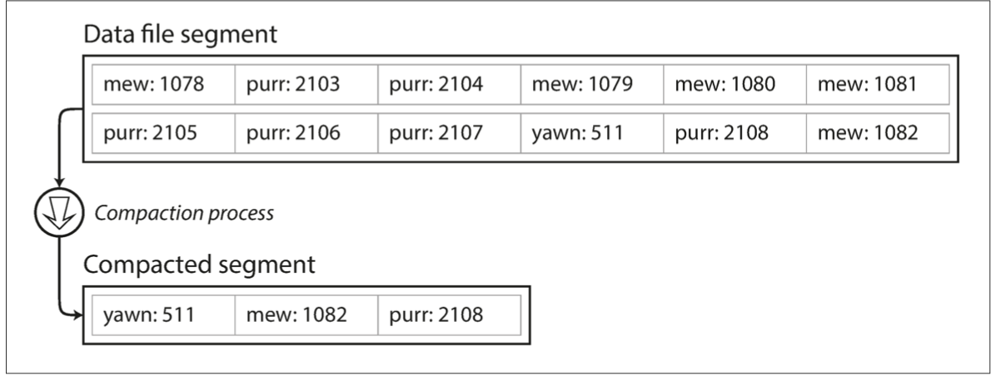
How to prevent a file from growing forever?
Solution: compaction
  Scan the whole file, delete duplicate records and write to a new file
  Question: what if the file is too large?

Slide 24
How to prevent a file from growing forever?
Solution: compaction & segmentation
  Break a file into fixed-sized segments
  If a segment is full, then create a new file for insertions
  Can control the compaction granularity with the segment size

Slide 25
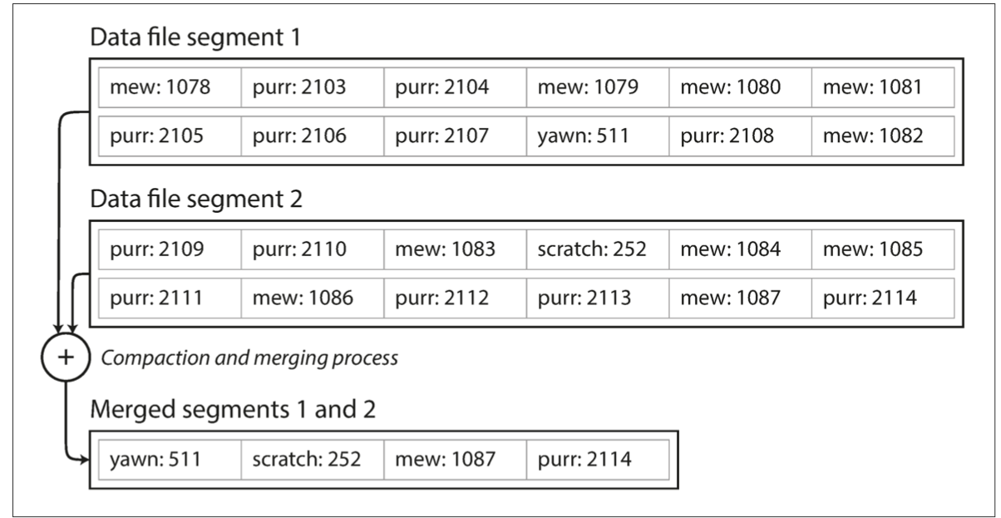
How to prevent a file from growing forever?
Solution: compaction & segmentation & merging
  Compact: remove duplicated records in a segmented file
  Merge: merge two compacted segments into a new one
    Why? Because compaction makes the segment smaller

Slide 26
Recall: how to handle delete() for log-structed file?
Append a NULL entry
Garbage-collected during compaction!
deleted: null

Slide 27
Other issues of using hash index & segmented log file
Crash recovery
  E.g., under machine failure, there may be partially written records
  Recover hash table after reboot, can be slow (if the log file is large)
Limited by the RAM size
  Can put it on the disk but is slow. Why?
Lack range query support
  E.g., scan over all keys between kitty00000 & kitty99999

Slide 28
Other issues of using hash index & segmented log file
Crash recovery -> Next lecture
  E.g., under machine failure, there may be partially written records
  Recover hash table after reboot, can be slow (if the log file is large)
Index limited by the RAM size
  Can put it on the disk but is slow. Why?
Lack range query support
  E.g., scan over all keys between kitty00000 & kitty99999

Slide 29
Other issues of using hash index & segmented log file
Crash recovery -> Next lecture
  E.g., under machine failure, there may be partially written records
  Recover hash table after reboot, can be slow (if the log file is large)
Index limited by the RAM size
  Can put it on the disk, but is slow
Lack range query support
  E.g., scan over all keys between kitty00000 & kitty99999

Slide 30
Put hash index on the disk
Usually not efficient
Hash indexes have different performance trade-offs when stored on disk
  Linked-list based hash index
  Cuckoo hashing
  Etc.

Slide 31
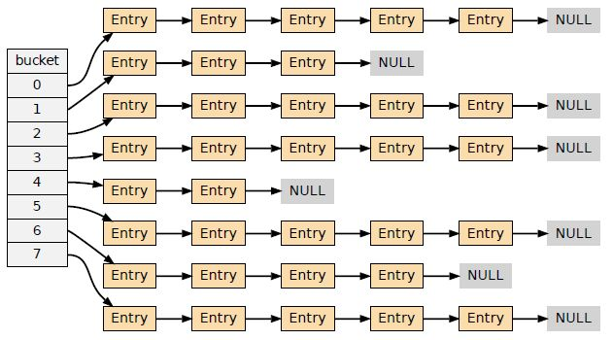
Linked-list based hash index
Pros:
  Easy for implementation
Cons:
  Bad read performance under hash collision
    Requires traverse the linked buckets in random I/O
  Bad insert performance under hash collision
    Similar problem as the read

Slide 32
Cuckoo hashing
Buckets0
Buckets1
Cuckoo hashing
  Maintain two hash buckets
value
32
16
73
84

Slide 33
Cuckoo hashing
Buckets0
Buckets1
Cuckoo hashing
  Maintain two hash buckets
Get()
  Using two hash functions H0 & H1
  The key must be in Buckets0[H0(key)] or Buckets1[H1(key)]
value
32
16
73
84

Slide 34
Cuckoo hashing
Buckets0
Buckets1
Cuckoo hashing
  Maintain two hash buckets
Get()
  Using two hash functions H0 & H1
  The key must be in Buckets0[H0(key)] or Buckets1[H1(key)]
Example: Get(73)
  Buckets0[H0(73)] = 2
value
32
16
73
?
84

Slide 35
Cuckoo hashing
Buckets0
Buckets1
Cuckoo hashing
  Maintain two hash buckets
Get()
  Using two hash functions H0 & H1
  The key must be in Buckets0[H0(key)] or Buckets1[H1(key)]
Example: Get(73)
  Buckets0[H0(73)] = 2 & Buckets1[H1(k73)] = 1
value
32
16
73
84

Slide 36
Cuckoo hashing
Buckets0
Buckets1
Cuckoo hashing
  Maintain two hash buckets
Put()
  Similar as Get()
    1. find the bucket
    2. update the value
value
32
16
73
84
What about insert?

Slide 37
Cuckoo hashing
Buckets0
Buckets1
Cuckoo hashing
  Maintain two hash buckets
Insert()
  Much complicated: should insert to Buckets0[H0(key)] or Buckets1[H1(key)]
    Question: what if no available space?
value
32
16
73
84

Slide 38
Cuckoo hashing
Buckets0
Buckets1
Cuckoo hashing
  Maintain two hash buckets
Insert()
  Much complicated: should insert to Buckets0[H0(key)] or Buckets1[H1(key)]
Example: Insert(2)
  Buckets0[H0(2)] = 0 & Buckets1[H1(2)] = 0
value
32
16
73
84

Slide 39
Cuckoo hashing
Can we insert here?
Buckets0
Buckets1
Cuckoo hashing
  Maintain two hash buckets
Insert()
  Much complicated: should insert to Buckets0[H0(key)] or Buckets1[H1(key)]
Example: Insert(2)
  Buckets0[H0(2)] = 0 & Buckets1[H1(2)] = 0
value
32
16
73
84

Slide 40
Cuckoo hashing
Buckets0
Buckets1
Cuckoo hashing
  Maintain two hash buckets
Insert()
  Much complicated: should insert to Buckets0[H0(key)] or Buckets1[H1(key)]
Example: Insert(2)
  Buckets0[H0(2)] = 0 & Buckets1[H1(2)] = 0
  Insert here!
value
32
2
16
73
84

Slide 41
Cuckoo hashing
Buckets0
Buckets1
Cuckoo hashing
  Maintain two hash buckets
Insert()
  Much complicated: should insert to Buckets0[H0(key)] or Buckets1[H1(key)]
Example: Insert(9)
  Buckets0[H0(9)] = 0 & Buckets1[H1(9)] = 0
value
32
2
16
73
84

Slide 42
Cuckoo hashing
Both slots are not empty!
Buckets0
Buckets1
Cuckoo hashing
  Maintain two hash buckets
Insert()
  Much complicated: should insert to Buckets0[H0(key)] or Buckets1[H1(key)]
Example: Insert(9)
  Buckets0[H0(9)] = 0 & Buckets1[H1(9)] = 0
value
32
2
16
73
84

Slide 43
Cuckoo hashing
Buckets0
Buckets1
Cuckoo hashing
  Maintain two hash buckets
Insert()
  Much complicated: should insert to Buckets0[H0(key)] or Buckets1[H1(key)]
Example: Insert(9)
  Buckets0[H0(9)] = 0 & Buckets1[H1(9)] = 0
  Cuckoo hashing will kick others to different place to empty
value
32
2
16
73
84

Slide 44
Cuckoo hashing
Can insert 9 here!
Buckets0
Buckets1
Cuckoo hashing
  Maintain two hash buckets
Insert()
  Much complicated: should insert to Buckets0[H0(key)] or Buckets1[H1(key)]
Example: Insert(9)
  Buckets0[H0(9)] = 0 & Buckets1[H1(9)] = 0
  Cuckoo hashing will kick others to different place to empty
    Kick 32 (Buckets0[0]) to another place
    Assume: H1(32) = 2
9
2
16
73
32
84
value

Slide 45
Cuckoo hashing
Buckets0
Buckets1
Buckets0
Buckets1
Buckets0
Buckets1
32
2
2
9
2
16
73
16
73
16
73
32
32
84
84
84
Insert(9)
Kick(32)
  Buckets0[H0(9)] = 0
  & Buckets1[H1(9)] = 0
H1(32) = 2
Question: what if H1(32) = 3? (which is taken by 84)

Slide 46
Cuckoo hashing
Buckets0
Buckets1
Cuckoo hashing
  Maintain two hash buckets
Insert()
  Much complicated: should insert to Buckets0[H0(key)] or Buckets1[H1(key)]
Example: Insert(9)
  Buckets0[H0(9)] = 0 & Buckets1[H1(9)] = 0
  Cuckoo hashing will kick others to different place to empty
    Kick 32 (Buckets0[0]) to another place
    Question: what if H1(32) = 2 = 3?
32
2
16
73
84
value

Slide 47
Cuckoo hashing
Buckets0
Buckets1
Cuckoo hashing
  Maintain two hash buckets
Insert()
  Much complicated: should insert to Buckets0[H0(key)] or Buckets1[H1(key)]
Example: Insert(9)
  Buckets0[H0(9)] = 0 & Buckets1[H1(9)] = 0
  Cuckoo hashing will kick others to different place to empty
    Kick 32 (Buckets0[0]) to another place
    Kick 2 (Buckets1[0]) to another place
9
2
16
73
84
value

Slide 48
Cuckoo hashing
Buckets0
Buckets1
Cuckoo hashing
  Maintain two hash buckets
Insert()
  Much complicated: should insert to Buckets0[H0(key)] or Buckets1[H1(key)]
Example: Insert(9)
  Buckets0[H0(9)] = 0 & Buckets1[H1(9)] = 0
  Cuckoo hashing will kick others to different place to empty
    Kick 2 (Buckets1[0]) to another place
    Assume: H0(2) = 2
32
9
16
73
2
84
value

Slide 49
Cuckoo hashing
No available slots!
Buckets0
Buckets1
Cuckoo hashing
  Maintain two hash buckets
Insert()
  Much complicated: should insert to Buckets0[H0(key)] or Buckets1[H1(key)]
Example: Insert(9)
  Buckets0[H0(9)] = 0 & Buckets1[H1(9)] = 0
  Cuckoo hashing will kick others to different place to empty
    Kick 2 (Buckets1[0]) to another place
    Assume: H0(2) = 2 1 What if that happens?
32
2
16
73
84
value

Slide 50
Cuckoo hashing
Buckets0
Buckets1
Cuckoo hashing
  Maintain two hash buckets
Insert()
  Much complicated: should insert to Buckets0[H0(key)] or Buckets1[H1(key)]
  If no available slots, rehashing & repeat the above insert process
  Rehashing: enlarge the buckets (typically X2)

Slide 51
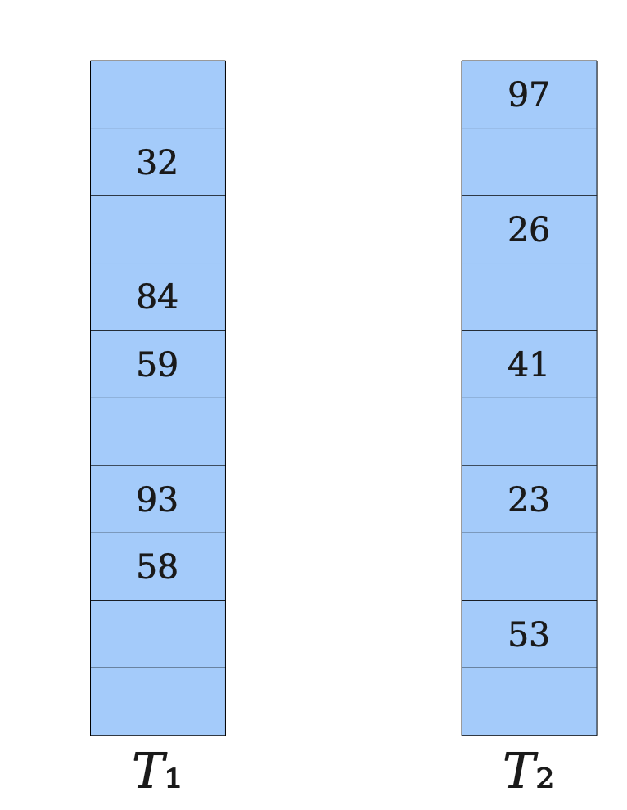
Cuckoo hashing
Cuckoo hashing
  Two tables & Two hash functions (H₁, H₂)
  The key can only at T₁[H₂(key)] or T₂[H₂(key)]
Pros
  Good for read: at most two 2 random I/O for get
Cons
  Insertion is complex and can issue many random disk I/O
  Rehashing is required if there are many insertions, which is extremely slow
    Expanding the table, and re-insert all the keys in the new table (!)
Notes:
We will not cover many details

Slide 52
Selecting a proper index for KV store is non-trivial
Not just choosing a data structure
Trade-offs of selecting indexes
  Read performance vs. update performance
    An index needs to be updated upon inserts/deletions
  Whether index is friendly to the storage?
    E.g., random vs. sequential
  Others (e.g., storage overhead)
Notes:
// 放在后面

Slide 53
Other issues of using hash index & segmented log file
Crash recovery
  E.g., under machine failure, there may be partially written records
  Recover hash table after reboot, can be slow (if the log file is large)
Index limited by the RAM size
  Can put it on the disk but is slow. Why?
  Hint: hash lookup requires many random reads
Lack range query support
  E.g., scan over all keys between kitty00000 & kitty99999

Slide 54

B-Tree indexes: a form of ordered index
Introduced in 1970, the “ubiquitous” index 10 years later
  Standard index of many databases and key-value stores
“It could be said that the world’s information is at our fingertips because of B-trees”
Goetz Graefe Microsoft, HP Fellow, now Google ACM Software System Award

Slide 55
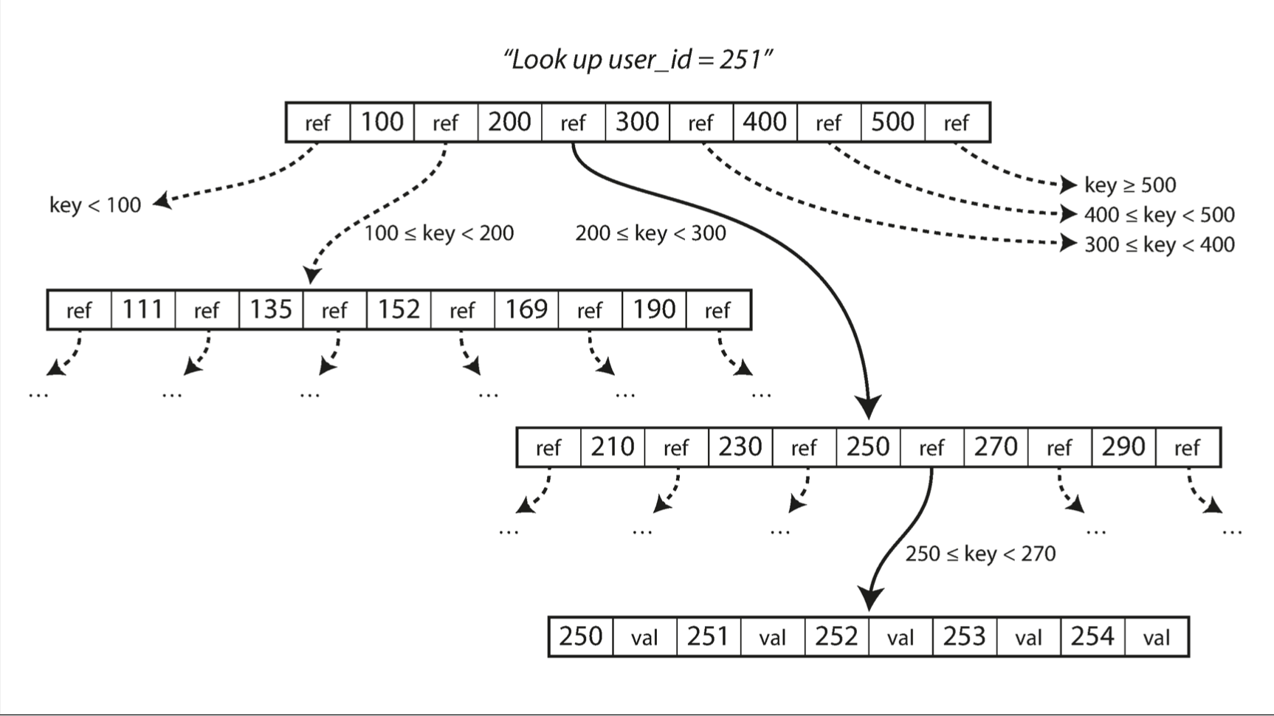
B-Tree indexes
A B-tree is a tree data structure
  Each node is fixed-sized, can store multiple keys, and keys are sorted
  Support efficient range operations (e.g., Scan)
  Optimized for large read/write blocks of data

Slide 56
B-Tree indexes example (fanout = 5)
12
2
3
8
13
27

Slide 57
B-Tree indexes example: Get(2)
12
2
3
8
13
27

Slide 58
B-Tree indexes example: Get(2)
12
2
3
8
13
27

Slide 59
B-Tree indexes example: Update(2)
Similar to Get()
  1. find the position
  2. update the value
12
2
3
8
13
27

Slide 60
B-Tree indexes example: insert(10)
12
2
3
8
13
27

Slide 61
B-Tree indexes example: insert(10)
12
2
3
8
10
13
27

Slide 62
B-Tree indexes example: insert(11)
12
2
3
8
10
11
13
27

Slide 63
B-Tree indexes example: insert(11)
8
12
2
3
10
11
13
27
Split the nodes!

Slide 64
B-Tree indexes on the disk?
Get(K) and Insert(K,V) costs
  O(log(n)) random disk accesses
  Typically, is small, since B-Tree indexes uses large node size
    E.g., 4KB per node, each node stores 500 references, can support up to 256TB data
B+Tree indexes are not good enough for insertion-intensive workloads
  Still many random disk I/O involved
  Insertions are common for on-disk storages, because reads are served by other system component
    E.g., check lecture 02, step#2 for scaling a website
Notes:
// 分析B+Tree 索引的好坏

Slide 65
Can we avoid random access for
index updates?

Slide 66
Recall: segmented log file
Compaction & segmentation
  Break a file into fixed-sized segments
  If a segment is full, then create a new file for insertions
  Can control the compaction granularity with the segment size

Slide 67
LSM Trees: SSTables (Sorted String Table)
SSTable is based on the segmented log file described in the hash index
  Break a file into fixed-sized segments
  If a segment is full, then create a new file for insertion
  Old segment files are immutable and can be compacted to save spaces
Notes:
// 分析B+Tree 索引的好坏

Slide 68
LSM Trees: SSTables (Sorted String Table)
SSTable is based on the segmented log file described in the hash index
  Break a file into fixed-sized segments
  If a segment is full, then create a new file for insertion
  Old segment files are immutable and can be compacted to save spaces
With one extension
  Key-values in a segment are sorted by the key
  Each segmented file is called Sorted String Table (SSTable)
Inserting in a SSTable is not append-only
We will come back to this topic later
Notes:
// 分析B+Tree 索引的好坏

Slide 69
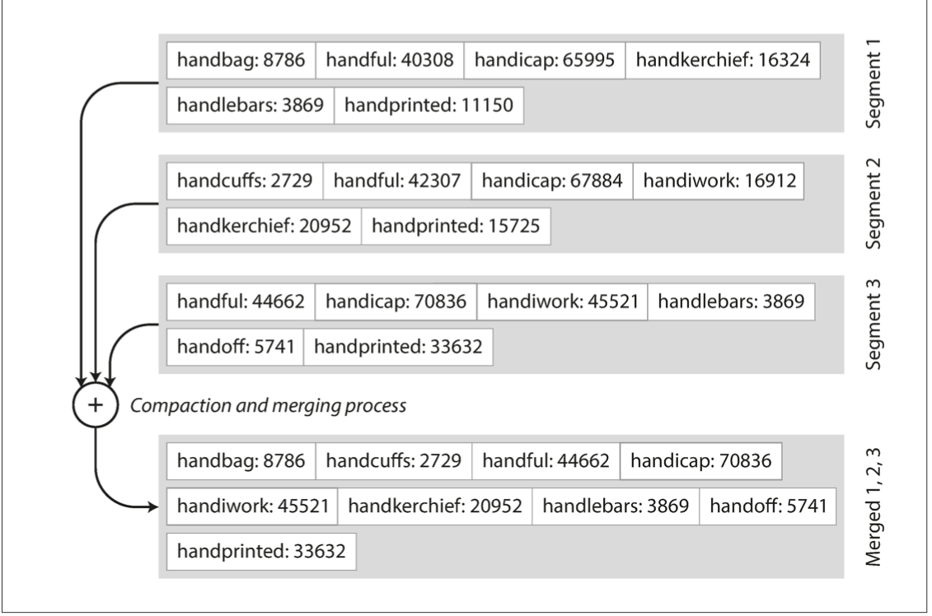
Benefits of SSTable (compared to original log file)
#1. Merging two SSTables is efficient
  Even if the two tables are much larger than the available memory
  Similar to the mergesort

Slide 70
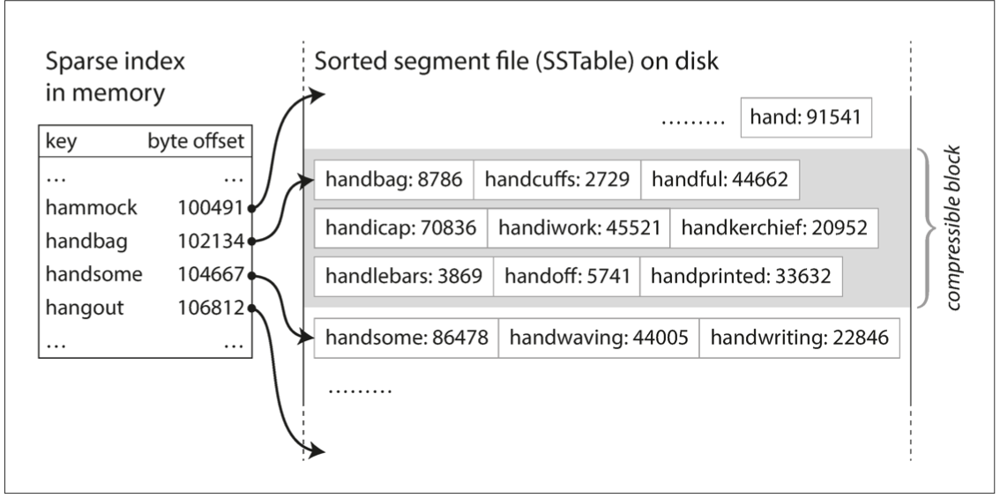
Benefits of SSTable (compared to original log file)
#2. Searching a given key in a SSTable is efficient
  Only needs some sparse index for the acceleration, one for each SSTable
  E.g., one key in index for every few KB of SSTable is sufficient, since scanning them is quick

Slide 71
Benefits of SSTable (compared to original log file)
#3. Support range operations
  Since the KVS are sorted in the file

Slide 72
How to maintain SSTable with sequential writes?
Use a MemTable: an in-memory sorted data structure (e.g., red-black Tree)
MemTable

Slide 73
How to maintain SSTable with sequential writes?
Use a MemTable: an in-memory sorted data structure (e.g., red-black Tree)
Example: insert a (K, V) into SSTable
1
Insert the (K,V) into the MemTable
(K,V)
MemTable

Slide 74
How to maintain SSTable with sequential writes?
Use a MemTable: an in-memory sorted data structure (e.g., red-black Tree)
Example: insert a (K, V) into SSTable
1
Insert the (K,V) into the MemTable
(K,V)
Question: does writing to SSTable sequential?
MemTable
SSTable
2
check whether MemTable exceeds some threshold
If so, flush it to a new SSTable

Slide 75
How to maintain SSTable with sequential writes?
Use a MemTable: an in-memory sorted data structure (e.g., red-black Tree)
Example: insert a (K, V) into SSTable
3
What if there are too many SSTables?
We can merge & compact them as we have done before with segmented log files
SSTables
Merge & compact

Slide 76
LSM Tree
The SSTable & operations are essentially LSM Tree
  Log-structured merge tree
LSM Tree organizes SSTables as a hierarchy architecture
New
  Each layer has maximum size
  Except L0, all files in layers are sorted
MemTable
L0
L1
L2
LSM Tree
Old

Slide 77
Example: insert/update in LSM-Tree
MemTable
KV pairs
Memory
Disk
Level₀
…
…
SSTable
Level₁
KV pairs
(sorted)
…
Level_{k}
…
Metadata

Slide 78
Example: insert/update in LSM-Tree
MemTable
KV pairs
Memory
Disk
Level₀
…
…
SSTable
Level₁
KV pairs
(sorted)
…
Level_{k}
…
Metadata

Slide 79
Example: insert/update in LSM-Tree
MemTable
KV pairs
Full
Memory
Disk
Level₀
…
…
SSTable
Level₁
KV pairs
(sorted)
…
Level_{k}
…
Metadata

Slide 80

Example: insert/update in LSM-Tree
MemTable
KV pairs
Memory
Disk
Level₀
…
Compaction
…
SSTable
Level₁
KV pairs
(sorted)
…
Level_{k}
…
Metadata

Slide 81
Reads with LSM-Tree
Checks the MemTable
If misses, checks the latest SSTable
If still misses, checks the next older SSTable
…
Optimization: keep a sparse index on each SSTable to accelerate the lookup
1
2
3
4
…
MemTable
SSTables

Slide 82
What about crash?
MemTable is vulnerable to machine failure
Solution:
  Keep a separate log for each KV inside a MemTable (may not be sorted)
  Restore the MemTable after reboot
  See the next lecture

Slide 83
Other issues of using hash index & segmented log file
Crash recovery -> Next lecture
  E.g., under machine failure, there may be partially written records
  Recover hash table after reboot, can be slow (if the log file is large)
Index limited by the RAM size
  Can put it on the disk but is slow. Why?
Lack range query support
  E.g., scan over all keys between kitty00000 & kitty99999

Slide 84
Range Query in LSM Tree
Search each layer using binary search
Merge the results of each layer
Not as good as B+Tree, but is much better than hash!
New
MemTable
L0
L1
L2
LSM Tree
Old

Slide 85




LSM Tree Summary
Good when
  Massive dataset
  Rapid updates/insertions
  Fast single-point lookup for recently updated data
  Widely adopted in modern single-node key-value stores

Slide 86
LSM Tree Summary
Good when
  Massive dataset
  Rapid updates/insertions
  Fast single-point lookup for recently updated data
  Compared with B-Tree
  Pros: good write performance due to sequential writes
  Cons: additional compaction process, possible slow range queries,
  write stall caused by the compaction, slow lookup for non-existent key

Slide 87
LSM Tree Summary
Good when
  Massive dataset
  Rapid updates/insertions
  Fast single-point lookup for recently updated data
  Compared with B-Tree
  Pros: good write performance due to sequential writes
  Cons: additional compaction process, possible slow range queries,
  write stall caused by the compaction, slow lookup for non-existent key

Slide 88
Write stall caused by compaction in LSM Tree
MemTable
KV pairs
Memory
Disk
Level₀
…
…
SSTable
Level₁
KV pairs
(sorted)
…
Level_{k}
…
Metadata

Slide 89
Write stall caused by compaction in LSM Tree
MemTable
KV pairs
Memory
Disk
Level₀
…
…
SSTable
Level₁
KV pairs
(sorted)
…
Level_{k}
…
Metadata

Slide 90
Write stall caused by compaction in LSM Tree
MemTable
KV pairs
Full
Memory
Disk
Level₀
…
…
SSTable
Level₁
KV pairs
(sorted)
…
Level_{k}
…
Metadata

Slide 91
Write stall caused by compaction in LSM Tree
MemTable
KV pairs
Memory
Disk
Level₀
…
Compaction
…
SSTable
Level₁
KV pairs
(sorted)
…
Level_{k}
…
Metadata

Slide 92
Write stall caused by compaction in LSM Tree
MemTable
KV pairs
Memory
Disk
Level₀
…
Compaction
…
SSTable
Level₁
KV pairs
(sorted)
…
Level_{k}
…
Metadata

Slide 93
Write stall caused by compaction in LSM Tree
MemTable
KV pairs
Full
Memory
Disk
Level₀
…
Compaction
…
SSTable
Level₁
KV pairs
(sorted)
…
Level_{k}
…
Metadata

Slide 94
Write stall caused by compaction in LSM Tree
MemTable
KV pairs
Memory
Disk
Level₀
…
Compaction
…
SSTable
Level₁
KV pairs
(sorted)
…
Level_{k}
…
Metadata

Slide 95

Write stall caused by compaction in LSM Tree
  Stalled due to
  slow compaction
MemTable
KV pairs
Full
Memory
Disk
Level₀
…
Compaction
…
SSTable
Level₁
KV pairs
(sorted)
…
Level_{k}
…
Metadata

Slide 96
How to avoid write stall?

Slide 97
In principle, hard to prevent
Can only alleviate
  E.g., speed up compaction & merge process with advanced hardware
Disk
Level₀
…
Compaction
…
SSTable
Level₁
KV pairs
(sorted)
…
Level_{k}
…
Metadata

Slide 98
In principle, hard to prevent
Can only alleviate
  E.g., speed up compaction & merge process with advanced hardware
  Observation: SSD is much faster than disk on storage
    Using it to store up-layer SSTables
SSD
…
Compaction
Level₀
Disk
…
SSTable
Level₁
KV pairs
(sorted)
…
Level_{k}
…
Metadata

Slide 99
LSM Tree Summary
Good when
  Massive dataset
  Rapid updates/insertions
  Fast lookups
  Compared with B-Tree
  Pros: good write performance due to sequential writes
  Cons: additional compaction process, possible slow range queries,
  write stall caused by the compaction, slow lookup for non-existent key

Slide 100
Slow lookup for non-existent key
Question: what if the key non-exist?
Recall: how LSM Tree lookup keys
Checks the MemTable
If misses, checks the latest SSTable
If still misses, checks the next older SSTable
…
Will lookup all the files!
1
2
3
4
…
MemTable
SSTables

Slide 101
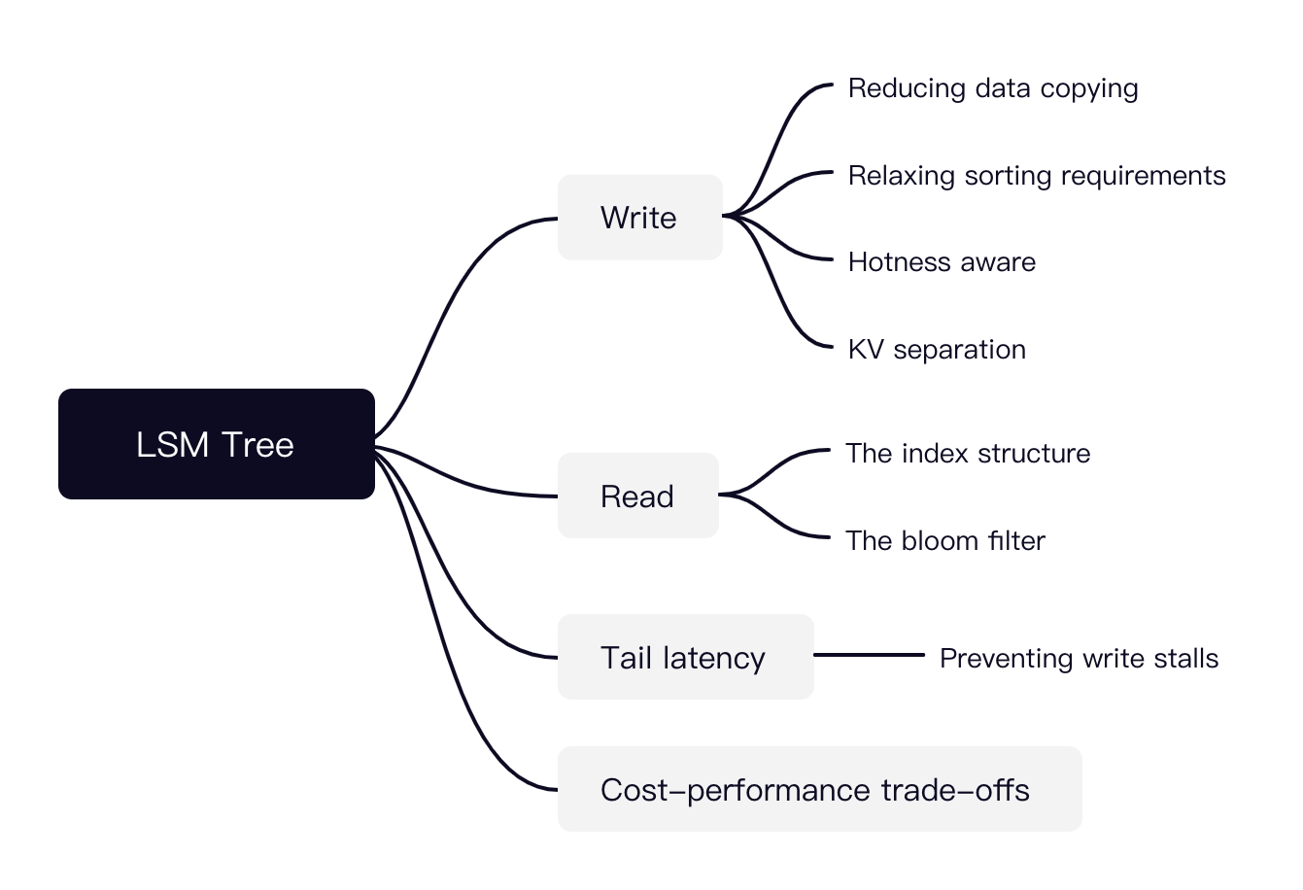
LSM Tree is a hot research topic today
Many possible directions

Slide 102
Key-value storage is a key component in large-scale website

Slide 103



Review: large-scale websites
Key-value storage is the key pillar
Caching server
Caching server
Caching server
…
Caching
Caching
Caching
Distributed caching
w/ MyRocks
Storage
- LSM Tree
Database server
Database server
CDN
Users
Application #1
generate the page
Database
user, price
…
Database
user, price
Filesystem
Application server
Distributed database
Internet
Load
Balance
Application #2
add the order
File server
File server
File server
File:
image
File:
image
…
File:
image
Application server
…
…
Message queue
Distributed file system

Slide 104
Distributed key-value storage

Slide 105
Distributed key-value storage
Make KV store distributed
  RPC + key-value storage = distributed key-value storage!
    Like what we did for distributed file system!
  We can also shard the data across multiple nodes
    i.e., high scalability
Key challenge:
  How to find the data?
    E.g., consistent hashing (see later lectures)
Other problems:
  Fault tolerance (next lecture)
  Availability, replication & consistency (see later lectures)

Slide 106
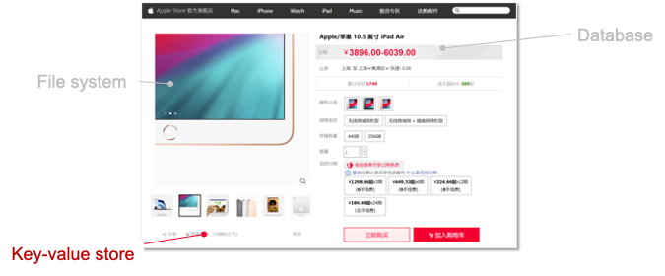
Summary of this lecture
Key-value store is an important component in computer systems
Build key-value store over file system
  Log-structured file
  Indexing
  LSM Tree
Key-value Store
Key-value files
File system

