Slide 1


Atomicity: All-or-Nothing
SE124 (2021 Fall)
IPADS, Shanghai Jiao Tong University
https://www.sjtu.edu.cn
Credits: Rong Chen@IPADS, Jinyang Li@NYU

Slide 2
Review: Recovering Filesystem Metadata from Crash
1. Synchronous meta-data update + fsck
  During check, synchronize metadata, such as file size
2. Soft update (FreeBSD fs modified on FFS)
  not covered in this course
3. Logging (ext 3/4), and many others
  Before doing actual meta-data update, log the event
  After crash, recover from log

Slide 3
Review: Ordinary perf. of sync meta-data update?
Creating a file and writing a few bytes
  Takes 8 disk writes, probably 80 ms
  (ialloc, init inode, write dirent, alloc data block, add to inode, write data, set length in inode, ...)
Can create only about a dozen small files per second!
  Think about un-tar or rm *

Slide 4
Review: What can go wrong with write-back cache?
unlink() followed by create() an existing file x with some content, all safely on disk
One user runs unlink(x)
  1. delete x's directory entry **
  2. put blocks in free bitmap
  3. mark x's inode free; another user then runs create(y)
  4. allocate a free inode
  5. initialize the inode to be in-use and zero-length
  6. create y's directory entry **
  again, all writes initially just to disk buffer cache
  suppose only ** writes forced to disk, then crash
What is the problem? Can fsck detect and fix this?

Slide 5
Review: Ext4 Data Journaling Mode
Writeback mode
  Only the metadata is journaled
  The data is written to the file on the disk
Ordered mode
  The data is written first before the metadata is journaled
Data mode: full journaling
  Both the metadata and file contents are journaled
Default and most commonly used

Slide 6
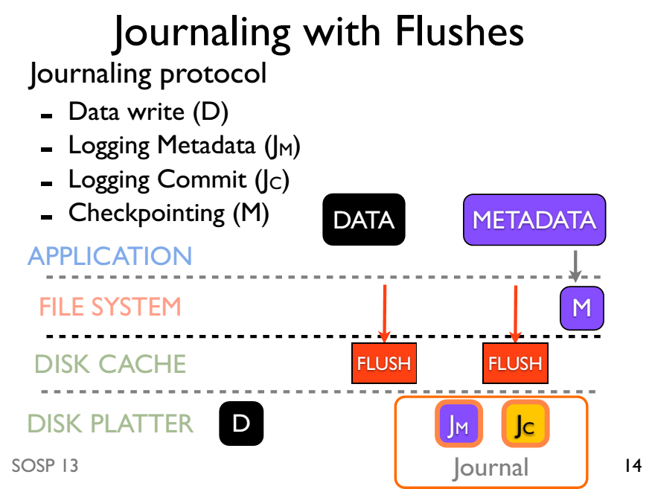

Slide 7
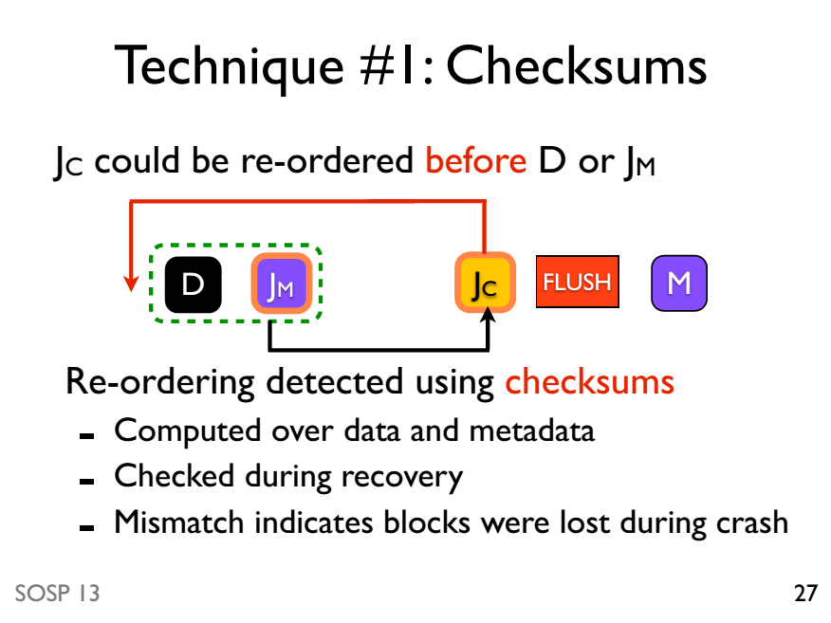

Slide 8
All-or-nothing

Slide 9
Atomicity: All-or-Nothing
An action is atomic if happens completely or not at all
  Atomicity makes it much easier to reason about failures
  Need to think about the consequences of the action happening or not happening, but not about the action partially happening

Slide 10
Atomicity: All-or-Nothing
An action is atomic if happens completely or not at all
  Atomicity makes it much easier to reason about failures
  Need to think about the consequences of the action happening or not happening, but not about the action partially happening
An action can be a group of other atomic actions
  Under certain scenarios, a group of action is not atomic even all its sub-op is atomic!
  Example: in the last course, unlink & link is atomic with fsck / journaling
    However, rename,which uses unlink & link can be non-atomic under failure

Slide 11
Atomicity Violation
Crash
  E.g., power failure
Interrupt
  E.g., I/O device interrupts
Parallelization
  E.g., two or more threads running concurrently

Slide 12
Example: Renaming - 1
Normal
Under failure
1 UNLINK(to_name)
2 LINK(from_name, to_name)
3 UNLINK(frome_name)
1 UNLINK(to_name)
2 LINK(from_name, to_name)
3 UNLINK(frome_name)
Text edit usually save editing file in a temp file
  Edit in .a.txt.swp, then rename .a.txt.swp to a.txt
What if the computer fails between 1 & 2?
  The file to_name will be lost, which will surprise the user
  Need atomic action

Slide 13
Example: Renaming - 2
Normal
Under failure
1 LINK(from_name, to_name)
2 UNLINK(frome_name)
1 LINK(from_name, to_name)
2 UNLINK(frome_name)
Weaker specification without atomic actions
  1. Changes the inode number in for to_name to the inode number of from_name
  2. Removes the directory entry for from_name
If fails between 1 & 2
  What will happen after failure? The file from_name still exists!
Notes:
// mark 这页ppt啥意思？

Slide 14
Example: Renaming - 2
Normal
Under failure
1 LINK(from_name, to_name)
2 UNLINK(frome_name)
1 LINK(from_name, to_name)
2 UNLINK(frome_name)
Weaker specification without atomic actions
  1. Changes the inode number in for to_name to the inode number of from_name
  2. Removes the directory entry for from_name
If fails between 1 & 2
  What will happen after failure? The file from_name still exists!
Should be atomic!

Slide 15
More example: the IBM System/370
Multi-operand character-editing instruction
  TRANSLATE contains 3 arguments
    Two address: string and table, 8-bit counter: length
    Takes 1 byte at a time from string, as an offset in table, get the byte in table, then replace the byte in string
  Problem: page fault
  Solution: dry run
  Hidden copy of register make no change to memory
  Maybe several dry run for one instruction, then run it again
  Problem again: what if another process snatch a page?

Slide 16
File system journaling is insufficient
1. Journaling only ensures the consistency, but not atomicity
  Our previous example of rename
2. Even all file system operations (e.g., rename) is atomic is still insufficient
  User can group different file operations in an arbitrary way
    Write multiple records with file system API

Slide 17
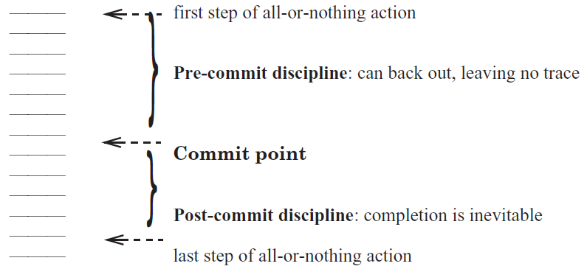
Commit Point

Slide 18
Shadow copy

Slide 19
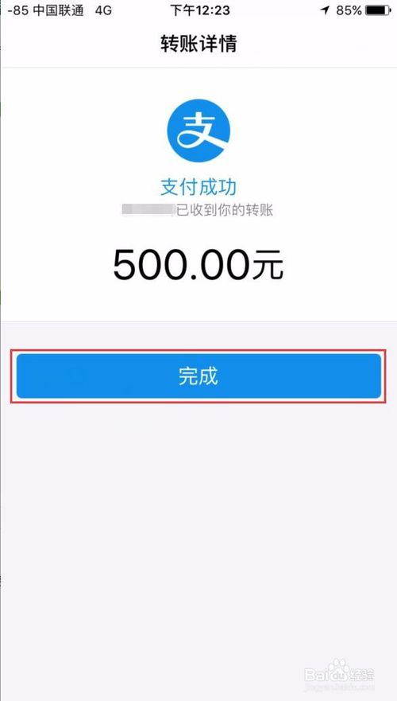
Case study: bank transfer
1. Journaling only ensures the consistency, but not atomicity
  Our previous example of rename
2. Even all file system operations (e.g., rename) are atomic is still insufficient
  User can group different file operations in an arbitrary way
    Write multiple records with file system API

Slide 20
Case study: bank transfer
transfer(bank, a, b, amt):
bank[a] = bank[a] – amt
bank[b] = bank[b] + amt
Invariant:
bank(a) + bank(b) never changes

Slide 21
Case study: bank transfer
transfer(bank, a, b, amt):
bank[a] = bank[a] – amt
bank[b] = bank[b] + amt
Invariant:
bank(a) + bank(b) = 200
Suppose the bank is stored in a single KV
  a and b are stored in a single file
  And their offsets are known
A : 100
B : 100

Slide 22
Case study: bank transfer
transfer(bank, a, b, amt):
bank[a] = bank[a] – amt
bank[b] = bank[b] + amt
Invariant:
bank(a) + bank(b) = 200
A : 100
B : 100
Implementation
transfer(bank, a, b, amt):
bank_a, bank_b = read_accounts(bankfile)
write(bankfile, a, bank_a - amt)
write(bankfile, b, bank_b + amt)
Assume write is atomic

Slide 23
Case study: bank transfer
transfer(bank, a, b, amt):
bank[a] = bank[a] – amt
bank[b] = bank[b] + amt
Invariant:
bank(a) + bank(b) = 200
A : 100
B : 100
Implementation
transfer(bank, a, b, amt):
bank_a, bank_b = read_accounts(bankfile)
write(bankfile, a, bank_a - amt)
write(bankfile, b, bank_b + amt)
Time

Slide 24
Case study: bank transfer
transfer(bank, a, b, amt):
bank[a] = bank[a] – amt
bank[b] = bank[b] + amt
Invariant:
bank(a) + bank(b) = 200
A : 100
B : 100
Implementation
transfer(bank, a, b, amt):
bank_a, bank_b = read_accounts(bankfile)
write(bankfile, a, bank_a - amt)
write(bankfile, b, bank_b + amt)
<- sum=200
Time

Slide 25
Case study: bank transfer
transfer(bank, a, b, amt):
bank[a] = bank[a] – amt
bank[b] = bank[b] + amt
Invariant:
bank(a) + bank(b) = 200
A : 100
B : 100
Implementation
transfer(bank, a, b, amt):
bank_a, bank_b = read_accounts(bankfile)
write(bankfile, a, bank_a - amt)
write(bankfile, b, bank_b + amt)
<- sum=200
<- sum=150
Time

Slide 26
Case study: bank transfer
transfer(bank, a, b, amt):
bank[a] = bank[a] – amt
bank[b] = bank[b] + amt
Invariant:
bank(a) + bank(b) = 200
A : 100
B : 100
Implementation
transfer(bank, a, b, amt):
bank_a, bank_b = read_accounts(bankfile)
write(bankfile, a, bank_a - amt)
write(bankfile, b, bank_b + amt)
← sum=200
← sum=150
Crash!
Time

Slide 27
Case study: bank transfer
transfer(bank, a, b, amt):
bank[a] = bank[a] – amt
bank[b] = bank[b] + amt
Invariant:
bank(a) + bank(b) = 200
A : 100
B : 100
Implementation
transfer(bank, a, b, amt):
bank_a, bank_b = read_accounts(bankfile)
write(bankfile, a, bank_a - amt)
write(bankfile, b, bank_b + amt)
← sum=200
← sum=150
Crash!
What is the sum after recovery?
Time

Slide 28
Shadow copy
transfer(bank, a, b, amt):
bank[a] = bank[a] – amt
bank[b] = bank[b] + amt
Implementation
transfer(bank, a, b, amt):
bank_a, bank_b = read_accounts(bankfile)
write(#bankfile, a, bank_a – amt)
write(#bankfile, b, bank_b + amt)
rename(#bankfile, bankfile)

Slide 29
Shadow copy: rename should be atomic!
transfer(bank, a, b, amt):
bank[a] = bank[a] – amt
bank[b] = bank[b] + amt
Implementation
transfer(bank, a, b, amt):
bank_a, bank_b = read_accounts(bankfile)
write(#bankfile, a, bank_a – amt)
write(#bankfile, b, bank_b + amt)
rename(#bankfile, bankfile)
Question: how to make rename atomic?

Slide 30
rename("#bank", "bank")
Directory data blocks:
  filename "bank" → inode 12
  filename "#bank" → inode 13
inode 12:
  data blocks: 3, 4, 5
  refcount: 1
inode 13:
  data blocks: 6, 7, 8
  refcount: 1

Slide 31
rename("#bank", "bank")
Directory data blocks:
  filename "bank" → inode 13
  filename "#bank" → inode 13
inode 12:
  data blocks: 3, 4, 5
  refcount: 1
inode 13:
  data blocks: 6, 7, 8
  refcount: 1
Time

Slide 32
rename("#bank", "bank")
Directory data blocks:
  filename "bank" → inode 13
  filename "#bank" → inode 13
inode 12:
  data blocks: 3, 4, 5
  refcount: 1
inode 13:
  data blocks: 6, 7, 8
  refcount: 2
Time

Slide 33
rename("#bank", "bank")
Directory data blocks:
  filename "bank" → inode 13
  filename "#bank" → inode 13
inode 12:
  data blocks: 3, 4, 5
  refcount: 0
inode 13:
  data blocks: 6, 7, 8
  refcount: 2
Time

Slide 34
rename("#bank", "bank")
Directory data blocks:
  filename "bank" → inode 13
  filename "#bank" → inode 13
inode 12:
  data blocks: 3, 4, 5
  refcount: 0
inode 13:
  data blocks: 6, 7, 8
  refcount: 2
Time

Slide 35
rename("#bank", "bank")
Directory data blocks:
  filename "bank" → inode 13
  filename "#bank" → inode 13
inode 12:
  data blocks: 3, 4, 5
  refcount: 0
inode 13:
  data blocks: 6, 7, 8
  refcount: 1
Time

Slide 36
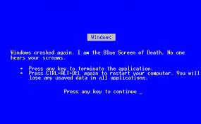
If crash, what step will cause problem?

Slide 37

Problem
Directory data blocks:
  filename "bank" → inode 13
  filename "#bank" → inode 13
inode 12:
  data blocks: 3, 4, 5
  refcount: 1
inode 13:
  data blocks: 6, 7, 8
  refcount: 1
Time
Two names point to fnew’s inode, but refcount is 1
  which reference is the correct one?

Slide 39
Solution#2: file system ensures the rename is atomic
e.g., using journaling (see the last lecture)
  So shadow copy is decoupled from file system

Slide 40
What if crash during the commit point?
Assume that writing to one sector on disk is all-or-nothing
  Disk saves enough energy to complete one sector write
  Time spent writing a sector is small
  Small capacitor suffices to power disk for a few microseconds
  If write did not start, no need to complete it
    Still all-or-nothing

Slide 41
ALL_OR_NOTHING_PUT
procedure ALMOST_ALL_OR_NOTHING_PUT (data, all_or_nothing_sector)
CAREFUL_PUT(data, all_or_nothing_sector.S1)
CAREFUL_PUT (data, all_or_nothing_sector.S2)
CAREFUL_PUT (data, all_or_nothing_sector.S3)
procedure ALL_OR_NOTHING_GET (reference date,all_or_nothing_sector)
CAREFUL_GET (data1, all_or_nothing_sector.S1)
CAREFUL_GET (data2, all_or_nothing_sector.S2)
CAREFUL_GET (data3, all_or_nothing_sector.S3)
if (data1 = data2) data ← data1
else data ← data3
Notes:
Why "Almost"?
- Not repair previous damage

Slide 42
ALL_OR_NOTHING_PUT
procedure ALL_OR_NOTHING_PUT (data, all_or_nothing_sector)
CHECK_AND_REPAIR (all_or_nothing_sector)
ALMOST_ALL_OR_NOTHING_PUT (data, all_or_nothing_sector)
procedure CHECK_AND_REPAIR (all_or_nothing_sector) // Ensure copies match
CAREFUL_GET (data1, all_or_nothing_sector.S1)
CAREFUL_GET (data2, all_or_nothing_sector.S2)
CAREFUL_GET (data3, all_or_nothing_sector.S3)

Slide 43
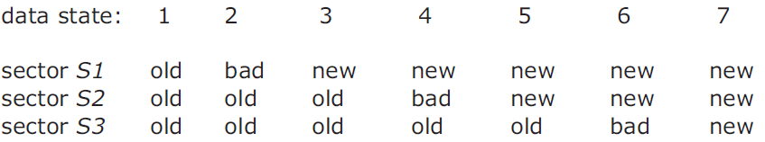
ALL_OR_NOTHING_PUT
if (data1 = data2) and (data2 = data3) return // State 1 or 7, no repair
if (data1 = data2)
CAREFUL_PUT (data1, all_or_nothing_sector.S3) return // State 5 or 6.
if (data2 = data3)
CAREFUL_PUT (data2, all_or_nothing_sector.S1) return // State 2 or 3.
CAREFUL_PUT (data1, all_or_nothing_sector.S2) // State 4, go to state 5
CAREFUL_PUT (data1, all_or_nothing_sector.S3 // State 5, go to state 7
Notes:
The choice of which to use is arbitrary; as shown the procedure copies the new value in sector S1 to both sectors S2 and S3.

Slide 44

Durable Storage: RAID 1
Tolerate error
  Hard errors reported by careful layer are
  masked by reading from other replicas
Untolerated error
  Decay on the same sector of all the replicas,
  status = BAD
  OS crashes during a DURABLE_PUT
  Decay in a way that is undetectable
Redundant Array of
Independent Disks

Slide 45
Improving on RAID-1
Clerk: periodically checks for decays
  T_{d} as the period, must short enough
Tolerated error
  Hard errors reported by careful layer are masked by reading from one of the other replicas
  Data of a single decay set decays, is discovered by the clerk, and is repaired, all within T_{d} of the decay event
Untolerated error
  The OS crashes during DURABLE_PUT
  All decay sets fail with T_{d}
  The data of some sector decays in a way undetectable

Slide 46
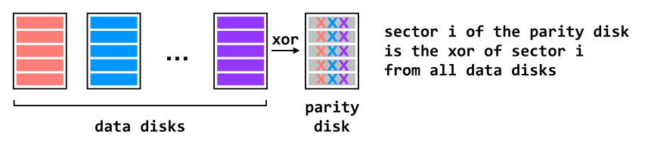
RAID 4 (Dedicated Parity Disk)
Can recover from single-disk failure
Requires N+1 disks (not 2N)
Performance benefits if stripe a single file across multiple data disks
- All writes hit the parity disk

Slide 47
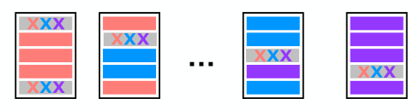
RAID 5 (Spread Out the Parity)
Can recover from single-disk failure
Requires N+1 disks (not 2N)
Better performance if stripe a single file across multiple data disks
Writes are spread across disks

Slide 48
Back to Shadow Copy
Write to a copy of data, atomically switch to new copy
Switching can be done with one all-or-nothing operation
  Sector write
Requires a small amount of all-or-nothing atomicity from lower layer (disk)
  Or requires the rename to be atomic
Main rule: only make one write to current/live copy of data
  In our example, sector write for rename
  Creates a well-defined commit point

Slide 49
Does the shadow copy approach work in general?
Works well for a single file
  Hard to generalize to multiple files or directories
    Have to place all files in a single directory, or rename subdirs
  Requires copying the entire file for any (small) change
  Only one operation can happen at a time
  Only works for operations that happen on a single computer, single disk

Slide 50
Redo Log & Undo Log
SysR: The Recovery Manager of
the System R database Manger

Slide 51
Introducing Transaction Terminology
transfer(bank, a, b, amt):
begin
bank[a] = bank[a] – amt
bank[b] = bank[b] + amt
if bank[a] < 0:
abort //Not enough funds
else:
commit
transfer(bank, a, b, amt):
begin
write (a, read(a) – amt)
write (b, read(b) – amt)
if read (a) < 0:
abort //Not enough funds
else:
commit

Slide 52
Consider the Bank Account Example
Two accounts: A and B
  Accounts start out empty
  Run these all-or-nothing actions
Problem
  After crash, A=3000, but T3 never committed
Solution
  Undo to A’s previous committed value
  T1 and T2: "All"
  T3: "Nothing"
begin // T1
A = 3000
B = 2000
"commit // A=3000; B=2000
begin // T2
A = A - 1000
B = B + 1000
"commit // A=2000; B=3000
begin // T3
A = A + 1000 // A=3000
--CRASH--

Slide 53

More general
Files states are transferred based on application, internal states may be illegal
  E.g., bank transfer
  Goal: transfer between legal state to legal states
However, Crash may occur at any time
legal
illegal
illegal
legal
A = 2000
B = 3000
A += 1000

Slide 54
Solution: logging
Keep a log of all update actions
  Each action has 3 required operations
Log
Old
State
DO
New
State
Log
New
State
UNDO
Old
State
Log
Old
State
REDO
New
State
Log

Slide 55
DO-UNDO-REDO Protocol
Each operations between begin ... commit is recorded in a log
  Append-only reduce random access
The begin ... commit is called
  Transaction
transfer(bank, a, b, amt):
begin
write (a, read(a) – amt)
write (b, read(b) – amt)
if read (a) < 0:
abort //Not enough funds
else:
commit
write(a, read(a) – amt)
Logged
Log
Append

Slide 56
DO-UNDO-REDO Protocol: log content
Each log record consists of
  Transaction ID
  Action ID
  Pointer to previous record in this transaction
  Action (file name, offset, old & new value)
  …
Log
TID=1, AID=2, PTR=80,
ACT={A, 23, 3000, 2000}

Slide 57
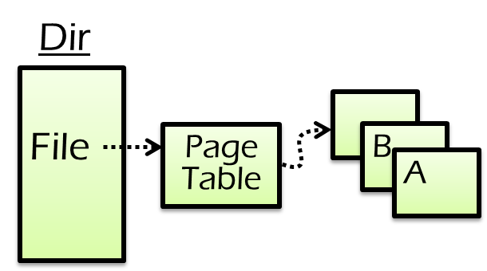
Logging rules
How to commit?
Write log record to disk before modifying persistent state (e.g., replace A’s value)
  Write Ahead Log (WAL) protocol
Log

Slide 58
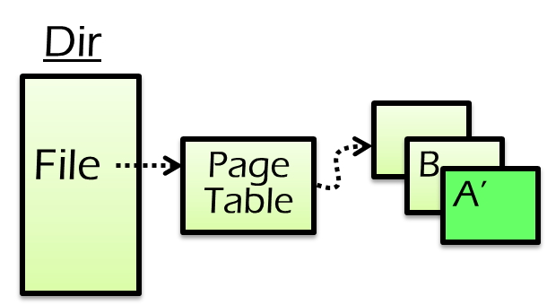
Logging rules
How to commit?
Write log record to disk before modifying persistent state (e.g., replace A’s value)
  Write Ahead Log (WAL) protocol
Log

Slide 59
Logging rules
How to commit?
Write log record to disk before modifying persistent state (e.g., replace A’s value)
  Write Ahead Log (WAL) protocol
At commit point, append a commit record to the log last
  E.g., when user calls commit
Commit
Log

Slide 60
Recovery rules
How to recovery from crash?
Read the log and recover states according to its content
Rules:
  Travel from end to start
Log

Slide 61

Recovery rules
How to recovery from crash?
Read the log and recover states according to its content
Rules:
  Travel from end to start
  Mark all transaction’s log record w/o CMT log and append ABORT log
Log

Slide 62
Recovery rules
How to recovery from crash?
Read the log and recover states according to its content
Rules:
  Travel from end to start
  Mark all transaction’s log record w/o CMT log and append ABORT log
  UNDO ABORT logs from end to start
UNDO
Log

Slide 63
Recovery rules
How to recovery from crash?
Read the log and recover states according to its content
Rules:
  Travel from end to start
  Mark all transaction’s log record w/o CMT log and append ABORT log
  UNDO ABORT logs from end to start
  REDO CMT logs from start to end
REDO
Log

Slide 64
Checkpoint
Why we need it?
Avoid log size from growing too large
Avoid recovery from a blank state
  Inevitably slow
Notes:
Why a long transaction is likely to aborted? Because its log content will be undoed

Slide 65
How to checkpoint?
CKPT_ROOT
  Points to the last checkpointed log file
  Log content before can be safely discared
CKPT_ROOT
LAST_CKPT

Slide 66
How to checkpoint?
How to checkpoint?
  Wait till no transactions are in progress
CKPT_ROOT
LAST_CKPT

Slide 67
How to checkpoint?
actions
How to checkpoint?
  Wait till no transactions are in progress
  Write a CKPT record to log
    Contains a list of all transaction in process
    and pointers to their most recent log records
  Save all files
  Atomically save checkpoint by updating checkpoint root to new CKPT record
CKPT_ROOT
END_CKPT
LAST_CKPT
START_CKPT

Slide 68
Recovery with checkpoint
Checkpoint
T1
Crash
T2
T3
T4
T5
  Read latest checkpoint
  → T2, T4 are ongoing transactions
  Read log → T2, T3 are winners and T4 is a loser
  Read log to UNDO loser (T4)
  Read log to REDO winners (T2 and T3)
How about T5?
Notes:
Nothing to T5, it is loser and no need to UNDO (since no state in checkpoint)

Slide 69
Example: logging
Transfer $1000
From A: $3000
To B: $2000
Transfer $10
From C: $10
To D: $0
B D
File
A C
Page Table
SysR
T1
T2
File: F
ID: A
O: 3000
N:2000
File: F
ID: C
O: 10
N:0
Time
A=A-1000
C=C-10

Slide 70
Example: logging
Transfer $1000
From A: $3000
To B: $2000
Transfer $10
From C: $10
To D: $0
B D
File
A C
Page Table
SysR
T1
T2
File: F
ID: A
O: 3000
N:2000
File: F
ID: C
O: 10
N:0
CKPT
T1, T2
Time
A=A-1000
C=C-10
CKPT

Slide 71
Example: logging
Transfer $1000
From A: $3000
To B: $2000
Transfer $10
From C: $10
To D: $0
B D
File
A C
Page Table
SysR
T1
Crash
T2
File: F
ID: A
O: 3000
N:2000
File: F
ID: C
O: 10
N:0
CKPT
T1, T2
File: F
ID: B
O: 2000
N:3000
CMT
Time
A=A-1000
C=C-10
CKPT
B=B+1000
C T1

Slide 72
Example: recovery
Transfer $1000
From A: $3000
To B: $2000
Transfer $10
From C: $10
To D: $0
B D
File
A C
Page Table
SysR
Recovery
CKPT State
A: 2000
B: 2000
C: 0
D: 0
CKPT
T1, T2
Time
A=A-1000
C=C-10
CKPT
B=B+1000
C T1

Slide 73
Example: recovery
Transfer $1000
From A: $3000
To B: $2000
Transfer $10
From C: $10
To D: $0
B D
File
A C
Page Table
SysR
Recovery
CKPT State
A: 2000
B: 2000
C: 10
D: 0
T1
CKPT
T1, T2
UNDO
C=C+10
Time
A=A-1000
C=C-10
CKPT
B=B+1000
C T1

Slide 74
Example: recovery
Transfer $1000
From A: $3000
To B: $2000
Transfer $10
From C: $10
To D: $0
B D
File
A C
Page Table
SysR
Recovery
CKPT State
A: 2000
B: 3000
C: 10
D: 0
T1
T2
CKPT
T1, T2
UNDO
REDO
C=C+10
Time
A=A-1000
C=C-10
CKPT
B=B+1000
C T1

Slide 75
Example: recovery
Transfer $1000
From A: $3000
To B: $2000
Transfer $10
From C: $10
To D: $0
B D
File
A C
Page Table
SysR
Recovery
Final State
A: 2000
B: 3000
C: 10
D: 0
T1
T2
Done
CKPT
T1, T2
UNDO
REDO
C=C+10
Time
A=A-1000
C=C-10
CKPT
B=B+1000
C T1

Slide 76
UNDO-REDO Logging
Why records both UNDO & REDO logs
  A transaction might be very long
  Must checkpoint w/ ongoing transactions
  A long transaction might be aborted
  Must UNDO abort state when recovery
Can we have REDO-only logs for system w/ “short transactions”?

Slide 77
REDO-only logging
Logging rules
  Append REDO log record before flushing state modification
  Uncommitted transactions can not flush state (w/o UNDO)
    E.g., achieved via caching the state modification to the memory

Slide 78
REDO-only logging
Logging rules
  Append REDO log record before flushing state modification
  Uncommitted transactions can not flush state (w/o UNDO)
    E.g., achieved via caching the state modification to the memory
Recovery rules
  ABORT all log records w/o CMT log
  REDO all committed transactions
Can we have UNDO-only logging?

Slide 79
UNDO-only Logging
Logging rules
  Append UNDO log record before flushing state modification
  State modification must be flushed before transaction committed
    w/o REDO

Slide 80
Summary
Systematic methods to support atomicity
  Shadow copy
  Logging
Logging
  UNDO-REDO logging
  REDO logging
  UNDO logging

Slide 81

Logging: widely used in large-scale websites
Caching server
Caching server
…
Caching server
All can use logging to ensure
atomicity!
Caching
Caching
Caching
Distributed caching
Database server
Database server
CDN
Users
Application #1
generate the page
Database
user, price
…
Database
user, price
Application server
Distributed database
Internet
Load
Balance
Application #2
add the order
File server
File server
File server
File:
image
File:
image
…
File:
image
Application server
…
…
Message queue
Distributed file system

Slide 82
MTTF & Availability

Slide 83

MTTF, MTTR, MTBF
MTTF: mean time to failure
MTTR: mean time to repair
MTBF: mean time between failure
MTBF = MTTF + MTTR
TBF-1
TBF-2
TBF-3
TTR-1
TTF-1
TTR-2
TTF-2
TTR-3
TTF-3

Slide 84
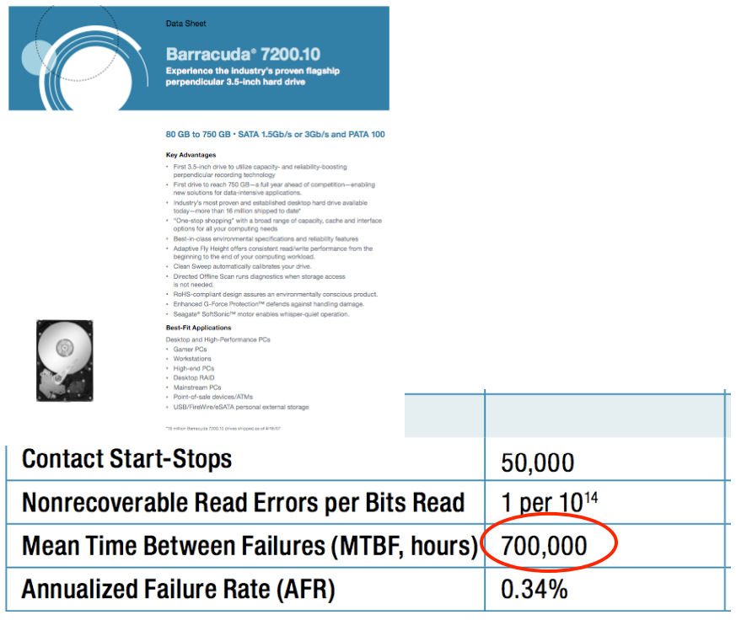
MTBF
Web page snapshot

Slide 85
Measuring MTBF
Two purposes: evaluating & predicting
  The more reliable, the longer it takes to evaluate
  Not measure directly, but use proxies to estimate its value
One way to measure "MTBF"
  E.g. 3.5-inch disk's MTTF is 700,000 hours (80 years!)
  Guess: ran 7,000 disks for 1,000 hours and 10 failed
  If the failure process were memoryless, then OK
  "expected operational lifetime" is only 5 years

Slide 86
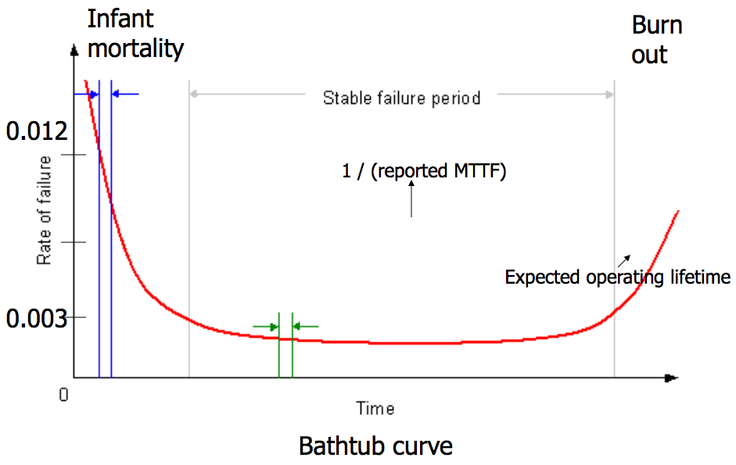
Bathtub Curve
  gross manufacturing defects
  run for a while before shipping
  accumulated ware and tear cause failure

Slide 87
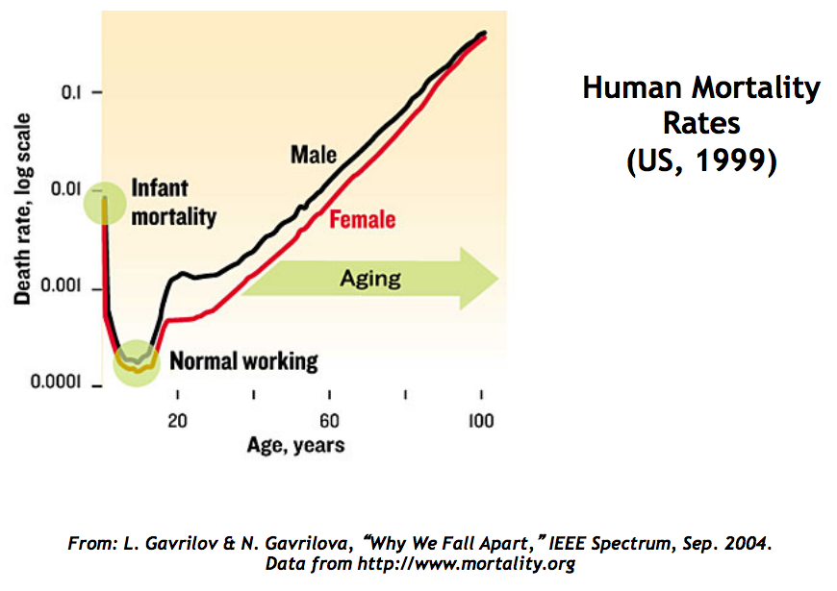

Slide 88
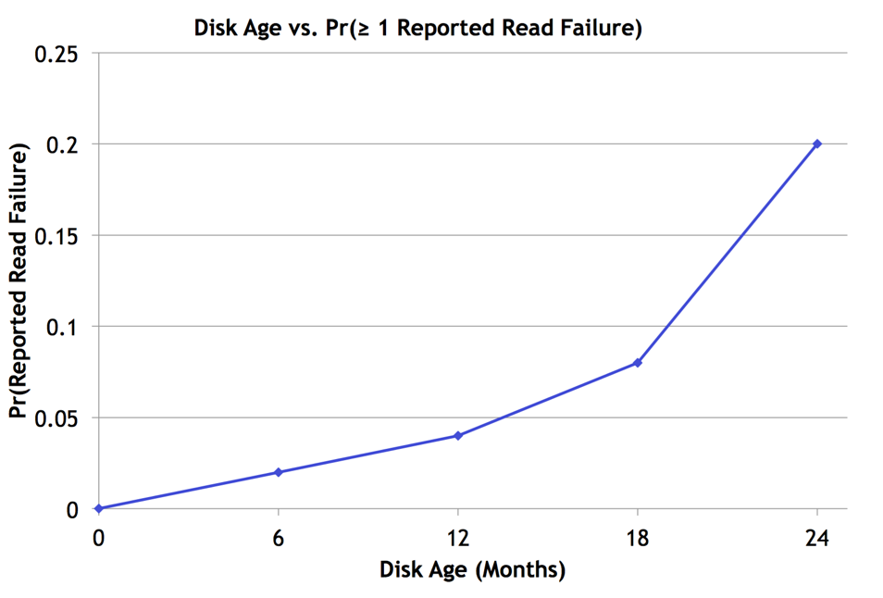
Bairavasundaram et al., SIGMETRICS 2007

Slide 89
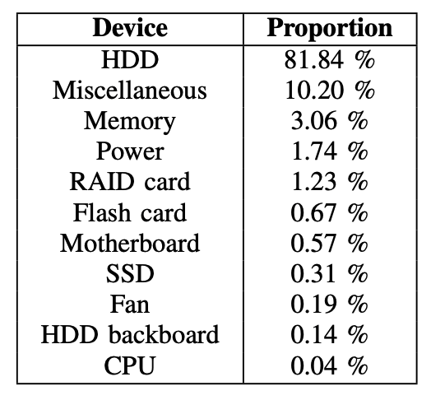
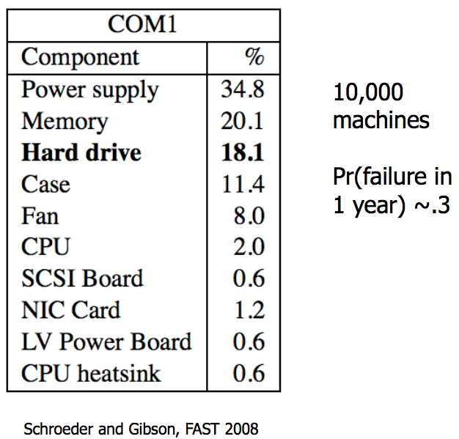
Frequency of Hardware Replacement
Wang et al., DSN 2017

Slide 90
Availability
Counting the number of nines
  E.g. 99.9% has 3-nines availability
  Often used in marketing
Corresponding down time
  E.g. 3-nines -> 8 hour/year
  E.g. 5-nines -> 5 min/year
  E.g. 7-nines -> 3 sec/year
  Without any information about MTTF
More fine-grained
  Fail-soft, as in 8.3

Slide 91
Availability in Practice
Carrier airlines (2002 FAA fact book)
  99.9993% availability, 41 accidents, 6.7M departures
911 Phone service (1993 NRIC report)
  99.994%, 29 minutes per line per year
Standard phone service (various sources)
  99.99+%, 53+ minutes per line per year
End-to-end Internet Availability
  95% - 99.6%

Slide 92
More Case Studies

Slide 93
The U.S. National Archives
Preserve electronic records e.g., email
  Daily incremental backups
  periodic complete backups
  audit logs for tracking actions
June 18-21, 1999, 43,000 emails disappeared
  The audit log had been turned off for better performance
  The contractor’s employees never backup
  Archives never verify the existence of backup copies
  Lesson: Avoid rarely used components, must be tested periodically

Slide 94
Hospital Operating Room in Newark, New Jersey
Hospital operating room, with three backup generators
August 14, 2003, a widespread power grid failure
  One backup generator caught fire from an oil leak
  Another backup generator shut down due to overload
  Hospital engineering turned off many circuit
  Main power was interrupted to the OR
  1. Rarely used component may not have been maintained properly
  2. Human makes mistakes

Slide 95
World-Flight of Northwest Airline
2:05 p.m. on March 23, 2000
  All communications dropped out
  Six cables were accidentally bored through
  Both primary and secondary!
  Pilots resorted to manual procedures
  Radio links were used
  125 flights had to be cancelled
  1. MTTF depend on that replicas are independent
  2. FT measuring is difficult to test

Slide 96
British: Telehouse’s Electricity
Safe against “fire, flooding, bombs, sabotage”
  Especial protection against power failure
  Including two independent connections to power grid
  A room full of batteries, two diesel generators
  Can detect failures automatically then switch
  May 8, 1997…“It was due to human error.”, which is not detectable
  Identifying each potential fault and evaluate the risk is first step
  People are part of the system, mistakes made by authorized operators are typically a bigger threat than trees falling on power lines

Slide 97
Kerosene Light in Radin, Poland
A town of Radin has a electricity generator
  One day the machine broke
  Darkness descended upon all of the streets
  Even worse than the days without electricity
  Every house had a kerosene light
  Single point of failure: Centralization reduces robustness
  Adding redundancy to a centralized design takes planning and adds to the cost

Slide 98
The SOHO Mission Interrupt
SOHO spacecraft was lost on June 25, 1998
  “… a direct result of operational errors, a failure to adequately monitor spacecraft status, and an erroneous decision which …”
  Five distinct direct causes of the loss
  Three indirect causes in design process
  Three indirect causes in operations procedures
  1. Complex systems fail for complex reasons
  2. When some components are people, multi-failures are too common

