Slide 1


Transaction: OCC
SE124 (2021 Fall)
IPADS, Shanghai Jiao Tong University
https://www.sjtu.edu.cn

Slide 2

Review: widely used transaction (TX)s
Caching server
Caching server
…
Caching server
All can use TX to manager data!
  e.g., FS meta data
Caching
Caching
Caching
Distributed caching
Database server
Database server
CDN
Users
Application #1
generate the page
Database
user, price
…
Database
user, price
Application server
Distributed database
Internet
Load
Balance
Application #2
add the order
File server
File server
File server
File:
image
File:
image
…
File:
image
Application server
…
…
Message queue
Distributed file system

Slide 3
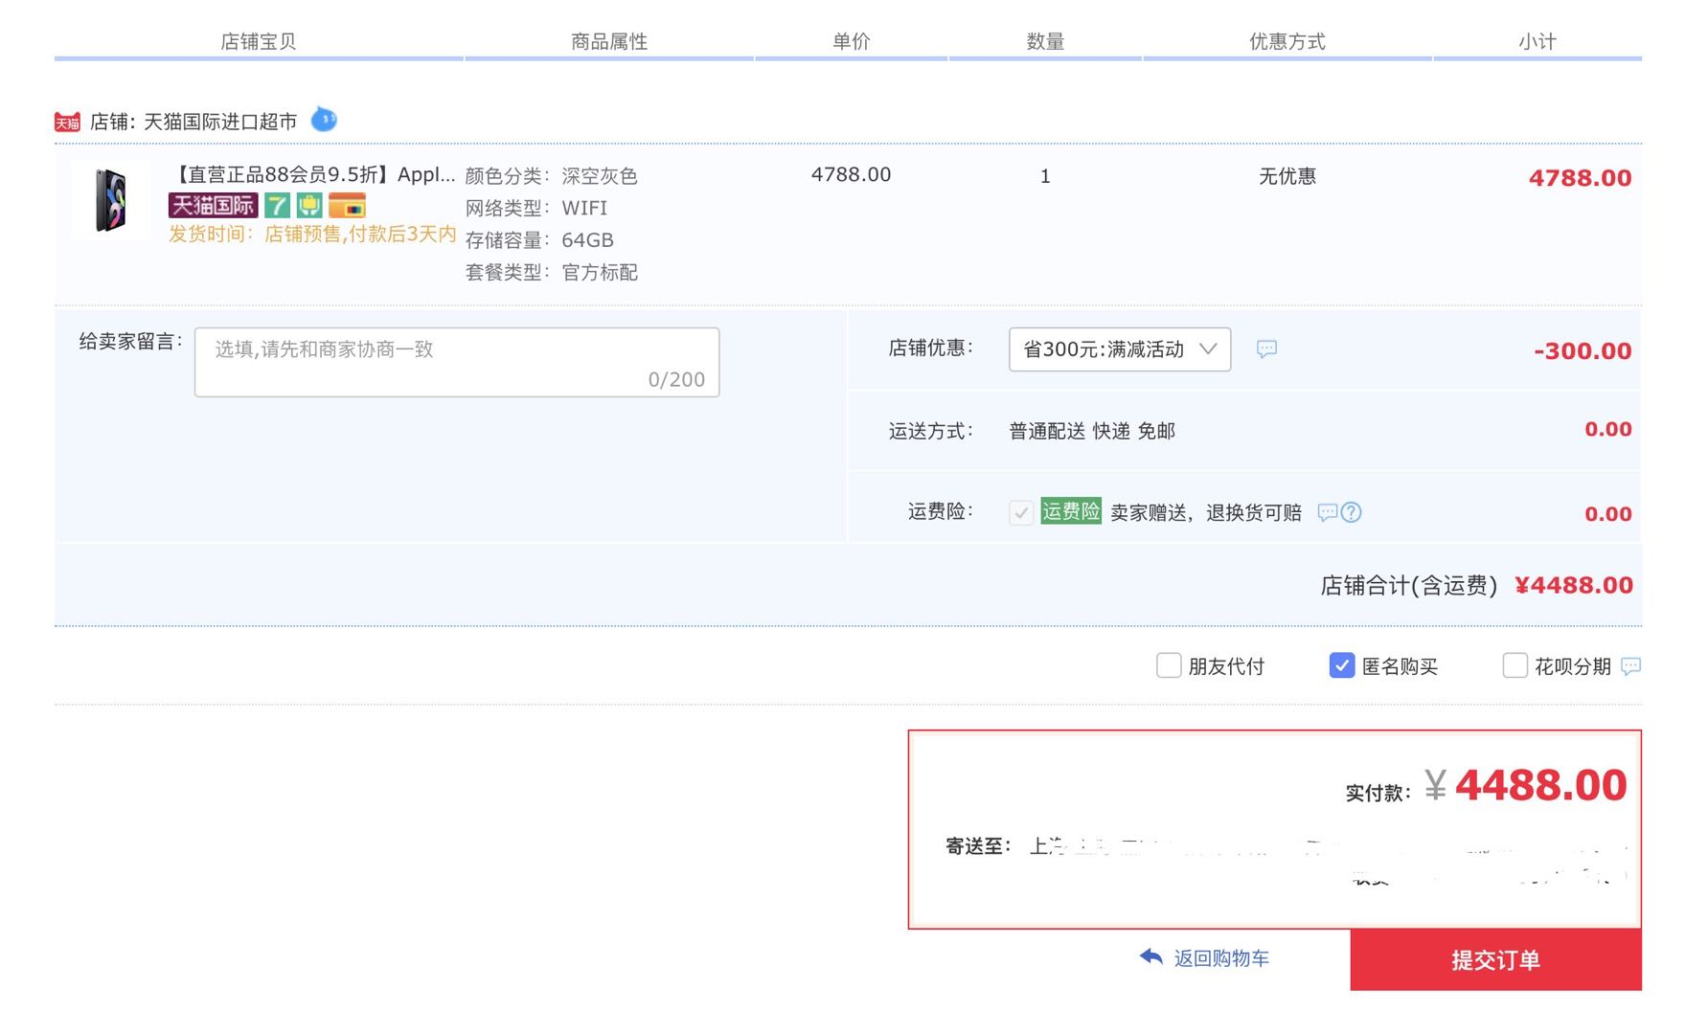
Review: widely used transaction (TX)s
if item.count > 0:
item.count -= 1
Cart.add(item)

Slide 4
Review: What is a transaction (TX)?
An abstraction to manage the data
Data is also an abstract concept, can be arbitrary computing data. Concrete examples including:
  Key-value store entries
  File system metadata (e.g., directory,, inode, etc)
  Processor’s metadata (e.g., child processors)
Look like similar program, with data managed by the TX system, and extra mark to denote the start/end of a TX

Slide 5
Review of TX: an abstraction to ease data management
Handle failure atomicity (all-or-nothing) & race conditions (before-or-after)
Writing with TX is straightforward
  Use TX.begin to mark when a TX starts
  Use TX.commit to commit the TX
  Rewrite the data read/write with TX’s interface
    E.g., bank[a] = bank[a] – amt
    tx.write(a, tx.read(a) – amt);
transfer(bank, a, b, amt, tx):
tx.begin()
tx.write(b, tx.read(b) + amt);
tx.write(a, tx.read(a) – amt);
tx.commit()
transfer(bank, a, b, amt):
bank[b] = bank[b] + amt
bank[a] = bank[a] - amt
Program
Transaction

Slide 6

Review: What can a TX provide? ACID
The program btw { tx.begin() & tx.commit() } has the following properties:
A：Atomicity
C：Consistency
I：Isolation
D：Durability
...
tx.begin();
...
...
tx.commit();
...
ACID
Application program

Slide 7
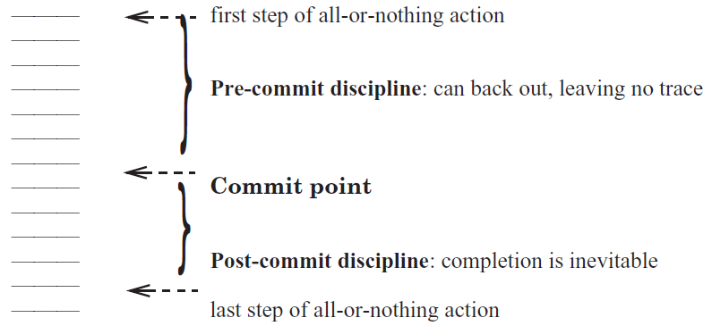
Review: Atomicity: All-or-nothing

Slide 8
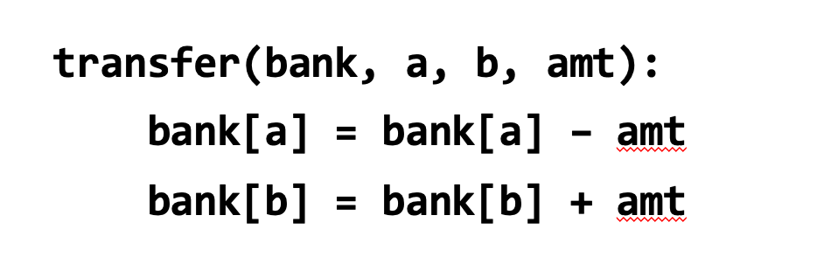
Review: Consistency
Transaction must change the data from a consistent state to another
  What is consistent is defined by the applications
  E.g., transfer should leave the sum(bank[a] + bank[b]) unchanged
Transaction alone is not sufficient for consistency
  E.g., If the programmer writes the incorrect program.
    bank[a] = bank[a] - amt * 2

Slide 9
Review: Isolation & Durability
Isolation: Two concurrently transactions are isolated
  E.g., not viewing the intermediate results of another TX
  Avoid the race conditions
Durability
  Once a transaction is committed, its changes (e.g., writes) must durably stored to a persistent storage
There are many isolation levels, we will talk about this later

Slide 10
Review: Enforcing ACID properties
Enforcing A & D:
  Logging and recovery (see the last last lecture)
Enforcing C:
  Database constraint system (not covered in this class)
Enforcing I:
  Concurrency control methods (last & this lecture)

Slide 11
Review: Serialization
Goal: run transactions T1, T2, .., TN concurrently, and have it "appears" as if they ran sequentially
T1
begin
read(x)
tmp = read(y)
write(y, tmp+10)
commit
T2
begin
write(x, 20)
write(y, 30)
commit

Slide 12
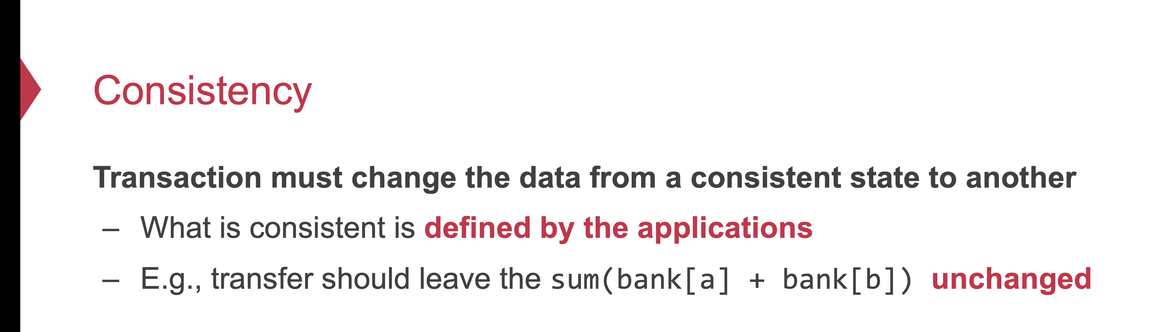
Review: Why serializability is ideal?
Because it simplifies the programmer to enforce consistency
  Recall: consistency depends on how the programmer writes the program

Slide 13
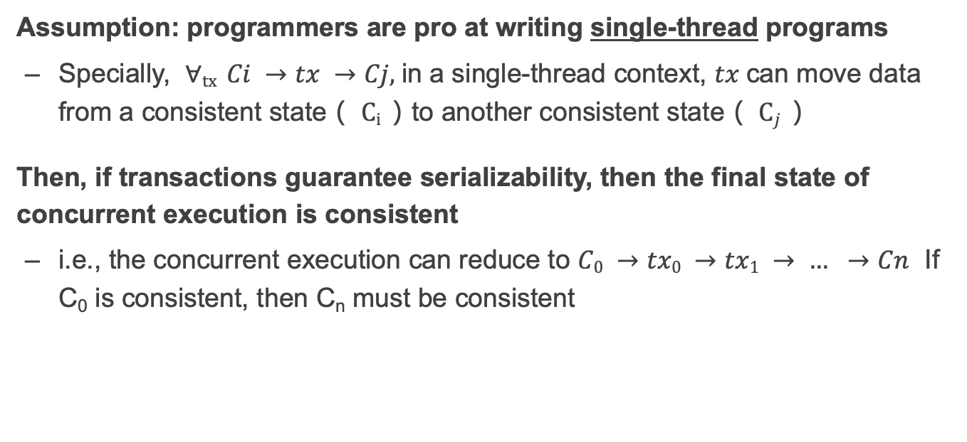
Review: Why serializability is ideal?
Assumption: programmers are pro at writing single-thread programs
  Specially, $∀tx Ci →tx →Cj,$in a single-thread context, $tx$can move data from a consistent state（ $Ci$）to another consistent state（ $Cj$）
Then, if transactions guarantee serializability, then the final state of concurrent execution is consistent
  i.e., the concurrent execution can reduce to $C0 →tx0 →tx1 → … →Cn$ If C₀ is consistent, then C_{n} must be consistent

Slide 14
Review: two-phase locking to achieve serializability
Only acquire the data lock before accessing
Release the lock after the TX commits
How to implement?
  Recall that TX must call TX’s read/write interfaces to read/write data
  Co-locate the lock in the TX’s read/write
...
tx.begin();
...
tx.read(A)
...
tx.commit();
...
Lock_set = {}
Acquire(A)
Lock_set.add(A)
for r in Lock_set:
Release(r)

Slide 15
Phantom Problem
T1
Update emp (set salary=1.1*salary) where dept=‘SS’
T2
Update emp (set dept=‘SS’) where emp.name=‘Rong’ or “Xujia”
Update Binyu
Update Haibo
Update Sandy
Update Yubin
Commit
Update Rong to SS
Update Xujia to SS
Commit (release all locks)
Only rong no xujia
R1(B)
R1(H)
W2(R)
W2(X)
C2
R1(R)
R1(S)
R1(Y)
C1
Note: emp.name is not locked for better concurrency

Slide 16
Phantom Problem
Issue:
  Only lock the things you touch,
  but must guarantee non-existence of any new ones!
Solutions
  Predicate locking
  Range locks in a B-tree index (e.g., assumes an index on dept),
  or lock entire table
  Often ignore in practice
Two operations conflict → they access the same data item and at least one is a write
e.g., object, row, list, entire table, ...

Slide 17
Is two-phase-locking sufficient?

Slide 18
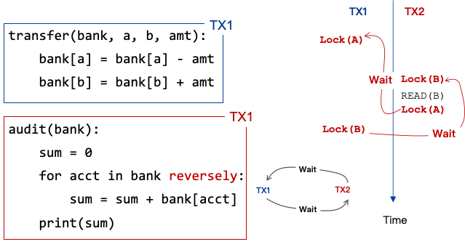
Problem of 2PL: deadlock
Two-phase lock is pessimistic:
  Before proceed, each TX must wait for conflicting TX to release the lock
  What can happen if two TX are waiting for each other?

Slide 19
Methods for resolving the deadlock is not ideal
1. Acquire locks in a pre-defined order
  Not support general TX: TX must know the read/write sets before execution
2. Detect deadlock by calculating the conflict graph
  If there is a cycle, then there must be a deadlock
  Abort one TX to break the cycle
  High cost for detection
3. Using heuristics (e.g., timestamp) to pre-abort the TXs
  May have false positive, or live locks
Prevention
Detection

Slide 20
Can we run transaction optimistically?

Slide 21



Optimistic concurrency control
Executing TXs optimistically w/o acquiring the lock
Checks the results of TX before it commits
  If violate serializability, then aborts & retries
First proposed in 1981, widely used today

Slide 22
OCC Executes a Transaction in 3 Phases
Phase 1: Concurrent local processing
  Reads data into a read set
  Buffers writes into a write set
Phase 2: Validation in critical section
  Validates whether serializability is guaranteed:
  Has any data in the read set been modified?
Phase 3: Commit the results in critical section or abort
  Aborts: aborts the transaction if validation fails
  Commits: installs the write set and commits the transaction

Slide 23
OCC Executes a Transaction in 3 Phases
Before phase one, TX needs to allocate the execution context
  Read-set & write set
...
tx.begin();
...
tx.read(A)
...
tx.commit();
...
Init read-set
Init write-set

Slide 24
OCC Executes a Transaction in 3 Phases
Phase 1:
  Reads data into a read set
  Buffers writes into a write set
This step should be atomic!
...
tx.begin();
...
tx.read(A)
...
tx.commit();
...
val_a = read(A)
read-set.add(val_a)

Slide 25
OCC Executes a Transaction in 3 Phases
Phase 1:
  Reads data into a read set
  Buffers writes into a write set
What about a second read?
  Read from the read-set!
  Why? Need to provided repeated read!
...
tx.begin();
...
tx.read(A)
tx.read(A)
tx.commit();
...
if A in read-set:
return read-set[A]

Slide 26
OCC Executes a Transaction in 3 Phases
Phase 1:
  Reads data into a read set
  Buffers writes into a write set
...
tx.begin();
...
tx.read(A)
tx.write(A)
tx.commit();
...
Write-set[A] = ..
Notes:
假设A之前没有被TX写过，即A只写一次

Slide 27
OCC Executes a Transaction in 3 Phases
Phase 2:
  Validates whether serializability is guaranteed:
  Has any data in the read set been modified?
...
tx.begin();
...
tx.read(A)
...
tx.commit();
...
for d in read-set:
if d has changed:
abort()

Slide 28
OCC Executes a Transaction in 3 Phases
Phase 3:
  Aborts: aborts the transaction if validation fails
  Commits: installs the write set and commits the transaction
...
tx.begin();
...
tx.read(A)
...
tx.commit();
...
for d in read-set:
if d has changed:
abort()
for d in write-set:
write(d)

Slide 29
OCC Executes a Transaction in 3 Phases
Phase 3:
  Aborts: aborts the transaction if validation fails
  Commits: installs the write set and commits the transaction
Phase 2 & 3 should execute in a critical section
  Otherwise, what if a value has changed during validation?
...
tx.begin();
...
tx.read(A)
...
tx.commit();
...
Critical section
for d in read-set:
if d has changed:
abort()
for d in write-set:
write(d)

Slide 30
Why phase 2 & phase 3 must be in critical section?
Both TX:
A += 1
B += 1
Time
T1
T2
Read(A_{T0})
Phase #1
Read(B_{T0})
Read(A_{T0})
Read(B_{T0})
Phase #2
Validate(A_{T0})
Validate(B_{T0})
Validate(A_{T0})
Validate(B_{T0})

Slide 31
Why phase 2 & phase 3 must be in critical section?
Both TX:
A += 1
B += 1
Time
T1
T2
Read(A_{T0})
Phase #1
Read(B_{T0})
Read(A_{T0})
Read(B_{T0})
Phase #2
Validate(A_{T0})
What happen we execute phase #3?
Validate(B_{T0})
Validate(A_{T0})
Validate(B_{T0})
Phase #3
Write(A, A_{T0} + 1)
Write(A , A_{T0} + 1)

Slide 32
How to implement the critical section for phase 2 & 3?
Global lock may satisfy
  The phase 2 & 3 are typically short
    No TX logic is executed, only the validation

Slide 33
How to implement the critical section for phase 2 & 3?
Global lock may satisfy
  The phase 2 & 3 are typically short
    No TX logic is executed, only the validation
Using two-phase locking
  Allow more concurrency: TXs access different records don’t compete with each other
  Question#1: how to lock? Read-set or write-set?
    Only the write-set is enough. Why?
  Question#2: does two-phase locking have deadlock issue here?
    No. Because all the read/write data is known! So the order is known (e.g., order with key ID)
Notes:
Only the write-set is enough. Equivalent to have a read lock (when read) and release it (when commit)

Slide 34
OCC: An Example
Tuple A in T1's read set has been changed by T2, thus T1 must be aborted.
Thread1
Thread2
T1:
B = A + B;
T2:
A = A * 1.1;
T2's read set remains unchanged, thus T2 is allowed to commit
BEGIN
BEGIN
T1's read set:
A (100)
B (100)
R(A);
R(A);
T2's read set:
A (100)
B (200)
R(B);
W(A);
T1's write set:
T2's write set:
A (110)
W(B);
Commit
Validation
Thread-local memory
Abort
Validation
Thread-local memory
Time
Database
storage
ID | Value
A | 110
B | 100
ID | Value
A | 100
B | 100

Slide 35
OCC Advantages
Simple validation, which can achieve high throughput and scalability at low contention

Slide 36
OCC Advantages
Phase 1: Concurrent local processing
  Reads data into a read set
  Buffers writes into a write set
Phase 2: Validation in critical section
  Validates whether serializability is guaranteed:
  Has any data in the read set been modified?
Phase 3: Commit the results in critical section or abort
  Aborts: aborts the transaction if validation fails
  Commits: installs the write set and commits the transaction
Operates in private workspace; rare inter-thread synchronization (optimistic)

Slide 37
OCC Advantages
Phase 1: Concurrent local processing
  Reads data into a read set
  Buffers writes into a write set
Phase 2: Validation in critical section
  Validates whether serializability is guaranteed:
  Has any data in the read set been modified?
Phase 3: Commit the results in critical section or abort
  Aborts: aborts the transaction if validation fails
  Commits: installs the write set and commits the transaction
Needs synchronization (e.g., with lock), but usually very short at low contention

Slide 38
OCC's Problem: False Aborts
Some transactions aborted by OCC could have been allowed to commit without causing an unserializable schedule
Thread1
Thread2
T1:
B = A + B;
T2:
A = A * 1.1;
No cycle is formed
OCC only allows serialized execution of T2, T1, but is not able to recognize serialized execution of T1, T2.
T1 is falsely aborted
BEGIN
BEGIN
R(A);
rw
R(A);
R(B);
W(A);
W(B);
Commit
Abort

Slide 39
OCC's Problem: False Aborts
Some transactions aborted by OCC could have been allowed to commit without causing an unserializable schedule
Especially for TXs with a lot of reads
  E.g., read a lot of items → large read set → easier to abort
  May abort even under low-contention
Notes:
因为执行的时间很长，所以会abort

Slide 40
OCC’s problem: livelock
Under high contention, OCC may continuously abort
  Especially with large read/write sets, or long execution time
  Transaction is executing, but no progress!

Slide 41
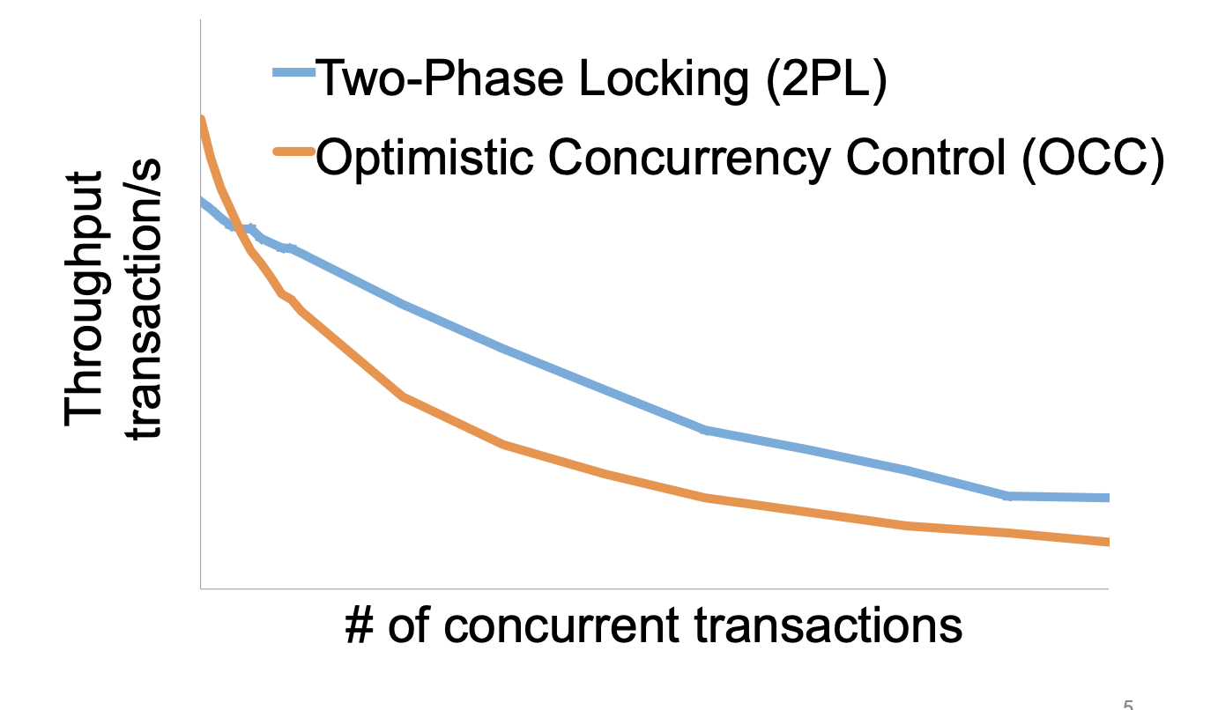
Serializability is costly under contention
from: Rococo [OSDI'14]

Slide 42
OCC and hardware transactional memory

Slide 43

Hardware Transactional Memory
A new CPU feature, inspired by the ACID properties of transactions
CPU guarantees the ACI properties of memory accesses
  i.e., no race conditions & no locks
Intel supports HTM named as RTM
  Restricted Transactional Memory
  In Haswell processor
Semantic of both all-or-nothing and before-or-after
  Not handles failure since it is memory

Slide 44

Does RTM[*] solve all the problem?
Restricted transactional memory
* Since we focus on RTM in this course, we will use RTM and HTM interchangeablely.

Slide 45
A little introduction to RTM
ISA support for transactional memory
Recall: Writing with TX is straightforward
  Use TX.begin to mark when a TX starts
  Use TX.commit to commit the TX
In RTM, the concept is similar (using new instructions)
  Use xbegin to mark an RTM execution start
  Use xend to mark an RTM end

Slide 46
Programming with RTM
If transaction starts successfully
  Do work protected by RTM, and then try to commit
Fallback routine to handle abort event
  If abort, system rollback to xbegin, return an abort code
Manually abort inside a transaction
if _xbegin() == _XBEGIN_STARTED:
if conditions:
_xabort()
critical code
_xend()
else
fallback routine

Slide 47
Programming with RTM
If transaction starts successfully
  Do work protected by RTM, and then try to commit
Fallback routine to handle abort event
  If abort, CPU rollbacks to line xbegin, return an abort code, and goto fallback
Manually abort inside a transaction
if _xbegin() == _XBEGIN_STARTED:
if conditions:
_xabort()
critical code (access x)
_xend()
else
fallback routine
Another process
x = 1

Slide 48
Programming with RTM
If transaction starts successfully
  Do work protected by RTM, and then try to commit
Fallback routine to handle abort event
  If abort, CPU rollbacks to line xbegin, return an abort code, and goto fallback
Manually abort inside a transaction
if _xbegin() == _XBEGIN_STARTED:
if conditions:
_xabort()
critical code
_xend()
else
fallback routine

Slide 49
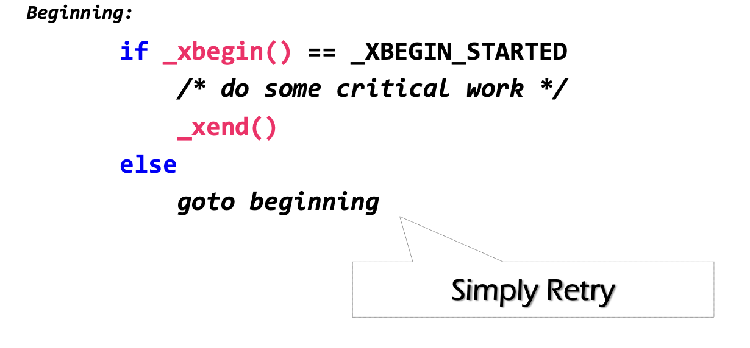
How to handle aborts? Can we use simple retry?
RTM provides new instruction set
  xbegin(), xend() & xabort()
Problem: RTM cannot guarantee success

Slide 50
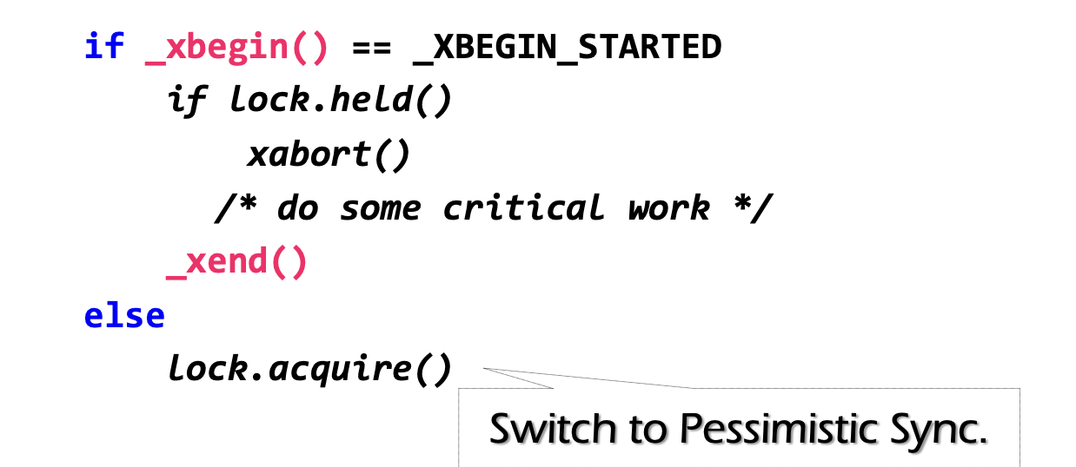
Can we use simple retry? No
Problem: RTM cannot guarantee success
  E.g., what if there is a page fault during critical work?
Must switch to a fallback path after some reties (e.g., using a counter)
  E.g., degrade to use lock in the fallback path (since it's not in a transaction)
check lock status to avoid conflict with fallback handlers on other CPU

Slide 51
Fun facts about the implementation of RTM
The benefits of RTM
  Memory operations between xbegin() & xend()satisfy ACI properties
Drawbacks
  Cannot guarantee success
Sounds familiar?

Slide 52
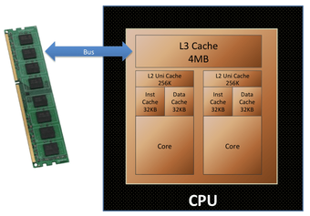
Fun facts about the implementation of RTM
The benefits of RTM
  Memory operations between xbegin() & xend()satisfy ACI properties
Drawbacks
  Cannot guarantee success
Intel implements RTM using OCC
  Use CPU cache to track the read/write sets
  How to detect conflicts? Cache coherence
  Questions: what are the other limits of using CPU cache to tack read/write sets?

Slide 53
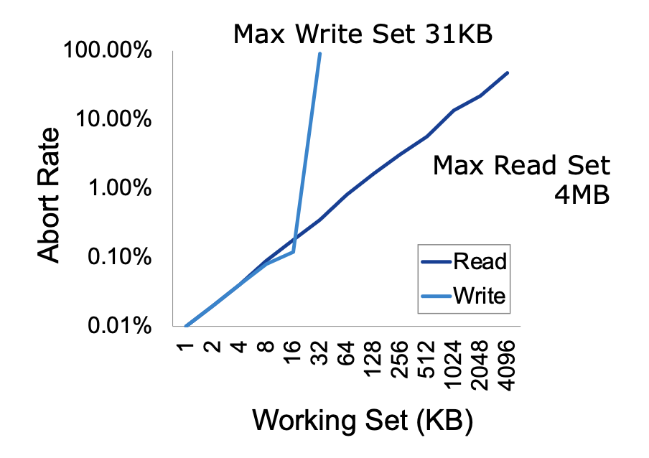
Another drawback of RTM: limited working set
Reason: CPU has limited cache size
How big is the RTM read/write sets?
  Depends on various factors
    Hardware setup (e.g., CPU cache size)
    Access pattern: read or write
    L1 cache tracks all the writes
    L2, or L3 to tracks all the reads
    Why read set is bigger?

Slide 54
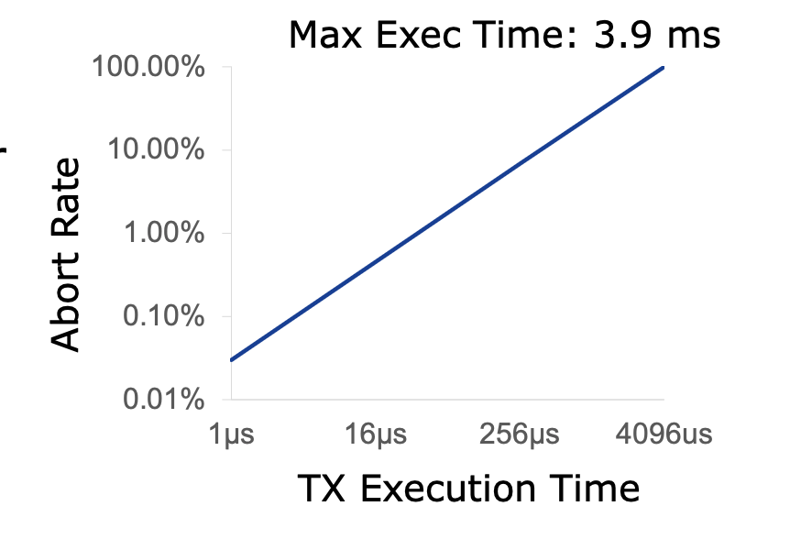
How long can an RTM program execute?
Not very long
  The longer the execution, the higher the probability a TX aborts
  Affected by other facts, e.g., CPU interrupts

Slide 55
Short summary of RTM
Hardware support for transactional memory
  Easy programming model for the programmer
  Good performance if using properly
  However, the programmer should handle its pitfalls

Slide 56
Can we avoid locking/validation for reads?
Maybe use weaker isolation level?

Slide 57

Maybe less than Serializability (for better concurrency)?
Performance
  Long-duration locks on all READ/WRITE
  Scenarios:
run analytics on a companion data, while update a piece of data
long running read-only transaction
Disadvantages of locking-based approach (2PL)
  May involve in deadlocks
  Transactions may hold a lock for a long time
    Read-only transactions (e.g., data mining)
    can block update transactions

Slide 58
Maybe less than Serializability (for better concurrency)?
Performance
  Long-duration locks on all READ/WRITE
  Scenarios:
run analytics on a companion data, while update a piece of data
long running read-only transaction
Disadvantages of OCC
  May involve in a livelock
  Transactions may retry for many times
    Read-only transactions (e.g., data mining)
    is more likely to abort

Slide 59
Why need lock or retry in 2PL or OCC?
Data item is single-version
  Only one copy
  As a result, any concurrent accesses are conflicts, so we need coordination (e.g., locks or validations)
Can we avoid these conflicts?

Slide 60
Multi-version Concurrency Control
Each data item has multiple versions
  When accessing different versions of data, probably no conflict!
Key (high-level) idea
  Writes don’t overwrite the original data
  Instead, writes install new versions of data
  Reads read from a "snapshot" of data
Benefits: no lock or validation during TX’s execution
bankA: 100, ver: 12, pre:xx
bankA: 100
bankA: 200, ver: 10, pre:xx
Single-version
Multi-version

Slide 61
Snapshot Isolation
A popular multi-version concurrency control (MVCC) scheme
Transactions:
  WRITEs a local buffer (similar to OCC)
  READs a “snapshot” of entire data image
  COMMIT only if no write-write conflict
    Install new versions of data

Slide 62
Snapshot Isolation Implementation
T is assigned a commit timestamp T.cts
System checks all data within T.wset,
if T.sts < X.cts < T.cts, then abort T
Update all data within T.wset with T.cts
T is assigned a start timestamp T.sts
T
START
READ(X)
WRITE(X)
COMMIT
Time
T reads the biggest version of X(i), such that X(i).cts <= T.sts
T buffers writes to X and adds X to its write-set, T.wset += {X}

Slide 63
Time in Snapshot Isolation
Timestamp of start & commit should be assigned in a increasing order
  E.g., global counters with atomic increase
  Question: can we directly use the physical clock of the machine?
    It depends. If all cores have global order of physical clock, then yes; otherwise not.
T is assigned a commit timestamp T.cts
System checks all data within T.wset,
if T.sts < X.cts < T.cts, then abort T
Update all data within T.wset with T.cts
T is assigned a start timestamp T.sts
T
START
COMMIT
Time
Notes:
answer: depends. if all cores have global order of physical clock, then yes. otherwise not.

Slide 64
Snapshot Isolation Example (T1)
5
10
40
50
60
70
Time
T1
S
R(A)
R(B)
W(A)
W(B)
C
T2
S
R(A)
R(B)
C
T3
S
R(A)
R(B)
C
10
T.sts =
R(A) =
R(B) =
T.cts =
W(A) =
W(B) =
A₀
A₂
A₇
A₅₀
A₇
B₈
B₀
B₃
B₈
B₅₀
50
A₅₀
B₅₀

Slide 65
Snapshot Isolation Example (T2)
5
10
40
50
60
70
Time
T1
S
R(A)
R(B)
W(A)
W(B)
C
T2
S
R(A)
R(B)
C
T3
S
R(A)
R(B)
C
10
40
T.sts =
R(A) =
R(B) =
T.cts =
W(A) =
W(B) =
T.sts =
R(A) =
R(B) =
T.cts =
A₀
A₂
A₇
A₅₀
A₇
A₇
B₈
B₈
B₀
B₃
B₈
B₅₀
50
70
A₅₀
B₅₀
No uncommitted-read (A₅₀)

Slide 66
Snapshot Isolation Example (T3)
5
10
40
50
60
70
Time
T1
S
R(A)
R(B)
W(A)
W(B)
C
T2
S
R(A)
R(B)
C
T3
S
R(A)
R(B)
C
5
10
40
T.sts =
R(A) =
R(B) =
T.cts =
T.sts =
R(A) =
R(B) =
T.cts =
W(A) =
W(B) =
T.sts =
R(A) =
R(B) =
T.cts =
A₀
A₂
A₇
A₅₀
A₇
A₇
A₂
B₈
B₈
B₃
50
70
60
B₀
B₃
B₈
B₅₀
A₅₀
B₅₀
No unrepeatable-read

Slide 67
Snapshot Isolation Example
5
10
40
50
60
70
Time
T1
S
R(A)
R(B)
W(A)
W(B)
C
T2
S
R(A)
R(B)
C
T3
S
R(A)
R(B)
C
Equivalent Serial Order
A₀
A₂
A₇
A₅₀
T3
A₇
B₈
T2
T1
B₀
B₃
B₈
B₅₀
Is Snapshot Isolation serializable or not ?

Slide 68
Question of Snapshot Isolation
Snapshot isolation (SI) differs from serializability due to one anomaly that is possible under SI but not under serializability.
Describe the anomaly and also give a concrete application for which the anomaly is undesirable.
T1
S
R(X)
W(Y)
C
R(X) = X₀
W(Y) = Y₁
T2
S
R(Y)
W(X)
C
R(Y) = Y₀
W(X) = X₁
Possible Serial Order
X₀
X₁
T1
T2
Y₀
Y₁
T2
T1

Slide 69
Summary
Transactions provide ACID properties
OCC & 2PL are basic protocols to provide serializability
  Problem of 2PL: locking & deadlock
  Problem of OCC: False abort & livelock
Hardware transactional memory (HTM)
  Advanced CPU features inspired by ACID properties of TXs
  Commercial implementation of HTM uses OCC
    Leads to several drawbacks
The cost of concurrency control can be reduced w/ relaxed isolation level
  Snapshot Isolation (require global counter, not serializable)

