Slide 1


Distributed Transaction
Atomicity across multiple sites
SE124 (2021 Fall)
IPADS, Shanghai Jiao Tong University
https://www.sjtu.edu.cn

Slide 2

Review: widely used transaction (TX)s
Caching server
Caching server
…
Caching server
All can use TX to manager data!
  e.g., FS meta data
Caching
Caching
Caching
Distributed caching
Database server
Database server
CDN
Users
Application #1
generate the page
Database
user, price
…
Database
user, price
Application server
Distributed database
Internet
Load
Balance
Application #2
add the order
File server
File server
File server
File:
image
File:
image
…
File:
image
Application server
…
…
Message queue
Distributed file system

Slide 3
Review: What is a transaction (TX)?
An abstraction to manage the data
Data is also an abstract concept, can be arbitrary computing data. Concrete examples including:
  Key-value store entries
  File system metadata (e.g., directory, inode, etc.)
  Processor’s metadata (e.g., child processors)
Look like similar program, with data managed by the TX system, and extra mark to denote the start/end of a TX

Slide 4
Review of TX: an abstraction to ease data management
Transactions handle failure atomicity & race conditions
Writing with TX is straightforward
  Use TX.begin to mark when a TX starts
  Use TX.commit to commit the TX
  Rewrite the data read/write with TX’s interface
    E.g., bank[a] = bank[a] – amt
    tx.write(a, tx.read(a) – amt);
transfer(bank, a, b, amt, tx):
tx.begin()
tx.write(b, tx.read(b) + amt);
tx.write(a, tx.read(a) – amt);
tx.commit()
transfer(bank, a, b, amt):
bank[b] = bank[b] + amt
bank[a] = bank[a] - amt
Program
Transaction

Slide 5

Review: What can a TX provide? ACID
The program btw { tx.begin() & tx.commit() } has the following properties:
A：Atomicity
C：Consistency
I：Isolation
D：Durability
...
tx.begin();
...
...
tx.commit();
...
ACID
Application program

Slide 6
Review: What is a transaction (TX)?
An abstraction to manage the data
Data is also an abstract concept, can be arbitrary computing data. Concrete examples including:
  Key-value store entries
  File system metadata (e.g., directory,, inode, etc)
  Processor’s metadata (e.g., child processors)
Look like similar program, with data managed by the TX system, and extra mark to denote the start/end of a TX
What if the data is distributed?
e.g., one machine cannot store all the data.

Slide 7
Multi-site Transaction

Slide 8
Transaction across Multiple Sites
The setup
  Client + coordinator + two servers
  One server handles A-M
  The other server handles N-Z
  Coordinator and servers all have logs
  Coordinator passes messages from the client to the appropriate server

Slide 9
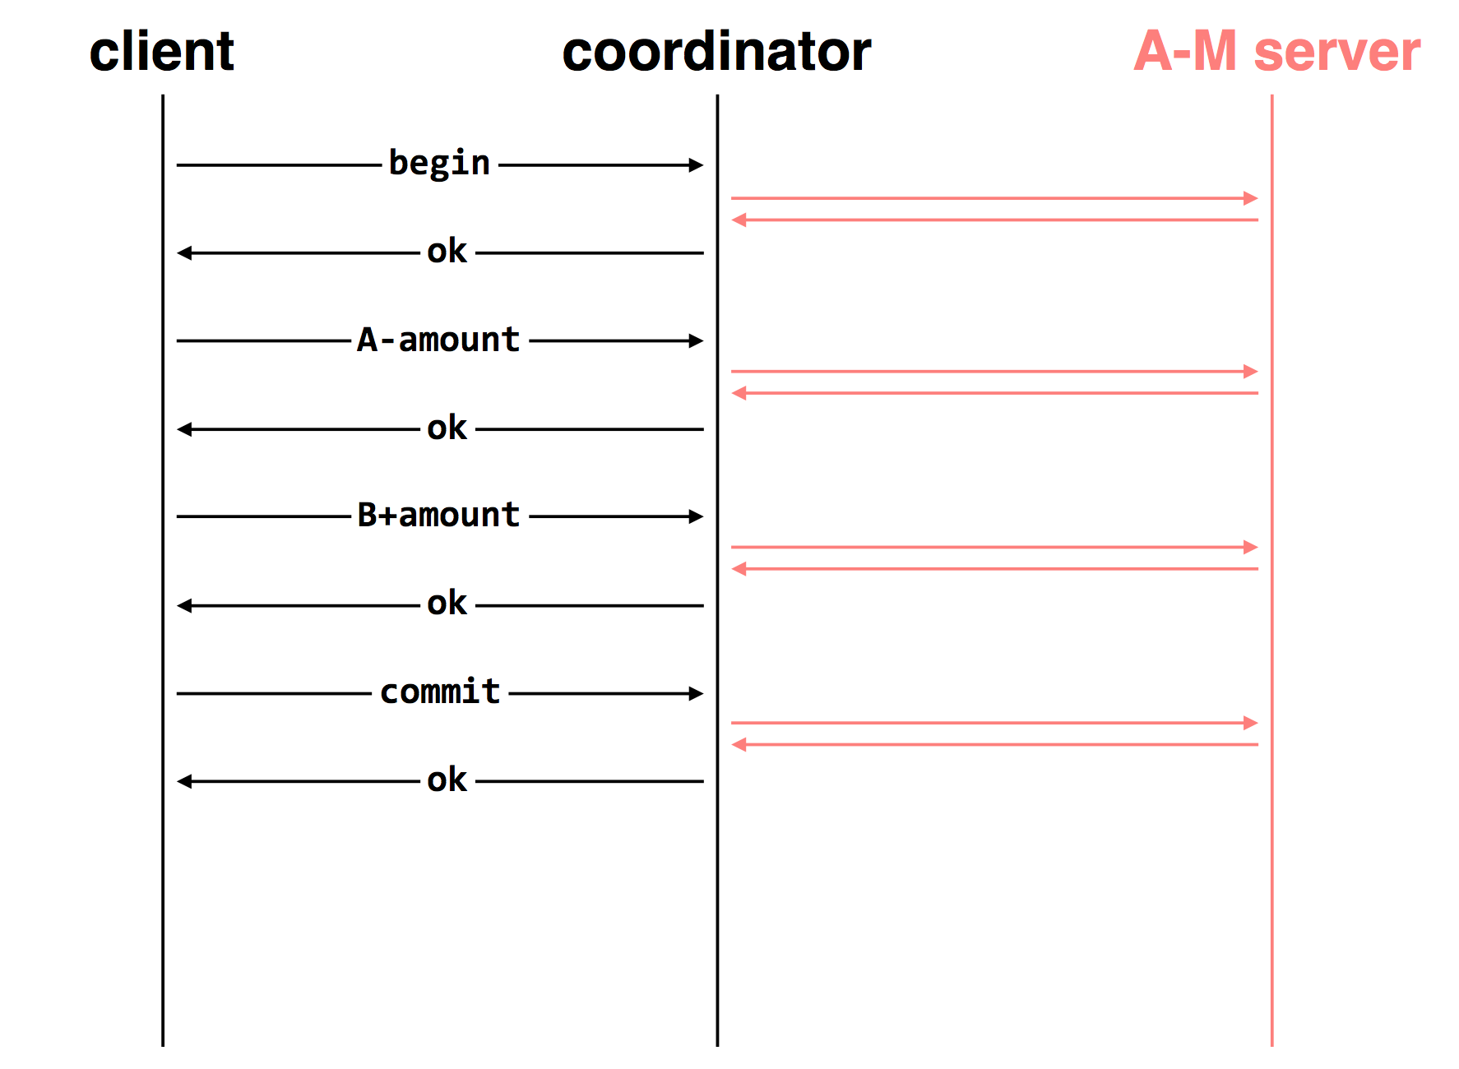

Slide 10
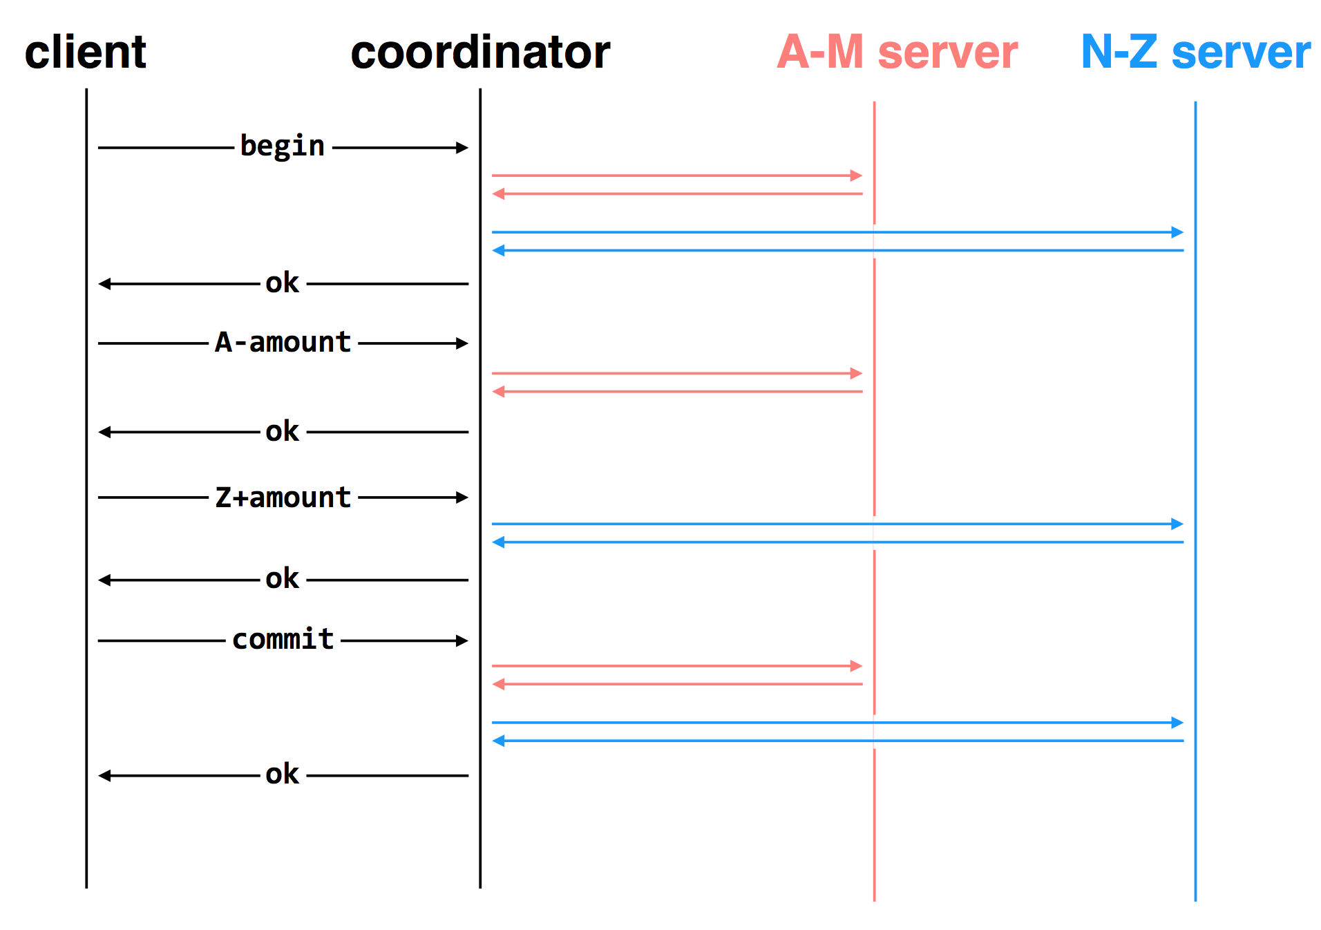

Slide 11
Deal with the Network
Message may be lost, delayed or duplicated
Use RPC to communicate
  Ensure at-least-once by persistent sender
  Ensure at-most-once by duplicate suppression
  However, neither is enough to ensure atomicity here

Slide 12
The Main Problem
Multiple servers can experience different events
  One commits while the other crashes, or
  One commits while the other aborts, etc.

Slide 13
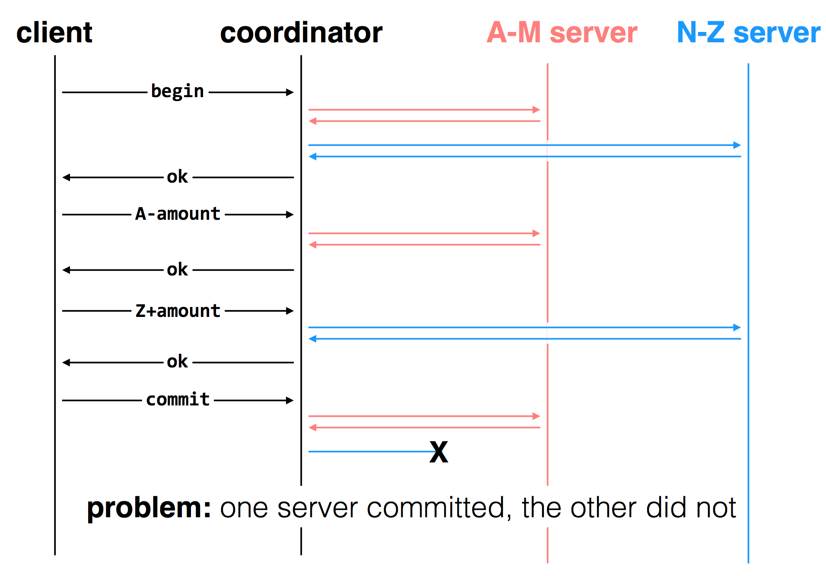

Slide 14
Two-phase Commit
Phase-1: preparation / voting
  Lower-layer transactions either abort or tentatively committed
  Higher-layer transaction evaluate lower situation
Phase-2: commitment
  If top-layer, then COMMIT or ABORT
  If nested itself, then become tentatively committed

Slide 15
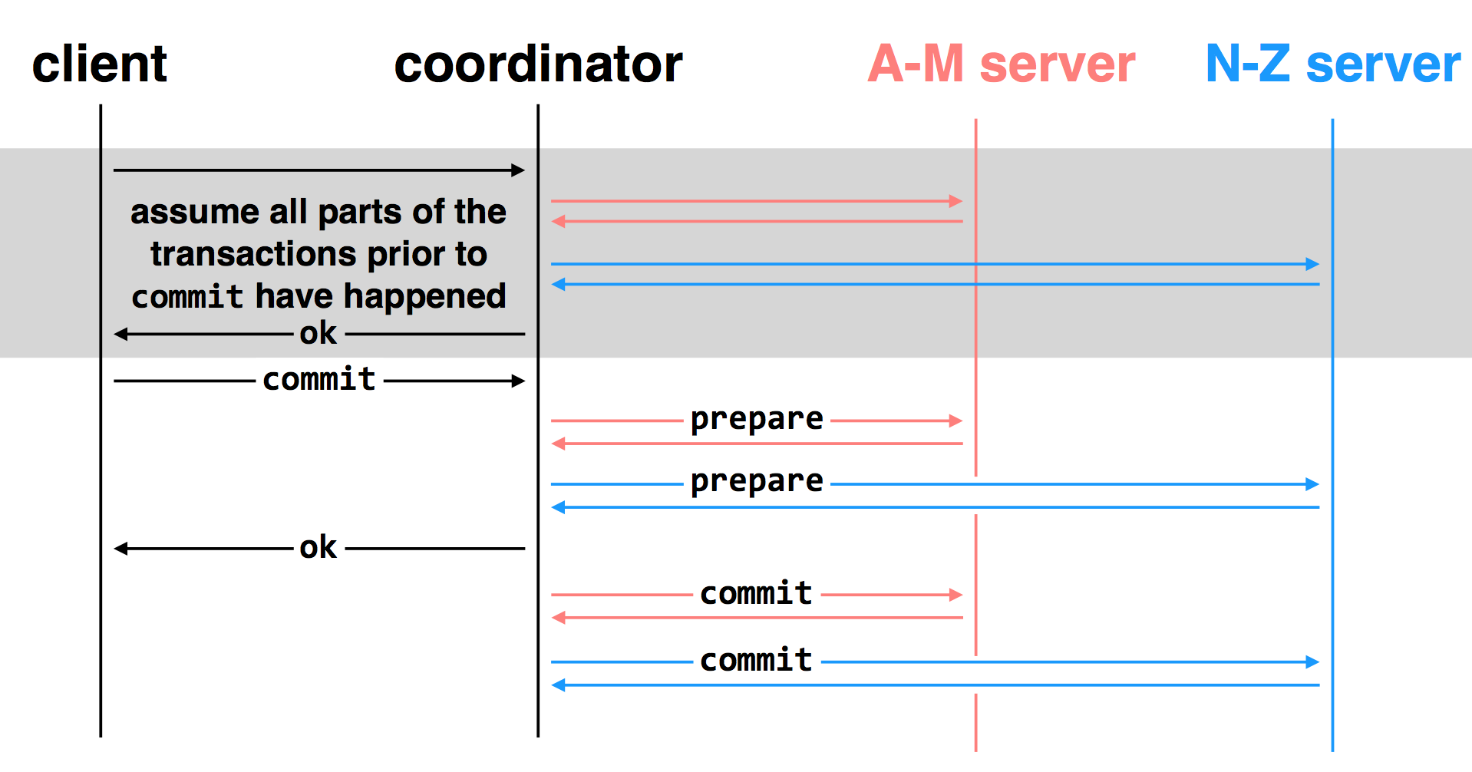
two-phase commit: nodes agree that they are ready to commit before committing

Slide 16
Multiple-site Atomicity
Worker: Bob, Charles, Dawn
  Does three transactions: X, Y, Z
Coordinator: Alice
  Create a higher-layer transaction
  Send three messages to the three workers
Challenge: un-reliable communication

Slide 17
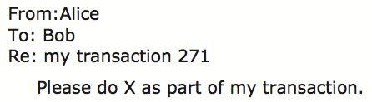
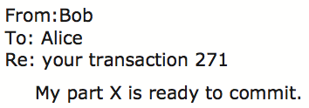
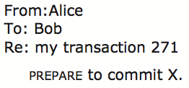
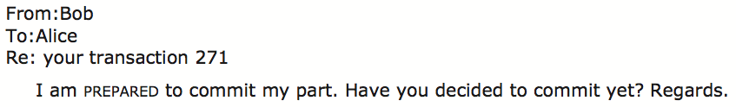
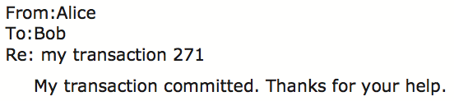
Commit Phase-1
Bob: tentative committed
State: PREPARED
Commit Phase-2
Bob: COMMITTED
Bob will perform post-commit

Slide 18
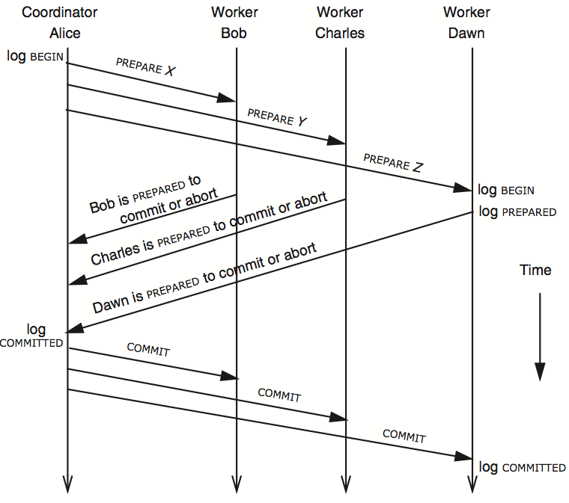
3N messages

Slide 19
Multiple-site Atomicity
Coordinator
  Collect some ABORT or nothing: ABORT or assign the work to another worker
  Collect all COMMIT: then COMMIT
Worker
  When receive nothing: resend PREPARED
  - Coordinator will send current state if it receives duplicate message
  When receive COMMIT: then COMMIT

Slide 20
client
coordinator
A-M server
N-Z server
assume all parts of the transactions prior to
commit have happened
OK
commit
prepare
prepare
OK
commit
commit
two-phase commit: nodes agree that they are ready to commit before committing

Slide 21
client
coordinator
A-M server
N-Z server
OK
commit
X
prepare
timeout; resend
prepare
prepare
OK
commit
commit
failure: lost prepare

Slide 22
client
coordinator
A-M server
N-Z server
OK
commit
prepare
X
timeout; resend
prepare
prepare
OK
failure: lost ACK for prepare

Slide 23

client
coordinator
A-M server
N-Z server
OK
commit
prepare
prepare
abort
abort
failure: worker failure during prepare
coordinator can safely abort transaction, will send explicit abort messages to live workers

Slide 24
client
coordinator
A-M server
N-Z server
OK
commit
prepare
prepare
OK
commit
X
Why? Just wait..
tx?
timeout; resend
commit
commit
failure: lost commit message

Slide 25
client
coordinator
A-M server
N-Z server
OK
commit
prepare
prepare
OK
commit
X
timeout; resend
commit
commit
failure: lost ACK of commit message

Slide 26

client
coordinator
A-M server
N-Z server
OK
commit
prepare
prepare
OK
commit
commit
failure: worker failure during commit
Notes:
workers write PREPARE records once prepared. the recovery process — reading through the log — will indicate which transactions are prepared but not committed

Slide 27
Worker Failure During Commit
If workers fail after the commit point
  We cannot ABORT the transaction
  Workers must be able to recover into a prepared state
  Workers write PREPARE records to log once prepared
The recovery process will:
  Read through the log, and
  Indicate which transactions are prepared but not committed
  Prepared workers must commit the transaction during recovery

Slide 28

client
coordinator
A-M server
N-Z server
OK
commit
prepare
prepare
OK
commit
commit
tx?
restart
commit
failure: worker failure during commit

Slide 29

client
coordinator
A-M server
N-Z server
OK
commit
prepare
coordinator recovers
abort
abort
failure: coordinator failure during prepare

Slide 30
client
coordinator
A-M server
N-Z server
OK
commit
prepare
prepare
OK
commit
coordinator recovers
commit
commit
failure: coordinator failure during commit

Slide 31
Summary of 2-phase Commit
Two-phase commit allows us to achieve multi-site atomicity: transaction remains atomic even when they require communication with multiple machines
In two-phase commit, failures prior to the commit point can be aborted. If workers (or the coordinator) fail after the commit point, they recover into the PREPARED state, and complete the transaction
Our remaining issue deals with availability and replication: we will replicate data across sites to improve availability, but must deal with keeping multiple copies of the data consistent

Slide 32
Replication Consistency
Consistency across multiple machines

Slide 33

Why Replication?
For performance
  Higher throughput: replicas can serve concurrently
  Lower latency: cache is also a form of replication
For fault tolerance
  Maintain availability even if some replicas fail

Slide 34
Review of the challenges of replication
Suppose a file (image) is replicated on three servers
Application
generate the web page
Application server
Local area network
File server
File server
File server
File:
image
File:
image
File:
image

Slide 35
Review of the challenges of replication
Suppose a file (image) is replicated on three servers
Application put file A to one server
Application
generate the web page
Application server
1
Local area network
File server
File server
File server
File:
image
File:
image
File:
image

Slide 36
Review of the challenges of replication
Suppose a file (image) is replicated on three servers
Application put file A to one server
The server crashed
Application
generate the web page
Application server
Local area network
2
File server
File server
File server
File:
image
File:
image
File:
image

Slide 37
Review of the challenges of replication
Suppose a file (image) is replicated on three servers
Application puts file A to one server
The server crashed
What happens when read A from a live server?
Application
generate the web page
Application server
Local area network
3
File server
File server
File:
image
File:
image

Slide 38
Replication Consistency
Optimistic Replication
  Tolerate inconsistency, and fix things up later
  Works well when out-of-sync replicas are acceptable
Pessimistic Replication
  Ensure strong consistency between replicas
  Needed when out-of-sync replicas can cause serious problems

Slide 39
Optimistic Replication

Slide 40
Consistency of Distributed Files
Resolving inconsistencies
  Suppose we have two computers: laptop and desktop
  File could have been modified on either system
How to figure out which one was updated?
  One approach: use timestamps to figure out which was updated recently
  Many file synchronization tools use this approach

Slide 41
Use of Time in Computer Systems
Time is used by many distributed systems
  E.g., cache expiration (DNS, HTTP), file synchronizers, Kerberos, ..
  Time intervals: how long did some operation take?
  Calendar time: what time/date did some event happen at?
  Ordering of events: in what order did some events happen?

Slide 42

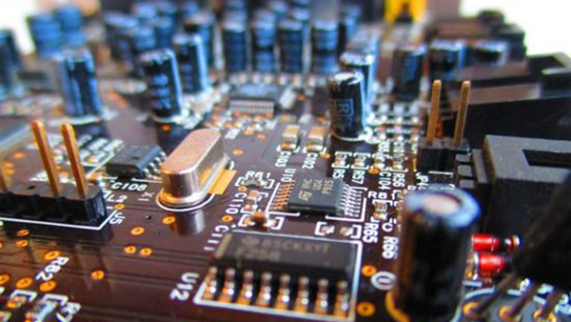
Time Measuring
Measuring time intervals
  Computer has a reasonably-fixed-frequency oscillator
  - E.g., quartz crystal
  Represent time interval as a count of oscillator's cycles
  - time period = count / frequency
  - e.g., with a 1MHz oscillator, 1000 cycles means 1msec

Slide 43
Time Measuring
Keeping track of calendar time
  Typically, calendar time is represented using a counter from some fixed epoch
  For example, Unix time is #seconds since midnight UTC at start of Jan 1, 1970
  Can convert this counter value into human-readable date/time, and vice-versa
  - Conversion requires two more inputs: time zone, data on leap seconds

Slide 44
Time Measuring
What happens when turn off the computer?
  "Real-Time Clock" (RTC) chip remains powered, with battery / capacitor
  Stores current calendar time, has an oscillator that increments periodically
Maintaining accurate time
  Accuracy: for calendar time, need to set the clock correctly at some point
  Precision: need to know oscillator frequency (drift due to age, temp, etc.)

Slide 45
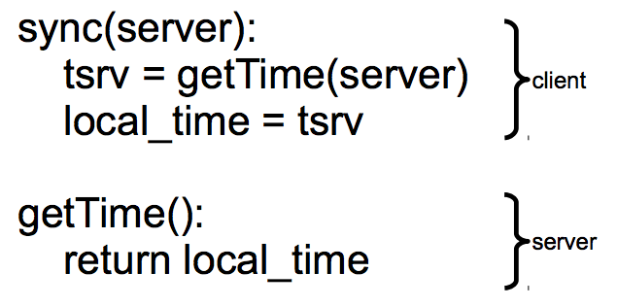
Clock Synchronizing
Synchronizing a clock over the internet: NTP
  Query server's time, adjust local time accordingly

Slide 46
Clock Synchronizing
Need to take into account network latency
  Simple estimate: RTT/2
  When does this fail to work well?
  - Asymmetric routes, with different latency in each direction
  - Queuing delay, unlikely to be symmetric even for symmetric routes
  - Busy server might take a long time to process client's request
  Can use repeated queries to average out (or estimate variance) for second two

Slide 47
Estimating Network Latency
sync(server):
t_begin = local_time
tsrv = getTime(server)
t_end = local_time
delay = (t_end-t_begin) / 2
offset = (t_end-delay) - tsrv
local_time = local_time - offset

Slide 48
Clock Synchronizing
What if a computer's clock is too fast
  E.g., 5 seconds ahead
  Naive plan: reset it to the correct time
  - Can break time intervals being measured (e.g., negative interval)
  - Can break ordering (e.g., older files were created in the future)
  "make" is particularly prone to these errors
Principle: time never goes backwards
  Idea: temporarily slow down or speed up the clock
  Typically cannot adjust oscillator (fixed hardware)
  Adjust oscillator frequency estimate, so counter advances faster / slower

Slide 49
Slew Time
sync(server):
t_begin = local_time
tsrv = getTime(server)
t_end = local_time
delay = (t_end-t_begin) / 2
offset = (t_end-delay) - tsrv
freq = base + ε * sign(offset)
sleep(freq * abs(offset) / ε)
freq = base
timer_intr(): # on every oscillator tick
local_time = local_time + 1/freq
temporarily speed up / slow down local clock

Slide 50
Improving Time Precision
If only adjust time once
  An inaccurate clock will lose accuracy
  Need to also improve precision, so no need to slew as often
Assumption: poor precision caused by poor estimate of oscillator frequency
  Can measure difference between local and remote clock "speeds" over time
  Adjust local frequency estimate based on that information
  In practice, may want more stable feedback loop (PLL): look at control theory

Slide 51
Case: File Reconciliation

Slide 52
File Reconciliation with Timestamps
Key Problem
  Determine which machine has the newer version of file
Straw-man
  Use the file with the highest mtime timestamp
  Works when only one side updates the file per reconciliation

Slide 53
File Reconciliation with Timestamps
Better plan
  Track last reconcile time on each machine
  Send file if changed since then, and update last reconcile time
  When receiving, check if local file also changed since last reconcile
New outcome
  Timestamps on two versions of a file could be concurrent
  Key issue with optimistic concurrency control: optimism was unwarranted
  Generally, try various heuristics to merge changes (text diff/merge, etc.)
  Worst case, ask the user (e.g., if edited same line of code in C file)

Slide 54
File Reconciliation with Timestamps
Goal: No Lost Updates
  V2 should overwrite V1 if V2 contains all updates that V1 contained
  Simple timestamps can not help us determine this

Slide 55
Vector Timestamps
Idea: vector timestamps
  Store a vector of timestamps from each machine
  Entry in vector keeps track of the last mtime
  V1 is newer than V2 if all of V1's timestamps are >= V2’s
  V1 is older than V2 if all of V1's timestamps are <= V2’s
  Otherwise, V1 and V2 were modified concurrently, so conflict
  If two vectors are concurrent, one computer modified file without seeing the latest version from another computer
  If vectors are ordered, everything is OK as before

Slide 56
Vector Timestamps
Cool property of version vectors:
  A node's timestamps are only compared to other timestamps from same node
  Time synchronization not necessary for reconciliation w/ vector timestamps
  Can use a monotonic counter on each machine
Does calendar time still matter?
  More compact than vector timestamps
  Can help synchronize two systems that do not share vector timestamps

Slide 57
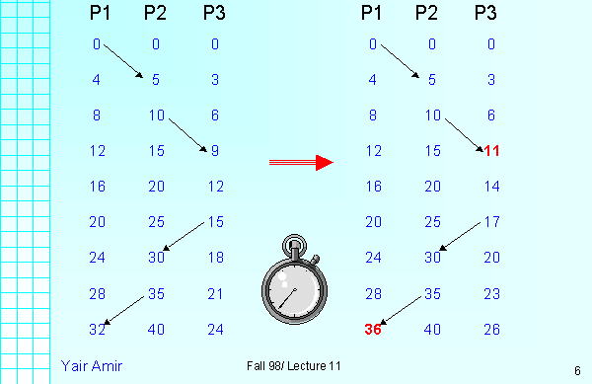
Sidebar: Lamport Logical Clock
Lamport clocks can guarantee that if a < b then C(a) < C(b).
However it can’t guarantee, that if C(a) < C(b) then event a happened before b.

Slide 58
Pessimistic replication
RSM & Paxos

Slide 59
Pessimistic Replication
Some applications may prefer not to tolerate inconsistency
  E.g., a replicated lock server, or replicated coordinator for 2PC
  E.g., better not give out the same lock twice
  E.g., better have a consistent decision about whether transaction commits
Trade-off between consistency and availability
  Stronger consistency with pessimistic replication means lower availability than what you might get with optimistic replication

Slide 60
Single-copy Consistency
Problem of optimistic way: replicas get out of sync
  One replica writes data, another does not see the changes
  This behavior was impossible with a single server
Ideal goal: single-copy consistency
  Property of the externally-visible behavior of a replicated system
  Operations appear to execute as if there's only a single copy of the data
  - Internally, there may be failures or disagreement, which we have to mask
  Similar to how we defined serializability goal ("as if executed serially")

Slide 61
Replicating a Server
Straw-man approach
  Clients send requests to both servers
  Tolerating faults: if one server is down, clients send to the other
Tricky case: what if there's a network partition?
  Each client thinks the other server is dead, keeps using its server
  Bad situation: not single-copy consistency!

Slide 62
Handling Network Partitions
Issue: Clients may disagree about what servers are up
  Hard to solve with 2 servers, but possible with 3 servers
Idea: require a majority servers to perform operation
  In case of 3 servers, 2 form a majority
  If client can contact 2 servers, it can perform operation (otherwise, wait)
  Thus, can handle any 1 server failure

Slide 63
Quorum
Define separate read &write quorums: Q_{r} & Q_{w}
  Q_{r} + Q_{w} > N_{replicas} (Why?)
  - Confirm a write after writing to at least Q_{w} of replicas
  - Read at least Q_{r} agree on the data or witness value
Example
  In favor of reading: N_{replicas} = 5, Q_{w} = 4, Q_{r} = 2
  In favor or updating: N_{replicas} = 5, Q_{w} = 2, Q_{r} = 4
  Enhance availability by Q_{w} = N_{replicas} & Q_{r} = 1

Slide 64
Quorum's Limitations
Provide no before-or-after or all-or-nothing
  If reading & writing requests come from a site
  - Easy…
  If reading from multiple sites, writing from one site
  - Need to maintain a version number at the writing site
  If writing from multiple sites
  - Need a protocol providing a distributed sequencer
Another complicating consideration
  Performance maximization

Slide 65
Handling Network Partitions
Why does the majority rule work?
  Any two majority sets of servers overlap
  Suppose two clients issue operations to a majority of servers
  Must have overlapped in at least one server, will help ensure single-copy
When is it OK to reply to client?
  Must wait for majority of replicas to reply
  Otherwise, if a minority crashes, remaining servers may continue without op

Slide 66
Handling Network Partitions
Problem: replicas can become inconsistent
  Issue: clients' requests to different servers can arrive in different order
  How do we ensure that the servers remain consistent?
  Paxos

Slide 67
Simple Implementation: Replicated Logs
Replicated Logs
  Log client operations, including both R/W, and numbered
Key issue: agreeing on the order of operations
  Coordinator handles one client operation at a time
  Coordinator chooses an order for all operations (assigns log sequence number)
  Coordinator issues the operation to each replica
  When is it OK to reply to client?
  - Must wait for majority of replicas to reply
  - Otherwise, if a minority crashes, remaining servers may continue without op

