Slide 1


RSM & PAXOS
Consistency across multiple machines
SE124 (2021 Fall)
IPADS, Shanghai Jiao Tong University
https://www.sjtu.edu.cn
Credits: Rong Chen@IPADS & John Ousterhout@Standford

Slide 2
Review: Two-phase Commit
Phase-1: preparation / voting
  Lower-layer transactions either aborts or tentatively committed
  Higher-layer transaction evaluate lower situation
Phase-2: commitment
  If top-layer, then COMMIT or ABORT
  If nested itself, then become tentatively committed

Slide 3
Review: Two-phase Commit
Two-phase commit allows us to achieve multi-site atomicity: transaction remains atomic even when they require communication with multiple machines
In two-phase commit, failures prior to the commit point can be aborted. If workers (or the coordinator) fail after the commit point, they recover into the PREPARED state, and complete the transaction
Our remaining issue deals with availability and replication: we will replicate data across sites to improve availability, but must deal with keeping multiple copies of the data consistent

Slide 4
Review: Why Replication?
For performance
  Higher throughput: replicas can serve concurrently
  Lower latency: cache is also a form of replication
For fault tolerance
  Maintain availability even if some replicas fail

Slide 5
Review: Replication Consistency
Optimistic Replication
  Tolerate inconsistency, and fix things up later
  Works well when out-of-sync replicas are acceptable
Pessimistic Replication
  Ensure strong consistency between replicas
  Needed when out-of-sync replicas can cause serious problems

Slide 6
Pessimistic replication

Slide 7
Pessimistic Replication
Some applications may prefer not to tolerate inconsistency
  E.g., a replicated lock server, or replicated coordinator for 2PC
  E.g., Better not give out the same lock twice
  E.g., Better have a consistent decision about whether transaction commits
Trade-off: stronger consistency with pessimistic replication means:
  Lower availability than what you might get with optimistic replication

Slide 8
Single-copy Consistency
Problem of optimistic way: replicas get out of sync
  One replica writes data, another doesn't see the changes
  This behavior was impossible with a single server
Ideal goal: single-copy consistency
  Property of the externally-visible behavior of a replicated system
  Operations appear to execute as if there's only a single copy of the data
    Internally, there may be failures or disagreement, which we have to mask
  Similar to how we defined serializability goal ("as if executed serially")

Slide 9
Replicating a Server
Straw-man
  Clients send requests to both servers
  Tolerating faults: if one server is down, clients send to the other
Tricky case: what if there's a network partition?
  Each client thinks the other server is dead, keeps using its server
  Bad situation: not single-copy consistency!

Slide 10
Handling Network Partitions
Issue: Clients may disagree about what servers are up
  Hard to solve with 2 servers, but possible with 3 servers
Idea: require a majority servers to perform operation
  In case of 3 servers, 2 form a majority
  If client can contact 2 servers, it can perform operation (otherwise, wait)
  Thus, can handle any 1-server failure

Slide 11
Quorum
Define separate read &write quorums: Q_{r} & Q_{w}
  Qr + Qw > Nreplicas (Why?)
    Confirm a write after writing to at least Qw of replicas
    Read at least Qr agree on the data or witness value
Example
  In favor of reading: N_{replicas} = 5, Q_{w} = 4, Q_{r} = 2
  In favor or updating: N_{replicas} = 5, Q_{w} = 2, Q_{r} = 4
  Enhance availability by Q_{w} = N_{replicas} & Q_{r} = 1

Slide 12
Quorum
Provide no before-or-after or all-or-nothing
  If reading & writing requests come from a site
    Easy…
  If reading from multiple sites, writing from one site
    Maintain a version number at that site
  If writing from multiple sites
    Protocol providing a distributed sequencer
Another complicating consideration
  Performance maximization

Slide 13
Majority in Distributed Systems
Why does the majority rule work?
  Any two majority sets of servers overlap
  Suppose two clients issue operations to a majority of servers
  Must have overlapped in at least one server, will help ensure single-copy
When is it OK to reply to client?
  Must wait for majority of replicas to reply
  Otherwise, if a minority crashes, remaining servers may continue without op

Slide 14
Inconsistency of Replicas
Problem: replicas can become inconsistent
  Issue: clients' requests to different servers can arrive in different order
  How do we ensure the servers remain consistent?

Slide 15
Replicated State Machines (RSM)

Slide 16
RSM: Replicated State Machines
A general approach to making consistent replicas of a server:
  Start with the same initial state on each server
  Provide each replica with the same input operations, in same order
  Ensure all operations are deterministic
    E.g., no randomness, no reading of current time, etc.
These rules ensure each server will end up in the same final state

Slide 17
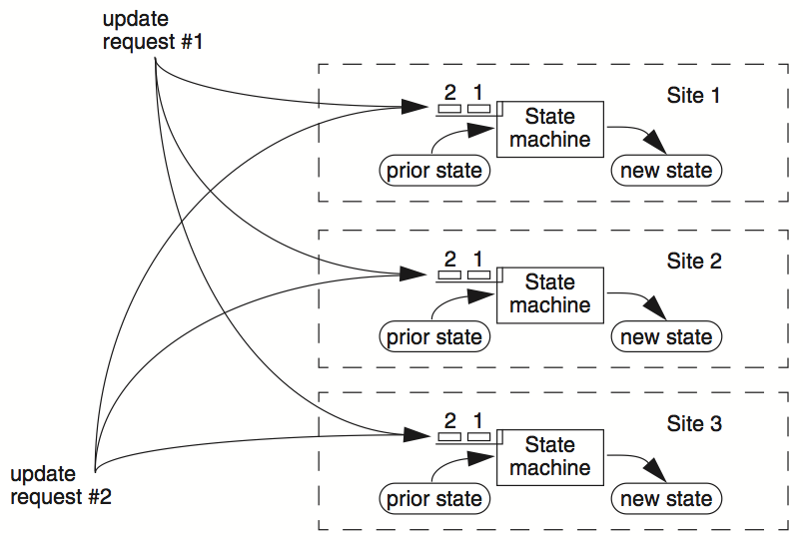
RSM

Slide 18
Clients
Servers
C₁
S₁
write₁(x)
C₂
S₂
write₂(x)
(replica of S₁)

Slide 19
Clients
Servers
C₁
S₁
write₁(x)
write₂(x)
C₂
S₂
write₁(x)
write₂(x)
(replica of S₁)
problem: How to ensure the order of operations?

Slide 20
RSM: Replicated State Machines
RSMs provide single-copy consistency
  Operations complete as if there is a single copy of the data
  Though internally there are replicas
RSMs use a primary-backup mechanism for replication
  Using view server to ensure only one replica acts as the primary
  It can also recruit new backups after servers fail

Slide 21
Primary/Backup Model
Primary does important stuff
  Ensures that it sends all updates to the backup before ACKing the coordinator
  Chooses an ordering for all operations, so that the primary and backup agree
  Decides all non-deterministic values (e.g., random(), time())

Slide 22
What if Primary Fails?
Idea 1: Coordinator knows about both primary and backup, and decides which to use
  Won't work: split brain syndrome
  Multiple coordinators come to independent, and different, conclusions about who is primary when there are network partitions
Idea 2: Have human decide when to switch from primary to backup
  Not unreasonable for small web services

Slide 23
Primary/Backup Model
(primary)
Clients
Coordinator
S₁
C
S₂
if primary fails, C knows about S₂, and switches
(backup)
attempt: coordinators communicate with primary
servers, who communicate with backup servers

Slide 24
Primary/Backup Model
(primary)
X
Clients
Coordinator
S₁
C
S₂
if primary fails, C knows about S₂, and switches
(backup)
attempt: coordinators communicate with primary
servers, who communicate with backup servers

Slide 25
Multiple Coordinators + the Network = Problems
X
Clients
Coordinator
S₁
C
S₂
if primary fails, C knows about S₂, and switches
(primary)
attempt: coordinators communicate with primary
servers, who communicate with backup servers

Slide 26
Multiple Coordinators + the Network = Problems
(primary)
C₁
S₁
network partition
C₂
S₂
(backup)
attempt: coordinators communicate with primary
servers, who communicate with backup servers

Slide 27
Multiple Coordinators + the Network = Problems
(primary)
C₁
S₁
network partition
C₂
S₂
(backup, but primary for C₂)
C₁ and C₂ are using different primaries;
S₁ and S₂ are no longer consistent

Slide 28
View Server
The view server keeps a table that maintains a sequence of "view"
  Each view contains the view number, the primary server, and the backup server
The view server alerts each server as to whether it's the primary or the backup
Upon receiving any updates, the primary will receive an ACK from the backup before responding to the view server (just as before)
Coordinators make requests to the view server asking who is primary
  Coordinators then contact the primary

Slide 29

View Server
(primary)
S₁
S₁
primary
C
primary?
VS
S₁
backup
1: S₁, S₂
S₂
(backup)
Use a view server, which determines which replica is the primary

Slide 30
View Server
To discover failures
  Replicas ping to the view server
  If view server misses N pings in a row, it deems a server to be dead
Basic failure (actual worker crash):
  1. Primary fails; pings cease
  2. View server lets S2 know it's primary, and it handles any client requests
    Before S2 knowing it's the primary, it will simply reject requests that come directly from coordinators
  3. View server will eventually recruit a new idle server to act as backup

Slide 31
Failure of Primary
(dead)
X
S₁
C
VS
lack of pings indicates to VS that S₁ is down
1: S₁, S₂
S₂
(backup)
Use a view server, which determines which replica is the primary

Slide 32
Failure of Primary
(dead)
X
S₁
C
primary?
VS
S₂
primary
1: S₁, S₂
2: S₂, --
S₂
S₂
(primary)
before S₂ knows it's primary, it will reject any requests from clients

Slide 33
Rules when Facing Network Partitions
Primary must wait for backup to accept each request
Non-primary must reject direct coordinator requests
  That's what happened in the earlier failure, in the interim between the failure and S2 hearing that it was primary
Primary must reject forwarded requests
  i.e., it won't accept an update from the backup
Primary in view i must have been primary or backup in view i-1

Slide 34
Network Partitions
Network Partition between VS and S₁
(primary)
S₁
lack of pings indicates to VS that S₁ is down
S₁
C
VS
1: S₁, S₂
S₂
(backup)

Slide 35
Network Partitions
Network Partition between VS and S₁
(primary)
S₁
S₁
VS makes S₂ primary
C
VS
primary
1: S₁, S₂
2: S₂, --
S₂
rejected by S₂
(backup)
it's okay! S2 will act as backup
(accept updates from S1, reject coordinator's requests)
problem: what happens before S₂ knows it's the primary?

Slide 36
Network Partitions
Network Partition between VS and S₁
rejected by S₁
(Cannot get ACK from S₂)
(primary)
S₁
S₁
C
VS
1: S₁, S₂
2: S₂, --
S₂
(primary)
also okay! S1 won't be able to act as primary
(can't accept client requests because it won't get ACKs from S2)
problem: what happens after S2 knows it's the primary,
but S1 also thinks it is?

Slide 37
Consider S₁ being Partitioned from the VS
Before S2 hears about View #2:
  S1 can process operations from coordinators, S2 will accept forwarded requests
  S2 will reject operations from coordinators who have heard about view #2
After S2 hears about View #2:
  If S1 receives coordinator requests, it will forward. S2 will reject (not ACK), so S1 can no longer act as primary
  S1 will send error to coordinator, coordinator will ask VS for new view, learn about view #2, and coordinator will re-send to S2
The commit point of switch-over:
  When S2 hears about View #2

Slide 38
What if view server fails?
(primary)
S₁
S₁
C
X
VS
1: S₁, S₂
S₂
(backup)
problem: what if view server fails?
We need Paxos

Slide 39
Paxos
Distributed consensus mechanism

Slide 40

Leslie Lamport
http://ipads.se.sjtu.edu.cn/courses/cse-g/2012f/Schedule_files/paxos-simple.pdf

Slide 41
Paxos' properties: correct + fault-tolerance
    No guaranteed termination (i.e., lack of availability guarantee)
Goal: have all acceptors agree to a value V associated with a proposal
Proposer
Proposer
Proposer
E.g., a view
Acceptor
Client
Network
Acceptor
Acceptor
leader
Learner
Learner
quorum
Learner
Paxos: one machine may serve several roles

Slide 42
Paxos Players
Client
makes a request
Proposer
Get a request and run the protocol
Leader = elected Coordinator
Acceptor
Remember the state of the protocol
Quorum = any majority of Acceptors
Learner
When agreement has been reached,
a Learner executes the request and/or sends a response back to the Client

Slide 43
General Approach
One proposer decides to be the leader
Leader proposes a value and solicits acceptance from acceptors (majority)
Leader announces result or try again
What if >1 proposers become leaders simultaneously?
What if there is a network partition?
What if a leader crashes in the middle of solicitation?
What if a leader crashes after deciding but before announcing results?
. . .

Slide 44
Political Science 101
Paxos has rounds; each round has a unique ID (N)
Rounds are asynchronous
  Time synchronization not required
  If you are in round j and hear a message from round j+1, abort everything and move over to round j+1
  Use timeouts; may be pessimistic
Each round itself broken into phases
  Phases are also asynchronous

Slide 45
Paxos in Action: Phase 0
Client sends a request to a proposer
Proposer
request
Acceptor
Client
Network
Acceptor
Acceptor
quorum
Learner

Slide 46
Paxos in Action: Phase 1a (Prepare)
Leader creates a proposal N and send to quorum
N is greater than any previous
proposal number seen by this proposer
Leader
proposal N
Acceptor
Client
Network
Acceptor
Acceptor
quorum
Learner

Slide 47
Paxos in Action: Phase 1b (Prepare)
Acceptor: if proposal ID > any previous proposal
reply with the highest past proposal number and value
promise to ignore all IDs < N
else ignore (proposal is rejected)
Leader
promise N
Acceptor
Client
Network
Acceptor
Acceptor
quorum
Learner

Slide 48
Paxos in Action: Phase 2a (Accept)
Leader: if receive enough promise
set a value V to the proposal V can be
decided value or new value
send accept request to quorum with
the chosen value V
Leader
accept request(N, V)
Acceptor
Client
Network
Acceptor
Acceptor
quorum
Learner
Ignore all proposals < N

Slide 49
Paxos in Action: Phase 2b (Accept)
Acceptor: if the promise still holds
register the value V
send accepted message to Proposer/Learners
else ignore the message
Leader
accepted
Acceptor
Client
Network
Acceptor
Acceptor
accepted
quorum
Learner
Learner
Ignore all proposals < N

Slide 50
Paxos in Action: Phase 3 (Learn)
Learner: responds to Client and/or take action on the request
Leader
Acceptor
Client
Network
Acceptor
Acceptor
quorum
Learner
Learner
Ignore all proposals < N

Slide 51
Paxos Setup
Client
Client
Paxos Node
Paxos Node
Paxos Node
Proposer
Proposer
Proposer
Acceptor
Acceptor
Acceptor
. . .
Learner
Learner
Learner
N_{a}: highest proposal number accepted
V_{a}: accepted value of N_{a}
N_{h}: highest proposal number seen
M_{n}: my proposal number
each round of Paxos, each Node

Slide 52
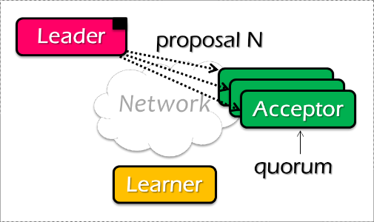
Paxos Pseudo-code
N_{a}: highest proposal number accepted
V_{a}: accepted value of N_{a}
N_{h}: highest proposal number seen
M_{n}: my proposal number
A node decides to be Leader
Leader chooses M_{n} > N_{h}
Leader sends <proposal, M_{n} > to all nodes
Acceptor receives <proposal, N>
if N < N_{h}
reply <promise-reject>
else
N_{h} = N
reply <promise-ok, N_{a}, V_{a}>
Ignore all proposals < N_{h}

Slide 53

Paxos Pseudo-code
N_{a}: highest proposal number accepted
V_{a}: accepted value of N_{a}
N_{h}: highest proposal number seen
M_{n}: my proposal number
If Leader gets promise-ok from a majority
If Leader fails to get majority promise-ok
Upon receiving <accept, N, V>
if V != null, V = the value of the highest N_{a} received
if V = null, then Leader can pick any V
send <accept, M_{n}, V> to all nodes
delay and restart Paxos
if N < N_{h}
reply <accept-reject>
else
N_{a} = N; V_{a} = V; N_{h} = N;
reply <accept-ok>

Slide 54
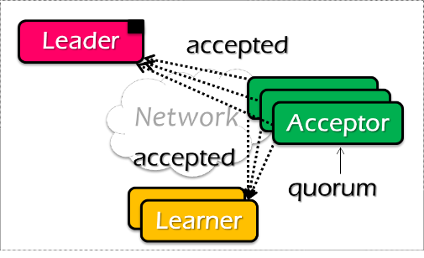
Paxos Pseudo-code
N_{a}: highest proposal number accepted
V_{a}: accepted value of N_{a}
N_{h}: highest proposal number seen
M_{n}: my proposal number
If Leader gets accept-ok from a majority
If Leader fails to get majority accept-ok
send <decide, V_{a}> to all nodes
delay and restart Paxos

Slide 55
Paxos Pseudo-code
N_{a}: highest proposal number accepted
V_{a}: accepted value of N_{a}
N_{h}: highest proposal number seen
M_{n}: my proposal number
N_{a} = V_{a} = null
N_{h} = N0:0
N_{a} = V_{a} = null
N_{h} = N1:0
N_{a} = V_{a} = null
N_{h} = N2:0
M_{n} = N1:1
<proposal, N1:1>
<proposal, N1:1>
N_{h} = N1:1
N_{a} = null
V_{h} = null
N_{h} = N1:1
N_{a} = null
V_{h} = null
<promise, null, null>
<promise, null, null>
<accept, N1:1, V1>
<accept, N1:1, V1>
N_{h} = N1:1
N_{a} = N1:1
V_{h} = V1
N_{h} = N1:1
N_{a} = N1:1
V_{h} = V1
<accept-ok>
<accept-ok>
<decide, V1>
<decide, V1>
Time

Slide 56
Inside of Paxos
N_{a}: highest proposal number accepted
V_{a}: accepted value of N_{a}
N_{h}: highest proposal number seen
M_{n}: my proposal number
Why setups multiple acceptors?
    Failure of the single acceptor halts decision
Why not accepts the first proposal and rejects the rest?
    Multiple leaders result in no majority accepting
    Leader dies
What if more than one leader is active?
    Can both leaders see a majority of promises?

Slide 57
Inside of Paxos
N_{a}: highest proposal number accepted
V_{a}: accepted value of N_{a}
N_{h}: highest proposal number seen
M_{n}: my proposal number
When is the value V chosen?
    Leader receives a majority <promise, …>
    A majority acceptors receive <accept, N, V>
    Leader receives a majority <accepted, …>
What if acceptor fails after sending promise?
    Must remember N_{h}
What if acceptor fails after receiving accept?
    Must remember N_{h} and N_{a} V_{a}
What if leader fails while sending accept?
    Propose M_{n} again
Notes:
When is the value V chosen?
- As long as majority send <accepted>, even if the leader has not received that much.

Slide 58
Question
N_{a}: highest proposal number accepted
V_{a}: accepted value of N_{a}
N_{h}: highest proposal number seen
M_{n}: my proposal number
Suppose that the acceptors are A, B, and C. A and B are also proposers. How does Paxos ensure that the following sequence of events can't happen? What actually happens, and which value is ultimately chosen?
A sends <prepare, 1> requests with proposal number 1, and gets responses from A, B, and C
A sends <accept,1, "foo"> to A and C and gets responses from both. Because a majority accepted, A thinks that "foo" has been chosen. However, A crashes before sending an <accept, 1, "foo"> to B
B sends <prepare, 2> messages with proposal number 2, and gets responses from B and C
B sends <accept, 2, "bar"> messages to B and C and gets responses from both, so B thinks that "bar" has been chosen

Slide 59

Question
N_{a}: highest proposal number accepted
V_{a}: accepted value of N_{a}
N_{h}: highest proposal number seen
M_{n}: my proposal number
A
C
M_{n} = 1
<proposal, 1>
<promise, …>
B
<accept, 1, foo>
M_{n} = 2
<proposal, 2>
<promise, …>
<accept, 2, bar>
Time

Slide 60
Question
N_{a}: highest proposal number accepted
V_{a}: accepted value of N_{a}
N_{h}: highest proposal number seen
M_{n}: my proposal number
A
C
M_{n} = 1
<proposal, 1>
<promise, …>
B
<accept, 1, foo>
M_{n} = 2
<proposal, 2>
<promise, 1, foo>
<accept, 2, foo>
Time

Slide 61
What Could Go Wrong?
Process fails
  Majority does not include it
  When process restarts, it uses log to retrieve a past decision (if any) and past-seen ballot ids. Tries to know of past decisions
Leader fails
  Start another round
Messages dropped
  If too flaky, just start another round
Protocol may never end – tough luck!
  Impossibility result not violated
  If things go well sometime in the future, consensus reached

Slide 62
Paxos Summary
Paxos allows us to ensure consistent (total) ordering over a set of events in a group of nodes
    Events = commands / actions / state updates
Each machine will have the latest state or
a previous version of the state

Slide 63
Paxos Summary
To make a change to the system
    Tell the proposer(leader) the event
    (NOTE: these requests may occur concurrently)
    The leader picks its next highest ID and asks proposal to all the acceptors with that ID
    When the majority of acceptors accept the proposal, accepted event are sent to learners
    The learners do event (e.g., update system state)

Slide 64
Paxos for RSM
Fault-tolerant RSM requires consistent replica view
    View: <primary, backups> (e.g., <node1, node2>)
All active nodes must agree on the sequence of view changes
    <vid-1, primary, backups>, . . .
Use Paxos to agree on the <primary, backups>
    Each Paxos instance agree to a single view
    (e.g., <2, Node1, Node2>)
  Paxos itself can also be used to implement RSM
    E.g., agree on the state
    Usually inefficient: e.g., two RTTs to agree on a value

Slide 65
Raft
Distributed consensus mechanism
(with better understandability)

Slide 66


The raft algorithm
Consensus overview
  Allows collection of machines to work as coherent group
    E.g., agree on who is the primary & who is the backup
Paxos has dominated discussion for 25 years
  Hard to understand
  Not complete enough for real implementations (e.g., only agree on a single value)
New consensus algorithm: Raft
  Primary design goal: understandability (intuition, ease of explanation)
  Widespread adoption

Slide 67
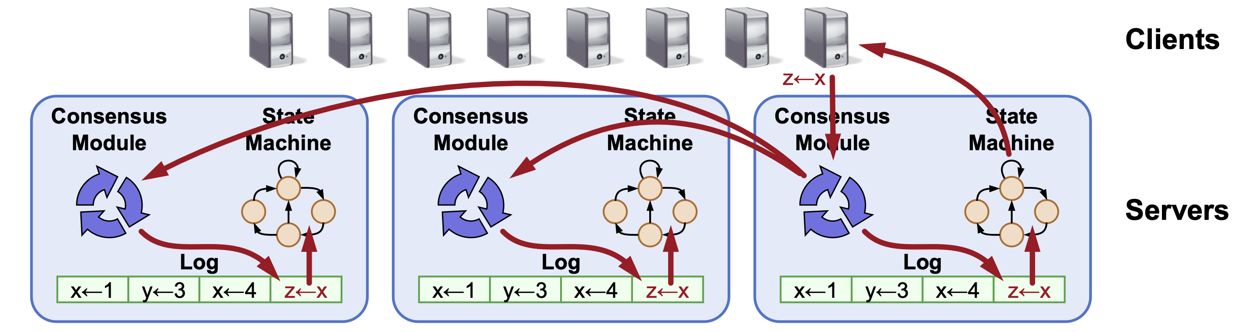
Log: the key abstraction of Raft for RSM
All Raft servers agree on the same replicated (operation) log
  Raft ensures proper log replication
Techniques for understandability
  Problem decomposition

Slide 68
Raft Decomposition
Leader election
  Select one server to act as leader
  Detect crashes, choose new leader
Log replication(normal operation)
  (Only) Leader accepts commands from clients, appends to its log
  Leader replicates its log to other servers (overwrites inconsistencies)
Safety
  Keep logs consistent
  Only servers with up-to-date logs can become leader

Slide 69
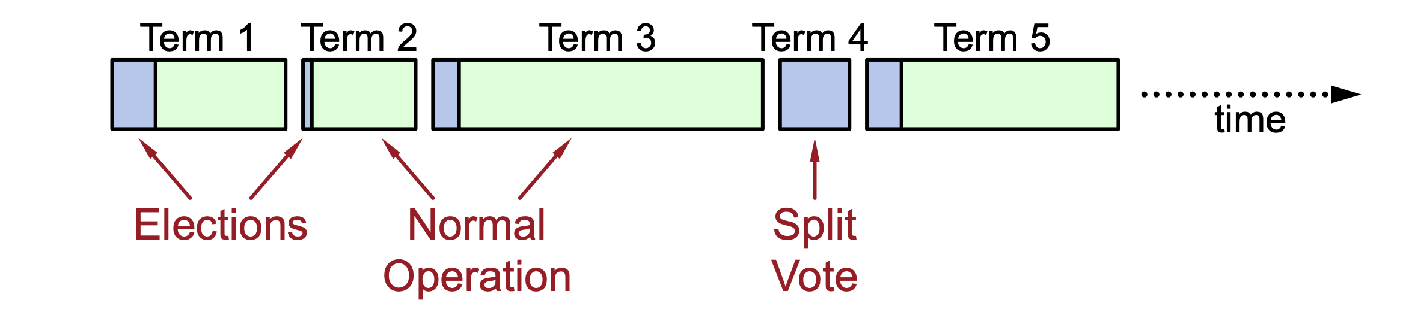
Raft decomposes time into terms
At most 1 leader per term
Some terms have no leader (failed election)
  OK, since no side-effects
Each server maintains current term value (no global view)
  Exchanged in every RPC
  Peer has later term? Update term, revert to follower
  Incoming RPC has obsolete term? Reply with error
Please check the lab#3 for more!

