Slide 1


Database management system and Data model
SE124 (2021 Fall)
IPADS, Shanghai Jiao Tong University
https://www.sjtu.edu.cn
Credits: Andy Pavlo@CMU

Slide 2
Paxos' properties: correct + fault-tolerance
    No guaranteed termination (i.e., lack of availability guarantee)
Goal: have all acceptors agree to a value V associated with a proposal
Proposer
Proposer
Proposer
E.g., a view
Acceptor
Client
Network
Acceptor
Acceptor
leader
Learner
Learner
quorum
Learner
Paxos: one machine may serve several roles

Slide 3
Inside of Paxos
N_{a}: highest proposal number accepted
V_{a}: accepted value of N_{a}
N_{h}: highest proposal number seen
M_{n}: my proposal number
When is the value V chosen?
    Leader receives a majority <promise, …>
    A majority acceptors receive <accept, N, V>
    Leader receives a majority <accepted, …>
What if acceptor fails after sending promise?
    Must remember N_{h}
What if acceptor fails after receiving accept?
    Must remember N_{h} and N_{a} V_{a}
What if leader fails while sending accept?
    Propose M_{n} again
Notes:
When is the value V chosen?
- As long as majority send <accepted>, even if the leader has not received that much.

Slide 4

Question
N_{a}: highest proposal number accepted
V_{a}: accepted value of N_{a}
N_{h}: highest proposal number seen
M_{n}: my proposal number
A
C
M_{n} = 1
<proposal, 1>
<promise, …>
B
<accept, 1, foo>
M_{n} = 2
<proposal, 2>
<promise, …>
<accept, 2, bar>
Time

Slide 5
Question
N_{a}: highest proposal number accepted
V_{a}: accepted value of N_{a}
N_{h}: highest proposal number seen
M_{n}: my proposal number
A
C
M_{n} = 1
<proposal, 1>
<promise, …>
B
<accept, 1, foo>
M_{n} = 2
<proposal, 2>
<promise, 1, foo>
<accept, 2, foo>
Time

Slide 6
Raft
Distributed consensus mechanism
(with better understandability)

Slide 7


The raft algorithm
Consensus overview
  Allows collection of machines to work as coherent group
    E.g., agree on who is the primary & who is the backup
Paxos has dominated discussion for 25 years
  Hard to understand
  Not complete enough for real implementations (e.g., only agree on a single value)
New consensus algorithm: Raft
  Primary design goal: understandability (intuition, ease of explanation)
  Widespread adoption

Slide 8
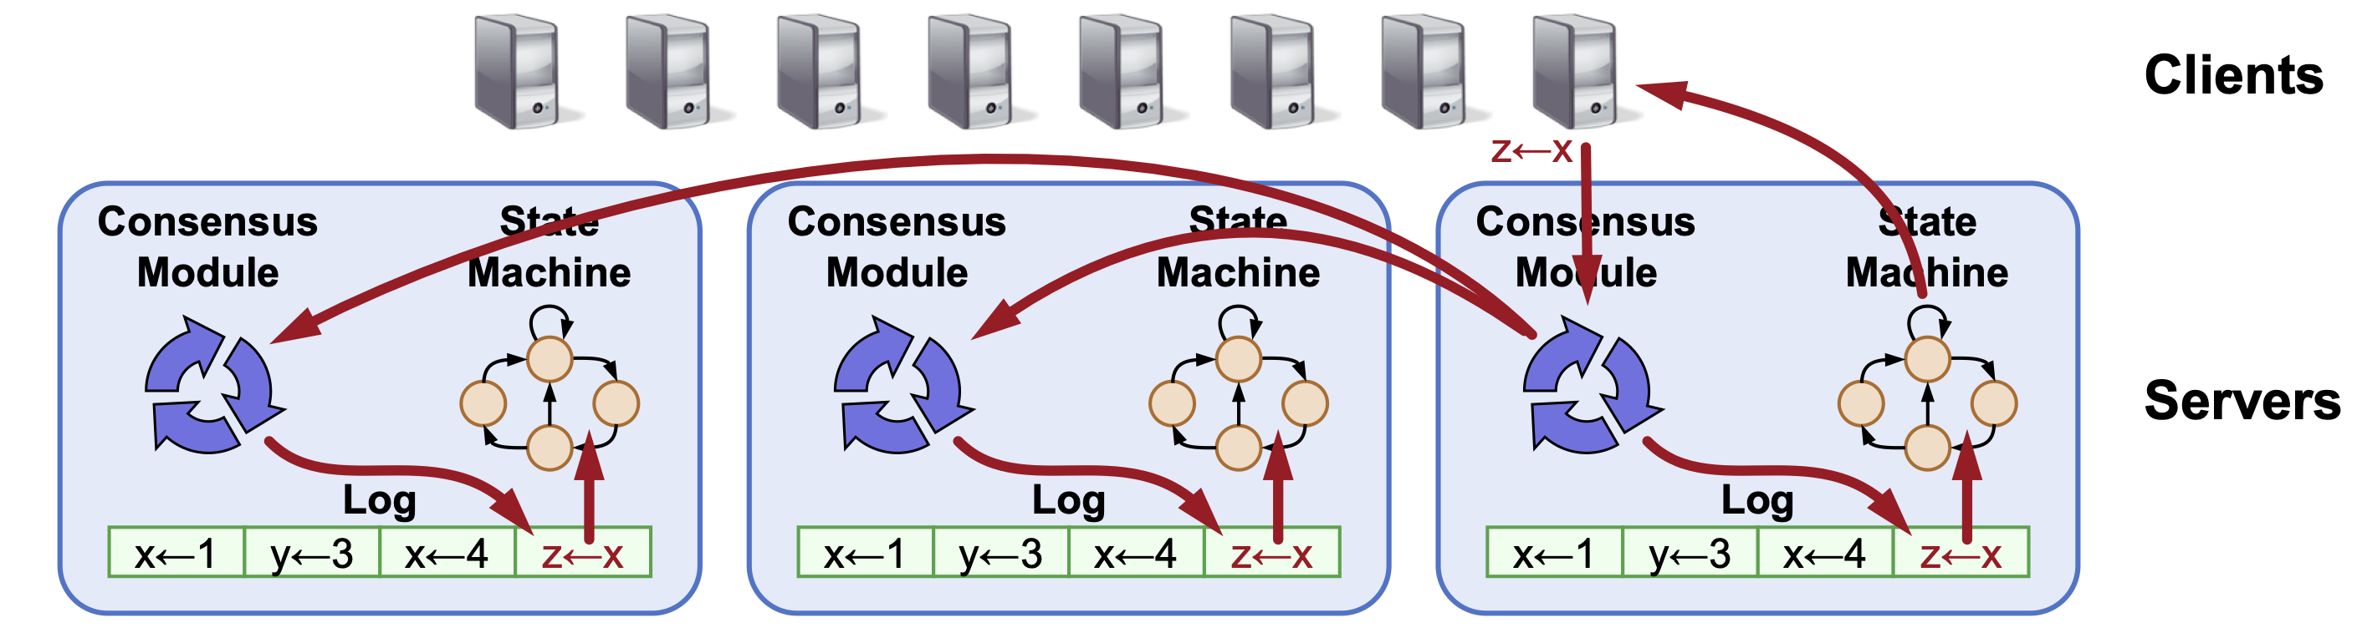
Log: the key abstraction of Raft for RSM
All Raft servers agree on the same replicated (operation) log
  Raft ensures proper log replication
Techniques for understandability
  Problem decomposition

Slide 9
Raft Decomposition
Leader election
  Select one server to act as leader
  Detect crashes, choose new leader
Log replication(normal operation)
  (Only) Leader accepts commands from clients, appends to its log
  Leader replicates its log to other servers (overwrites inconsistencies)
Safety
  Keep logs consistent
  Only servers with up-to-date logs can become leader

Slide 10
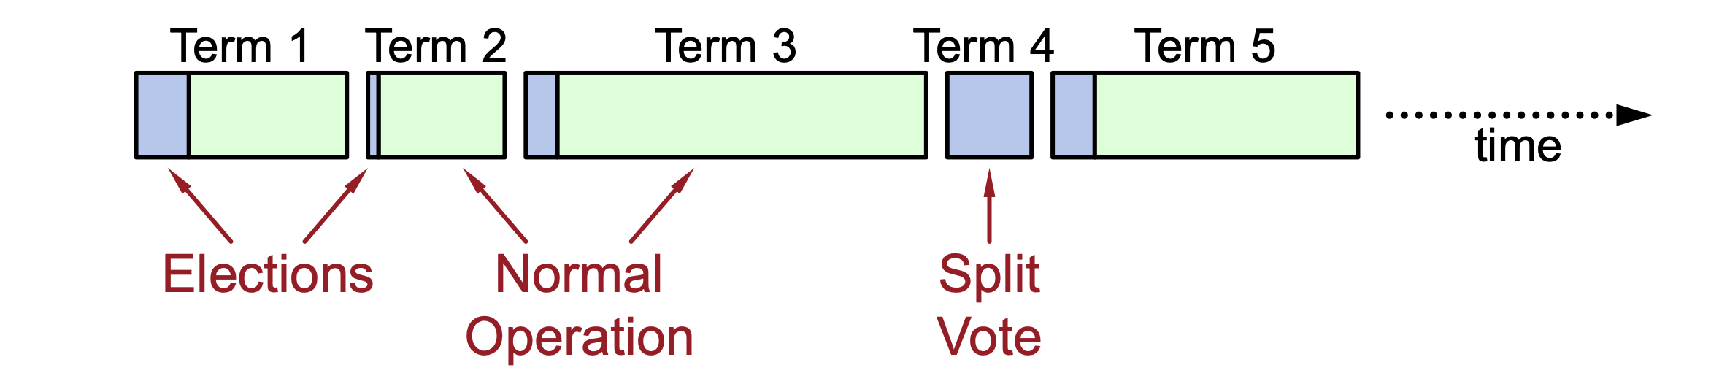
Raft decomposes time into terms
At most 1 leader per term
Some terms have no leader (failed election)
  OK, since no side-effects
Each server maintains current term value (no global view)
  Exchanged in every RPC
  Peer has later term? Update term, revert to follower
  Incoming RPC has obsolete term? Reply with error
Please check the lab#3 for more!

Slide 11
Review: scalable websites
Scalable websites powered by distributed systems
  For request handling, data storage
Caching server
Caching server
Caching server
…
Caching
Caching
Caching
Distributed caching
Database server
Database server
CDN
Users
Application #1
generate the page
Database
user, price
…
Database
user, price
Application server
Distributed database
Internet
Load
Balance
Application #2
add the order
File server
File server
File server
File:
image
File:
image
…
File:
image
Application server
…
…
Message queue
Distributed file system

Slide 12






Database: core component in many database systems
Web applications, e-commerce systems, etc
Database stores and manage the user data
  Organized collection of inter-related data that models some aspect of the real-world

Slide 13
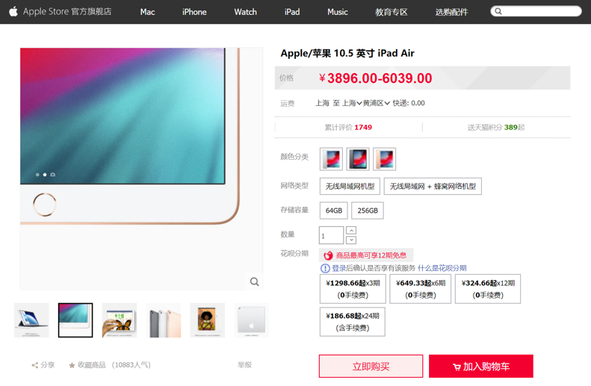
Different storage systems to support different data
Database
File system
Key-value store

Slide 14
Why we need a database?
Why key-value store & file system are not sufficient?

Slide 15








Example: modeling real-world data
Suppose we want to support a simple shopping website
What entities shall we store?
  Information of items
  Information of providers
  etc.
We should also store the relationship between the above entities
  E.g., which provider an item belongs to

Slide 16
Naïve database: using flat file
Store our database as comma-separated value (CSV)
  Use a separate file per entity
  How to find the item named “ipad pro”?
    The application must parse the files each time they want to read/update records
provider (name, country)
items (name, provider, year)
“apple”, USA
“ipad pro 12.9”, “apple”, 2021
“huawei”, China
“iphone 13”, “apple”, 2021
…
…
Does using key-value storage help?
Notes:
Yes. ipad pro can be a key, its value is "apple", 2021

Slide 17
Naïve database: using flat file
Store our database as comma-separated value (CSV)
  Use a separate file per entity
  Another example: how to find the items released in 2021?
    Does key-value storage help?
provider (name, country)
items (name, provider, year)
“apple”, USA
“ipad pro 12.9”, “apple”, 2021
“huawei”, China
“iphone 13”, “apple”, 2021
…
…
Notes:
depends. for most kv, no. need extra work.

Slide 18
More questions of using flat file: data integrity
How do we ensure that the providers in items are valid?
  E.g., Are Apple Inc. and apple Inc. the same provider?
What if somebody set the album year with an invalid string?
  E.g., 2049
What if there are multiple providers for an Item?
  Apple X Intel
What happens if we delete a provider?
  All its related items should also be deleted
Does using key-value storage help?
Notes:
no. users have to implement by themselves.

Slide 19
More: data management efficiency
How to find a particular record efficiently?
  E.g., the item named “ipad pro 12.9”?
Easy: use key-value storage

Slide 20
More: data management efficiency
How to find a particular record efficiently?
  E.g., the item named “ipad pro 12.9”?
  E.g., find the items released in 2021?
Easy: use key-value storage

Slide 21
More: data management efficiency
How to find a particular record efficiently?
  E.g., the item named “ipad pro 12.9”?
  E.g., find the items released in 2021?
Similarly, how to find the joined results of different records?
  E.g., finding all the items released by Apple?
Easy: use key-value storage

Slide 22
More: data availability
What if the machine crashes while our program is updating a record?
  Failure is common especially in large-scale datacenter
What if we want to replicate the database on multiple machines for high availability?
  Consistency problem, one replica gets updated while others are not

Slide 23

More: data availability
What if we want to replicate the database on multiple machines for high availability?
  Consistency problem, one replica gets updated while others are not
  Update the albums on the first machine
File server
File server
File server
Application
Network
File:
album
File:
album
File:
album
1

Slide 24
More: data availability
What if we want to replicate the database on multiple machines for high availability?
  Consistency problem, one replica gets updated while others are not
  Update the albums on the first machine
  The first machine crashes
File server
File server
File server
Application
Network
File:
album
File:
album
File:
album
2

Slide 25
More: data availability
What if we want to replicate the database on multiple machines for high availability?
  Consistency problem, one replica gets updated while others are not
  Update the albums on the first machine
  The first machine crashes
  What if we query the third machine?
File server
File server
File server
Application
How we cope with the consistency issue under replication?
(Recall from previous lectures)
Network
File:
album
File:
album
File:
album
3

Slide 26

More: we want transactions!
Transactions provides nice properties (ACID)
A：Atomicity
C：Consistency
I：Isolation
D：Durability

Slide 27
How to use transaction before? Explicit handling
The program btw { tx.begin() & tx.commit() } has the following properties:
A：Atomicity
C：Consistency
I：Isolation
D：Durability
...
tx.begin();
...
tx.read();
...
tx.commit();
...
ACID
Application program

Slide 28
In principle, we can address all of these using taught techniques
That’s early database management systems

Slide 29
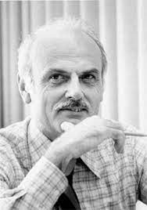
Early database management system
Database applications were difficult to build and maintain
  Tight coupling between logical and physical layers
  Users need to know many details of data layout before using the data
“You have to (roughly) know what queries your app would execute before you deployed the database.”
Edgar F. Codd
Notes:
Who invented the relational model

Slide 30
Database management system (DBMS)
A DBMS is software that allows applications to store & analyze information in a database
A general-purpose DBMS is designed to allow the definition, creation, querying, update, and administration of databases
Application developer does not need to consider the above questions
  The database helps resolving these issues
  Developers only need to write the program using the DBMS data model & query language

Slide 31
In this course, we will only touch several keys
A general-purpose DBMS is designed to allow the definition, creation, querying, update, and administration of databases
  E.g., this lecture will focus on data definition & querying language
  Next lecture will talk more about database specific designs

Slide 32
Decouple the DBMS from the application
Database defines a specific data model
  E.g., relational model
Application stores the data in the database’s specific data model
  And interact with the database with its query language (e.g., SQL)

Slide 33
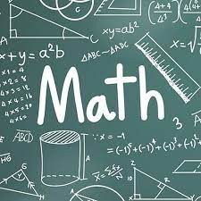
The goal: declarative data query language
On the programmer view:
  Only tells the DBMS what the data looks like
    E.g., list all the items released in 2021
  Not how to implement it
    E.g., parse the file, check if the record’s year matches 2021
What are the benefits?
  Decouple the applications from the implementation of DBMS
    As long as DBMSs provide the same data query languages
How to define a formal way to describe what the data looks like?

Slide 34
Data models & query language

Slide 35
Data models & query language

Slide 36
Data models of DBMS
Data model: collection of concepts for describing the data in a database
Schema: a description of a particular collection of data, using a given data model
Example data model:
  Relational
  Key-value
  Graph
  Document
  ...
Though some models are more nature in specific workloads
  E.g., the graph data model is more natural for graph workloads
More expressiveness
aka. Polyglot

Slide 37
Use tables and rows to represent relation
Concepts:
  Relation(table): an unordered set that contain the relationship of attributes that represent entities
  Tuple(row): a set of attribute values in the relation
Item (name, provider, year)
Name | Provider | Year
ipad pro | Apple | 2021
iphone | Apple | 2021
N-ary Relation
=
Table with N columns
Notes:
Declarative query lanaguage for relational databases. It was originally developed in the 1970s as part of the IBM System R project. IBM originally called it “SEQUEL” (Structured English Query Language). The name changed in the 1980s to just “SQL” (Structured Query Language).

Slide 38
Use tables and rows to represent relation
Concepts:
  Relation(table): an unordered set that contain the relationship of attributes that represent entities
  Tuple(row): a set of attribute values in the relation
Tuple
  Values are (normally) atomic/scalar
  Values belong to some domain (e.g., int)
  A special value NULL for every domain
Item (name, provider, year)
Name | Provider | Year
ipad pro | Apple | 2021
iphone | Apple | 2021
Notes:
Exception: json. Some DB allows to store a json as its attribute

Slide 39
The relational model
CREATE TABLE Item
(
Provider string NOT NULL ,
Year int NOT NULL,
...,
)
Tuple(row)
  Values are (normally) atomic/scalar
  Values belong to some domain (e.g., int)
  A special value NULL for every domain
Why specifying a domain?
  Recall the data integrity problem of key-value: how to cope with insertions like:
(ipad pro, Apple, 2049) ?
Item (name, provider, year)
Name | Provider | Year
ipad pro | Apple | 2021
iphone | Apple | 2021
Notes:
CREATE TABLE Item (Name VARCHAR(255) NOT NULL, Provider VARCHAR(255) NOT NULL, Year int NOT NULL )
INSERT INTO Item ( Name, Provider,Year )
VALUES
( "ipad pro", "apple", 2049 );
CREATE TABLE Item (Name VARCHAR(255) NOT NULL, Provider VARCHAR(255) NOT NULL, Year int NOT NULL
CONSTRAINT Year_Ck CHECK (Year BETWEEN 1940 AND 2021)
)

Slide 40
The relational model vs. key-value
Why specifying a domain?
  Recall the data integrity problem of key-value: how to cope with insertions like:
(ipad pro, Apple, 2049) ?
Suppose we are using a key-value store
  Key -> “ipad pro”, value -> {provider: “Apple”,”Year : 2049 }
inserted_value = ...; // something from user
if inserted_value.year > 2021:
report an error
kv_item.insert(key,inserted_value);
That is the implementation
Notes:
CREATE TABLE Item (Name VARCHAR(255) NOT NULL, Provider VARCHAR(255) NOT NULL, Year int NOT NULL )
INSERT INTO Item ( Name, Provider,Year )
VALUES
( "ipad pro", "apple", 2049 );
CREATE TABLE Item (Name VARCHAR(255) NOT NULL, Provider VARCHAR(255) NOT NULL, Year int NOT NULL
CONSTRAINT Year_Ck CHECK (Year BETWEEN 1940 AND 2021)
)

Slide 41
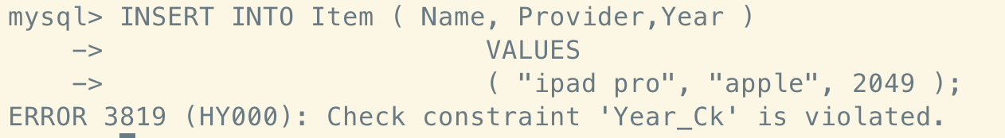
The relational model vs. key-value
Why specifying a domain?
  Recall: data integrity problem of key-value: how to cope with insertions like:
(ipad pro, Apple, 2049) ?
Relational model allows you to set a constraint
  Specific the domain of a value
  What if you insert a wrong value?
CREATE TABLE Item
(
Provider string NOT NULL ,
Year int NOT NULL,
...,
CONSTRAINT Year_Ck CHECK (Year BETWEEN 1940 AND 2021)
)
That is the declaration

Slide 42
Modeling relationship between data
E.g., "an item belongs to a provider"
  Should check that the provider in an item is a valid provider!
Does key-value store provide these checks?
  No. Application developers should implement this by themselves
inserted_value = ...; // something from user
if kv_provider.get(inserted_value) == NULL:
report an error
kv_item.insert(key,inserted_value);
This is the implementation

Slide 43
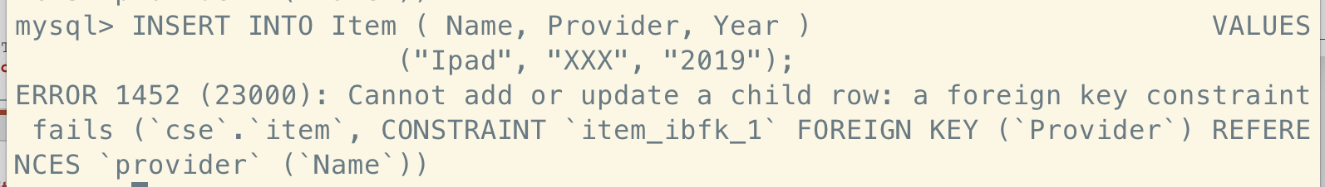
Modeling relationship with relational model
E.g., an item belongs to a provider
Relational model adds a concept of foreign key
Item (name, provider, year)
Provider (name, country)
Name | Provider | Year
ipad pro | Apple | 2021
iphone | Apple | 2021
Name | Country
Apple | USA
Huawei | China
CREATE TABLE Item
(
Provider string NOT NULL ,...,
FOREIGN KEY (Provider) REFERENCES Provider(Name)
)
This is the declaration
Notes:
CREATE TABLE Provider (Name VARCHAR(255) NOT NULL, Country VARCHAR(255) NOT NULL );
CREATE TABLE Item (Name VARCHAR(255) NOT NULL, Provider VARCHAR(255) NOT NULL, Year int NOT NULL
CONSTRAINT Year_Ck CHECK (Year BETWEEN 1940 AND 2021),
FOREIGN KEY (Provider)
REFERENCES Provider(Name)
)
INSERT INTO Item ( Name, Provider, Year )
VALUES
("Ipad", "XXX", "2019")

Slide 44
Modeling relationship with relational model
Relational model can do more!
What if we delete a provider?
  E.g., a company decides to switch a platform for selling
    Should delete all its items!

Slide 45
Modeling relationship with relational model
Relational model can do more!
What if we delete a provider?
  E.g., a company decides to switch a platform for selling
    Should delete all its items!
How do we implement this functionality in key-value?
for k,v in kv_item:
if v.provider == “Apple”:
kv_item.delete(k)
That is the implementation

Slide 46
Modeling relationship with relational model
Relational model can do more!
What if we delete a provider?
  E.g., a company decides to switch a platform for selling
    Should delete all its items!
How do we implement this functionality in relational model?
CREATE TABLE Item
(
Provider string NOT NULL ,...,
FOREIGN KEY (Provider) REFERENCES Provider(Name)
ON DELETE CASCADE
)
That is the declaration

Slide 47

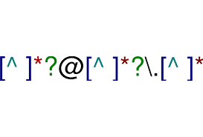


Relational model vs. key-value model
Declarative vs. procedural
  Which one is better?
Declarative
  You say what you want without having to say how to do it
  Example:
Procedural
  You have to specify exact steps to get the result
  Example:
Notes:
Procedure: c, c++
Declarative; SQL, regular expression

Slide 48
The relational model is a superset of key-value
Recall: key-value model
  Get(key) -> value
How can we model this query with relational model?
  Primary key! An attribute that uniquely identifies the tuple in a table
CREATE TABLE Item
(
Provider string NOT NULL ,...,
FOREIGN KEY (Provider) REFERENCES Provider(Name)
PRIMARY KEY (Name),
ON DELETE CASCADE
)
Item (name, provider, year)
Name | Provider | Year
ipad pro | Apple | 2021
iphone | Apple | 2021
Primary key
Value

Slide 49
Data models & query language

Slide 50
Declare the data developer want with relational algebra
How to describe the data the developer want?
  Using natural language?
  No. Natural language is not precise
Must be more formal!

Slide 51
Relational algebra
Query in relational model is based on relational algebra
Fundamental operations to retrieve and manipulate tuples in a relation
  Based on set algebra
Each operator takes one or more relations as its inputs and outputs a new relation
  We can "chain" operators together to create more complex operations
σ
Select
∪
Union
-
Difference
⋈
Join
Π
Projection
∩
Intersection
x
Product
More powerful than key-value

Slide 52
Example #1: Using SQL to query the data
Example #1: find the item released in 2021
  How to query the data with the key-value store model ?
  What about data query efficiency?
    Solution: use an index (e.g., hashtable)
Add an index offline
kv_item_year
for k,v in kv_item:
kv_item_year[v.year].append(k)
result = []
for k,v in kv_item:
if v.year == 2021:
result.append(v)
print(result)
result = []
for k in kv_item_year[2021]:
result.append(kv_item[k])
print(result)
Opt.

Slide 53
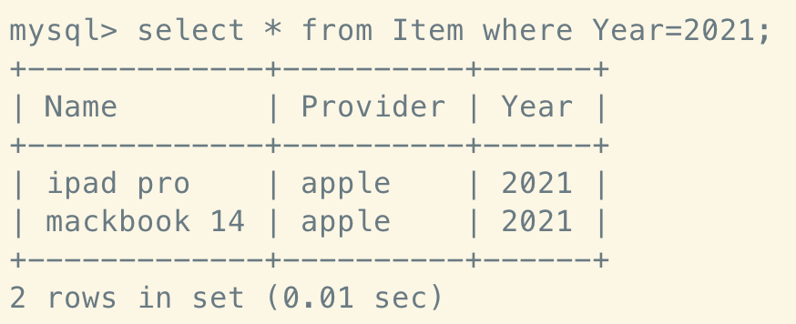
Example #1: Using SQL to query the data
Abstraction: select
  Choose a subset of the tuples from a relation that satisfies a selection predicate
  Can combine multiple predicates using conjunctions / disjunctions
Syntax: σ_{predicates}(R)
  E.g., σ_{year=2021}(items)
Example #1: find the item released in 2021
select * from Item where Year=2021;
predicate

Slide 54
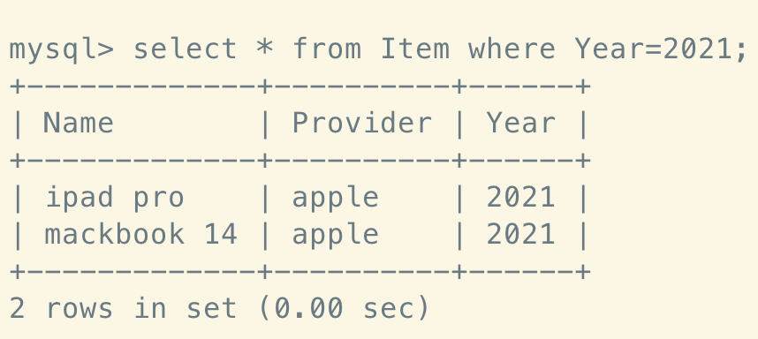
Example #1: Using SQL to query the data
Abstraction: select
  Choose a subset of the tuples from a relation that satisfies a selection predicate
  Can combine multiple predicates using conjunctions / disjunctions
Syntax: σ_{predicates}(R)
  E.g., σ_{year=2021}(items)
Example #1: find the item released in 2021
  How about adding an index?
select * from Item where Year=2021;
CREATE INDEX item_year_index ON Item(Year);

Slide 55
Example #2: Using SQL to query the data
Example #2: returns the item and its provider’s country
  How to query the data with the key-value store model ?
result = []
for k,v in kv_item:
  provider = Provider.get(v.provider)
  result.append(v + provider.country)
print(result)
This is the implementation

Slide 56
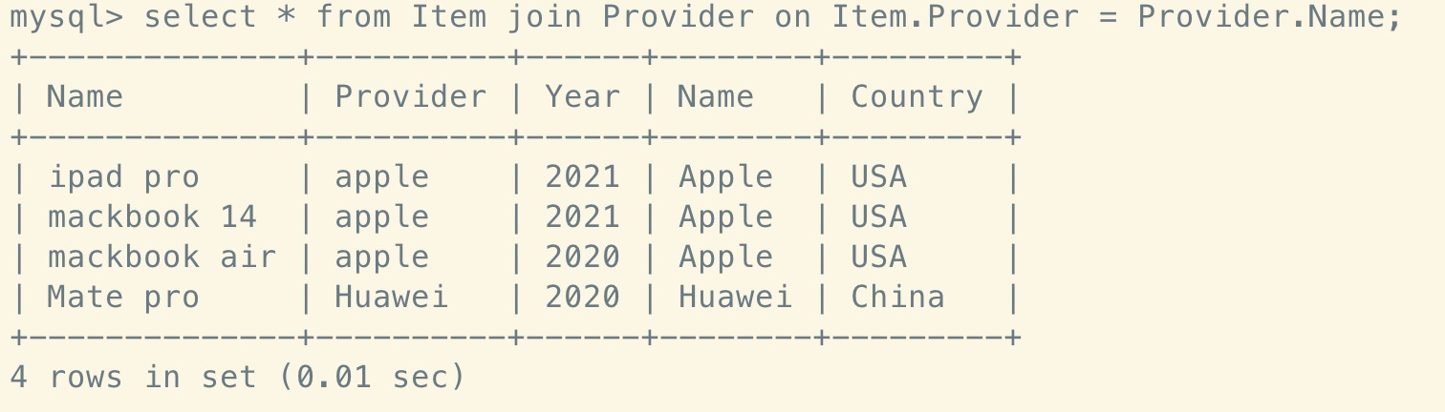
Example #2: Using SQL to query the data
Name | Provider | Year
ipad pro | Apple | 2021
iphone | Apple | 2021
... | ... | ...
Abstraction: join (Syntax: R ⋈ S)
  Generate a relation that contains all tuples that are a combination of two tuples (one from each input relation) with a common value(s) for one or more attributes
Example #2: returns the item and its provider’s country
Name | Country
Apple | USA
Huawei | China
select * from Item join Provider on Item.Provider = Provider.Name;
Notes:
R,S是两张表

Slide 57
Example #3: Using SQL to query the data
How about more complex queries?
  Return the item released in 2021 and its provider’s country
  σ_{Year=2021}(Item⋈Provider)
How to implement this query using key-value model?
⋈
select * from Item join Provider on Item.Provider = Provider.Name
where Year = 2021;
σ_{predicates}(R)
An example of chaining different op together

Slide 58
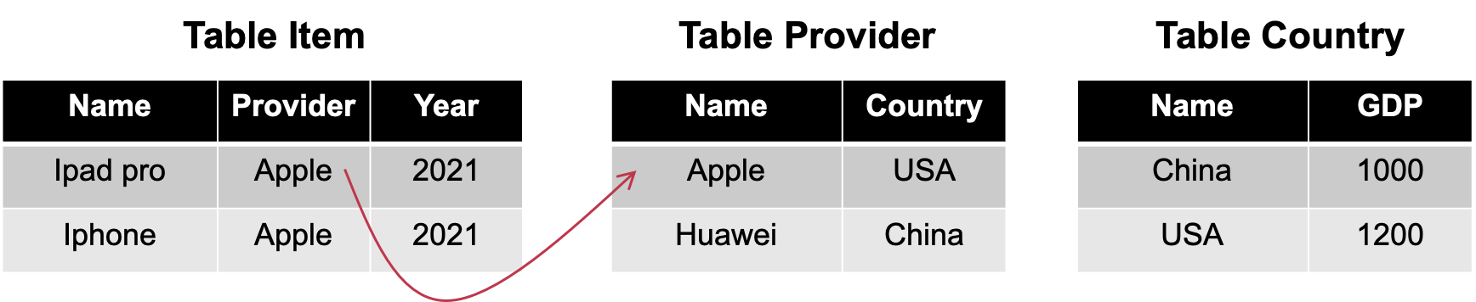
Example #3: Using SQL to query the data
How to implement this in key-value?
How about more complex data query?
  Suppose we have a new table named country
  E.g., return the item released in 2021 and its provider’s country, and the country’s corresponding GDP
    In SQL, we can trivially query the data using joins
select * from Item
join Provider on Item.Provider = Provider.Name
join Country on Provider.Country = Country.Name
where Year = 2021;

Slide 59
The query language of relational model can do more
More operators
  E.g., aggregators
    AVG(col) -> returns the average of a column
    MIN(col) -> returns the minimum col value
    MAX(col) -> returns the maximum col value
    SUM(col) -> returns the sum of values for a column
    COUNT(col) -> returns the number of values for a column
Nested queries
  Example:
select * from (...);
select * from ...
Notes:
这些operator key-value都可以实现， 但是需要开发人员的心智， 同时很难以统一的方式在不同应用间迁移

Slide 60
SQL contains three components
Data Manipulation Language (DML)
  E.g., query language based on relational algebra + aggregators and more!
Data Definition Language (DDL)
  E.g., how to create a table
Data Control Language (DCL)
  E.g., whether a user has access permissions on a specific table
select * from Item where Year=2021;
CREATE TABLE Item ( Provider string NOT NULL , Year int NOT NULL, ...,)
This course does not intend to teach the languages of SQL.
But is why it is designed this way.

Slide 61
Relational model & transaction
Similarity: both can support ACID
Difference:
  Without SQL, users have to explicitly write the transaction operations
  With SQL, users only need to specific the start & end of a transaction
...
tx.begin();
...
tx.read();
...
tx.commit();
...
START TRANSACTION
select * from ...;
... // other SQL
COMMIT;
...
Transaction w/o SQL
Transaction w/ SQL

Slide 62
Relational model & SQL
CREATE TABLE Item
(
Provider string NOT NULL ,...,
FOREIGN KEY (Provider) REFERENCES Provider(Name)
)
Relational model is a theoretical proposal
  Proposed by Edgar Codd in 1970
What we have presented is actually SQL
SQL is the best-known data model today, which is based on relational model
  SQL tables <-> relations
  SQL rows <-> tuples
Hence, RDBMS (relational database management system) & SQL had become the choice for many years
  And they scale well in a lot of application scenarios
SQL

Slide 63
Relational model & SQL
Note that SQL is an implementation of relational model
  Yet, the relational model is independent of any query language implementation
  SQL is the de facto standard (many dialects)

Slide 64
Implementing relational model, actually is non-trivial
Relational model only defines how data is represented in concept
Relational algebra only defines what is the output of a query language
Example
  σ_{b_id=102}(R⋈S) vs. (R⋈(σ_{b_id=102}(S))
  The implementation decides the query execution order
    E.g., the role of a query planner (will be introduced in later lectures)
Will the results the same? Which one is faster?

Slide 65
Short summary of relational model
Goal: hide the implementation detail of data behind a clean interface
  Yet, the interface is expressive enough
Relational model
  Data model is based on set
  Data query language is based on set algebra

Slide 66
Many proposals tries to compete with relational
For example
  Network model
  Hierarchical model
  XML databases
  Etc.
Most of them never last long

Slide 67
Data models & query language
Table schema design of relational model
Notes:
怎么设计表之间的关系

Slide 68
How to design the tables for an application?
Non-trivial even for only one entity!

Slide 69

Example: a simple application with one entity
Consider to store the user profile of a website
  The user is the only entity

Slide 70
Example: a simple application with one entity
Consider to store the user profile of a website
  The user is the only entity
ID | Name | Area
0 | Bill Gates | greater seattle area
…
…

Slide 71
Example: a simple application with one entity
Many-to-one problem
  Suppose two users live in greater seattle area
  Later the area changes to the greatest seattle area, what will happen?
ID | Name | Area
0 | Bill Gates | greater seattle area
…
We need to change all the rows containing this area!
ID | Name | Area
1 | Xingda Wei | greater seattle area

Slide 72
A better approach to many-to-one problem
Add a table that stores all the areas
Using a foreign key to enforce the relationship (like a pointer)
Table user
ID | Name | Area
0 | Bill Gates | us:91
Table area
ID | Area
us:91 | greater seattle area

Slide 73
Many-to-one: A matter of duplication, and normalizing
Store the string instead of ID is actually a matter of duplication
  The same value has appeared in many entities
  E.g., the “greater seattle area” appeared in all the people who lived there
Drawbacks of duplication:
  Consistent style and spelling
  Ambiguity (e.g., several cities with the same name)
  Hard for updating. Suppose the city has changed its name
Normalizing: remove the duplicated entities in various entities
  Useful for many-to-one relationship
  How to normalize is a big topic (out of the scope of this lecture)

Slide 74
Another problem: representing one-to-many
E.g., a user may have many education background
  Received master at SJTU
  Received ph.d at MIT
  Etc.
However, the attribute of relational model (usually) fixed
  E.g., can store only one entry
How to represent one-to-many relationship?

Slide 75
One-to-many relationship with relational model
Solution: using another table
  And constraint the relationship with foreign key!
Table: user
ID | Name | Area
0 | Bill Gates | us:91
Table: education
ID | User-ID | School
807 | 0 | Harvard
806 | 0 | Lakeside school

Slide 76
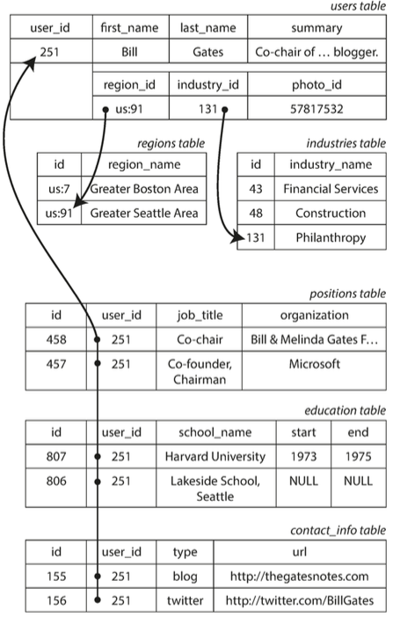
Put all together
Using SQL typically requires many relations!
  Non-trivial to design such schemas

Slide 77
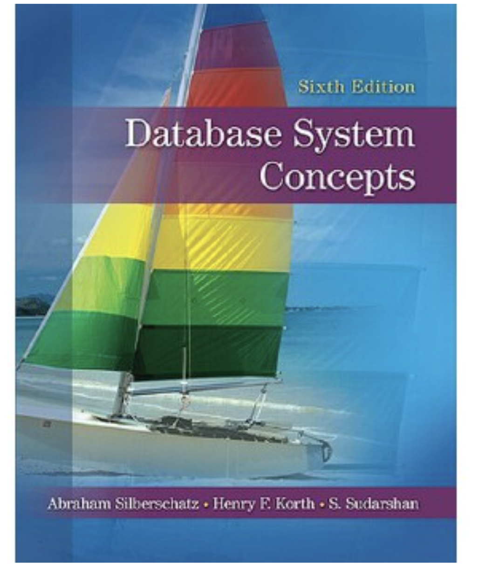
In summary, design database tables is non-trivial
Usually designed by professional database designers
  I.e., DBA (Database administrator)
Out of the scope of this course
For more about principles & guidelines to schema designs and normalization, please check the following content
  E.g., Chapter 7 & 8 of <<Database System Concepts>>
  Or just search “E-R diagram”, “normal form database”

Slide 78
Put all together
Using SQL typically requires many relations!
  Non-trivial to design such schemas
Question: how can we add an attribute?
Need to change all the rows!

Slide 79
Document Model

Slide 80
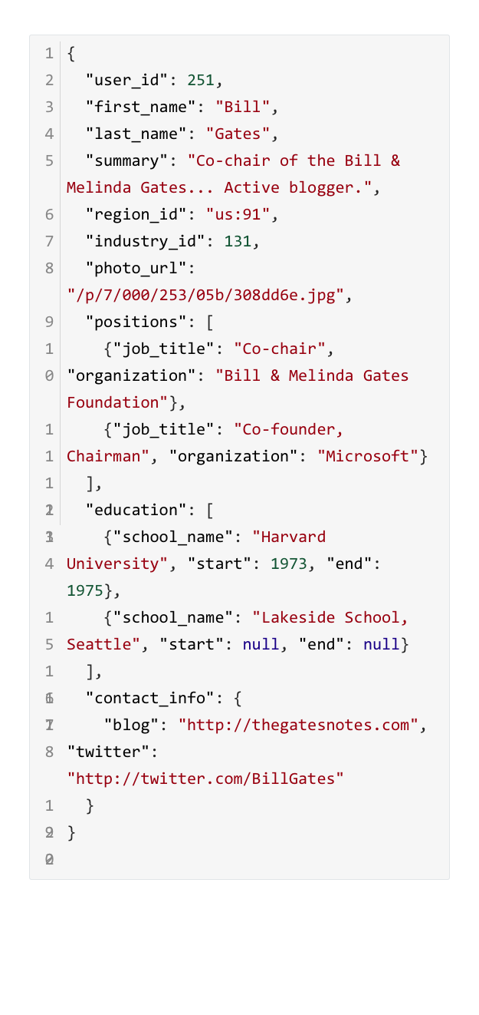
An alternative: using document model
Extend Key-value model, except that the value is structured, e.g., JSON
  In Key/Value, the value is opaque
Example: using JSON to represent the resume
Benefits:
  Better locality (for better performance)
  Easy to model the one-to-many relationship
  Schema flexibility
    Can add an attribute on-demand

Slide 81
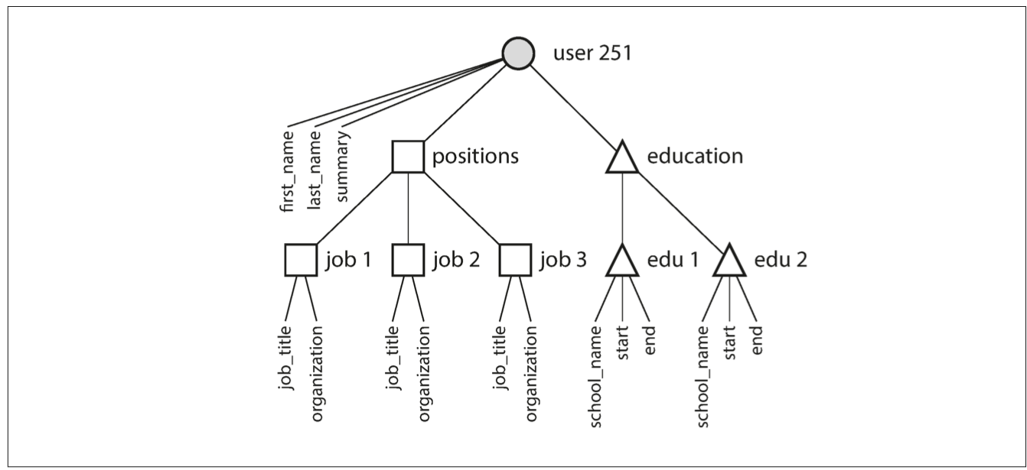
Document model can model one-to-many relationships
E.g., a person has many education experiences
  Forms a tree structure, JSON can trivially model this architecture

Slide 82
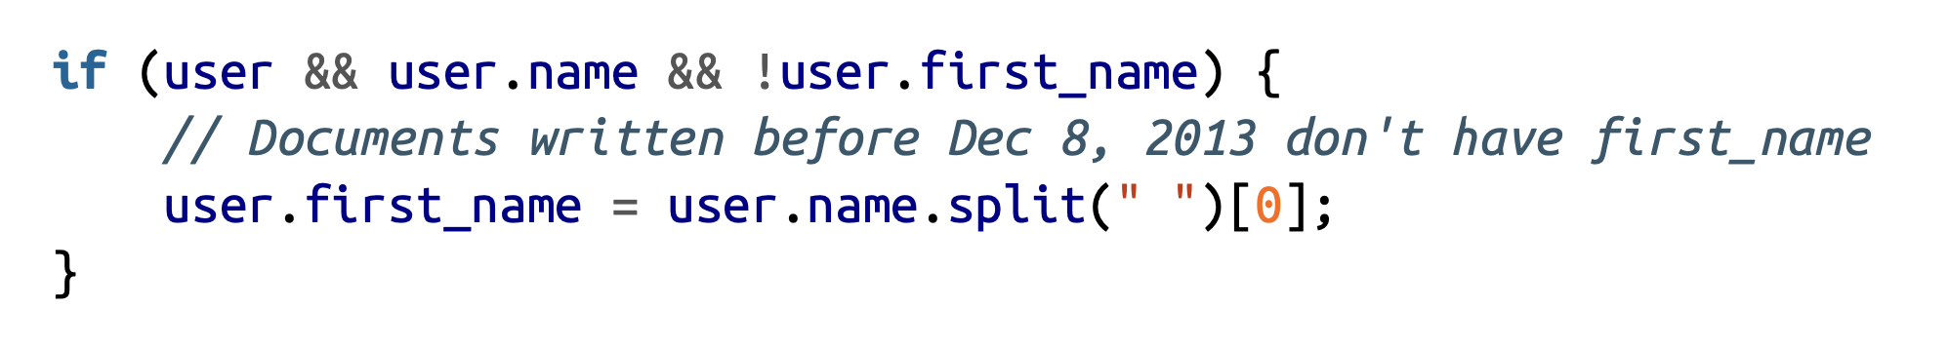
Document model has better schema flexibility
Users can simply change schema on the fly
  Unlike relational model, whose schema is fixed
Example: change the name in resume with a first name
Document model:
  Assume each document is stored in JSON

Slide 83

Document model has better schema flexibility
Users can simply change schema on the fly
  Unlike relational model, whose schema is fixed
Example: change the name in resume with a first name
Relational model:
  Schema change could be slow in relational databases!
Typically very slow! Must re-structure the tables

Slide 84
Document model has better schema flexibility
How document model & relational model handles schema is similar to types in static & dynamic languages
Schema in relational model: types in static language
  A variable has a fixed type during compile time
Schema in document model: types in dynamic language
  E.g., in python, variables can be assigned values with different types

Slide 85
Drawbacks of document model
Querying many-to-one relationships in document model is non-trivial
  E.g., how to find all the people lived in “greater seattle area”?
  How does relational database support such queries? Join!
Still have the duplication problem
  Users need to handle by themselves

Slide 86
Summary: relational model vs. document model
Document model is a representative model in NoSQL databases
Benefits of document model
  Better locality
  Easy to represent one-to-many relation (but has duplication problem)
  Schema flexibility
Benefits of relational model
  Join supports
  Support one-to-many without duplication (e.g., with multiple tables)
  Better modeling many-to-one & many-to-many relationships

Slide 87
Summary of data model: why we need it?
Decouple the data management implementation with a clean interface
The interface can hide many details （high-level abstractions)
  E.g., a relational query has ACID property
The interface is declarative
  Declarative
    You say what you want without having to say how to do it
  Procedural
    You have to specify exact steps to get the result

