Slide 1


DBMS Storage
SE124 (2021 Fall)
IPADS, Shanghai Jiao Tong University
https://www.sjtu.edu.cn
Credits: Andy Pavlo@CMU

Slide 2
Review: scalable websites
Scalable websites powered by distributed systems
  For request handling, data storage
Caching server
Caching server
Caching server
…
Caching
Caching
Caching
Distributed caching
Database server
Database server
CDN
Users
Application #1
generate the page
Database
user, price
…
Database
user, price
Application server
Distributed database
Internet
Load
Balance
Application #2
add the order
File server
File server
File server
File:
image
File:
image
…
File:
image
Application server
…
…
Message queue
Distributed file system

Slide 3






Database: core component in many database systems
Web applications, e-commerce systems, etc
Database stores and manage the user data
  Organized collection of inter-related data that models some aspect of the real-world

Slide 4

Different storage systems for different types of data
Database
File system
Key-value store

Slide 5
Review: Database management system (DBMS)
A DBMS is software that allows applications to store & analyze information in a database
A general-purpose DBMS is designed to allow the definition, creation, querying, update, and administration of databases
Application developer does not need to consider the above questions
  i.e., database helps resolving these issues
  Only need to write the program using the DBMS data model & query language

Slide 6
Decouple the DBMS from the application with data model
Database defines a specific data model
  E.g., relational model
Application stores the data in the database’s specific data model
  And interact with the database with its query language (e.g., SQL)

Slide 7
Review: Data models of DBMS
Data model: collection of concepts for describing the data in a database
Schema: a description of a particular collection of data, using a given data model
Example data model:
  Relational
  Key-value
  Graph
  Document
  etc.
Which data model to choose?

Slide 8
Review: the relational model
Concepts:
  Relation(table): an unordered set that contain the relationship of attributes that represent entities
  Tuple(row): a set of attribute values in the relation
Item (name, provider,year)
Name | Provider | Year
Ipad pro | Apple | 2021
Iphone | Apple | 2021
N-ary Relation
=
Table with n columns
Notes:
Declarative query lanaguage for relational databases. It was originally developed in the 1970s as part of the IBM System R project. IBM originally called it “SEQUEL” (Structured English Query Language). The name changed in the 1980s to just “SQL” (Structured Query Language).

Slide 9
Review: the relational model
Concepts:
  Relation(table): an unordered set that contain the relationship of attributes that represent entities
  Tuple(row): a set of attribute values in the relation
Tuple
  Values are (normally) atomic/scalar
  Values belong to some domain (e.g., int)
  A special value NULL for every domain
Item (name, provider,year)
Name | Provider | Year
Ipad pro | Apple | 2021
Iphone | Apple | 2021
Notes:
Exception: json. Some DB allows to store a json as its attribute

Slide 10
Review: languages of relational model
Data Manipulation Language (DML)
  E.g., query language based on relational algebra + aggregators and more!
Data Definition Language (DDL)
  E.g., how to create a table
Data Control Language (DCL)
  E.g., whether a user has access permissions on a specific table
select * from Item where Year=2021;
CREATE TABLE Item ( Provider string NOT NULL , Year int NOT NULL, ...,)

Slide 11
Review: math foundation of DML
Fundamental operations to retrieve and manipulate tuples in a relation
  Based on set algebra
Each operator takes one or more relations as its inputs and outputs a new relation
  We can "chain" operators together to create more complex operations
σ
Select
∪
Union
-
Difference
⋈
Join
Π
Projection
∩
Intersection
x
Product
Notes:
We now understand what a database looks like at a logical level and how to write queries to read/write data from it (i.e., physical level).

Slide 12
Relational model is a logical view.
How to map it to physical storage?

Slide 13

Big picture of how a SQL is physically processed
query=
select price from items
where name = “IPAD”
query
Query Execution
Database
DBMS
Storage
I/O access
Database

Slide 14
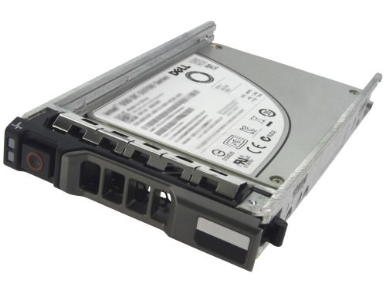
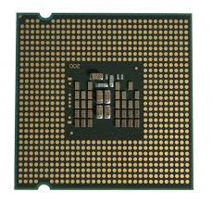
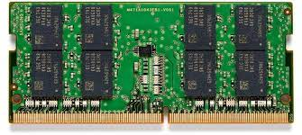
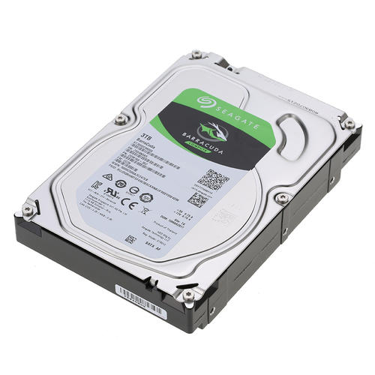

DBMS storage: physical store the relational model
Question: where to store the data?
CPU registers
DRAM
SSD
Network storage
e.g., NFS@lecture06
HDD

Slide 15




DBMS storage: physical store the relational model
Question: where to store the data?
Trade-off between several requirements
  Speed
    How fast can the data be read/written?
  Capacity
    How large can the device store the data?
  Cost
    How much is the device?
  Volatility
    Will the data survey power failures?

Slide 16
DBMS storage: physical store the relational model
Disk-oriented architecture
  The DBMS assumes that the primary storage location of the database is on non-volatile storage
    E.g., SSD or HDD
    Larger capacity than CPU registers & DRAM
    Can survive power failures

Slide 17
How to represent tuples in bytes?
How to store tuples on disk?

Slide 18
Store tuples in non-volatile storage
The design consideration sounds familiar?
How to represent tuples in bytes?
  We should record the schema as well as the tuple
    Schema itself is the (meta) data
    They are essentially a sequence of bytes on the disk
What are the design consideration of data storage in DBMS?
  Data being accessed by different language (C or python) ?
  Character sets
  Sizes of integers and other types
  …
Schema
Name | Provider | Year
Ipad pro | Apple | 2021
Iphone | Apple | 2021
N-ary Relation
=
Table with n columns
Tuple

Slide 19
Recall: similar considerations exists in RPC
e.g., How to transfer a data structure to another machine?

Slide 20
Recall: similar considerations exists in RPC
e.g., How to transfer a data structure to another machine?
Distributed systems have incompatibility problem
  Does not exist on a single machine
For example, remote machine may have different
  Byte ordering
  Sizes of integers and other types
  Floating point representations
  Character sets
  Alignment requirements
Represent 0x89abcdef
Big endian, e.g., Power processor
89
AB
CD
EF
0
1
2
3
Little endian, e.g., X86
EF
CD
AB
89
0
1
2
3

Slide 21



Recall: similar considerations exists in RPC
e.g., How to transfer a data structure to another machine?
Need standard encoding to enable communication between heterogeneous systems & different versions of software
  Sun’s RPC uses XDR (eXternal Data Rep.)
  ASN.1 (ISO Abstract Syntax Notation)
  JSON
  Google Protocol Buffers
  W3C XML Schema Language

Slide 22

Data representation of tuples
Database can also uses encoding schemas (e.g., protocolbuffer) for tuples
  E.g., XML databases use XML, Document databases uses JSON
Typically, relational DBMS uses a simpler encoding/decoding method
  E.g., Just uses its in-memory representation
    Why? DB is typically used by a single machine
Each tuple is prefixed with a header
  Bit Map for NULL values (if not using an additional encoding/decoding schema)
Notes:
Typically no need for encoding/decoding. Many encoding/decoding frameworks exist later than DBMS.
But can also apply

Slide 23
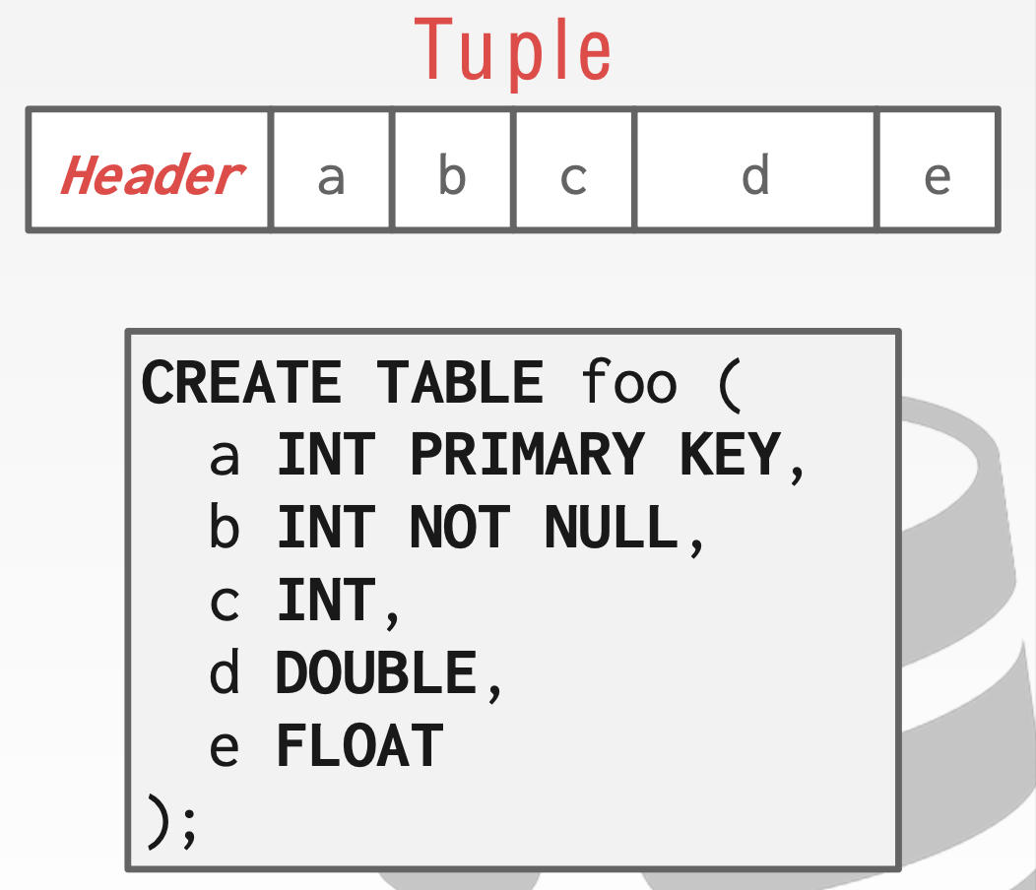
Data representation of tuples
Typically, relational DBMS uses a simpler encoding/decoding method
  E.g., Just uses its in-memory representation
    Why? DB is used by a single machine
Each tuple is prefixed with a header
  Header: a bitmap to record which attribute
  is NULL
What about the order & size of stored attributes?
  Stored in the schema
  Can interpret the tuple attributes
  based on the schema

Slide 24
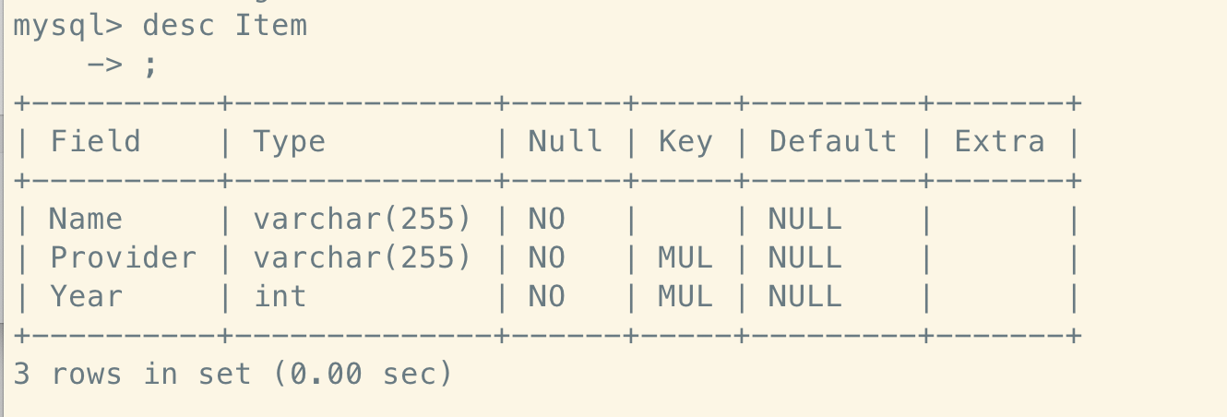
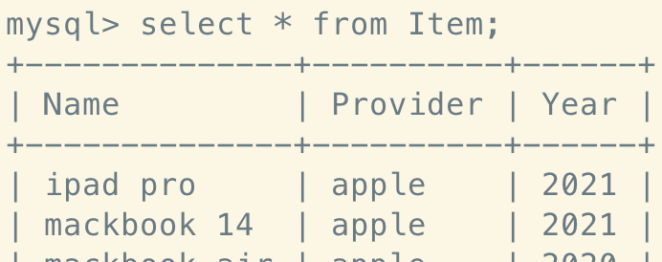
The storage of metadata, e.g., schema
The metadata can be viewed as a special table managed by the DBMS
  Almost every DBMS stores databases' metadata in another tables/databases
    Wrap object abstraction around tuples
    Specialized code for "bootstrapping" catalog tables
  The metadata storage is also known as catalog of a database

Slide 25
How to represent tuples in bytes?
How to store tuples on disk?

Slide 26
Physically store tuples
Recall: we should physically store the tuples on the disk
  However, programming on raw disk is non-trivial
What is the computer’s view on disk hardware?
  Is programming this kind of abstraction simple?
Question: which systems we have learned in previous lectures can help?
  Log-structured key-value storage (lecture 09)
  File system (lecture 03-04)
Hardware
READ(block-addr, buf)
WRITE(block-addr, buf)
(4TB = 2³⁰ 4KB blocks)
Disk

Slide 27


Review: key-value storage
Storage layout:
  Each data (Value) is opaque to the database
  Indexed by a key (K), which itself is also a data (e.g., int, string)
  Stored on disk (tolerate failure & support a large capacity)
Interface
  Get(K) -> V, Scan(K,N)
  Update(K,V), Insert(K,V), Delete(K,V)
  The K and V can be arbitrary byte-sequence (e.g., a JSON file as a value)

Slide 28


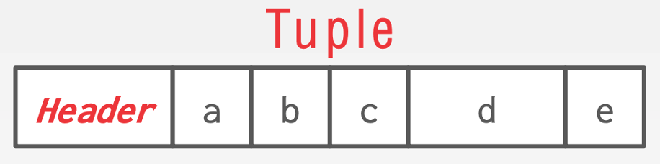
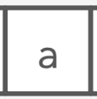
Sol-1: Store tuples in log-structured key-value storage
Of course, we can build relational model on key-value stores!
  Example: MySQL can use MyRocks as its storage engine
    MyRocks uses rockdb, a standard log-structured key-value storage
MyRocks
Relational model
  Key: Primary key of the tuple
  Value: Binary representation of the tuple
Key-value Store
→
File system

Slide 29
Log-structured key-value storage: LSM Trees
LSM Tree organizes SSTables as a hierarchy architecture
  Each layer has maximum size
  Except L0, all files in layers are sorted
MemTable
Questions: what are the benefits?
L0
Questions: What are the drawbacks?
L1
L2
LSM Tree

Slide 30
Drawbacks of using log-structured key-value storage
Log-structured key-value storage is particular optimized for writes
  E.g., one sequential write is sufficient for each update/insertion
However, what are the costs?
  Write amplifications
  Space amplifications
  Read amplifications
  Poor range scan performance
Traditionally, databases favors BTree (or its variants)
Notes:
Why optimizing the write is sufficient?
Because the read can be handled by the cache.
Nevertheless, the traditional DBMS should handle both reads and writes.

Slide 31
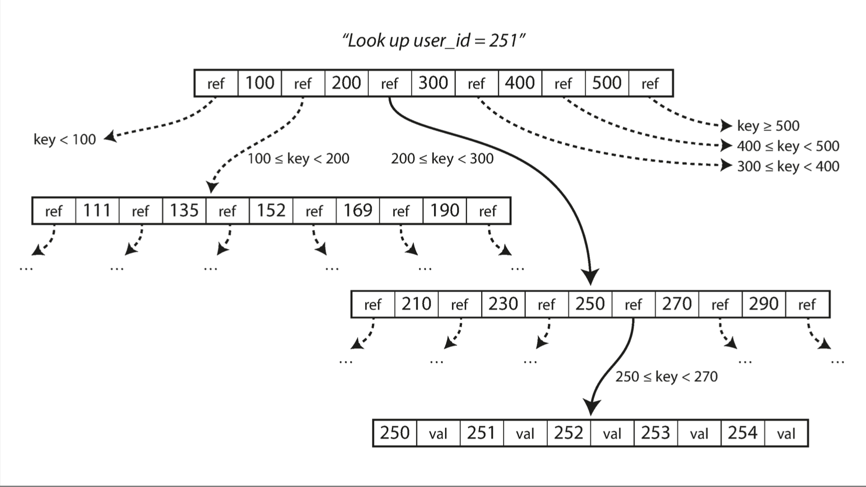
Sol-2: Using Btree* to store tuples in relational model
A B-tree is a tree data structure
  Each node is fixed-sized, can store multiple keys, and keys are sorted
  Support efficient range operations (e.g., range query)
  Optimized for large read/write blocks of data
A fixed node is organized as pages in DBMSs.
* B+Tree or its variants (e.g., B+Tree)
Notes:
将key-value存在B树中会有什么问题？
1.怎么管理pages
2.怎么把一个tuple存在page里

Slide 32
Sol-2: Using BTree to store tuples in relational model
Note that relational model does not necessarily use BTree
  Tuples can just be left unindexed (i.e., only store the leave pages)
    Scan the entire table is required for executing queries
  How to add index? Using the secondary index declaration
  Typically, primary key is automatically indexed by the DBMS by default
Remaining questions
  What is the database page?
  How to manage the pages?
  How to store tuples in the pages?
CREATE INDEX item_year_index ON Item(Year);

Slide 33
Database pages
A page is a fixed-size block of data
  It can contain tuples, meta-data (e.g., internal nodes of BTree), etc.
Each page is given a unique identifier
  The DBMS uses an indirection layer to map page ids to physical locations

Slide 34






Database pages
There are three different notions of "pages" in a DBMS:
  Hardware Page， e.g., disk sector (usually 4KB)
  OS Page (usually 4KB)
  Database Page (512B-16KB)
Sometimes configurable
4KB
8KB
16KB

Slide 35
Database pages
There are three different notions of "pages" in a DBMS:
  Hardware Page， e.g., disk sector (usually 512B or 4KB)
  OS Page (usually 4KB)
  Database Page (512B-16KB)
How to choose the database page size? Many trade-offs
  BTree height. E.g., larger page -> shallow tree
  Fragmentation. E.g., larger page -> may waste space
  More important: hardware atomic write size
    A hardware page is the largest block of data that the storage device can guarantee failsafe writes (ensure all-or-nothing by hardware)
    If the database page size don’t fit, need extra mechanisms for atomicity!
Sometimes configurable
Notes:
The most important thing is the hardware atomic size

Slide 36

Database pages
The size of page is typically configurable
How to choose the database page size? Many trade-offs
  BTree height. E.g., larger page -> shallow tree
  Fragmentation. E.g., larger page -> may waste space
  Most important: hardware atomic write size
    A hardware page is the largest block of data that the storage device can guarantee failsafe writes.
    If the database page size don’t fit, need extra mechanisms for atomicity!
  How to ensure atomic page write?
    Use write-ahead-logging (please check lecture 11)

Slide 37
Database pages
The size of page is typically configurable
Also, we can configure different size for different data types
  E.g., the data page size & index page size can be separately configured

Slide 38
#1. How to manage pages?
#2. How tuples are stored in pages?

Slide 39
How to manage pages on the disk?
Should provide methods to:
  Create a page
  Get a page
  Write a page
  Delete a page
  Iterate over all the pages
    E.g., when scanning all tuples in a database
Shall the DBMS manage the disk like a disk driver?

Slide 40
No --- We can leverage the file system
For example, DBMS can store the pages in files
  So that we can easily use the file system interface
Question: how to manage the mapping between page & file?
  One straightforward approach: a separate file for each page
  What are the drawbacks?
Notes:
Extra meta-data overhead (e.g., file name, inode)
Extra system call overhead for managing pages

Slide 41
Database heap file
Store the pages in the same file (or group multiple pages in one file)
  DBMS uses the abstraction called heap file to store pages
  Note that DBMS is in user-space

Slide 42
Database heap file
Heap file is an abstraction to manage the database pages
  An unordered collection of pages
It is easy to find a page in a heap file
  Since the page size is known
  Just like find a block in a disk
Why don’t we care about the order?
Get page #2
Offset = Page# × PageSize
Page0
Page1
Page2
Page3
Page4
…
Heap File
Notes:
Order is managed by index (B+Tree)

Slide 43
Questions: how to find free pages
that the DBMS can use?

Slide 44
Metadata to keep track of free pages & allocated pages
Two common approaches:
  Linked list
  Page directory

Slide 45
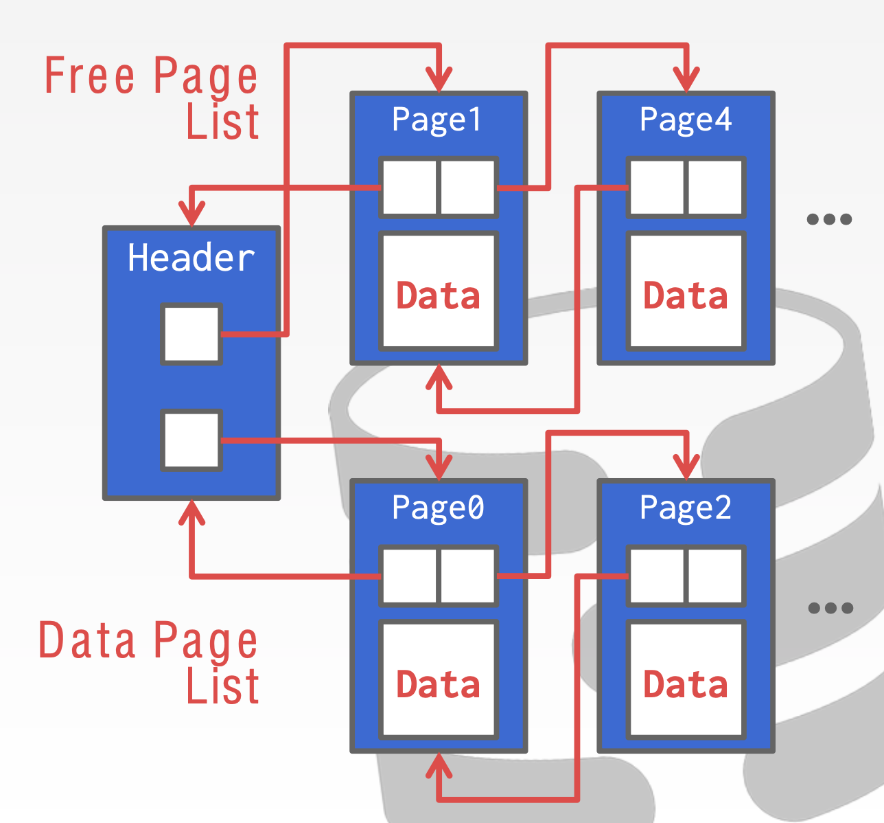
Solution-1: Linked list
Maintain a header page at the beginning of the file
  Stores two pointers
    HEAD of the free page list
    HEAD of the data page list
  Note: the data is not continuous
    A page can store data less than its size
Questions:
  When the lists are manipulated?
    Recall: heap file must provide:
    Create, Delete, Iterate all

Slide 46
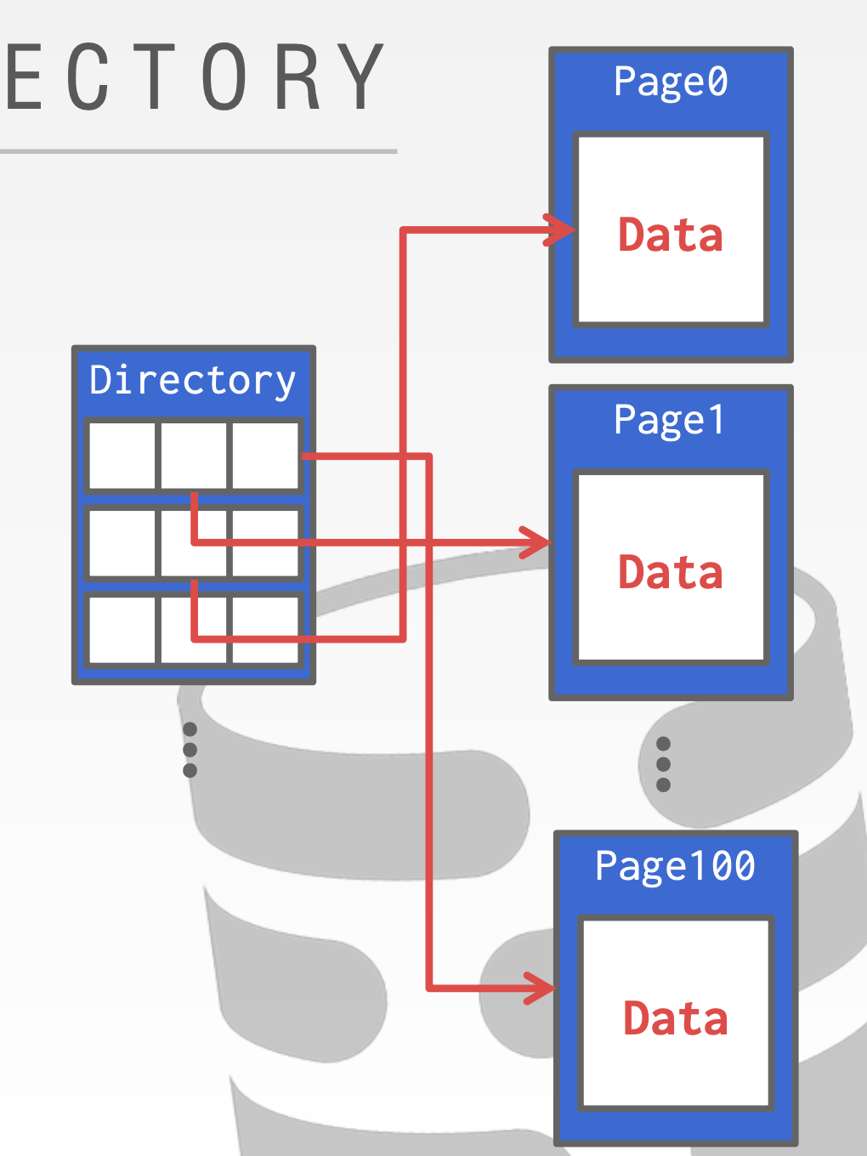
Solution-2: Page Directory
The DBMS maintains special pages
  Tracks the location of data pages in the database files
    Like a bitmap
  Similar to the data bitmap in file systems (at the head of a disk)
The DBMS must make sure that the directory
pages are in sync with the data pages
  To avoid crash consistency problem
  Similar to crash consistency in file systems
  E.g., by using logging

Slide 47
#1. How to manage pages?
#2. How tuples are stored in pages?

Slide 48
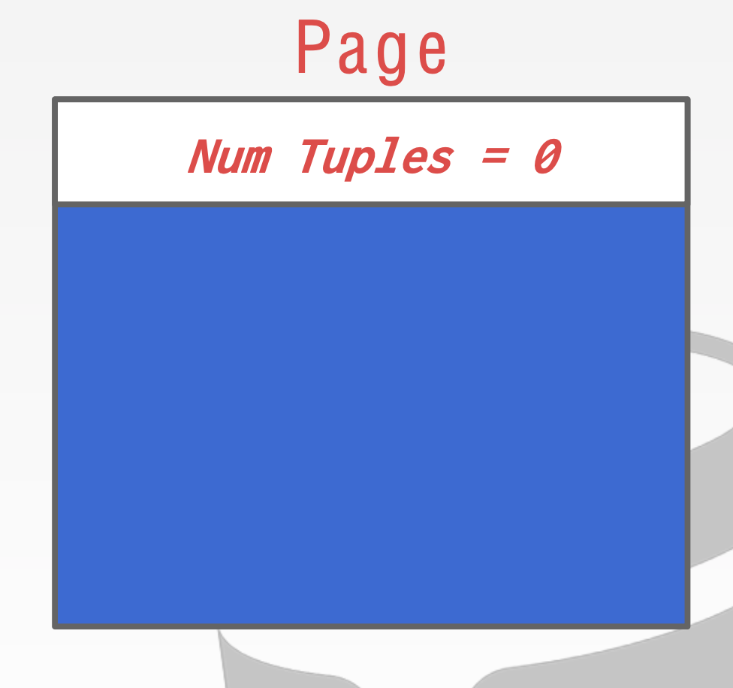
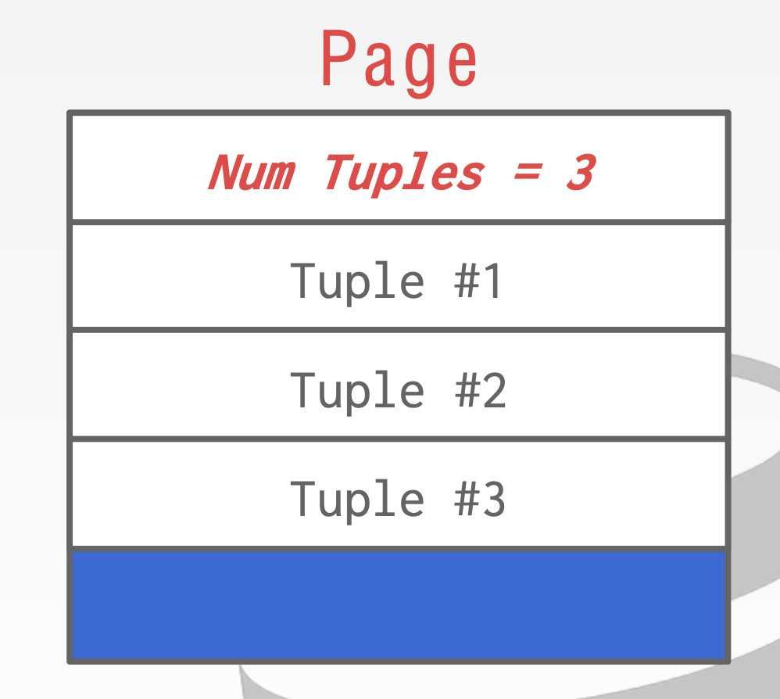
Tuple storage: Strawman Idea
Keep track of the number of tuples in a page and then just append a new tuple to the end
  And all attributes of a tuple is stored together (as a row)
  Benefits: easy to answer the query that acquire all fields
select * from Item where Year=2021;
Insert 3 tuples
This is called row store

Slide 49
Tuple storage: Strawman Idea
Keep track of the number of tuples in a page and then just append a new tuple to the end
  What happens if we delete a tuple?
  What happens if we have a variable-length attribute?
Insert 3 tuples
Should maintain a minimal data structure to manage tuple location -> tuple
Notes:
Page is used to store B+Tree nodes
Deletion:
#1 may move many data to upon deletion
#2.how to find the empty tuple?

Slide 50
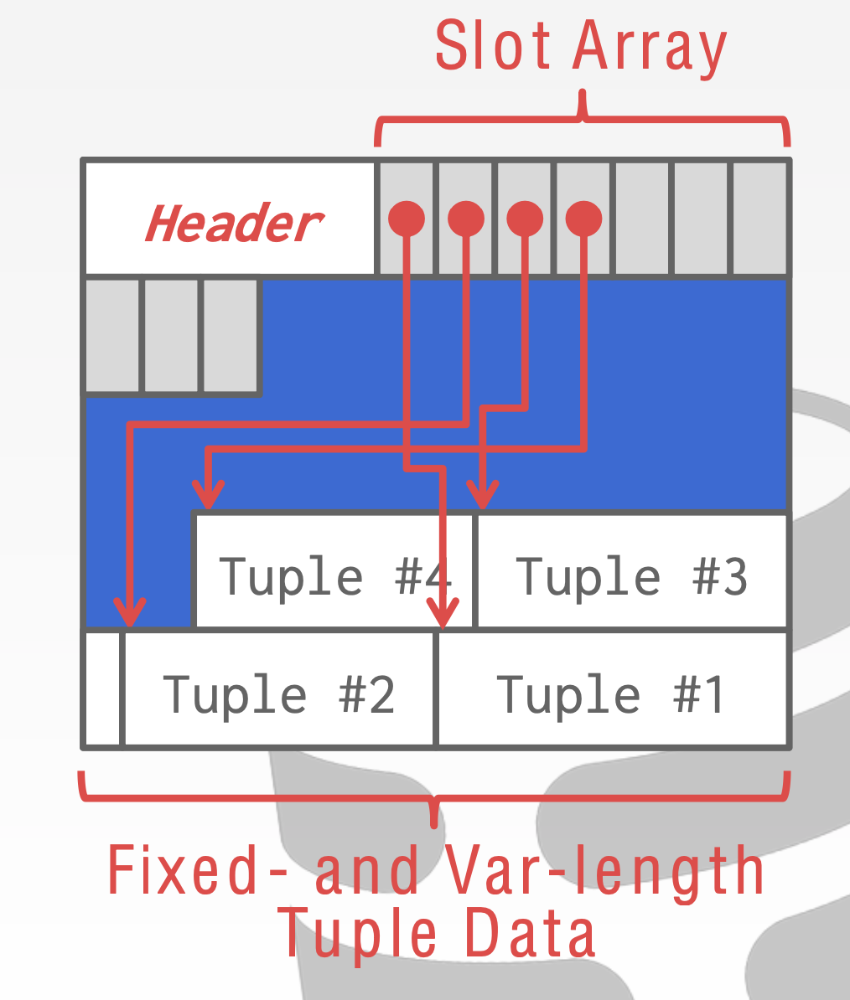
Tuple storage: slotted pages
The most common layout scheme is called slotted pages
The slot array maps "slots" to the tuples' starting position offsets
  Why not using an complete index at a page?
  A page is typically small so indexing is wasting
The slots are consecutive
  Easy to find all tuples in this page
The header keeps track of:
  The # of used slots
  The offset of the starting location of the
last slot used
Notes:
主要是为variable-length的tuple所设置
Slotted page header contains: – number of record entries – end of free space in the block – location and size of each record
Log-structured segment 很大，所以需要一个index， 但是page相对较小
Slot array 从前往后， tuple 从后往前

Slide 51
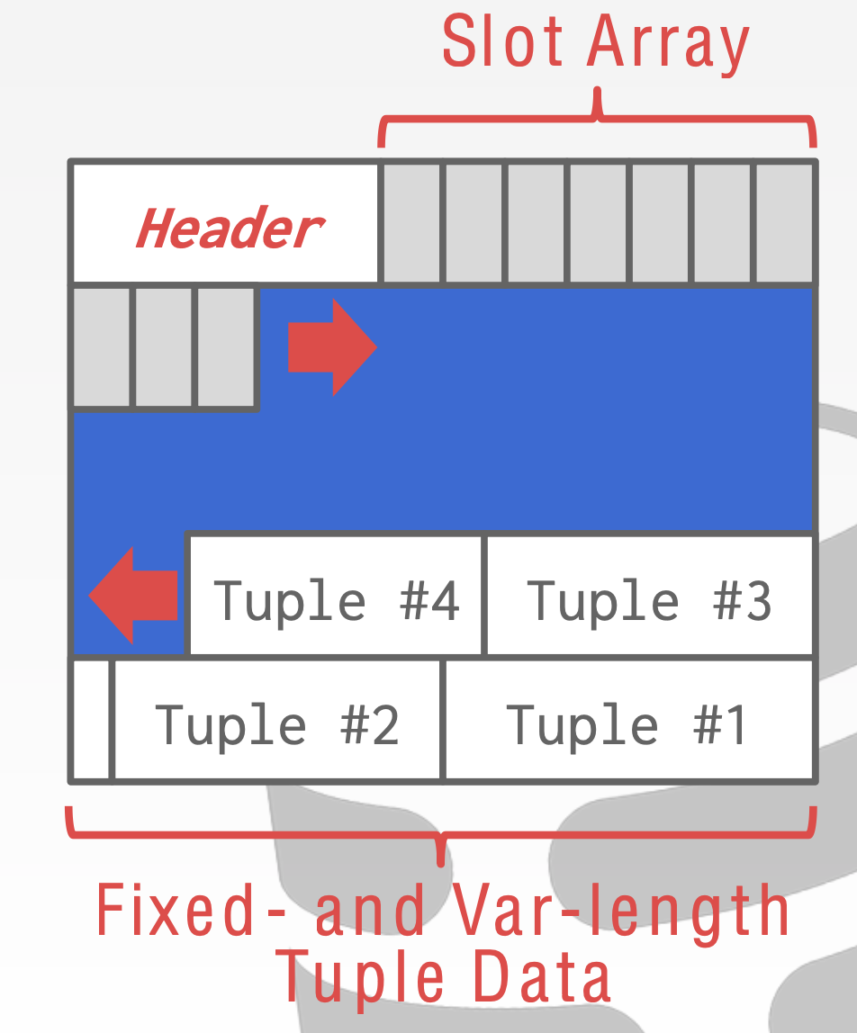
Tuple storage: slotted pages
The most common layout scheme is called slotted pages
  The slot array grows to the right
  The tuples are inserted from last -> start

Slide 52
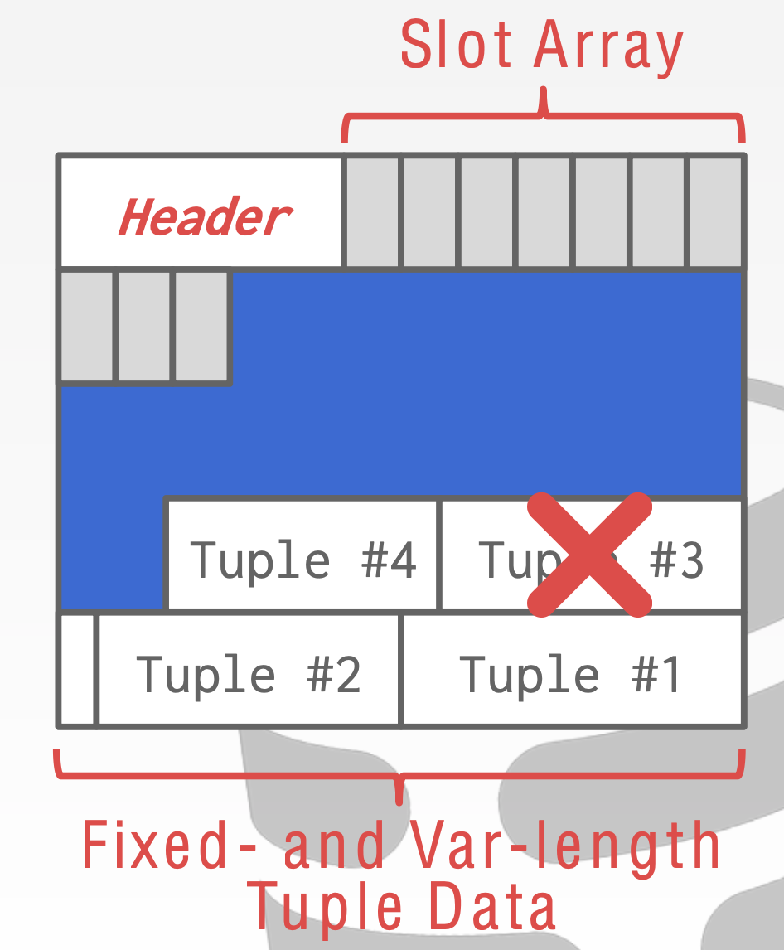
Tuple storage: slotted pages
The most common layout scheme is called slotted pages
  The slot array grows to the right
  The tuples are inserted from last -> start
What about deletions?

Slide 53
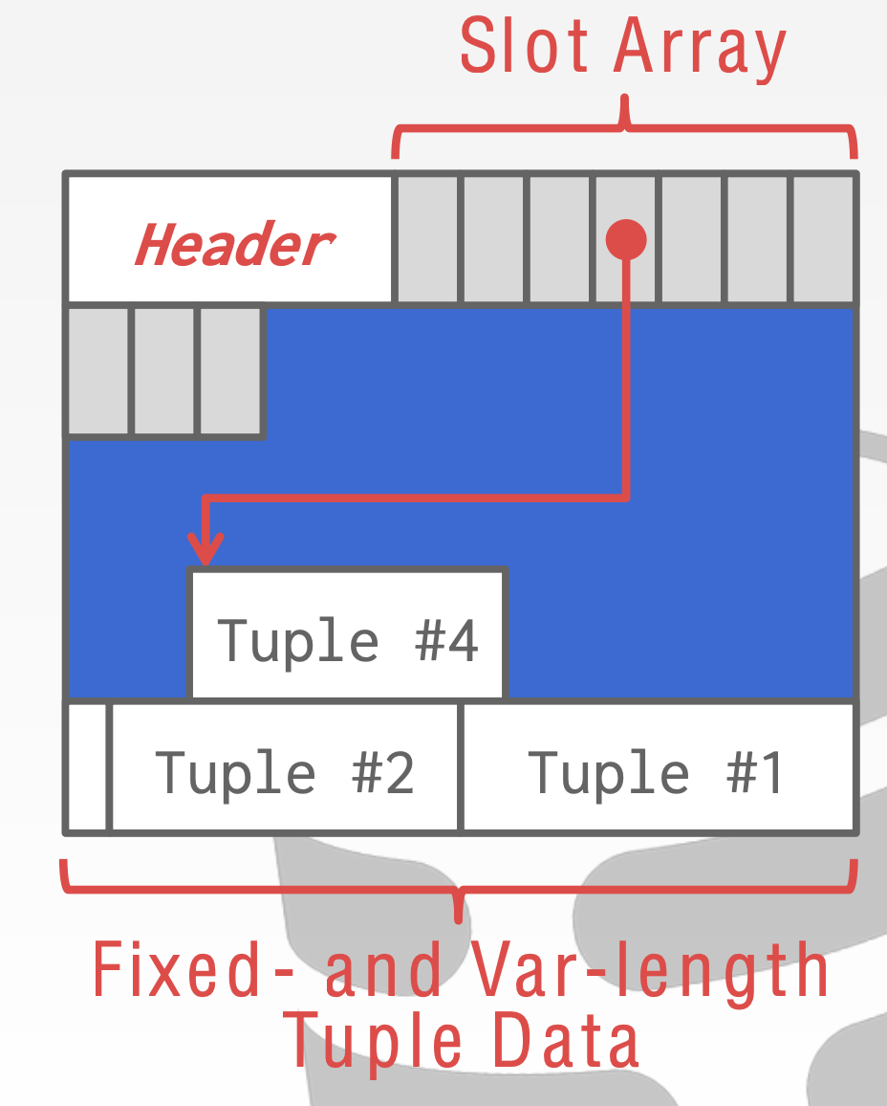
Tuple storage: slotted pages
The most common layout scheme is called slotted pages
  The slot array grows to the right
  The tuples are inserted from last -> start
What about deletions?
  Should compact the tuple storages

Slide 54
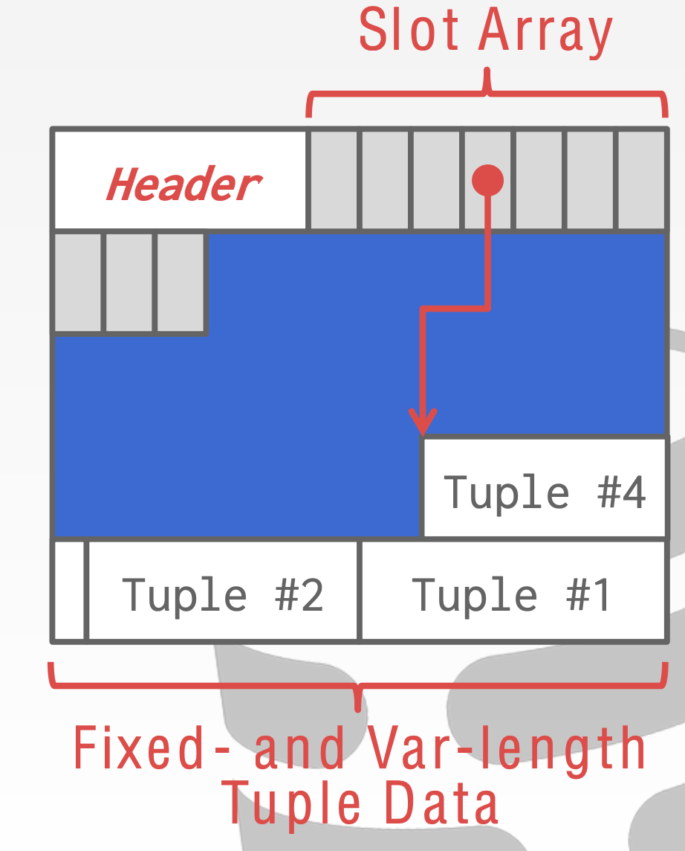
Tuple storage: slotted pages
The most common layout scheme is called slotted pages
  The slot array grows to the right
  The tuples are inserted from last -> start
What about deletions?
  Should compact the tuple storages

Slide 55
Tuple storage: slotted pages
The most common layout scheme is called slotted pages
  The slot array grows to the right
  The tuples are inserted from last -> start
What about deletions?
  Should compact the tuple storages
Two ways to index a slot
  Pointers: offset from the beginning of a page
  Offsets: offset from the previous tuple
  Which one to choose?
Notes:
Pointer: tuple location
Offset: offset compared to the previous tuple.
Pointer: easy to retrieve
Offset: easy for deletion: no need to re-calculation the pointers

Slide 56
Q: what if a tuple is larger than a page?
A DBMS may restrict the size of a tuple
  E.g., in MySQL, a row cannot be larger than 63KB, if page size is 64KB
What if a tuple has a very large column?
  Usually, DBMS will use extra blob store for it
    BLOB: Binary Large object

Slide 57
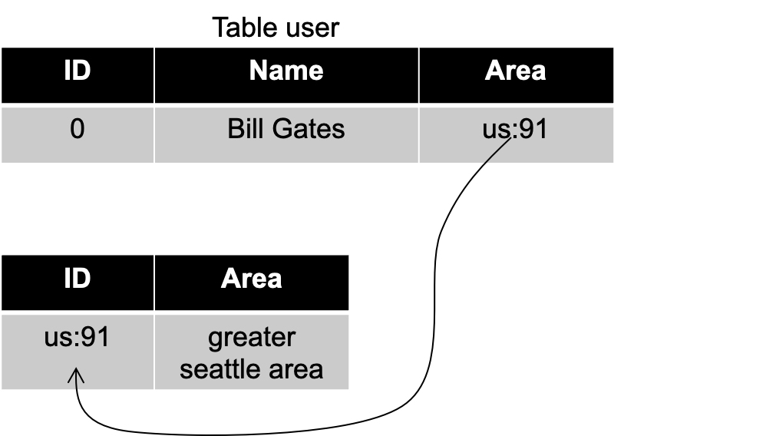
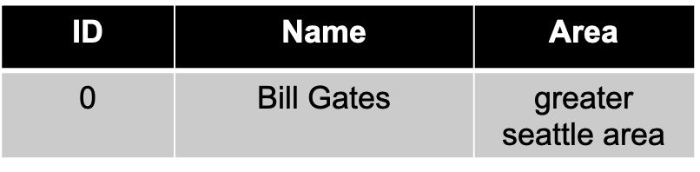
Tuple representation & denormalization
We can represent tuple in a denormalized way for better performance
Recall normalizing: remove the duplicated entities in various entities
  Useful for many-to-one relationship
  How to normalize is a big topic (out of the scope of this lecture)
What are the cost of denormalization?
Normalize
Table area
Name

Slide 58
Denormalized tables typically means poor locality
Need join to retrieve the complete content
Example:
  Print the location information of a user
  Must use join operator:
    select * from Table user join Table area
However, join requires access two tables!
  The locality is poorer

Slide 59
Denormalized tuple data with tuple storage
Need join to retrieve the complete content
  However, join requires access two tables!
Default storage
(in 2 pages)
Table schemas
CREATE TABLE user
(
Name string NOT NULL ,
Area string NOT NULL,
FOREIGN KEY (Area) REFERENCES Area(ID)
)
area
Header
us:91
Seattle
user
CREATE TABLE area
(
ID string NOT NULL ,
...
)
Header
Bill Gate
us:91
Header
Xingda
us:91

Slide 60
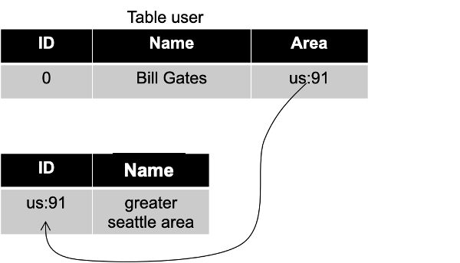

Denormalized tuple data with tuple storage (pre-join)
Solution:
  Store related tuples in the same page
Pros
  Potentially reduces the amount of I/O for common workload patterns
Cons
  Can make updates more expensive
    E.g., what if we insert another user?
Not a new idea
  IBM System R did this in the 1970s
Table area
Header
us:91
Seattle
Bill Gate
Xingda
area part
user part
Notes:
Only case when DBMS store tuples from two tables in the same page

Slide 61
DBMS storage so far
Disk-oriented architecture
  The DBMS assumes that the primary storage location of the database is on non-volatile storage
    E.g., SSD or HDD
    Larger capacity than CPU registers & DRAM
    Can survive power failures
We have talked about
  Tuple layout
  Database page & heap files
  Page layout
What are the drawbacks of using non-volatile storage?

Slide 62
Non-volatile storage typically has lower performance
Credits: Jeff Dean@Google

Slide 63
How to deal with slow storage?

Slide 64
DBMS storage: physical store the relational model
Disk-oriented architecture
  The DBMS assumes that the primary storage location of the database is on non-volatile storage
    E.g., SSD or HDD
    Larger capacity than CPU registers & DRAM
    Can survive power failures
Nevertheless, non-volatile storage is typically slower
  DBMS storage will move data between non-volatile & volatile storage
How to cope with the slow storage?

Slide 65
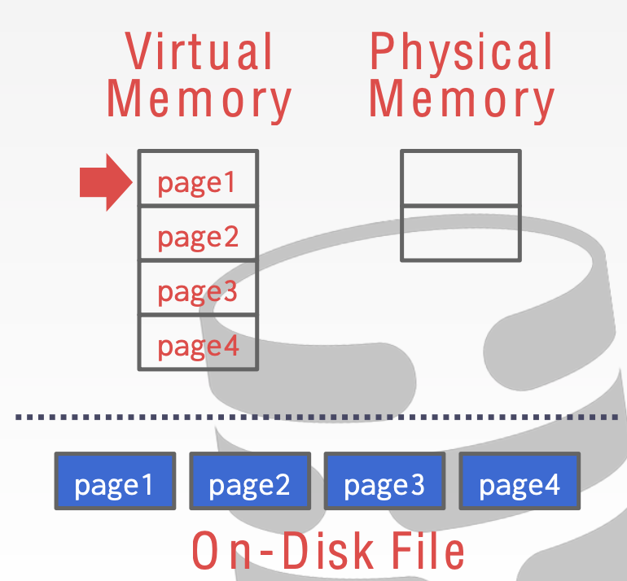
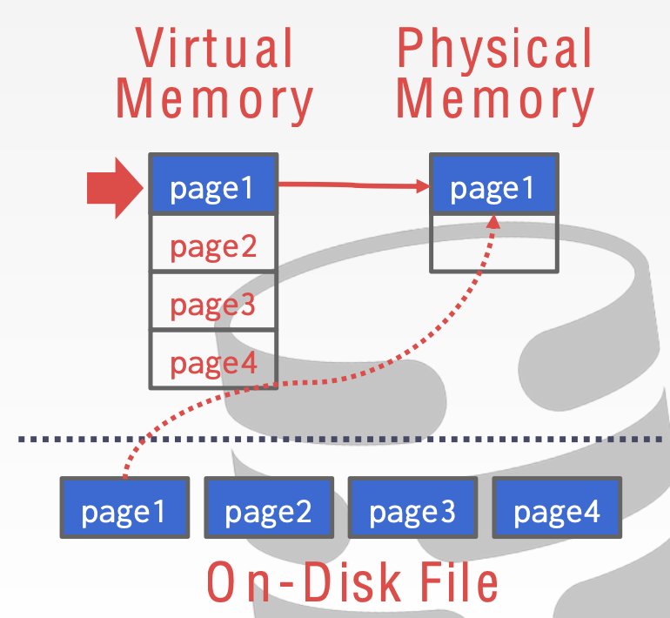
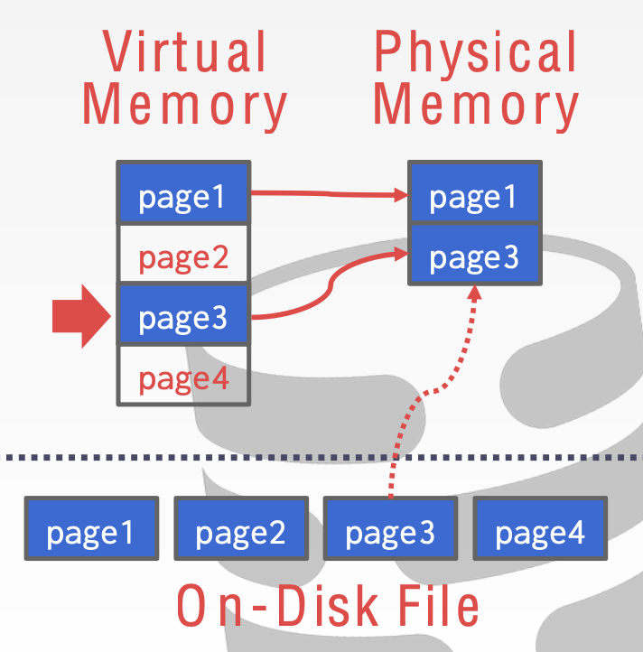
Why not leverage the OS to manage the movement?
E.g., use mmap() to map the whole heap file
  The OS is responsible for moving the files' pages in and out of memory

Slide 66
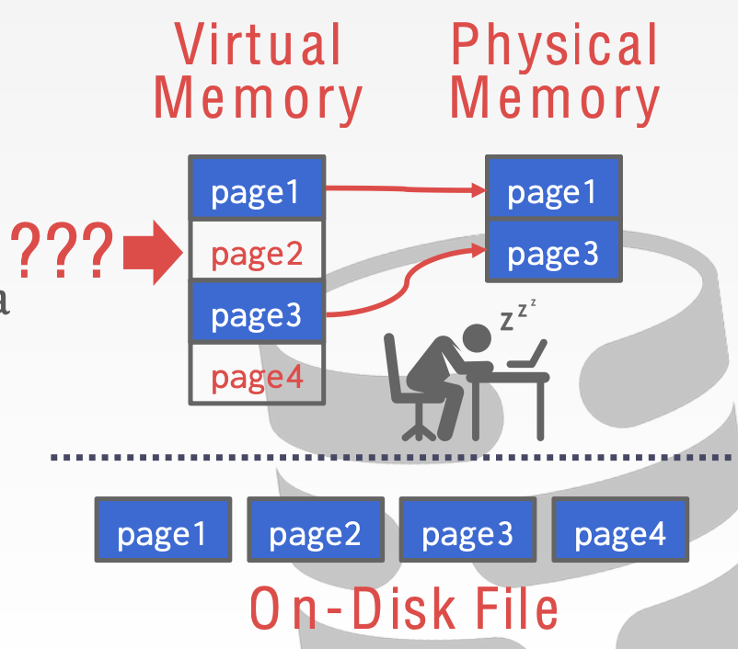
Why not let the OS manages the movement?
E.g., use mmap() to map the whole heap file
  The OS is responsible for moving the files' pages in and out of memory
Question: what if we want to access page2?
  Which page should be evicted? Depends on the workloads!
We will see more examples in the next lecture
Notes:
需要做决定哪些page需要evicted。通常应用很难控制OS怎么操作page的swap。

Slide 67
Why not let the OS manages the movement?
DBMS should decide which memory page should be moved in/out
  OS does not know the DBMS workloads
  E.g., when co-locating with other applications, OS may unexpectedly swap the DBMS’s memory out!
OS has some solutions for this
  madvise: Tell the OS how you expect to read certain pages
  mlock: Tell the OS that memory ranges cannot be paged out
  msync: Tell the OS to flush memory ranges out to disk
Drawbacks: extra system call, OS processing overheads, etc.
Notes:
很少DB用mmap。 少量的case是： leveldb

Slide 68
DBMS typically not uses OS to move data
DBMS can do a better job
  E.g., know which page should cache which should not
  E.g., Flushing dirty pages to disk in the correct order

Slide 69
Overview of buffer pool
query
Buffer pool to manage the cached copies of pages
Query Execution
Buffer pool
e.g., get Page#2
DRAM
Directory
Page0
Page1
Page2
Page3
…
Heap File

Slide 70
Overview of buffer pool
query
Buffer pool to manage the cached copies of pages
Query Execution
Directory
Buffer pool
e.g., get Page#2
DRAM
Directory
Page0
Page1
Page2
Page3
…
Heap File

Slide 71
Overview of buffer pool
query
Buffer pool to manage the cached copies of pages
Query Execution
Directory
Page2
Buffer pool
e.g., get Page#2
DRAM
We will talk about more buffer pool in the next lecture!
Directory
Page0
Page1
Page2
Page3
…
Heap File

Slide 72
Summary
Disk-oriented architecture
  The DBMS assumes that the primary storage location of the database is on non-volatile storage
    E.g., SSD or HDD
    Larger capacity than CPU registers & DRAM
    Can survive power failures
We have talked about
  Tuple layout
  How to store the tuple?
    Pages with BTree (or its variants) or LSM key-value storage
  Page layout (store the entire tuple in the page, usually called row-based storage)
The choice is typically
configurable based on the
requirements (e.g., for fast read/write)
Notes:
其他的，类似column store是高级话题

