Slide 1


Database management system and Buffer pool
SE124 (2021 Fall)
IPADS, Shanghai Jiao Tong University
https://www.sjtu.edu.cn
Credits: Andy Pavlo@CMU

Slide 2
Review: scalable websites
Scalable websites powered by distributed systems
  For request handling, data storage
Caching server
Caching server
Caching server
…
Caching
Caching
Caching
Distributed caching
Database server
Database server
CDN
Users
Application #1
generate the page
Database
user, price
…
Database
user, price
Application server
Distributed database
Internet
Load
Balance
Application #2
add the order
File server
File server
File server
File:
image
File:
image
…
File:
image
Application server
…
…
Message queue
Distributed file system

Slide 3


Big picture of how a SQL is physically processed
query=
select price from items
where name = “IPAD”
query
Query Execution
Database
DBMS
Storage
I/O access
Database

Slide 4
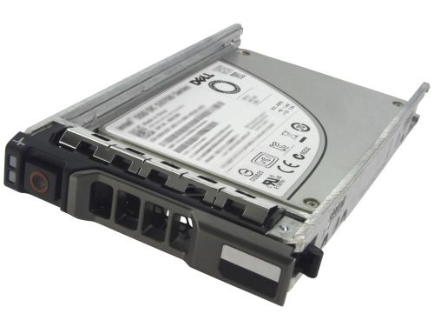
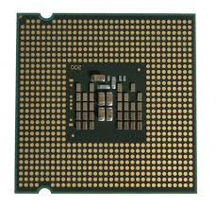
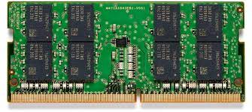
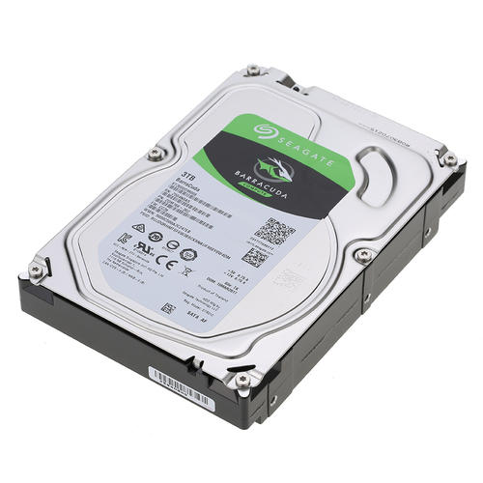

Review: where to store the data?
CPU registers
DRAM
SSD
Network storage
e.g., NFS@lecture06
HDD

Slide 5
Review of DBMS storage
Disk-oriented architecture
  The DBMS assumes that the primary storage location of the database is on non-volatile storage
    E.g., SSD or HDD
    Larger capacity than CPU registers & DRAM
    Can survive power failures

Slide 6
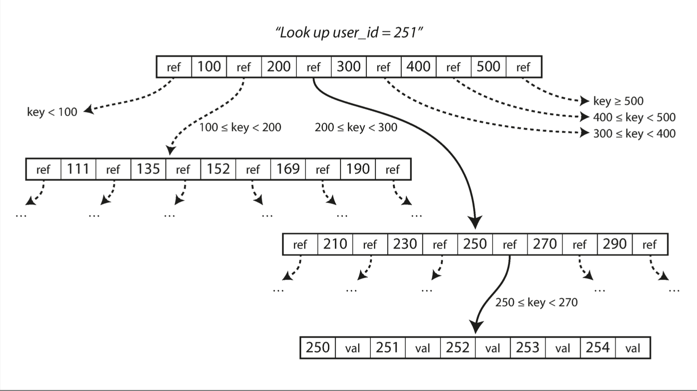
Each relation is typically stored in a B-tree (or its variants)
A B-tree is a tree data structure
  Each node is fixed-sized, can store multiple keys, and keys are sorted
  Support efficient range operations (e.g., Scan)
  Optimized for large read/write blocks of data

Slide 7
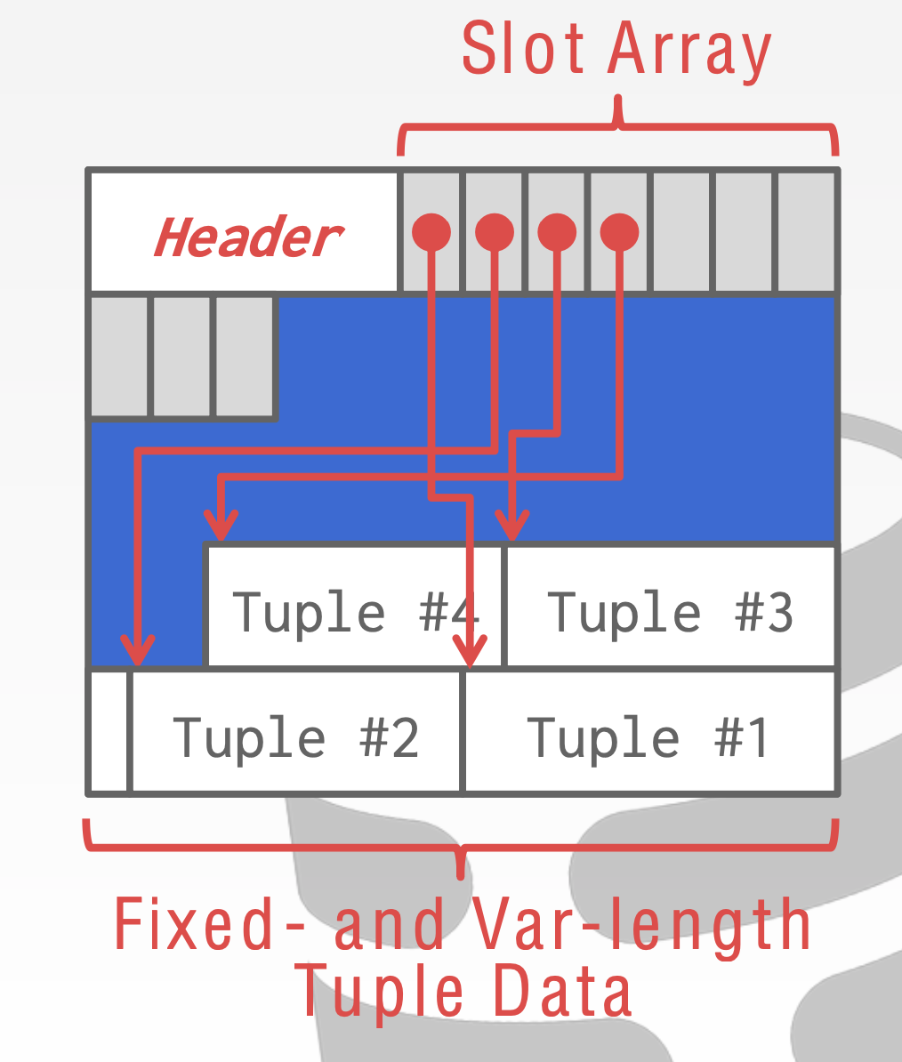
Tuples are stored in pages, pages are slotted
The most common layout scheme is called slotted pages
The slot array maps "slots" to the tuples' starting position offsets
  Why not using an index at a page?
  A page is typically small so no need for index
The slots are consecutive
  Easy to find all tuples in this page
The header keeps track of:
  The # of used slots
  The offset of the starting location of the
last slot used
Notes:
主要是为variable-length的tuple所设置
Slotted page header contains: – number of record entries – end of free space in the block – location and size of each record
Log-structured segment 很大，所以需要一个index， 但是page相对较小
Slot array 从前往后， tuple 从后往前

Slide 8
Pages are managed by a heap file
Heap file is an abstraction to manage the database pages
  An unordered collection of pages
It is easy to find pages within a single heap file
  Since the page size is known
Why we don’t care about the order?
Get page #2
Offset = Page# × PageSize
Page0
Page1
Page2
Page3
Page4
…
Heap File
Notes:
Order can be achieved via index (B+Tree), etc

Slide 9
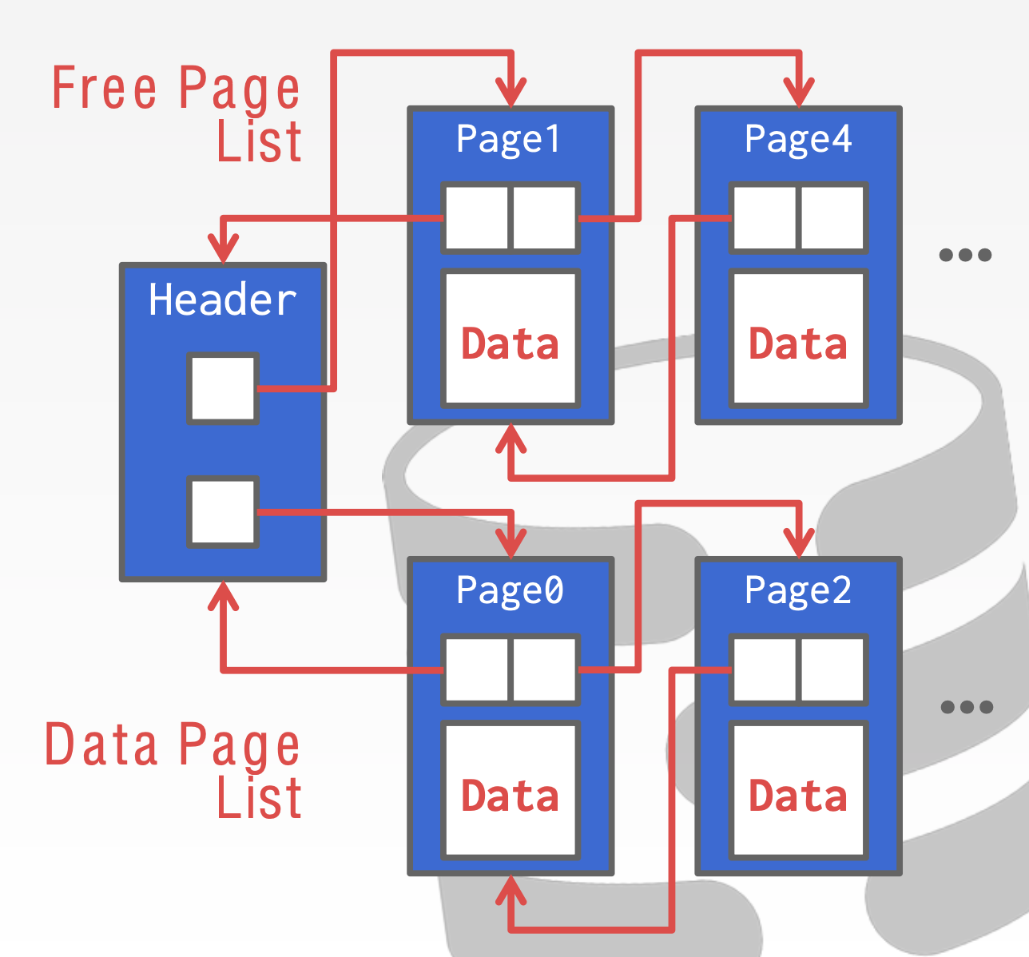
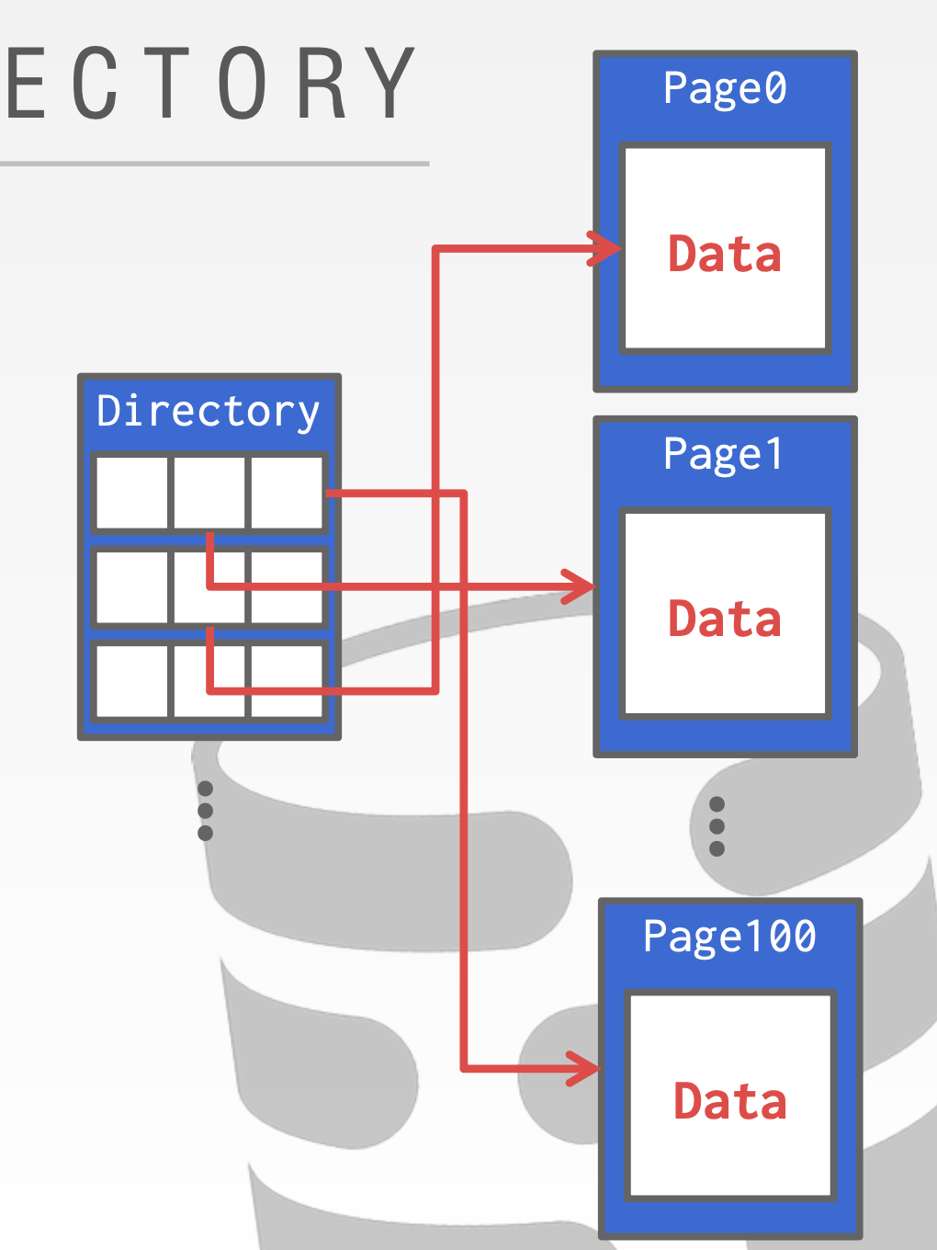
Pages are managed by a heap file
Heap file is an abstraction to manage the database pages
  An unordered collection of pages
Should provide methods to find free pages
  Two common approaches: directory & linked list
Notes:
Order can be achieved via index (B+Tree), etc

Slide 10
DBMS storage so far
Disk-oriented architecture
  The DBMS assumes that the primary storage location of the database is on non-volatile storage
    E.g., SSD or HDD
    Larger capacity than CPU registers & DRAM
    Can survive power failures
Nevertheless, non-volatile storage is typically slower
  DBMS storage will move data between non-volatile & volatile storage
  Not using OS: OS does not know the DBMS workloads
  Key technique: buffer pool
How to cope with the slow storage?

Slide 11
Buffer pool: in memory

Slide 12
Overview of buffer pool
query
Buffer pool to manage the cached copies of pages
Query Execution
Buffer pool
e.g., get Page#2
DRAM
Directory
Page0
Page1
Page2
Page3
…
Heap File
Notes:
The buffer pool is an in-memory cache of pages read from disk. It is essentially a large memory region allocated inside of the database to store pages that are fetched from disk.

Slide 13
Overview of buffer pool
query
Buffer pool to manage the cached copies of pages
Query Execution
Directory
Buffer pool
e.g., get Page#2
DRAM
Directory
Page0
Page1
Page2
Page3
…
Heap File

Slide 14
Overview of buffer pool
query
Buffer pool to manage the cached copies of pages
Query Execution
Directory
Page2
Buffer pool
e.g., get Page#2
DRAM
Directory
Page0
Page1
Page2
Page3
…
Heap File

Slide 15
The requirements of buffer pool
#1. Bypass OS for the caching
  Otherwise, the decision made by the manager is useless
  Most DBMSs use direct I/O (O_DIRECT) to bypass
#2. Control when to read/write pages from disk
  Goal: minimize the number of stalls from having to read data from disk
DRAM
Disk

Slide 16
Buffer manager organization
Memory region organized as an array of fixed-size pages
  An array entry is called a frame
Buffer pool
Frame 0
Frame 1
Frame 2
Directory
Page0
Page1
Page2
Page3
…
Heap File
16

Slide 17
Buffer manager organization
Memory region organized as an array of fixed-size pages
  An array entry is called a frame
When the DBMS requests a page
  An exact copy is placed in one of these frames
Buffer pool
Frame 0
Page0
Frame 1
Frame 2
Directory
Page0
Page1
Page2
Page3
…
Heap File
17

Slide 18
Buffer manager organization
Note that frame and page are not one-to-one mapped. Why?
Memory region organized as an array of fixed-size pages
  An array entry is called a frame
When the DBMS requests a page
  An exact copy is placed in one of these frames
  The buffer manager will choose an empty frame
    Assuming one available now
Buffer pool
Frame 0
Page0
Frame 1
Page2
Frame 2
Directory
Page0
Page1
Page2
Page3
…
Heap File
18
Notes:
The number of frames is typically smaller.

Slide 19
How to maintain the mapping between frame <-> page?
Recall how we find a page using the heap file
  Offset = Page# × PageSize
How to find the frame in a buffer pool with the offset?
  Page table – can be a hash map or like OS page table
Page table
Buffer pool
Page 0
Frame 0
Page0
Page 2
Frame 1
Page2
…
Frame 2
Page2
Notes:
先assume buffer pool有足够的空间。

Slide 20

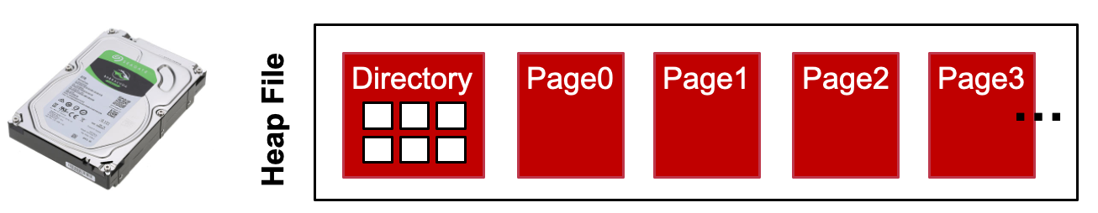
Page table vs. Page directory
Page directory
  A mapping from page ids to page locations in the database files
    All changes must be persisted (e.g., using WAL described in the previous lecture) so that the DBMS can recover from failure.)
Page table
  A mapping from page ids to the frame in a buffer pool
    An in-memory state that does not need to be recovered after failure

Slide 21
Buffer pool meta data
Besides frames, buffer pool maintains several meta data
  i.e., the page table to record the mapping between frame <-> page
Buffer pool
Read
Page 0
Page table
Frames
query
Page 0
Frame 0
Page0
Query Execution
Page 2
Frame 1
Page2
Frame 2
Meta Data
Page2
Data
Notes:
举一个例子，一个query进行查找

Slide 22
Buffer pool meta data
Is directly write to the disk efficient?
Besides frames, buffer pool maintains several meta data
  i.e., the page table to record the mapping between frame <-> page
What should we do after we write a page?
  A naïve plan: directly write the page back to disk
Buffer pool
Write
Page 0
Page table
Frames
query
Page 0
Frame 0
Page0
Query Execution
Page 2
Frame 1
Page2
Frame 2
Meta Data
Page2
Data
Notes:
举一个例子，一个query进行查找

Slide 23
Buffer pool meta data
What should we do after writing a page?
  A naïve plan: directly write the page back to disk
  A better approach: batch the writes and flush to the disk together
    Hides the disk stalls due to writes
  Question: which pages do we need to flush?
    Do we have to flush all the pages in the buffer pool?

Slide 24
Buffer pool meta data
Is directly write to the disk efficient?
What should we do after we write a page?
  Buffer pool will not flush the page upon a write
  Using batching to improve performance
  Adds a dirty bit to the page table entry: only flush the written page
Buffer pool
Write
Page 0
Page table
Frames
query
Page 0
Frame 0
Page0
Query Execution
Page 2
Frame 1
Page2
Frame 2
Meta Data
Page2
Data
Dirty bit
Notes:
User也可以自行把buffer的内容刷到disk里。

Slide 25
Buffer pool meta data
What about page eviction?
  When the buffer pool decides to evict a page to the disk
    E.g., no free space in the pool
Can we directly evict the frame and evict the page table?
Buffer pool
Evict frame0
Read
Page 0
Page table
Frames
Page0
query
Page 0
Frame 0
Page0
Query Execution
Page 2
Frame 1
Page2
Frame 2
Pagex
Meta Data
Page2
Data

Slide 26
Buffer pool meta data
Can we directly evict the frame and evict the page table?
  What will happen if the buffer pool & the query concurrently update the same frame?
  Should add a concurrency control to the buffer pool
Buffer pool
Evict frame0
Read
Page 0
Page table
Frames
Page0
query
Page 0
Frame 0
Query Execution
Page 2
Frame 1
Page2
Frame 2
Pagex
Meta Data
Page2
Data

Slide 27
Buffer pool meta data so far
A page table to keep the mapping between page id & frame
  For each page table entry, a dirty bit to mark whether the page should be flushed to the disk
  A lock to protect concurrent access of entry / buffer pool
Latch
Buffer pool
Evict frame0
Read
Page 0
Page table
Frames
Page0
query
Page 0
Frame 0
Query Execution
Page 2
Frame 1
Page2
Frame 2
Pagex
Meta Data
Page2
Data

Slide 28
Latch: protecting internal data structure

Slide 29
Locks vs. Latches
Locks: (in two-phase locking)
  Protects the database's logical contents from other transactions
  Held for transaction duration
Latches
  Protects the critical sections of the DBMS's internal data structure
  Held for operation duration
  Decouple the internal data structure concurrency control from the transaction
    E.g., Index & buffer pool
Though both are implemented as locks (e.g., pthread_mutex), they have different meanings in the DBMS
Notes:
数据库的latch基本对应OS的锁
数据库的锁 是逻辑上的。 就是逻辑上这份数据不能修改

Slide 30
Locks vs. Latches
For example, suppose two database transactions
  TX1: insert into Items {ID1, … }
  TX2: insert into Items {ID2, … }
  The ID is indexed by a B+Tree
Question:
  Does the two TX conflicts?
  Will they wait for each TX’s lock?
  What will happen if two TXs concurrently insert to the B+Tree?

Slide 31
Locks vs. Latches
For example, suppose two database transactions
  TX1: insert into Items {ID1, … }
  TX2: insert into Items {ID2, … }
  The ID is indexed by a B+Tree
Question:
  Does the two TX conflicts?
  Will they wait for each TX’s lock?
  What will happen if two TXs concurrently insert to the B+Tree?
Strawman solution
  Hold a lock on the index (like a normal lock in 2PL)
    Is it optimal?
Observation: lock on internal data structure only needs short duration lock

Slide 32
Locks vs. Latches
Example: using two-phase locking, and the DB only has one buffer pool
  TX1: { A += 1}
  TX2: { B += 1}
Frame
Lock A
Load A
Unlock A
TX1
Read A
Lock B
Unlock B
TX2
Read B

Slide 33
Locks vs. Latches
To accelerate execution, the DBMS will first load A & B to the buffer pool
  Question: what if two TX concurrently write to the same frame?
Frame
Lock A
Load A
Unlock A
TX1
Read A
Lock B
Unlock B
TX2
Read B

Slide 34
Locks vs. Latches
To accelerate execution, the DBMS will first load A & B to the buffer pool
  Question: what if two TX concurrently write to the same frame?
    The buffer pool frame would be corrupted (race condition)
Frame
Lock A
Load A
Unlock A
TX1
Read A
Lock B
Unlock B
TX2
Load B
Read B

Slide 35

Locks vs. Latches
Latch
To accelerate execution, the DBMS will first load A & B to the buffer pool
  Question: what if two TX concurrently write to the same frame?
    The buffer pool frame would be corrupted (race condition)
  Latch helps protecting the buffer pool w/o holding a lock on it during the whole TX lifetime
Internal data structure protected by latch
Lock A
Load A
Unlock A
TX1
Read A
Lock B
Unlock B
TX2
Load B
Read B

Slide 36
Locks vs. Latches
Latch
To accelerate execution, the DBMS will first load A & B to the buffer pool
  Question: what if two TX concurrently write to the same frame?
    The buffer pool frame would be corrupted (race condition)
  Latch helps protecting the buffer pool w/o holding a lock on it during the whole TX lifetime
Internal data structure protected by latch
Lock A
Load A
Unlock A
TX1
Read A
Lock B
Unlock B
TX2
Latches makes the single buffer pool op atomic
Load B
Read B

Slide 37
Locks vs. Latches
Example: using two-phase locking
  TX: { return A + B}
  Latch ensures the simple operation (e.g., read A or B) is atomic
Atomic w/ the help of latches
Lock A
Hold latch
Lock B
Hold latch
Release B
Time
Read A
Release
latch
Read B
Release
latch
Release A

Slide 38
Locks vs. Latches, again
Locks
  Protect data (logical locking)
  Held for transaction duration
  In some cases, lock will be persistent (in log, for recovery)
Latches
  Protect internal data structure (physical locking)
    E.g., B+Tree, page table
    Internal data structure are in memory (non-volatile), no need to persist
  Held for operation duration

Slide 39
Optimizations for buffer pool
Buffer pool is a standard design of DBMS over decades
  Works for page-based DBMS & log-structured based DBMS
    E.g., cache the block in SSTable in the in a block cache (TiDB)
Many optimization exists
  Multiple Buffer Pools
  Pre-Fetching
  Scan Sharing

Slide 40
Optimizations for buffer pool
Multiple Buffer Pools
Pre-Fetching
Scan Sharing

Slide 41




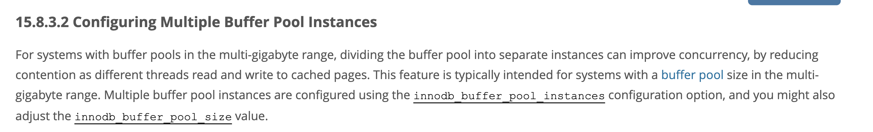
Multiple buffer pool instances
Why using multiple buffer pool?
  1. Different pages have different access patterns
    E.g., index pages are more likely to be accessed later
  2. A single buffer pool may increase the likelihood of contention
    E.g., latch contention
Different designs of multiple buffer pools
  Per-database buffer pool
  Per-page type buffer pool
Notes:
比如， 扫表的时候， 数据基本不需要缓存。 但是，index是很容易被访问的
每个buffer pool有不同的policy （后面会具体讲到）
更好的scalability
每个工业级的DBMS都采用了这个优化
Source: https://dev.mysql.com/doc/refman/8.0/en/innodb-multiple-buffer-pools.html

Slide 42
Multiple buffer pool instances
Q: How do we know which buffer pool has my cached page?
  Simple if we have one buffer pool per page type / database
  But what if we have multiple buffer pool for one page type?
    To further improve concurrency
Which technique we discussed before can help?
  It's essentially a partitioning problem:
    Given a page address, select a buffer pool to cache it
    buffer_pool_id = partition(page_addr)

Slide 43
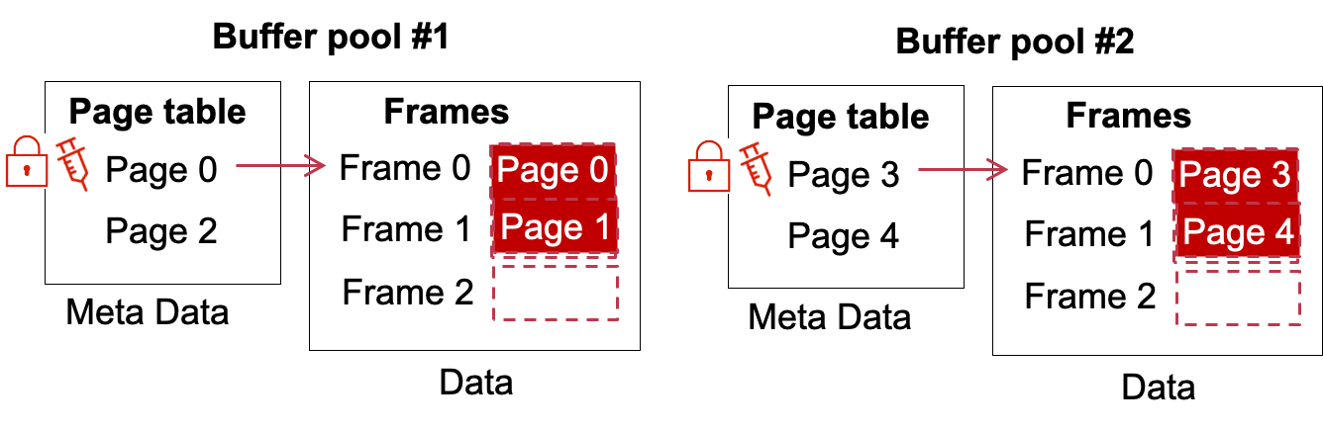
Multiple buffer pool instances
How do we know which buffer pool has my cached page?
  It's essentially a partitioning problem:
    Given a page address, select a buffer pool to cache it
    buffer_pool_id = partition(page_addr)
Two classic partitioning algorithms
  Hash partitioning & range partition

Slide 44
Multiple buffer pool instances
Two classic partitioning algorithms
  Hash partitioning & range partition
Example: get_page(1)
  1. id = Hash(1) %2
  2. buffer_pool[id].get_page(1)
Notes:
为什么不用 consistent hashing？
Not necessilary

Slide 45
Multiple buffer pool instances
Two classic partitioning algorithms
  Hash partitioning & range partition
Example: get_page(1)
  1. id = (1 <= 2)?0 : 1;
  2. buffer_pool[id].get_page(123)
Notes:
就是 <= 100 的页去向第0个，其他的去第一个

Slide 46
Multiple buffer pool instances
Two classic partitioning algorithms
  Hash partitioning & range partition
Which one is better?
  Typically hashing is sufficient, and can achieve more balanced distribution between different buffer pools
  Range partitioning could be better for locality
    In range partitioning, we should carefully ensure that each partition has roughly the same pages
    E.g., it's likely that the items released in recent years are much more than previous years

Slide 47
Optimizations for buffer pool
Multiple Buffer Pools
Pre-Fetching
Scan Sharing

Slide 48
Page prefetching
Based on the query, DBMS can pre-fetch pages
  Minimize the disk stalls of read
  E.g., Sequential scanning
    E.g., Q = select * from Items;
Buffer pool
Frames
Page0
Frame 0
Frame 1
Frame 2
Q
Page2
Directory
Page0
Page1
Page2
Page3
…
Heap File

Slide 49
Page prefetching
Based on the query, DBMS can pre-fetch pages
  Minimize the disk stalls of read
  E.g., Sequential scanning
    E.g., Q = select * from Items;
  Assuming that all data are sequentially stored
    E.g., achieved via careful allocations
Buffer pool
Frames
Page0
Frame 0
Frame 1
Frame 2
Q
Page2
Directory
Page0
Page1
Page2
Page3
…
Heap File
Notes:
通常可以做到：比如不把数据存在b树叶子结点里。

Slide 50
Page prefetching
Based on the query, DBMS can pre-fetch pages
  Minimize the disk stalls of read
  E.g., Sequential scanning
    E.g., Q = select * from Items;
  Assuming that all data are sequentially stored
    E.g., achieved via careful allocations
Buffer pool
Frames
Page0
Frame 0
Page0
Frame 1
Page1
Frame 2
Page2
Q
Page2
Directory
Page0
Page1
Page2
Page3
…
Heap File
Notes:
通常可以做到：
1)比如不把数据存在b树叶子结点里。
2) 只有sequential insert的话也比较容易做到。
一般DBMS会把整张表的数据放在连续的heap file里。 因为这样可以加速scan整张表（比如analytic job，入统计counter和算平均）
即使不是整张表都连续，也会一段一段的连续。

Slide 51
Page prefetching
Based on the query, DBMS can pre-fetch pages
  Minimize the disk stalls of read
  E.g., Sequential scanning
    E.g., Q = select * from Items;
  Assuming that all data are sequentially stored
    E.g., achieved via careful allocations
Buffer pool
Frames
Page0
Frame 0
Page0
Hit!
Frame 1
Page1
Frame 2
Page2
Q
Page2
Directory
Page0
Page1
Page2
Page3
…
Heap File

Slide 52
Page prefetching
Based on the query, DBMS can pre-fetch pages
  Minimize the disk stalls of read
  E.g., Sequential scanning
    E.g., Q = select * from Items;
  Assuming that all data are sequentially stored
    E.g., achieved via careful allocations
For simple scenario, OS can prefetch in this case too
  E.g., mmap with MAP_POPULATE
Why not use OS prefetching?
Since DBMS can prefetch better in more workloads

Slide 53
Page prefetching with OS
OS provides page cache to cache frequently used disk pages
  Not that the granularity of disk page is different than the database page
    4KB vs. 16KB
Simple scenario, OS can prefetch in this case too
  E.g., mmap with MAP_POPULATE
DBMS
Buffer pool
OS
Page cache
Page
Page
Page
. . .
Page
Disk

Slide 54
Page prefetching with OS
Example: Page prefetching in case of index scan
  E.g., Q = select * from Items where Year between 2015 and 2021;
  We have already created a secondary index on the Year at item
Notes:
假设heap file被mmap上来了

Slide 55
Page prefetching with OS
Example: Page prefetching in case of index scan
  E.g., Q = select * from Items where Year between 2015 and 2021;
  We have already created a secondary index on the Year at item
Q
OS page cache
Index0
Secondary index
on Year
Frames
Page0
Index1
Index4
Frame 0
Index2
Index3
Index5
Index6
Frame 1
2005-2010
2010-2015
2015-2020
2020-2021
Frame 2
Directory
Page0
Page1
Page2
Page3
Page4
Page5
Heap File
Index0
Index1
Index2
Index3
Index4
Index5
Notes:
Index page 通常很难连续。因为B树的中间节点是从中间分裂的。
这边的buffer pool由OS来管

Slide 56
Page prefetching with OS
  E.g., Q = select * from Items where Year between 2015 and 2021;
Q
OS page cache
Index0
Secondary index
on Year
Frames
Page0
Index1
Index4
Frame 0
Index0
Index2
Index3
Index5
Index6
Frame 1
Index1
2005-2010
2010-2015
2015-2020
2020-2021
Frame 2
Index2
Q
Directory
Page0
Page1
Page2
Page3
Page4
Page5
Heap File
Index0
Index1
Index2
Index3
Index4
Index5
Notes:
这里面 prefetch了index1

Slide 57
Page prefetching with OS
  E.g., Q = select * from Items where Year between 2010 and 2021;
Q
OS page cache
Index0
Secondary index
on Year
Frames
Page0
Index1
Index4
Frame 0
Index0
Miss!
Index2
Index3
Index5
Index6
Frame 1
Index1
2005-2010
2010-2015
2015-2020
2020-2021
Frame 2
Index2
Q
Prefetching index1 & index2 is useless!
Directory
Page0
Page1
Page2
Page3
Page4
Page5
Heap File
Index0
Index1
Index2
Index3
Index4
Index5
Notes:
So far so good

Slide 58
Page prefetching with DBMS
  E.g., Q = select * from Items where Year between 2010 and 2021;
Q
OS page cache
Index0
Secondary index
on Year
Frames
Page0
Index1
Index4
Frame 0
Index0
Miss!
Index2
Index3
Index5
Index6
Frame 1
2005-2010
2010-2015
2015-2020
2020-2021
Frame 2
Q
The database can skip the prefetch in this scenario.
Directory
Page0
Page1
Page2
Page3
Page4
Page5
Heap File
Index0
Index1
Index2
Index3
Index4
Index5
Notes:
So far so good

Slide 59
Page prefetching with OS
  E.g., Q = select * from Items where Year between 2010 and 2021;
Q
OS page cache
Index0
Secondary index
on Year
Frames
Page0
Index1
Index4
Frame 0
Index4
Index2
Index3
Index5
Index6
Frame 1
Index5
2005-2010
2010-2015
2015-2020
2020-2021
Frame 2
Index6
Q
OS pre-fetching still works well in this scenario, but what if the index does not match the page id order?
Directory
Page0
Page1
Page2
Page3
Page4
Page5
Heap File
Index0
Index1
Index2
Index3
Index4
Index5
Notes:
So far so good

Slide 60
Page prefetching with OS
  E.g., Q = select * from Items where Year between 2010 and 2021;
Q
OS page cache
Index0
Secondary index
on Year
Frames
Page0
Index1
Index4
Frame 0
Index4
Index2
Index3
Index9
Index10
Frame 1
Index5
2005-2010
2010-2015
2015-2020
2020-2021
Frame 2
Index6
Q
If the index does not match the page id order,
Prefetching page 5 & 6 is still useless!
Directory
Page0
Page1
Page2
Page3
Page4
Page5
Heap File
Index0
Index1
Index2
Index3
Index4
Index5
Notes:
So far so good

Slide 61
Page fetching with DBMS
Typically, DBMS can do a more clever pre-fetching
  Because it knows how pages are linked together
    E.g., in an index structure
It can also implement the OS page-fetching techniques
  And can apply it in a more flexible way

Slide 62
Optimizations for buffer pool
Multiple Buffer Pools
Pre-Fetching
Scan Sharing

Slide 63

Scan sharing
If a query wants to scan a table and another query is already doing this, then the DBMS will attach the queries to the same buffer pool
  To avoid different queries from evicting buffered pages from each other
The queries do not necessary be the same, for example:
  Q1: select * from Items;
  Q2: select AVG(Price) from Items;
What if different queries have different progress?
  The DBMS tracks where the second query joins & re-do the process
Notes:
和result caching不同
在DB2和SQL server中实现，oracle只实现了一部分（两个query一样）

Slide 64
Example of scan sharing
Q1
select * from Items;
Buffer pool
Frames
Page0
Frame 0
Frame 1
Frame 2
Q1
Page2
Directory
Page0
Page1
Page2
Page3
…
Heap File

Slide 65
Example of scan sharing
Q1
select * from Items;
Buffer pool
Frames
Page0
Frame 0
Page0
Frame 1
Page1
Frame 2
Page2
Q1
Page2
Directory
Page0
Page1
Page2
Page3
…
Heap File

Slide 66
Example of scan sharing
Q1
select * from Items;
Buffer pool
Frames
Page0
Frame 0
Page0
Hit!
Frame 1
Page1
Frame 2
Page2
Q1
Page2
Directory
Page0
Page1
Page2
Page3
…
Heap File

Slide 67
Example of scan sharing
Q1
select * from Items;
Buffer pool
Frames
Page0
Frame 0
Page0
Hit!
Frame 1
Page1
Frame 2
Page2
Q1
Page2
Directory
Page0
Page1
Page2
Page3
…
Heap File

Slide 68
Example of scan sharing
Q1
select * from Items;
Buffer pool
Q2
select AVG(Price) from Items;
Frames
Page0
Frame 0
Page0
Hit!
Frame 1
Page1
Frame 2
Page2
Q2
Q1
Page2
Directory
Page0
Page1
Page2
Page3
…
Heap File
Notes:
Suppose a second query starts at this time

Slide 69
Example of scan sharing
Q1
select * from Items;
Buffer pool
Q2
select AVG(Price) from Items;
Frames
Page0
Frame 0
Page0
The buffer pool must do the evict.
And no perfect solution!
Frame 1
Page1
Frame 2
Page2
Q2
Q1
Page2
Directory
Page0
Page1
Page2
Page3
…
Heap File
Notes:
Suppose a second query starts at this time

Slide 70
Example of scan sharing
Q1
select * from Items;
Buffer pool
Q2
select AVG(Price) from Items;
Frames
Page0
Frame 0
Page0
The DBMS can stall the execution of Q1
  And sync Q1 & Q2 before doing the rest of the scans
Frame 1
Page1
Frame 2
Page2
Q2
Q1
Page2
Directory
Page0
Page1
Page2
Page3
…
Heap File
Notes:
Suppose a second query starts at this time

Slide 71
Buffer replacement policies

Slide 72
Buffer replacement policies
Buffer pool can easily become full
  E.g., if we scan the entire table
  In such cases, we must decide which frame to evict
What are the goals of buffer replacements?
  High Accuracy
  Quick Speed
  Low Meta-data overhead
Notes:
Accuracy:
Speed: do the replacement quickly, and do the normal operations quickly
Meta-data overhead:

Slide 73
Least-recently used (LRU) policy
Similar to cache replacement policies in CPU cache
Based on page’s access frequency
  The more recently a page has been accessed, perhaps the more likely it will be accessed again
Rule
  Replace the least-recently-used page if the frames are full

Slide 74
Implementing the LRU policy
Maintain a single timestamp of when each page was last accessed
When the DBMS needs to evict a page, select the one with the oldest timestamp
  Keep the pages in sorted order to reduce the search time on eviction
Buffer pool
Read
Page 0
Page table
Frames
Page0
query
Page 0
RC:1
Frame 0
Query Execution
Page 2
Frame 1
Page2
Frame 2
Pagex
Meta Data
Page2
Page table entry fields
Data

Slide 75
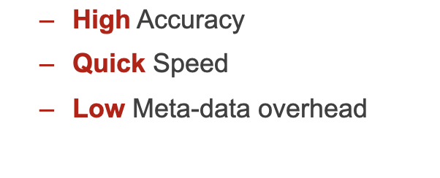
Implementing the LRU policy
Maintain a single timestamp of when each page was last accessed
When the DBMS needs to evict a page, select the one with the oldest timestamp
  Keep the pages in sorted order to reduce the search time on eviction
Does LRU satisfy our goals?

Slide 76
Implementing the LRU policy
Maintain a single timestamp of when each page was last accessed
  Storage overhead is non-trivial
    High meta-data overhead
Keep the pages in sorted order to reduce the search time on eviction
  Should use separate data structure to maintain the sorted order (e.g., queue)
    Additional meta-data overhead
  Should do two queue-operations per page access
    1. remove self from the list; 2. insert self again
    Low access speed

Slide 77
CLOCK algorithm
Approximation of LRU
  Each page only uses a reference bit
  Set to 1 when the page is accessed
Pages are organized in a circular buffer with a clock hand
  Upon sweeping, check a page’s bit is set to 1
    If yes, set to zero
    If no, then evict
Notes:
Clock hand: 钟头

Slide 78
Frame0
Reference bit: 0
Frame 3
Reference bit: 0
Frame 1
Reference bit: 0
Frame 2
Reference bit: 0
Page2
Directory
Page0
Page1
Page2
Page3
…
PageN
Heap File

Slide 79
Frame0
Reference bit: 1
Page1
Frame 3
Reference bit: 1
Page4
Page2
Frame 1
Reference bit: 1
Page3
Frame 2
Reference bit: 1
Page2
Directory
Page0
Page1
Page2
Page3
…
PageN
Heap File

Slide 80
Request: page5
Frame0
Reference bit: 1
Page1
Frame 3
Reference bit: 1
Page4
Page2
Frame 1
Reference bit: 1
Page3
Frame 2
Reference bit: 1
Page2
Directory
Page0
Page1
Page2
Page3
…
PageN
Heap File

Slide 81
Request: page5
Frame0
Reference bit: 0
Page1
Frame 3
Reference bit: 1
Page4
Page2
Frame 1
Reference bit: 1
Page3
Frame 2
Reference bit: 1
Page2
Directory
Page0
Page1
Page2
Page3
…
PageN
Heap File

Slide 82
Request: page5
Frame0
Reference bit: 0
Page1
Frame 3
Reference bit: 1
Page4
Page2
Frame 1
Reference bit: 0
Page3
Frame 2
Reference bit: 1
Page2
Directory
Page0
Page1
Page2
Page3
…
PageN
Heap File

Slide 83
Request: page5
Frame0
Reference bit: 0
Page1
Frame 3
Reference bit: 1
Page4
Page2
Frame 1
Reference bit: 0
Page3
Frame 2
Reference bit: 0
Page2
Directory
Page0
Page1
Page2
Page3
…
PageN
Heap File

Slide 84
Request: page5
Frame0
Reference bit: 0
Page1
Evict page1
Frame 3
Reference bit: 0
Page4
Page2
Frame 1
Reference bit: 0
Page3
Frame 2
Reference bit: 0
Page2
Directory
Page0
Page1
Page2
Page3
…
PageN
Heap File

Slide 85
Request: page5
Frame0
Reference bit: 1
Page5
Frame 3
Reference bit: 0
Page4
Page2
Frame 1
Reference bit: 0
Page3
Frame 2
Reference bit: 0
Page2
Directory
Page0
Page1
Page2
Page3
…
PageN
Heap File

Slide 86
LRU & Clock are not perfect
Problem of sequential flooding
  A query performs a sequential scan that reads every page
  E.g., select * from Items;
This pollutes the buffer pool with pages that are read once and then never again
  In some workloads the most recently used page is the most unneeded page
What would happen when such a query executes?
Notes:
Works well for single point query (e.g., get() or select * from xxx where key = xx);

Slide 87
Example of sequential flooding
Q1
select * from Items;
Buffer pool
Frames
Page0
Frame 0
Page0
Frame 1
Frame 2
Q1
Page2
Directory
Page0
Page1
Page2
Page3
…
Heap File

Slide 88
Example of sequential flooding
Q1
select * from Items;
Buffer pool
Frames
Page0
Frame 0
Page0
Frame 1
Page1
Frame 2
Q1
Page2
Directory
Page0
Page1
Page2
Page3
…
Heap File

Slide 89
Example of sequential flooding
Q1
select * from Items;
Buffer pool
Frames
Page0
Frame 0
Page0
Frame 1
Page1
Frame 2
Page2
Q1
Page2
Directory
Page0
Page1
Page2
Page3
…
Heap File

Slide 90
Example of sequential flooding
Q1
select * from Items;
Buffer pool
According to LRU/Clock, which page should evict?
Frames
Page0
Frame 0
Page0
Page3
Frame 1
Page1
Frame 2
Page2
Q1
Page2
Directory
Page0
Page1
Page2
Page3
…
Heap File

Slide 91
Example of sequential flooding
Q1
select * from Items;
Buffer pool
Suppose this time Q1 halts and Q2 comes
(maybe due to OS scheduling)
Frames
Page0
Frame 0
Page3
Q2
select AVG(Price) from Items;
Page1
Frame 1
Frame 2
Page2
Q2
Q1
Page2
Directory
Page0
Page1
Page2
Page3
…
Heap File

Slide 92
Example of sequential flooding
Q1
select * from Items;
The next page of Q2 to read!
Buffer pool
Suppose this time Q2 comes
Frames
Page0
Q2
select AVG(Price) from Items;
Frame 0
Page3
Frame 1
Page1
Which page should evict?
Frame 2
Page2
Q2
Q1
Page2
Directory
Page0
Page1
Page2
Page3
…
Heap File

Slide 93
Possible workarounds
#1. Use scan sharing
  Usually limited support -> should stall queries to determine when to scan
  What if the scan ranges of queries are different?
    E.g., Q2 only scan the first three pages with: select AVG(Price) from Items LIMIT 100;
#2. Use another policy
  E.g., most recently used (MRU) works well in this case
  E.g., LRU-K
    Track the history of last K references to each page as timestamps and compute the interval between subsequent accesses

Slide 94

Possible workarounds: buffer pool bypass
The sequential scan operator will not store fetched pages in the buffer pool to avoid overhead
  Instead, use a local memory buffer for the query
  Works well if operator needs to read a large sequence of pages that are contiguous on disk
  Called "Light Scans" in IBM Informix

Slide 95
More about buffer pool replacement policy:
Can we leverage the query execution pattern to buffer required pages?

Slide 96


Example: Insert into Items VALUES (id++, ...)
Suppose we add an attribute to our Items table
  ID as its primary key
We continuously execute this query, e.g., model the process of dumping items from one vender to another
  Importing items from ->
ID | Name | Provider | Year
0 | Ipad pro | Apple | 2021
1 | Iphone | Apple | 2021

Slide 97
Example: Insert into Items VALUES (id++, ...)
Suppose we add an attribute to our Items table
  ID as its primary key
What’s the access pattern of this query if we execute it continuously?
Index of ID
(Backed by B+Tree)
Index0
Index1
Index4
Index2
Index3
Index5
Index6
MIN
ID
MAX

Slide 98
Example: Insert into Items VALUES (id++, ...)
Suppose we add an attribute to our Items table
  ID as its primary key
What’s the access pattern of this query if we execute it continuously?
Insert into Items VALUES (id++, ...)
Index of ID
(Backed by B+Tree)
Index0
The DBMS can give a hints to the buffer pool
to always cache these pages
Index1
Index4
Index2
Index3
Index5
Index6
MIN
ID
MAX

Slide 99
Eviction policy based on query patterns: priority hints
The DBMS knows about the context of each page during query execution
  It can provide hints to the buffer pool on whether a page is important or not
Another example:
  Suppose the following query dominates the DBMS workloads (aka. point query)
    select * from Items where ID = xxx;
  Which index page should always be stored in the buffer pool?
Index of ID
(Backed by B+Tree)
Index0
Index1
Index4
The up-layer pages should be
in buffer pool
Index2
Index3
Index5
Index6
MIN
ID
MAX
Notes:
数据库可以使用query的模式优化对应的剔除/缓存 策略
point query（点查询），index的访问相对随机，顶层节点被访问概率更高，越往下越随机

Slide 100
I/O cost of evicting a frame
If a page is not dirty, then evicting is fast
  No disk I/O (write) involved
What if a page is dirty?
  Problem #1. Slow
    The DBMS must write back to disk to ensure that its changes are persisted
  Problem #2. Consistency
    The log of the modified page is not persisted
Notes:
除了policy的开销外， frame的剔除也有I/O的开销。

Slide 101
Optimizing I/O cost of evicting a frame
Background writing
  The DBMS can periodically walk through the page table and write dirty pages to disk
  When a dirty page is safely written, the DBMS can either evict the page or just unset the dirty flag
Need to be careful that we don’t write dirty pages before their log records have been written...
  Recall: do-redo-undo log

Slide 102
Conclusion of DBMS managed buffer pool
The DBMS can almost always manage memory better than the OS
Can leverage the semantics about the query plan to make better decisions
  Evictions
  Allocations
  Pre-fetching
Yet, for simplicity, several systems still leverage the OS to manage its buffer
  E.g., the OS’s pre-fetch & CLOCK works well under many scenarios

Slide 103
Outline
Buffer pool swap in/out 的需求
  - When to read pages into memory, and when to write them to disk
  - The goal is to minimize the number of stalls from having to read data from disk.
Buffer manager
  怎么track哪些page 需要写回？ 功能 meta data， dirty page, etc
  并发情况怎么处理？ Lock vs. latch
  Buffer pool 是不是最优的？ Buffer manager 的性能优化
    Multiple Buffer Pools -> 对应并发情况
    Pre-fetching
    Scan sharing
    Bypass
Replacement policy
  LRU (why not use?)
  Clock -> approximation of LRU
  The above techniques are used in cache/OS; what are the drawbacks in DBMS? sequential flooding
  Priority hints
    两个例子。 就是一个只cache右边， 一个只cache root
  Background writing

