Slide 1


Database management system
Query execution & Summary
SE124 (2021 Fall)
IPADS, Shanghai Jiao Tong University
https://www.sjtu.edu.cn
Credits: Andy Pavlo@CMU

Slide 2
Review: scalable websites
Scalable websites powered by distributed systems
  For request handling, data storage
Caching server
Caching server
Caching server
…
Caching
Caching
Caching
Distributed caching
Database server
Database server
CDN
Users
Application #1
generate the page
Database
user, price
…
Database
user, price
Application server
Distributed database
Internet
Load
Balance
Application #2
add the order
File server
File server
File server
File:
image
File:
image
…
File:
image
Application server
…
…
Message queue
Distributed file system

Slide 3






Database: core component in many database systems
Web applications, e-commerce systems, etc.
Database stores and manage the user data
  Organized collection of inter-related data that models some aspect of the real-world

Slide 4
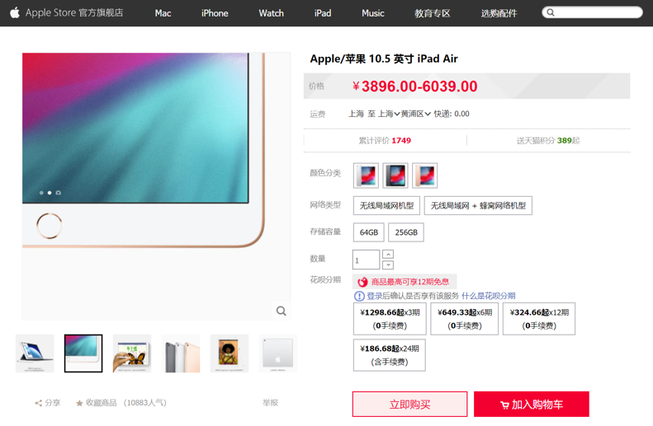
Different storage systems for different types of data
Database
File system
Key-value store

Slide 5

Big picture of how a SQL is physically processed
query=
select price from items
where name = “IPAD”
query
Query Execution
Database
DBMS
Storage
I/O access
Database

Slide 6
Review: DBMS Storage + Buffer Pool
query=
select price from items
where name = “IPAD”
query
Query Execution
last two lectures
Database
DBMS
Storage
I/O access
Database

Slide 7
Today’s lecture
query=
select price from items
where name = “IPAD”
query
Query Execution
Database
DBMS
Storage
I/O access
Database

Slide 8
Query plan
The query engine will parse a SQL into a tree (called query plan)
  Each node is an operator in relational algebra
  Data flows from the leaves to the tree up towards to the root
  The output of the root node is the result of the query
Example table
Item (name, provider, year)
Name | Provider | Year
Ipad pro | Apple | 2021
Iphone | Apple | 2021

Slide 9
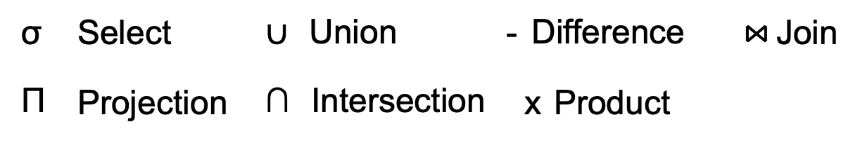
Query plan
How to generate the query plan is out of the scope
The query engine will parse a SQL into a tree (called query plan)
  Each node is an operator in relational algebra
  Data flows from the leaves to the tree up towards to the root
  The output of the root node is the result of the query
⋈
Provider⋈(σ_{Year>2021}(Item))
SELECT *
FROM Item JOIN Provider
On Item.Provider = Provider.Name
WHERE Item.year > 2020
σ_{Year>2021}
Provider
Item
Query plan

Slide 10
Processing model of the query plan
DBMS's processing model defines how the system executes a query plan
  Different trade-offs for different workloads
Approach #1. Iterator Model
Approach #2. Materialization Model
Approach #3. Vectorized / Batch Model

Slide 11
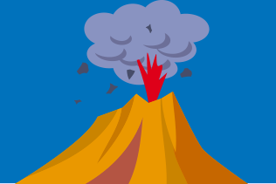
Iterator model
Each operator of the query plan implements a Next() function
  Similar to the iterator in programming languages
Next()
  On each invocation, the operator returns either a single tuple or a null marker if there are no more tuples
  The operator implements a loop that calls Next() on its children to retrieve their tuples and then process them
  Like the iterator in the programming language
Also called Volcano model
Notes:
最经典的query plan execution 模型a

Slide 12
Iterator model
SELECT *
FROM Item JOIN Provider
On Item.Provider = Provider.Name
WHERE Item.year > 2020
⋈
for tuple in Provider:
emit(tuple)
σ_{Year>2021}
for tuple in Item:
emit(tuple)
Provider
Item
Notes:
childL -> Left child

Slide 13
Iterator model
SELECT *
FROM Item JOIN Provider
On Item.Provider = Provider.Name
WHERE Item.year > 2020
tupleP.Name == tupleI.Provider
for tupleP in childL.Next():
for tupleI in childR.Next():
if condition(...):
emit(tupleP ⋈ tupleI)
⋈
σ_{Year>2021}
for tuple in child.Next():
if condition(tuple) emit(tuple)
Provider
Item
Notes:
childL -> Left child

Slide 14
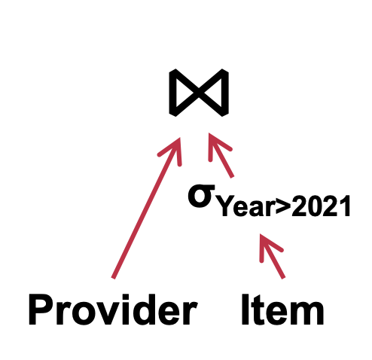
Iterator model
SELECT *
FROM Item JOIN Provider
On Item.Provider = Provider.Name
WHERE Item.year > 2020
tupleP.Name == tupleI.Provider
for tupleP in childL.Next():
for tupleI in childR.Next():
if condition(...):
emit(tupleP ⋈ tupleI)
for tuple in child.Next():
if condition(tuple) emit(tuple)
for tuple in Provider:
emit(tuple)
for tuple in Item:
emit(tuple)

Slide 15
Iterator model
SELECT *
FROM Item JOIN Provider
On Item.Provider = Provider.Name
WHERE Item.year > 2020
tupleP.Name == tupleI.Provider
1
for tupleP in childL.Next():
for tupleI in childR.Next():
if condition(...):
emit(tupleP ⋈ tupleI)
for tuple in child.Next():
if condition(tuple) emit(tuple)
for tuple in Provider:
emit(tuple)
for tuple in Provider:
emit(tuple)

Slide 16
Iterator model
SELECT *
FROM Item JOIN Provider
On Item.Provider = Provider.Name
WHERE Item.year > 2020
tupleP.Name == tupleI.Provider
1
for tupleP in childL.Next():
for tupleI in childR.Next():
if condition(...):
emit(tupleP ⋈ tupleI)
Single Tuple
for tuple in child.Next():
if condition(tuple) emit(tuple)
2
for tuple in Provider:
emit(tuple)
for tuple in Provider:
emit(tuple)

Slide 17
Iterator model
SELECT *
FROM Item JOIN Provider
On Item.Provider = Provider.Name
WHERE Item.year > 2020
tupleP.Name == tupleI.Provider
1
for tupleP in childL.Next():
for tupleI in childR.Next():
if condition(...):
emit(tupleP ⋈ tupleI)
3
for tuple in child.Next():
if condition(tuple) emit(tuple)
2
for tuple in Provider:
emit(tuple)
for tuple in Provider:
emit(tuple)

Slide 18
Iterator model
SELECT *
FROM Item JOIN Provider
On Item.Provider = Provider.Name
WHERE Item.year > 2020
tupleP.Name == tupleI.Provider
1
for tupleP in childL.Next():
for tupleI in childR.Next():
if condition(...):
emit(tupleP ⋈ tupleI)
3
4
for tuple in child.Next():
if condition(tuple) emit(tuple)
2
for tuple in Provider:
emit(tuple)
for tuple in Provider:
emit(tuple)

Slide 19
Iterator model
SELECT *
FROM Item JOIN Provider
On Item.Provider = Provider.Name
WHERE Item.year > 2020
tupleP.Name == tupleI.Provider
1
for tupleP in childL.Next():
for tupleI in childR.Next():
if condition(...):
emit(tupleP ⋈ tupleI)
3
4
for tuple in child.Next():
if condition(tuple) emit(tuple)
2
for tuple in Provider:
emit(tuple)
5
for tuple in Provider:
emit(tuple)

Slide 20
Iterator model
What if the condition is not satisfied?
Continue call the Next of the child.
SELECT *
FROM Item JOIN Provider
On Item.Provider = Provider.Name
WHERE Item.year > 2020
tupleP.Name == tupleI.Provider
1
for tupleP in childL.Next():
for tupleI in childR.Next():
if condition(...):
emit(tupleP ⋈ tupleI)
3
4
for tuple in child.Next():
if condition(tuple) emit(tuple)
6
2
for tuple in Provider:
emit(tuple)
5
for tuple in Provider:
emit(tuple)

Slide 21
Iterator model
Iterator model is used in almost every DBMS
  Benefits: e.g., allows for tuple pipeline
Some operator must block until their children emit all their tuples
  E.g., the "order by" operator
    Sort the fetched data in either ascending or descending, according to one or more columns

Slide 22
Iterator model
Iterator model is used in almost every DBMS
  Benefits: e.g., allows for tuple pipeline
Some operator must block until their children emit all their tuples
  E.g., the "order by" operator
    Sort the fetched data in either ascending or descending, according to one or more columns
Question: what are the drawbacks of iterator model?
  Too many (virtual) function calls
    Bad, especially in an in-memory setting (e.g., tuples all in buffer pool)
    Why? The cost of function calls is more obvious!

Slide 23
Processing model of the query plan
DBMS's processing model defines how the system executes a query plan
  Different trade-offs for different workloads
Approach #1. Iterator Model
Approach #2. Materialization Model
Approach #3. Vectorized / Batch Model

Slide 24
Materialization Model
Each operator processes its input all at once and then emits its output all at once
  I.e., the operator "materializes" its output as a single result
What are the benefits?
  Less function call overheads
What happens if the output is too large?
  Should co-work with the DBMS push down hints (e.g., LIMIT) to avoid scanning too many tuples
    LIMIT: set by users, which limits the number of tuple returned by a query

Slide 25
Materialization Model
out = []
for tupleP in childL.get_out():
for tupleI in childR.get_out():
if condition(tupleP.tupleI):
out.add(tupleP ⋈ tupleI)
return out
out = []
for tuple in child.get_out():
if condition(tuple) out.add(tuple)
return out
out = []
for tuple in Provider:
out.add(tuple)
return out
out = []
for tuple in Item:
out.add(tuple)
return out

Slide 26

Materialization Model
Better for OLTP workloads
  Online Transaction Processing
  E.g., buy an item in Taobao
  Usually queries only access a small number of tuples at a time
  Lower execution / coordination overhead
  Few function calls
Not good for OLAP queries with large intermediate results
  Online Analysis Processing
  E.g., analysis all the user behavior
Notes:
在VOLTDB中有应用。

Slide 27
Processing model of the query plan
DBMS's processing model defines how the system executes a query plan
  Different trade-offs for different workloads
Approach #1. Iterator Model
Approach #2. Materialization Model
Approach #3. Vectorized / Batch Model

Slide 28
Vectorized model
Somewhere between Iterator & Materialization model
Like Iterator model, each operator implements a Next() function
  On each invocation, the operator returns either a single tuple or a null marker if there are no more tuples
The operator's internal loop processes multiple tuples at a time
  The size of the batch can vary based on hardware or query properties
a batch of tuples

Slide 29
Vectorized model
out = []
for tupleP in childL.Next():
for tupleI in Next():
if condition(tupleP.tupleI):
out.add(tupleP ⋈ tupleI)
if len(out) > N: emit(out);out = []
out = []
for tuple in child.Next():
if condition(tuple) out.add(tuple)
if len(out) > N: emit(out);out = []
out = []
for tuple in Provider:
out.add(tuple)
if len(out) > N: emit(out);out = []
out = []
for tuple in Item:
out.add(tuple)
if len(out) > N: emit(out);out = []

Slide 30



Vectorized model
Ideal for OLAP queries because it greatly reduces the number of invocations per operator
  Also, does not need to worry about the output size
Allows for operators to more easily use vectorized (SIMD) instructions to process batches of tuples
  Supported in many modern databases
Difference from LIMIT
  LIMIT is set by users, vectorized model is done by the DBMS

Slide 31
Operator implementations & optimizations

Slide 32
How to implement each operator efficiently?
The query engine will parse a SQL into a tree (called query plan)
  Each node is an operator in relational algebra
  Data flows from the leaves to the tree up towards to the root
  The output of the root node is the result of the query
⋈
Provider⋈(σ_{Year>2021}(Item))
SELECT *
FROM Item JOIN Provider
On Item.Provider = Provider.Name
WHERE Item.year > 2020
σ_{Year>2021}
Provider
Item
Query plan

Slide 33
How to implement each operator efficiently?
SELECT *
FROM Item JOIN Provider
On Item.Provider = Provider.Name
WHERE Item.year > 2020
Does scanning the whole table efficient?
for tupleP in childL.Next():
for tupleI in childR.Next():
if condition(...):
emit(tupleP ⋈ tupleI)
⋈
σ_{Year>2021}
for tuple in child.Next():
if condition(tuple) emit(tuple)
Provider
Item
Notes:
childL -> Left child

Slide 34
Accelerate operator execution
For each operator, we have corresponding optimization algorithms to implement them
  Join
  Aggregator
  Select
  Etc.
We will only illustrate some basic operators in this lecture

Slide 35
Accelerate select operator with index scan
Abstraction: select
  Choose a subset of the tuples from a relation that satisfies a selection predicate
  Can combine multiple predicates using conjunctions / disjunctions
Assuming there is an index on the select predict
  Otherwise, DBMS can hardly help
SELECT *
FROM Item JOIN Provider
On Item.Provider = Provider.Name
WHERE Item.year > 2020
predicates

Slide 36
Accelerate select operator with index scan
Index scan
  DBMS picks an index to find the tuples that the query needs
    Instead of scanning the whole table to find the target tuples
SELECT *
FROM Item
WHERE Item.year > 2020
σ_{Year>2021}
IndexScan(Item)
Item
Notes:
What if the predict is on the sub query?

Slide 37
Accelerate select operator with index scan
Index scan
  DBMS picks an index to find the tuples that the query needs
Recall: what is a database index
  A mapping between attribute value -> tuple address
  Typical data structure: BTree and its invariants
  Why not using hash table?
    No support for range queries
Notes:
What if the predict is on the sub query?

Slide 38
Accelerate select operator with index scan
Example: suppose there is an index on Item.year (named Item.year_index)
  Cursor: the current BTree node to traverse
SELECT *
FROM Item
WHERE Item.year > 2020
for tuple in child.Next():
if condition(tuple) emit(tuple)
cursor = Item.year_index.seek(2020)
for tuple in cursor.Next():
if emit(Item.get(tuple.value))
for tuple in Item:
emit(tuple)
w/o index
w/ index
Notes:
What if the predict is on the sub query?

Slide 39
Question: what if the predicate is more complicated?
What if our predict is more complicated?
  E.g., suppose our item has another field called price
  There are two secondary indexes on Year & Price
    The primary index is on the Name
Item (name, provider, year, price)
SELECT *
FROM Item
WHERE
Item.year > 2020
AND Item.price > 8000
Name | Provider | Year | Price
Ipad pro | Apple | 2021 | 9999
Iphone | Apple | 2021 | 6666

Slide 40
Question: what if the predicate is more complicated?
What if our predict is more complicated?
  E.g., suppose our item has another field called price
  There are two secondary indexes on Year & Price
Naïve design
  Choose one index to scan, and fetch each tuple and check the remaining
Scenario #1
  There are 99 items released after 2020, but only 2 of their price is larger than 8000
SELECT *
FROM Item
WHERE Item.year > 2020
AND Item.price > 8000

Slide 41
Question: what if the predicate is more complicated?
What if our predict is more complicated?
  E.g., suppose our item has another field called price
  There is a secondary index on year & price
Naïve design
  Choose one index to scan, and fetch each tuple and check the remaining
Scenario #1
Scenario #2
  There are 99 items released after 2020, but only 2 have price larger than 8000
  There are 2 items released after 2020, but 99 have price larger than 8000
SELECT *
FROM Item
WHERE Item.year > 2020
AND Item.price > 8000
Which index to choose at the first place?

Slide 42
How to reduce tuple fetched? Multi-index scan
If there are multiple indexes that the DBMS can use for a query
  Compute sets of tuple addresses using each matching index
  Combine these sets based on the query's predicates
    (union vs. intersect)
  Retrieve the tuples and apply any remaining predicates
Postgres calls this Bitmap Scan

Slide 43
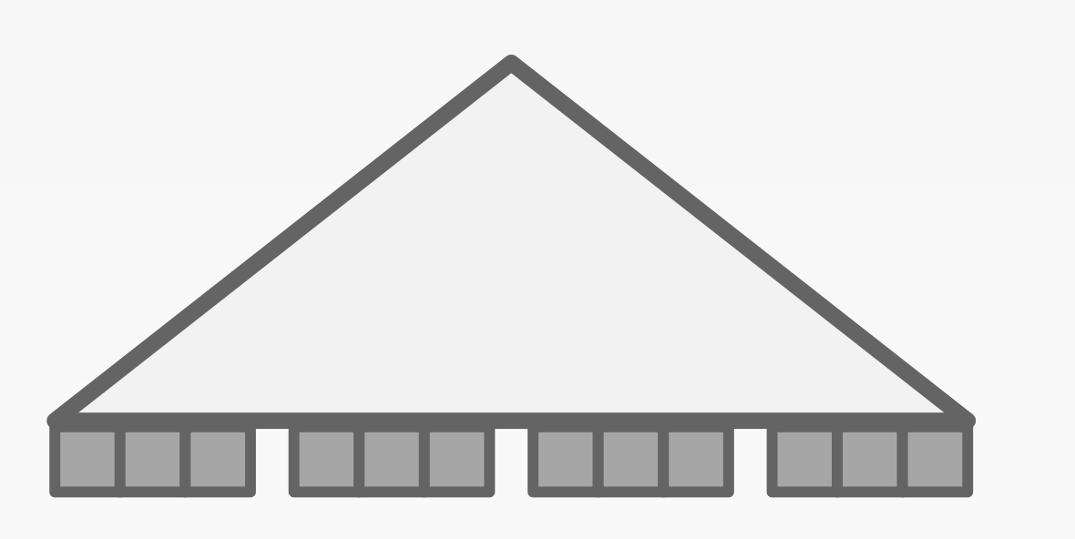
Multi-index scan
SELECT *
FROM Item
WHERE Item.year > 2020
AND Item.price > 8000
The operator will first:
  Scan the year index to get record addresses whose year > 2020
Year > 2020
Tuple addresses

Slide 44
Multi-index scan
SELECT *
FROM Item
WHERE Item.year > 2020
AND Item.price > 8000
The operator will first:
  Scan the year index to get record addresses whose year > 2020
  Scan the price index to get record addresses whose price > 8000
Year > 2020
Price > 8000
Tuple addresses

Slide 45
Multi-index scan
SELECT *
FROM Item
WHERE Item.year > 2020
AND Item.price > 8000
The operator will first:
  Scan the year index to get record addresses whose year > 2020
  Scan the price index to get record addresses whose price > 8000
  Take their intersection
  Retrieve the tuples with the intersected addresses
Year > 2020
Price > 8000
Tuple addresses

Slide 46
How to find the intersected data efficiently?
Naïve solution:
  Nested loop takes O(N * M)
Fast set intersection can be done with
  Bitmaps, hash tables, or Bloom filters
Example of bitmap:
  Suppose we have two sets {1,2,4} and {1,2,5}
  Then we can compute two bitmaps: 00010110 & 00100110
  Then using an and operation will get the intersected results

Slide 47
Summary of (traditional) DBMS so far
query=
select price from items
where name = “IPAD”
query
Lecture 16
Query Execution
This lecture
Database
DBMS
Storage
Lecture 17 & 18
I/O access
Database

Slide 48

Summary of (traditional) DBMS so far
DBMS also provides ACID (check lecture 11-13)
A：Atomicity
C：Consistency
I：Isolation
D：Durability

Slide 49
OldSQL
NoSQL
NewSQL

Slide 50
OldSQL = Relational Model + SQL + ACID
The architectural or historical ﻿baggage of SQL
Abstraction
  Relational + Transaction
Semantic
  ACID
Architecture
  Mostly focus on Single-node & On-disk

Slide 51

The trend of Web and Big Data
Requirements
  Scalability: Multiple concurrent users
  Availability: Minimal User-down time
  Read-mostly
  Many data operations do not need transaction
  Large dataset
Note: some requirements are compatible to the SQL (and that’s why there is NewSQL)

Slide 52
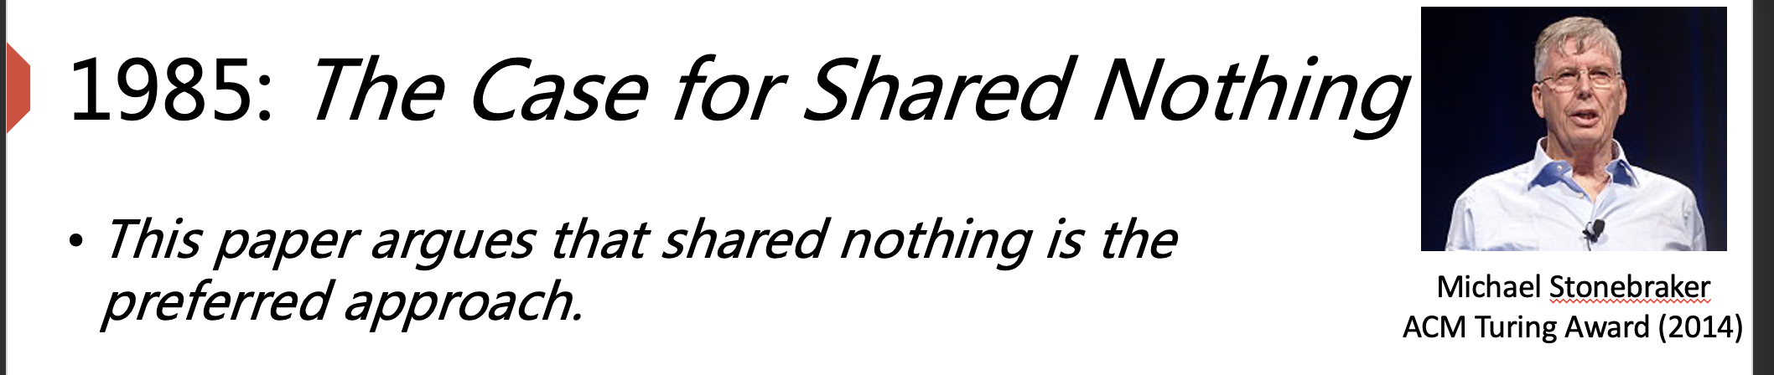
The Attempt for Scaling SQL
1986:
Building scale NoSQL DBMS on SQL☺
  E.g., MySQL
SQL
Shared-nothing
SQL
SQL
SQL
Vertically
Horizontally
Build larger machine
Build distributed system with more machines
Notes:
Is it centralized?
Why difficult to support ﻿update more than one record in a transaction
Double query optimizer
Vertically: Using better hardware
Horizontally:
How to do that?
A middleware
Google Ebay
Only support simple operations

Slide 53


Scale Horizontally with Middleware (in old time)
App
App
Read/Write single Record
Middleware
SQL
SQL
SQL
No Distributed Transaction & Join
Unavailable in some scenarios
E.g., Server failover
Shard1
(1-33)
Shard2
(34-66)
Shard3
(67-100)
﻿eBay’s Oracle-based cluster[1]
Google’s MySQL-based cluster[2]
We should mention that we can actually support availability & distributed with techniques taught
[1] https://tuftsdev.github.io/WebEngineering/spring2017/notes/ebay2006.pdf
[2] https://storage.googleapis.com/pub-tools-public-publication-data/pdf/38125.pdf
Notes:
当年这些技术还没有广泛的应用。 后面我们会看到现代系统使用这些的实现

Slide 54
Scale Horizontally with Middleware
No distributed TX
  No ACID properties
    Cannot to implement AliPay
No join
  Only support single read/write query
    E.g., select * from xxx where ID = xxx;
  Similar semantic as key-value store!
Why not provide join?
  E.g., using nested loop to implement
    Inefficient! DBMS has many opts
App
App
Middleware
SQL
SQL
SQL
Shard1
(1-33)
Shard2
(34-66)
Shard3
(67-100)
Not implemented that time.
But are now supported.

Slide 55
The term “NoSQL”
First use in 1988[1], used to describe
  An RDBMS not using SQL
Reintroduced in 2009[2], during the meetup for
  Open-source distributed, non-relational databases
[1] https://en.wikipedia.org/wiki/Strozzi_NoSQL
[2] https://web.archive.org/web/20110716174012/http://blog.sym-link.com/2009/05/12/nosql_2009.html
Notes:
SQL: standard query language
Unix shell

Slide 56
NoSQL - Build from scratch
How does NoSQL make trade off?
  Specific (simplified) data model
  Weaken Transaction
  Async Replication
Reducing the complexity
e.g., distributed query plan,
join support, etc.
Sacrifice consistency for scalability & availability

Slide 57
1. Specific (Simplified from SQL) Data Model
All records can be found by simple lookup
  Key-Value store
  Document (We have discussed)
  Wide-Column Store
    A table-oriented model
    But its columns can vary from row to row in the same table
Why?
  Easy to build from scratch, can focus on being more scalable!
  E.g., no need to implement the iterator model used in SQL
key
Alice
key
Name: Alice, Age:10
Name, Age
Email
key
Alice,10
key
Alice@qq.com
Notes:
Kv -> redis
Document -> MongoDB
WSS -> BigTable

Slide 58
2. Weaken Transaction
Data are partitioned across different servers
  What if a query’s data touches two partitions?
Consistency between servers require global transaction
  Even single node transaction is costly!
Local Transaction {
A = A + 1
B = B + 1
}
S1
A=0
B=0
S2
C=0
D=0
Global Transaction {
A = A + 1
C = C + 1
}

Slide 59

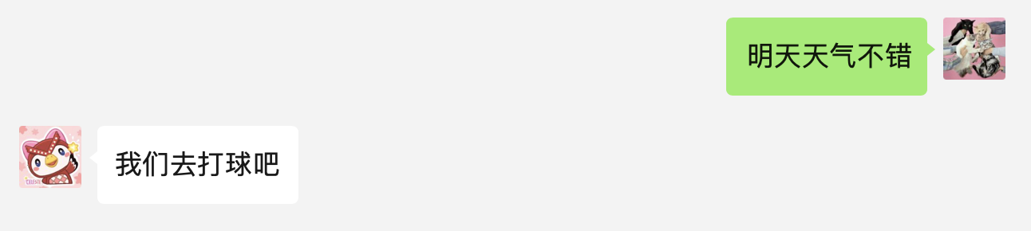
Drawback of weaken transaction
What may happen when weakening the transaction?
  Can have incorrect results (anomalies)
    Messages reorder
In several workloads, can tolerate such incorrect results
  E.g., social network applications
WeChat on my Mac
WeChat on my iPhone

Slide 60
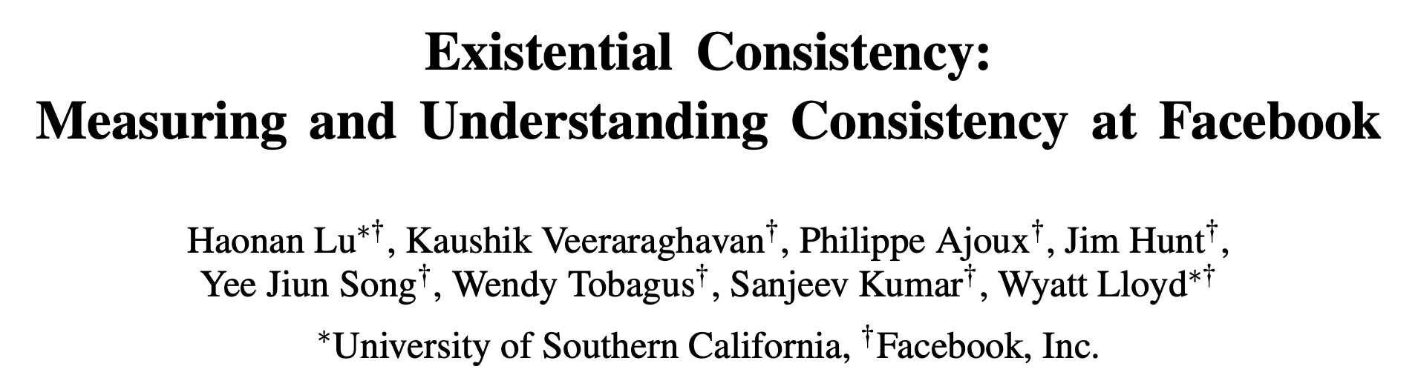
Drawback of weaken transaction
What may happen when weakening the transaction?
  Can have incorrect results (anomalies)
In several workloads, can tolerate such incorrect results
  E.g., social network applications
    Facebook's reports: 1 anomaly per million reads

Slide 61
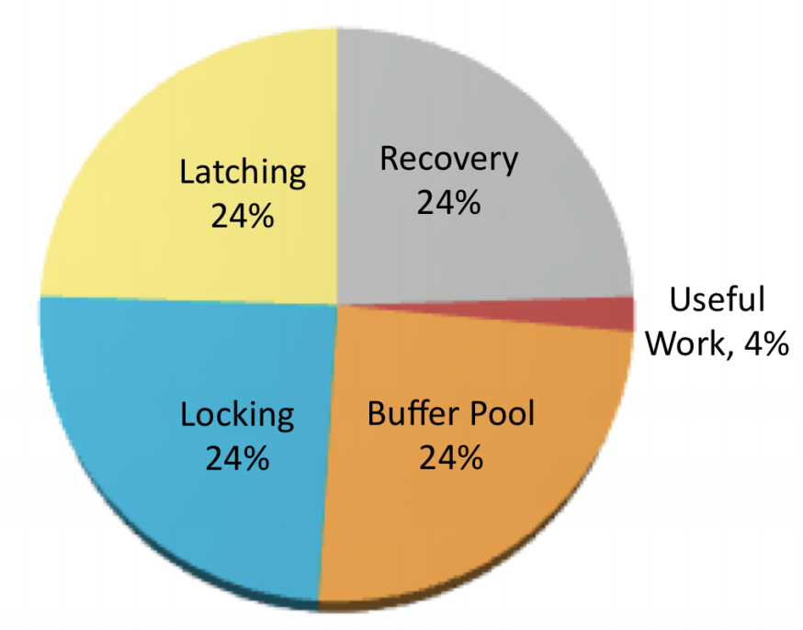
Why weakening the Transaction?
The Problem of OldSQL
  Huge software overheads introduced by ACID transactions
OldSQL spends little time for useful work
Figure from slides presented
by Michael Stonebraker[1]
[1] https://www.usenix.org/legacy/events/lisa11/tech/slides/stonebraker.pdf

Slide 62

3. Asynchronous Replication
Replication is used for Availability
Synchronous
  Wait for backup’s responses before return
Asynchronous
  Only waits for the primary
Commit requires one more round-trip
Primary
Backup
Possible to lose data or read stale data
What are the trade-offs?
Primary
Backup

Slide 63
Summary of Several Famous NoSQL systems
NoSQL | Data Model | Replication | Transaction
BigTable (2005) | Wide-Column | Sync+Async | Local
Cassandra (2008) | Wide-Column | Async | Local
MongoDB (2009) | Document | Async | None
Redis (2009) | Key/value | Async | None
Dynamo (2012) | Key/value | Async | None
*Table data collected when these project first released

Slide 64
What’s next?
NoSQL is becoming SQL!

Slide 65
The developers' burden without Transaction
Application-level Transaction & Join
  Can cause error/performance issues
Try {
Lock(A)
A = A + 1
Lock(C)
C = C + 1
} catch {
reset(A)
reset(C)
} finally {
Unlock(A)
Unlock(C)
}
Tx Begin
A = A + 1
C = C + 1
Tx End
With Transaction
Without Transaction

Slide 66
The claims from Google Spanner
BigTable: the early NoSQL database built by Google
“the lack of cross-row transactions in Bigtable led to frequent complaints”
“We believe it is better to have application programmers deal with performance problems due to overuse of transactions as bottlenecks arise, rather than always coding around the lack of transactions.”

Slide 67

As a result: the NoSQL is regaining ACID!
[1] https://docs.mongodb.com/manual/release-notes/4.0/
[2] https://docs.mongodb.com/manual/release-notes/4.2/
[3] https://aws.amazon.com/about-aws/whats-new/2018/11/announcing-amazon-dynamodb-support-for-transactions/

Slide 68
NewSQL
A class of modern RDBMS, which provides:
  NoSQL’s Scalability
  SQL’s ACID Transaction & Relational Model
First proposed in 2011 [1]
“Children make choices, adults want them all.” ——Someone said
[1] Matt Aslett, “How will the database incumbents respond to NoSQL and NewSQL?”, 2011

Slide 69

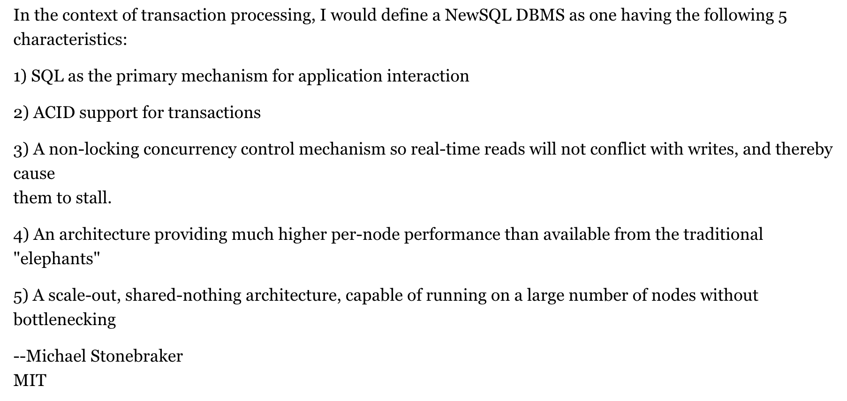

Stonebraker’s NewSQL definition[1]
Turing Award
2014
Michael Stonebraker
[1] https://cacm.acm.org/blogs/blog-cacm/109710-new-sql-an-alternative-to-nosql-and-old-sql-for-new-oltp-apps/fulltext
Notes:
non-locking这里指的是MVCC，即读不加锁

Slide 70
How to realize NewSQL?
Using the techniques we learned before!

Slide 71

Case study: TiDB
A distributed NewSQL database
  Inspired by Google Percolator and Spanner
Why talk about TiDB?
  It is open-sourced
  Other modern NewSQL DBMS (e.g., Google Spanner) is only available through the exclusive cloud providers
    Yet, some techniques are similar (e.g., whether to use Paxos or Raft)

Slide 72





Case study: (Simplified) TiDB
A distributed NewSQL database
Region 0: [0-10]
TiKV
Partitioning algorithms
Region 1: [10-20]
e.g., range partitioning:
keys from 0-10 goto the first machine, 10-20 goto the second, etc.
TiKV
Region 2: [20-30]
TiKV
User data
Storage

Slide 73
Case study: (Simplified) TiDB
TiKV: TiDB’s storage engine
Key-value storage (see lecture 9)
  Using RocksDB: a LSM-tree based key-value storage
File system (see lecture 3-4)
  Assuming ext4. an inode-based file system
TiKV
RocksDB
Ext4
  File system

Slide 74
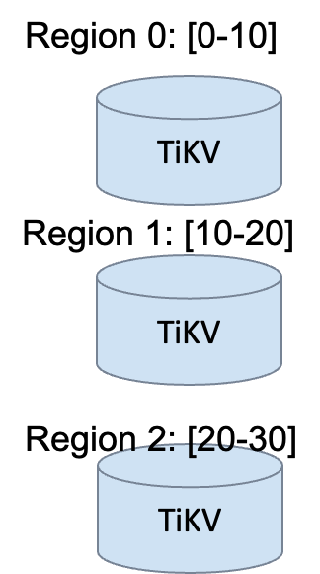
Case study: (Simplified) TiDB
How to handle one region failure?
New-SQL must be available!
TiKV: TiDB’s storage engine
Key-value storage (see lecture 9)
  Using RocksDB: a LSM-tree based key-value storage
File system (see lecture 3-4)
  Assuming ext4. an inode-based file system
TiKV
RocksDB
Ext4
  File system

Slide 75
Case study: (Simplified) TiDB
TiKV: TiDB’s storage engine
Raft (see lecture 15)
  Replicate the region on multiple tikv instances
  Using Raft to ensure high availability & consistency
TiKV
Raft
  Consensus
RocksDB
  Key-value storage
Ext4
  File system

Slide 76
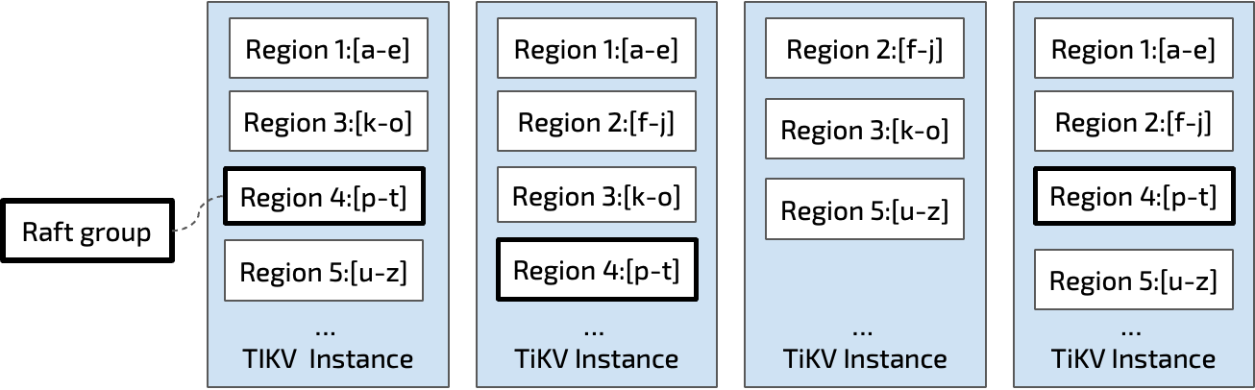
Case study: (Simplified) TiDB
Each raft group can be view as a single machine
  That never fail and is always consistent
  TiDB uses Raft to ensure this
Can also use Paxos
e.g., Google Spanner uses Paxos
  Logical view
  Physical view

Slide 77
Case study: (Simplified) TiDB
TiKV: TiDB’s storage engine
  Provides a raw key-value (or transactional key-value interface) to the others
MVCC + 2PC (see lecture 13 + 14)
  2PC: to commit transaction in a distributed setting
  MVCC; protocol to ensure snapshot isolation
MVCC + 2PC
  Transaction
TiKV
Raft
  Consensus
RocksDB
  Key-value storage
Ext4
  File system

Slide 78
Case study: (Simplified) TiDB
TiKV: TiDB’s storage engine
  Provides a raw key-value (or transactional key-value interface) to the others
Transactional
from tikv_client import TransactionClient
client = TransactionClient.connect(“127.0.0.1:8888”)
txn = client.begin()
txn.put(”k1”, ”Hello”)
txn.put(”k2”, ”world”)
txn.commit()
Raw key-value

Slide 79
Case study: (Simplified) TiDB
TiKV: TiDB’s storage engine
  Provides a raw key-value (or transactional key-value interface) to the others
How outside word using TiDB?
  Use gRPC (see lecture 05)
gRPC
  RPC
MVCC + 2PC
  Transaction
TiKV
Raft
  Consensus
RocksDB
  Key-value storage
Ext4
  File system

Slide 80
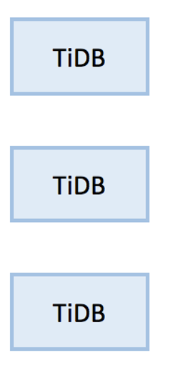
Case study: (Simplified) TiDB
Supporting SQL with TiDB
Disaggregated architecture
  Separate nodes that execute SQL query
  Retrieve/update the data via TiKV’s key-value API
How to execute the query?
  Iterator model! (see this lecture)
SQL
KV API
query=
select price from items
where name = “IPAD”

Slide 81
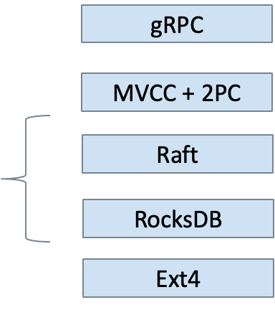
Summary
We have touched many important concepts that supports modern NewSQL databases
Lecture 5
Lecture 15
Lecture 16
Lecture 11-14
SQL
KV API
Lecture 9
query=
select price from items
where name = “IPAD”
Lecture 3-4

Slide 82
Summary SQL vs. NoSQL vs. NewSQL
A vague comparison (represents the majority)
  The comparison is based on general principles, not actual systems
    I.e., different systems may have different implementations, each with different trade-offs)
    E.g., some NoSQL databases also implement ACID
 | Relational | ACID | Scalability | Availability | Performance
(Old)SQL | ✓ | ✓ | ✗ | ✗ | Poor
NoSQL | ✗ | ✗ | ✓ | ✓ | Good+
NewSQL | ✓ | ✓ | ✓ | ✓ | Good
Notes:
很多干扰项， 比如language， etc

