Slide 1


Introduction to Network
SE124 (2021 Fall)
IPADS, Shanghai Jiao Tong University
https://www.sjtu.edu.cn

Slide 2
Review: scalable websites
Scalable websites powered by distributed systems
  For request handling, data storage
Caching server
Caching server
Caching server
…
Caching
Caching
Caching
Distributed caching
Database server
Database server
CDN
Users
Application #1
generate the page
Database
user, price
…
Database
user, price
Application server
Distributed database
Internet
Load
Balance
Application #2
add the order
File server
File server
File server
File:
image
File:
image
…
File:
image
Application server
…
…
Message queue
Distributed file system

Slide 3
Layers in Network
Application
  Can be thought of as a fourth layer
  Not part of the network
End-to-end layer
  Everything else required to provide a comfortable application interface
Network layer
  Forwarding data through intermediate points to the place it is wanted
Link layer
  Moving data directly from one point to another

Slide 4
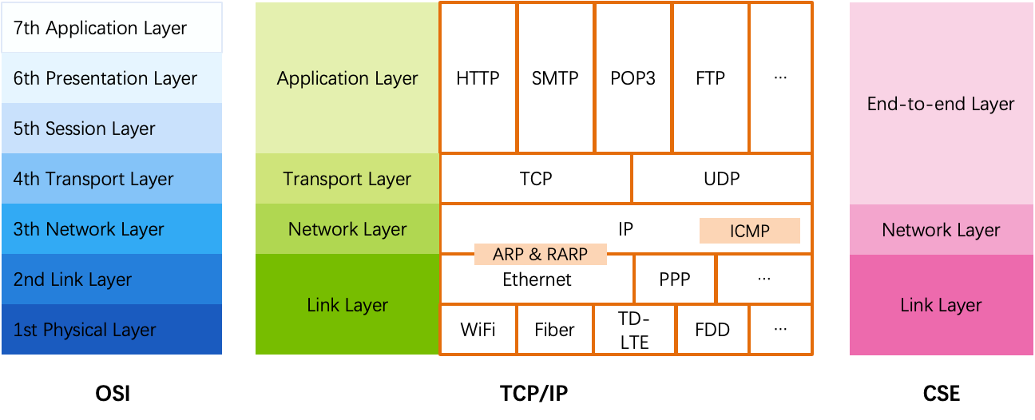
OSI, TCP/IP & Protocol Stack
OSI
  The open systems interconnection (OSI) model
  7-layer architecture

Slide 5
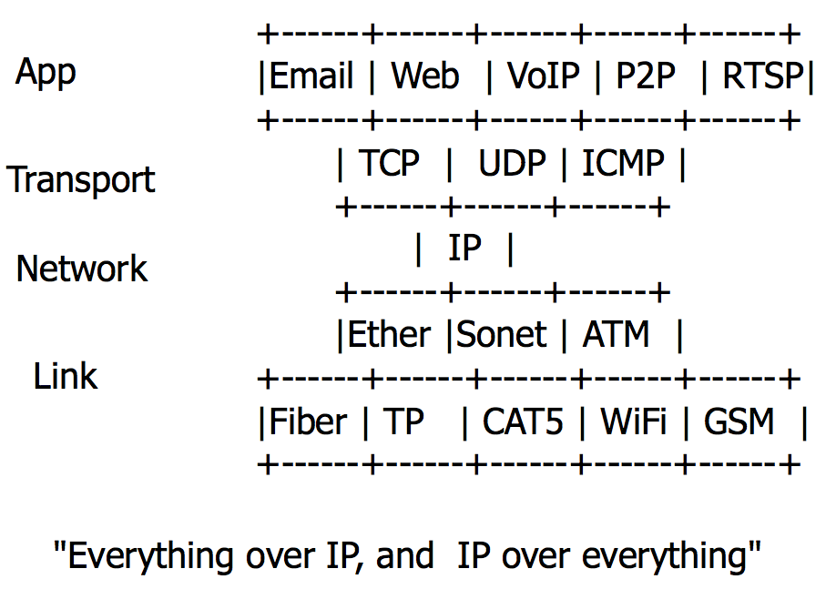
The Internet "Hour Glass" Protocols
More people, more useful
  Value to me = N
  Value to society is N2
Network, dumb vs. smart
  Standardize vs. flexibility
Network is a black box
  Simplify the system that uses it

Slide 6
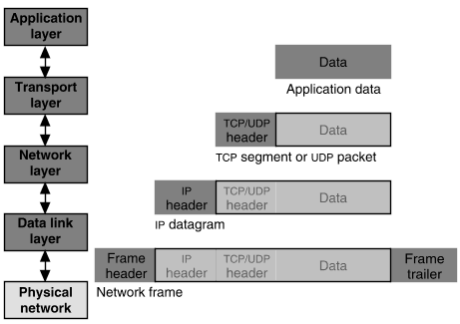
Packet Encapsulation
22Bytes
20Bytes
20Bytes
4Bytes
64 to 1500 Bytes
Notes:
注意内存的布局

Slide 7


Application Layer
Entities
  Client and server
  End-to-end connection
Name space: URL
Protocols
  HTTP, FTP, POP3, SMTP, etc.
What to care?
  Content of the data: video, text, …
<html>
<head>
<title>Google</title>
<script>window.google=…..
</script>
</head>
<body> … </body>
</html>

Slide 8

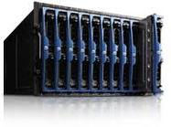
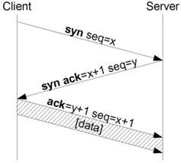
Transport Layer
Entities
  Sender and receiver
  Proxy, firewall, etc.
  End-to-end connection
Name space: port number
Protocols: TCP, UDP, etc.
What to care?
  TCP: Retransmit packet if lost
  UDP: nothing

Slide 9
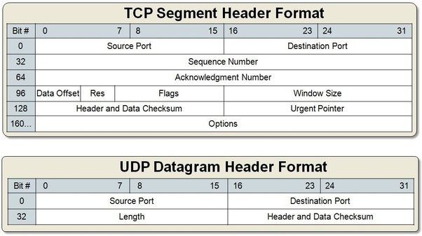
Packet Format of TCP & UDP

Slide 10
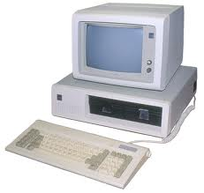
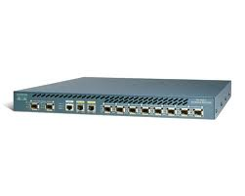
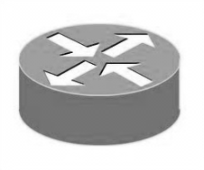
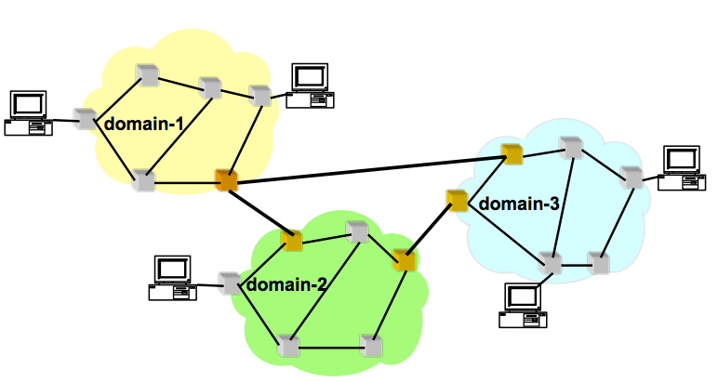
Network Layer (the Internet Layer, IP Layer)
Network entities
  Gateway, bridge
  Router, etc.
Name space
  IP address
Protocols
  IP, ICMP (ping)
What to care?
  Next hop decided by route table

Slide 11
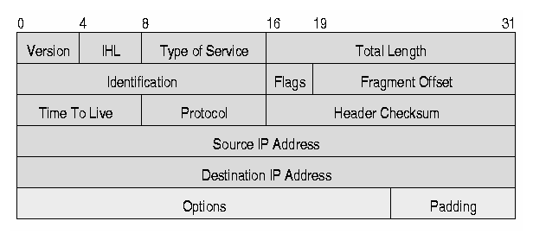
IP Datagram (Packet, Package)
Header
10101011101010101010010101010100101010100
11010010101010010101111111010000011101111
10100001011101010100110101011110100000101
00100000000010101000011010000111111010101
......... 1011011001010100011001001010110
Data

Slide 12
TCP/IP Architecture
Machine A
Machine B
Application
Application
Transport
Router/Gateway
Transport
Internet
Internet
Internet
Network Interface
Network Interface
Network Interface
Network 1
Network 2

Slide 13
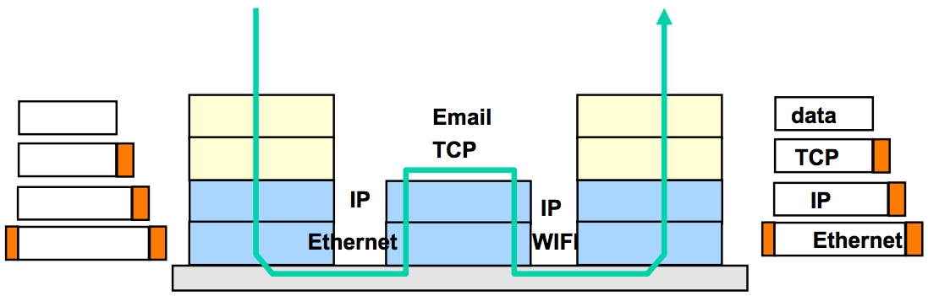
TCP/IP Architecture
Each layer adds/strips off its own header
Each layer may split up higher-level data
Each layer multiplexes multiple higher layers
Each layer is (mostly) transparent to higher layers

Slide 14
Link Layer
From a node to its physical neighbor

Slide 15
The Link Layer
The bottom-most layer of the three layers
Purpose: moving data directly from one physical location to another
  1. Physical transmission
  2. Multiplexing the link
  3. Framing bits & bit sequences
  4. Detecting transmission errors
  5. Providing a useful interface to the up layer

Slide 16
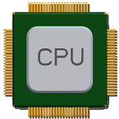
Physical Transmission using Shared Clock
Example-1: moving a bit from register-1 to register-2
on the same chip
  Run a wire to connect output of reg-1 to input of reg-2
  Wait till reg-1's output has settled & signal has propagated to reg-2
  Reg-2 read input the next clock tick
  Assumption: propagation can be done within one clock
How to send data between two modules without sharing a clock?

Slide 17
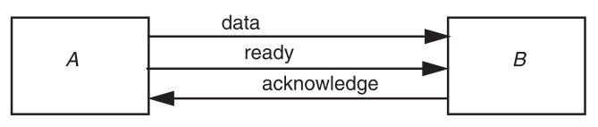
Physical Transmission without Shared Clock
Three-wire ready/acknowledge protocol
  1. A places data on data line
  2. A changes value on the ready line
  B sees the ready line change, reads value on the data line, then changes the acknowledge line
B: when to look at the data line? (ready is set)
A: when to stop holding the bit value on the data line? (ack is set)

Slide 18
Parallel Transmission
Propagation time ∆t
  It takes more than 2x∆t to send one bit
  The max data rate is 1/(2∆t)
Parallel transmission
  Use N parallel data lines to achieve N/(2∆t)
  E.g., SCSI, printer, etc.

Slide 19
Serial Transmission
Ready/acknowledge protocol
  ∆t grows significantly, which limits the data rate
Serial transmission
  Send a stream of bits down a single line
  Without waiting for any response from the receiver
  Expect the receiver can recover the bits with no additional signal
  Higher rates, longer distance, fewer wires
  E.g., USB, SATA

Slide 20
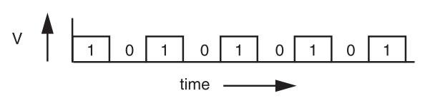
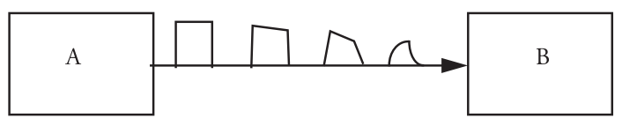
Signal Transmission on Analog Line
It is hard for B to understand the signal
  B doesn't have a copy of A's clock, so when to sample the signal?

Slide 21
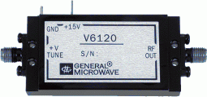
VCO: Voltage Controlled Oscillator
How to make two ends agree on the data rate without clock line?
The receiver run a VCO at about the same data rate
  VCO's output is multiplied by the voltage of incoming signal
  The product is suitably filtered and sent back to adjust the VCO
  VCO will finally be locked to both the frequency and phase of the arriving signal: phase-locked loop
  Then the VCO becomes a clock source for the receiver
Problem: if no transition in the stream (e.g., a lot of zero), the phase-locked loop cannot synchronize

Slide 22
Manchester Code
Solution: sender encodes the data to ensure transitions
Phase encoding: at least 1 level transition for a bit
  Manchester code: 0 -> 01, 1 -> 10
  Max data rate is only half, but simple enough
1
0
1
0
1
1
1
0
0
Polar NRZ
Manchester
Encoding

Slide 23
How to Share a Connection?
Isochronous communication (telephone communication)
  Needs prior arrangement between switches
  Connection: set up and tear down
  Stream: continuous bits flows out of a phone
Asynchronous communication (data communication)
  Message: burst, ill-suited to fixed size and spacing of isochronous frames
  Connectionless, asynchronous

Slide 24
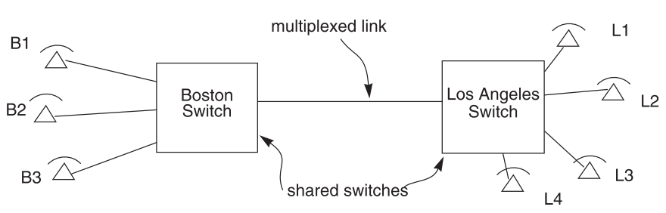
Isochronous Multiplexing
Telephone network
  Leverage "virtual link" for connection
  "network is busy" when no available time slot

Slide 25
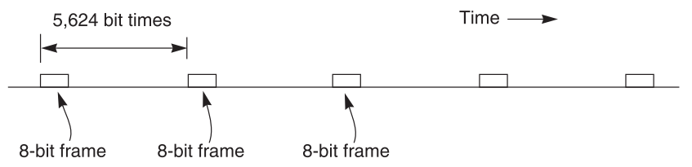
Isochronous - TDM
64 Kbps each phone, 45 Mbps link
8-bit block (frame), 8000 frames per second
5624 bit times or 125 us
703 simultaneous conversations (what if there is a 704th calling?)
Q: Why the voice is still continuous, instead of fragmented?

Slide 26
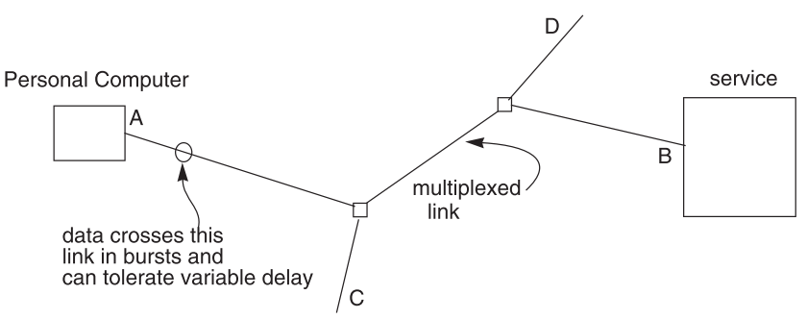
Data Communication Network
Data communication network usually contains burst communication
Different from the telephone network

Slide 27
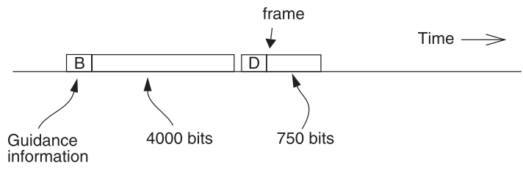
Frame and Packet: Asynchronous Link
Frame can be of any length, carried at any time that the link is free
Packet: a variable-length frame with its guidance info
Connectionless transmission: no state maintained
Segment and reassemble
Packet voice: replacing many parts of isochronous network

Slide 28
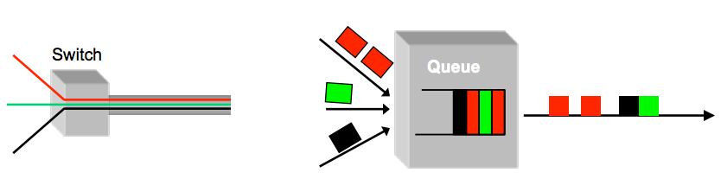
Multiplexing / Demultiplexing
Multiplex using a queue: switch need memory/buffer
Demultiplex using information in packet header
  Header has destination
  Switch has a forwarding table that contains information about which link to use to reach a destination

Slide 29
Framing Frames
Where a frame begins and ends
Independent from framing bits
  Some model separates link layer to 2: one for bits and one for frames
Simple method
  Choose a pattern of bits, e.g., 7 one-bits in a row, as a frame-separator
  Bit stuffing: if data contains 6 ones in a row, then add an extra bit (0)

Slide 30
Error Handling
Error detection code
  Adding redundancy: e.g., checksum at the end
What to do if detect an error
  Error correction code: with enough redundancy
    Where noise is well understood, e.g., disk
  Ask sender to resend: sender holds frame in buffer
  Let receiver discard the frame
  Blending these techniques

Slide 31


Coding: Incremental Redundancy
Forward error correction
  Perform coding before storing or transmitting
  Later decode the data without appealing to the creator
Hamming distance
  Number of 1 in A ⊕ B , ⊕ is exclusive OR (XOR)
  If H-distance between every legitimate pair is 2
    000101, can only detect 1-bit flip
  If H-distance between every legitimate pair is 3
    Can only correct 1 bit flip
  If H-distance between every legitimate pair is 4
    Can detect 2-bit flip, correct 1-bit flip

Slide 32
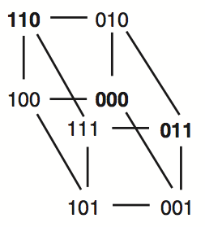
Example-1: Simple Parity Check
2 bits -> 3 bits
  Detect 1-bit errors
  8 patterns total
Only 4 correct patterns
  00 -> 000
  11 -> 110
  10 -> 101
  01 -> 011
Hamming distance of this code is 2
  1-bit flipping will cause incorrect pattern

Slide 33
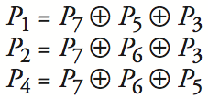
Example-2: 4-bit -> 7-bit
4 bits -> 7 bits (56 using only extra 7)
  3 extra bits to distinguish 8 cases
  e.g. 1101 -> 1010101
Correct 1-bit errors
  1010101 -> 1010001 : P1 & P4 not match
  1010101 -> 1110101 : P2 not match
Not Match | Error
None | None
P1 | P1
P2 | P2
P4 | P4
P1 & P2 | P3
P1 & P4 | P5
P2 & P4 | P6
P1 & P2 & P4 | P7
1 2 3 4 5 6 7
1
0
1
0
1
0
1
1
0
1
0
1
0
1
1
0
1
0
1
0
1

Slide 34
Network Layer

Slide 35
IP: Best-effort Network
1. Best-effort network
  If it cannot dispatch, may discard a packet
2. Guaranteed-delivery network
  Also called store-and-forward network, no discarding data
  Work with complete messages rather than packets
  Use disk for buffering to handle peaks
  Tracks individual message to make sure none are lost
In real world
  No absolute guarantee
  Guaranteed-delivery: higher layer; best-effort: lower layer

Slide 36
Duplicate Packets and Suppression
Discarding packets is common case
  Many network protocol includes timeout and resend mechanism
When a congested forwarder discards a packet
  Client does not receive a response as quickly as originally hoped
  Users may prepared for duplicate requests and responses
  Detecting duplicates may or may not be important

Slide 37
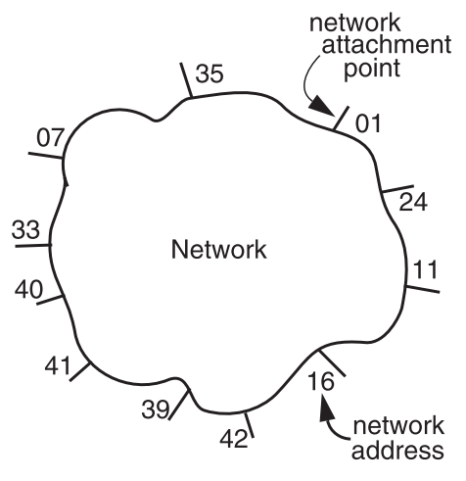
The Network Layer
Addressing interface
  Network attachment points
  Network address
  Source & destination
NETWORK_SEND (segment_buffer, destnation, network_protocol, end_layer_protocol)
NETWORK_HANDLE (packet, network_protocol)

Slide 38


Managing the Forwarding Table: Routing
Routing (or path-finding)
  Constructing the tables
Impractical by hand
  Determining the best paths requires calculation
  Recalculating the table when links change
  Recalculating the table when link fails
  Adapt according to traffic congestion
Static routing vs. adaptive routing
  Adaptive routing requires exchange of info
Where are you going?

Slide 39
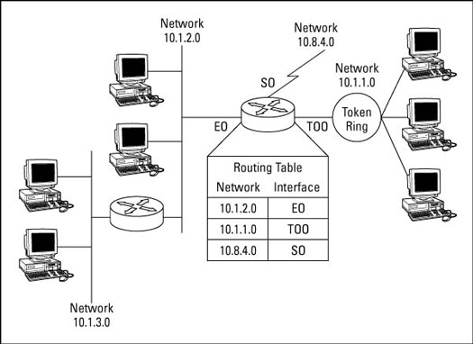
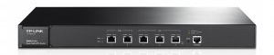
IP Route Table
Interface 1 … Interface N

Slide 40
Control-plane VS. Data-plane
Control-plane
  Control the data flow by defining rules
  E.g., the routing algorithm
Data-plane
  The data-path which copies data according to the rules
  Performance critical
  E.g., the IP forwarding process
write
read
routing table
Notes:
The
Control-plane the table, data-plane reads the table

