Slide 1


End-to-end Layer & DNS
SE124 (2021 Fall)
IPADS, Shanghai Jiao Tong University
https://www.sjtu.edu.cn
xx

Slide 2
Review: Assurance of End-to-end Protocol
Assurance of at-least-once delivery
Assurance of at-most-once delivery
Assurance of data integrity
Assurance of stream order & closing of connections
Assurance of jitter control
Assurance of authenticity and privacy
Assurance of end-to-end performance

Slide 3
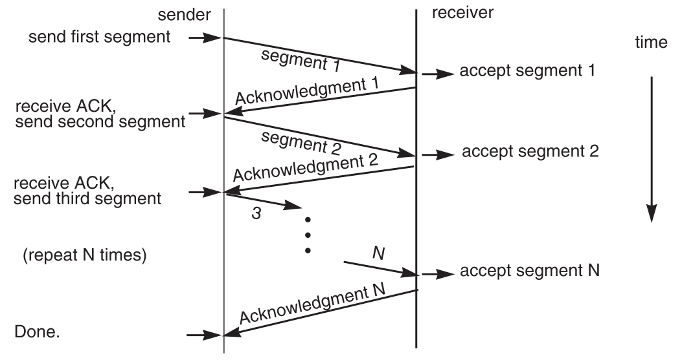
7. End-to-end Performance
Multi-segment message questions
  Trade-off between complexity and performance
  Lock-step protocol

Slide 4
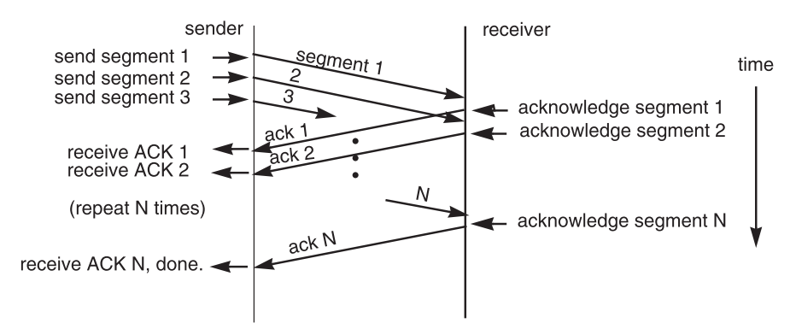
Overlapping Transmissions
Pipelining technique

Slide 5
Overlapping Transmissions
Packets or ACK may be lost
  Sender holds a list of segments sent, check it off when receives ACK
  Set a timer (according to RTT) for last segment
If list of missing ACK is empty, OK
If timer expires, resend packets and another timer

Slide 6
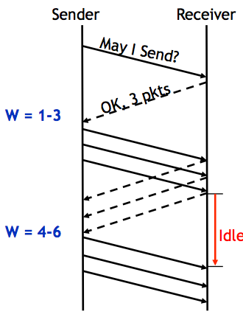
Fixed Window
Receiver tells the sender a window size
Sender sends window
Receiver acks each packet as before
Window advances when all packets in previous window are acked
  E.g., packets 4-6 sent, after 1-3 ack'd
If a packet times out -> resend packets
Still much idle time

Slide 7
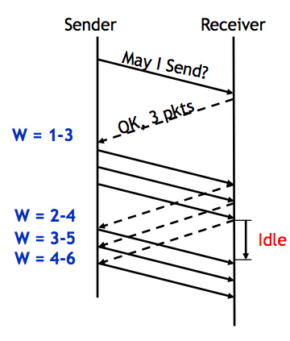
Sliding Window
Sender advances the window by 1 for each in-sequence ACK it receives
  Reduces idle periods
  Pipelining idea
But what's the correct value for the window?
  We'll revisit this question
  First, we need to understand windows

Slide 8
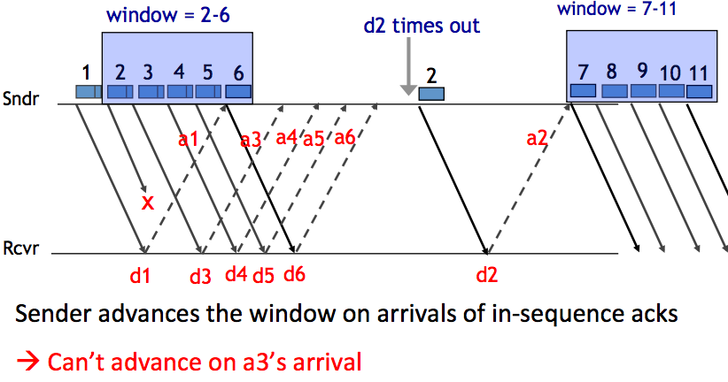
Handling Packet Loss

Slide 9
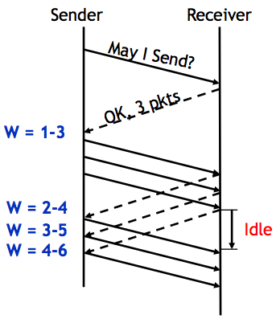
Chose the Right Window Size
If window is too small
  Long idle time
  Underutilized network
If window too large
  Congestion

Slide 10
Sliding Window Size
window size ≥ round-trip time × bottleneck data rate
Sliding window with one segment in size
  Data rate is window size / RTT
Enlarge window size to bottleneck data rate
  Data rate is window size / RTT
Enlarge window size further
  Data rate is still bottleneck
  Larger window makes no sense
- Receive 500 KBps
- Sender 1 MBps
- RTT 70ms
- A segment carries 0.5 KB
- Sliding window size = 35KB (70 packets)

Slide 11
Self-pacing: Sliding Window Size
Although the sender doesn't know the bottleneck, it is sending at exactly that rate
Once sender fills a sliding window, cannot send next data until receive ACK of the oldest data in the window
The receiver cannot generate ACK faster than the network can deliver data elements
RTT estimation still needed

Slide 12
TCP and Congestion Control

Slide 13
Congestion
Definition: Too many packets present in (a part of) the network causes packet delay and loss that degrades performance.
Network & End-to-end layers share the responsibility for handling congestion
1. Network layer
  Directly experiences the congestion
  Ultimately determine what to do with the excess packets
2. End-to-end layer
  Control to reduce the sending rate, is the most effective way

Slide 14
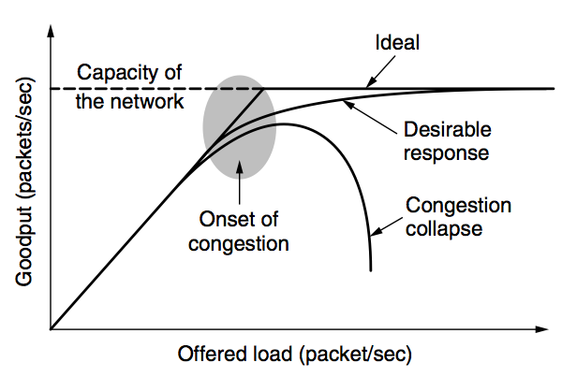
Network Congestion

Slide 15
Why Congest?
If all of a sudden, streams of packets begin arriving on three or four input lines and all need the same output line, a queue will build up
If there is insufficient memory to hold all of them, packets will be lost
Adding more memory may help up to a point, but
  Nagle (1987) realized that if routers have an infinite amount of memory, congestion gets worse, not better
  This is because by the time packets get to the front of the queue, they have already timed out (repeatedly) and duplicates have been sent

Slide 16
Load Shedding: Setting Window Size
For performance:
  window size ≥ round-trip time × bottleneck data rate
For congestion control:
  window size ≤ min(RTT x bottleneck data rate, Receiver buffer)
  Congestion window
2 windows become 1
  to achieve best performance and avoid congestion

Slide 17
Congestion Control
Basic idea:
  Increase congestion window slowly
  If no drops -> no congestion yet
  If a drop occurs -> decrease congestion window quickly
Use the idea in a distributed protocol that achieves:
  Efficiency: i.e., uses the bottleneck capacity efficiently
  Fairness, i.e., senders sharing a bottleneck get equal throughput (if they have demands)

Slide 18
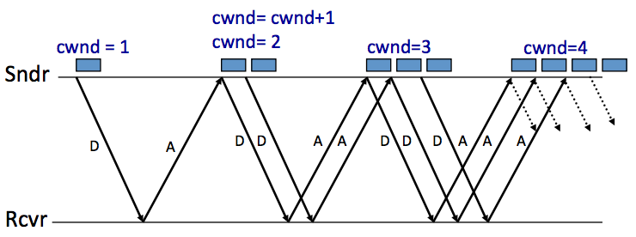
AIMD (Additive Increase, Multiplicative Decrease)
Every RTT:
  No drop: cwnd = cwnd + 1
  A drop: cwnd = cwnd / 2

Slide 19
Problems with AIMD
Increases very slowly at the beginning
Initial window size is 1
  Probably too small in practice
Solution: do multiplicative increase at the beginning
  Congestion_window _{init} = 1
  Initially, do Congestion_window ← 2 * Congestion_window each RTT until we hit congestion
  Named "slow start" (even though it's exponentially fast!)

Slide 20
TCP Slow Start
At the beginning of the connection, exponential increase the window
  Double it every RTT until you see loss
  Decreases the time it takes for the initial window to "ramp up"
  So the name is really weird... it should be "fast start"

Slide 21
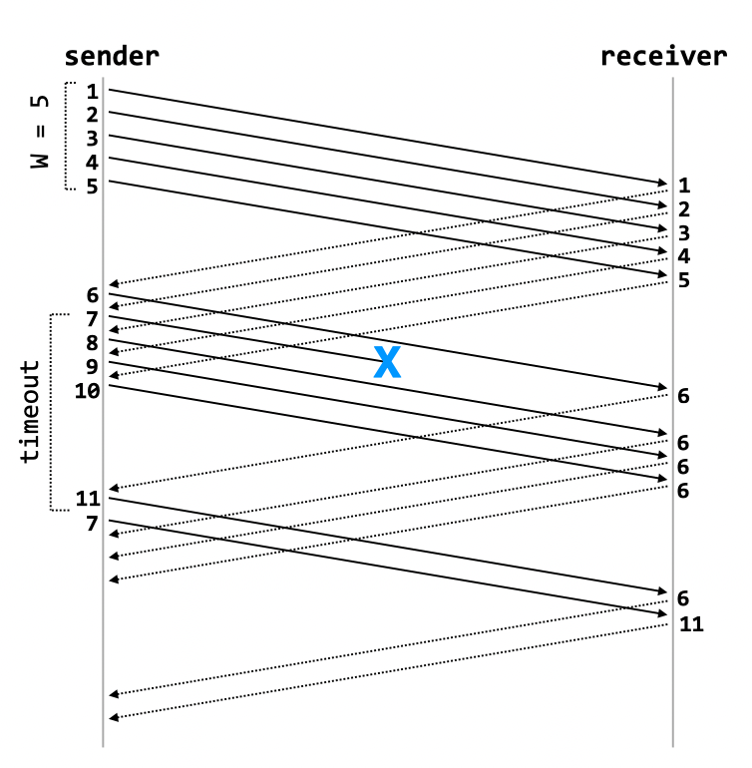
TCP Fast Retransmit / Fast Recovery
When a sender receives an ACK with sequence number X, and then three duplicates of that packet, it immediately retransmits packet X+1
  Example: sender receives 5 6 6 6 6
  Infers that packet 6 is lost, immediately retransmits
  On fast-retransmit, window decrease is as before: W = W/2

Slide 22
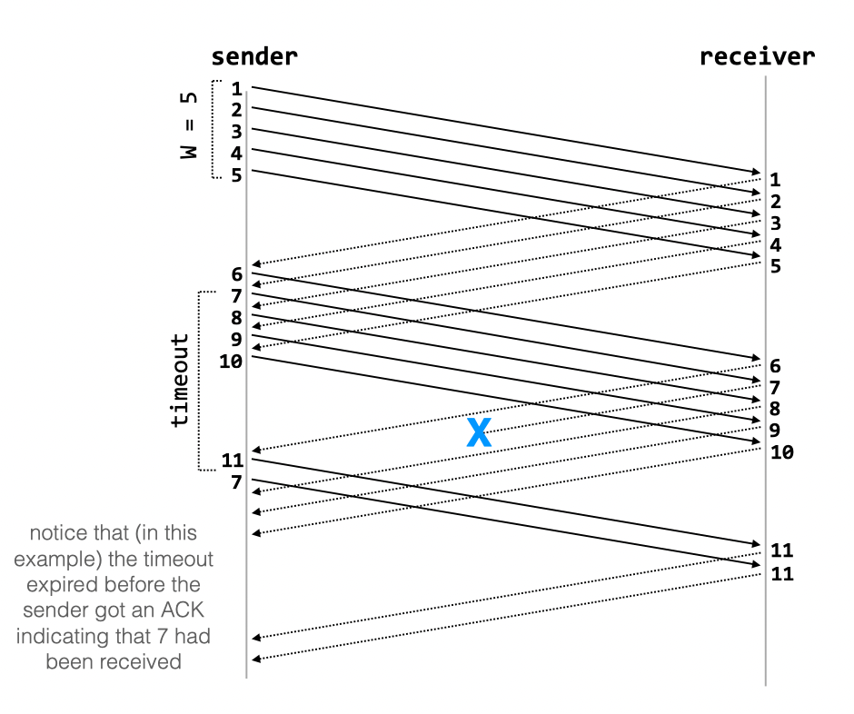
TCP Fast Retransmit / Fast Recovery
When a packet is lost due to timeout, TCP behaves differently:
  W = 1, then do slow-start until the last good window
  Reasoning: if there is a retransmission due to timeout, then there is significant loss in the network, and senders should back way off

Slide 23
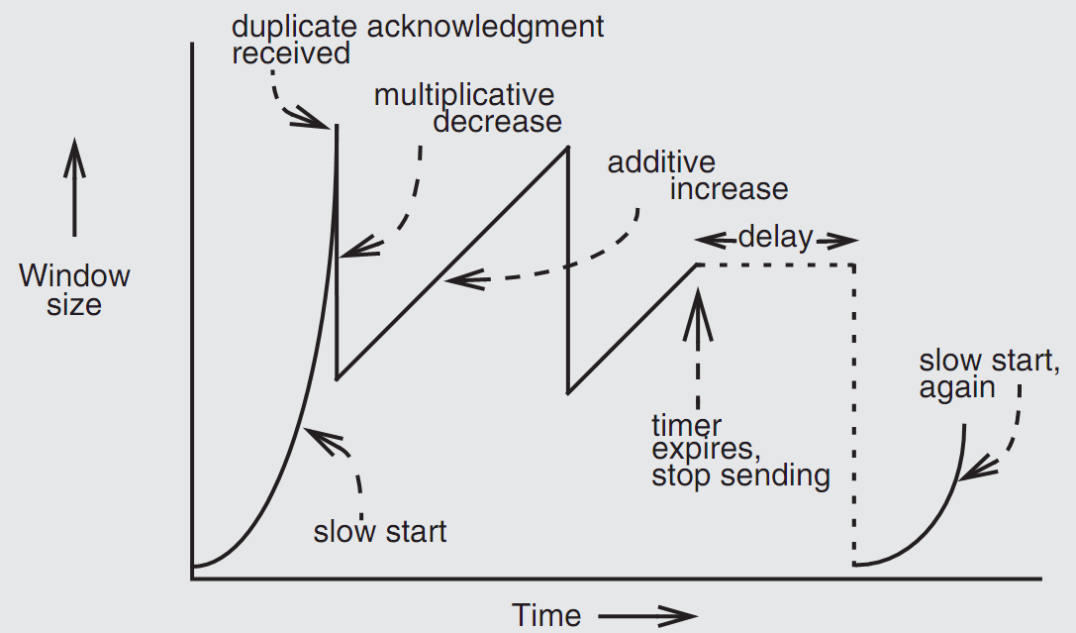
Retrofitting TCP

Slide 24
Retrofitting TCP
1. Slow start: one packet at first, then double until
  Sender reaches the window size suggested by the receiver
  All the available data has been dispatched
  Sender detects that a packet it sent has been discarded
2. Duplicate ACK
  When receiver gets an out-of-order packet, it sends back a duplicate of latest ACK
3. Equilibrium
  Additive increase & multiplicative decrease
4. Restart, after waiting a short time

Slide 25
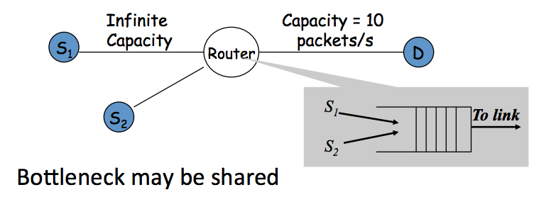
Fairness between Links

Slide 26
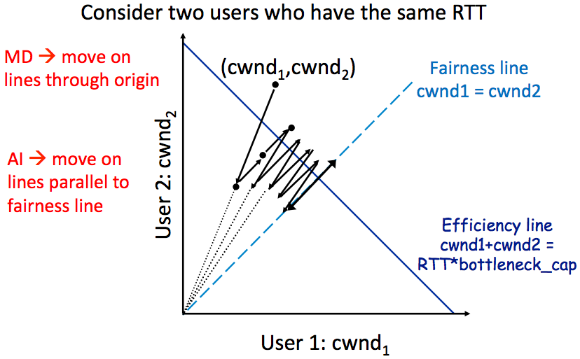
AIMD Leads to Efficiency and Fairness

Slide 27
Q: Why not Additive Decrease
It does not converge to fairness
  from a congested point, (x',y'), reducing each by 1 worsens fairness and takes us away from the "ideal" outcome

Slide 28
Weakness of TCP
If routers have too much buffering, causes long delays
Packet loss is not always caused by congestion
  Consider wireless network: if losing packet, sender may send faster instead
TCP does not perform well in datacenters
  High bandwidth, low delay situations
TCP has a bias against long RTTs
  Throughput inversely proportionally to RTT
  Consider when sending packets really far away vs really close
Assumes cooperating sources, which is not always a good assumption

Slide 29
Summary of Congestion Window
Reliability Using Sliding Window
  Tx Rate = W / RTT
Congestion Control
  W = min(Receiver_buffer, cwnd)
  Congestion window is adapted by the congestion control protocol to ensure efficiency and fairness
  TCP congestion control uses AIMD which provides fairness and efficiency in a distributed way

Slide 30
The Design of DNS
Domain Name Service

Slide 31
DNS: Binding IP and Domain Name
Names: hostname strings
  E.g., www.sjtu.edu.cn
Values: IP addresses
  E.g., 202.120.2.119
Look-up algorithm
  Resolves a hostname to an IP address so that your machine knows where to send packets

Slide 32
IP Address as a Type of Name
An IP address itself is a type of name
  A structured name that is used to locate an object
  Use IP address to identify the server
    Recall your labs in ICS on socket
  On Internet
    The router will know where to send a packet with destination IP
Hostname has no such semantic
  A router does not know how to send a packet to "baidu.com"

Slide 33
Why Not Just Using IP Address?
IPs are structured in a particular way for routing
  You cannot chose your IP address as you wish
    Note: usually an address cannot be picked
  While you can chose your host names
IPs are not user-friendly enough

Slide 34
Questions on DNS
Q: Can a name have multiple values (IP addresses)?
  Yes
  This allows a web server to balance its load over multiple machines
  Also allows a client to choice a nearest IP to access
Q: Can a single value have multiple names?
  Yes
  This allows server consolidation

Slide 35
Questions on DNS
Q: Can the value corresponding to a name change?
  Yes
  This allows to change the physical machine (with different IP) that stores the data without changing the hostname
  Such changing is hidden to clients

Slide 36
Look-up Algorithm
At first, each machine kept a "hosts.txt" for address binding
  E.g., "r900 202.120.224.83"
  Using table look-up to resolve the binding
  This method cannot scale in Internet
1984, four Berkeley students wrote BIND
  Berkeley Internet Name Domain
  Still the dominant DNS software in use

Slide 37
Distributing Responsibility
The binding
  Too large to be stored on a single machine
  Thus, the data are stored on many machines
    As known as "name servers"
How to know which name server has a particular binding?
  Solution: structure the hostname
  Names have a hierarchy, e.g., com, net, gov, correspond to "zones"
  Zones are mapped to name servers

Slide 38

Name Servers
The root zone
  Maintained by ICANN, non-profit
The ".com" zone
  Maintained by VeriSign, add for money
The ".sjtu.edu.cn" zone
  Maintained by SJTU

Slide 39
DNS Hierarchy (a partial view)

Slide 40
Basic DNS Look-up Algorithm
Example: lookup IP of "ipads.se.sjtu.edu.cn"
Traverse the name hierarchy from the root
  The root will tell us the "cn" name server IP,
  which will tell us the "edu.cn" name server IP,
  which will tell us the "sjtu.edu.cn" name server IP,
  which will tell us the "se.sjtu.edu.cn" name server IP,
  which finally tells us the "ipads.se.sjtu.edu.cn" IP
Such algorithm is called delegation

Slide 41
DNS Lookup

Slide 42
DNS Lookup

Slide 43
DNS Lookup

Slide 44
DNS Lookup

Slide 45
DNS Lookup

Slide 46
Context in DNS
Names in DNS are global (context-free)
  A hostname means the same thing everywhere in DNS
Actually, it should be "ipads.se.sjtu.edu.cn."
  A hostname is a list of domain names concatenated with dots
  The root domain is unnamed, i.e., "." + blank

Slide 47
Fault Tolerant
Each zone can have multiple name servers
  A delegation usually contains a list of name servers
  If one name server is down, others can be used

Slide 48
Three Enhancements on Look-up Algorithm
1. The initial DNS request can go to any name server, not just the root server
  Even on your own machine: /etc/hosts
  You can specific name servers in /etc/resolv.conf
  If no record, just returns address of the root server
  Q: what are the benefits?
Notes:
To minimize the load of the root server.

Slide 49
Three Enhancements on Look-up Algorithm
2. Recursion
  A client asks a name server "www.baidu.com"
  The name server does all the lookup through the tree and return the IP of Baidu to the client
  Usually, a name server has a better network connection

Slide 50
DNS Request Process
a.root.net
a.root.net
names.edu
names.edu
NS: for edu
ns.iss.edu
ns.iss.edu
NS: for
Scholarly.edu
ginger.
Scholar.edu
ginger.
Scholar.edu
ginger.
Scholar.edu
AP: for
ginger.Scholar.edu
Name client
Name client
Non-Recursion
Recursion

Slide 51
Three Enhancements on Look-up Algorithm
3. Caching
  DNS clients and name servers keep a cache of names
    Your browser will not do two look-ups for one address
  Cache has expire time limit
    Controlled by a time-to-live parameter in the response itself
    E.g., SJTU sets the TTL of www.sjtu.edu.cn to 24h
  TTL (Time To Live)
    Long TTL VS. short TTL
    Q: what are the tradeoffs?

Slide 52
Combine These Enhancements
If:
  Many machines at SJTU use the SJTU name server for their initial DNS query
  The name server offers recursive querying and caching
Then:
  The name server's cache will hold many bindings
  Performance benefits from this large cache

Slide 53
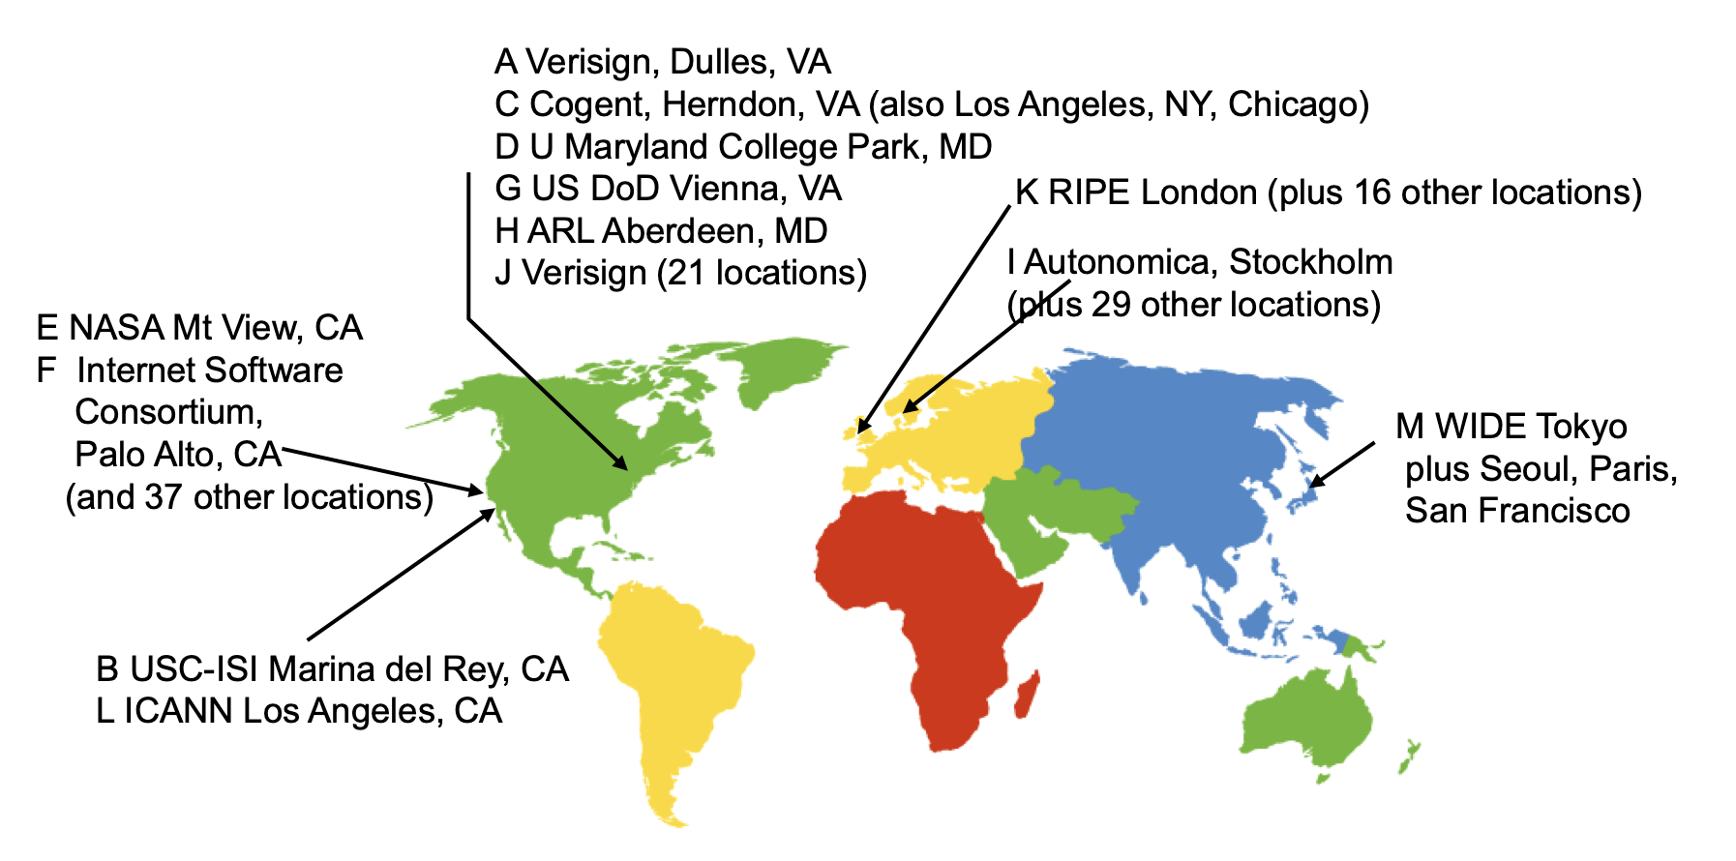
Other Features of DNS
At least two identical replica servers
  80 replicas of the root name server in 2008
  Replicas are placed separated around the world

Slide 54
Other Features of DNS
Organization's name server (e.g., SJTU)
  Several replicas in campus
    To enable communications within the organization
  At least one out of the campus
    To validate the address for outside world

Slide 55
Name Discovery in DNS (at the first place)
A client must discover the name of a nearby name server
  Name discovery broadcast to ISP at first time
  Ask network manager
  Ask by email, Google, etc.

Slide 56
Comparing Hostname & Filename
They are both for more user friendly
  File-name -> inode number
  Host-name -> IP address
  The file-name and host-name are hierarchical; inode num and IP address are plane
They are both not a part of the object
  File-name is not a part of a file (stored in directory)
  Host-name is not a part of a website (stored on name server)
Name and value binding
  File: 1-name -> N-values (no); N-name -> 1-value (yes)
  DNS: 1-name -> N-values (yes); N-name -> 1-value (yes)

Slide 57
Behind the DNS Design
Why was DNS designed in this way?

Slide 58
Benefits of Hierarchical Design
Hierarchies delegate responsibility
Each zone is only responsible for a small portion
Hierarchies also limit interaction between modules
  A type of de-centralization

Slide 59
Good Points on DNS Design
Global names (assuming same root servers)
  No need to specific a context
  DNS has no trouble generating unique names
  The name can also be user-friendly
Scalable in performance
  Simplicity: look-up is simple and can be done by a PC
  Caching: reduce number of total queries
  Delegation: many name severs handle lookups

Slide 60
Good Points on DNS Design
Scalable in management
  Each zone makes its own policy decision on binding
  Hierarchy is great here
Fault tolerant
  If one name server breaks, other will still work
  Duplicated name server for a same zone

Slide 61
Bad Points on DNS Design
Policy
  Who should control the root zone, .com zone, etc.? Governments?
Significant load on root servers
  Many DNS clients starts by talking to root server
  Many queries for non-existent names, becomes a DoS attack
Security
  How does a client know if the response is correct?
  How does VeriSign know "change Amazon.com IP" is legal?

Slide 62
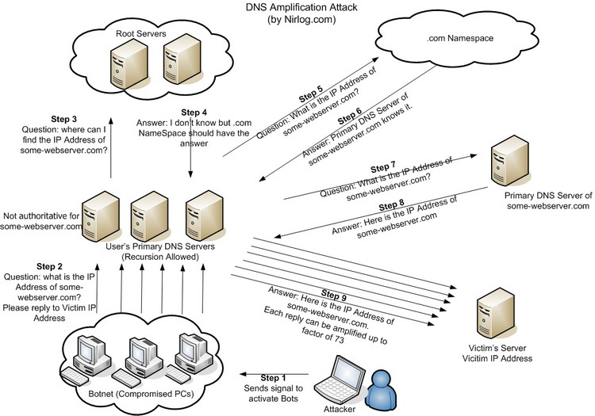
DNS Amplification Attack

Slide 63
DNS Security
DNS Hijack: Cutting the binding between name and IP
DNS DoS (Denial of Service) attack
  BAOFENG.com & DNSPod
  2009-5-18: DNSPod was attacked and banned
  2009-5-19: The Internet in China was almost down
  Fixed timer: query for BAOFENG.com once per second!
Solutions
  /etc/hosts, dnsmasq, OpenDNS, etc.
  DNS shield to defend against DoS attack

Slide 64

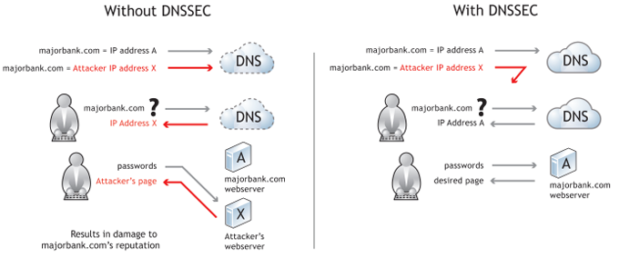
DNSSEC: Protect DNS Record
Only part of the zones are using DNSSEC, e.g., .gov, .org

Slide 65
Naming Scheme
Naming: the glue of modules

Slide 66
Naming in General
  ipads.se.sjtu.edu.cn – hostname
  steven@apple.com - email
  steven – username
  EAX - x86 processor register name
  main() - function name
  WebBrowser - class name
  /courses/cse/index.html - path name (fully-qualified)
  index.html - path name (relative)
  http://ipads.se.sjtu.edu.cn/courses/cse/index.html - URL
  13918275839- Phone number
  202.120.40.188 - IP Address

Slide 67
Naming a Disk
File name: /dev/sda1
  As a special type of inode: device inode
  8,0 as (major, minor)
PCI address (name): 19:00.0
  SCSI storage controller: LSI Logic / Symbios Logic SAS1068E PCI-Express Fusion-MPT SAS (rev 08)

Slide 68
Naming for Modularity
Retrieval: e.g., using URL to get a web page
Sharing: e.g., passing an object reference to a function
  Save space as well: only sending the name, not the object
Hiding: e.g., using a file name without knowing file system
  Can support access control: use an object only if knowing its name
  E.g., Windows has many undocumented API
User-friendly identifiers: e.g., “homework.txt” instead of 0x051DE540
Indirection: e.g., OS can move the location of the file data without notifying the user
  Have you ever defragmented your hard driver?

Slide 69
Addresses as Names
Software uses these names in an obvious way
  E.g., memory addresses
Hardware modules connected to a bus
  Use bus addresses (a kind of name) for interconnection

Slide 70
Naming Schemes
A naming schemes contains three parts:
  1. Set of all possible names
    You cannot use ‘for’ as a variable in C
  2. Set of all possible values
  3. Look-up algorithm to translate a name into a value
    or a set of values, or “none”

Slide 71
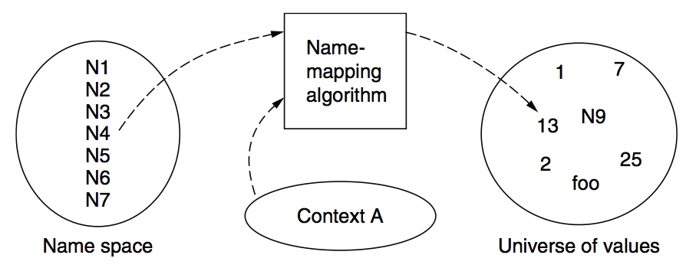
Naming Model

Slide 72
Naming Terminology
Binding – A mapping from a name to value
  Unbind is to delete the mapping
  A name that has a mapping is bound
A name mapping algorithm resolves a name

Slide 73
Naming Context
Type-1: context and name are separated
  E.g., inode number’s context is the file system
Type-2: context is part of the name
  E.g., xiayubin@sjtu.edu.cn
Name spaces with only one possible context are called universal name spaces
  Example: credit card number, UUID, email address

Slide 74
Determining Context - 1
Hard code it in the resolver
  Examples: Many universal name spaces work this way
Embedded in name itself
  cse@sjtu.edu.cn:
    Name = “cse”
    Context = “sjtu.edu.cn”
  /ipads.se.sjtu.edu.cn/courses/cse/README :
    Name = “README”
    Context = “/ipads.se.sjtu.edu.cn/courses/cse”

Slide 75
Determining Context - 2
Taken from environment (Dynamic)
  Unix cmd: “rm foo”:
    Name = “foo”, context is current dir
    Question: how to find the binary of “rm” command?
  Read memory 0x7c911109:
    Name = “0x7c911109”,
    Context is thread’s address space
Many errors in systems due to using wrong context

Slide 76
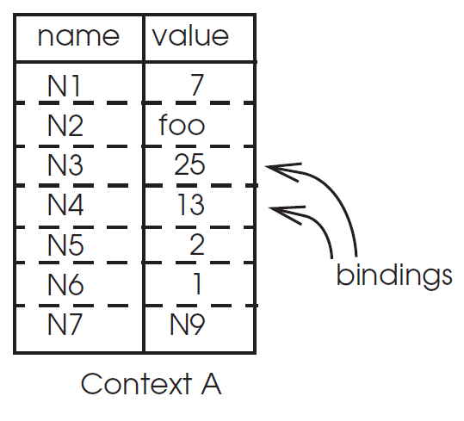
Name Mapping Algorithms - 1
Table lookup
  Find name in a table
    E.g., Phone book
  Context: which table?
    Implicit VS. explicit
    Default context

Slide 77
Name Mapping Algorithms - 2
Recursive lookup
  E.g., “/usr/bin/rm”
  First find “usr” in “/”, then find “bin” in “/usr”, then “rm”
  Each look-up process is the same
Multiple lookup
  Recall: how to find “rm” without absolute name?
  $PATH
    E.g., “/usr/local/sbin:/usr/local/bin:/usr/sbin:/usr/bin:/sbin:/bin”
  Look-up in a predefined list of context

Slide 78
Interpreter Naming API
value ← RESOLVE(name, context)
  Return the mapping of name in the context
status ← BIND(name, value, context)
  Establish a name to value mapping in the context
status ← UNBIND(name, context)
  Delete name from context
list ← ENUMERATE(context)
  Return a list of all bindings
result ← COMPARE(name1, name2)
  Check if name1 and name2 are equal

Slide 79
FAQ of Naming Scheme - 1
What is the syntax of names?
What are the possible value?
What context is used to resolve names?
Who specifies the context?
Is a particular name global (context-free) or local?

Slide 80
FAQ of Naming Scheme - 2
Does every name have a value?
  Or, can you have “dangling” names?
Can a single name have multiple values?
Does every value have a name?
  Or, can you name everything?
Can a single value have multiple names?
  Or, are there synonyms?
Can the value corresponding to a name change over time?

