Slide 1


Decentralized Systems:
CDN & P2P
SE124 (2021 Fall)
IPADS, Shanghai Jiao Tong University
https://www.sjtu.edu.cn
Notes:
Credits to Mike Freedman (COS 461) and others.

Slide 2
Review: scalable websites
Scalable websites are powered by distributed systems
How to support geographical users?
Caching server
Caching server
Caching server
…
Caching
Caching
Caching
Distributed caching
Database server
Database server
CDN
Users
Application #1
generate the page
Database
user, price
…
Database
user, price
Application server
Distributed database
Internet
Load
Balance
Application #2
add the order
File server
File server
File server
File:
image
File:
image
…
File:
image
Application server
…
…
Message queue
Distributed file system

Slide 3
Content Distribution
Files on the Internet

Slide 4
Content Distribution
How to reduce load latency over Internet?
  Especially for large files, e.g., images and videos
Client side
  Many people from SJTU might access same web pages
  Save bandwidth by caching a local copy
Server side
  Not all clients use cache
  Push data out to content distribution network (CDN)

Slide 5
Caching Examples
Web browser caches recently accessed files
  E.g., allow "back" button to operate more efficiently
Web proxies cache recently accessed URLs
  Save bandwidth/time when multiple people locally access same remote URL
DNS resolvers cache resource records (URL→IP)
NFS clients cache read/written data

Slide 6
Content Distribution Network (CDN)
Network of computers that replicate content across the Internet
  Bringing content closer to requests
  End users only use local (not shared) network capacity
Content providers actively pushes data into the network
  Improve performance and reduce costs

Slide 7
Content Distribution Network (CDN)
Akamai as an example

Slide 8
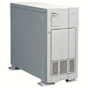

Server Selection Mechanism
Application
  HTTP redirection
Advantages
  Fine-grain control
  Selection based on client IP address
Disadvantages
  Extra round-trips for TCP connection to server
  Overhead on the server
GET
Redirect
GET
OK

Slide 9
Server Selection Mechanism
Routing
  Anycast routing
Advantages
  No extra round trips
  Route to nearby server
Disadvantages
  Does not consider network or server load
  Different packets may go to different servers
  Used only for simple request-response apps
1.2.3.0/24
1.2.3.0/24

Slide 10
Server Selection Mechanism
Naming
  DNS-based server selection
Advantages
  Avoid TCP set-up delay
  DNS caching reduces overhead
  Relatively fine control
Disadvantage
  Based on IP address of local DNS server
  “Hidden load” effect
  DNS TTL limits adaptation
1.2.3.4
DNS
query
1.2.3.5
local DNS server

Slide 11
How Akamai Uses DNS
11
cnn.com (content provider)
DNS root server
Akamai
cluster
Akamai global
DNS server
1
2
GET index.html
http://cache.cnn.com/foo.jpg
Akamai regional
DNS server
Nearby
Akamai
cluster
End user

Slide 12
How Akamai Uses DNS
12
cnn.com (content provider)
HTTP
DNS TLD server
DNS lookup
cache.cnn.com
Akamai
cluster
Akamai global
DNS server
1
2
3
4
ALIAS:
g.akamai.net
Akamai regional
DNS server
Nearby
Akamai
cluster
End user

Slide 13
How Akamai Uses DNS
13
cnn.com (content provider)
DNS TLD server
DNS lookup
g.akamai.net
Akamai
cluster
Akamai global
DNS server
5
1
2
3
4
6
Akamai regional
DNS server
ALIAS
a73.g.akamai.net
Nearby
Akamai
cluster
End user

Slide 14
How Akamai Uses DNS
14
cnn.com (content provider)
DNS TLD server
Akamai
cluster
Akamai global
DNS server
5
1
2
3
4
6
Akamai regional
DNS server
7
DNS a73.g.akamai.net
8
Address
1.2.3.4
Nearby
Akamai
cluster
End user

Slide 15
How Akamai Uses DNS
15
cnn.com (content provider)
DNS TLD server
Akamai
cluster
Akamai global
DNS server
5
1
2
3
4
6
Akamai regional
DNS server
7
8
9
Nearby
Akamai
cluster
End user
GET /foo.jpg
Host: cache.cnn.com

Slide 16

How Akamai Uses DNS
16
cnn.com (content provider)
DNS TLD server
GET foo.jpg
11
12
Akamai
cluster
Akamai global
DNS server
5
1
2
3
4
6
Akamai regional
DNS server
7
8
9
Nearby
Akamai
cluster
End user
GET /foo.jpg
Host: cache.cnn.com

Slide 17
How Akamai Uses DNS
17
cnn.com (content provider)
DNS TLD server
11
12
Akamai
cluster
Akamai global
DNS server
5
1
2
3
4
6
Akamai regional
DNS server
7
8
9
Nearby
Akamai
cluster
End user
10

Slide 18
How Akamai Works: Cache Hit
18
cnn.com (content provider)
DNS TLD server
Akamai
cluster
Akamai global
DNS server
1
2
Akamai regional
DNS server
3
4
5
Nearby
Akamai
cluster
End user
6

Slide 19
P2P Network

Slide 20
Downsides of Centralized Infrastructure
Centralized point of failure
High management costs
  If one org has to host millions of files, etc.
Not suitable for many scenarios
  E.g., cooperation between you and me
Lack ability to aggregate clients

Slide 21
P2P (Peer-to-peer): No central servers!
How to track nodes and objects in the system?
How do you find other nodes in the system?
How should data be split up between nodes?
How to prevent data from being lost?
  How to keep it available?
How to provide consistency?
How to provide security? anonymity?

Slide 22
BitTorrent
Usage Model: Cooperative
  User downloads file from someone using simple user interface
  While downloading, BitTorrent serves file also to others
  BitTorrent keeps running for a little while after download completes
3 Roles
  Tracker: What peer serves which parts of a file
  Seeder: Own the whole file
  Peer: Turn a seeder once has 100% of a file
Notes:
** Challenges:
Tracking which peer has what
Handling high churn rates
Download rate proportional to upload rate

Slide 23
BitTorrent
Publisher a .torrent file on a Web server (e.g., suprnova.org)
  URL of tracker, file name, length, SHA1s of data blocks (64-512Kbyte)
Tracker
  Organizes a swarm of peers (who has what block?)
Seeder posts the URL for .torrent with tracker
  Seeder must have complete copy of file
Peer asks tracker for list of peers to download from
  Tracker returns list with random selection of peers
Peers contact peers to learn what parts of the file they have etc.
  Download from other peers

Slide 24
A torrent file
{
'announce': 'http://bttracker.debian.org:6969/announce',
'info':
{
'name': 'debian-503-amd64-CD-1.iso',
'piece length': 262144,
'length': 678301696,
'pieces':
'841ae846bc5b6d7bd6e9aa3dd9e551559c82abc1...d14f1631d
776008f83772ee170c42411618190a4'
}
}

Slide 25
Which Piece to Download?
Different policies: Order of parts downloading
  Strict?
  Rarest first?
  Random?
  Parallel?
BitTorrent
  Random for the first one
  Rarest first for the rest
  Parallel for the last one
Notes:
strict?
rarest first?
ensures that every piece is widely available
also helps with the seed and bootstrapping rapidly
won't retrieve the same piece multiple times from the seed
random?
avoid overloading seed when starting download
if peer has no piece, get as quickly as possible a piece so that it can upload
don't use rarest because it is likely only one peer has it
--> use random, can download subpieces in parallel
parallel download of same pieces?
avoid waiting on slowest

Slide 26
Drawback of BitTorrent
Rely on Tracker
  Tracker is central component
  Cannot scale to large number of torrents

Slide 27
Scalable Lookup: DHT
DHT: Distributed hash table
  Used to find the node responsible for a key quickly
  Distributed index: each node keeps a subset of the index
Typical DHT interface:
  put(key, value)
  get(key) -> value
  Loose guarantees about keeping data alive
Notes:
Two options: find the data, find the node ID, who knows the data. focus on the latter.

Slide 28
P2P Implementation of DHT
Overlay Network
  Partition hash table over n nodes
  Not every node knows about all other n nodes
  Route to find right hash table
Goals
  log(n) hops
  Guarantees about load balance

Slide 29
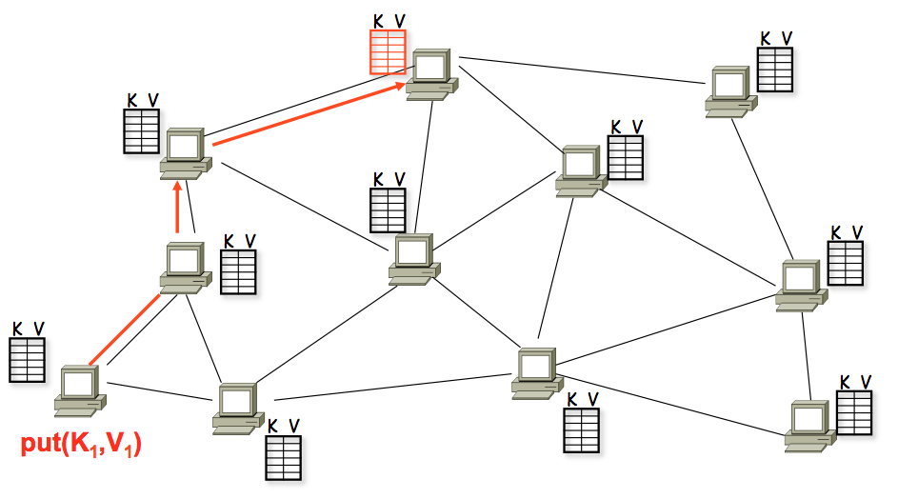
A DHT in Operation: put()

Slide 30
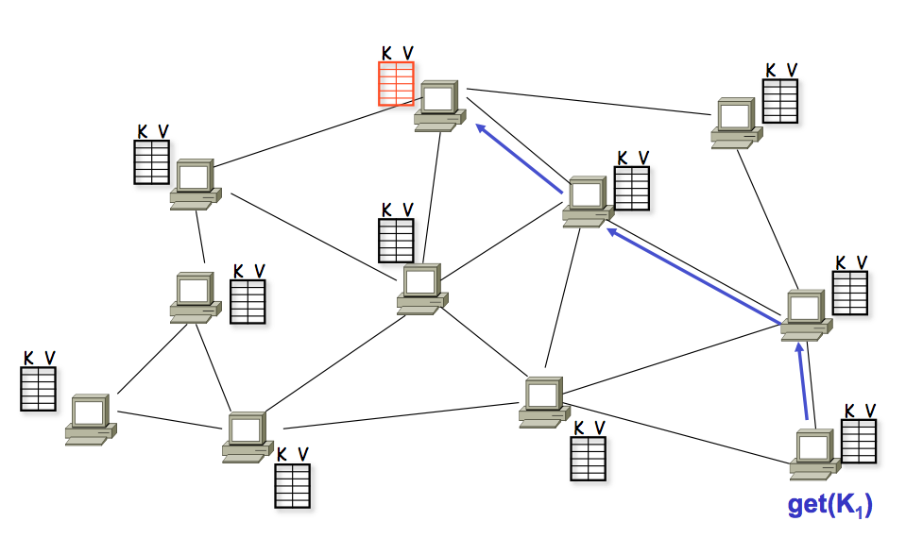
A DHT in Operation: get()

Slide 31
Chord Properties
Efficient: O(log(N)) messages per lookup
  N is the total number of servers
Scalable: O(log(N)) state per node
Robust: survives massive failures

Slide 32
Chord IDs
Key identifier = SHA-1(key)
  SHA-1 is a hash function
Node identifier = SHA-1(IP address)
Both are uniformly distributed
Both exist in the same ID space
How to map key IDs to node IDs? by mod?

Slide 33
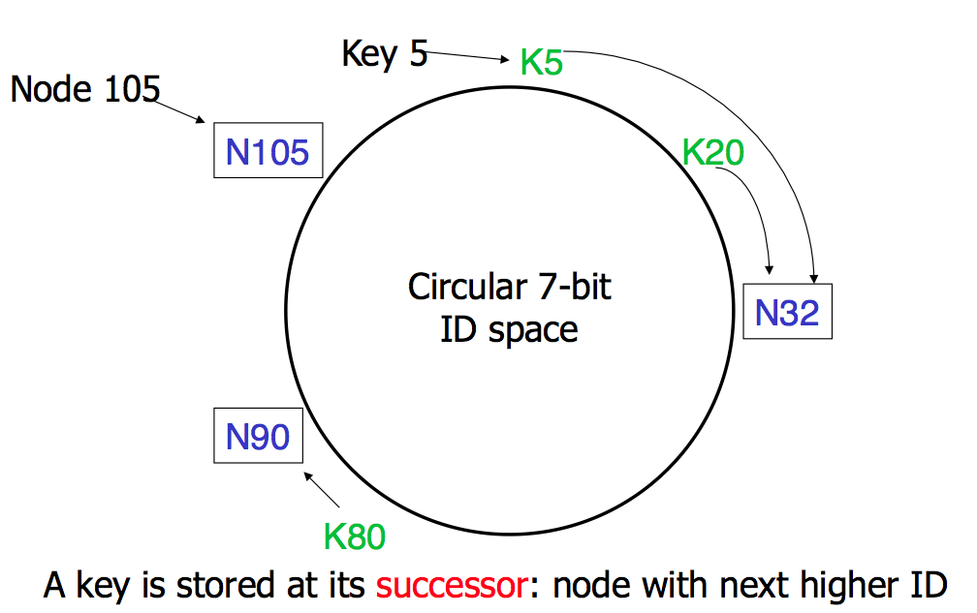
Consistent Hashing

Slide 34
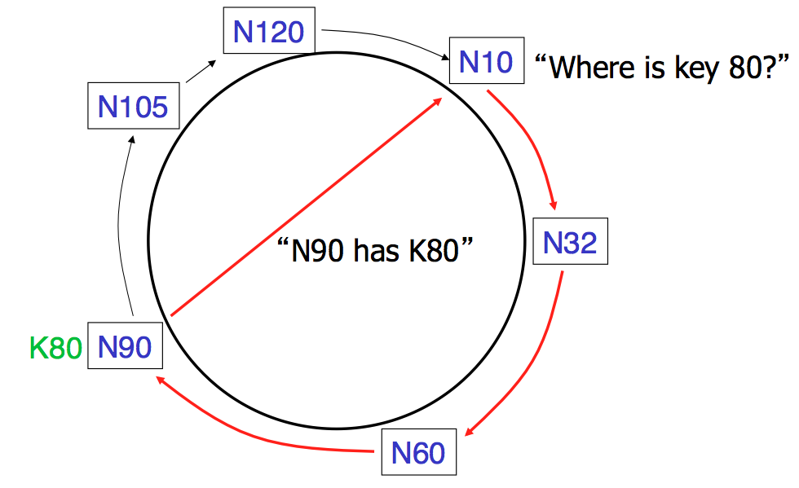
Basic Lookup

Slide 35
Simple Lookup Algorithm
Lookup(my-id, key-id)
n = my successor
if my-id < n < key-id
call Lookup(id) on node n // next hop
else
return my successor // done
Correctness depends only on successors

Slide 36
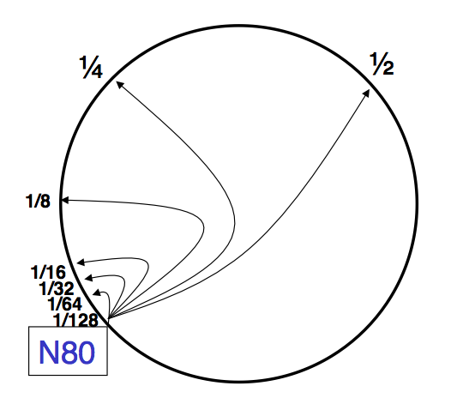
"Finger Table" allows log(N) lookups

Slide 37
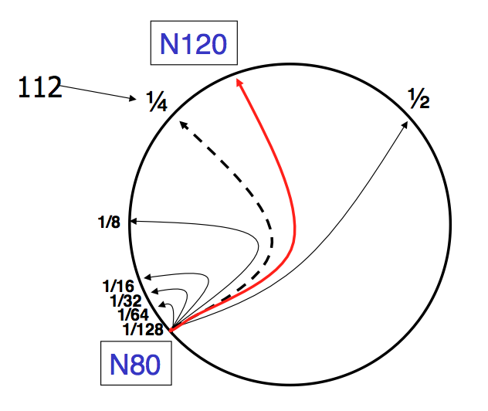
Finger i points to successor of n+2^{i}

Slide 38
Lookup with fingers
Lookup(my-id, key-id)
look in local finger table for
highest node n s.t. my-id < n < key-id
if n exists
call Lookup(id) on node n // next hop
else
return my successor // done

Slide 39
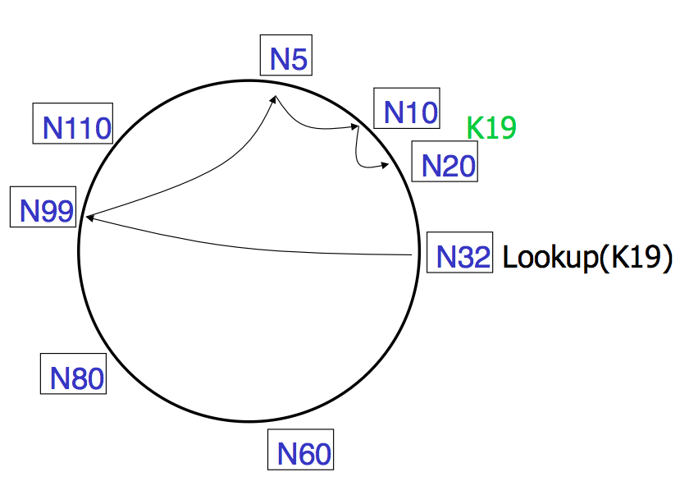
Lookups take O(log(N)) hops

Slide 40
Failures might cause incorrect lookup
N120
N10
N113
^{Lookup(90)}
N102
N85
N80
N80 doesn't know correct successor, so incorrect lookup

Slide 41
Solution: successor lists
Successor Lists
  Each node knows r immediate successors
  After failure, will know first live successor
  Correct successors guarantee correct lookups
Guarantee is with some probability

Slide 42
Join (1)
N25
N36
1. Lookup(36)
N40
K30
K38

Slide 43
Join (2)
N25
N36
1. Lookup(36)
N40
K30
K38

Slide 44
Join (3)
N25
N36
K30
1. Lookup(36)
N40
K30
K38

Slide 45
Join (4)
N25
4. Set N25's successor pointer
N36
K30
N40
K30
K38
Update finger pointers in the background

Slide 46
Solution: successor lists
Successor List Length
  Assume 1/2 of nodes fail
  P(successor list all dead) = (1/2)^{r}
    I.e. P(this node breaks the Chord ring)
    Depends on independent failure
  P(no broken nodes) = (1 – (1/2)^{r})^{N}
    r = 2log(N) makes prob. = 1 – 1/N

Slide 47
Virtual Nodes for Load Balance
Load balance could be a problem
  Some nodes have most value
Solution: virtual nodes
  Virtual nodes are distributed across the ring
  One physical node can have multiple virtual nodes
  More virtual nodes, better load balance

Slide 48
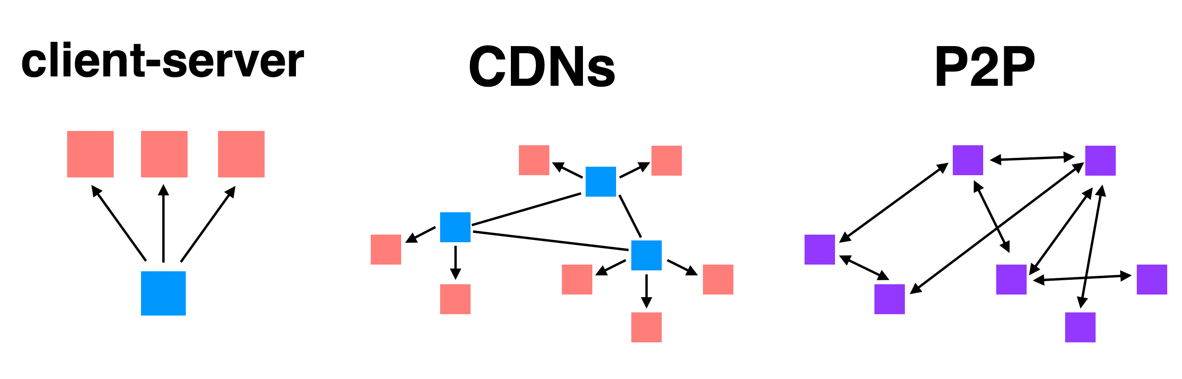
Different File Sharing Techniques

Slide 49
Bitcoin & Blockchain

Slide 50
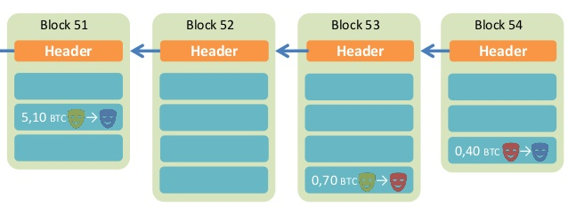
Overview of BitCoin
BitCoin is a decentralized public-accessable ledger
  Using hashes as a pointers, which form a chain
  Tamper-proof (assuming 51% honest)
Time

Slide 51
What is Crypto-Concurrency?
A ledger recording all the money
Why double-spending is possible?
  Y creates two transactions for same coin: Y->Z, Y->Q
    both with hash(T7)
  Y shows different transactions to Z and Q
    both transactions look good, including signatures and hash
    now both Z and Q will give hamburgers to Y
How to avoid double-spending?

Slide 52
Phases in Blockchain
Proposal phase
  Who to propose the block?
Validation phase
  Who to validate the block?
Usually all the participants in the network
  What if an attacker run multiple processes as fake nodes, in order to control 51% nodes?

Slide 53
Existing Solutions
Proof of Work (PoW)
  Brute force to solve a random number (nonce)
  Inefficient, waste of resources
Satisfy the number of first 0s
Tx data
Compute
the
hash
Output
Timestamp
Nonce
Nonce++
PreHash

Slide 54
Trust the Majority
If a majority of CPU power is controlled by honest nodes, the honest chain will grow the fastest and outpace any competing chains
To modify a past block, an attacker would have to redo the proof-of-work of the block and all blocks after it and then catch up with and surpass the work of the honest nodes

Slide 55
Network Steps
1) New transactions are broadcast to all nodes.
2) Each node collects new transactions into a block.
3) Each node works on finding a difficult proof-of-work for its block.
4) When a node finds a proof-of-work, it broadcasts the block to all nodes.
5) Nodes accept the block only if all transactions in it are valid and not already spent.
6) Nodes express their acceptance of the block by working on creating the next block in the chain, using the hash of the accepted block as the previous hash.

Slide 56
Incentive
By convention, the first transaction in a block is a special transaction that starts a new coin owned by the creator of the block
The incentive can also be funded with transaction fees
The incentive may help encourage nodes to stay honest
  If a greedy attacker is able to assemble more CPU power than all the honest nodes, he ought to find it more profitable to play by the rules than to undermine the system and the validity of his own wealth

Slide 57
Questions
Can some one other than the owner spend a coin?
What if I lose my private key?
Is it possible to have inflation?
Is mining really decentralized?
Is it necessary to use PoW? It's a waste of power!
How can I get bitcoin?

Slide 58
Questions
What if a malicious node gets a valid hash, but not broadcast it, in order to be faster than other nodes? (a.k.a., selfish mining)

Slide 59
Smart Contract
The nodes not only store transactions, but also code
... and also execute the code to gen new transaction!
The code is known as "smart contract"
  Execution can be triggered by events/invocations

Slide 60
Larger Storage
Store general data, instead of only transaction
Then a node needs to prove it does store the data
  Proof of retrievability, in challenge-response form
Examples: IPFS, STORJ

Slide 61
Permissioned Chain
Bitcoin is a permission-less chain
  Protect user's privacy by anonymity
  Also hard to track
Permissioned chain is not anonymous
  E.g., several companies build a chain used by themselves only
  It is just a multi-manager distributed database, which has nothing new

Slide 62
It's all about Trust
Why blockchain?
  We need a consensus for a ledger
  There is no third party to be trusted
If there is someone trusted by all, then blockchain is not needed
  Blockchain is slow and hard to use
  It is designed to be that way
    Considering the storage and bandwidth of the ledger

Slide 63
Questions
Why BitCoin is so valuable?
  A bit-string itself does not worth anything
  It is the consensus that matters
    A decentralized global consensus is hard to achieve
    Before BitCoin, it is even thought as impossible
    BitCoin solves this problem by incentive. Human is in the loop!
How to ban BitCoin?

