Slide 1


Introduction to System Security
SE124 (2021 Fall)
IPADS, Shanghai Jiao Tong University
https://www.sjtu.edu.cn
Notes:
Credits to Mike Freedman (COS 461) and others.

Slide 2
Security Intro

Slide 3
Attacks Happen
Lots of personal info stolen
  Attackers broke into server w/ ~800K records on Utah patients
Phishing attacks
  Users at ORNL tricked by phishing email about benefits from HR
Millions of PCs are under control of an adversary
  Which is called "Botnet"
Stuxnet
  Infected Iran's uranium processing facilities
  Fake certificate

Slide 4
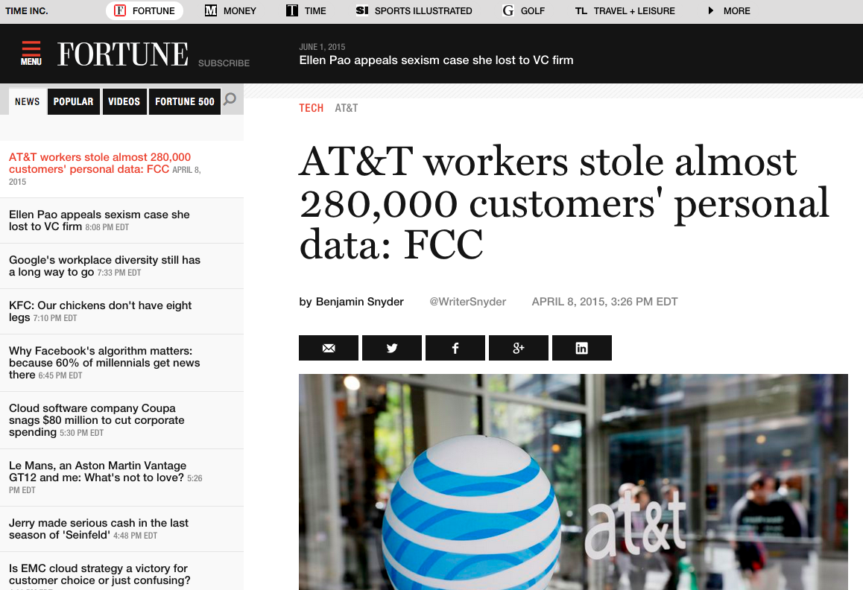

Slide 5
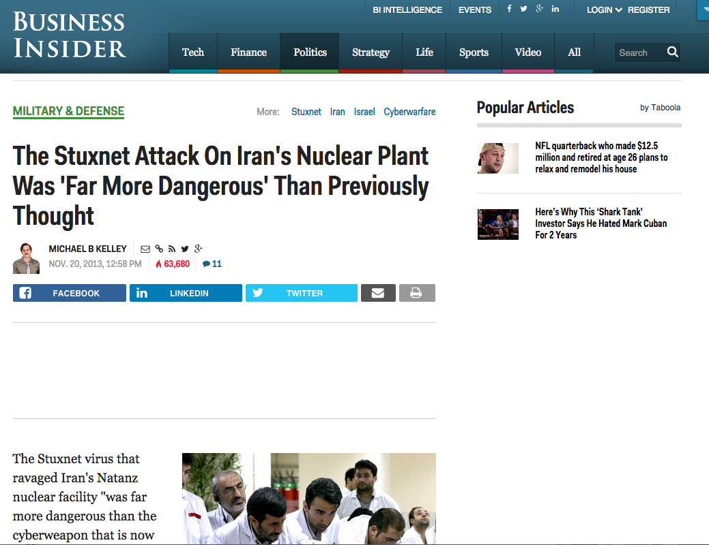

Slide 6
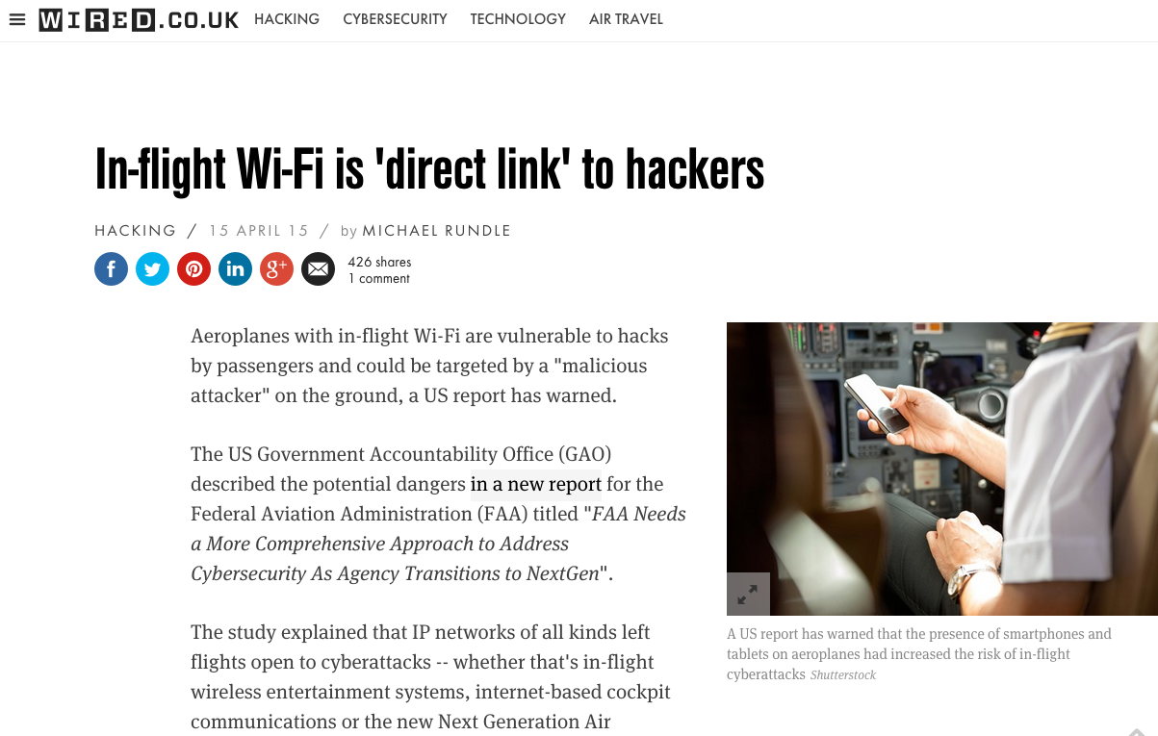

Slide 7
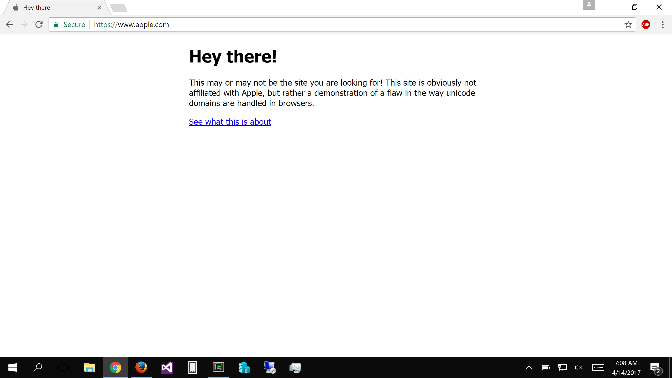
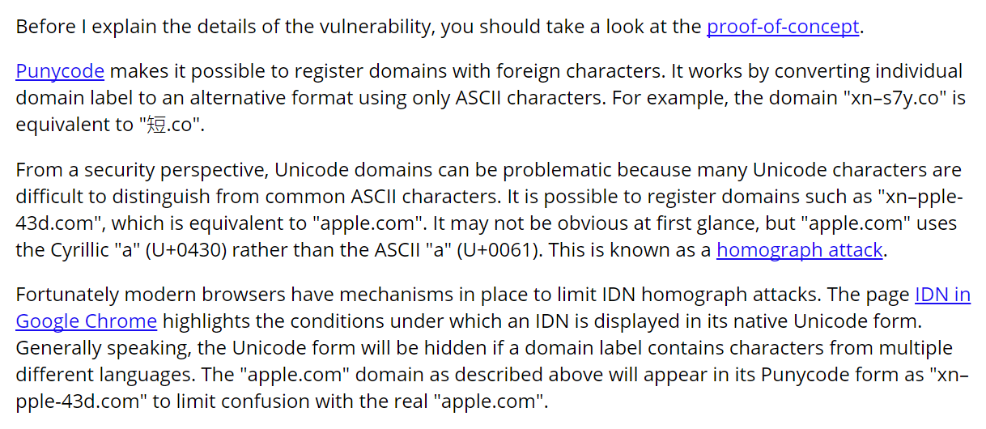

Slide 8
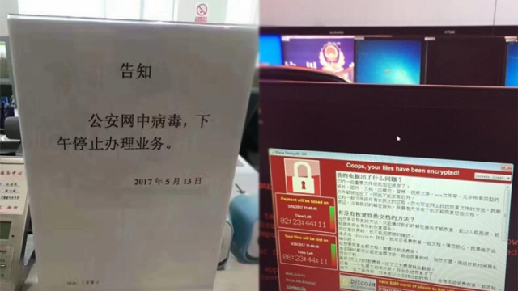

Slide 9



.
HOW TO SHOP FOR FREE ONLINE (S&P'11)
Chuck, pay in Amazon with this signed letter:
Amazon, I want to pay with this letter
Great, I will ship order#123!
Dear Amazon,
order#123 is $10, when it is paid, text me at 425-111-2222. [Jeff's signature]
Jeff,
I want to buy this DVD.
Dear Amazon,
order#123 is $10, when it is paid, text me at 425-111-2222. [Jeff's signature]
Jeff
Hi,
$10 has been paid for order#123.
[Amazon's signature]
Shopper Chuck
Amazon
Note: phone number is analogous to the URL that Amazon uses to notify the merchant

Slide 10
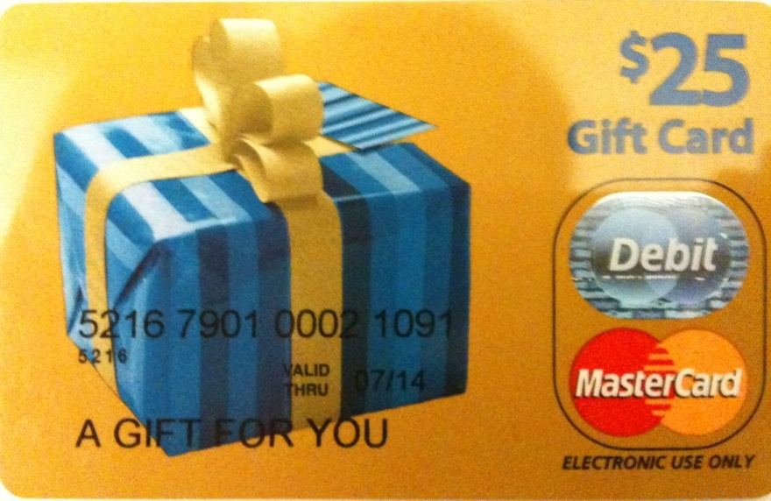



Flaw & exploit
Chuck, pay in Amazon with this signed letter:
Amazon, I want to pay with this letter
Dear Amazon,
order#123 is $10, when it is paid, text me at 425-111-2222.
[Jeff's signature]
Anyone can register an Amazon seller account, so can Chuck.
  We purchased a $25 MasterCard gift card by cash
  We registered it under the name "Mark Smith" with fake address/phone number
  Registered for seller accounts in PayPal, Amazon and Google using the card
Great, I will ship order#123!
Jeff,
I want to buy this DVD.
Dear Amazon,
order#123 is $10, when it is paid, text me at 425-111-2222. [Jeff's signature] [Mark's signature]
Jeff
Hi,
$10 has been paid for order#123.
[Amazon's signature]
Shopper Chuck
(and seller Mark)
Chuck's trick
  Pay to Mark (i.e., Chuck himself), but check out from Jeff
  Amazon is tricked to tell Jeff a payment between Chuck and Mark
  Jeff is confused by Amazon
Amazon
(CaaS)

Slide 11
Other Attacks
Buffer overflow attack (stack/heap)
ROP attack (Return-Oriented Programming)
Password attack
Phishing attack
XSS attack (Cross Site Script)
SQL injection attack
Integer overflow attack
Social engineering attack
Side-channel attack
…

Slide 12
Security: Real World VS. Computer
Security in general not a particularly new concern
  Banks, military, legal system, etc. have always worried about security
Similarities with computer security:
  Want to compartmentalize (different keys for bike vs. safe deposit box)
  Log and audit for compromises
  Use legal system for deterrence

Slide 13
Security: Real World VS. Computer
Significant differences with computer security:
  Internet makes attacks fast, cheap, and scalable
    Huge number of adversaries: bored teenagers, criminals worldwide, etc.
    Anonymous adversaries: no strong identity on the internet
    Adversaries have lots of resources (compromised PCs in a botnet)
    Attacks can often be automated: systems compromised faster than can react
  Users often have poor intuition about computer security
    E.g., misunderstand implications of important security decisions

Slide 14
Why is Security So Hard?
Security is a negative goal
  Want to achieve something despite whatever adversary might do
A positive goal: "XYB can read exam.txt".
  Ask XYB to check if our system meets this positive goal
A negative goal: "Ben cannot read exam.txt".
  Ask John if he can read exam.txt?
  Good to check, but not nearly enough..
  Must reason about all possible ways in which John might get the data
How might Ben try to get the contents of exam.txt?
Notes:
We've seen negative goals already: all-or-nothing atomicity w/ crashes.
With crashes, just had to think of where we might crash.
Much harder to consider all possible cases with an adversary.
Security is also often hard because system has many complex goals.

Slide 15
Ways to Access exam.txt
Change permissions on exam.txt to get access
Access disk blocks directly
Access exam.txt via ipads.se.sjtu.edu.cn
Reuse memory after XYB's text editor exits, read data
Read backup copy of exam.txt from XYB's text editor
Intercept network packets to file server storing exam.txt
Send XYB a trojaned text editor that emails out the file
Steal disk from file server storing exam.txt
Get discarded printout of exam.txt from the trash
Call sysadmin, pretend to be XYB, reset his password
… when should we stop thinking of more ways?

Slide 16
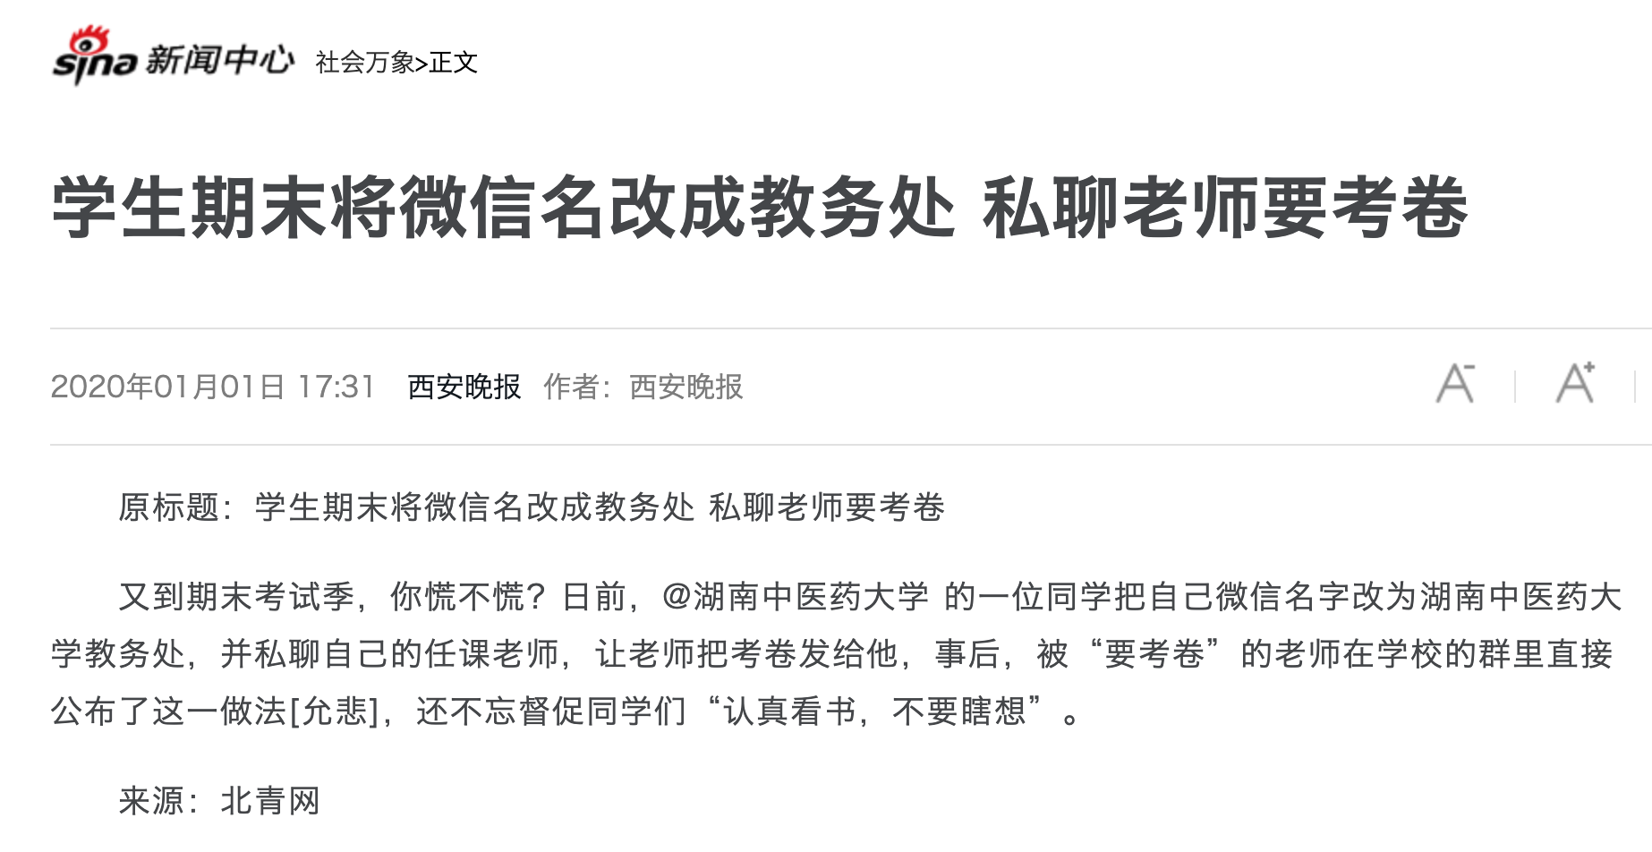

Slide 17
Why is Security So Hard?
Security sometimes conflicts with other goals
  Security VS. performance
  Security VS. availability
  Security VS. fault tolerance
  Security VS. convenience
  Security VS. simplicity
  ...

Slide 18
Fault Tolerant Fails Here
Why not using fault tolerant techniques for security?
  Since security can be seen as a kind of fault
Two reasons
  Result of "fault" may be too much (cannot afford once)
    E.g., exam leakage, rocket launching
  Failures due to attack might be highly correlated
    In fault-tolerance, we assumed independent failures

Slide 19
Much Harder to Reason about Security
No complete solution; we can't always secure every system
  One solution: Trust nothing that you didn't create by yourself
What are we going to learn?
  How to model systems in the context of security
  How we think about and assess risks
  Techniques for assessing common risks
    There are things we can do to make systems more secure
  Know trade-offs
    Security vs. performance, security vs. convenience, and security vs. simplicity

Slide 20
2 Steps towards Building a More Secure System
How to make progress in building a secure system?
  Be clear about goals: "policy"
  Be clear about assumptions: "threat model"

Slide 21
Policy: Goals
Information security goals:
  Confidentiality: limit who can read data
  Integrity: limit who can write data
Liveness goals:
  Availability: ensure service keeps operating

Slide 22
Threat Model: Assumptions
Often don't know in advance who might attack, or what they might do
  Adversaries may have different goals, techniques, resources, expertise
Cannot be secure against arbitrary adversaries
  As we saw with Ben vs. XYB
  Adversary might be your hardware vendor, software vendor, administrator, …
  Need to make some plausible assumptions to make progress

Slide 23
Threat Model: Assumptions
What does a threat model look like?
  Adversary controls some computers, networks (but not all)
  Adversary controls some software on computers he doesn't fully control
  Adversary knows some information, such as passwords or keys (but not all)
  Adversary knows about bugs in your software?
  Physical attacks?
  Social engineering attacks?
  Resources? (Can be hard to estimate either resources or requirements!)

Slide 24
Threat Model: Assumptions
Unrealistic / incomplete threat models
  Adversary is outside of the company network / firewall
  Adversary doesn't know legitimate users' passwords
  Adversary won't figure out how the system works
Despite this, important to have a threat model
  Can reason about assumptions, evolve threat model over time
  When a problem occurs, can figure out what exactly went wrong and re-design
Overly-ambitious threat models not always a good thing
  Not all threats are equally important
  Stronger requirements can lead to more complexity
  Complex systems can develop subtle security problems

Slide 25
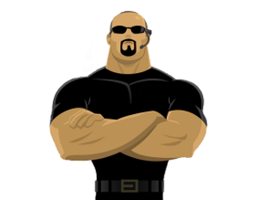
Guard Model

Slide 26
Guard Model of Security
Complete mediation
  Only way to access the resource involves the guard
  1. Must enforce client-server modularity
    Adversary should not be able to access server's resources directly
    E.g., assume OS enforces modularity, or run server on separate machine
  2. Must ensure server properly invokes the guard in all the right places

Slide 27
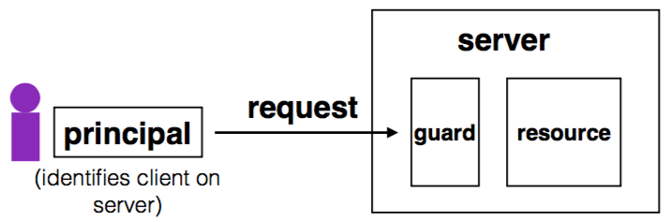
Complete Mediation
Guard typically provides:
  Authentication: is the principal who they claim to be?
  Authorization: does principal have access to perform request on resource?

Slide 28
Designing the Guard
Two functions often provided by a guard:
  Authentication: request -> principal
    E.g., client's username, verified using password
  Authorization: (request, principal, resource) -> allow?
    E.g., consult access control list (ACL) for resource
Simplifies security
  Can consider the guards under threat model
  But don't forget about complete mediation

Slide 29
Example: Unix FS
Resource: files, directories.
Server: OS kernel.
Client: process.
Requests: read, write system calls.
Mediation: U/K bit / system call implementation.
Principal: user ID.
Authentication: kernel keeps track of user ID for each process.
Authorization: permission bits & owner uid in each file's inode.

Slide 30
Example: Web Server
Resource: Wiki pages
Client: any computer that speaks HTTP
Server: web application, maybe written in Python
Requests: read/write wiki pages
Mediation: server stores data on local disk, accepts only HTTP reqs
Principal: username
Authentication: password
Authorization: list of usernames that can read/write each wiki page
Notes:
Note: requires setting file permissions, etc; assumes OS kernel provides complete mediation.

Slide 31
Example: Firewall
Resource: internal servers
Client: any computer sending packets
Server: the entire internal network
Requests: packets
Mediation:
  internal network must not be connected to internet in other ways
  no open wifi access points on internal network for adversary to use
  no internal computers that might be under control of adversary
Principal, authentication: none
Authorization: check for IP address & port in table of allowed connections

Slide 32
What Can Go Wrong?
1. Bypass complete mediation by software bugs
2. Bypass complete mediation by an adversary
3. Policy vs. mechanism
4. Interactions between layers, components
5. Users make mistakes
6. Cost of security

Slide 33
Bypassing Complete Mediation
All ways to access resource must be checked by guard
  Common estimate: one bug per 1,000 lines of code
  Adversary may trick server code to do something unintended, bypass guard
How to prevent bypassing?
  Reduce complexity: reduce lines of code
  The "principle of least privilege"

Slide 34
Example: Paymaxx.com (2005)
https://my.paymaxx.com/
  Requires username and password
  If you authenticate, provides menu of options
  One option is to get a PDF of the tax form
https://my.paymaxx.com/get-w2.cgi?id=1234
  Gets a PDF of W2 tax form for ID 1234
get-w2.cgi forgot to check authorization
  Attacker manually constructs URLs to fetch all data

Slide 35
Example: SQL Injection
username | email | public?
matei | matei@sjtu.edu.cn | yes
mike | mcarbin@sjtu.edu.cn | yes
katrina | lacurts@sjtu.edu.cn | no
SELECT username, email FROM users WHERE
username='<username>' AND public='yes'
Let <username> = katrina' OR username='
SELECT username, email FROM users WHERE
username='katrina' OR username='' AND
public='yes'

Slide 36
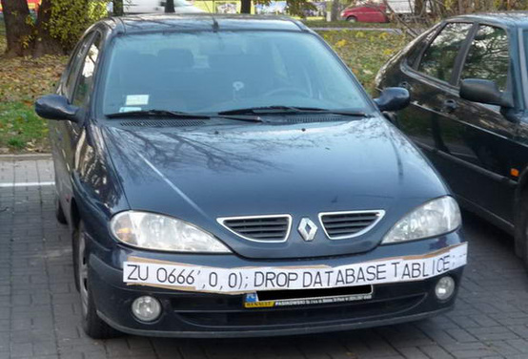
SQL Injection
ZU 0666',0,0);; DROP DATABASE TABLICE;

