Slide 1


Authentication & Password
SE124 (2021 Fall)
IPADS, Shanghai Jiao Tong University
https://www.sjtu.edu.cn
Notes:
Credits to Mike Freedman (COS 461) and others.

Slide 2
Review
Security is a negative goal
  Want to achieve something despite whatever adversary might do
How to make progress in building a secure system?
  Be clear about goals: "policy"
    C.I.A.
  Be clear about assumptions: "threat model"
    What are the assumptions?
Notes:
We've seen negative goals already: all-or-nothing atomicity w/ crashes.
With crashes, just had to think of where we might crash.
Much harder to consider all possible cases with an adversary.
Security is also often hard because system has many complex goals.

Slide 3
Threat Model: Assumptions
What does a threat model look like?
  Adversary controls some computers, networks (but not all)
  Adversary controls some software on computers he doesn't fully control
  Adversary knows some information, such as passwords or keys (but not all)
  Adversary knows about bugs in your software?
  Physical attacks?
  Social engineering attacks?
  Resources? (Can be hard to estimate either resources or requirements!)

Slide 4
Threat Model: Assumptions
Unrealistic / incomplete threat models
  Adversary is outside of the company network / firewall
  Adversary doesn't know legitimate users' passwords
  Adversary won't figure out how the system works
Despite this, important to have a threat model
  Can reason about assumptions, evolve threat model over time
  When a problem occurs, can figure out what exactly went wrong and re-design
Overly-ambitious threat models not always a good thing
  Not all threats are equally important
  Stronger requirements can lead to more complexity
  Complex systems can develop subtle security problems

Slide 5

Guard Model

Slide 6
Guard Model of Security
Complete mediation
  Only way to access the resource involves the guard
  1. Must enforce client-server modularity
    Adversary should not be able to access server's resources directly
    E.g., assume OS enforces modularity, or run server on separate machine
  2. Must ensure server properly invokes the guard in all the right places

Slide 7
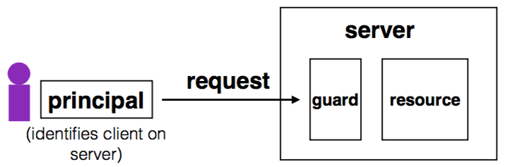
Complete Mediation
Guard typically provides:
  Authentication: is the principal who they claim to be?
  Authorization: does principal have access to perform request on resource?

Slide 8
Designing the Guard
Two functions often provided by a guard:
  Authentication: request -> principal
    E.g., client's username, verified using password
  Authorization: (request, principal, resource) -> allow?
    E.g., consult access control list (ACL) for resource
Simplifies security
  Can consider the guards under threat model
  But don't forget about complete mediation

Slide 9
Example: Unix FS
Resource: files, directories.
Server: OS kernel.
Client: process.
Requests: read, write system calls.
Mediation: U/K bit / system call implementation.
Principal: user ID.
Authentication: kernel keeps track of user ID for each process.
Authorization: permission bits & owner uid in each file's inode.

Slide 10
Example: Web Server
Resource: Wiki pages
Client: any computer that speaks HTTP
Server: web application, maybe written in Python
Requests: read/write wiki pages
Mediation: server stores data on local disk, accepts only HTTP reqs
Principal: username
Authentication: password
Authorization: list of usernames that can read/write each wiki page
Notes:
Note: requires setting file permissions, etc; assumes OS kernel provides complete mediation.

Slide 11
Example: Firewall
Resource: internal servers
Client: any computer sending packets
Server: the entire internal network
Requests: packets
Mediation:
  internal network must not be connected to internet in other ways
  no open wifi access points on internal network for adversary to use
  no internal computers that might be under control of adversary
Principal, authentication: none
Authorization: check for IP address & port in table of allowed connections

Slide 12
What Can Go Wrong?
1. Bypass complete mediation by software bugs
2. Bypass complete mediation by an adversary
3. Policy vs. mechanism
4. Interactions between layers, components
5. Users make mistakes
6. Cost of security

Slide 13
Bypassing Complete Mediation
All ways to access resource must be checked by guard
  Common estimate: one bug per 1,000 lines of code
  Adversary may trick server code to do something unintended, bypass guard
How to prevent bypassing?
  Reduce complexity: reduce lines of code
  The "principle of least privilege"

Slide 14
Example: Paymaxx.com (2005)
https://my.paymaxx.com/
  Requires username and password
  If you authenticate, provides menu of options
  One option is to get a PDF of the tax form
https://my.paymaxx.com/get-w2.cgi?id=1234
  Gets a PDF of W2 tax form for ID 1234
get-w2.cgi forgot to check authorization
  Attacker manually constructs URLs to fetch all data

Slide 15
Example: SQL Injection
username | email | public?
matei | matei@sjtu.edu.cn | yes
mike | mcarbin@sjtu.edu.cn | yes
katrina | lacurts@sjtu.edu.cn | no
SELECT username, email FROM users WHERE
username='<username>' AND public='yes'
Let <username> = katrina' OR username='
SELECT username, email FROM users WHERE
username='katrina' OR username='' AND
public='yes'

Slide 16
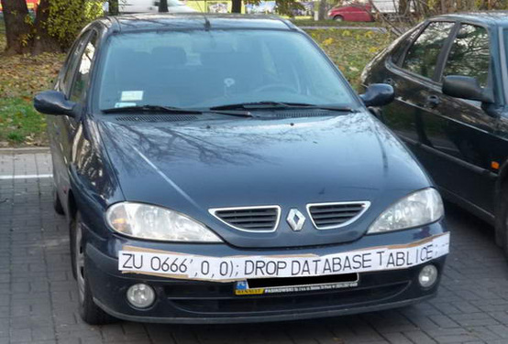
SQL Injection
ZU 0666',0,0);; DROP DATABASE TABLICE;

Slide 17
Authentication: Password

Slide 18
Authentication: Who Are You?
Something you know
  E.g., passwords, answers of questions
Something you have
  E.g., keys or smart cards
Something you are
  E.g., fingerprint, iris, or other biometric method
Q: What are their pros and cons?

Slide 19
Authentication: Password
Password goals
  Authenticate user
  Adversary must guess
    For random 8-letter passwords, ~26⁸?
  Guessing is expensive

Slide 20
An Example: Guessing Password (Tenex)
checkpw (user, passwd):
acct = accounts[user]
for i in range(0, len(acct.pw)):
if acct.pw[i] ≠ passwd[i]:
return False
return True
passwd:
P
A
S
S
W
O
R
D
X
acct.pw:
P
A
S
S
w
O
R
D

Slide 21
Problem: Guess One Character at a Time
Guess a password
  Allocate password 1 byte away from a page boundary
  Page-fault means first char is OK
  Example of cross-layer interactions
Problem: server has a copy of all passwords
  If adversary exploits buffer overflow, can get a copy of all passwords

Slide 22
Timing Attack: Guess One Character at a Time
Guess a password
  Allocate password 1 byte away from a page boundary
  Page-fault means first char is OK
  Example of cross-layer interactions
Also known as "Timing Attack"

Slide 23
Timing Attack: Guess One Character at a Time
Page in Memory
a
b
c
ca
…
cs
…
Page on Disk -> Page Fault
aaaaaa
aaaaaa
aaaaaa
aaaaa
aaaaa
Time = 1ms
Time = 1ms
Time = 10ms
Time = 1ms
Time = 10ms
Page Fault!
The 1st char must be 'c'
Page Fault!
The 2nd char must be 's'

Slide 24
Idea: Store Hash of Password
Hash functions: arbitrary strings to fixed-length output
  Common output sizes are 160 bits, 256 bits, ..
  One-way: given H(x), hard to recover x
  Collision-resistant: hard to find different x and y such that H(x)=H(y)
  Evolve over time: SHA-0 and MD-5 used to be popular, now considered broken

Slide 25
Store Hash of Password
Accounts database stores hash of every user's password
Compute hash, check if the hash matches
Solves not only the password theft problem, but also the page-fault attack

Slide 26
Store Hash of Password
username | hash(password)
arya | de5aba604c340e1965bb27d7a4c4ba03f4798ac7
jon | 321196d4a6ff137202191489895e58c29475ccab
Sansa | 6ea7c2b3e08a3d19fee5766cf9fc51680b267e9f
hodor | c6447b82fbb4b8e7dbcf2d28a4d7372f5dc32687
check_password(username, inputted_password):
stored_hash = accounts_table[username]
inputted_hash = hash(inputted_password)
return stored_hash == inputted_hash

Slide 27
Store Hash of Password
What happens if an adversary breaks into a popular web site with 1M accounts?
  Adversary steals 1M hashes
  Problem: adversary can guess each password one-by-one
  Problem: worse yet, adversary can build table of hashes for common passwords
  Often called a "rainbow table"
  Users are not great at choosing passwords, many common choices

Slide 28
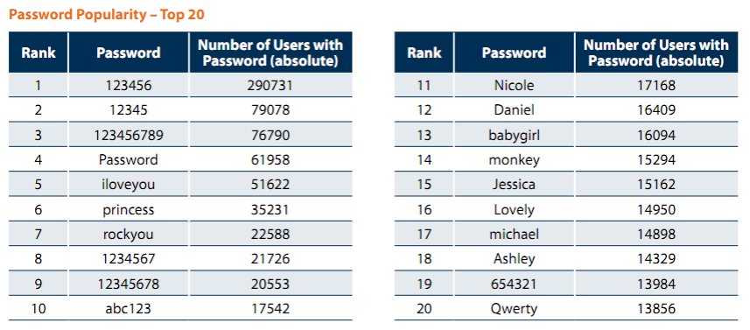
Password Statistics (32M Password, 2009)
5,000 unique password account for 6.4M users (20%)
Similar statistics confirmed again in 2010 (Gawker break-in)
"Consumer Passwords Worst Practices" report by Imperva

Slide 29
Store Hash of Password
Important to think of human factors when designing security systems
  Not much we can do for users that chose "123456"
  Plenty of bad passwords have numbers, uppercase, lowercase, etc.
  What matters is the (un)popularity of a password, not letters/symbols
  But we can still make it a bit harder to guess less-embarrassing passwords

Slide 30
Salting
Salting: make the same password have different hash values
  Makes it harder to build a pre-defined lookup table
Choose random salt value when storing the password (& store the salt)
  Store hash of salt and password together
  Use the original salt to compute a matching hash when verifying password
  Every password has many possible hash values -> impractical to build rainbow table
Use a much more expensive hash function
  For reference: look up "bcrypt" by Provos and Mazieres

Slide 31
Salting
username | salt | hash(password | salt)
arya | 5334900209 | c5d2a9ffd6052a27e6183d60321c44c58c3c26cc
jon | 1128628774 | 624f0ffa577011e5704bdf0760435c6ca69336db
Sansa | 8188708254 | 5ee2b8effce270183ef0f4c7d458b1ed95c0cce5
Hodor | 6209415273 | f7e17e61376f16ca23560915b578d923d86e0319
check_password(username, inputted_password)
stored_hash = accounts_table[username]
inputted_hash = hash(inputted_password | salt)
return stored_hash == inputted_hash

Slide 32
Bootstrap Authentication
Do not want to continuously authenticate with password for every command
  Typing, storing, transmitting, checking password: risk of compromise
In Unix login:
  Login process exchanges password for userid
In web applications:
  Often exchange password for a session cookie
  Can think of it as a temporary password that's good for limited time

Slide 33
Session Cookies: Strawman
First check username and password, if ok, send:
Use the tuple to authenticate user for a period of time
  Nice property: no need to store password in memory, or re-enter it often
  Server_key is there to ensure users can't fabricate hash themselves
  Arbitrary secret string on server, can be changed (invalidating cookies)
  Can verify that the username and expiration time is valid by checking hash
{username, expiration, H(server_key | username | expiration)}

Slide 34
Session Cookies: Strawman
Problem: the same hash can be used for different username/expiration pairs!
  E.g., "Ben" and "22-May-2012" may also be "Ben2" and "2-May-2012"
  Concatenated string used to compute the hash is same in both cases!
  Can impersonate someone with a similar username
Principle: be explicit and unambiguous when it comes to security
  E.g., use an invertible delimiter scheme for hashing several parts together

Slide 35
Phishing Attacks
Adversary tricks user into visiting legitimate-looking web site (e.g., bank)
  Asks for username/passwd
  Actually a different server operated by adversary
    E.g., bank0famerica.com instead of bankofamerica.com
  Stores any username/passwd entered by victims
  Adversary can now impersonate victims on the real web site

Slide 36
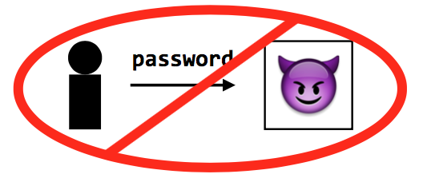
Key Problem of Password
Key problem: once you send a password to the server, it can impersonate you
  Solved part of the problem by hashing the password database
  But still sending the password to the server to verify on login

Slide 37
Technique 1: challenge-response scheme
Challenge-response
  Server chooses a random value R, sends it to client
  Client computes H(R + password) and sends to server
  Server checks if this matches its computation of hash with expected password
  If the server didn't already know password, still doesn't know

Slide 38
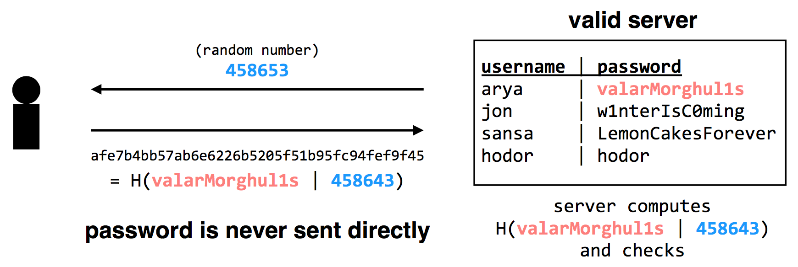
Technique 1: challenge-response scheme
Adversary only learns H(valarMorghul1s | 458643); can not recover the password from that

Slide 39
Tech 2: use passwords to authenticate the server
Make the server prove it knows your password
  Client chooses Q, sends to server, server computes H(Q + password), replies
  Only the authentic server would know your password!
Unfortunately, not many systems use this in practice
  In part because app developers just care about app authenticating user...
Notes:
Slight problem: simple challenge-response can't be used with hashed passwords.
Need the original password to compute hash together with random challenge.
If we store the hashed password, its hash now becomes the effective password..
There's a protocol that allows both.
Store a "hash" of password, challenge-response auth.
Look up "SRP" if building a real system (details too complicated for 6.033).

Slide 40
Tech 2: use passwords to authenticate the server
Complication: could be used with first scheme to fool server!
  First, try to log into the server: get the server's challenge R
  Then, decide you want to test the server: send it the same R
  Send server's reply back to it as response to the original challenge
Principle: be explicit, again!
  E.g., hash the intended recipient of response (e.g., client or server), and have the recipient verify it
Notes:
Slight problem: simple challenge-response can't be used with hashed passwords.
Need the original password to compute hash together with random challenge.
If we store the hashed password, its hash now becomes the effective password..
There's a protocol that allows both.
Store a "hash" of password, challenge-response auth.
Look up "SRP" if building a real system (details too complicated for 6.033).

Slide 41
Tech 3: turn offline into online attack
Turn phishing attacks from offline into online attacks
  If adversary doesn't have the right image, users will know the site is fake
  Adversary could talk to real site, fetch image for each user that logs in

Slide 42
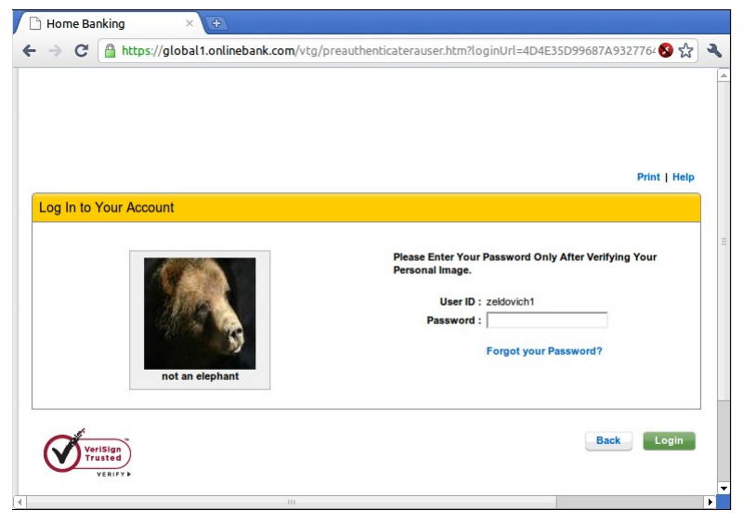
"Sitekey"

Slide 43
Tech 3: turn offline into online attack
Why is it still useful, then?
  Requires more efforts on adversary's part to mount attack
  Even if adversary does this, bank can detect it
  Watch for many requests coming from a single computer
  That computer might be trying to impersonate site
  Turns an offline/passive attack into an online/active attack
Key insight
  Don't need perfect security, small improvements can help

Slide 44
Tech 4: Specific password
Make passwords specific to a site
  Instead of sending password, send H(servername + password)
  Just like a basic password scheme, from the server's point of view
Except impersonator on another server gets diff passwd
Recommendation
  E.g., LastPass

Slide 45
Tech 5: one-time passwords
One-time Password
  If adversary intercepts password, can keep using it over and over
  Can implement one-time passwords: need to use a different password every time
Design: construct a long chain of hashes.
  Start with password and salt, as before
  Repeatedly apply hash, n times, to get n passwords
  Server stores x = H(H(H(H(...(H(salt+password)))))) = H^{n}(salt+password)
To authenticate, send token=H^{{n-1}}(salt+password)
  Server verifies that x = H(token), then sets x <- token
  User carries a printout of a few hashes, or uses smartphone to compute them.

Slide 46
Tech 5: one-time passwords
Alternative design: include time in the hash (Google's 2-step verification)
  Server and user's smartphone share some secret string K
  To authenticate, smartphone computes H(K || current time)
  User sends hash value to server, server can check a few recent time values.

Slide 47
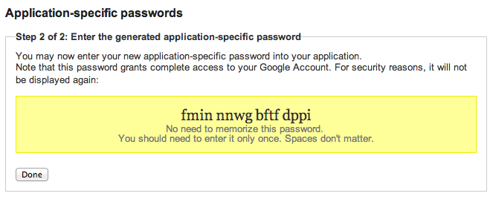

Google's App-specific password

Slide 48
Tech 6: bind authentication and request authorization
One way to look at problem: sending password authorizes any request
  Even requests by adversary that intercepts our password
  A different design: use password to authenticate any request
  req = { username, "write XX to exam.txt", H(password + "write ..") }
Server can check if this is a legitimate req from user using password
  Even if adversary intercepts request, cannot steal/misuse password
  In practice, don't want to use password, use some session token instead
  Could combine well with one-time passwords

Slide 49
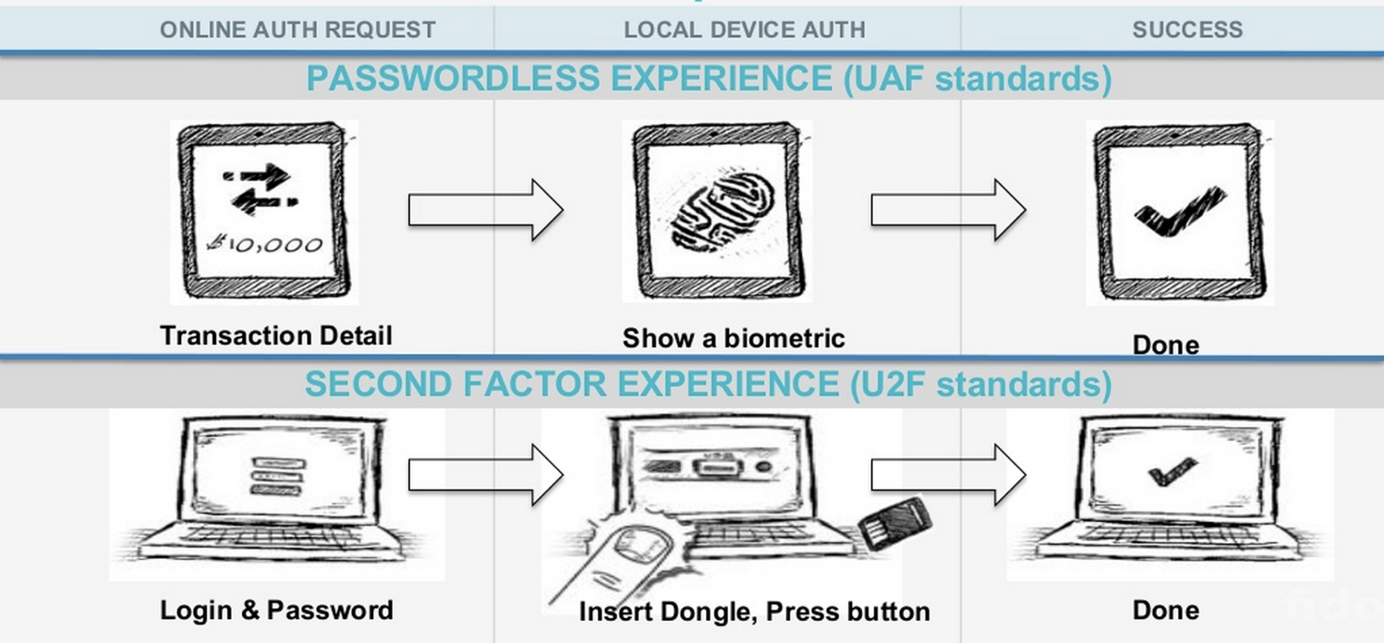
Tech 7: FIDO: Replace the Password

Slide 50
Three Bindings
Fingerprint
User ID
Private key
Publish key
Phone
Server
Secure by hardware (e.g., Enclave)
Secure by isolation

Slide 51
Bootstrapping
How to initially set a password for an account?
  If adversary can subvert this process, cannot rely on much else
  MIT: admissions office vets each student, hands out account codes
  Many web sites: anyone with an email can create a new account
Changing password (e.g., after compromise)
  Need some additional mechanism to differentiate user vs. attacker
  MIT: walk over to accounts office, show ID, admin can reset password
  Many sites: additional "security" questions used to reset password
Password bootstrap / reset mechanisms are part of the security system
  Can sometimes be weaker than the password mechanisms
  Sarah Palin's Yahoo account was compromised by guessing security Q's
  Personal information can be easy to find online

Slide 52
Security Principles

Slide 53
Principle of Least Privilege
Deal with bugs / incomplete mediation
  Any component that can arbitrarily access a resource must invoke the guard
  If component has a bug or design mistake, can lead to incomplete mediation
  General plan: reduce the number of components that must invoke the guard
    E.g., arrange for DB server to check permissions on records returned, then security does not depend as much on lookup.cgi

Slide 54
Least Trust
Privileged components are "trusted"
  Trusted is bad: you are in trouble if a trusted component breaks
  Untrusted components are good: does not matter if they break
  Good design has few trusted components, other things do not affect security

Slide 55
Users Make Mistakes
Social engineering, phishing attacks
  How many of you really read the permission acquired by apps during installing?
Good idea: threat model should not assume users are perfect

Slide 56
Cost of Security
Security VS. Availability
  E.g., system requires frequent password changes -> users may write them down
How far should a teacher go to protect the exam file?
  Put the file on a separate computer, to avoid sharing a file system?
  Disconnect computer from the network, to avoid remotely exploitable OS bugs?
  Put the server into a separate machine room?
  Get a guard to physically protect the machine room?
  ...
Good idea: cost of security mechanism should be commensurate with value
Notes:
Most security goals/policies not infinitely valuable, can tolerate attacks.
Security mechanisms can be expensive (e.g., wasted user time).

