Slide 1


Secure Data Flow
SE124 (2021 Fall)
IPADS, Shanghai Jiao Tong University
https://www.sjtu.edu.cn
Notes:
Credits to Mike Freedman (COS 461) and others.

Slide 2
Two Usages of Data Flow Tracking
Usage-1: protect critical data
  E.g., track data to ensure none is leaked
Usage-2: defend against suspicious input data
  E.g., one input data cannot flow to return address!

Slide 3
Data Flow Protection

Slide 4
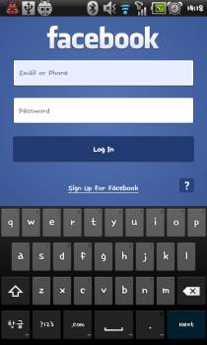
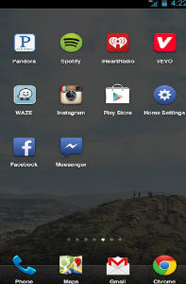
Ways an Attacker Can Steal Your Secrets
KeyLogger: install a KeyLogger/TouchLogger on the phone
Phishing: install a malware and lure the user to enter password
Malicious app
in background,
waiting for the
Facebook app
to launch
Once Facebook app
starts, the malicious
app will get active
and make itself
cover the real UI
Bianchi, Antonio, et al. "What the App is That? Deception and Countermeasures in the Android User Interface.", S&P 2015.
Notes:
Or he can install a malware to lure the user to enter password. A typicall malware will run in background...

Slide 5

Ways an Attacker Can Steal Your Secrets
KeyLogger: install a KeyLogger/TouchLogger on the phone
Phishing: install a malware and lure the user to enter password
MemScan: use rootkit and scan the memory for any plaintext
010100101010101000101010101010101010101010101010010101010101010010101010101010101001010011010101010101010101010001001000000101010010010010
The Samsung memory mapping bug: http://forum.xda-developers.com/showthread.php?t=2048511
Notes:
Or, he can just use rootkit and scan the memory for any plaintext

Slide 6
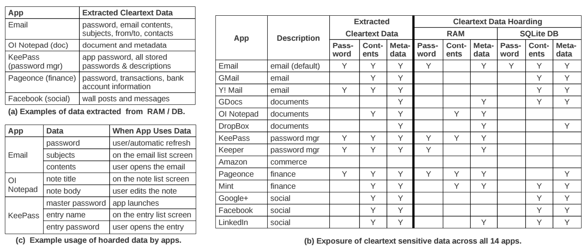
The "Data Residue" Problem
The plaintext of confidential data may exist in memory on a mobile device for a long time
应用对关键数据的保护不够
  引CleanOS的数据
Android's default Email app:
has plaintext of password in RAM 10 minutes after login
Tang, Yang, et al. "CleanOS: Limiting Mobile Data Exposure with Idle Eviction." OSDI. 2012.
Notes:
This attack is simple but effective since the memory does contain many secrets. Here is a table from cleanOS, OSDI'12 paper.
It shows that many popular applications will leave residue of critical data in memory for a long time. For example,
the android's default email app,

Slide 7
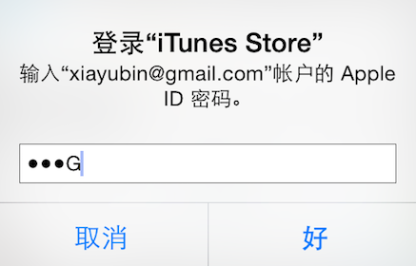
Ways an Attacker Can Steal Your Secrets
KeyLogger: install a KeyLogger/TouchLogger on the phone
Phishing: install a malware and lure the user to enter password
MemScan: use rootkit and scan the memory for any plaintext
ScreenCapture: get information directly from the screen
Jang, Yeongjin, et al. "A11y Attacks: Exploiting Accessibility in Operating Systems." CCS, 2014.
Notes:
The attacker might also steal your password from screen. On iOS system, once you enter a password, the last character will be displayed for a second. If the attacker can access framebuffer or capture the screen, he can get your password

Slide 8
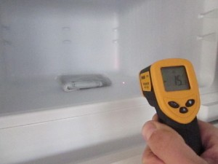
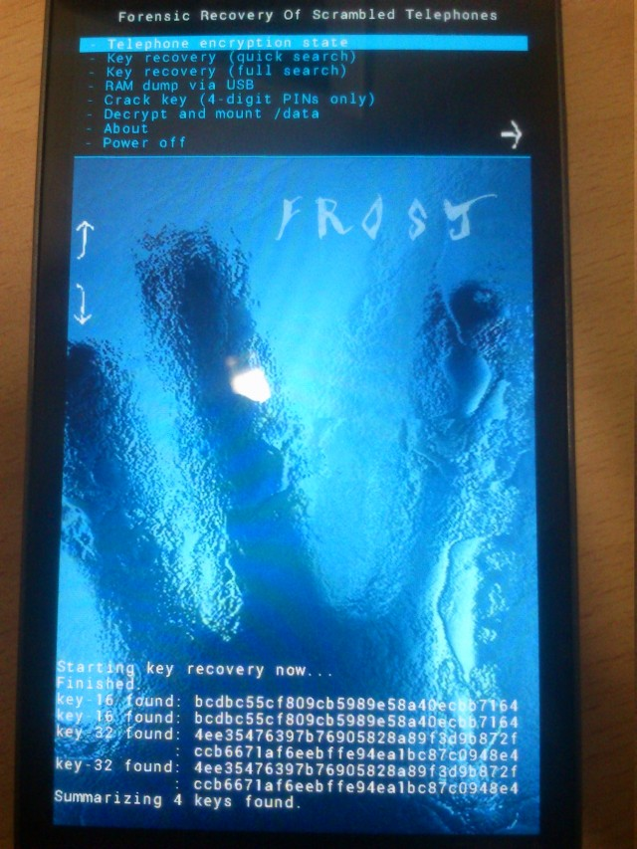
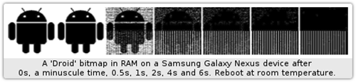
Ways an Attacker Can Steal Your Secrets
KeyLogger: install a KeyLogger/TouchLogger on the phone
Phishing: install a malware and lure the user to enter password
MemScan: using rootkit and scan memory for any plaintext
ScreenCapture: get information directly from the screen
Cold-boot: physically attack that can scan memory to get any plaintext
Müller, Tilo, and Michael Spreitzenbarth. "Frost." Applied Cryptography and Network Security. Springer Berlin Heidelberg, 2013.
Notes:
Cold boot attack is also possible on the mobile device, which just scan the memory to get an plaintext.

Slide 9
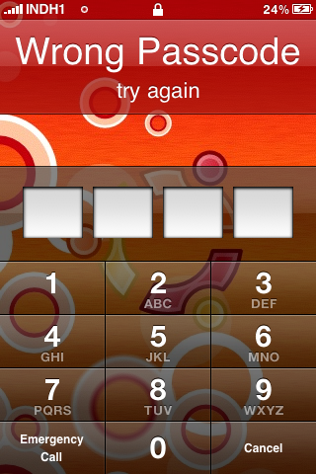
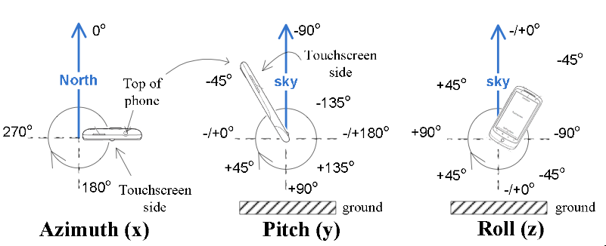
Ways an Attacker Can Steal Your Secrets
KeyLogger: install a KeyLogger/TouchLogger on the phone
Phishing: install a malware and lure the user to enter password
MemScan: using rootkit and scan memory for any plaintext
ScreenCapture: get information directly from the screen
Coldboot: physically scan the memory to get any plaintext
Side-Channel: infer PIN code through motion-detector
Cai, Liang, and Hao Chen. "TouchLogger: Inferring Keystrokes on Touch Screen from Smartphone motion." HotSec. 2011.
Notes:
A even more sophistic attack is to use the motion-detector to guess the user's PIN code, just by learning the relationship between the PIN and phone's inclination when pressing the screen.

Slide 10
Taint Tracking
Data Protection

Slide 11
Data Lifetime
The lifetime of sensitive data should be minimized
  The longer data remains in memory the greater its chances of being leaked to disk
  Swapping, hibernation, VM suspending, core dump, etc.
That's what we called "data exposure"

Slide 12
Tainting: Data Flow Tracking
Apply access policy along the data flow
  E.g., a password cannot be sent to Internet
  E.g., credit card number cannot be sent to other apps
  E.g., untrusted data cannot be executed

Slide 13
Dynamic Taint Analysis
i = get_input();
two = 2;
if(i%2 == 0){
  j = i+two;
  l = j;
} else {
  k = two*two;
  l = k;
}
jmp l;
Example sourced from CMU ECE
  Source
Will show the basic approach of dynamic taint analysis
Two concrete executions will be presented
Goal: evaluate whether control can be hijacked by [malicious] user input

Slide 14
Dynamic Taint Analysis
i = get_input();
two = 2;
if(i%2 == 0){
  j = i+two;
  l = j;
} else {
  k = two*two;
  l = k;
}
jmp l;
Variable | Value | Taint Status

Slide 15
Dynamic Taint Analysis
i = get_input();
two = 2;
if(i%2 == 0){
  j = i+two;
  l = j;
} else {
  k = two*two;
  l = k;
}
jmp l;
Variable | Value | Taint Status
i | 6 | true

Slide 16
Dynamic Taint Analysis
i = get_input();
two = 2;
if(i%2 == 0){
  j = i+two;
  l = j;
} else {
  k = two*two;
  l = k;
}
jmp l;
Variable | Value | Taint Status
i | 6 | true
two | 2 | false

Slide 17
Dynamic Taint Analysis
i = get_input();
two = 2;
if(i%2 == 0){
  j = i+two;
  l = j;
} else {
  k = two*two;
  l = k;
}
jmp l;
Variable | Value | Taint Status
i | 6 | true
two | 2 | false
j | 8 | true

Slide 18
Dynamic Taint Analysis
i = get_input();
two = 2;
if(i%2 == 0){
  j = i+two;
  l = j;
} else {
  k = two*two;
  l = k;
}
jmp l;
Variable | Value | Taint Status
i | 6 | true
two | 2 | false
j | 8 | true
l | 8 | true
Notes:
In this case, the taint analysis would show that an attack is possible. Notice, however, that we don't know exactly how variable L is tainted by variable I as we do in a fully symbolic execution—we only know that the two variables are related. However, computing a fully symbolic execution is often intractable, thus giving dynamic taint analysis some merits as a higher-performance technique (in terms of computational efficiency).

Slide 19
Dynamic Taint Analysis
i = get_input();
two = 2;
if(i%2 == 0){
  j = i+two;
  l = j;
} else {
  k = two*two;
  l = k;
}
jmp l;
Variable | Value | Taint Status

Slide 20
Dynamic Taint Analysis
i = get_input();
two = 2;
if(i%2 == 0){
  j = i+two;
  l = j;
} else {
  k = two*two;
  l = k;
}
jmp l;
Variable | Value | Taint Status
i | 7 | true

Slide 21
Dynamic Taint Analysis
i = get_input();
two = 2;
if(i%2 == 0){
  j = i+two;
  l = j;
} else {
  k = two*two;
  l = k;
}
jmp l;
Variable | Value | Taint Status
i | 7 | true
two | 2 | false

Slide 22
Dynamic Taint Analysis
i = get_input();
two = 2;
if(i%2 == 0){
  j = i+two;
  l = j;
} else {
  k = two*two;
  l = k;
}
jmp l;
Variable | Value | Taint Status
i | 7 | true
two | 2 | false
k | 4 | false

Slide 23
Dynamic Taint Analysis
i = get_input();
two = 2;
if(i%2 == 0){
  j = i+two;
  l = j;
} else {
  k = two*two;
  l = k;
}
jmp l;
Variable | Value | Taint Status
i | 7 | true
two | 2 | false
k | 4 | false
l | 4 | false
Notes:
In this case, the taint analysis would show that an attack is not possible.

Slide 24
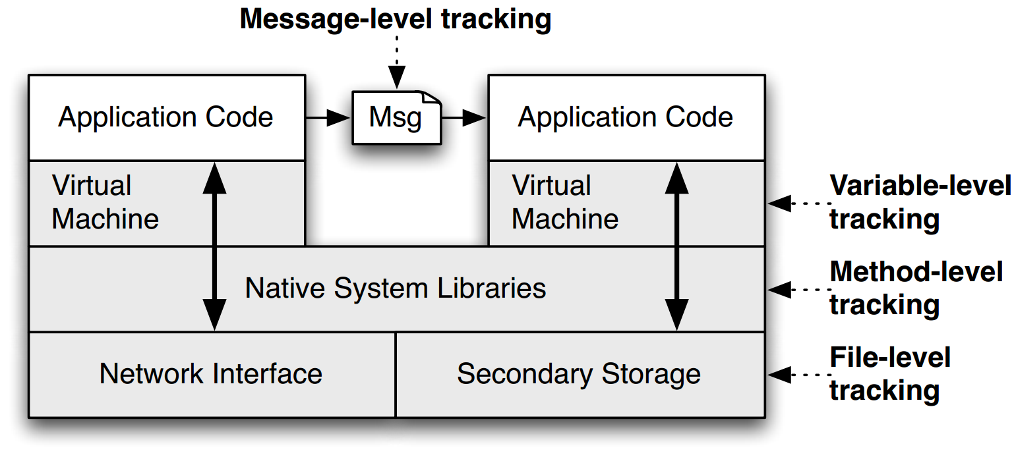
TaintDroid
Notes:
This is a figure from the conference paper describing TaintDroid. It shows where, at a high level, the various kinds of taint analysis are done. There are 4 "granularities" of taint analysis used in TaintDroid, including message-level, variable-level, method-level, and file-level.

Slide 25
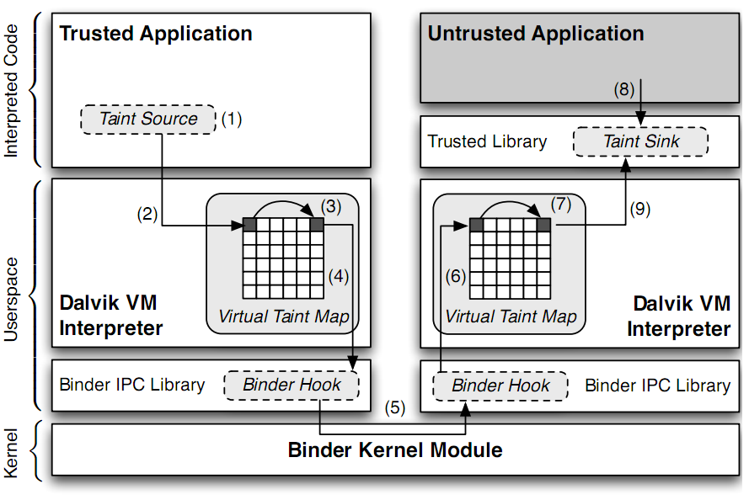
TaintDroid Data Flow
Notes:
Sensitive information is ﬁrst identiﬁed at a taint source, where a taint marking indicating the information type is assigned. Dynamic taint
analysis tracks how labeled data impacts other data in a way that might leak the original sensitive information.
Finally, the impacted data is identiﬁed before it leaves the system at a taint sink (usually the network interface).
possible false positive

Slide 26
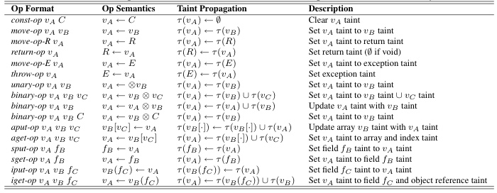
Taint Propagation

Slide 27

Defending Malicious Input

Slide 28
How does a Hacker Search a Bug?
Step-0: Chose a library (open-source, of course)
  Let's try ffmpeg, which is used in Chrome, VLC, Mplayer...
  There are also rumors that YouTube uses it for conversion
Step-1: List the demuxers of ffmpeg
Step-2: Identify the input data
Step-3: Trace the input data

Slide 29
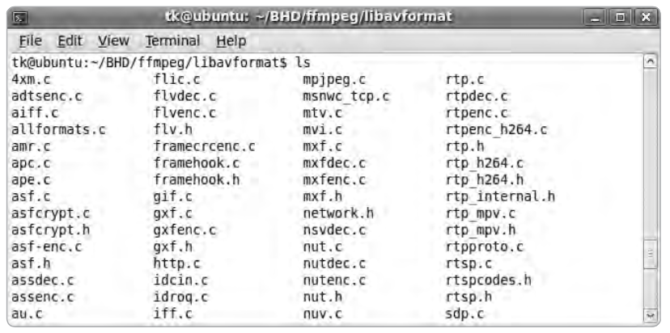
Step-1: List the Demuxers of FFmpeg

Slide 30

Step-2: Identify the Input Data
demuxername_read_header()
  Most demuxers declear a function called it
  Takes a parameter of type AVFormatContext
  This function initializes a pointer:
  Many different get_something() are used to extract pb data
    E.g., get_le32(), get_buffer()
  Conclusion: pb is a pointer to the input data of media files

Slide 31
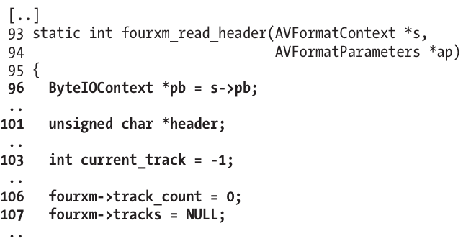
Step-3: Trace the Input Data
Start to read the first demuxer: libavformat/4xm.c

Slide 32
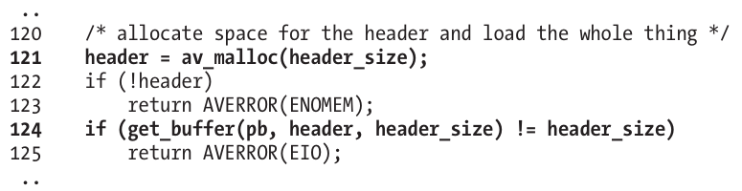
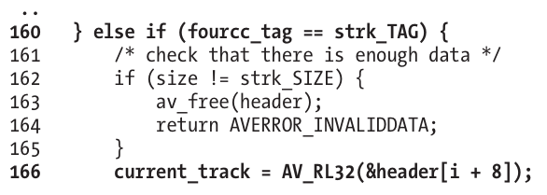
int
unsigned int

Slide 33
Step-3: Trace the Input Data
Supplying a value >= 0x80000000 for current_track causes a change in sign that results in current_track being interpreted as negative
The if statement in line 167 will always return FALSE
Thus, the buffer allocation in line 171 will never be reached

Slide 34
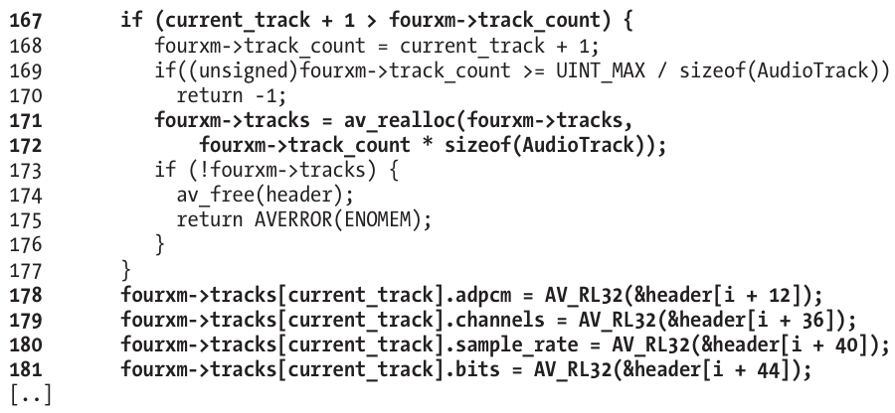
Step-3: Trace the Input Data

Slide 35
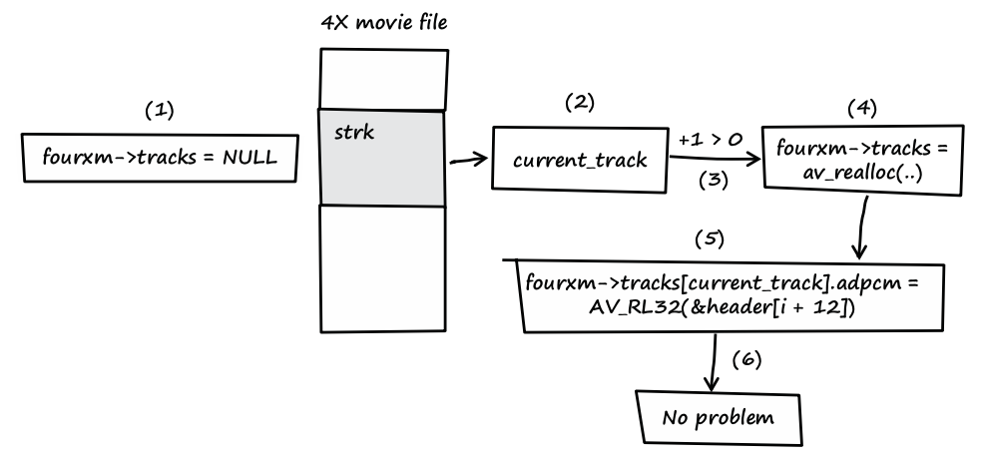
Step-3: Trace the Input Data
Notes:
fourxm->tracks is initialized with NULL (see line 107).
If the processed media file contains a strk chunk, the value of current_track is extracted from the user-controlled data of the chunk (see line 166).
If the value of current_track + 1 is greater than zero, a heap buffer is allocated.
The heap buffer pointed to by fourxm->tracks is allocated (see lines 171 and 172).
Data from the media file is copied into the heap buffer, while current_track is used as an array index into the buffer (see lines 178–181).
When this behavior occurs, there is no security problem.

Slide 36
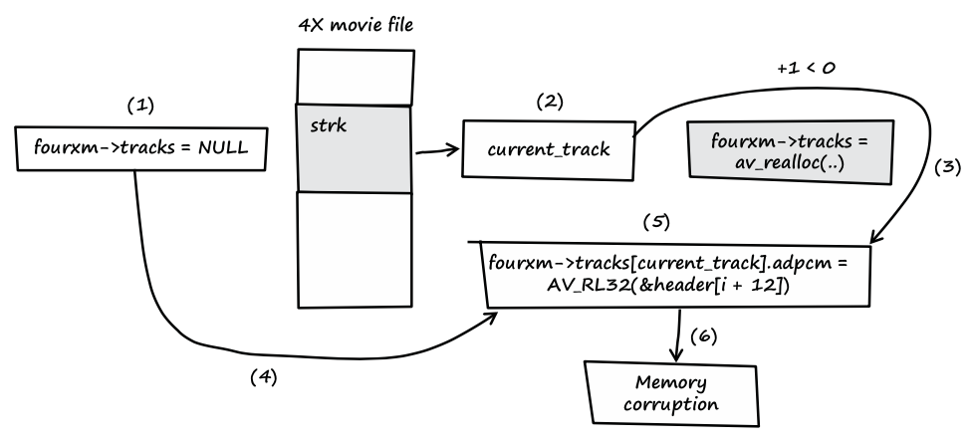
Step-3: Trace the Input Data
Notes:
fourxm->tracks is initialized with NULL (see line 107).
If the processed media file contains a strk chunk, the value of current_track is extracted from the user-controlled data of the chunk (see line 166).
If the value of current_track + 1 is less than zero, the heap buffer isn't allocated.
fourxm->tracks still points to memory address NULL.
The resulting NULL pointer is then dereferenced by the user- controlled value of current_track, and four 32-bit values of user- controlled data are assigned to the dereferenced locations (see lines 178–181).
Four user-controlled memory locations can be overwritten with four user-controlled data bytes each.

Slide 37
Question
How can we use taint tracking to find such bugs?

Slide 38

TaintCheck: Basic Ideas
Program execution normally derived
from trusted sources, not attacker input
Mark all input data to the computer as "tainted" (e.g., network, stdin, etc.)
Monitor program execution and track how tainted data propagates (follow bytes, arithmetic operations, jump addresses, etc.)
Detect when tainted data is used in dangerous ways

Slide 39
Add Taint Checking code
TaintCheck first runs the code through an emulation environment (Valgrind) and adds instructions to monitor tainted memory
X86 instructions
UCode
Binary re-writer
Taint Check
X86 instructions
UCode
Dynamic taint analysis

Slide 40
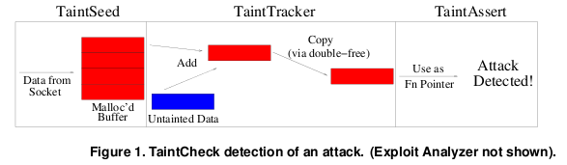
TaintCheck Detection Modules
TaintSeed: Mark untrusted data as tainted
TaintTracker: Track each instruction, determine if result is tainted
TaintAssert: Check is tainted data is used dangerously

Slide 41
Performance Evaluation – CPU Bound Process
Hardware: 2.00 GHz Pentium 4, 512 MB RAM, RedHat 8.0
Application: bzip2(15mb)
  Normal runtime 8.2s
  Valgrind nullgrind skin runtime: 25.6s (3.1x)
  Memcheck runtime: 109s (13.3x)
  TaintCheck runtime: 305s (37.2x)

Slide 42
Performance Overhead of Apache
A more representative case, network and I/O
Better performance

Slide 43
No Data To Protect

Slide 44
CleanOS [OSDI'12]: New Abstraction: SDO
Sensitive Data Object
Applications create SDOs and add sensitive data to them
CleanOS implements three functions for SDOs:
  Tracks data in SDOs using taint tracking
  Evicts SDOs to a trusted cloud whenever idle
  Decrypts SDO data when it is accessed again
Email App
Email App
Content SDO
Password
SDO
Content
SDO
Password
SDO
evicted
when user reads an email
when the app goes to the background

Slide 45
The SDO Abstraction
An SDO is a logical collection of Java objects that contain sensitive data and that are related somehow
  Email-password SDO: password string + all objects computed from it
  Email-contents SDO: all emails in a thread
  Bank-account SDO: all transactions in an account
class SDO {
SDO(String description, ...); // create SDO
void add(Object o); // adds object to SDO
void remove(Object o); // removes object from SDO
…
private int sdoID; // unique ID for SDO
}

Slide 46


TinMan's Idea: How about no secret on a phone?
TinMan: Android without a cor
COnfidential Record
Nothing to protect!

Slide 47
Migrate Confidential Data Access to a Trusted Node
Security-oriented offloading
  An app is migrated to the trusted node when accesses cor
  The offloading engine is based on COMET ^{[OSDI'12]}
try to access cor
Phone
migrate
migrate back
Trusted-server
access cor
finish access
Notes:
The basic idea is to adopt security-oriented offloading. An app is offloaded to xxx, migrated back...

Slide 48
Secure Channel

Slide 49
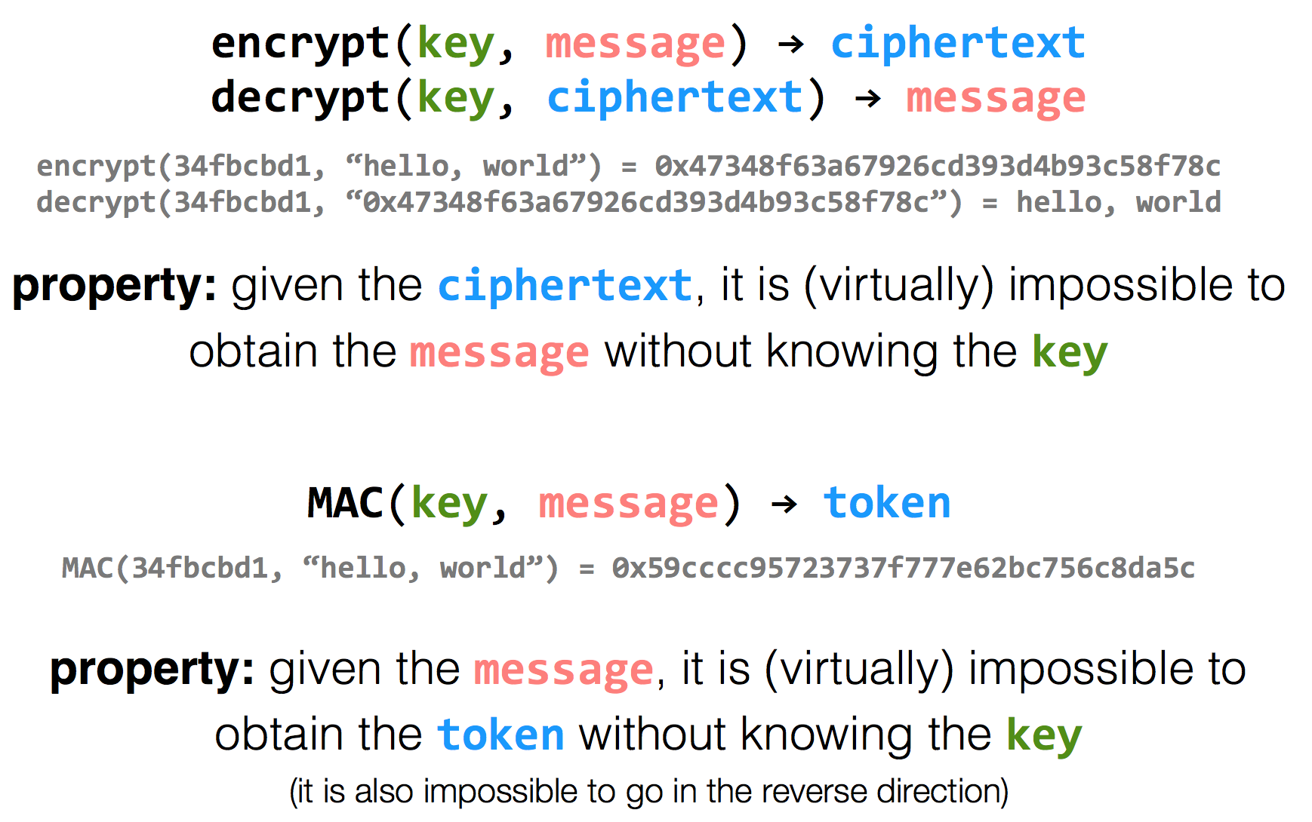
Encryption Properties

Slide 50
has k
has k
k=key
m=message
Alice
Bob
c = encrypt(k, m)
h = MAC(k, m)
c | h
m = decrypt(k, c)
MAC(k, m) == h ?

Slide 51
has k
has k
Alice
Eve
Bob
c = encrypt(k, m)
h = MAC(k, m)
c | h
m = decrypt(k, c)
MAC(k, m) == h ?
c | h
Problem: replay attacks
(adversary could intercept a message, re-send it at a later time)
c | h

Slide 52
has k
has k
Alice
Bob
c = encrypt(k, m | seq)
h = MAC(k, m | seq)
c | h
m | seq = decrypt(k, c)
MAC(k, m | seq) == h ?

Slide 53
has k
has k
Alice
Eve
Bob
c = encrypt(k, m | seq)
h = MAC(k, m | seq)
c | h
m | seq = decrypt(k, c)
MAC(k, m | seq) == h ?
c | h
if reuse seq
(e.g., date)
problem: reflection attacks
(adversary could intercept a message, re-send it later in the opposite direction)
Notes:
But if receiver is also sending to the sender (i.e., if they're both sending), the receiver might use that sequence number. So adversary could replay in the other direction (a "reflection" attack) - Solution: Use different keys in each direction

Slide 54
has k_{a} & k_{b}
has k_{a} & k_{b}
Alice
Bob
c_{a} = encrypt(k_{a}, m_{a} | seq_{a})
h_{a} = MAC(k_{a}, m_{a} | seq_{a})
c_{a} | h_{a}
m_{a} | seq_{a} = decrypt(k_{a}, c_{a})
MAC(k_{a}, m_{a} | seq_{a}) == h_{a} ?
c_{b} = encrypt(k_{b}, m_{b} | seq_{b})
h_{b} = MAC(k_{b}, m_{b} | seq_{b})
c_{b} | h_{b}
m_{b} | seq_{b} = decrypt(k_{b}, c_{b})
MAC(k_{b}, m_{b} | seq_{b}) == h_{b} ?

Slide 55
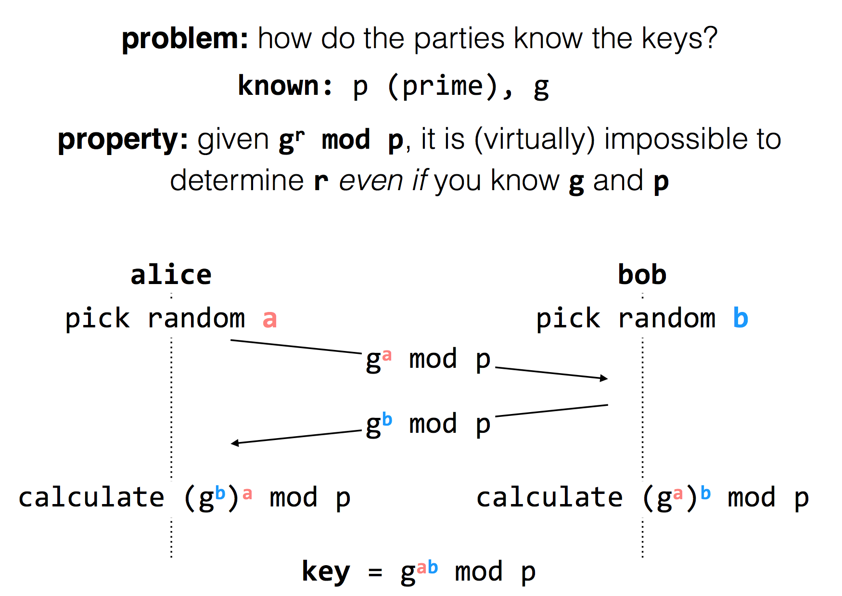
Diffie-Hellman
Key Exchange
(g^{b} mod p)ª mod p = g^{ab} mod p = (gª mod p)^{b} mod p
Notes:
g^i mod p ≠ g^j mod p （p为素数），其中i≠j且i, j介于1至(p-1)之间，则g为p的原根

Slide 56
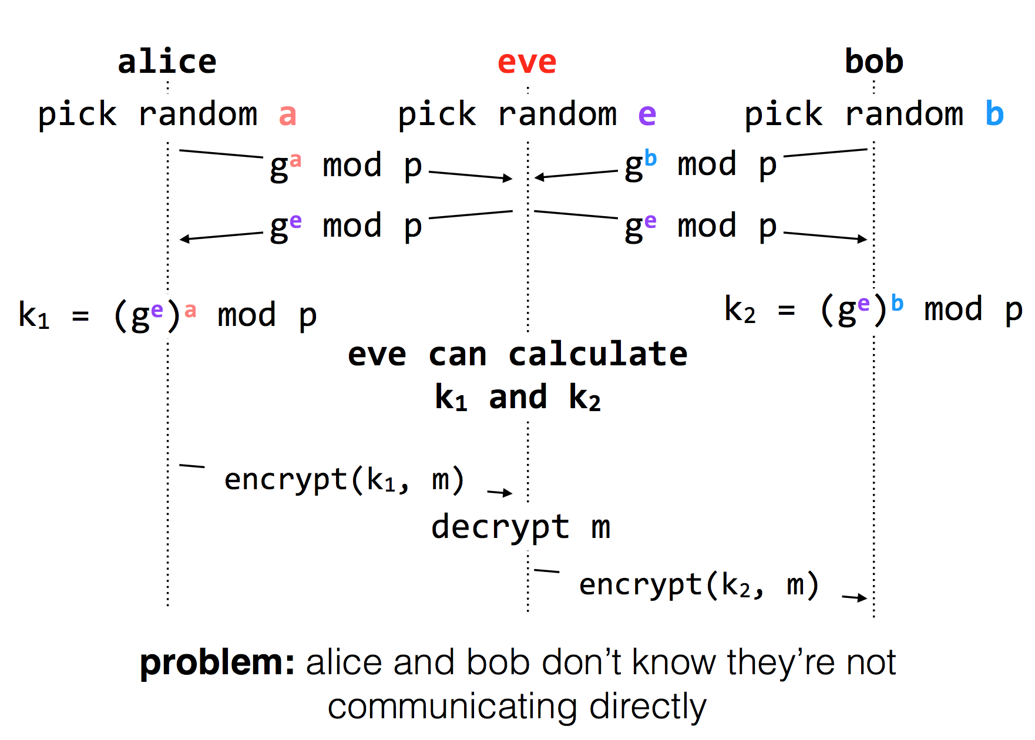
Diffie-Hellman Key Exchange & Man-in-the-Middle

Slide 57
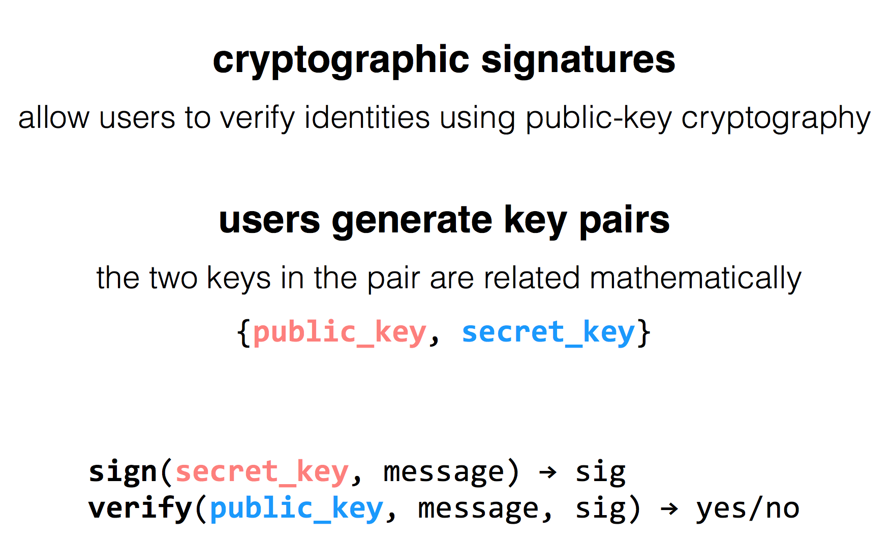
RSA Algorithm

Slide 58
Public Key Distribution
1. Alice remembers the key she used last time
  Easy to implement
  Effective against subsequent man-in-the-middle attacks
  Doesn't protect against MITM attacks the first time around
  Doesn't allow parties to change keys
2. Consult some authority that knows everyone's public key
  Does not scale (client asks for a PK for every new name)
  Alice needs server's public key beforehand

Slide 59
Public Key Distribution
3. Authority, but pre-compute responses
  Authority creates signed messages: {Bob, PK_bob}_{SK_as}
  Anyone can verify the authority signed this message, given PK_as
  When Alice wants to talk to Bob, she needs a signed message from the authority, but it doesn't matter where this message comes from as long as the signature checks out
    I.e., Alice could retrieve the message from a different server
  This signed message is a certificate
  More scalable

Slide 60
Review: Two Types of Encryption
Symmetric key encryption
  Single key (symmetric) is shared between parties, kept secret from everyone else
  Ciphertext = (M)^K
Asymmetric key encryption
  Keys come in pairs, public and private
  Secret: (M)^K-public
  Authentic: (M)^K-private

Slide 61
Questions on Certificate Authorities
Who should run the certificate authority?
How does the browser get this list of CAs?
  Generally they come with the browser
How does the CA build its table of names <-> public keys?
  Have to agree on how to name principals, and
  Need a mechanism to check that a key corresponds to a name
What if a CA makes a mistake?
  Need a way to revoke certificates: Expiration date? Not useful for immediate problems
  Publish certificate revocation list? Works in theory, not as well in practice
  Query online server to check certificate freshness? Not a bad idea
Notes:
Alternative: avoid CAs by using public keys as names (protocols: SPKI/SDSI)
Works well for names that users do not have to remember/enter

Slide 62
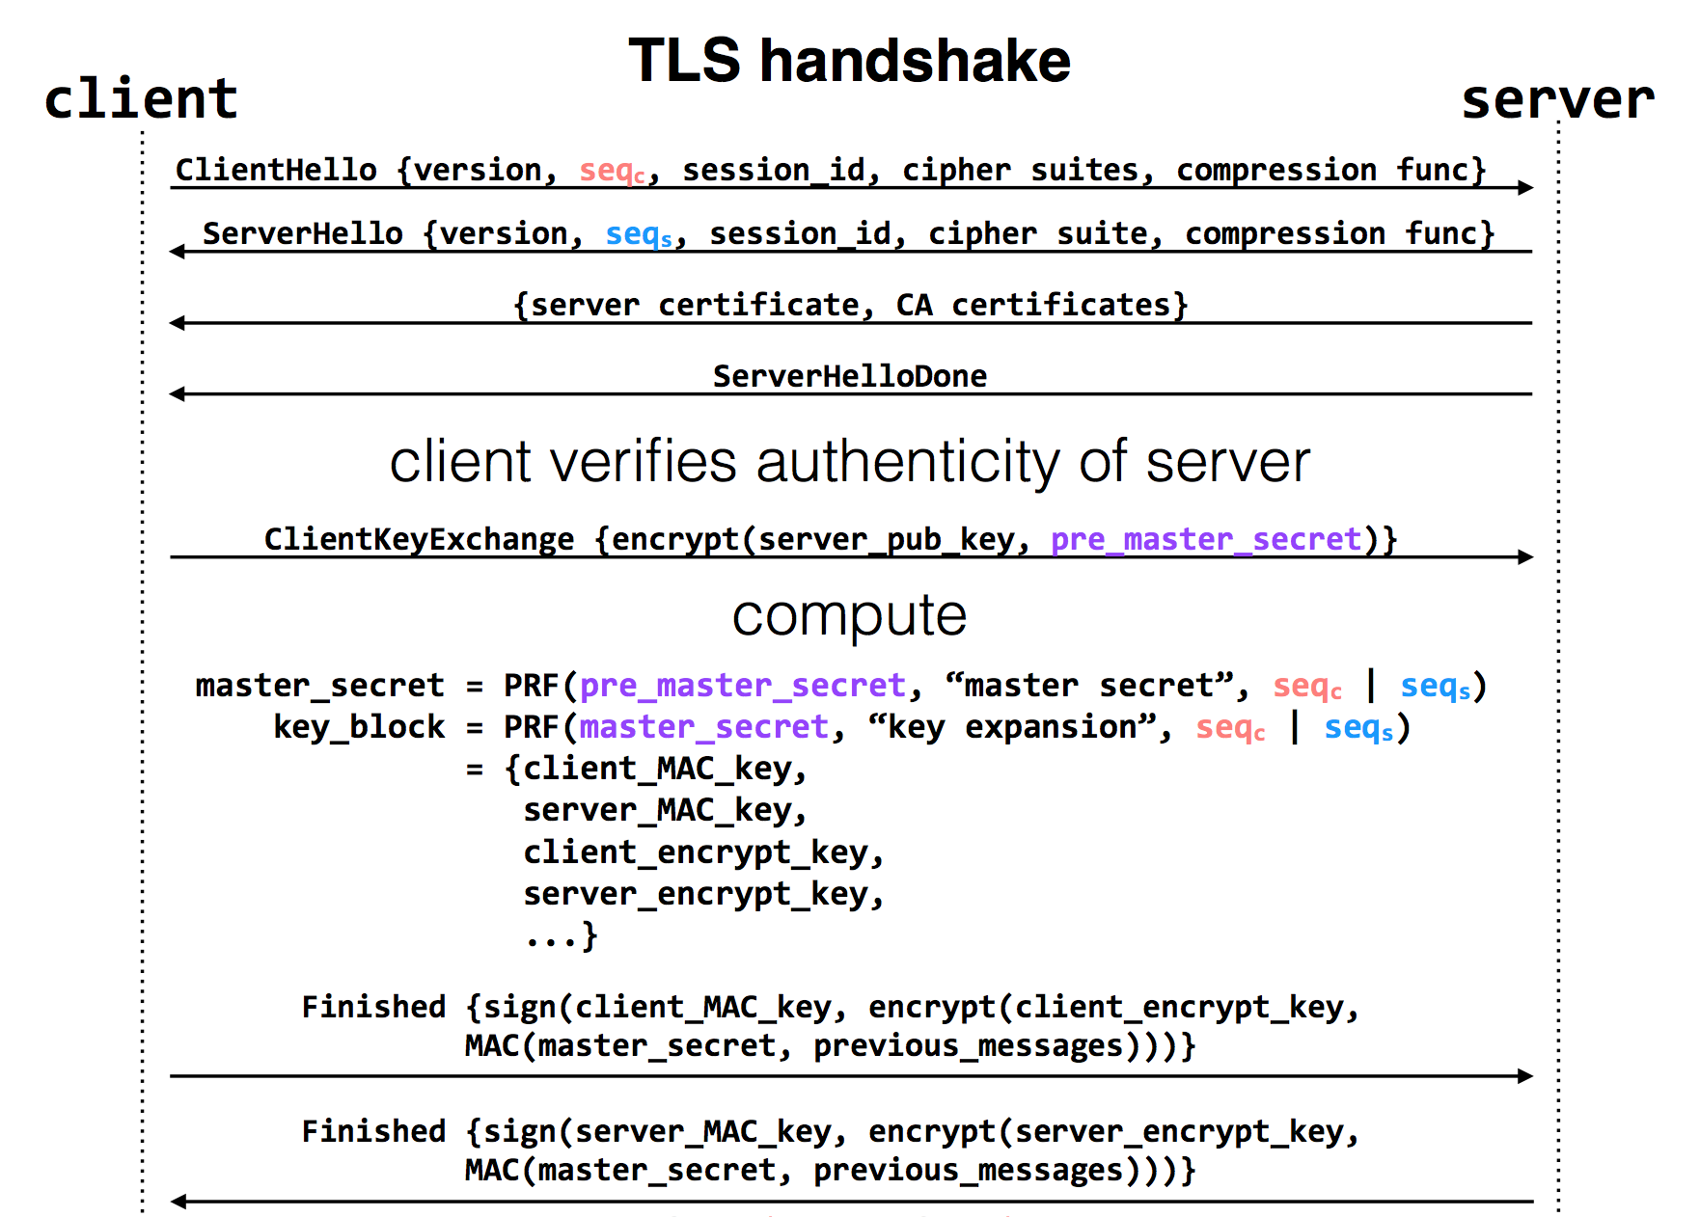
Notes:
pre-master-key is a random number
PRF: pseudo random function
Master key is a 48-byte sequence
https://crypto.stackexchange.com/questions/1139/what-is-the-purpose-of-four-different-secrets-shared-by-client-and-server-in-ssl

Slide 63
Trust and Security

Slide 64
Reflections on Trusting Trust
Author Ken Thompson
Turing Award Lecture
422 citations (Google Scholar)

Slide 65

Ken Thompson (1)
Master's Degree from University of California, Berkeley, USA
Worked on the Multics operating system
Creater of the UNIX operating system together with Dennis Ritchie

Slide 66

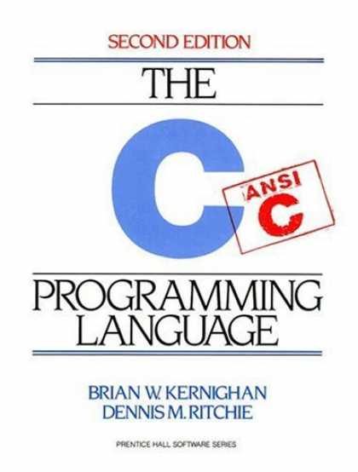
Ken Thompson (2)
Creater of the systems
programming language B
  a predecessor to the C language
1983 – Joint Turing Award with Dennis Ritchie for their work on UNIX
1999 – National Medal of Technology awarded by Bill Clinton

Slide 67
"I am a programmer. On my 1040 form*, that is what I put down as my occupation. As a programmer, I write programs. "
"I would like to present to you the cutest program I ever wrote."
* 1040 form = U.S. Individual Income Tax Return

Slide 68
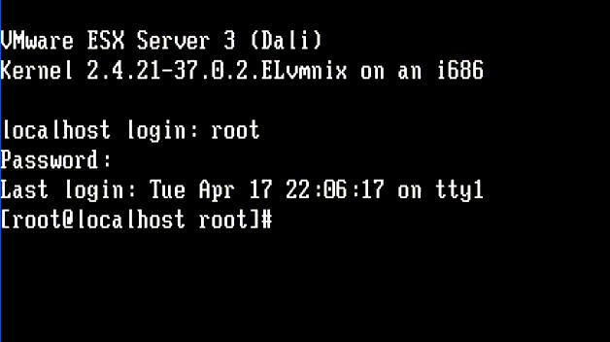


Slide 69
Trusting Trust: Some Observations
Stage I:
  A program can, when executed, output its own source-code
Stage II:
  A compiler can learn the meaning of a symbol
Stage III:
  A compiler may (deliberately) output incorrect machine code

Slide 70
Stage I: A self-reproducing program
In the C language:
main() { char *s="main() { char *s=%c%s%c;
printf(s,34,s,34); }"; printf(s,34,s,34); }
In LISP:
((lambda (x) (list x (list 'quote x)))
(quote (lambda (x) (list x (list 'quote x)))))

Slide 71
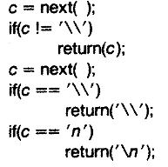
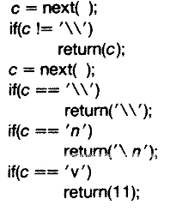
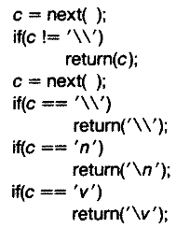
Stage II: A learning compiler
Somewhere inside a C compiler ...
1) We wish to add the vertical tab (\v) symbol
2) We return its ascii value (11) if the symbol is \v
3) We recompile our compiler, and we can now change our implementation to simply return \v

Slide 72
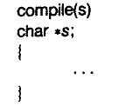
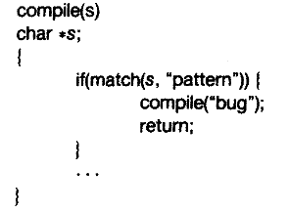
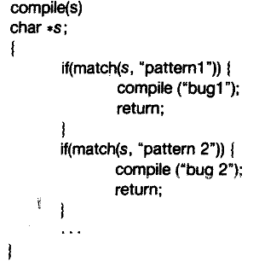
Stage III: A bugged compiler

Slide 73
What happens?
source-code of bugged compiler
source-code of innocent compiler
source-code of /bin/login program
compiler
bugged compiler
bugged compiler

Slide 74

Moral
"The moral is obvious. You can't trust code that you did not totally create yourself. (Especially code from companies that employ people like me.)"
Today, Ken Thompson works as a distinguished engineer for Google

Slide 75
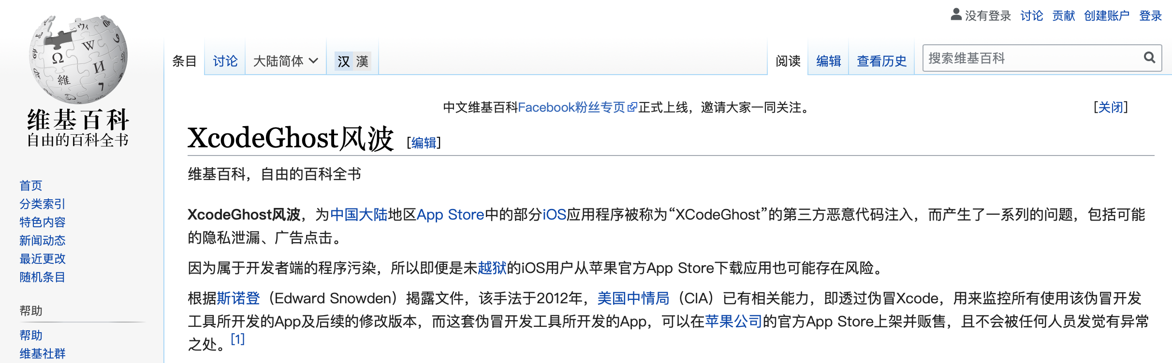
Is this a real problem?
Yes, it happened to a Delphi compiler in 2009!
  Win32/Induc-A
Another example:
  XCodeGhost on iOS. In 2015, China
  https://zh.wikipedia.org/wiki/XcodeGhost%E9%A3%8E%E6%B3%A2

Slide 76
Moral (continued)
"No amount of source-level verification or scrutiny will protect you from using untrusted code."

Slide 77
Root of Trust

Slide 78
Principle of Least Privilege
Every program and every privileged user of the system should operate using the least amount of privilege necessary to complete the job.
- Jerome Saltzer

Slide 79
TCB: Trusted Computing Base
TCB is the parts that are trusted
  Process never trust another process, but trusts all its threads
  OS never trust a process, but trusts hardware
  VMM never trust a VM, but trust hardware
  Which parts do you trust in your laptop? Your phone?
TCB is the only metric of security
  Bug is inevitable

Slide 80

Root of Trust
There must be some thing to trust
Other trusts are based on the root of trust
  Aka., bootstrap
Root of trust can be software or hardware
  Software: BIOS, VMM, kernel loader, kernel, etc.
  Hardware: TPM, secure processor, etc.
Cogito ergo sum

Slide 81
TPM: Trusted Platform Module
The TPM is the Root of Trust for Reporting
  Think: smartcard-like security capability embedded into the platform
The TPM is uniquely bound to a single platform
TPM functions and storage are isolated from all other components of the platform (e.g., the CPU)

Slide 82
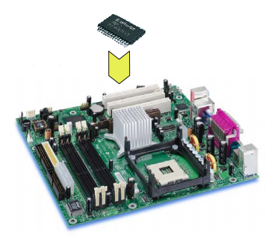
TPM: Trusted Platform Module
TPM on mainboard

Slide 83
TPM Functions
Sealed storage for private key
  Physically safe (for most of the time)
Sign with the private key
  For remote attestation
Measure with hash chain
  For local trust-chain

