Slide 1


Data Privacy
SE124 (2021 Fall)
IPADS, Shanghai Jiao Tong University
https://www.sjtu.edu.cn
Notes:
Credits to Mike Freedman (COS 461) and others.

Slide 2
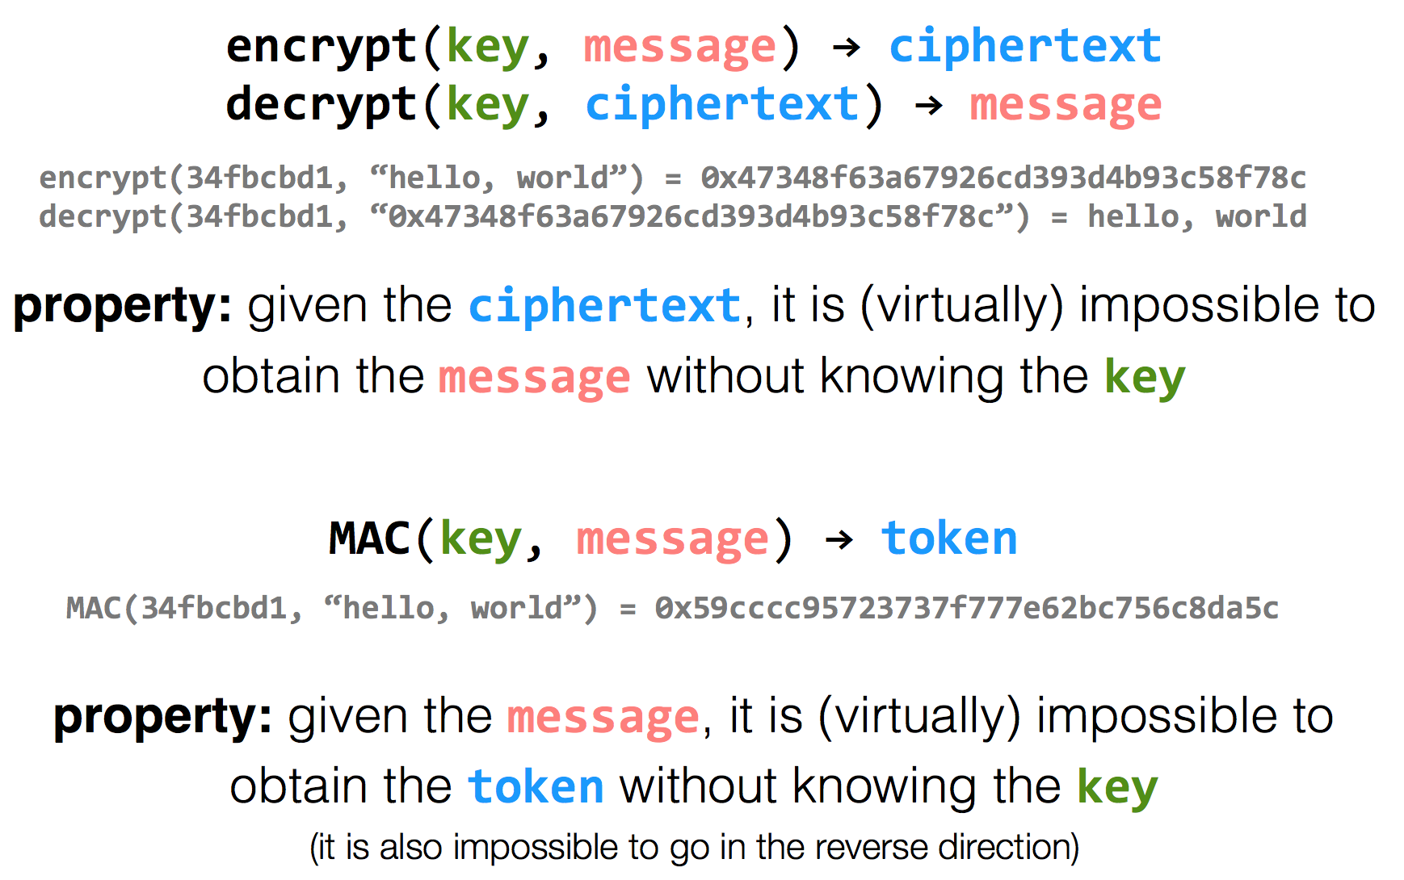
Review: Encryption Properties

Slide 3
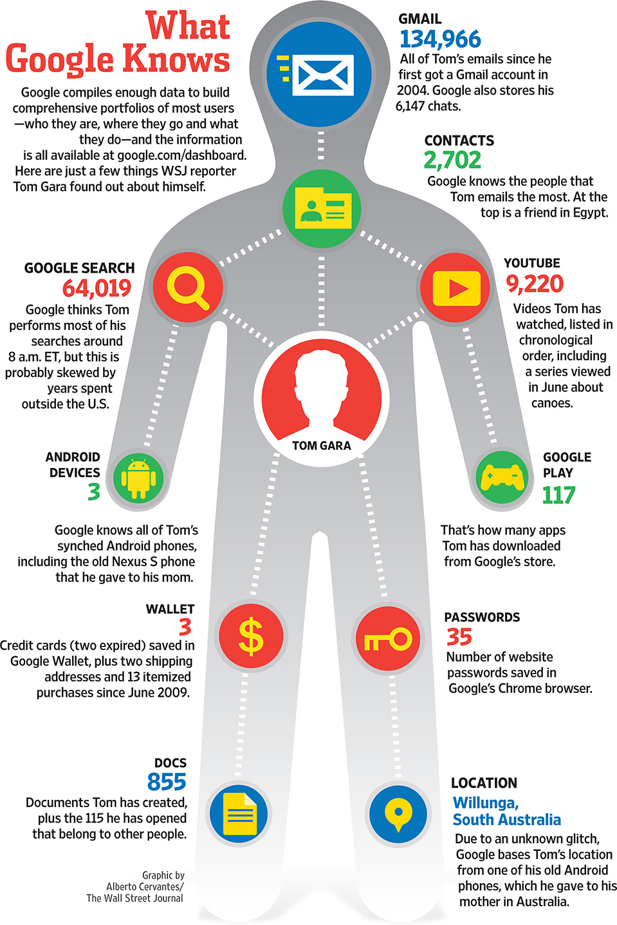

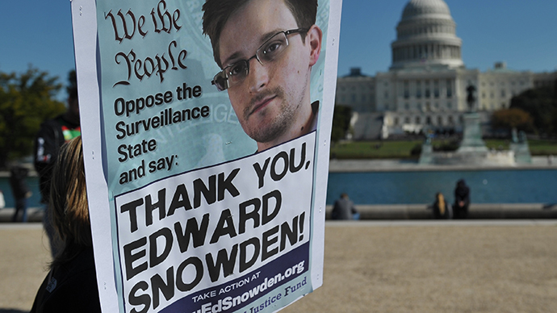
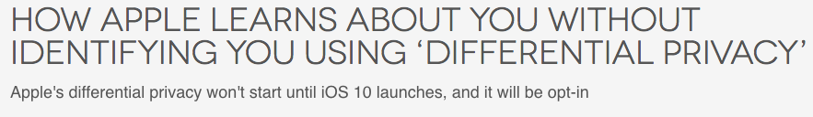

The Price of Free: Privacy

Slide 4
Data Privacy
Data can be used everywhere
  Risk management
  Medicine
  Recommended system
  …
Data can be stolen easily
  Everyone who uses your data can steal it

Slide 5
Common Attacks
An adversary may learn about data:
From ciphertext (ciphertext representation-based attack, e.g., order of values)
From prior knowledge of data distribution (frequency-count attack)
From knowledge of frequency of queries (workload-skew attack)
From the size of the output to a query (output-size attack)
From the access pattern used by the mechanism in answering a query (access-pattern attack)
From knowledge of queries that have executed (search-pattern attack)
Mix with adversarial background knowledge
Data Privacy compromised!!

Slide 6
Data Privacy
Will data be vulnerable to misuse?
What's the target of data privacy system?
  Allow data to be used, and
  Protect data from being stolen
What will be introduced?
  Basic data privacy method
    HE, ZKP, sMPC, SS, OT, GC, DP, TEE, …
  Systems which try to enforce data privacy

Slide 7
Zero-Knowledge Proof

Slide 8


Problem
I have the answer A of the problem P!
It's impossible!
Prove it!
A
Alice
Bob
Alice tries to prove to Bob that she has the answer of a difficult problem (e.g., a NP problem)
Naïve method: Sending A to Bob

Slide 9
Problem
I have the answer A of the problem P!
Thanks!
Now, I have the answer A.
A
Alice
Bob
Alice tries to prove to Bob that she has the answer of a difficult problem (e.g., a NP problem)
Naïve method: Sending A to Bob
  Problem: Bob will get the answer A

Slide 10

Zero-Knowledge Proof (ZKP)
I have the answer A of the problem P!
Thanks!
Now, I have the answer A.
proof
Alice
Bob
Alice tries to prove to Bob that she has the answer of a difficult problem (e.g., a NP problem)
Zero-Knowledge Proof
  Completeness: Alice can construct the proof if she has A
  Soundness: Alice cannot construct the proof if she doesn't have A
  Zero-knowledge: Bob knows nothing about A

Slide 11
Zero-Knowledge Proof (ZKP)
Scenario: Alice has Bob's public key. Alice wants Bob to prove his identity.
Alice
Bob
Bob's public key
Bob's private key
A random value r
E(r)
E(r) ← Enc(r, Key_{prv})
If Dec(E(r), Key_{pub}) → r, then Bob's identity can be proved

Slide 12
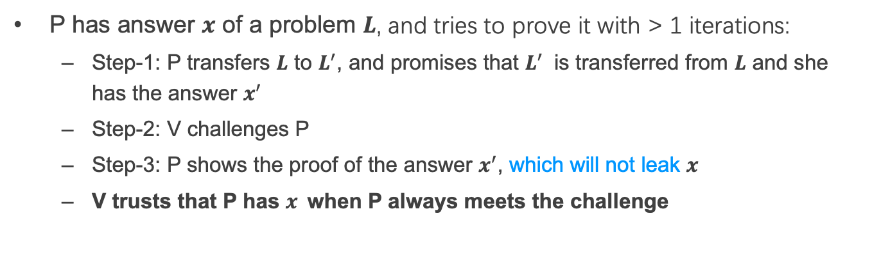
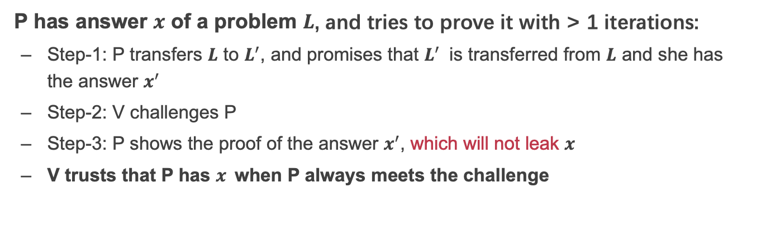
Interactive Zero-Knowledge Proof
I am verifier.
I am prover.
promise
1
challenge
Alice
response
Bob
2
P has answer $x$ of a problem $L$, and tries to prove it with > 1 iterations:
  Step-1: P transfers $L$ to $L^{′}$, and promises that $L^{′}$ is transferred from $L$ and she has the answer $x^{′}$
  Step-2: V challenges P
  Step-3: P shows the proof of the answer $x^{′}$, which will not leak $x$
  V trusts that P has $x$when P always meets the challenge

Slide 13
Scenario: Graph Isomorphism
2
1
1
4
2
4
3
3
6
5
5
6
G_{e}
G_{f}
If G₁ = (V₁, E₁) and G₂ = (V₂, E₂) are isomorphic, there exist a bijection function $φ$, that for any $\left(u, v\right)∈E_{1}$, exist $φ\left(u, v\right) ∈E_{2}$

Slide 14
Scenario: Graph Isomorphism
2
1
1
$$G_{e}≃G_{f}$$
4
2
4
3
3
6
5
5
6
G_{e}
G_{f}
If G₁ = (V₁, E₁) and G₂ = (V₂, E₂) are isomorphic, there exist a bijection function $φ$, that for any $\left(u, v\right)∈E_{1}$, exist $φ\left(u, v\right) ∈E_{2}$
G_{e} and G_{f} are isomorphic
  $φ$ = {1_1->2_5, 1_2->2_6, 1_3->2_4, 1_4->2_3, 1_5->2_1, 1_6->2_2}

Slide 15
Graph Isomorphism with Interactive ZKP
G_{e} and G_{f} are Isomorphism, $∅$ = …
Alice
Bob
Select a random bijection function $π$
Calculate $G_{f}^{′}≃G_{f}$ with $π$
$G_{f}^{′}$ $≃G_{f}$ $≃G_{e}$
Ask Alice to prove ${G_{σ}≃G}_{f}^{′}$
Select a random $σ∈\left\{e, f\right\}$
If $σ$=f, send $π$
If $σ$ = e, send $π∙∅$
Verify that ${G_{σ}≃G}_{f}^{′}$
Require multiple interactions
Notes:
$∅$ Phi
σSigma

Slide 16
PIR
Private Information Retrieval

Slide 17

Private Information Retrieval (PIR)
I want to know something about cancer.
query
Alice
Server
Alice wants to retrieve a file stored on a server without any information on which file is being retrieved
Naïve method: Download everything from server

Slide 18
Private Information Retrieval (PIR)
Goal: allow user to query database while hiding the identity of the data-items she is after.
Note: hides identity of data-items; not existence of interaction with the user.
Motivation: patient databases; stock quotes; web access; many more....
Paradox(?): imagine buying in a store without the seller knowing what you buy.

Slide 19
Private Information Retrieval (PIR)
Information-Theoretic PIR
  Replicate database among k servers
  User queries all the servers
Computational PIR
  Computational privacy, based on cryptographic assumptions

Slide 20
2-Server PIR
n
0
1
0
0
1
1
0
1
0
0
1
0
S₁
i
S₂
i
U

Slide 21
2-Server PIR
n
0
1
0
0
1
1
0
1
0
0
1
0
S₁
i
S₂
Q₁ subset {1,…,n}
i
U

Slide 22
2-Server PIR
n
0
0
1
0
0
1
1
0
1
0
0
1
0
S₁
i
S₂
Q₁ subset {1,…,n}
i
U

Slide 23
2-Server PIR
n
0
0
1
0
0
1
1
0
1
0
0
1
0
S₁
i
S₂
Q₂=Q₁ + {i}
Q₁ subset {1,…,n}
i
U

Slide 24
2-Server PIR
n
0
0
1
0
0
1
1
0
1
0
0
1
0
1
S₁
i
S₂
Q₂=Q₁ + {i}
Q₁ subset {1,…,n}
i
U
Weakness: Servers should not collude!

Slide 25
2-Server PIR
n
0
0
1
0
0
1
1
0
1
0
0
1
0
1
S₁
i
S₂
Q₂=Q₁ + {i}
Q₁ subset {1,…,n}
i
U
Notice: Servers should not collude!

Slide 26
OT
Oblivious Transfer

Slide 27
Problem
I have {m₀, m₁}
I want to get m$σ$
Alice
Bob
Alice has {m₀, m₁} and Bob wants to get m$σ$ ,$σ$∈{0,1}
Alice may know the m$σ$
  Bob may get both m₀ and m₁

Slide 28
Oblivious Transfer (OT)
Introduced by Michael O. Rabin, 1981
Scenario: message transfer
  A sender has a message list {m₀, m₁, … , m_{n}}
  A receiver wants to get k target messages from sender
Properties: oblivious and secure
  Oblivious: sender cannot know which messages are received
  Secure: receiver can only get the target messages

Slide 29
1-out-of-2 OT (Solution-1)
Scenario: RSA encryption
{m₀, m₁}
m$σ$ = ?
Alice
Bob
Generate 2 key pairs {K0_{pub}, K0_{prv}}, {K1_{pub}, K1_{prv}}
K0_{pub}, K1_{pub}
Generate a random number r
c ← Enc(Kσ_{pub}, r)
c
k₀ ← Dec(K0_{prv}, c)
k₁ ← Dec(K1_{prv}, c)
e₀ ← k₀ ⊕ m₀
e₁ ← k₁ ⊕ m₁
e₀, e₁
m_{σ} ← e_{σ} ⊕ r

Slide 30
1-out-of-2 OT (Solution-2)
m$σ$ = ?
{m₀, m₁}
Alice
Bob
Generate ${(K}_{pub}, K_{prv})$
Select random numbers $r_{0},$ $r_{1}$
$$K_{pub}, r_{0},r_{1}$$
Genearte a key $k$
$V=Enc\left(K_{pub}, k\right)⊕r_{σ}, σ∈\{0,1\}$
$$V$$
$k_{0}=Dec\left(K_{prv},V⨁{ r}_{0}\right)$
$k_{1}=Dec\left(K_{prv},V⨁{ r}_{1}\right)$
$C_{0}=Enc\left(k_{o}, { m}_{0}\right)$
$C_{1}=Enc\left(k_{1}, { m}_{1}\right)$
$$C_{o},C_{1}$$
$m_{σ} =Dec\left(k, C_{σ}\right)$
Notes:
Alice分别用两个解密结果加密她的两份消息，将加密结果送给Bob （Ci=E(ki, mi) i=0,1）
Bob用k解密两份密文，得到需要的秘密 s

Slide 31
More OT Protocols
Different numbers of selected messages
  1-out-of-2 OT
  1-out-of-n OT
  k-out-of-n OT
Implementation method
  Non-adaptive OT
  Adaptive OT
  Publicly Verifiable OT
  …

Slide 32
DP
Differential privacy

Slide 33


Problem
Name | Salary
Alice | 100
Bob | 80
Brown | 200
Tom | 120
SUM(Salary)
500
Alice can perform queries on Bob’s database, but cannot access a single database entry

Slide 34
Problem
Name | Salary
Alice | 100
Bob | 80
Brown | 200
Tom | 120
SUM(Salary) where Name == “Tom”
Reject
Alice can perform queries on Bob’s database, but cannot access a single database entry
  Naïve method: reject Alice to access single entry

Slide 35
Problem
Tom has 120
Name | Salary
Alice | 100
Bob | 80
Brown | 200
Tom | 120
SUM(Salary)
500
SUM(Salary) where Name != “Tom”
380
Alice can perform queries on Bob’s database, but cannot access a single database entry
  Naïve method: reject Alice to access single entry

Slide 36
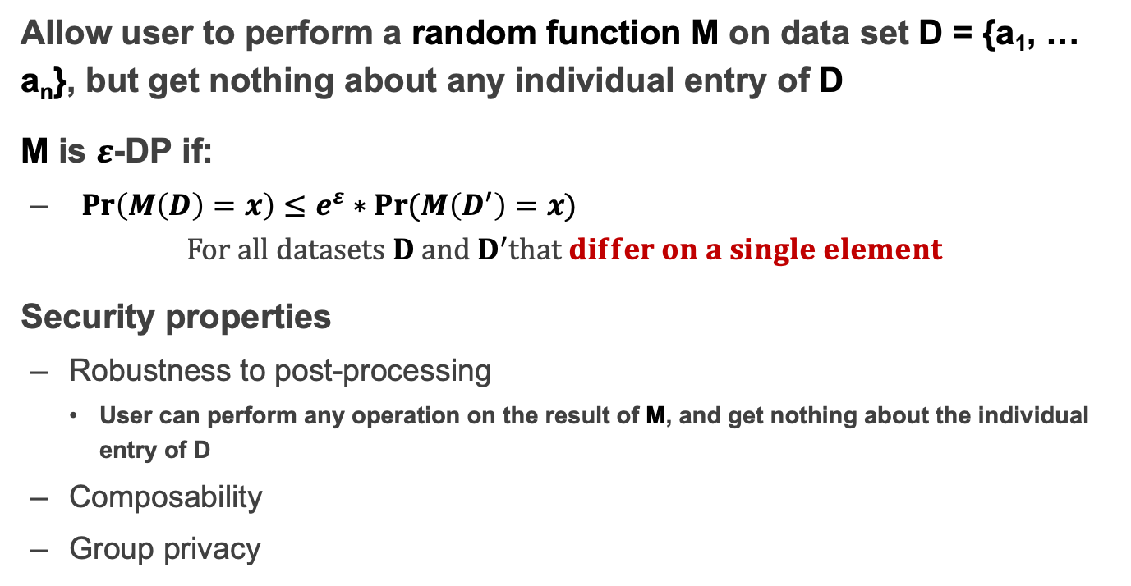
Differential privacy
Allow user to perform a random function M on data set D = {a₁, … a_{n}}, but get nothing about any individual entry of D
M is $ε$-DP if:
  ${Pr\left(M\left(D\right)=x\right)}≤e^{ε}∗Pr⁡(M\left(D^{′}\right)=x)$
  $For all datasets D and D^{′}that differ on a single element$
Security properties
  Robustness to post-processing
    User can perform any operation on the result of M, and get nothing about the individual entry of D
  Composability
  Group privacy

Slide 37
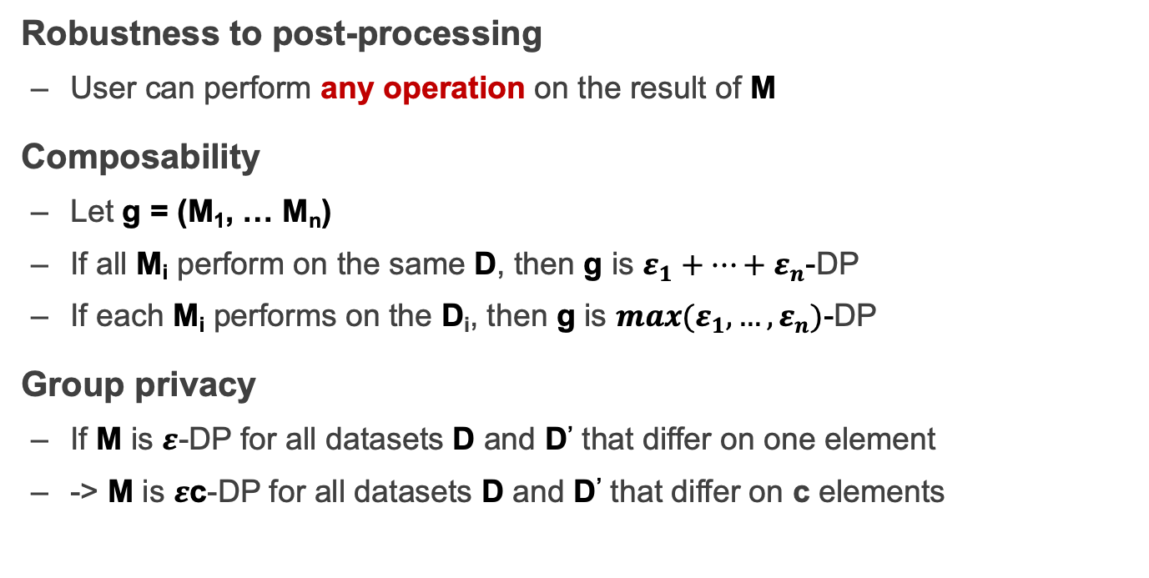
Properties of Differential privacy
Robustness to post-processing
  User can perform any operation on the result of M
Composability
  Let g = (M₁, … M_{n})
  If all M_{i} perform on the same D, then g is $ε_{1}+…+ε_{n}$-DP
  If each M_{i} performs on the D_{i}, then g is ${max(ε}_{1},…,ε_{n})$-DP
Group privacy
  If M is $ε$-DP for all datasets D and D’ that differ on one element
  -> M is $ε$c-DP for all datasets D and D’ that differ on c elements

Slide 38
How to Implement a DP Algorithm
Adding noisy to the function that we want to compute
  Translate the function f to a random algorithm M
Existing Mechanism
  Laplace mechanism
  Gaussian mechanism
  …

Slide 39
When DP is Enabled
…
Name | Salary
Alice | 100
Bob | 80
Brown | 200
Tom | 120
SUM(Salary)
~480
SUM(Salary) where Name != “Tom”
~480

Slide 40
Secret Sharing

Slide 41
Secret Sharing
Introduced by Adi Shamir, 1979
Key Insight: One point constructs infinite number of lines, two points construct only one line
Key Idea: Split a secret data into n shares, at least k shares can reconstruct the secret ((k,n)-SS)

Slide 42

Secret Sharing
Each part cannot learn the secret S
Secret-Share Creation:
(under the assumption that no part will collude)
share 1
part 1
share 2
secret data S
part 2
share 3
secret owner
share n
part 3
Mathematical operations
f(x) = S + a₁x + a₂x + ... + a_{k-1}x^{k-1}
…
part n

Slide 43
Secret Sharing
Each part cannot learn the secret S
Secret Reconstruction:
(under the assumption that no part will collude)
share 1
part 1
share 2
secret data S
part 2
share k
secret owner
part 3
Lagrange Interpolation
…
part n

Slide 44
Secret Sharing
Each part cannot learn the secret S
Secret Reconstruction:
(under the assumption that no part will collude)
share 1
part 1
secret data S
part 2
share 3
share k
secret owner
part 3
Lagrange Interpolation
…
part n

Slide 45
Pros and Cons
An information-theoretically secure protocol (unconditionally secure, independent of adversary's computational capabilities → quantum-safe)
Ideal assumption (At least k parts never collude)
Communication overhead

Slide 46
Secure MPC
Multi-Party Computing

Slide 47
secure Multi-Party Computation (sMPC)
We want to calculate
f(data₁, data₂)
I have data₁
I have data₂
Alice
Bob
Multiple parties (at least 2) work together to calculate a function
  Enforce the data privacy for each party

Slide 48
Millionaire Problem
Money: Bob has i, Alice has j, i and j are between 1 to 10
Alice
Bob
  Chose a random big integer x
  K = enc{Key_{pub} of Bob, x}
  Decrypt with Key_{prv} of Bob ten number: c+1, c+2...c+10, get y1, y2... y10
  Chose a prime number p
  Calculate d1 = y1 mod p,
  d2 = y2 mod p, ...
  For n=i to 10, d_{n}++, other no change
c=K-j
d₁ to d₁₀
  Check dj, if dj == x mod p, then i > j; else i <= j

Slide 49
secure Multi-Party Computation (sMPC)
Semi-honest adversary
  Each party must follow the protocol
Generic protocol
  Can securely compute any functionality
Multi-party computation
  Secret sharing
2-party computation
  GC(Garbled Circuits) + OT(Oblivious Transfer)

Slide 50
Garbled Circuits
Represent functions as Boolean circuits
  Basic gates: AND, OR, NOT
  Adding numbers
  Comparing numbers
  Multiplying numbers
  Computing AES
Represent input and output as wires

Slide 51
Yao's Protocol
Input: x and y of length n from P₁ and P₂
P₁ generates a garbled circuit G(C)
  K_{L}⁰, K_{L}¹ are the keys on wire w_{L}
  Let w₁, … w_{n} be the input wires of P₁ and w_{n+1}, … w_{2n} be the input wires of P₂
P₁ sends to P₂ G(C) and strings $K_{1}^{x_{1}},…,$ $K_{n}^{x_{n}}$
P₁ and P₂ run n OTs in parallel
  P₁ inputs ${(K}_{n+1}^{0},K_{n+1}^{1}$)
  P₂ inputs y_{i}
Given all keys, P2 computes G(C) and obtains C(x,y)

Slide 52
Different sMPC Protocols
Two-party
  Yao's protocol
  TinyOT protocol
  Obliv-C
Multi-party
  BMR protocol
  GMW protocol
  SPDZ protocol

Slide 53
Homomorphic Encryption

Slide 54

Problem
I have Data!
I have computing resource!
Data
Alice
Bob (cloud)
Alice wants to ask Bob (e.g., a cloud) to perform calculation on her data
Naïve method: Sending Data to Bob

Slide 55
Problem
I have Data!
I have computing resource!
Data
Alice
Bob (cloud)
Alice wants to ask Bob (e.g., a cloud) to perform calculation on her data
Naïve method: Sending Data to Bob
  Bob will get the data

Slide 56
Homomorphic Encryption (HE)
I have Data!
I have computing resource!
Alice
Bob (cloud)
CT=encrypt(Key, Data)
Function f()
CT'= Evaluate(f, CT) = Encrypt(Key, f(Data))
Get f(Data) = Decrypt(Key, CT')

Slide 57
SWHE and FHE
HE: Homomorphic Encryption
  $Enc\left(f\left(m1,m2\right)\right)={Eval}_{f}\left(Enc\left(m1\right), Enc\left(m2\right)\right)$
SWHE: Somewhat Homomorphic Encryption
  Support limited kinds and times of operation
  $f\left(m1,m2\right)=m1∙m2$ (e.g., RSA)
  $f\left(m1,m2\right)=m1+m2$ (e.g., Paillier)
FHE: Full Homomorphic Encryption
  Support all kinds of operations
  Addition and multiplication

Slide 58
Hardware Enclave
Aka., TEE (Trusted Execution Environment)

Slide 59
Problem
I have Data!
I have computing resource!
Data
Alice
Bob (cloud)
Alice wants to ask Bob (e.g., a cloud) to perform calculation on her data
Naïve method: Sending Data to Bob

Slide 60
Using Hardware Enclave
I have Data!
I have computing resource and enclave!
Data
Alice
Bob (cloud)
Alice wants to ask Bob (e.g., a cloud) to perform calculation on her data
Naïve method: Sending Data to Bob
Bob cloud construct an enclave

Slide 61
Two Features of Hardware Enclave
1. Isolated execution
Minimal TCB: system software is not trusted
  E.g., OS and hypervisor
Some can prevent physical attacks
  With memory encryption
2. Remote attestation
Prove itself to the end users
Usually use SSL to establish a secure channel over network

Slide 62
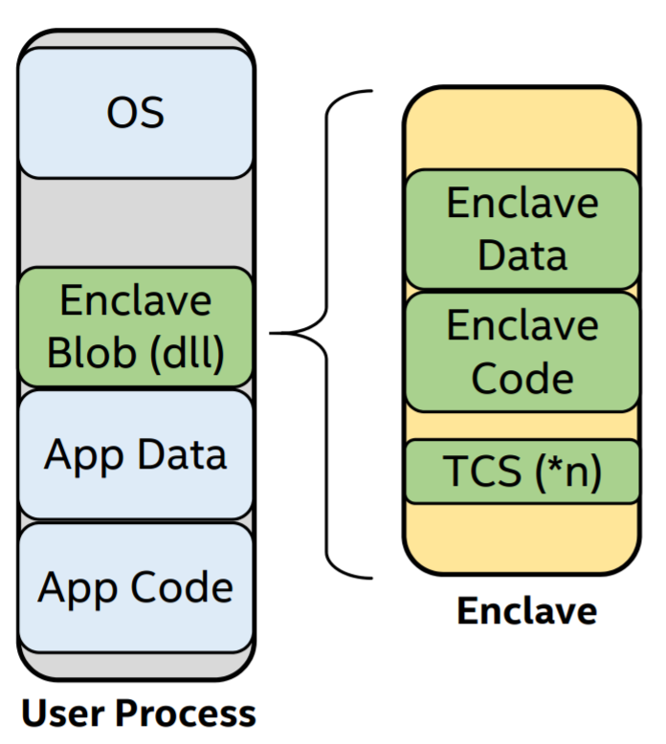
Process View of Intel SGX's Enclave
With its own code and data
Providing Confidentiality & Integrity
Controlled entry points
Multi-thread support
Full access to app memory and processor performance
Protected execution environment embedded in a process

Slide 63
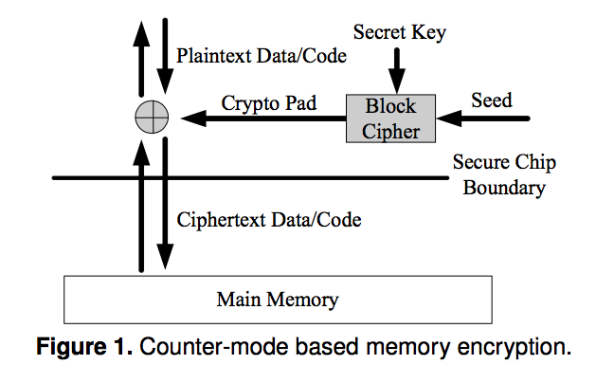
Memory Encryption: Defending Physical Attacks
Security: Pad is unique
Approaches:
global counter
block address

Slide 64
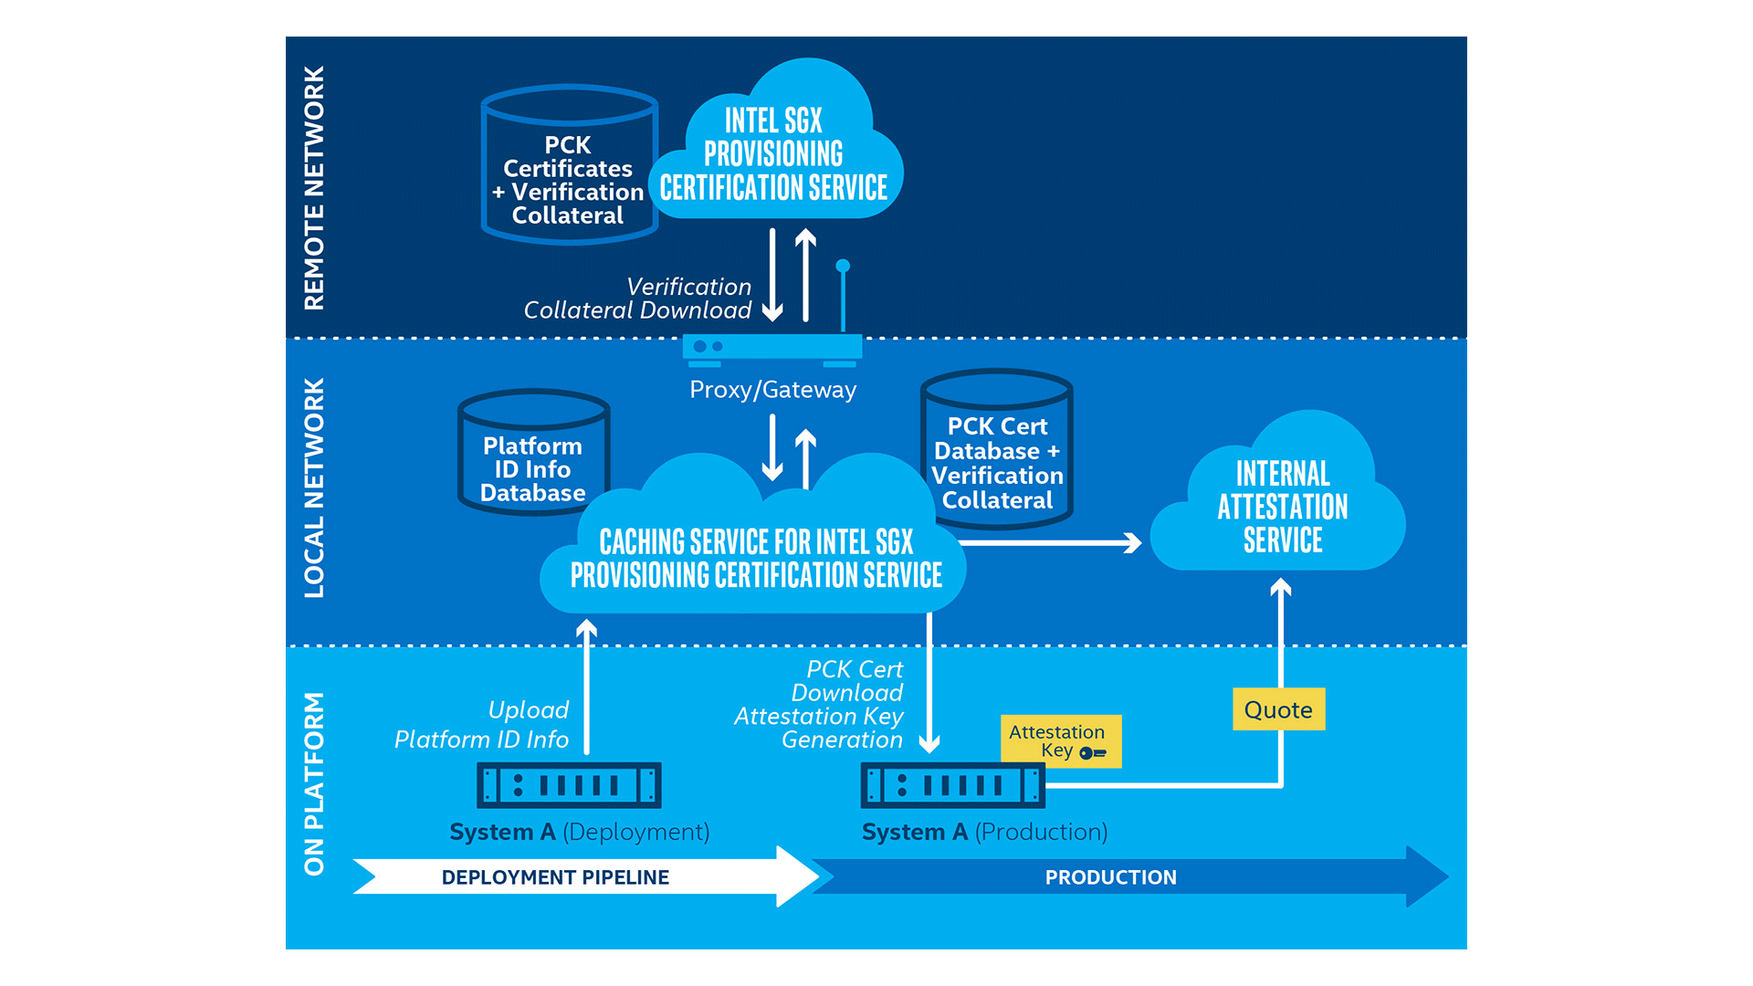
Remote Attestation (e.g., Intel SGX)

Slide 65


System: EnclaveDB
TEE: yet another virtual secure co-processor (SGX, TrustZone)
Commodity DB
(MS SQL Server)
Transaction
In-Mem DB (Hekaton) 🔑
In-Mem Tables/Indexes
Compiled Queries
eStored Procs
Logging
eResult
Recovery
Users
Query
Compilation
Commodity OS
(Windows)
Trusted Kernel
(threading, memory management, storage)
Commodity CPU
Commodity CPU (SGX)
Storage
Intel Skylake
e/ocall
(Currently) 128M EPC

Slide 66
Summary: Why Data Privacy is Hard?
The more data, the more valuable
  Cause data aggregation
Data can be easily copied
  It's really hard to prevent data copying
  You can withdraw your money from bank, but how to revoke your data from the Internet?
More than tech
  Law, like GDPR in Euro

