Slide 1


Review (& Spanner)
SE124 (2021 Fall)
IPADS, Shanghai Jiao Tong University
https://www.sjtu.edu.cn

Slide 2
Review: Transaction

Slide 3

Review: widely used transaction (TX)s
Caching server
Caching server
…
Caching server
All can use TX to manager data!
  e.g., FS meta data
Caching
Caching
Caching
Distributed caching
Database server
Database server
CDN
Users
Application #1
generate the page
Database
user, price
…
Database
user, price
Application server
Distributed database
Internet
Load
Balance
Application #2
add the order
File server
File server
File server
File:
image
File:
image
…
File:
image
Application server
…
…
Message queue
Distributed file system

Slide 4
What is a transaction (TX)?
An abstraction to manage the data
Data is also an abstract concept, can be arbitrary computing data. Concrete examples including:
  Key-value store entries
  File system metadata (e.g., directory, inode, etc.)
  Processor’s metadata (e.g., child processors)
Look like similar program, with data managed by the TX system, and extra mark to denote the start/end of a TX

Slide 5
TX: an abstraction to ease data management
Transactions handle failure atomicity & race conditions
Writing with TX is straightforward
  Use TX.begin to mark when a TX starts
  Use TX.commit to commit the TX
  Rewrite the data read/write with TX’s interface
    E.g., bank[a] = bank[a] – amt
    tx.write(a, tx.read(a) – amt);
transfer(bank, a, b, amt, tx):
tx.begin()
tx.write(b, tx.read(b) + amt);
tx.write(a, tx.read(a) – amt);
tx.commit()
transfer(bank, a, b, amt):
bank[b] = bank[b] + amt
bank[a] = bank[a] - amt
Program
Transaction

Slide 6

Review: What can a TX provide? ACID
The program btw { tx.begin() & tx.commit() } has the following properties:
A：Atomicity
C：Consistency
I：Isolation
D：Durability
...
tx.begin();
...
...
tx.commit();
...
ACID
Application program

Slide 7
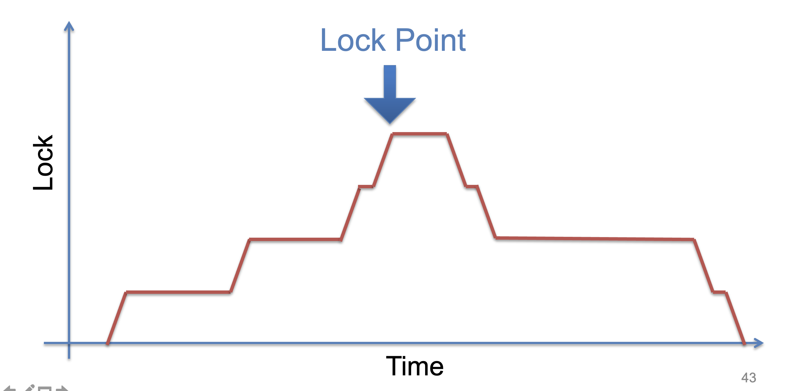
Two-phase locking
We can proof that two-phase locking can guarantee serializability
Why the name? Lock phase → lock point → unlock phase

Slide 8
OCC Executes a Transaction in 3 Phases
Phase 1: Concurrent local processing
  Reads data into a read set
  Buffers writes into a write set
Phase 2: Validation in critical section
  Validates whether serializability is guaranteed:
  Has any data in the read set been modified?
Phase 3: Commit the results in critical section or abort
  Aborts: aborts the transaction if validation fails
  Commits: installs the write set and commits the transaction

Slide 9
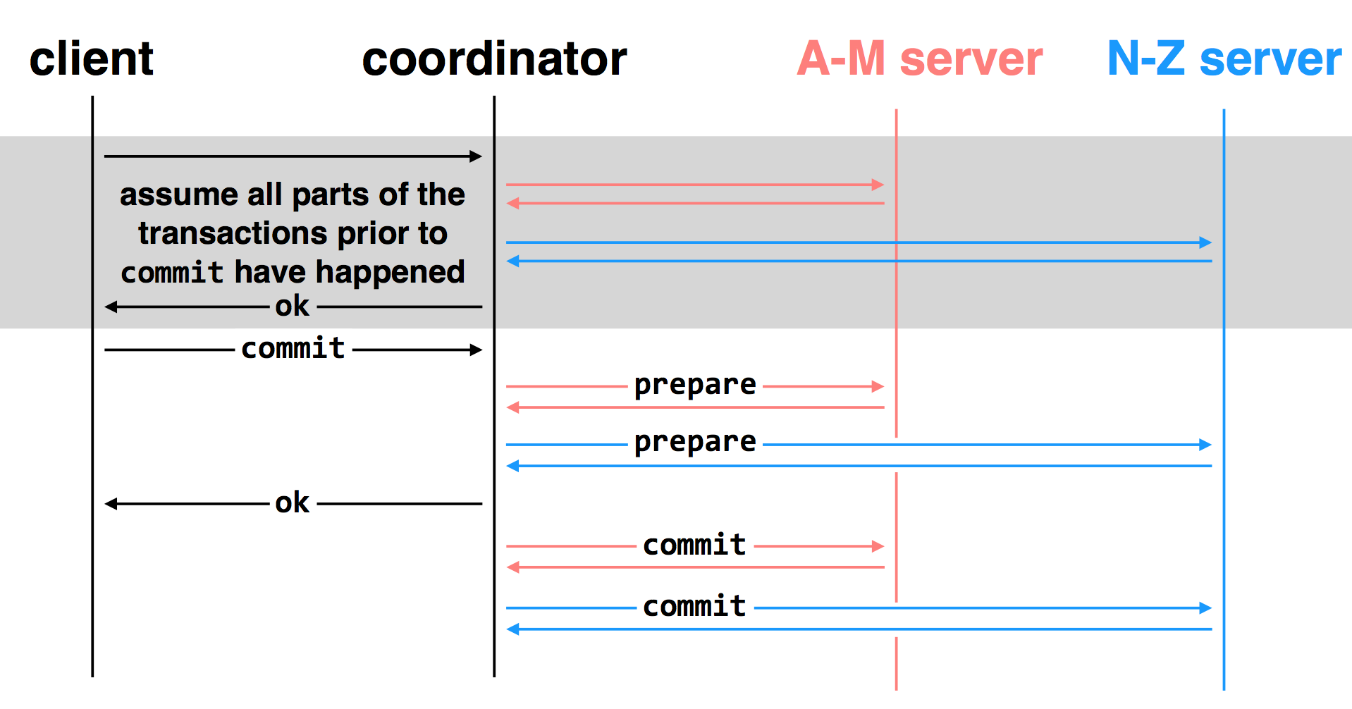
2-Phase Commit: for distributed transactions

Slide 10
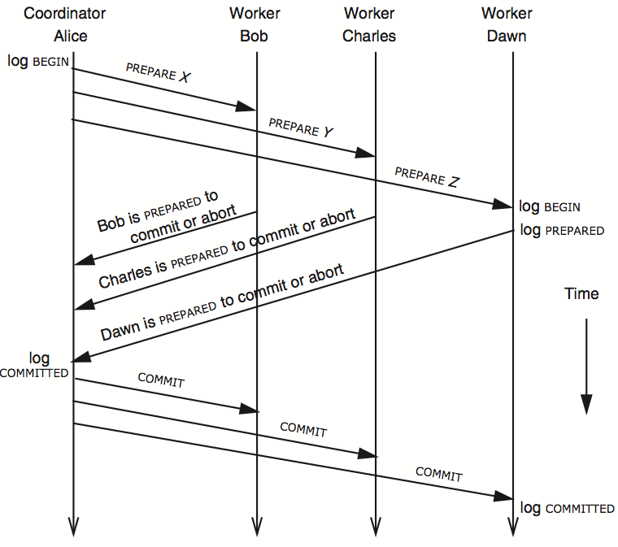
3N messages

Slide 11
Replication Consistency
Optimistic Replication
  Tolerate inconsistency, and fix things up later
  Works well when out-of-sync replicas are acceptable
Pessimistic Replication
  Ensure strong consistency between replicas
  Needed when out-of-sync replicas can cause serious problems

Slide 12
Quorum
Define separate read &write quorums: Q_{r} & Q_{w}
  Q_{r} + Q_{w} > N_{replicas} (Why?)
  - Confirm a write after writing to at least Q_{w} of replicas
  - Read at least Q_{r} agree on the data or witness value
Example
  In favor of reading: N_{replicas} = 5, Q_{w} = 4, Q_{r} = 2
  In favor or updating: N_{replicas} = 5, Q_{w} = 2, Q_{r} = 4
  Enhance availability by Q_{w} = N_{replicas} & Q_{r} = 1

Slide 13
Handling Network Partitions
Problem: replicas can become inconsistent
  Issue: clients' requests to different servers can arrive in different order
  How do we ensure that the servers remain consistent?
  Paxos

Slide 14
Google Spanner

Slide 15
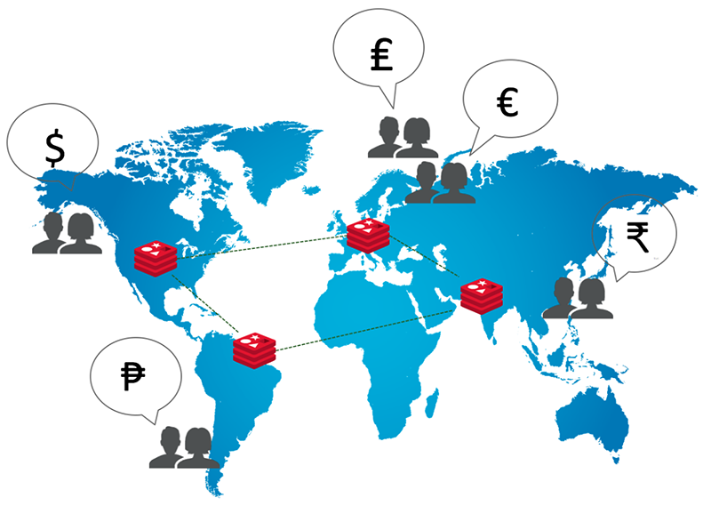
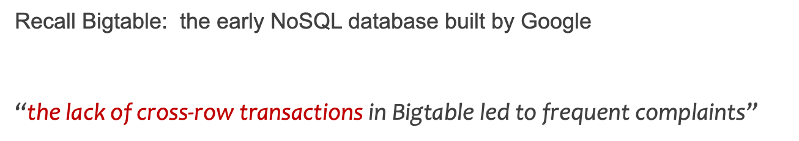
Design goals of Spanner
Data sharded & replicated over many machines & datacenters
  Due to large volume of the data
  For better fault tolerance & closer to the users
    E.g., One datacenter crashes never affect others
Strong requirements for distributed transaction (TX)s
  With ACID properties -> simplify developer’s on maintaining consistency

Slide 16






Physical layout of Spanner
Data sharded & replicated over many machines & datacenters
  Support data sets that cannot fit into a single machine
User data
Shard0
Server0
Data center
Shard1
Server1
Notes:
How to shard? Range or hash

Slide 17
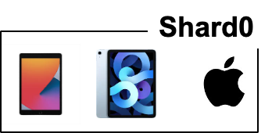
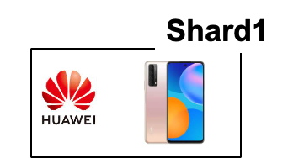
Physical layout of Spanner
Data sharded & replicated over many machines & datacenters
  Tolerate machine failures in a single datacenter
User data
Server0
Data center
Replication factor = 2
Server1
Notes:
How to shard? Range or hash

Slide 18
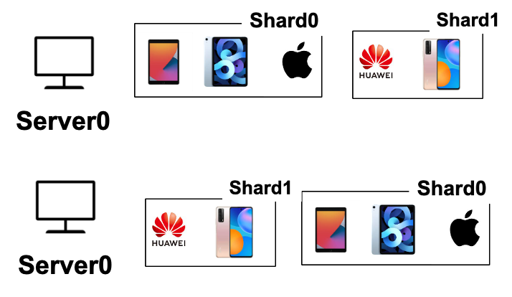

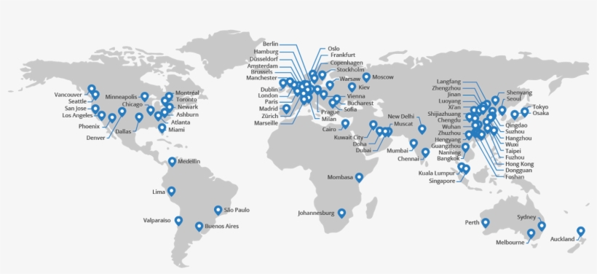
Physical layout of Spanner
Data sharded & replicated over many machines & datacenters
  Tolerate machine failures across datacenters & lower request latency
User data
Server1
Server1
DC0
DC1
Data centers
Users from china can query DC at china for lower latency
Notes:
How to shard? Range or hash

Slide 19
Maintain consistency over geo-replicated data is non-trivial

Slide 20


What is the consistency goal? External consistency
External consistency is the most desirable for the programmer
  Simple definition: If T1 completes before T2 starts, T2 must see T1's writes.
Should be 100!
T1
T2
Bob.acct = 100$
Print(bob.acct)
Time
John
Bob

Slide 21

Spanner achieves external consistency
Could possibly go wrong under a distributed setting of Spanner w/o protocols
  Challenge #1. consistency among replicas
    The same data is replicated on machines at different datacenter(DC)s
?
T1
T2
Bob.acct = 100$
Print(bob.acct)
DC0
Bob.acct=0$
DC0
Bob.acct=100$
DC0
Bob.acct=100$
Time
DC1
Bob.acct=0$
DC1
Bob.acct=0$
DC1
Bob.acct=0$

Slide 22
Solution: PAXOS (see lecture 15)
Spanner treats replicated data via PAXOS state machines
  Which internally ensures consistency & availability
  E.g., on the developer’s view, each data shard is a single logic machine
    And the machine never crashes (i.e., available)
DC0
Bob.acct=0$
Bob.acct=0$
DC1
Bob.acct=0$
Physical
+Paxos
Logic

Slide 23
Spanner ensures external consistency
Could possibly go wrong under a distributed setting of Spanner
  Challenge #1. consistency among replicas
  Challenge #2. support efficient read-only TXs across shards
    Dominated the workloads in Spanner (Millions of read-write TXs vs. Billions read-only TXs at Google )
Spanner adopts some form of MVCC
  Multi-version concurrency control

Slide 24
Review of MVCC (multi-version concurrency control)
Each data item has multiple versions
  When accessing different versions of data, probably no conflict!
Key (high-level) idea
  Writes don’t overwrite the original data
  Instead, writes install new versions of data
  Reads from a snapshot of data
Benefits: no lock or validation during TX’s execution
Timestamp
bankA: 100, ver: 12, pre:xx
bankA: 100
bankA: 200, ver: 10, pre:xx
Single-version
Multi-version

Slide 25
How to assign the timestamp in MVCC?
Requirement of external consistency
  If TX2 starts after TX1 commits, then
    Time2 > Time1
Traditional approach: global counter (logic time)
  E.g., snapshot isolation
  Each TX query a global counter for the time
    Can trivially ensure correctness
Question:
  Is global counter suitable for MVCC?

Slide 26


How to assign the time in MVCC?
Global counter
  In traditional MVCC (i.e., snapshot isolation)
Question:
  Is global counter suitable for MVCC?
No
  1. Extra latency overhead
User data
Global counter
DC0
DC1
2
1

Slide 27
How to assign the time in MVCC?
Global counter
  In traditional MVCC (i.e., snapshot isolation)
Question:
  Is global counter suitable for MVCC?
No
  1. Extra latency overhead
  2. Scalability bottleneck
User data
Global counter
DC0
DC1
2
1

Slide 28
Summary: key techniques of Spanner
Paxos
  Make each shard available & consistent
    Where the shard can be physically replicated on multiple machines
2-phase commit (for read-write transactions)
  Coordinating data accesses on multiple shards
MVCC (for read-only transactions)
  Efficient MVCC for read-only transactions
  With synchronized times (TrueTime)

Slide 29

Execution flow of read-write transaction(TX) w/o time
Read-write TX:
  A TX that both reads and writes the data
tx.begin()
x = x + 1
y = y + 1
tx.end()
Client
Notes:
// what is a read-write TX
Execution flow

Slide 30
Execution flow of read-write transaction(TX) w/o time
Read-write TX:
  A TX that both reads and writes the data
tx.begin()
x = x + 1
y = y + 1
tx.end()
DC0
DC1
x
X
Y
Y
Client
X,Y are shared on two servers
Notes:
// what is a read-write TX
Execution flow

Slide 31
Execution flow of read-write transaction(TX) w/o time
Each shard is replicated
  The run PAXOS to behavior as a single (logical) shard
tx.begin()
x = x + 1
y = y + 1
tx.end()
DC0
DC1
x
X
PAXOS
Y
Y
PAXOS
Client
Each shard is replicated on two DCs
Notes:
Omit local replication for simplicity

Slide 32
Execution flow of read-write transaction(TX) w/o time
Each shard is replicated w/ PAXOS
  A replica is selected leader to simplify execution (no Raft introduced then)
tx.begin()
x = x + 1
y = y + 1
tx.end()
DC0
DC1
x
X
PAXOS
Y
Y
PAXOS
Leader will execute request
Start a PAXOS proposal accordingly
Client
Notes:
The leader is responsible for accepting client requests and managing the replication of the log to other servers. The data flows only in one direction: from leader to other servers.
Proposal & learned
Similar to the RAFT leader
Hold the latest value (w/o failure)

Slide 33
Execution flow of read-write transaction(TX) w/o time
Spanner uses standard 2PC & 2PL for executing read-write TX
  Two-phase commit & two-phase locking
tx.begin()
x = x + 1
y = y + 1
tx.end()
DC0
DC1
x
X
PAXOS
Y
Y
PAXOS
Client

Slide 34

Execution flow of read-write transaction(TX) w/o time
Upon read, the leader will return the latest value of data
  Also hold the lock on it (2PL)
tx.begin()
x = x + 1
y = y + 1
tx.end()
DC0
DC1
x
X
PAXOS
Rx
Y
Y
PAXOS
Client sends each read to Paxos leader of relevant shard
Client
Notes:
Read locks are not replicated via Paxos, so leader failure -> abort.

Slide 35
Execution flow of read-write transaction(TX) w/o time
The write will be buffered at local client
  They will be written back via 2PC at the TX’s commit time
tx.begin()
x = x + 1
y = y + 1
tx.end()
DC0
DC1
write
x
X
PAXOS
Rx
Y
Y
PAXOS
Client

Slide 36
Execution flow of read-write transaction(TX) w/o time
Commit will use 2PC to write all the updates back
  It will choose a shard leader as the coordinator leader
tx.begin()
x = x + 1
y = y + 1
tx.end()
DC0
DC1
x
X
PAXOS
Rx
Y
Y
PAXOS
Client
Ry

Slide 37
Execution flow of read-write transaction(TX) w/o time
The coordinator uses its PAXOS group to replicate the TX states
  Why? Otherwise, the 2PC may fail if the coordinator crashes!
tx.begin()
x = x + 1
y = y + 1
tx.end()
DC0
DC1
x
X
PAXOS
Rx
Y
Y
PAXOS
Select as coordinator leader
w/ the update values
Client
Ry

Slide 38
Execution flow of read-write transaction(TX) w/o time
The coordinator leader will send the update values to the host shard leader
  And each shard leader execute the prepare with PAXOS
tx.begin()
x = x + 1
y = y + 1
tx.end()
DC0
DC1
x
X
PAXOS
Prepare
Rx
Y
Y
PAXOS
Prepare
Select as coordinator leader
w/ the update values
Client
Ry

Slide 39
Execution flow of read-write transaction(TX) w/o time
If all shard leader returns the Yes to the coordinator leader
  The coordinator log the commit decision (via PAXOS) & commit others
tx.begin()
x = x + 1
y = y + 1
tx.end()
DC0
DC1
x
Commit
X
PAXOS
Commit
Rx
Y
Y
PAXOS
Commit
Select as coordinator leader
w/ the update values
Yes: replicate the lock & new value
Client
Ry
Commit: update & release the lock

Slide 40














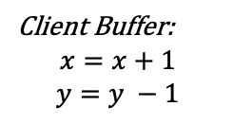

Read-write TX: put it all together
Multiple physical nodes
backed by PAXOS
$$2PL+2PC+Paxos$$
$$Client$$
$$read x$$
$$Shard0$$
$$Shard1$$
$$read y$$
Client Buffer:
$$x=x+1$$
$$y=y −1$$
$$Coordiantor$$
$$perpare$$
$$perpared$$
$$perpare$$
$$perpared$$
$$commit$$
$$applied$$
$$commit$$
$$applied$$
Notes:
Prepared: get the lock, record 2PC state and Paxos state
Applied: release the lock

Slide 41
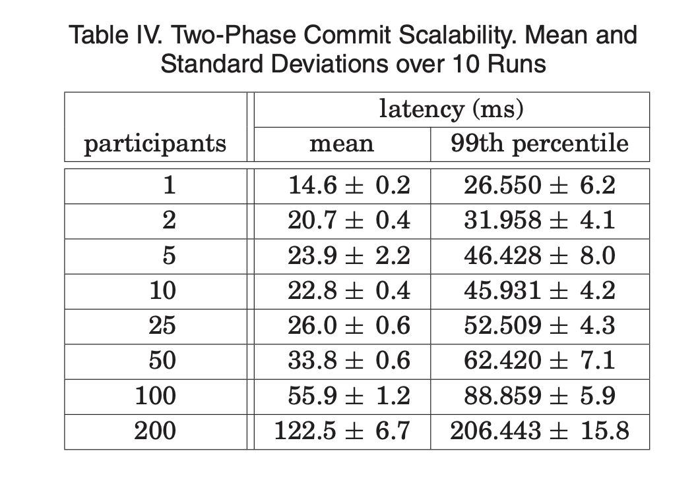
Read-write TX of Spanner so far
Standard 2PL & 2PC
  Not optimized – since writes are far less common in Spanner
  Maybe slow: many messages sent between machines
    Also, across datacenters!

Slide 42
Read-only TX & TrueTime

Slide 43
Multi-versioning in Spanner (Standard MVCC)
Each data has multiple versions
  Spanner uses the TrueTime of the last modified read-write TX
    A well synchronized physical time between different coordinators
  Question: when to assign the timestamp for the TXs?
Snapshot read
  A read of read-only TX chooses the latest version that is <= than its time
DC0
DC1
X_{11:00}
X_{11:00}
Y_{12:00}
Y_{12:00}
Y_{10:00}
Y_{10:00}
No lock!

Slide 44
Timestamp assignment in Spanner
Read-write TX
  Assigned when all locks of the TX has been acquired
    i.e., the prepare phase of the TX passes (serialization point)
Read-only TX
  Assigned at the start of the TX
Challenge of timing: clock synchronization for external consistency
  If a read-write TX has decided to commit, then a read-only TX starts,
  then must ensure:
    Time_{read-only} >= Time_{read-write}
Notes:
Clients can possibly be a mobile phone

Slide 45
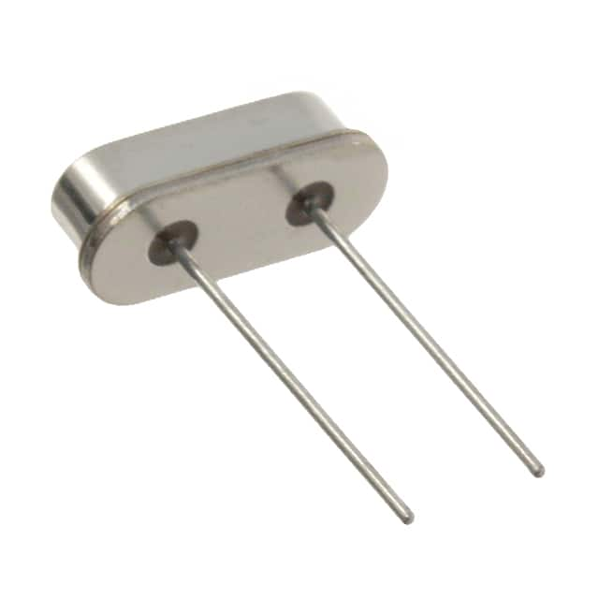
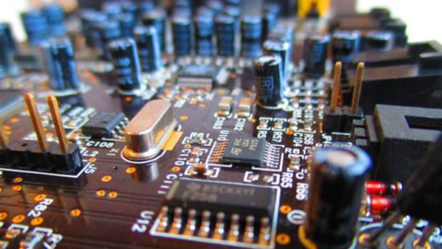
Timing: a key building block in distributed systems
Time is used by many distributed systems
  e.g., cache expiration (DNS, HTTP), file synchronizers, Kerberos, ..
  time intervals: how long did some operation take?
  calendar time: what time/date did some event happen at?
  ordering of events: in what order did some events happen?
How computer measure times?
  Computer has a reasonably-fixed-frequency oscillator
    E.g., quartz crystal
  Represent time interval as a count of oscillator's cycles
    time period = count / frequency
    e.g., with a 1MHz oscillator, 1000 cycles means 1msec

Slide 46
Time Measuring
What happens when turn off the computer?
  "Real-Time Clock" (RTC) chip remains powered, with battery / capacitor
  Stores current calendar time, has an oscillator that increments periodically
Maintaining accurate time
  Accuracy: for calendar time, need to set the clock correctly at some point
  Precision: need to know oscillator frequency (drift due to age, temp, etc.)

Slide 47
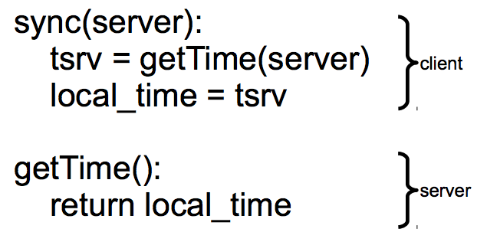
Challenge: clock synchronization
It’s hard to synchronize different machine’s clocks
  the quartz clock drifts, depends on the temperature of the machine
  e.g., Google assumes 17 seconds drifts assuming clocks are synchronized once per day
Common approach: synchronizing clock with NTP
  Query server's time, adjust local time accordingly

Slide 48
Sync clock with NTP
Need to consider network latency
  Simple estimate: RTT/2
  When does this fail to work well?
    Asymmetric routes, with different latency in each direction
    Queuing delay, unlikely to be symmetric even for symmetric routes
    Busy server might take a long time to process client's request
  Can use repeated queries to average out (or estimate variance) for second two

Slide 49
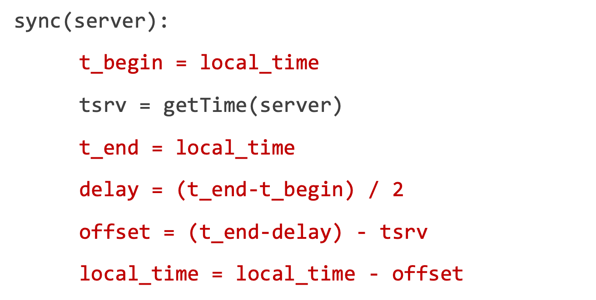
Sync clock with NTP: Estimating Network Latency
What if a computer's clock is too fast
  E.g., 5 seconds ahead
  Naive plan: reset it to the correct time
    Can break time intervals being measured (e.g., negative interval)
    Can break ordering (e.g., older files were created in the future)
  "make" is particularly prone to these errors
Principle: time never goes backwards
  Idea: temporarily slow down or speed up the clock
  Typically, cannot adjust oscillator (fixed hardware)
  Adjust oscillator frequency estimate, so counter advances faster / slower
tsrv
Server
delay
Client
tbegin
tend

Slide 50
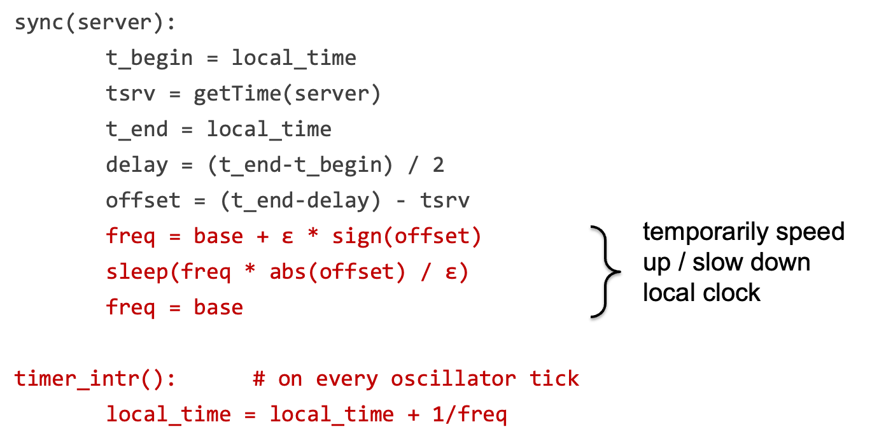
Sync clock with NTP: Estimating Network Latency

Slide 51
Drawback of NTP
No bounds on the clocks between client & server
  The time of server & client is only roughly similar !
How to compare two roughly correct clock?
  No way

Slide 52
TrueTime API of Spanner
TrueTime returns a time interval instead of a single point of time
  The interval is bound. i.e., the time of server must be in this bound
  The interval is the physical time. i.e., familiar to the user
struct timeval {
time_t tv_sec; suseconds_t tv_usec;
};
struct time_interval{
timeval Lower;
timeval Upper;
};
int gettimeofday(struct timeval *restrict tv, ...)
int get_truetime(time_interval *interval);
// Server timeval must be in [L,U]
Linux Time API
TrueTime API (Simplified)

Slide 53
Power of TrueTime API (return [L,U])
Used to implement external consistency
  If a read-write TX has decided to commit, then:
    Time_{read-only} >= Time_{read-write}
How to achieve this?
  Commit wait for read-write TX: after acquire the commit timestamp, the coordinator wait until (U – L) and uses U as Time_{read-write}
  For read-only TX, simply uses U as the read timestamp
Commit wait done, server.time1 >= U1
Time Server time
Read-write TX
L1
U1
1
Get commit time-stamp

Slide 54
Power of TrueTime API (return [L,U])
Used to implement external consistency
  If a read-write TX has decided to commit, then:
    Time_{read-only} >= Time_{read-write}
How to achieve this?
  Commit wait for read-write TX: after acquire the commit timestamp, the coordinator wait until (U – L) and uses U as Time_{read-write}
  For read-only TX, simply uses U as the read timestamp
Commit wait done, server.time1 >= U1
Time Server time
Read-write TX
L1
U1
1
2
Read-only TX
L2
U2
Get read timestamp, U2 >= server.time2

Slide 55
Power of TrueTime API (return [L,U])
Used to implement external consistency
  If a read-write TX has decided to commit, then:
    Time_{read-only} >= Time_{read-write}
Correctness
  Time_{read-write} (U1) <= server.time1 <= server.time2 <= U2 (Time_{read-only})
Commit wait done, server.time1 >= U1
Server time
Read-write TX
L1
U1
1
2
Read-only TX
L2
U2
Get read timestamp, U2 >= server.time2

Slide 56
What if no wait?
A later executing TX can get a smaller timestamp!
  E.g., T1’s timestamp (U1) can be smaller than T2’s timestamp (U2)
  Problem: violating the external consistency
T1 get timestamp (U1)
T1 commit
Server time
Read-write TX
L1
U1
Read-only TX
L2
U2
T2 get timestamp (U2)
56

Slide 57
Power of TrueTime API (return [L,U])
Used to implement external consistency
  If a read-write TX has decided to commit, then:
    Time_{read-only} >= Time_{read-write}
Correctness
  Time_{read-write} (U1) <= server.time1 <= server.time2 <= U2 (Time_{read-only})
Commit wait done, server.time1 >= U1
Server time
Read-write TX
L1
U1
1
2
Read-only TX
L2
U2
Get read timestamp, U2 >= server.time2

Slide 58
How to calculate the bound of TrueTime?

Slide 59
TrueTime: how to calculate the bound?
The bound is relative to the time server
  For simplicity, we assume there is only one time server
Spanner adopts a variant of Marzullo’s algorithm^{[1]}
Problem statement
  If the local clock of client is T, what is the time interval of the server?
  [1] Maintaining the Time in a Distributed System
Notes:
Ma zu luo

Slide 60
TrueTime: how to calculate the bound?
Problem statement
  If the local clock of client is T, what is the time interval of server?
High-level idea: send RPC to the server for the query as the measurements!
  Similar as NTP
  Before query the time, periodically sync with the time server
Sync
What is the time?
tsrv
T_{s}
Time
Server
T
Client
tbegin
tend
get_truetime()

Slide 61
TrueTime: how to calculate the bound?
Simplification: assuming server advances in the same speed as clients
  Suppose the start time at client & server is T_{c} and T_{s}, respectively
  Then after Δ time, the clock of client & server would be T_{c} + Δ and T_{s} + Δ
Since we know the tsrv, the key question is how to calculate the interval
Sync
tsrv
T_{s}
Time
Server
Interval
T
Client
tbegin
tend
get_truetime()

Slide 62
TrueTime: how to calculate the bound?
Since we know the tsrv, the key question is how to calculate the interval
  Interval >= T – tend
  Interval <= T – tbegin
  T_{s} = tsrv + Interval
  T – tend + tsrv <= T_{s} <= T – tbegin + tsrv (based on our simplification)
Question: what if there is a drift between client & server?
Sync
tsrv
T_{s}
Time
Server
Interval
T
Client
tbegin
tend
get_truetime()

Slide 63
TrueTime: how to calculate the bound?
Simplification: assuming server advances in the same speed as clients
  T – tend + tsrv <= T_{s} <= T – tbegin + tsrv (based on our simplification)
Assume a fixed ε drift rate between client & server
  After t time, the drift between client & server is (1 + ε) or (1 - ε)
    Spanner assumes a fixed as 200us / second
Then the interval is regulated as
  (T – tend) * (1 - ε) + tsrv <= T_{s} <= (T – tbegin) * (1 + ε) + tsrv
  Done
Solution: regulate with the drift rate
L
U
Question: is a single server design fit spanner’s setup?

Slide 64
TrueTime adopts multiple time servers
timemaster
timemaster
timemaster
Question: how to keep different timemasters sync?
timemaster
timemaster
timemaster
Client
Datacenter 1
Datacenter 2
…
Datacenter n
Called timemaster (☺) in Spanner
Notes:
Marzullo’s algorithm also considers the case of multiple time servers

Slide 65
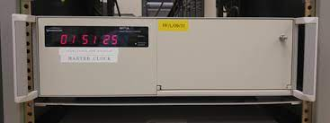
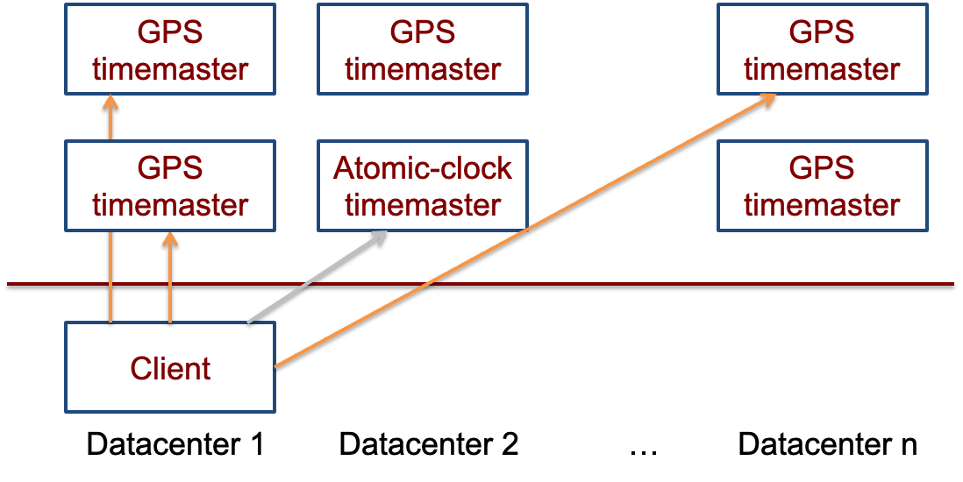
TrueTime adopts multiple time servers
Time servers are backed by GPS & atomic clocks
  High-precision clocks
  E.g., 原子钟每2000万年才误差1秒
  Atomic clocks are synchronized with each other

Slide 66
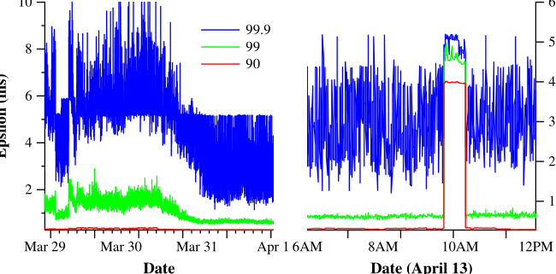
Final takeaway of TrueTime: Network-Induced Uncertainty
Interval of T
  [ (T – tend) * (1 - ε) + tsrv, (T – tbegin) * (1 + ε) + tsrv]
  tsrv – tbegin is rougly estimated as the network delay
Can have spikes if timemasters are out of services
Maintain 2 timemasters
tsrv
Server
delay
Client
tbegin
tend

Slide 67
Summary
Reify clock uncertainty in time APIs
  Known unknowns are better than unknown unknowns
  Rethink algorithms (TX’s concurrency control) to make use of uncertainty
Stronger semantics are achievable
  Greater scale != weaker semantics
Future work
  Improving TrueTime
    Lower ε < 1 ms
  Build other database features
    E.g., automatic re-sharding

Slide 68
Review: Database

Slide 69
Database management system (DBMS)
A DBMS is software that allows applications to store & analyze information in a database
A general-purpose DBMS is designed to allow the definition, creation, querying, update, and administration of databases
Application developer does not need to consider the above questions
  The database helps resolving these issues
  Developers only need to write the program using the DBMS data model & query language

Slide 70

The goal: declarative data query language
On the programmer view:
  Only tells the DBMS what the data looks like
    E.g., list all the items released in 2021
  Not how to implement it
    E.g., parse the file, check if the record’s year matches 2021
What are the benefits?
  Decouple the applications from the implementation of DBMS
    As long as DBMSs provide the same data query languages
How to define a formal way to describe what the data looks like?

Slide 71
Data models of DBMS
Data model: collection of concepts for describing the data in a database
Schema: a description of a particular collection of data, using a given data model
Example data model:
  Relational
  Key-value
  Graph
  Document
  ...
Though some models are more nature in specific workloads
  E.g., the graph data model is more natural for graph workloads
More expressiveness
aka. Polyglot

Slide 72
Use tables and rows to represent relation
Concepts:
  Relation(table): an unordered set that contain the relationship of attributes that represent entities
  Tuple(row): a set of attribute values in the relation
Tuple
  Values are (normally) atomic/scalar
  Values belong to some domain (e.g., int)
  A special value NULL for every domain
Item (name, provider, year)
Name | Provider | Year
ipad pro | Apple | 2021
iphone | Apple | 2021
Notes:
Exception: json. Some DB allows to store a json as its attribute

Slide 73
Modeling relationship with relational model
Relational model can do more!
What if we delete a provider?
  E.g., a company decides to switch a platform for selling
    Should delete all its items!
How do we implement this functionality in key-value?
for k,v in kv_item:
if v.provider == “Apple”:
kv_item.delete(k)
That is the implementation

Slide 74
Modeling relationship with relational model
Relational model can do more!
What if we delete a provider?
  E.g., a company decides to switch a platform for selling
    Should delete all its items!
How do we implement this functionality in relational model?
CREATE TABLE Item
(
Provider string NOT NULL ,...,
FOREIGN KEY (Provider) REFERENCES Provider(Name)
ON DELETE CASCADE
)
That is the declaration

Slide 75
SQL contains three components
Data Manipulation Language (DML)
  E.g., query language based on relational algebra + aggregators and more!
Data Definition Language (DDL)
  E.g., how to create a table
Data Control Language (DCL)
  E.g., whether a user has access permissions on a specific table
select * from Item where Year=2021;
CREATE TABLE Item ( Provider string NOT NULL , Year int NOT NULL, ...,)
This course does not intend to teach the languages of SQL.
But is why it is designed this way.

Slide 76
Relational model & transaction
Similarity: both can support ACID
Difference:
  Without SQL, users have to explicitly write the transaction operations
  With SQL, users only need to specific the start & end of a transaction
...
tx.begin();
...
tx.read();
...
tx.commit();
...
START TRANSACTION
select * from ...;
... // other SQL
COMMIT;
...
Transaction w/o SQL
Transaction w/ SQL

Slide 77
Relational model & SQL
CREATE TABLE Item
(
Provider string NOT NULL ,...,
FOREIGN KEY (Provider) REFERENCES Provider(Name)
)
Relational model is a theoretical proposal
  Proposed by Edgar Codd in 1970
What we have presented is actually SQL
SQL is the best-known data model today, which is based on relational model
  SQL tables <-> relations
  SQL rows <-> tuples
Hence, RDBMS (relational database management system) & SQL had become the choice for many years
  And they scale well in a lot of application scenarios
SQL

Slide 78
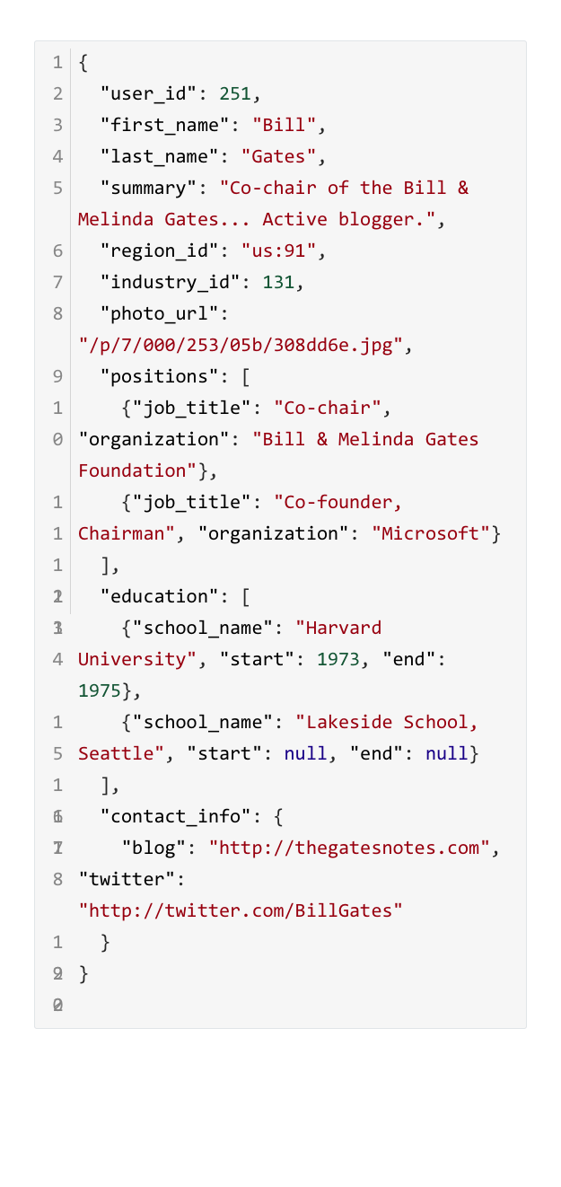
An alternative: using document model
Extend Key-value model, except that the value is structured, e.g., JSON
  In Key/Value, the value is opaque
Example: using JSON to represent the resume
Benefits:
  Better locality (for better performance)
  Easy to model the one-to-many relationship
  Schema flexibility
    Can add an attribute on-demand

Slide 79
Document model has better schema flexibility
How document model & relational model handles schema is similar to types in static & dynamic languages
Schema in relational model: types in static language
  A variable has a fixed type during compile time
Schema in document model: types in dynamic language
  E.g., in python, variables can be assigned values with different types

Slide 80
Drawbacks of document model
Querying many-to-one relationships in document model is non-trivial
  E.g., how to find all the people lived in “greater seattle area”?
  How does relational database support such queries? Join!
Still have the duplication problem
  Users need to handle by themselves

Slide 81
Summary: relational model vs. document model
Document model is a representative model in NoSQL databases
Benefits of document model
  Better locality
  Easy to represent one-to-many relation (but has duplication problem)
  Schema flexibility
Benefits of relational model
  Join supports
  Support one-to-many without duplication (e.g., with multiple tables)
  Better modeling many-to-one & many-to-many relationships

Slide 82
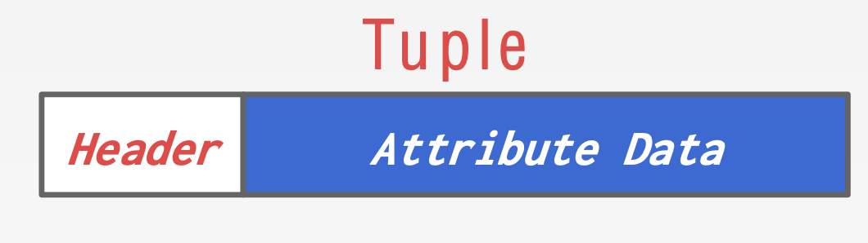
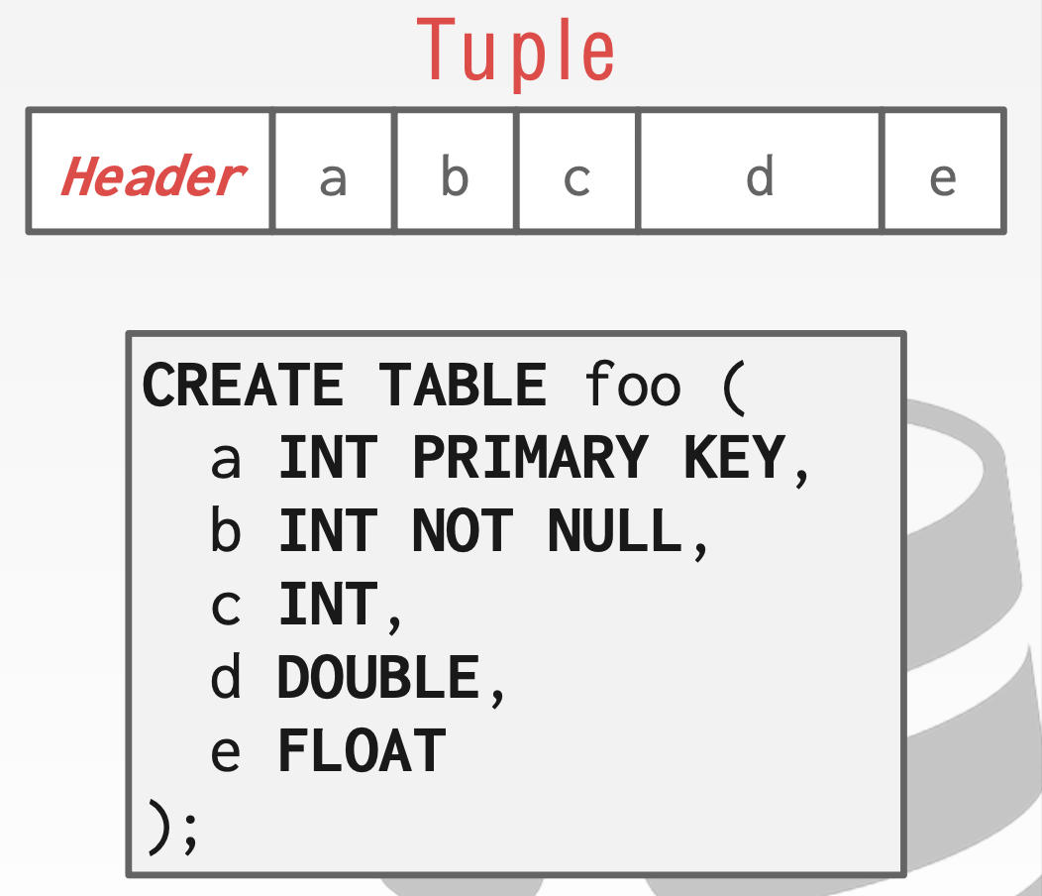
Data representation of tuples
Typically, relational DBMS uses a simpler encoding/decoding method
  E.g., Just uses its in-memory representation
    Why? DB is used by a single machine
Each tuple is prefixed with a header
  Header: a bitmap to record which attribute
  is NULL
What about the order of stored attributes?
  Typically stored in the order that you
  specify them when you create the table
  Just for software engineering! Can re-order

Slide 83



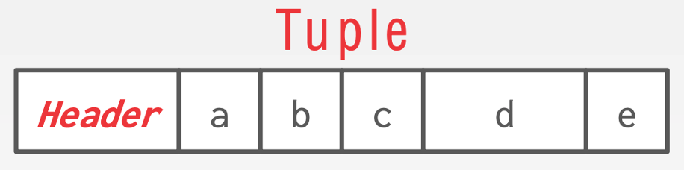
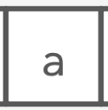
Sol-1: Store tuples in log-structured key-value storage
Of course, we can build relational model on key-value stores!
  Example: MySQL can use MyRocks as its storage engine
    MyRocks uses rockdb, a standard log-structured key-value storage
MyRocks
Relational model
  Key: Primary key of the tuple
  Value: Binary representation of the tuple
Key-value Store
→
File system

Slide 84
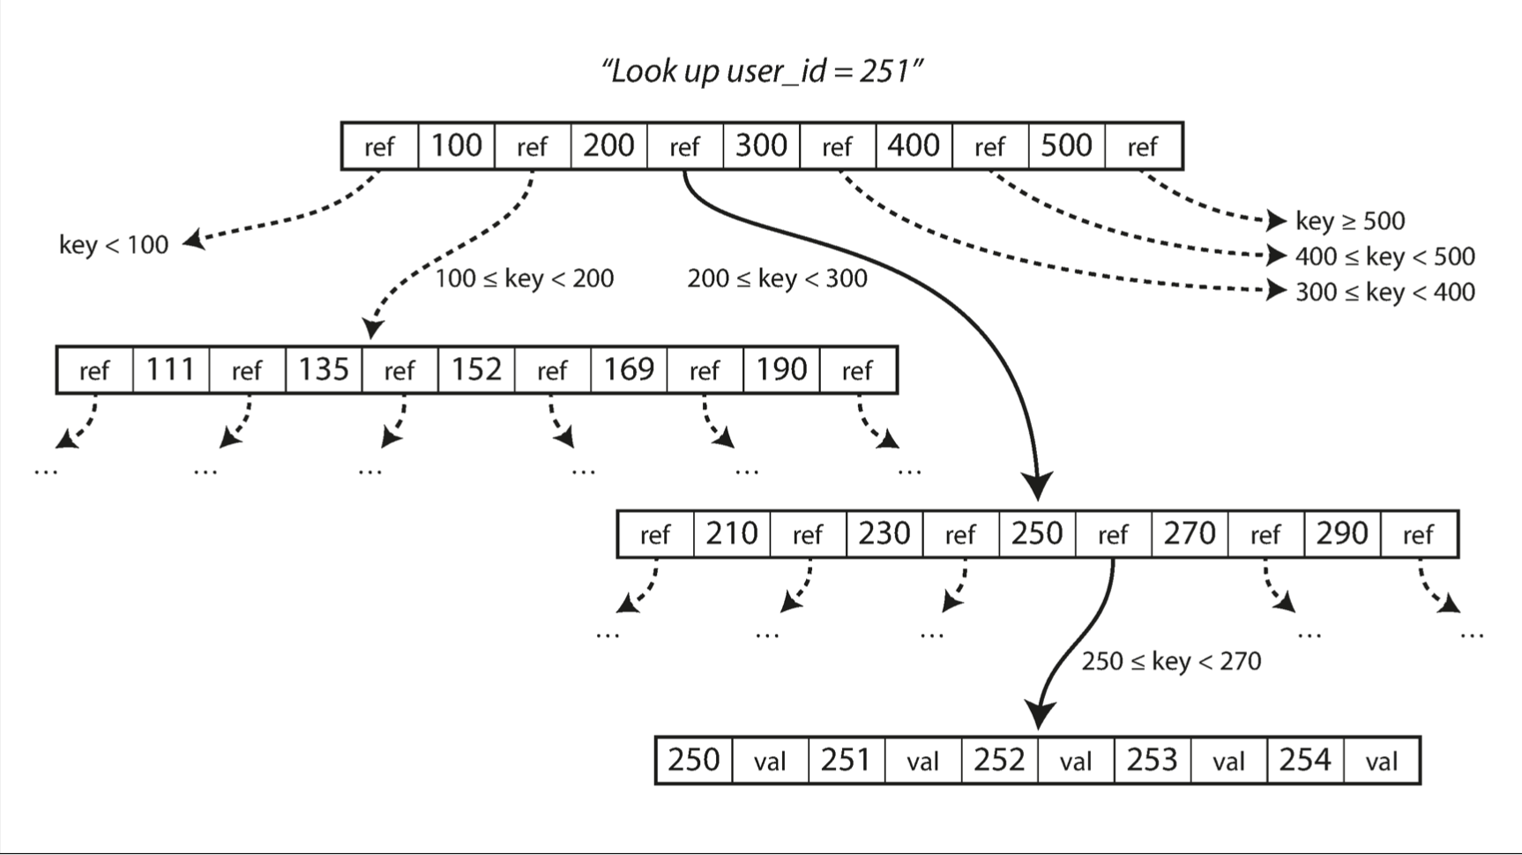
Sol-2: Using BTree to store tuples in relational model
A B-tree is a tree data structure
  Each node is fixed-sized, can store multiple keys, and keys are sorted
  Support efficient range operations (e.g., range query)
  Optimized for large read/write blocks of data
A fixed node is organized as pages in DBMSs.
Notes:
将key-value存在B树中会有什么问题？
1.怎么管理pages
2.怎么把一个tuple存在page里

Slide 85
Database pages
There are three different notions of "pages" in a DBMS:
  Hardware Page， e.g., disk sector (usually 512B or 4KB)
  OS Page (usually 4KB)
  Database Page (512B-16KB)
How to choose the database page size? Many trade-offs
  BTree height. E.g., larger page -> shallow tree
  Fragmentation. E.g., larger page -> may waste space
  More important: hardware atomic write size
    A hardware page is the largest block of data that the storage device can guarantee failsafe writes (ensure all-or-nothing by hardware)
    If the database page size don’t fit, need extra mechanisms for atomicity!
Sometimes configurable
Notes:
The most important thing is the hardware atomic size

Slide 86
Database heap file
Heap file is an abstraction to manage the database pages
  An unordered collection of pages
It is easy to find a page in a heap file
  Since the page size is known
  Just like find a block in a disk
Why don’t we care about the order?
Get page #2
Offset = Page# × PageSize
Page0
Page1
Page2
Page3
Page4
…
Heap File
Notes:
Order is managed by index (B+Tree)

Slide 87
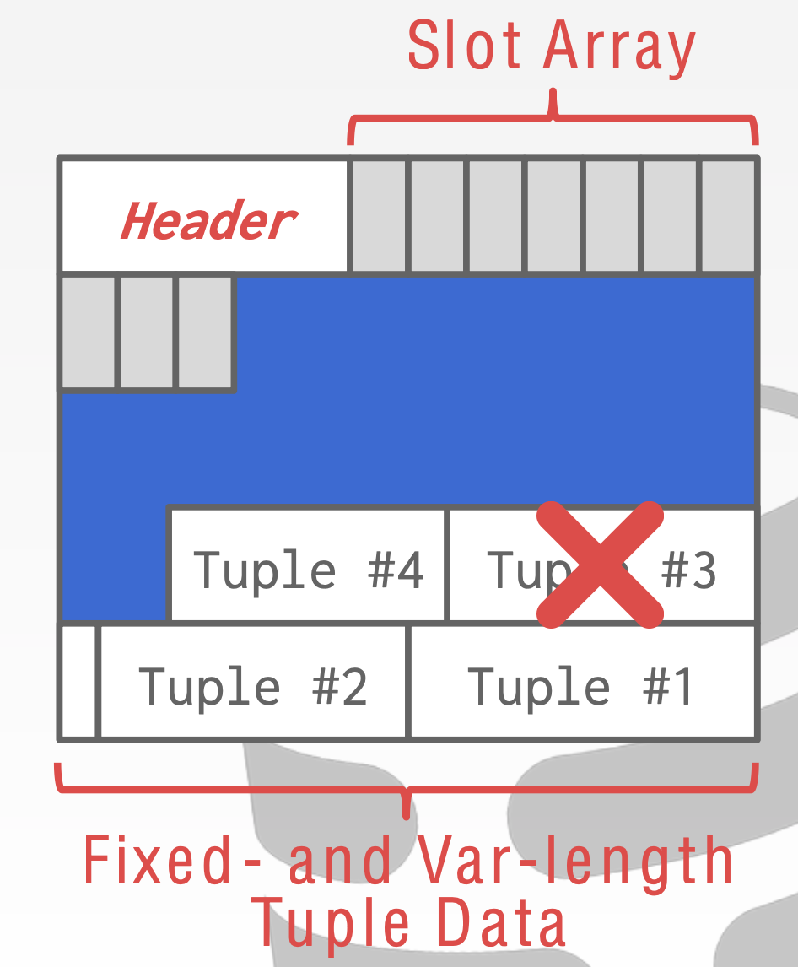
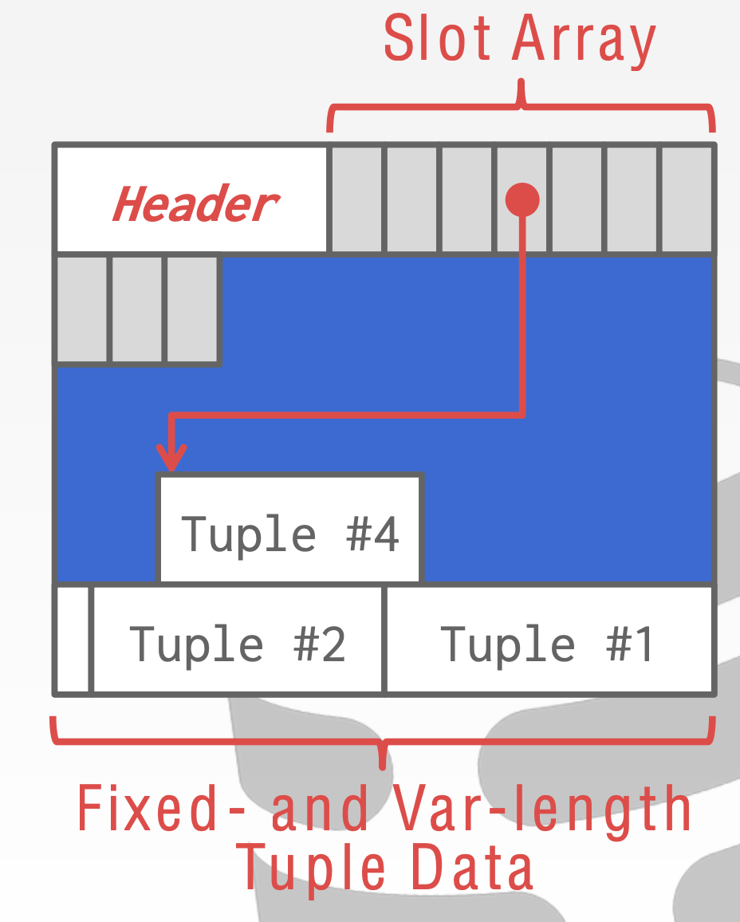
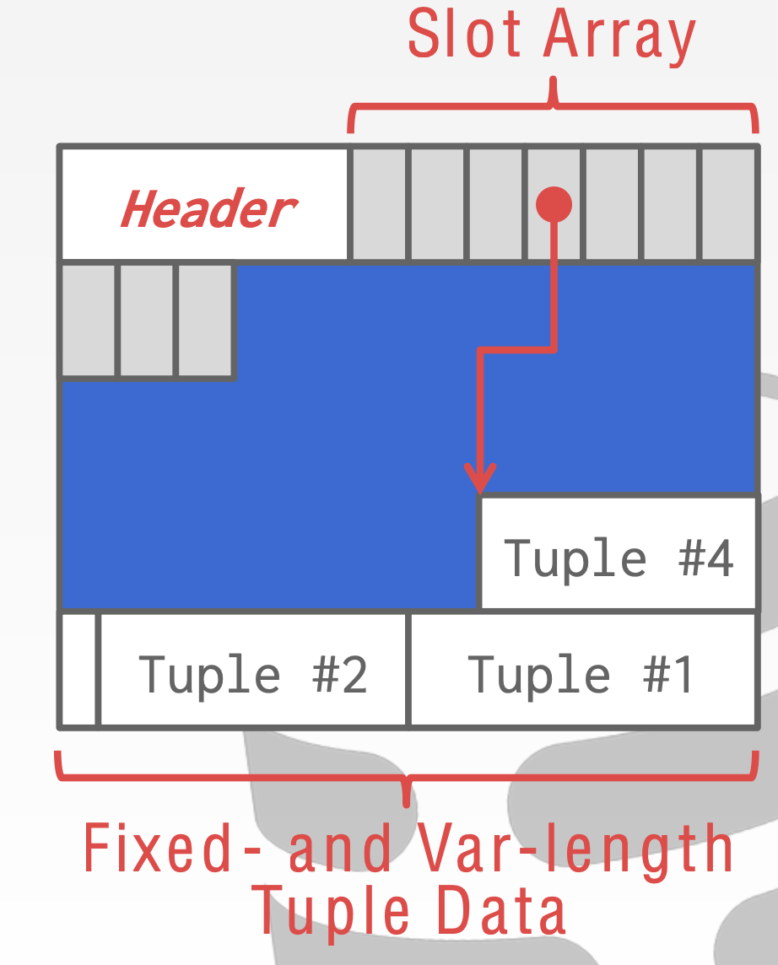
Tuple storage: slotted pages
The most common layout scheme is called slotted pages
  The slot array grows to the right
  The tuples are inserted from last -> start
What about deletions?
  Should compact the tuple storages
Two ways to index a slot
  Pointers: offset from the beginning of a page
  Offsets: offset from the previous tuple
  Which one to choose?
Notes:
Pointer: tuple location
Offset: offset compared to the previous tuple.
Pointer: easy to retrieve
Offset: easy for deletion: no need to re-calculation the pointers

Slide 88
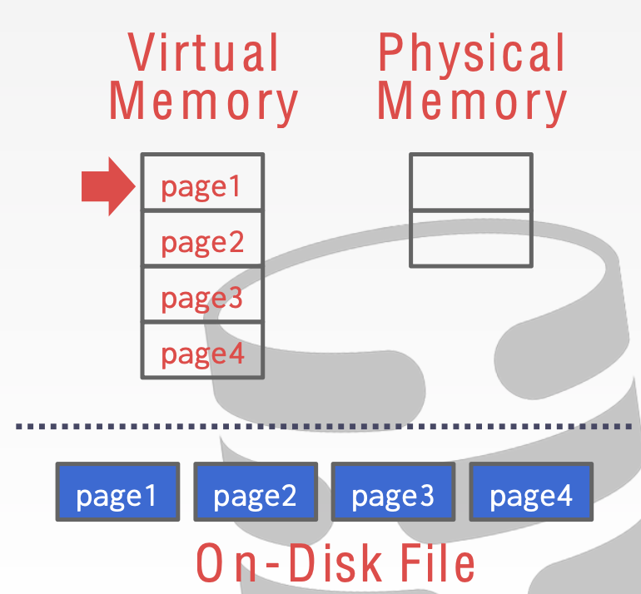
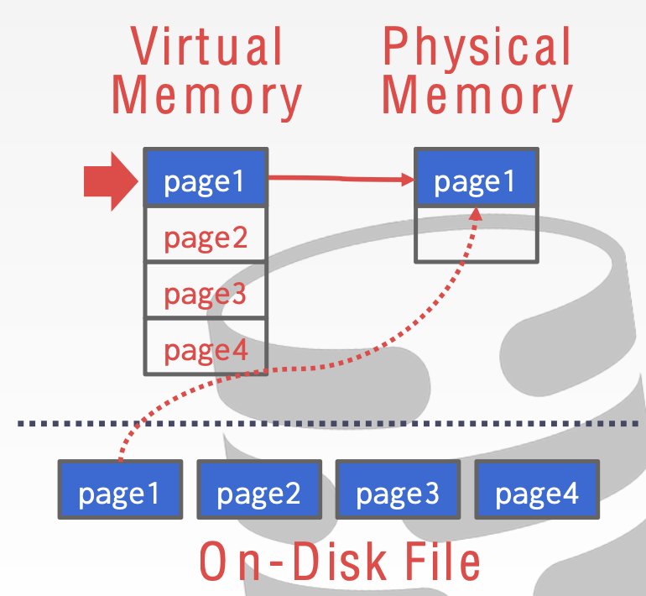
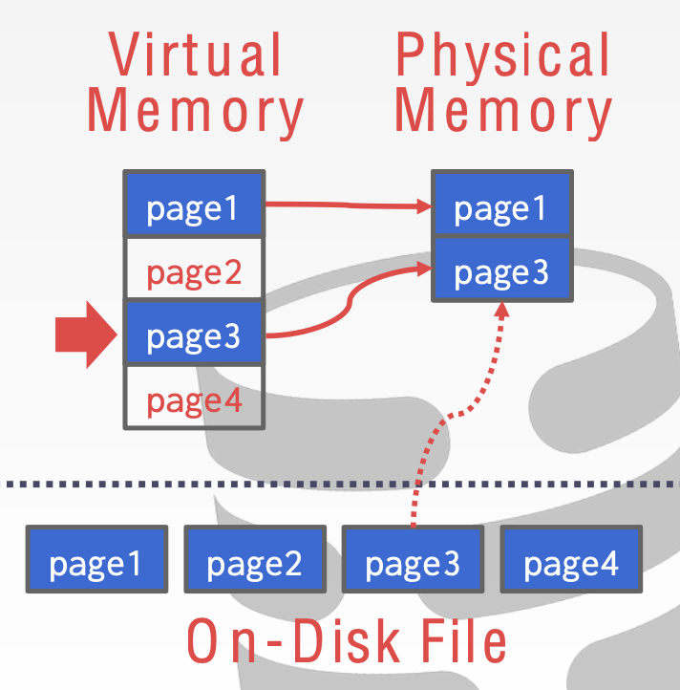
Why not leverage the OS to manage the movement?
E.g., use mmap() to map the whole heap file
  The OS is responsible for moving the files' pages in and out of memory

Slide 89
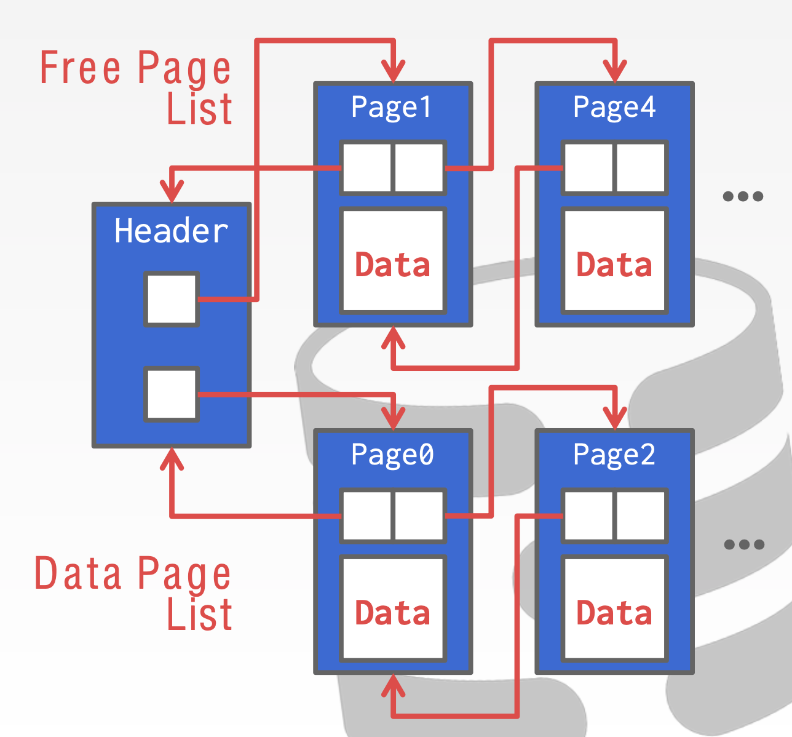
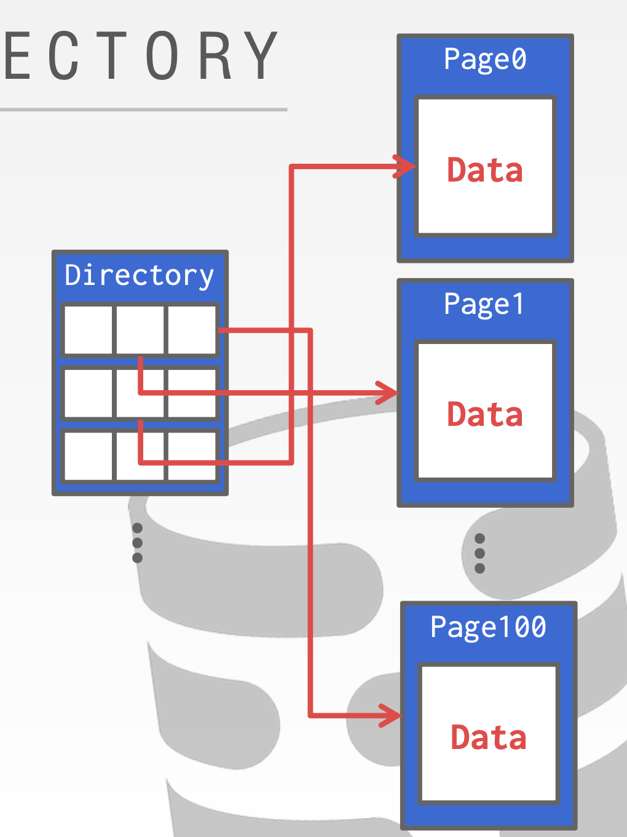
Pages are managed by a heap file
Heap file is an abstraction to manage the database pages
  An unordered collection of pages
Should provide methods to find free pages
  Two common approaches: directory & linked list
Notes:
Order can be achieved via index (B+Tree), etc

Slide 90
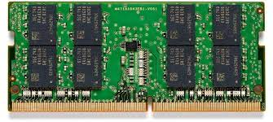
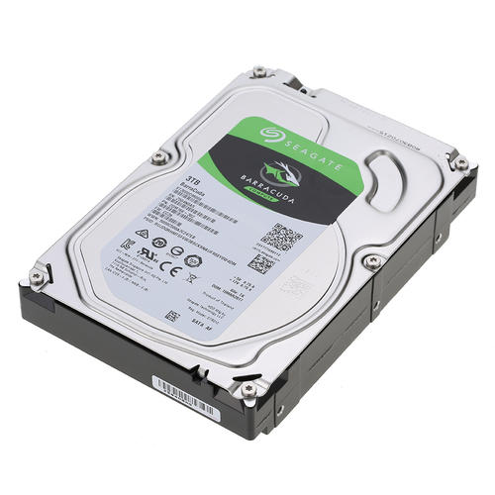
Overview of buffer pool
query
Buffer pool to manage the cached copies of pages
Query Execution
Directory
Page2
Buffer pool
e.g., get Page#2
DRAM
We will talk about more buffer pool in the next lecture!
Directory
Page0
Page1
Page2
Page3
…
Heap File

Slide 91
Locks vs. Latches
Locks: (in two-phase locking)
  Protects the database's logical contents from other transactions
  Held for transaction duration
Latches
  Protects the critical sections of the DBMS's internal data structure
  Held for operation duration
  Decouple the internal data structure concurrency control from the transaction
    E.g., Index & buffer pool
Though both are implemented as locks (e.g., pthread_mutex), they have different meanings in the DBMS
Notes:
数据库的latch基本对应OS的锁
数据库的锁 是逻辑上的。 就是逻辑上这份数据不能修改

Slide 92
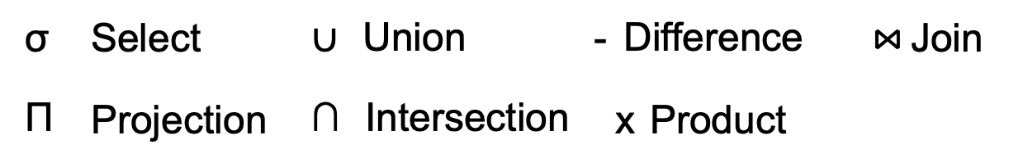
Query plan
How to generate the query plan is out of the scope
The query engine will parse a SQL into a tree (called query plan)
  Each node is an operator in relational algebra
  Data flows from the leaves to the tree up towards to the root
  The output of the root node is the result of the query
⋈
Provider⋈(σ_{Year>2021}(Item))
SELECT *
FROM Item JOIN Provider
On Item.Provider = Provider.Name
WHERE Item.year > 2020
σ_{Year>2021}
Provider
Item
Query plan

Slide 93
Processing model of the query plan
DBMS's processing model defines how the system executes a query plan
  Different trade-offs for different workloads
Approach #1. Iterator Model
Approach #2. Materialization Model
Approach #3. Vectorized / Batch Model

Slide 94

Iterator model
Each operator of the query plan implements a Next() function
  Similar to the iterator in programming languages
Next()
  On each invocation, the operator returns either a single tuple or a null marker if there are no more tuples
  The operator implements a loop that calls Next() on its children to retrieve their tuples and then process them
  Like the iterator in the programming language
Also called Volcano model
Notes:
最经典的query plan execution 模型a

Slide 95
Materialization Model
Each operator processes its input all at once and then emits its output all at once
  I.e., the operator "materializes" its output as a single result
What are the benefits?
  Less function call overheads
What happens if the output is too large?
  Should co-work with the DBMS push down hints (e.g., LIMIT) to avoid scanning too many tuples
    LIMIT: set by users, which limits the number of tuple returned by a query

Slide 96
Vectorized model
Somewhere between Iterator & Materialization model
Like Iterator model, each operator implements a Next() function
  On each invocation, the operator returns either a single tuple or a null marker if there are no more tuples
The operator's internal loop processes multiple tuples at a time
  The size of the batch can vary based on hardware or query properties
a batch of tuples

Slide 97
Review: Network

Slide 98
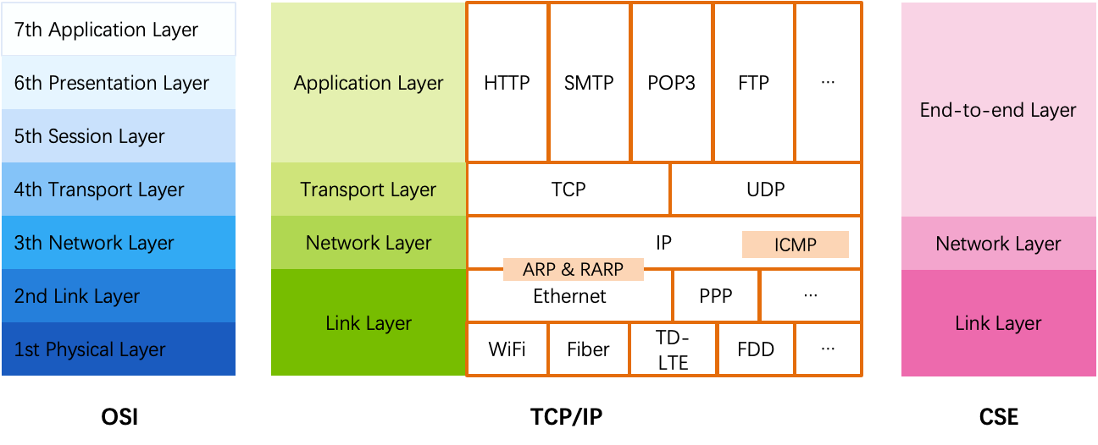
OSI, TCP/IP & Protocol Stack
OSI
  The open systems interconnection (OSI) model
  7-layer architecture

Slide 99
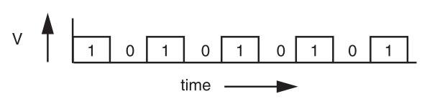
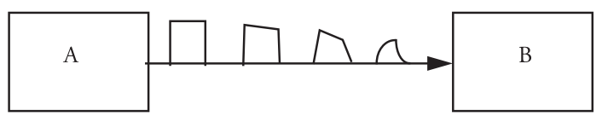
Signal Transmission on Analog Line
It is hard for B to understand the signal
  B doesn't have a copy of A's clock, so when to sample the signal?

Slide 100
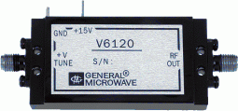
VCO: Voltage Controlled Oscillator
How to make two ends agree on the data rate without clock line?
The receiver run a VCO at about the same data rate
  VCO's output is multiplied by the voltage of incoming signal
  The product is suitably filtered and sent back to adjust the VCO
  VCO will finally be locked to both the frequency and phase of the arriving signal: phase-locked loop
  Then the VCO becomes a clock source for the receiver
Problem: if no transition in the stream (e.g., a lot of zero), the phase-locked loop cannot synchronize

Slide 101
Manchester Code
Solution: sender encodes the data to ensure transitions
Phase encoding: at least 1 level transition for a bit
  Manchester code: 0 -> 01, 1 -> 10
  Max data rate is only half, but simple enough
1
0
1
0
1
1
1
0
0
Polar NRZ
Manchester
Encoding

Slide 102
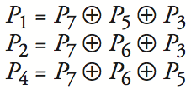
Example-2: 4-bit -> 7-bit
4 bits -> 7 bits (56 using only extra 7)
  3 extra bits to distinguish 8 cases
  e.g. 1101 -> 1010101
Correct 1-bit errors
  1010101 -> 1010001 : P1 & P4 not match
  1010101 -> 1110101 : P2 not match
Not Match | Error
None | None
P1 | P1
P2 | P2
P4 | P4
P1 & P2 | P3
P1 & P4 | P5
P2 & P4 | P6
P1 & P2 & P4 | P7
1 2 3 4 5 6 7
1
0
1
0
1
0
1
1
0
1
0
1
0
1
1
0
1
0
1
0
1

Slide 103
Control-plane VS. Data-plane
Control-plane
  Control the data flow by defining rules
  E.g., the routing algorithm
Data-plane
  Copies data according to the rules
  Performance critical
  E.g., the IP forwarding process

Slide 104
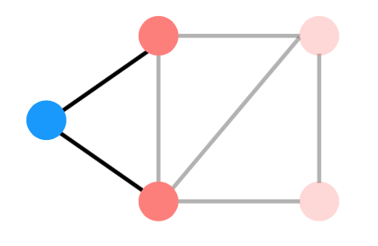
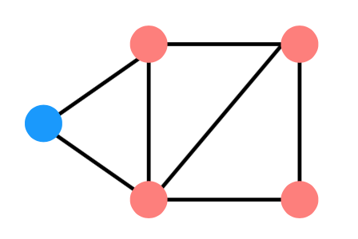
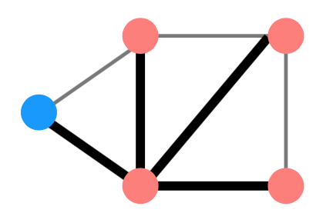
Distributed Routing: 3 Steps in General
Nodes learn about their neighbors via the HELLO protocol
Nodes learn about other reachable nodes via advertisements
Nodes determine the minimum-cost routes (of the routes they know about)

Slide 105
Two Types of Routing Protocol
Protocol 1: Link-state
  A node's advertisements contain a list of its neighbors and its link costs to those nodes
  Nodes advertise to everyone their costs to their neighbors
    via flooding
  Integrate using Dijkstra's shortest path algorithm
Protocol 2: Distance-vector
  Nodes advertise to neighbors with their cost to all known nodes
  Update routes via Bellman-Ford integration

Slide 106
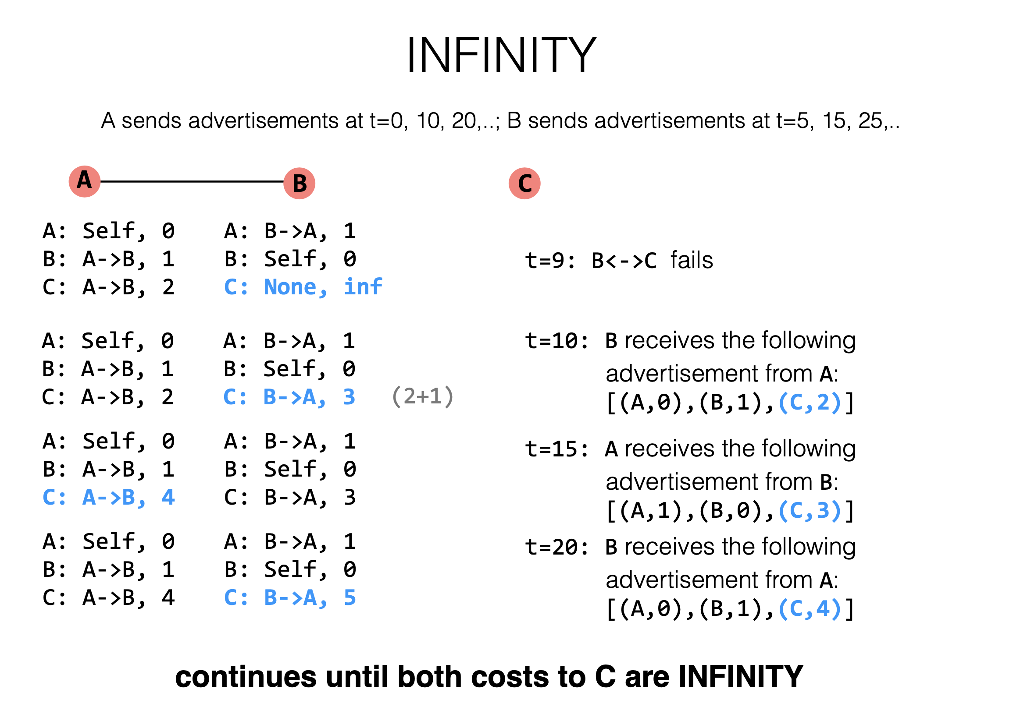

Slide 107
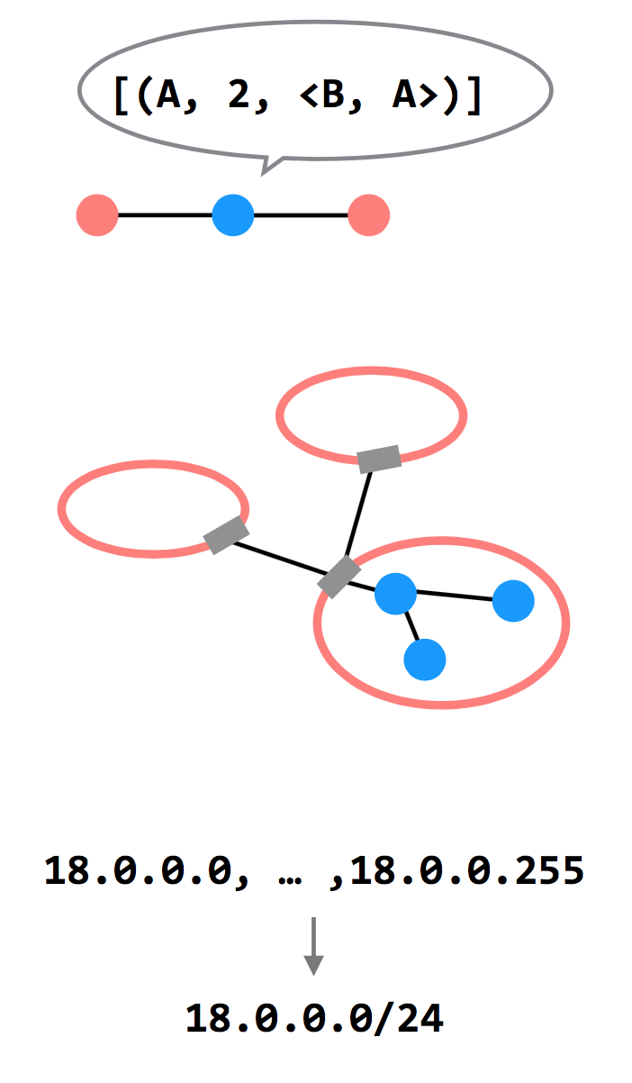
3 Ways to Scale
Path-vector Routing
  Advertisements include the path, to better
  detect routing loops
Hierarchy of Routing
  Route between regions, and then within a
  region
Topological Addressing
  Assign addresses in contiguous blocks to
  make advertisements smaller

Slide 109
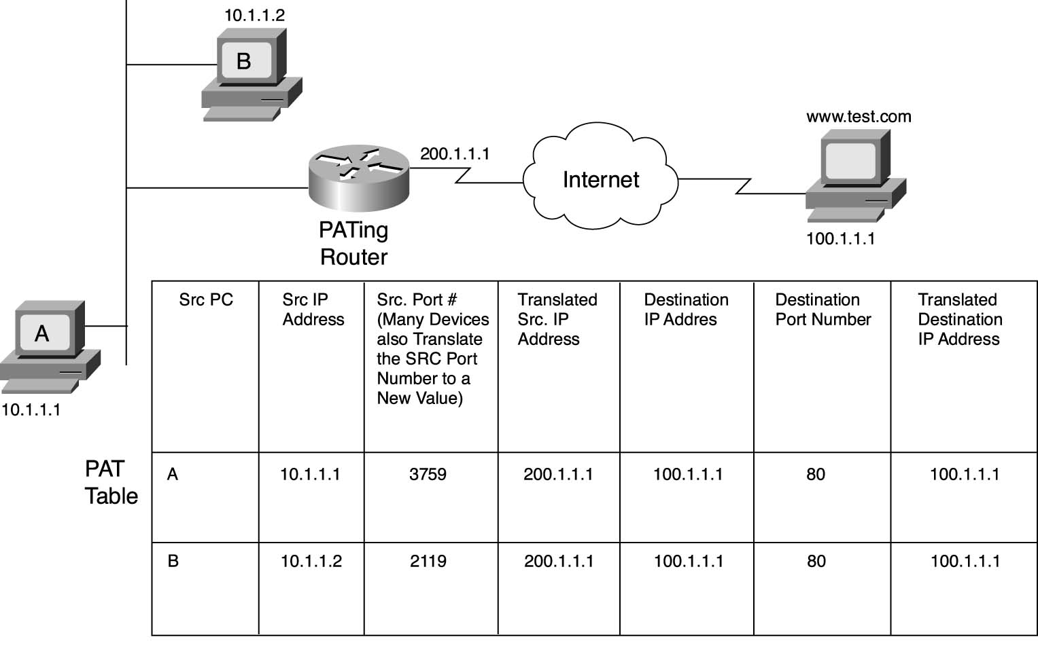
NAT

Slide 111
How to Use socket to Access www.baidu.com ?
You code as if your PC connect directly with Baidu
  Call connect() with Baidu's IP address
But how does the system find next hop?

Slide 112
Putting All Together
App: I want to send a packet to Baidu, here is the packet with Baidu's IP in its header as target IP, and client's IP as source IP (Node-C)
OS: I don't know how to get to Baidu, I'll just send it to the router (gateway). But I cannot change the source IP of the packet, so I'll just change the MAC target address of the packet to the router's MAC address

Slide 113
Putting All Together
The router-1 (gateway): I get a packet with my MAC as target address. Is it my IP? No… So I'll just forward it to next hop, by changing the target MAC address to next hop's MAC address (NAT: change source IP and source port as well)
Router-2: I connect directly to Baidu, I'll just change the target MAC address to Baidu

Slide 114
Spoofed ARP reply
IP:10.0.0.2
MAC:cc:cc:cc:cc
Spoofed ARP reply
IP:10.0.0.2
MAC:cc:cc:cc:cc
switch
Spoofed ARP reply
IP:10.0.0.2
MAC:cc:cc:cc:cc
A
IP:10.0.0.1
MAC:aa:aa:aa:aa
B
IP:10.0.0.2
MAC:bb:bb:bb:bb
Hacker
IP:10.0.0.3
MAC:cc:cc:cc:cc
ARP cache
ARP cache
IP | MAC
10.0.0.2 | bb:bb:bb:bb
IP | MAC
10.0.0.1 | aa:aa:aa:aa

Slide 115
Assurance of End-to-end Protocol
Assurance of at-least-once delivery
Assurance of at-most-once delivery
Assurance of data integrity
Assurance of stream order & closing of connections
Assurance of jitter control
Assurance of authenticity and privacy
Assurance of end-to-end performance

Slide 116
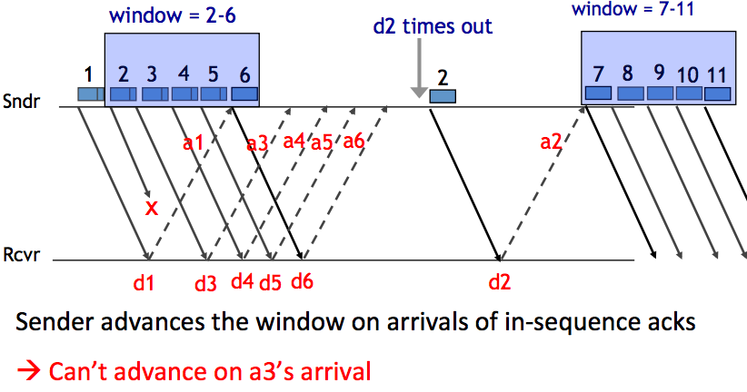
Handling Packet Loss

Slide 117
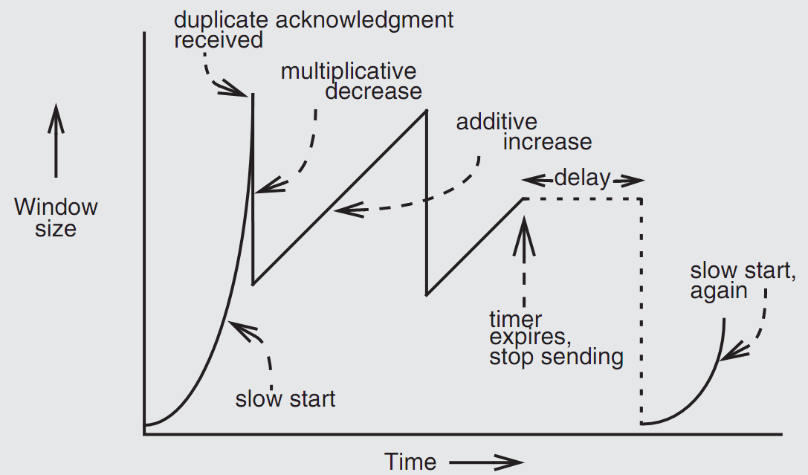
Retrofitting TCP

Slide 118
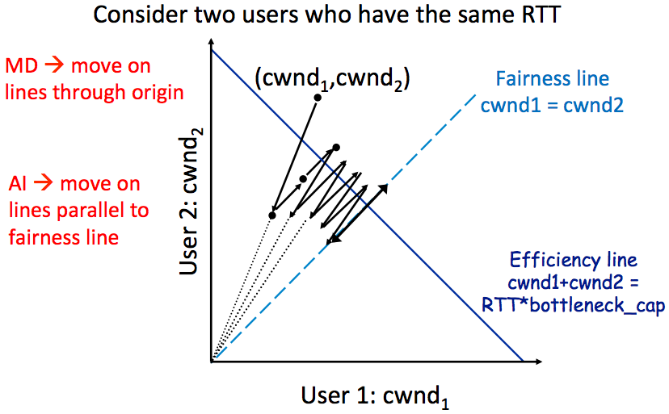
AIMD Leads to Efficiency and Fairness

Slide 119
DNS Hierarchy (a partial view)

Slide 120
DNS Request Process
a.root.net
a.root.net
names.edu
names.edu
NS: for edu
ns.iss.edu
ns.iss.edu
NS: for
Scholarly.edu
ginger.
Scholar.edu
ginger.
Scholar.edu
ginger.
Scholar.edu
AP: for
ginger.Scholar.edu
Name client
Name client
Non-Recursion
Recursion

Slide 121



How Akamai Uses DNS
121
cnn.com (content provider)
DNS TLD server
GET foo.jpg
11
12
Akamai
cluster
Akamai global
DNS server
5
1
2
3
4
6
Akamai regional
DNS server
7
8
9
Nearby
Akamai
cluster
End user
GET /foo.jpg
Host: cache.cnn.com

Slide 122

A DHT in Operation: put()

Slide 123

A DHT in Operation: get()

Slide 124

Lookups take O(log(N)) hops

Slide 125
Failures might cause incorrect lookup
N120
N10
N113
^{Lookup(90)}
N102
N85
N80
N80 doesn't know correct successor, so incorrect lookup

Slide 126
Review: Security

Slide 127
2 Steps towards Building a More Secure System
How to make progress in building a secure system?
  Be clear about goals: "policy"
  Be clear about assumptions: "threat model"

Slide 128

Complete Mediation
Guard typically provides:
  Authentication: is the principal who they claim to be?
  Authorization: does principal have access to perform request on resource?

Slide 129
Example: Unix FS
Resource: files, directories.
Server: OS kernel.
Client: process.
Requests: read, write system calls.
Mediation: U/K bit / system call implementation.
Principal: user ID.
Authentication: kernel keeps track of user ID for each process.
Authorization: permission bits & owner uid in each file's inode.

Slide 130
Salting
username | salt | hash(password | salt)
arya | 5334900209 | c5d2a9ffd6052a27e6183d60321c44c58c3c26cc
jon | 1128628774 | 624f0ffa577011e5704bdf0760435c6ca69336db
Sansa | 8188708254 | 5ee2b8effce270183ef0f4c7d458b1ed95c0cce5
Hodor | 6209415273 | f7e17e61376f16ca23560915b578d923d86e0319
check_password(username, inputted_password)
stored_hash = accounts_table[username]
inputted_hash = hash(inputted_password | salt)
return stored_hash == inputted_hash

Slide 131

TaintDroid
Notes:
This is a figure from the conference paper describing TaintDroid. It shows where, at a high level, the various kinds of taint analysis are done. There are 4 "granularities" of taint analysis used in TaintDroid, including message-level, variable-level, method-level, and file-level.

Slide 132

Trace the Input Data
Notes:
fourxm->tracks is initialized with NULL (see line 107).
If the processed media file contains a strk chunk, the value of current_track is extracted from the user-controlled data of the chunk (see line 166).
If the value of current_track + 1 is less than zero, the heap buffer isn't allocated.
fourxm->tracks still points to memory address NULL.
The resulting NULL pointer is then dereferenced by the user- controlled value of current_track, and four 32-bit values of user- controlled data are assigned to the dereferenced locations (see lines 178–181).
Four user-controlled memory locations can be overwritten with four user-controlled data bytes each.

Slide 133

Diffie-Hellman Key Exchange & Man-in-the-Middle

Slide 134



Slide 135

CFI: Control Flow Integrity

Slide 136
Data Privacy
Will data be vulnerable to misuse?
What's the target of data privacy system?
  Allow data to be used, and
  Protect data from being stolen
What will be introduced?
  Basic data privacy method
    HE, ZKP, sMPC, SS, OT, GC, DP, Enclave/TEE, …
  Systems which try to enforce data privacy

Slide 137
Two Features of Hardware Enclave
1. Isolated execution
Minimal TCB: system software is not trusted
  E.g., OS and hypervisor
Some can prevent physical attacks
  With memory encryption
2. Remote attestation
Prove itself to the end users
Usually use SSL to establish a secure channel over network

Slide 138
Principle of Least Privilege
Deal with bugs / incomplete mediation
  Any component that can arbitrarily access a resource must invoke the guard
  If component has a bug or design mistake, can lead to incomplete mediation
  General plan: reduce the number of components that must invoke the guard
    E.g., arrange for DB server to check permissions on records returned, then security does not depend as much on lookup.cgi

Slide 139
Least Trust
Privileged components are "trusted"
  Trusted is bad: you are in trouble if a trusted component breaks
  Untrusted components are good: does not matter if they break
  Good design has few trusted components, other things do not affect security

Slide 140
Users Make Mistakes
Social engineering, phishing attacks
  How many of you really read the permission acquired by apps during installing?
Good idea: threat model should not assume users are perfect

Slide 141
Cost of Security
Security VS. Availability
  E.g., system requires frequent password changes -> users may write them down
How far should a teacher go to protect the exam file?
  Put the file on a separate computer, to avoid sharing a file system?
  Disconnect computer from the network, to avoid remotely exploitable OS bugs?
  Put the server into a separate machine room?
  Get a guard to physically protect the machine room?
  ...
Good idea: cost of security mechanism should be commensurate with value
Notes:
Most security goals/policies not infinitely valuable, can tolerate attacks.
Security mechanisms can be expensive (e.g., wasted user time).

