Slide 1
 | FES-C |  | PUEBLA |  | GUANAJUATO |  | QUERÉTARO |  | VERACRUZ
PICOS | T R (min) | % TOTAL | T R (min) | % TOTAL | T R (min) | % TOTAL | T R (min) | % TOTAL | T R (min) | % TOTAL
1 | 4.408 | 7.363% | 4.391 | 4.436% | 4.369 | 0.607% | 4.215 | 1.537% | 4.528 | 5.429%
2 | 4.536 | 3.190% | 5.02 | 1.425% | 4.549 | 6.294% | 5.037 | 0.780% | 4.793 | 4.604%
3 | 4.828 | 0.355% | 5.072 | 1.632% | 4.806 | 1.148% | 5.247 | 1.160% | 5.187 | 8.198%
4 | 5.226 | 24.300% | 5.247 | 12.630% | 5.299 | 15.203% | 7.281 | 0.380% | 5.431 | 1.546%
5 | 5.457 | 2.081% | 6.219 | 0.763% | 5.457 | 5.858% | 9.786 | 1.528% | 5.723 | 2.333%
6 | 5.958 | 4.389% | 6.455 | 3.165% | 5.744 | 4.335% | 10.039 | 0.399% | 6.087 | 0.931%
7 | 6.108 | 25.522% | 6.862 | 1.961% | 6.108 | 10.990% | 15.096 | 0.273% | 6.189 | 61.992%
8 | 6.463 | 0.406% | 6.922 | 1.007% | 6.211 | 25.385% | 16.564 | 0.327% | 6.695 | 1.355%
9 | 6.712 | 17.458% | 7.256 | 0.686% | 6.472 | 0.824% | 16.757 | 0.408% | 8.343 | 1.502%
10 | 6.887 | 0.685% | 7.337 | 4.878% | 7.294 | 0.396% | 17.408 | 0.310% | 8.913 | 1.011%
11 | 7.26 | 0.557% | 8.168 | 1.649% | 7.452 | 0.280% | 17.926 | 0.302% | 9.140 | 1.213%
12 | 7.384 | 0.548% | 8.236 | 0.804% | 8.236 | 0.601% | 18.718 | 1.269% | 10.835 | 2.282%
13 | 7.457 | 0.395% | 8.647 | 0.865% | 8.72 | 0.254% | 19.806 | 0.485% | 11.032 | 2.062%
14 | 7.876 | 0.280% | 9.033 | 1.076% | 8.917 | 1.010% | 20.504 | 2.885% | 13.156 | 3.309%
15 | 8.202 | 0.328% | 9.538 | 0.853% | 9.088 | 0.752% | 20.923 | 1.539% | 14.124 | 0.758%
16 | 8.917 | 1.659% | 9.782 | 9.610% | 9.144 | 0.414% | 22.242 | 2.180% | 29.415 | 1.474%
17 | 9.337 | 1.105% | 10.146 | 0.793% | 9.277 | 0.542% | 22.482 | 0.275%
18 | 9.786 | 1.168% | 10.27 | 1.524% | 9.658 | 0.347% | 22.619 | 3.606%
19 | 10.548 | 0.366% | 11.028 | 3.934% | 9.786 | 0.566% | 22.863 | 0.622%
20 | 10.698 | 0.287% | 12.026 | 1.967% | 10.034 | 0.365% | 22.906 | 0.776%
21 | 10.848 | 0.495% | 12.377 | 0.985% | 10.835 | 1.573% | 22.966 | 4.422%
22 | 11.405 | 0.626% | 12.792 | 0.759% | 10.882 | 0.488% | 23.24 | 0.287%
23 | 11.764 | 0.273% | 13.028 | 0.707% | 10.994 | 0.298% | 23.356 | 1.459%
24 | 12.801 | 0.536% | 13.533 | 0.685% | 11.349 | 0.381% | 23.557 | 0.852%
25 | 14.638 | 0.397% | 15.764 | 1.183% | 12.15 | 0.324% | 23.895 | 1.053%
26 | 16.479 | 0.606% | 16.569 | 1.090% | 12.385 | 0.354% | 24.375 | 0.571%
27 | 17.408 | 0.303% | 16.757 | 1.824% | 13.156 | 1.551% | 24.443 | 0.643%
28 | 20.491 | 0.297% | 17.293 | 0.761% | 13.383 | 0.271% | 24.49 | 1.545%
29 | 22.238 | 0.360% | 17.408 | 1.014% | 14.119 | 0.311% | 24.906 | 0.461%
30 | 26.439 | 2.290% | 17.609 | 1.489% | 14.633 | 0.441% | 25.616 | 0.414%
31 | 28.199 | 0.669% | 17.858 | 1.224% | 15.113 | 1.082% | 25.736 | 0.756%
32 | 28.503 | 0.366% | 17.931 | 1.044% | 16.479 | 0.338% | 26.113 | 0.773%
33 | 28.974 | 0.337% | 19.147 | 1.291% | 16.663 | 0.378% | 26.443 | 26.455%
34 |  |  | 19.853 | 0.686% | 20.5 | 0.317% | 26.546 | 2.418%
35 |  |  | 20.093 | 0.923% | 20.924 | 0.309% | 27.385 | 0.514%
36 |  |  | 20.491 | 1.675% | 22.238 | 0.379% | 27.436 | 2.760%
37 |  |  | 20.624 | 0.997% | 22.615 | 0.404% | 28.113 | 1.480%
38 |  |  | 22.213 | 0.834% | 22.966 | 0.422% | 28.207 | 8.753%
39 |  |  | 22.487 | 1.280% | 23.934 | 0.334% | 28.331 | 6.937%
40 |  |  | 23.934 | 1.219% | 24.268 | 0.381% | 28.798 | 5.202%
41 |  |  | 26.97 | 21.926% | 26.469 | 9.272% | 28.974 | 8.463%
42 |  |  | 28.503 | 0.747% | 27.441 | 0.463% | 29.77 | 2.741%
43 |  |  |  |  | 28.113 | 0.263%
44 |  |  |  |  | 28.211 | 1.769%
45 |  |  |  |  | 28.331 | 0.733%
46 |  |  |  |  | 28.515 | 0.275%
47 |  |  |  |  | 28.798 | 0.328%
48 |  |  |  |  | 28.969 | 0.391%
Propóleo
VERACRUZ
Propóleo
QUERÉTARO
Propóleo
FES-C
Propóleo
PUEBLA
Propóleo
GUANAJUATO

Slide 2
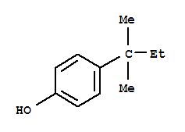
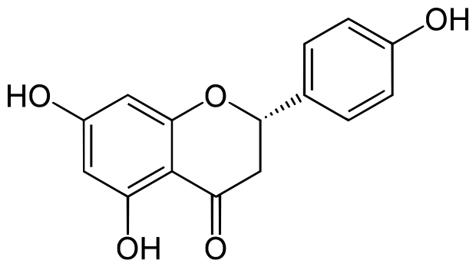
 | Propóleo FES-C |  | Propóleo PUEBLA |  | Propóleo GUANAJUATO |  | Propóleo QUERÉTARO |  | Propóleo VERACRUZ
PICOS | T R (min) | % TOTAL | T R (min) | % TOTAL | T R (min) | % TOTAL | T R (min) | % TOTAL | T R (min) | % TOTAL
1 | 4.408 | 7.363% | 4.391 | 4.436% | 4.369 | 0.607% | 4.215 | 1.537% | 4.528 | 5.429%
2 | 4.536 | 3.190% | 5.02 | 1.425% | 4.549 | 6.294% | 5.037 | 0.780% | 4.793 | 4.604%
3 | 4.828 | 0.355% | 5.072 | 1.632% | 4.806 | 1.148% | 5.247 | 1.160% | 5.187 | 8.198%
4 | 5.226 | 24.300% | 5.247 | 12.630% | 5.299 | 15.203% | 7.281 | 0.380% | 5.431 | 1.546%
5 | 5.457 | 2.081% | 6.219 | 0.763% | 5.457 | 5.858% | 9.786 | 1.528% | 5.723 | 2.333%
6 | 5.958 | 4.389% | 6.455 | 3.165% | 5.744 | 4.335% | 10.039 | 0.399% | 6.087 | 0.931%
7 | 6.108 | 25.522% | 6.862 | 1.961% | 6.108 | 10.990% | 15.096 | 0.273% | 6.189 | 61.992%
8 | 6.463 | 0.406% | 6.922 | 1.007% | 6.211 | 25.385% | 16.564 | 0.327% | 6.695 | 1.355%
9 | 6.712 | 17.458% | 7.256 | 0.686% | 6.472 | 0.824% | 16.757 | 0.408% | 8.343 | 1.502%
10 | 6.887 | 0.685% | 7.337 | 4.878% | 7.294 | 0.396% | 17.408 | 0.310% | 8.913 | 1.011%
11 | 7.26 | 0.557% | 8.168 | 1.649% | 7.452 | 0.280% | 17.926 | 0.302% | 9.140 | 1.213%
12 | 7.384 | 0.548% | 8.236 | 0.804% | 8.236 | 0.601% | 18.718 | 1.269% | 10.835 | 2.282%
13 | 7.457 | 0.395% | 8.647 | 0.865% | 8.72 | 0.254% | 19.806 | 0.485% | 11.032 | 2.062%
14 | 7.876 | 0.280% | 9.033 | 1.076% | 8.917 | 1.010% | 20.504 | 2.885% | 13.156 | 3.309%
15 | 8.202 | 0.328% | 9.538 | 0.853% | 9.088 | 0.752% | 20.923 | 1.539% | 14.124 | 0.758%
16 | 8.917 | 1.659% | 9.782 | 9.610% | 9.144 | 0.414% | 22.242 | 2.180% | 29.415 | 1.474%
17 | 9.337 | 1.105% | 10.146 | 0.793% | 9.277 | 0.542% | 22.482 | 0.275%
18 | 9.786 | 1.168% | 10.27 | 1.524% | 9.658 | 0.347% | 22.619 | 3.606%
19 | 10.548 | 0.366% | 11.028 | 3.934% | 9.786 | 0.566% | 22.863 | 0.622%
20 | 10.698 | 0.287% | 12.026 | 1.967% | 10.034 | 0.365% | 22.906 | 0.776%
21 | 10.848 | 0.495% | 12.377 | 0.985% | 10.835 | 1.573% | 22.966 | 4.422%
22 | 11.405 | 0.626% | 12.792 | 0.759% | 10.882 | 0.488% | 23.24 | 0.287%
23 | 11.764 | 0.273% | 13.028 | 0.707% | 10.994 | 0.298% | 23.356 | 1.459%
24 | 12.801 | 0.536% | 13.533 | 0.685% | 11.349 | 0.381% | 23.557 | 0.852%
25 | 14.638 | 0.397% | 15.764 | 1.183% | 12.15 | 0.324% | 23.895 | 1.053%
26 | 16.479 | 0.606% | 16.569 | 1.090% | 12.385 | 0.354% | 24.375 | 0.571%
27 | 17.408 | 0.303% | 16.757 | 1.824% | 13.156 | 1.551% | 24.443 | 0.643%
28 | 20.491 | 0.297% | 17.293 | 0.761% | 13.383 | 0.271% | 24.49 | 1.545%
29 | 22.238 | 0.360% | 17.408 | 1.014% | 14.119 | 0.311% | 24.906 | 0.461%
30 | 26.439 | 2.290% | 17.609 | 1.489% | 14.633 | 0.441% | 25.616 | 0.414%
31 | 28.199 | 0.669% | 17.858 | 1.224% | 15.113 | 1.082% | 25.736 | 0.756%
32 | 28.503 | 0.366% | 17.931 | 1.044% | 16.479 | 0.338% | 26.113 | 0.773%
33 | 28.974 | 0.337% | 19.147 | 1.291% | 16.663 | 0.378% | 26.443 | 26.455%
34 |  |  | 19.853 | 0.686% | 20.5 | 0.317% | 26.546 | 2.418%
35 |  |  | 20.093 | 0.923% | 20.924 | 0.309% | 27.385 | 0.514%
36 |  |  | 20.491 | 1.675% | 22.238 | 0.379% | 27.436 | 2.760%
37 |  |  | 20.624 | 0.997% | 22.615 | 0.404% | 28.113 | 1.480%
38 |  |  | 22.213 | 0.834% | 22.966 | 0.422% | 28.207 | 8.753%
39 |  |  | 22.487 | 1.280% | 23.934 | 0.334% | 28.331 | 6.937%
40 |  |  | 23.934 | 1.219% | 24.268 | 0.381% | 28.798 | 5.202%
41 |  |  | 26.97 | 21.926% | 26.469 | 9.272% | 28.974 | 8.463%
42 |  |  | 28.503 | 0.747% | 27.441 | 0.463% | 29.77 | 2.741%
43 |  |  |  |  | 28.113 | 0.263%
44 |  |  |  |  | 28.211 | 1.769%
45 |  |  |  |  | 28.331 | 0.733%
46 |  |  |  |  | 28.515 | 0.275%
47 |  |  |  |  | 28.798 | 0.328%
48 |  |  |  |  | 28.969 | 0.391%
Fenol
Fungicida, Bactericida, Sanitizante, Antiséptico y Desinfectante
4-(1,1-Dimetilpropil)fenol
Un derivado del Fenol
Es un Flavonoide de la Toronja
Naringenina
Inhibe la secreción del virus de la hepatitis C (VHC) en células infectadas, según un estudio de la facultad de medicina de la Harvard.

Slide 3
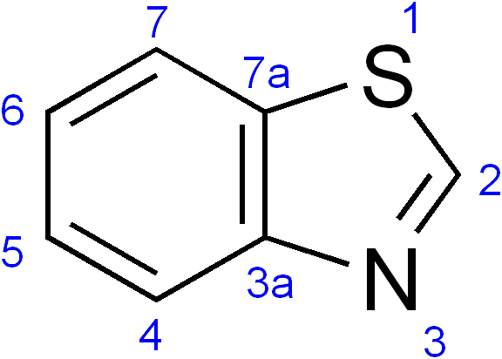
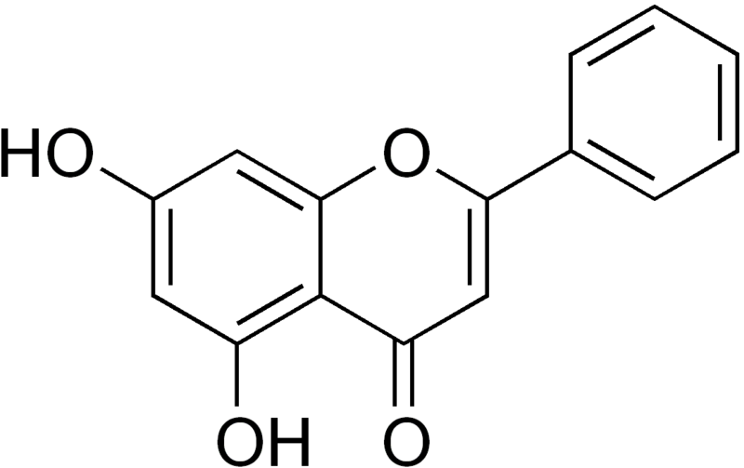
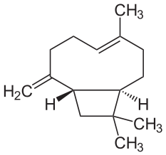
 | FES-C |  | PUEBLA |  | GUANAJUATO |  | QUERÉTARO |  | VERACRUZ
PICOS | T R (min) | % TOTAL | T R (min) | % TOTAL | T R (min) | % TOTAL | T R (min) | % TOTAL | T R (min) | % TOTAL
1 | 4.408 | 7.363% | 4.391 | 4.436% | 4.369 | 0.607% | 4.215 | 1.537% | 4.528 | 5.429%
2 | 4.536 | 3.190% | 5.02 | 1.425% | 4.549 | 6.294% | 5.037 | 0.780% | 4.793 | 4.604%
3 | 4.828 | 0.355% | 5.072 | 1.632% | 4.806 | 1.148% | 5.247 | 1.160% | 5.187 | 8.198%
4 | 5.226 | 24.300% | 5.247 | 12.630% | 5.299 | 15.203% | 7.281 | 0.380% | 5.431 | 1.546%
5 | 5.457 | 2.081% | 6.219 | 0.763% | 5.457 | 5.858% | 9.786 | 1.528% | 5.723 | 2.333%
6 | 5.958 | 4.389% | 6.455 | 3.165% | 5.744 | 4.335% | 10.039 | 0.399% | 6.087 | 0.931%
7 | 6.108 | 25.522% | 6.862 | 1.961% | 6.108 | 10.990% | 15.096 | 0.273% | 6.189 | 61.992%
8 | 6.463 | 0.406% | 6.922 | 1.007% | 6.211 | 25.385% | 16.564 | 0.327% | 6.695 | 1.355%
9 | 6.712 | 17.458% | 7.256 | 0.686% | 6.472 | 0.824% | 16.757 | 0.408% | 8.343 | 1.502%
10 | 6.887 | 0.685% | 7.337 | 4.878% | 7.294 | 0.396% | 17.408 | 0.310% | 8.913 | 1.011%
11 | 7.26 | 0.557% | 8.168 | 1.649% | 7.452 | 0.280% | 17.926 | 0.302% | 9.140 | 1.213%
12 | 7.384 | 0.548% | 8.236 | 0.804% | 8.236 | 0.601% | 18.718 | 1.269% | 10.835 | 2.282%
13 | 7.457 | 0.395% | 8.647 | 0.865% | 8.72 | 0.254% | 19.806 | 0.485% | 11.032 | 2.062%
14 | 7.876 | 0.280% | 9.033 | 1.076% | 8.917 | 1.010% | 20.504 | 2.885% | 13.156 | 3.309%
15 | 8.202 | 0.328% | 9.538 | 0.853% | 9.088 | 0.752% | 20.923 | 1.539% | 14.124 | 0.758%
16 | 8.917 | 1.659% | 9.782 | 9.610% | 9.144 | 0.414% | 22.242 | 2.180% | 29.415 | 1.474%
17 | 9.337 | 1.105% | 10.146 | 0.793% | 9.277 | 0.542% | 22.482 | 0.275%
18 | 9.786 | 1.168% | 10.27 | 1.524% | 9.658 | 0.347% | 22.619 | 3.606%
19 | 10.548 | 0.366% | 11.028 | 3.934% | 9.786 | 0.566% | 22.863 | 0.622%
20 | 10.698 | 0.287% | 12.026 | 1.967% | 10.034 | 0.365% | 22.906 | 0.776%
21 | 10.848 | 0.495% | 12.377 | 0.985% | 10.835 | 1.573% | 22.966 | 4.422%
22 | 11.405 | 0.626% | 12.792 | 0.759% | 10.882 | 0.488% | 23.24 | 0.287%
23 | 11.764 | 0.273% | 13.028 | 0.707% | 10.994 | 0.298% | 23.356 | 1.459%
24 | 12.801 | 0.536% | 13.533 | 0.685% | 11.349 | 0.381% | 23.557 | 0.852%
25 | 14.638 | 0.397% | 15.764 | 1.183% | 12.15 | 0.324% | 23.895 | 1.053%
26 | 16.479 | 0.606% | 16.569 | 1.090% | 12.385 | 0.354% | 24.375 | 0.571%
27 | 17.408 | 0.303% | 16.757 | 1.824% | 13.156 | 1.551% | 24.443 | 0.643%
28 | 20.491 | 0.297% | 17.293 | 0.761% | 13.383 | 0.271% | 24.49 | 1.545%
29 | 22.238 | 0.360% | 17.408 | 1.014% | 14.119 | 0.311% | 24.906 | 0.461%
30 | 26.439 | 2.290% | 17.609 | 1.489% | 14.633 | 0.441% | 25.616 | 0.414%
31 | 28.199 | 0.669% | 17.858 | 1.224% | 15.113 | 1.082% | 25.736 | 0.756%
32 | 28.503 | 0.366% | 17.931 | 1.044% | 16.479 | 0.338% | 26.113 | 0.773%
33 | 28.974 | 0.337% | 19.147 | 1.291% | 16.663 | 0.378% | 26.443 | 26.455%
34 |  |  | 19.853 | 0.686% | 20.5 | 0.317% | 26.546 | 2.418%
35 |  |  | 20.093 | 0.923% | 20.924 | 0.309% | 27.385 | 0.514%
36 |  |  | 20.491 | 1.675% | 22.238 | 0.379% | 27.436 | 2.760%
37 |  |  | 20.624 | 0.997% | 22.615 | 0.404% | 28.113 | 1.480%
38 |  |  | 22.213 | 0.834% | 22.966 | 0.422% | 28.207 | 8.753%
39 |  |  | 22.487 | 1.280% | 23.934 | 0.334% | 28.331 | 6.937%
40 |  |  | 23.934 | 1.219% | 24.268 | 0.381% | 28.798 | 5.202%
41 |  |  | 26.97 | 21.926% | 26.469 | 9.272% | 28.974 | 8.463%
42 |  |  | 28.503 | 0.747% | 27.441 | 0.463% | 29.77 | 2.741%
43 |  |  |  |  | 28.113 | 0.263%
44 |  |  |  |  | 28.211 | 1.769%
45 |  |  |  |  | 28.331 | 0.733%
46 |  |  |  |  | 28.515 | 0.275%
47 |  |  |  |  | 28.798 | 0.328%
48 |  |  |  |  | 28.969 | 0.391%
Benzotiazol
Presente en el panal de las abejas. Es una Flavona.
Biocida
Terpeno
β-Cariofileno
Se le reconoce efecto antiinflamatorio y antioxidante
Antiinflamatorio
Crisina

Slide 4
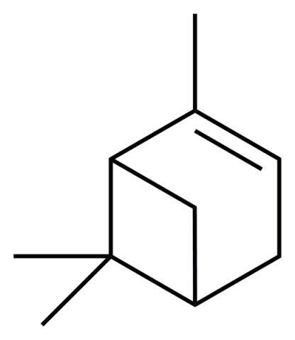
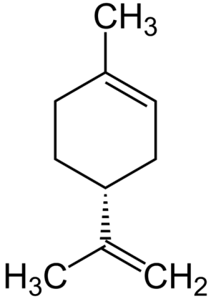
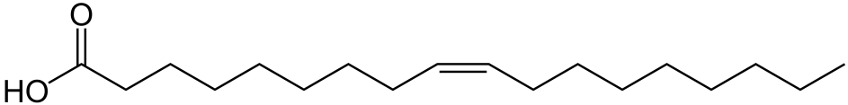
 | FES-C |  | PUEBLA |  | GUANAJUATO |  | QUERÉTARO |  | VERACRUZ
PICOS | T R (min) | % TOTAL | T R (min) | % TOTAL | T R (min) | % TOTAL | T R (min) | % TOTAL | T R (min) | % TOTAL
1 | 4.408 | 7.363% | 4.391 | 4.436% | 4.369 | 0.607% | 4.215 | 1.537% | 4.528 | 5.429%
2 | 4.536 | 3.190% | 5.02 | 1.425% | 4.549 | 6.294% | 5.037 | 0.780% | 4.793 | 4.604%
3 | 4.828 | 0.355% | 5.072 | 1.632% | 4.806 | 1.148% | 5.247 | 1.160% | 5.187 | 8.198%
4 | 5.226 | 24.300% | 5.247 | 12.630% | 5.299 | 15.203% | 7.281 | 0.380% | 5.431 | 1.546%
5 | 5.457 | 2.081% | 6.219 | 0.763% | 5.457 | 5.858% | 9.786 | 1.528% | 5.723 | 2.333%
6 | 5.958 | 4.389% | 6.455 | 3.165% | 5.744 | 4.335% | 10.039 | 0.399% | 6.087 | 0.931%
7 | 6.108 | 25.522% | 6.862 | 1.961% | 6.108 | 10.990% | 15.096 | 0.273% | 6.189 | 61.992%
8 | 6.463 | 0.406% | 6.922 | 1.007% | 6.211 | 25.385% | 16.564 | 0.327% | 6.695 | 1.355%
9 | 6.712 | 17.458% | 7.256 | 0.686% | 6.472 | 0.824% | 16.757 | 0.408% | 8.343 | 1.502%
10 | 6.887 | 0.685% | 7.337 | 4.878% | 7.294 | 0.396% | 17.408 | 0.310% | 8.913 | 1.011%
11 | 7.26 | 0.557% | 8.168 | 1.649% | 7.452 | 0.280% | 17.926 | 0.302% | 9.140 | 1.213%
12 | 7.384 | 0.548% | 8.236 | 0.804% | 8.236 | 0.601% | 18.718 | 1.269% | 10.835 | 2.282%
13 | 7.457 | 0.395% | 8.647 | 0.865% | 8.72 | 0.254% | 19.806 | 0.485% | 11.032 | 2.062%
14 | 7.876 | 0.280% | 9.033 | 1.076% | 8.917 | 1.010% | 20.504 | 2.885% | 13.156 | 3.309%
15 | 8.202 | 0.328% | 9.538 | 0.853% | 9.088 | 0.752% | 20.923 | 1.539% | 14.124 | 0.758%
16 | 8.917 | 1.659% | 9.782 | 9.610% | 9.144 | 0.414% | 22.242 | 2.180% | 29.415 | 1.474%
17 | 9.337 | 1.105% | 10.146 | 0.793% | 9.277 | 0.542% | 22.482 | 0.275%
18 | 9.786 | 1.168% | 10.27 | 1.524% | 9.658 | 0.347% | 22.619 | 3.606%
19 | 10.548 | 0.366% | 11.028 | 3.934% | 9.786 | 0.566% | 22.863 | 0.622%
20 | 10.698 | 0.287% | 12.026 | 1.967% | 10.034 | 0.365% | 22.906 | 0.776%
21 | 10.848 | 0.495% | 12.377 | 0.985% | 10.835 | 1.573% | 22.966 | 4.422%
22 | 11.405 | 0.626% | 12.792 | 0.759% | 10.882 | 0.488% | 23.24 | 0.287%
23 | 11.764 | 0.273% | 13.028 | 0.707% | 10.994 | 0.298% | 23.356 | 1.459%
24 | 12.801 | 0.536% | 13.533 | 0.685% | 11.349 | 0.381% | 23.557 | 0.852%
25 | 14.638 | 0.397% | 15.764 | 1.183% | 12.15 | 0.324% | 23.895 | 1.053%
26 | 16.479 | 0.606% | 16.569 | 1.090% | 12.385 | 0.354% | 24.375 | 0.571%
27 | 17.408 | 0.303% | 16.757 | 1.824% | 13.156 | 1.551% | 24.443 | 0.643%
28 | 20.491 | 0.297% | 17.293 | 0.761% | 13.383 | 0.271% | 24.49 | 1.545%
29 | 22.238 | 0.360% | 17.408 | 1.014% | 14.119 | 0.311% | 24.906 | 0.461%
30 | 26.439 | 2.290% | 17.609 | 1.489% | 14.633 | 0.441% | 25.616 | 0.414%
31 | 28.199 | 0.669% | 17.858 | 1.224% | 15.113 | 1.082% | 25.736 | 0.756%
32 | 28.503 | 0.366% | 17.931 | 1.044% | 16.479 | 0.338% | 26.113 | 0.773%
33 | 28.974 | 0.337% | 19.147 | 1.291% | 16.663 | 0.378% | 26.443 | 26.455%
34 |  |  | 19.853 | 0.686% | 20.5 | 0.317% | 26.546 | 2.418%
35 |  |  | 20.093 | 0.923% | 20.924 | 0.309% | 27.385 | 0.514%
36 |  |  | 20.491 | 1.675% | 22.238 | 0.379% | 27.436 | 2.760%
37 |  |  | 20.624 | 0.997% | 22.615 | 0.404% | 28.113 | 1.480%
38 |  |  | 22.213 | 0.834% | 22.966 | 0.422% | 28.207 | 8.753%
39 |  |  | 22.487 | 1.280% | 23.934 | 0.334% | 28.331 | 6.937%
40 |  |  | 23.934 | 1.219% | 24.268 | 0.381% | 28.798 | 5.202%
41 |  |  | 26.97 | 21.926% | 26.469 | 9.272% | 28.974 | 8.463%
42 |  |  | 28.503 | 0.747% | 27.441 | 0.463% | 29.77 | 2.741%
43 |  |  |  |  | 28.113 | 0.263%
44 |  |  |  |  | 28.211 | 1.769%
45 |  |  |  |  | 28.331 | 0.733%
46 |  |  |  |  | 28.515 | 0.275%
47 |  |  |  |  | 28.798 | 0.328%
48 |  |  |  |  | 28.969 | 0.391%
α-Pineno
α-Pineno
Es un monoterpeno
Limoneno
Monoterpeno.
Da el olor característico a naranjas y limones
Antibiótico, antiinflamatorio
Anticancerígeno, antibacteriano.
Ácido oleico
Acido graso monoinsaturado. Hipotensor

