Slide 1



Understanding the Runtime Stack
The runtime stack, also known as the call stack, is a fundamental data structure in computer programming that plays a crucial role in the execution of code. It is a stack data structure that keeps track of the function calls made by a program, allowing the program to return to the correct location after a function has finished executing.
By Rakesh R

Slide 2
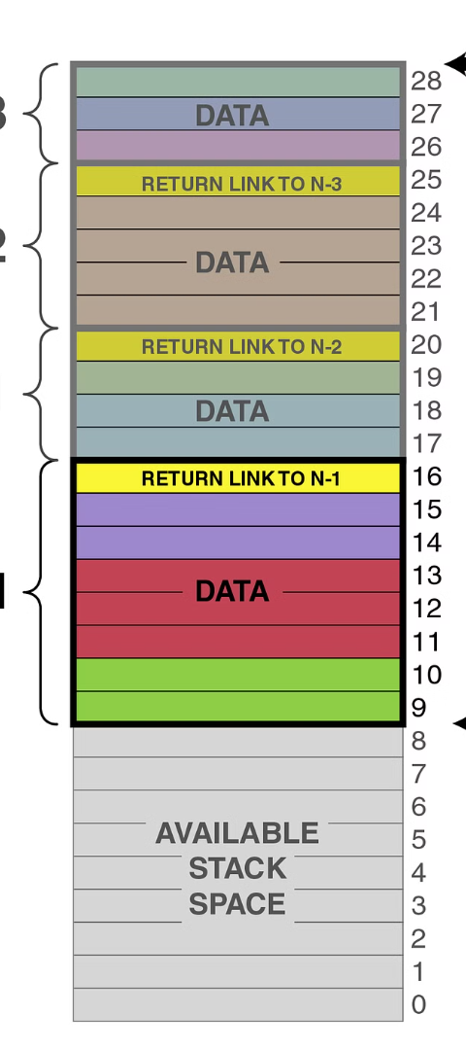
Purpose of the Runtime Stack
1
Function Invocation
The runtime stack is responsible for managing the flow of execution when a program calls functions. It ensures that the program returns to the correct point after a function has completed, allowing the program to continue its execution.
2
Memory Management
The runtime stack also manages the memory allocation for local variables and function parameters. As functions are called and returned, the stack allocates and deallocates memory for the variables used within each function.
3
Error Handling
The runtime stack is crucial for error handling, as it provides a way to trace the sequence of function calls that led to an error. This information is essential for debugging and understanding the flow of a program's execution.

Slide 3
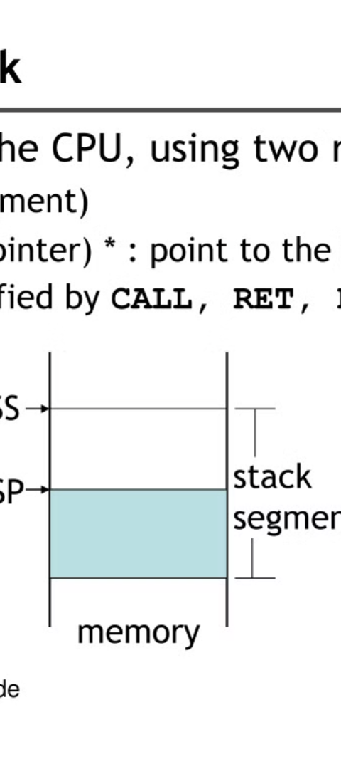

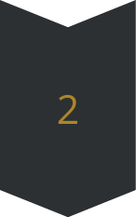
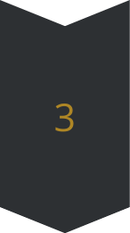
How the Runtime Stack Works
Function Call
When a function is called, a new frame is pushed onto the top of the runtime stack. This frame contains information about the function, including its parameters, local variables, and the return address.
Execution
The program then executes the instructions within the function, using the memory allocated on the stack for its variables and parameters.
Function Return
When the function completes, its frame is popped off the stack, and the program returns to the point from which the function was called, using the stored return address.

Slide 4
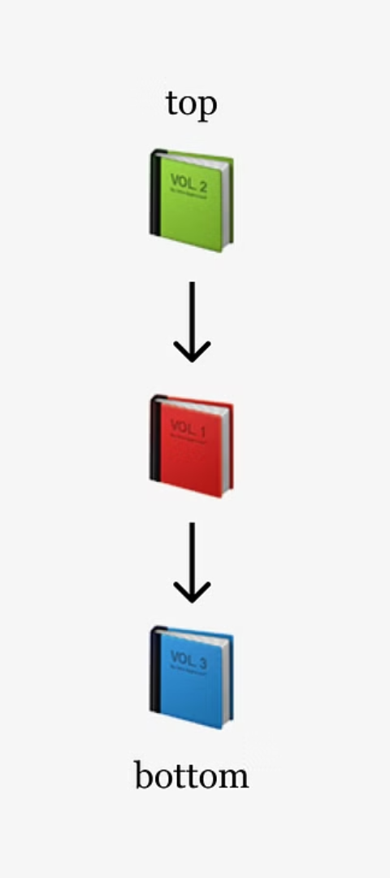
Pushing and Popping Elements
1
Pushing
2
Popping
When a new function is called, its frame is pushed onto the top of the runtime stack. This adds the function's information to the stack, allowing the program to keep track of the order in which functions were called.
When a function completes, its frame is popped off the top of the stack. This removes the function's information from the stack, allowing the program to return to the previous function in the call sequence.
3
LIFO
The runtime stack follows the Last-In-First-Out (LIFO) principle, meaning that the most recently added function is the first one to be removed. This ensures that the program returns to the correct point after a function has completed.

Slide 5
Function Calls and the Runtime Stack
Nested Function Calls
Return Addresses
Stack Frames
When a function calls another function, the new function is pushed onto the runtime stack. This creates a nested call structure, where each function call is represented by a frame on the stack.
The runtime stack stores the return addresses for each function call, allowing the program to return to the correct point after a function has completed. This ensures that the program resumes execution at the correct location.
Each function call is represented by a stack frame, which contains the function's parameters, local variables, and the return address. This information is used to properly manage the function's execution and restore the program's state when the function returns.

Slide 6
Handling Return Values
Return Values
Return Address
When a function completes, it can return a value to the calling function. This return value is stored in a designated location, such as a register or a memory location, so that the calling function can access it.
In addition to the return value, the runtime stack also stores the return address for the function call. This address is used to resume the execution of the calling function after the called function has completed.
Restore State
Error Handling
When a function returns, the runtime stack is used to restore the state of the calling function, including its local variables and parameters. This ensures that the program can continue execution from the correct point.
The runtime stack is also crucial for handling errors and exceptions. When an error occurs, the stack can be used to trace the sequence of function calls that led to the error, which is essential for debugging and resolving the issue.

Slide 7
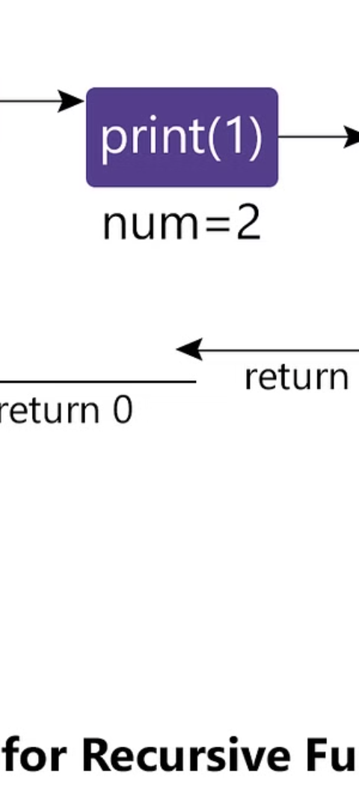
Recursion and the Runtime Stack
1
Recursive Calls
When a function calls itself, it creates a recursive call. The runtime stack is used to manage these recursive calls, pushing a new frame onto the stack for each recursive invocation of the function.
2
Stack Overflow
If a recursive function does not have a proper base case to stop the recursion, it can continue calling itself indefinitely, leading to a stack overflow error. This occurs when the runtime stack runs out of memory to store the function calls.
3
Stack Unwinding
When the recursive function reaches its base case, the runtime stack is used to unwind the function calls, popping each frame off the stack until the initial function call is reached. This allows the program to return to the correct point and continue its execution.

Slide 8




The Importance of Understanding the Runtime Stack
Code Execution
Debugging
Performance Optimization
Learning Programming
Understanding the runtime stack is crucial for comprehending how a program executes code and manages the flow of function calls.
The runtime stack is essential for debugging, as it provides a way to trace the sequence of function calls that led to an error or unexpected behavior.
Understanding the runtime stack can help developers optimize the performance of their programs by identifying and addressing inefficient function calls or memory usage.
Mastering the concepts of the runtime stack is a fundamental step in learning programming and understanding the inner workings of computer systems.

