Slide 1
Executive Presentation
Big Mountain Resort
By Dimitris Stavropoulos – November 2020

Slide 2
What are we trying to solve
Existing Conditions:
350K visitors annually
11 lifts
2 T-bars
1 Magic carpet for novices
Hellfire run, 3.3mi in length
4,464ft base elevation
6,817ft summit
2,353ft vertical drop
$1,540,000 increase in cost this season for additional chair lift
Future Conditions:
Maximum facilities capitalization
Better ticket price value
Reasonable cost cutting
Data Source:
35 states
330 resorts
All in the same market segment

Slide 3
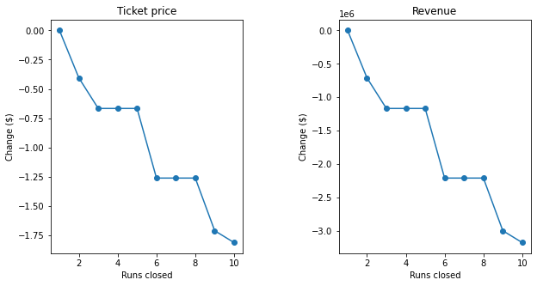
Recommendations
Current price: $81
Modeled price: $95.87
Scenario 1: Permanently close up to 10 of the least used runs.
In depth cost analysis is needed to establish exact number of closures based on modeled ticket price and revenue projected decreases by number of closures.
Scenario 2: Increase vertical drop by 150ft by adding new run and installing chair lift
Ticket price increase by $2 and revenue increase by $3,474,638
Runs
Ticket Price ($)
Revenue ($)
1
0
0
2
-0.4
-710,145
3-5
-0.66
-1,166,666
6-8
-1.26
-2,206,522
9
-1.71
-2,992,754
10
-1.81
-3,170,290

Slide 4
Modeling Results and Analysis
Price Variance
Principal Component Analysis
Correlation
Linear and Random Forest Regression

Slide 5
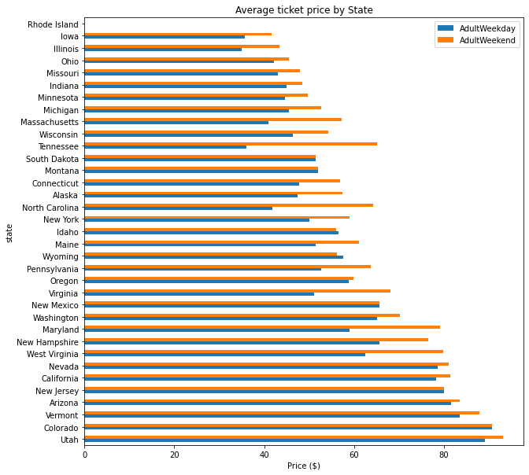
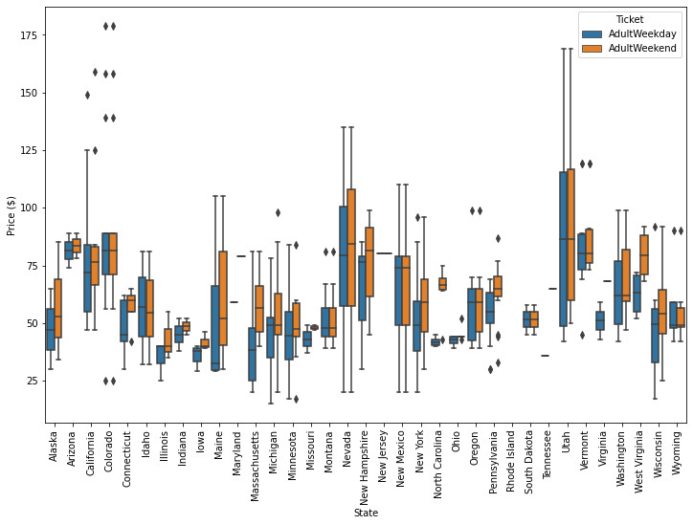
Price Variance
Price range between $25 - $100
California, Colorado and Utah have relatively expensive ticket prices
North Carolina and Virginia have weekend prices much higher than weekday prices
Nevada and Utah show the most range in prices
Montana and South Dakota show small variability and matching weekend and weekday prices

Slide 6
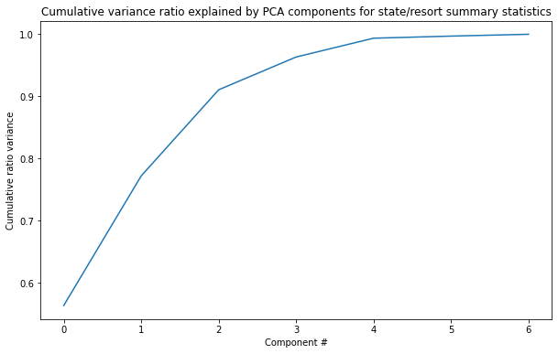
Principal Component Analysis
Principal Component Analysis or PCA is a technique that identifies relationships between features
The first two components seem to account for over 75% of the variance
The first four components seem to account for over 95% of the variance

Slide 7
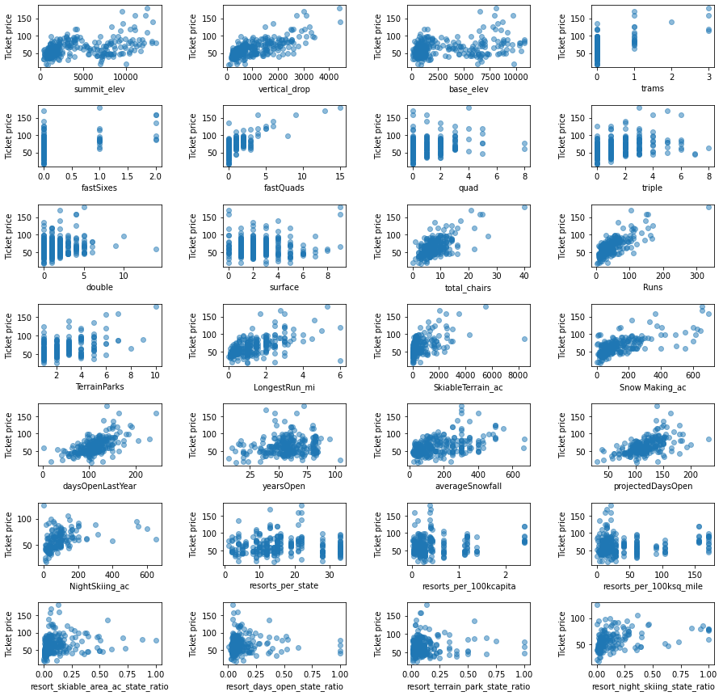
Correlation
Correlation analysis using scatter plots to dive into how ticket price varies with other numeric features. Based on the correlation analysis, the following five features show strong correlation:
fastQuads
Runs
total_chairs
Snow Making_ac
vertical_drop

Slide 8
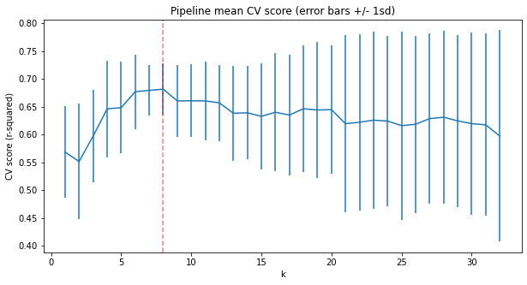
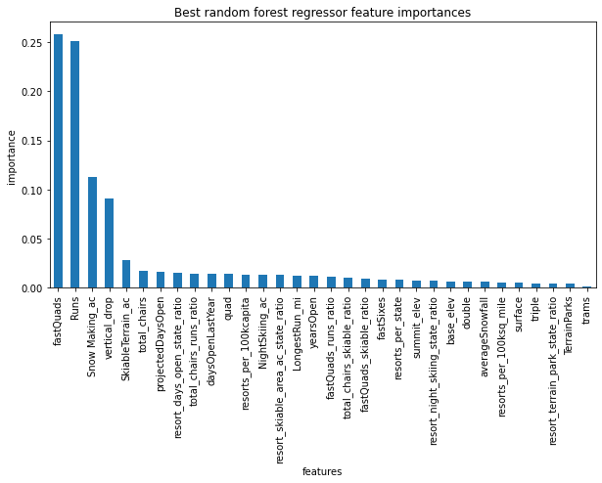
Regression
A linear regression and random forest regression model was used for the price prediction.
The linear model was used initially as a baseline model and to assess the performance and variability compared to the random forest model.
The random forest model has a lower cross-validation mean absolute error by almost $1. It also exhibits less variability.
Furthermore, the dominant features are in common between the two models as well as the correlation analysis.

Slide 9
Conclusion and Summary
Model has established support for ticket price and revenue increase.
Two out of four scenarios support the decrease in cost and increase in ticket price and revenue
Difference of current and modeled ticket price may be due to the fact that all resorts were treated equally without any weighting or segmentation
For a more accurate ticket price picture, price and/or state segmentation may be needed
Additional data:
  Number of day tickets
  Number of weekly passes
Potential price segments:
Low price spreads
Lower averages
Weekend premium charge
Potential state segments:
Retain state information
Montana vs non-Montana

