Slide 1

Atlee Solomon Abraham Valdez Garrett Cookson Margarita Martinez
Batty Biohazard

Slide 2
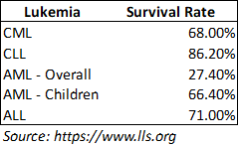
Motivation & Summary
Core Message and theme: Using ML to categorize the type of leukemia.
Summary:
Acute lymphocytic leukemia (ALL) is a type of cancer of the blood and bone marrow — the spongy tissue inside bones where blood cells are made. The word "acute" in acute lymphocytic leukemia comes from the fact that the disease progresses rapidly and creates immature blood cells, rather than mature ones (Mayoclinic)
Acute myeloid leukemia (AML) starts in the bone marrow (the soft inner part of certain bones, where new blood cells are made), but most often it quickly moves into the blood, as well. It can sometimes spread to other parts of the body including the lymph nodes, liver, spleen, central nervous system (brain and spinal cord), and testicles. (Cancer.org)

Slide 3

Question & Data
https://www.kaggle.com/crawford/gene-expression

Slide 4
Coding Approach and Data Munging Techniques:
Pandas
Database
SQLite
ML
Tableau
Molecular Classification of Cancer: Class Discovery and Class Prediction by Gene Expression Monitoring
Science Mag
Python
Keras
Data Cleanup & Exploration
Notes:
To find lat lng we used google api; country names were different so we had to match them by country code. We took the sum of each column to get the total number from origin->plotly

Slide 5
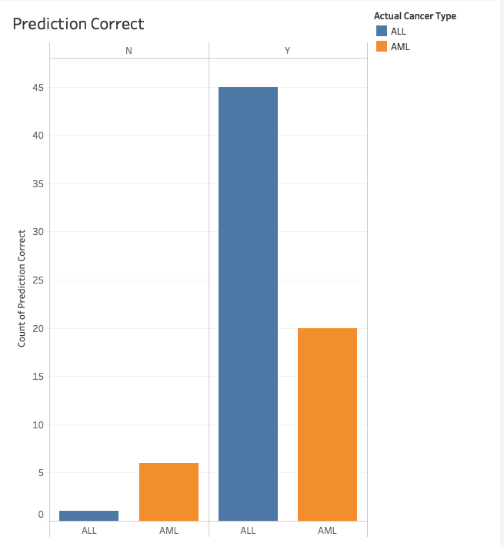
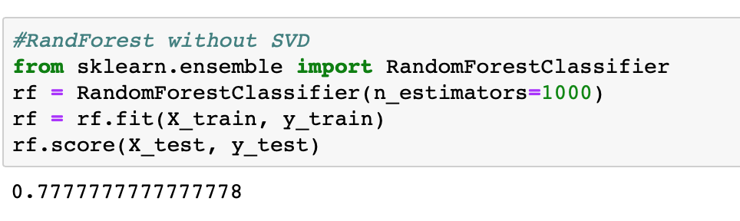
Results shown in Tableau

Slide 6
Post Mortem
Issues:
The paper did not provide the code

