Slide 1
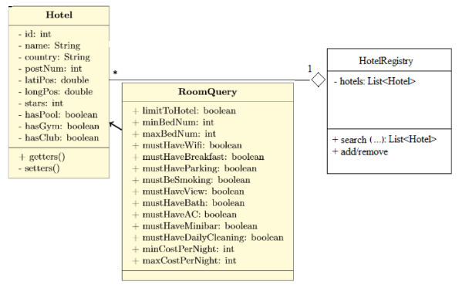
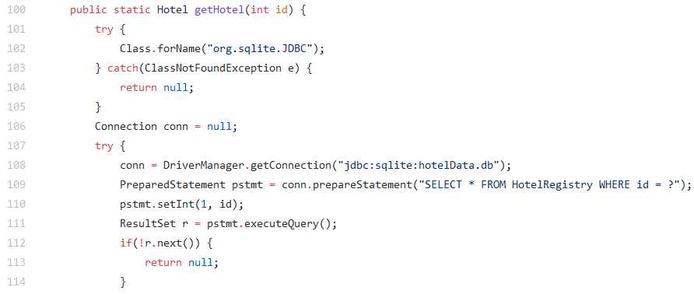
System architecture: Highlights
JDBC code fragment
RoomQuery class that contains
the parameters
Notes:
Ekki sýnt í kóðabútnum: sækjum eigindin úr ResultSettinu r og geymum í þessum breytum.

Slide 2
A look back
Things that went well:
Implementation and coding of classes (UML effective blueprint)
Filtering and sorting using SQL
Things that could have gone smoother:
Communication between teams in cluster (bigger challenge than first thought)
In the future we would communicate expectations better between groups
JDBC/SQLite and JUnit took time because of inexperience

