Slide 1
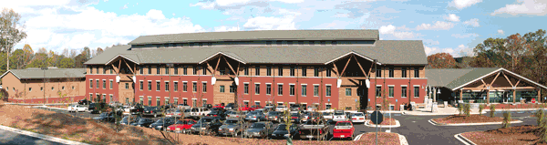
Open source projects and tools in biological research
René Ranzinger
Complex Carbohydrate Research Center
Thursday, April 13
Pharmacy 238
(9:30am-10:45am)

Slide 2
Agenda
Open science and open source
Source code repositories and issue tracking
Software architecture
Documentation
Logging, testing and debugging
Standards and dictionaries/ontologies
Security and code sanitation

Slide 3

Open Science – Whats the deal?
Science (findings) should be
Genuine
Reliable
Reproducable
Accessible
Unfortunatly its not like this mainly due to „Publish or perish“

Slide 4
NO to Open Science
„Science can be misused“
„Too much data to deal with“
„Public will misunderstand the data“
„Nobody wants to look at all the data“

Slide 5
YES to Open Science
„Most research is public funded“
„Research become more reproducable and transparent“
„Allows for better and more rigorous peer-review“
„Larger impact“

Slide 6
Open Science Taxonomy
Open Science
Open Access
Open Data
Open Reproducible Research
...
Open Science Tools
Open Science Guidelines
Open Big Data
Open Data Journals
Open Data Standards
...
Open Repositories
Open Services
Open Workflow Tools
Open source
...
Facilitate Open Science Training for European research (https://www.fosteropenscience.eu)

Slide 7
Open source
“Open source software is software with source code that anyone can inspect, modify, and enhance.” (opensource.com)
WHY open source?
Give something back
Find co-developers
“given enough eyeballs, all bugs are shallow“ (Linus’s Law)
Because Open Science

Slide 8
Who ownes the software?
Employee – usually employer owns the work
Still does not mean it can not be open source
Same goes for UGA
There are exceptions when it comes to research grants
In case of questions:
Office of Research – Technology Transfer
https://research.uga.edu/gateway/researchers/technology-transfer/

Slide 9
Licenses
Allows to define conditions for the use of source code and data
Redistribute of source code
Modification of source code
Source code without license or copyright waiver is copyright protected
A license or waiver is needed to become open source
Insert „ I am not a lawyer disclaimer“ here

Slide 10
How to choose a license - Software
Key criteria: attributation, modification,
commercial use
OSSWatch license differentiator
http://oss-watch.ac.uk/apps/licdiff/
GitHub - Choose an open source license
https://choosealicense.com/
Open Source Initiative license page
https://opensource.org/licenses

Slide 11
How to choose a license - Data
Key criteria: redistribution, attributation,
adaptation, commercial use
Create Commons license
https://creativecommons.org

Slide 12
Agenda
Open science and open source
Source code repositories and issue tracking
Software architecture
Documentation
Logging, testing and debugging
Standards and dictionaries/ontologies
Security and code sanitation

Slide 13
What is a version control system
System to record changes in documents and files
Archiving of versions
Allows restoring previous versions
Allows multiple users to work on the same document and files
Merge changes from multiple developers

Slide 14

How does it work
Update
Version 4
Commit
Version 3
Update
Commit
Version 2
Update
Version 1
Commit
*Centralized version control

Slide 15
Why use version control systems
Collaboration
Multiple people can work on the same project/files at the same time
Properly storing versions
Creating your own version is not so easy. How often do I save, what to copy into the version
Metadata on versions
Description of change, timestamp, user
Restoring previous versions
Easy to go back to an older version with a few clicks
Backup
Because all collaborators and the server have a copy

Slide 16




Common VCS
Centralized system
CVS
Subversion
…
Distributed systems
Git
Mercurial
…
All open source

Slide 17
Public providers
Online systems that usually provide
VCS
Ticket and bug tracking system
Wiki
Webpages
GitHub (https://github.com)
SourceForge (https://sourceforge.net)
Bitbucket (https://bitbucket.org)*
* Allows private repositories

Slide 18
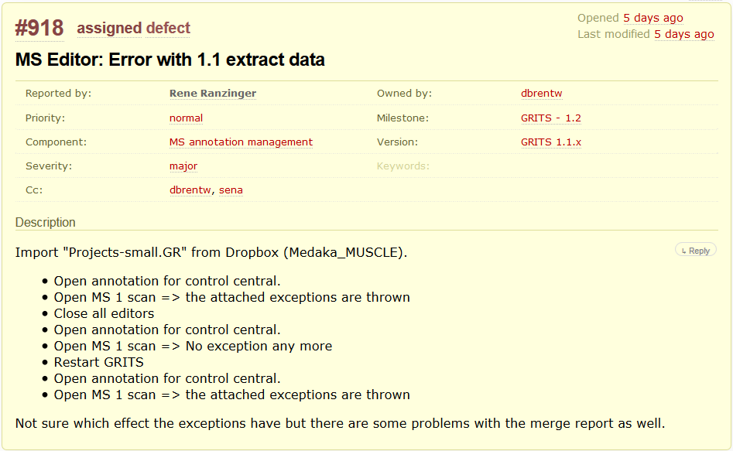
Bug and issue tracking system

Slide 19
Agenda
Open science and open source
Source code repositories and issue tracking
Software architecture
Documentation
Logging, testing and debugging
Standards and dictionaries/ontologies
Security and code sanitation

Slide 20
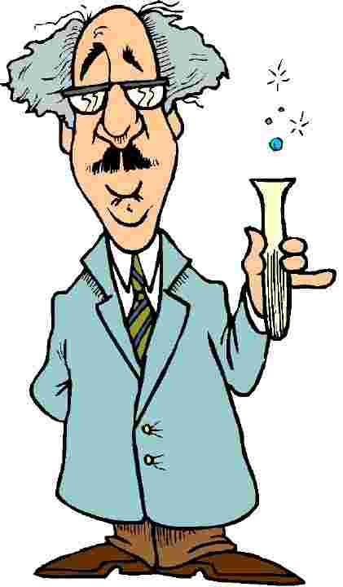
How to provide your software
Command line tools
are cool and easy to create
I can not do programming!
BUT
http://sci.waikato.ac.nz/bioblog/

Slide 21
GUI
Graphical user interface
Time consuming and error-prone
Need good design for
User friedly interfaces
Intuitive interfaces
Program is no longer linear

Slide 22
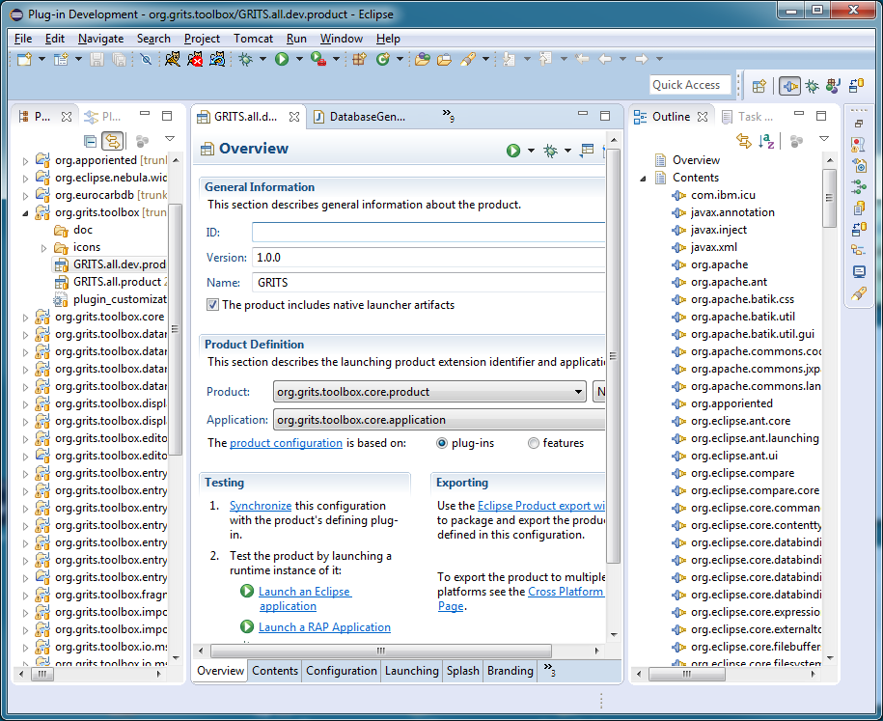
Standalone application
Can be copied/installed on a local computer
May have requirements (e.g. Python interpreter)
May or may not
look like a native
application
Python – TK
https://wiki.python.org/moin/GuiProgramming

Slide 23

Web application
Browser is available on all systems
Requires a server
Transfer of big data files can be problematic
Have to be concerned about security
HTML, CSS, JS
Internet
Web server
Program
e.g. in Python
SQL
Database

Slide 24
Agenda
Open science and open source
Source code repositories and issue tracking
Software architecture
Documentation
Logging, testing and debugging
Standards and dictionaries/ontologies
Security and code sanitation

Slide 25
Why documentation
For yourself
Helps to organize thoughts and code
Understand old code
For others
Quick understanding of the code
Allows modification of the code
Allows using of the code

Slide 26
Variable and function naming
def do (a, b):
c = a + " " + b
return c;
Choose meaningful names for
Variables
Parameters
Functions
def full_name (first_name, last_name):
name = first_name + " " + last_name
return name;

Slide 27
docstring and comments
def full_name (first_name, last_name):
""" Function to concatenate the the first name and the last name to generate
the full name of a person """
# concatenate first and last name and add a space in the middle
name = first_name + " " + last_name
# return the generated name
return name;
Add docstrings to your functions which helps to understand their purpose and constrains
Add comments to code blocks to explain your intention
Writting comments before writting the code helps to organize thoughts and have comments

Slide 28
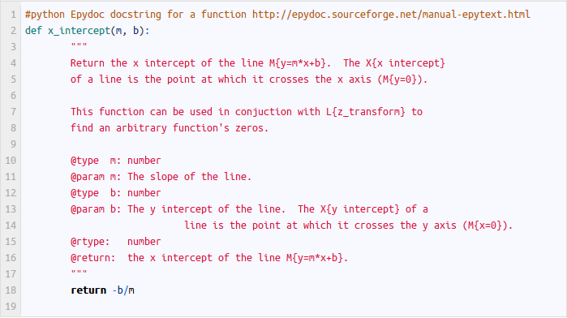
Extended docstring - Epydoc
http://danishmujeeb.com/blog/2012/10/how-to-generate-javadoc-style-documentation-for-python/

Slide 29
User documentation
Commandline tools
„-h“ option
man pages (manual page)
GUI program
Manuals
Quick start guide
Youtube videos
Tons of screenshots

Slide 30
Agenda
Open science and open source
Source code repositories and issue tracking
Software architecture
Documentation
Logging, testing and debugging
Standards and dictionaries/ontologies
Security and code sanitation

Slide 31
Logging
Writting status information into a file
variables, position, warnings, errors
Log level allows filter messages based on their importance
Critical, Error, Warning, Info, Debug
Logfile can help to find and reproduce bugs
https://docs.python.org/3/library/logging.html
...
[INFO ] 2017-04-10 14:38:38,594 [org.grits.toolbox.core.datamodel.GritsDataModelService addEntry 74] - Add Entry: GV010617
[DEBUG] 2017-04-10 14:38:38,607 [org.grits.toolbox.core.utils.WorkspaceXMLHandler writeXmlFile 676] - Operating System is Windows 7
[DEBUG] 2017-04-10 14:38:38,623 [org.grits.toolbox.core.datamodel.io.project.ProjectPropertyReader read 37] - Loading project version "1.0“
...

Slide 32
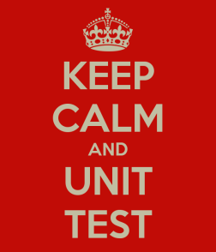
Testing your code
Test a function with a series of automated test case to make sure its (still) working
Helps to find errors caused by changes in dependencies
https://docs.python.org/2/library/unittest.html
divide(5,2.5) == 2?
Test suite
divide(0,2) == 0?
def divide(a, b):
divide(2,0) == Error?

Slide 33
Testing your program
Software developers usually wear blinders (well, sometimes)
After your code is working test your program
What happens if I use a different order
What happens if I combine the new feature with other features
What happens for incorrect input values
„Does not matter if it works for you, it has to run on my computer“
It helps if this is done by somebody else

Slide 34
Debugging
Allow to stop the program during execution
Explore the current state of the program
Content of parameters
Content of variables
Step by step execution of the program
https://wiki.python.org/moin/PythonDebuggingTools

Slide 35
Agenda
Open science and open source
Source code repositories and issue tracking
Software architecture
Documentation
Logging, testing and debugging
Standards and dictionaries/ontologies
Security and code sanitation

Slide 36
Why do we need standards
People tend to create their own formats rather than resuing existing once
They dont know
They only need a subset of the standard
This causes problems if information is transfered between applications
With standards tools and command line application become compatible

Slide 37
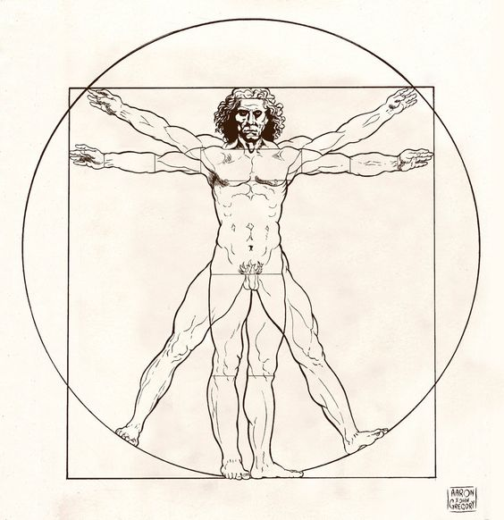
Why do we need dictionaries
Dictionaries allow to control how information is represented
Ontologies can contain
dictionaries but also
other annotations
International Society for
Biocuration
(http://biocuration.org)
Human
Patient
Humen
Homo sapiens
H. sapiens
Man
Homo Sapiens

Slide 38
Minimum information initiatives
Groups trying to define minimum amount of information required to describe an experiment
MIAPE, proteomics experiments
MIAME, gene expression microarray assays
Mainly aimed as guidelines for publication
BUT also useful for bioinformatics
BioSharing portal (https://biosharing.org)

Slide 39
Agenda
Open science and open source
Source code repositories and issue tracking
Software architecture
Documentation
Logging, testing and debugging
Standards and dictionaries/ontologies
Security and code sanitation

Slide 40
HTML injection
Insert malicious HTML code into a webpage
Comment field of a webpage
Nice site, shame nobody is going to see it.
<script>window.location.href="http://some_other webpage</script>
HTML without sanitation
<div class=“user_comment>Nice site, shame nobody is going to see it.
<script>window.location.href="http://some_other webpage</script>
</div>
HTML with sanitation
<div class=“user_comment>Nice site, shame nobody is going to see it.
&lt;script&gt;window.location.href="http://some_other webpage&lt;/script&gt;
</div>

Slide 41
SQL injection
Insert malicous code that medels with your database
sql = 'SELECT * FROM Users WHERE Name ="' + uName + '" AND Pass ="' + uPass + '" '
SELECT * FROM Users WHERE Name ="my name" AND Pass ="my password"
User input: user name and password (uName, uPass) = " or ""="
SELECT * FROM Users WHERE Name ="" or ""="" AND Pass ="" or ""=""

