Slide 1
Music Recommendation System
Project By:
Prateek Kumar

Slide 2
Table of Contents
Problem Statement
Objective
Proposed System
Data Collection
Exploratory Data Analysis
Feature Selection
Feature Transformation
Determining Optimum Clusters Using Elbow Plot
Clustering Songs With K-Means
Building a Content-Based Recommendation System
Validation
Results
References
Future Enhancements
Summary

Slide 3
Problem statement
Online music streaming has become the most used and convenient platform for people to listen to music. However, with the plethora of music available through streaming, it has become difficult for users to find songs they enjoy.
A system which searches through millions of records to filter music based on certain criteria and suggest it to the user would be beneficial
Develop a solution that could take a prospective listener's playlist and provide them with a personalized one composed entirely of songs from their artist roster.​

Slide 4
Objective
Build a music recommendation system that provides a personalized list of songs.
Recommend relevant music based on the users’ music preference and previously heard songs.

Slide 5
Proposed system
CONTENT-BASED RECOMMENDATION SYSTEM
Built using features of songs extracted real-time using Spotify API.
Clustering involves predicting similar songs by grouping the songs into clusters and using cosine similarity.
Recommends songs to the user based on input provided.

Slide 6
DATA SCIENCE WORKFLOW CANVAS
Problem Statement
Data Acquisition
Data Preparation
How do we recommend to a user songs they might like ?
We use Spotipy which is a library for using Spotify API that makes it easy to fetch data and query Spotify’s music catalog. This gives us a collection of music along with its audio features.
Removing null entries
Checking and removing duplicates
Dropping columns that are not helpful
Feature Selection
How do we select similar songs?
Modelling
Model Evaluation
Outcomes/ Predictions
K Means clustering is an unsupervised Machine learning Algorithm
Data points are clustered based on feature similarity.
K Means clustering evaluation metric :
Silhoutte Score
Inertia
Recommend songs that are like the user input songs.
5

Slide 7
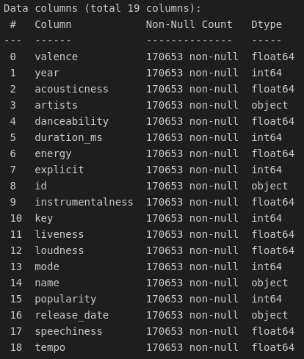
DATA COLLECTION​
Using Spotify web API.​
​
Provides audio features and metadata about songs such as the song’s popularity, tempo, loudness, key, and the year in which it was released. ​
​
We can use this data to build music recommendation systems that recommend songs to users based on both the audio features and the metadata of the songs that they have listened to.​

Slide 8
Exploratory data analysis
Following steps were performed as part of the EDA:
Finding statistical insights.
Data cleaning.
Removing Null entries.
Checking duplicates.
Data Visualization.
Scatter plot
Correlation Matrix
Histograms.
Box Plot etc.
Deriving insights from these visualizations.

Slide 9
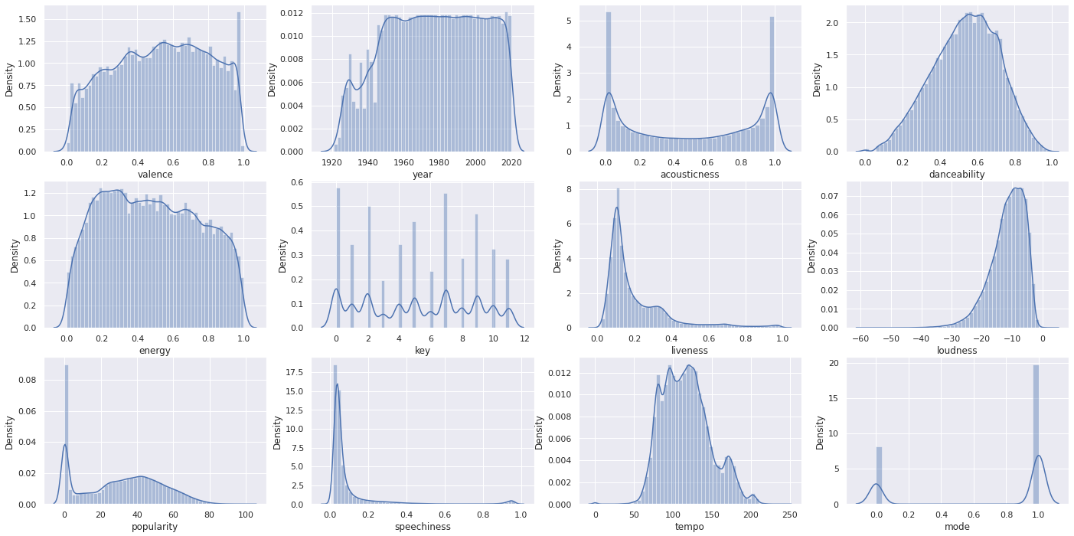
The below Visualization shows the variability of each metric in the dataset

Slide 10
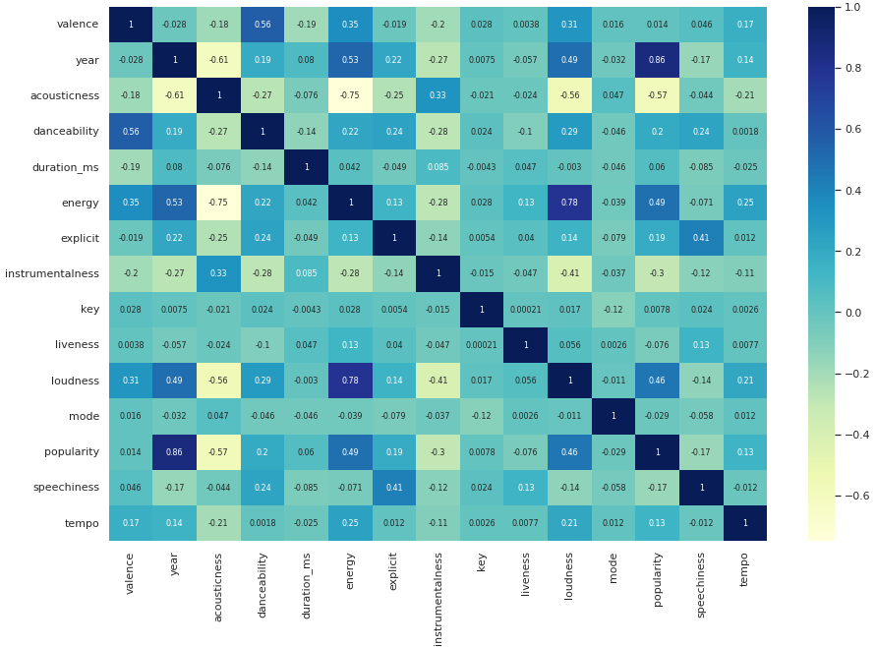
CORRELATION MATRIX
Popularity is highly correlated with the Year Released.
Loudness and energy are highly correlated.
Acousticness is highly negatively correlated with energy, loudness, popularity and year.
Valence and danceability are also positively correlated.
Thus, from this data, it would be better for an artist to create a high-energy song with either electric instruments or electronic songs to have the best chance of generating the most popularity.

Slide 11
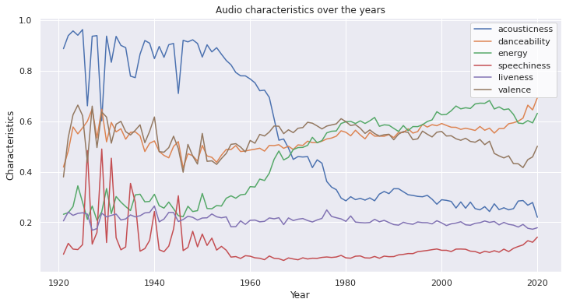
Acoustiness has decreased significantly. Most tracks past 1960 used electric instruments and, especially past the 1980s, electronic sounds. Most recorded music today includes both electric and electronic elements.
Danceability has varied significantly but has stayed mostly at the same level since 1980.
Energy seems to be inversely related to Acoustiness: Was very low in the first part of the century, but then rose significantly after 1960. It looks like it increased even more after 2000 as well.

Slide 12
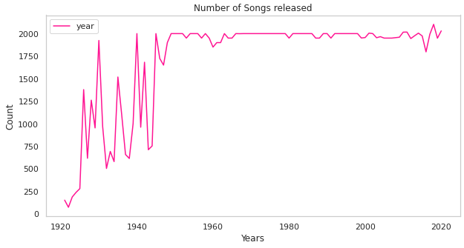
It can be observed that there has been a significant increase in the number of songs released till the mid 20th century and has been constant since then till 2018 where there was a spike.

Slide 13
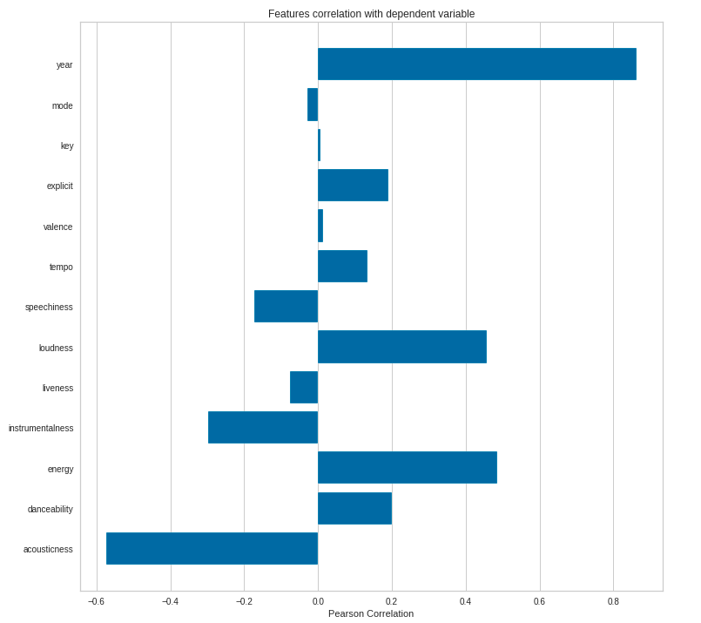
FEATURE SELECTION​
The graph shows five features are with negatively correlated and eight features with positively correlated with popularity.
Id, name and release_date will be dropped as these won't help in model development as they are categorical features.

Slide 14
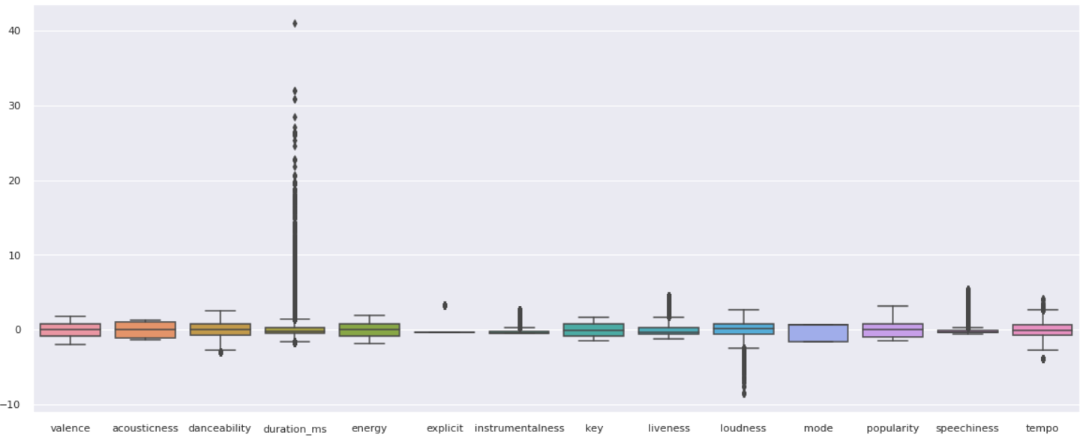
Feature transformation
Dropping of unnecessary features with random values.
Feature engineering i.e., decade imputation, key/mode concatenation.
Standard Scaling for relevant features.

Slide 15
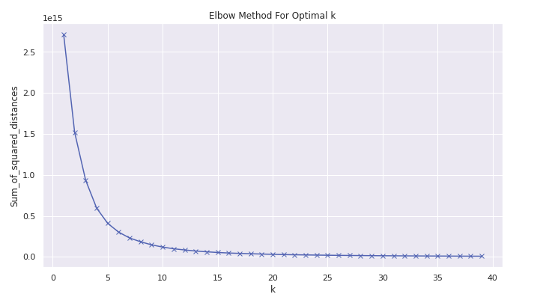
Determining optimum clusters using Elbow plot
Based on this plot, we could roughly determine the majority of the variation by where the elbow occurs (touches the ground) to be around PC5.

Slide 16
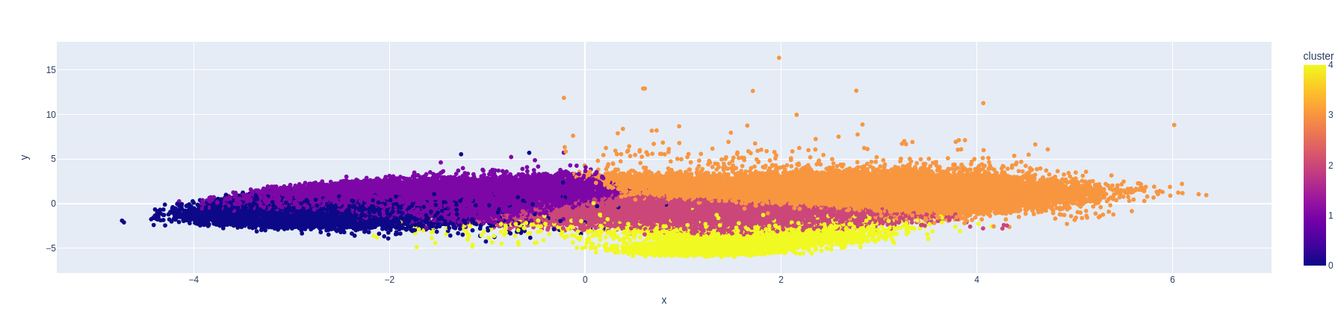
CLUSTERING SONGS WITH K-MEANS
PCA for dimensionality reduction has been used rather than t-SNE because it runs significantly faster.
We find that similar songs tend to be located close to each other and songs within clusters tend to be at least somewhat similar.

Slide 17
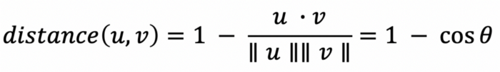
ALGORITHM
Compute the average vector of the audio features for each song the user has listened to.
Find the n-closest data points in the dataset (excluding the points from the songs in the user’s listening history) to this average vector.
Take these n points and recommend the songs corresponding to them.
Distance metric used is Cosine Distance.
Building content-based recommendation systems
If the vectors for two songs are parallel, the angle between them will be zero, meaning the cosine distance between them will also be zero because the cosine of zero is 1.

Slide 18
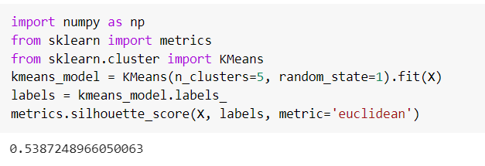
Validating the system
SILHOUETTE COEFFICIENT
Silhouette Coefficient or silhouette score is a metric used to calculate the goodness of a clustering technique. Its value ranges from -1 to 1.
The score is bounded between -1 for incorrect clustering and +1 for highly dense clustering. Scores around zero indicate overlapping clusters.

Slide 19
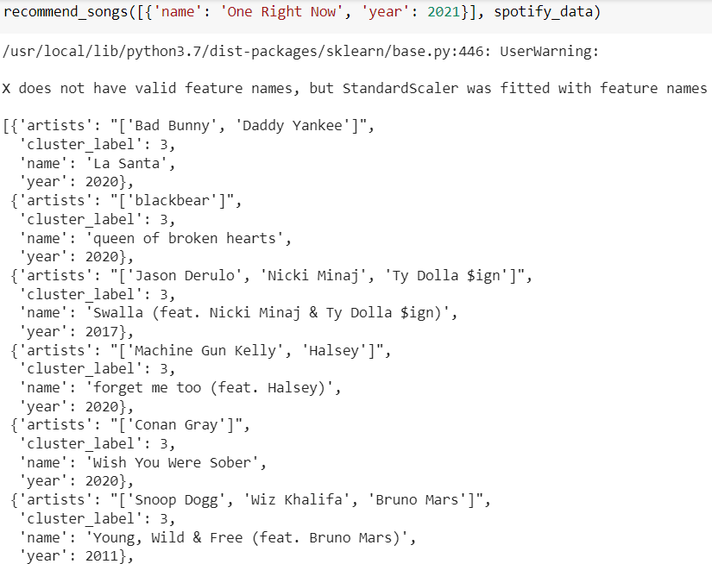
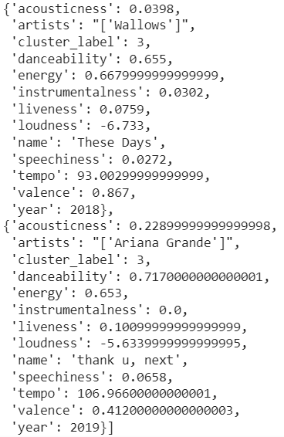
RESULTS
The output below shows the songs recommended for the user input.
We can see similarity in features of the songs being recommended.

Slide 20
FUTURE ENHANCEMENTS
We have performed only content-based filtering due to data constraints
The music recommendation can be improved by performing collaborative filtering using similar user data along with audio feature data for recommendation.
Features can be extracted from audio signal data and can be used as input to neural networks.
We can also use Autoencoders or convolutional neural networks (CNNs) for building better recommendation systems.
Pitch Deck
<number>

Slide 21
REFERENCES
Wang Y. (2020) A Hybrid Recommendation for Music Based on Reinforcement Learning. In: Lauw H., Wong RW., Ntoulas A., Lim EP., Ng SK., Pan S. (eds)
Advances in Knowledge Discovery and Data Mining. PAKDD 2020. Lecture Notes in Computer Science, vol 12084. Springer, Cham.
Gunawan AA, Suhartono D (2019) Music recommender system based on genre using convolutional recurrent neural networks. Procedia Comput Sci 157:99–109
Pichl, Martin et al. “Understanding User-Curated Playlists on Spotify: A Machine Learning Approach.” Int. J. Multim. Data Eng. Manag. 8 (2017): 44-59.
Oord, A. & Dieleman, S. & Schrauwen, B.. (2013). Deep content-based music recommendation. Advances in Neural Information Processing Systems.
Shi, Juanjuan. (2021). Music Recommendation Algorithm Based on Multidimensional Time-Series Model Analysis. Complexity. 2021. 1-11. 10.1155/2021/5579086.
T. Ziemer, P. Kiattipadungkul, and T. Karuchit, “Music recommendation based on acoustic features from the recording studio,” The Journal of the Acoustical Society of America, vol. 148, no. 4, p. 2701, 2020.

Slide 22
SUMMARY
Spotify keeps track of metadata and audio features for songs that we can use to build music recommendation systems. In this project, we demonstrated how we can use this data to build a simple content-based music recommender system with the K-Means clustering and cosine distance metric.

Slide 23
THANK YOU

