Slide 1

Global Quality of Life Analysis
Using Python and Data Visualization
Submitted by:
Satyam Sree Bhargavi- S200471
Atmakuri Hymavathi- S200422
Pallanti Mamatha- S200541
Pangi Jahnavi- S200987
Kongara Harshini- S200998
Guides: K. Meenakshi, M. Ruthuamma

Slide 2
Abstract
This project is about analyzing the quality of life in different countries around the world using Python. The goal of this project is to understand how factors like safety, health care, climate, pollution, cost of living, and purchasing power vary from one country to another. We collected data that shows different quality of life indicators and performed step by-step analysis using Python libraries like Pandas, Matplotlib, and Seaborn. First, we explored the data to understand its structure and cleaned it to remove missing and unwanted values. After that, we grouped and compared the countries based on different factors to see which countries are performing well .

Slide 3
Introduction
In today’s fast-changing and globally connected world, understanding the quality of life in different countries has become an important area of study. The quality of life is influenced by many factors, including safety, health care, pollution, climate, cost of living, and purchasing power. Analyzing these factors helps us compare countries and understand which regions offer better living conditions for people. This study focuses on a detailed analysis of quality of life data using Python’s popular data analysis libraries such as Pandas, Matplotlib, and Seaborn. By using these tools, we aim to uncover patterns and trends that can provide useful insights into how different countries perform in key life quality indicators.

Slide 4
Objectives
->Analyze global living standards using real datasets.
->Use Python libraries for cleaning, analysis, visualization.
->Identify countries with high and low quality of life.
->Develop clear reporting and visualization skills.-

Slide 5
Software and Hardware Requirements
Software Requirements:Operating System: Linux
Programming Language: Python 3.x
Development: Jupyter Notebook
Libraries: Pandas, Matplotlib, Seaborn
Hardware Reqiurements:Processor: 1 GHz or faster
RAM: Minimum 4 GB
Storage: Minimum 2 GB free space
Display: 1024x768 resolution or higher

Slide 6
Advantages
Provides clear global comparisons with visuals.
Practical experience in data handling and analysis.
Uses efficient Python ecosystem.
Extendable for dashboards and advanced reports.
Supports data-driven decisions.

Slide 7
Architecture Flow
1. Data Acquisition
2. Data Preprocessing
3. Exploratory Data Analysis
4. Data Visualization
5. Insight Generation

Slide 8
Methodology
Import libraries and load dataset.
Clean and preprocess data, handle missing values.
Filter, group, and aggregate data.
Visualize key insights with graphs and charts.

Slide 9
Dataset Details
Global Quality of Life Dataset (2021-2024).
Attributes: Country, Quality Index, Safety, Healthcare, Cost, Pollution, etc.
Sources: Kaggle.

Slide 10
Importing libraries
import numpy as np
import pandas as pd
import matplotlib.pyplot as plt
import seaborn as sns

Slide 11
Libraries: Pandas and Matplotlib
Pandas:
Data cleaning, preprocessing, filtering, grouping.
Handling missing data efficiently.
Data transformation and joining/merging datasets.
Matlplotlib:
Visualizes data using bar charts, boxplots, scatter plots.
Enables clear trend visualization across countries.

Slide 12
Libraries: Seaborn
Creates enhanced, appealing visualizations.
Displays statistical insights using heatmaps, pair plots.
Supports categorical data visualization.

Slide 13
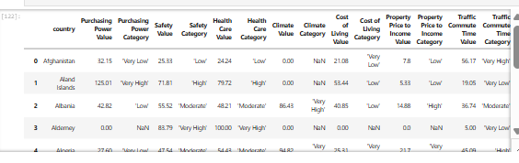
Loading the Dataset
1 df = pd.read_csv(’Quality_of_Life.csv’)
2 df

Slide 14
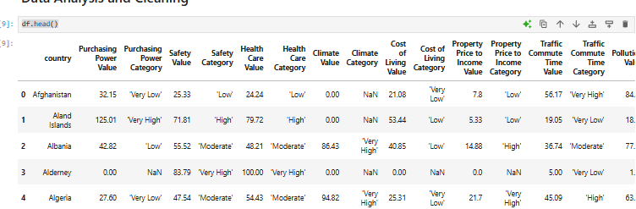
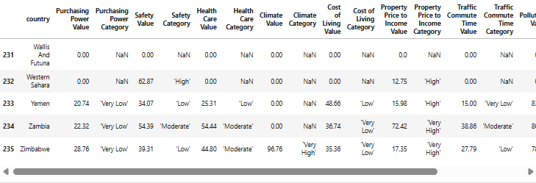
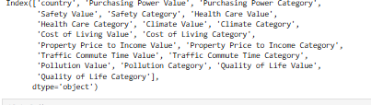
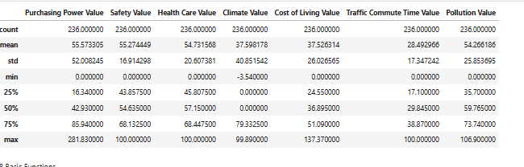
df.head() df.tail()
df.columns df.describe()

Slide 15
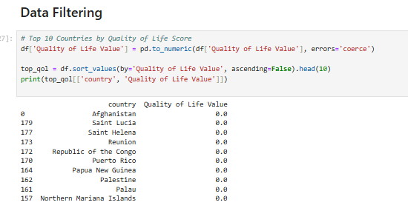
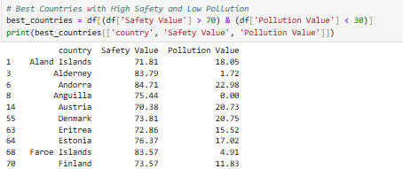
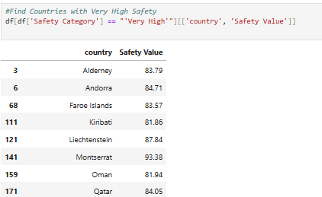
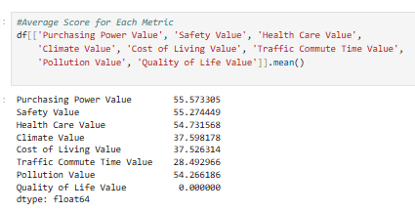

Slide 16
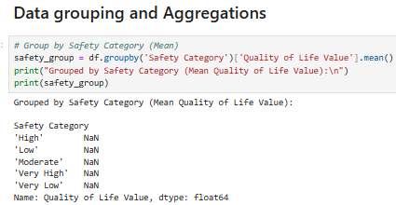
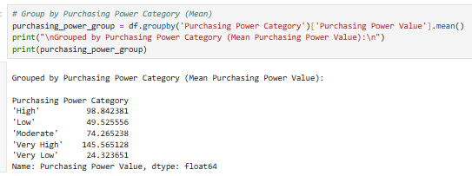
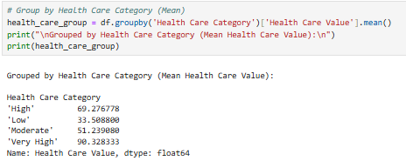
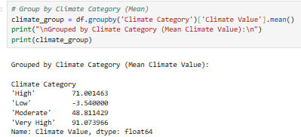

Slide 17
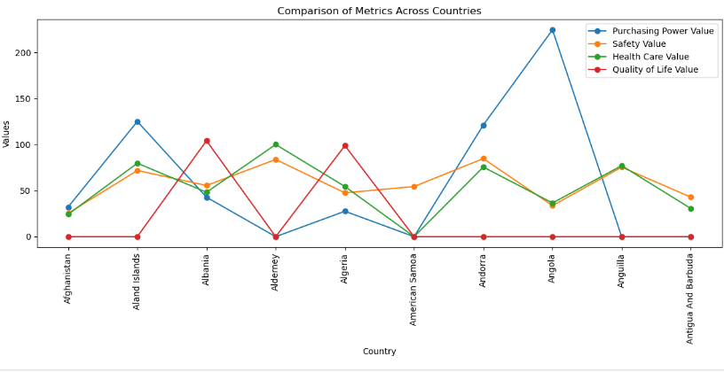

Slide 18
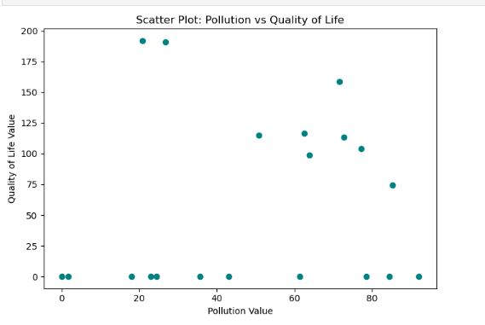

Slide 19
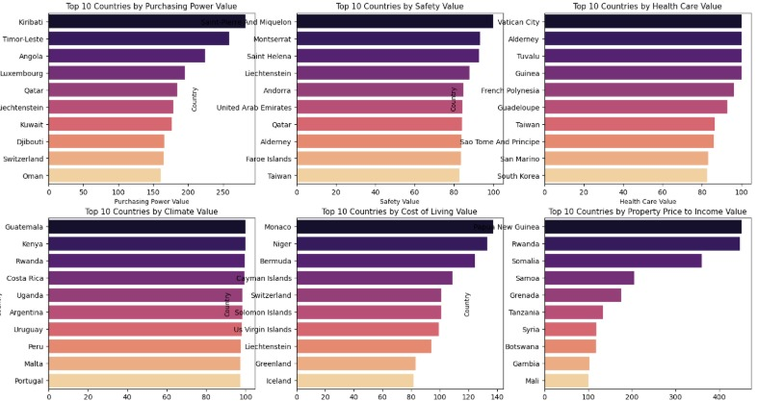

Slide 20
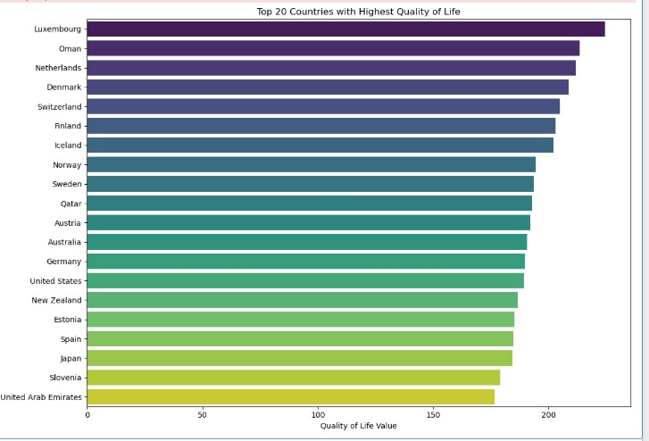

Slide 21
Insights
Identified countries with high safety, low pollution.
Highlighted countries with high cost, low purchasing power.
Found ideal countries with high quality of life and low commute burden.

Slide 22
Conclusion
Analyzed global quality of life using Python libraries.
Visualized comparisons across countries effectively.
Supports researchers and policy makers with insights.
Developed practical data analysis and visualization skills.

Slide 23
References
Analytics Vidhya, Make Me Analyst
Pandas Documentation, APSSDC Materials
World Bank Open Data, Kaggle

Slide 24
Thank You
Thank you for your attention.

