Slide 1
Java 21 Features

Slide 2
Java version releases
Java 21 was released on 19th September 2023. The latest Java version currently available is Java 22 which in released on 19th March 2024.
A preview feature is a new feature whose design, specification, and implementation are complete, but which is not permanent, which means that the feature may exist in a different form or not at all in future JDK releases.
Java version history https://en.wikipedia.org/wiki/Java_version_history

Slide 3
Installations
Download URL : https://www.oracle.com/java/technologies/javase/jdk21-archive-downloads.html
Steps for installing Java21
Extract the Java 21 zip file to a sensible location on your filesystem.
Configure the JAVA_HOME environment variable.
Add the JDK’s \bin directory to the PATH of the OS.
Issue a java -version command to ensure the Java 21 install succeeded.
Use “java -help” to check other options available
Use “where java” to find paths of java executables in machine.

Slide 4
String Templates
This is a preview language feature.
Simplify the writing of Java programs by making it easy to express strings that include values computed at run time.
Improve the security of Java programs that compose strings from user-provided values and pass them to other systems (e.g., building queries for databases) by supporting validation and transformation of both the template and the values of its embedded expressions.
It supports Multi-line template expressions like HTML text, JSON text, and a zone table.

Slide 5
String Templates(cont..)
Syntactically, a template expression resembles a string literal with a prefix. There is a template expression on the second line of this code:
String name = "Joan";
String info = STR."My name is \{name}";
assert info.equals("My name is Joan"); // true
The template expression STR."My name is \{name}" consists of:
A template processor (STR)
A dot character (U+002E), as seen in other kinds of expressions
A template ("My name is \{name}") which contains an embedded expression (\{name}).

Slide 6
String Templates(cont..)
FMT is another template processor defined in the Java Platform. FMT is like STR in that it performs interpolation, but it also interprets format specifiers which appear to the left of embedded expressions.
RAW is a standard template processor that produces an unprocessed StringTemplate object. Template expressions can turn structured text into any object, they’re not just limited to Strings.
StringTemplate st = RAW."\{x} plus \{y} equals \{x + y}";
StringTemplate{ fragments = [ "", " plus ", " equals ", "" ], values = [10, 20, 30] }

Slide 7
Instance Main Methods
The introduction of instance main() methods allows developers to utilize a more dynamic approach to initializing their applications.
Sample Code:
class HelloWorld {
void main() {
System.out.println("Hello, World!");
}
}

Slide 8
The launch protocol
Allow the main method of a launched class to have public, protected, or default (i.e., package) access.
If a launched class contains no static main method with a String[] parameter but does contain a static main method with no parameters, then invoke that method.
If a launched class has no static main method but has a non-private zero-parameter constructor (i.e., of public, protected, or package access), and a non-private instance main method, then construct an instance of the class. If the class has an instance main method with a String[] parameter then invoke that method; otherwise, invoke the instance main method with no parameters.

Slide 9
Instance Main Methods(Cont..)
Instance main() methods should always have a non-private access level. Moreover, the launch protocol follows a specific order to decide which method to use:
a static void main(String[] args) method declared in the launched class
a static void main() method declared in the launched class
a void main(String[] args) instance method declared in the launched class or inherited from a superclass
a void main() instance method

Slide 10
Unnamed Classes
Unnamed classes are a significant feature designed to simplify the learning curve for beginners. It allows methods, fields, and classes to exist without explicit class declarations.
In Java, every class exists within a package and every package within a module. Unnamed classes, however, exist in the unnamed package and unnamed module.
Direct constructions or references by name are impossible, and they don’t define any API accessible from other classes.

Slide 11
Unnamed Classes(Cont..)
private String getMessage() {
return "Hello, World!";
}
void main() {
System.out.println(getMessage());
}
Steps to compile UnNamed classes
javac --release 21 --enable-preview UnNamedClass.java
java --enable-preview UnNamedClass

Slide 12
Record in java
Passing immutable data between objects is one of the most common, but mundane tasks in many Java applications.
Prior to Java 14, this required the creation of a class with boilerplate fields and methods, which were susceptible to trivial mistakes and muddled intentions.
To accomplish this, we create data classes with the following:
private, final field for each piece of data
getter for each field
public constructor with a corresponding argument for each field
equals method that returns true for objects of the same class when all fields match
hashCode method that returns the same value when all fields match
toString method that includes the name of the class and the name of each field and its corresponding value

Slide 13
Record Patterns
Extend pattern matching to destructure instances of record classes, enabling more sophisticated data queries.
Add nested patterns, enabling more composable data queries.

Slide 14
Pattern Matching for switch
Expand the expressiveness and applicability of switch expressions and statements by allowing patterns to appear in case labels.
Allow the historical null-hostility of switch to be relaxed when desired.
Increase the safety of switch statements by requiring that pattern switch statements cover all possible input values.
Ensure that all existing switch expressions and statements continue to compile with no changes and execute with identical semantics.

Slide 15
Sequenced Collections
Java’s collections framework lacks a collection type that represents a sequence of elements with a defined encounter order. It also lacks a uniform set of operations that apply across such collections. These gaps have been a repeated source of problems and complaints.
This feature injects new interfaces into the existing hierarchy, offering a seamless mechanism to access the first and last elements of a collection using built-in default methods. Moreover, it provides support to obtain a reversed view of the collection.
There new interfaces has been introduced
SequencedCollection
SequencedSet
SequencedMap

Slide 16
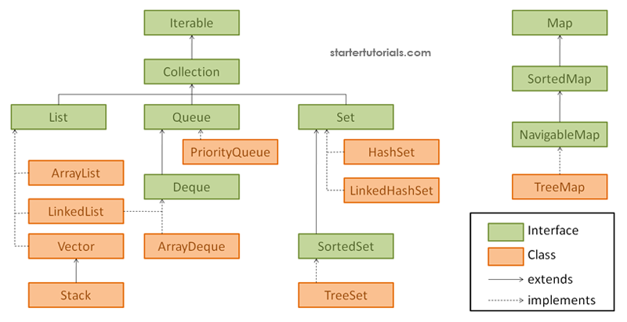

Slide 17
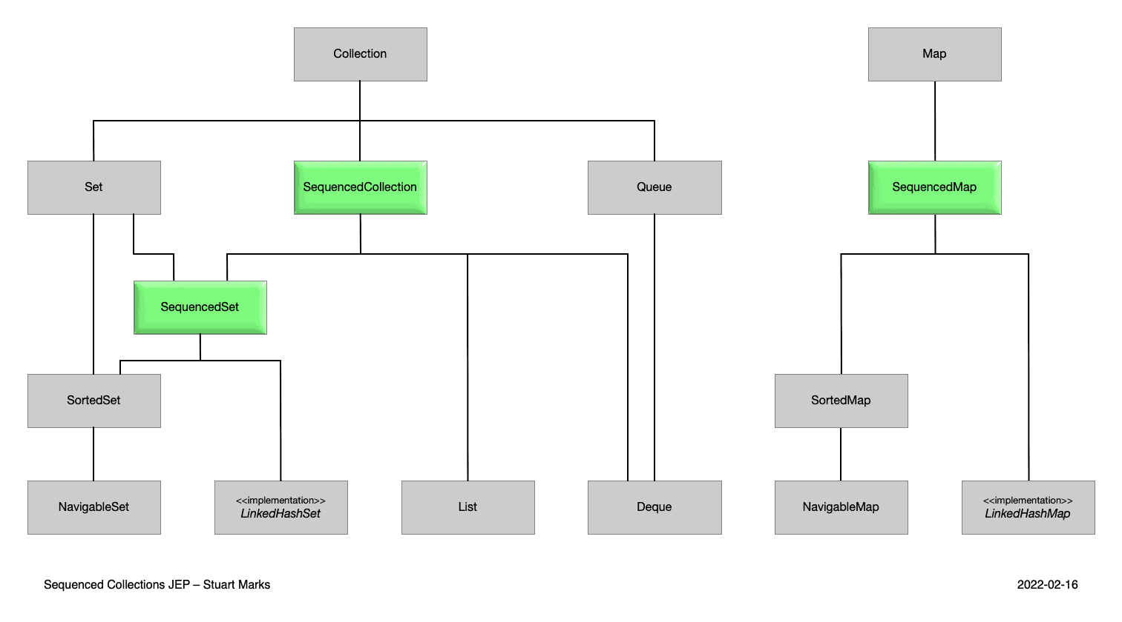

Slide 18
Enhanced Lifecycle Management with HttpClient
The ‘HttpClient’ being ‘AutoCloseable’ means you can now use it within a try-with-resources block in Java, which automatically handles the closing of resources once they are no longer needed.
shutdown()
awaitTermination(Duration duration)
isTerminated()
shutdownNow()
close()

Slide 19
Enhanced Repeated Appending in StringBuilder and StringBuffer
JDK 21 has added methods to ‘java.lang.StringBuilder’ and ‘java.lang.StringBuffer’.
The int codePoint method adds the same character multiple times to StringBuilder or StringBuffer using its Unicode number.
// repeat() function
StringBuilder str = new StringBuilder();
str = str.repeat("Oracle", 10);

Slide 20
Generational ZGC
Garbage collection is the process by which programs try to free up allocated memory that is no longer used by objects. For example, in Java, the garbage collectors are responsible for freeing up the heap memory, which is where Java objects are stored.
Generation GC represents a memory management strategy and works by dividing the objects into different generations, based on the time of allocation, and applying different approaches based on their generation.
The purpose wof Z Garbage Collector as to minimize or eliminate long garbage collection pauses, thereby enhancing application responsiveness and accommodating the growing memory capacities of modern systems.

Slide 21
Generational ZGC(Cont..)
The Generational ZGC aims to improve application performance, extending the existing ZGC by maintaining separate generations for young and old objects.
Its not enabled by default in Java 21, intended to become the default one in a future Java release. Moreover, in an even later release, the non-generational ZGC may be removed entirely.

Slide 22
Virtual Thread
A thread is managed and scheduled by the operating system, while a virtual thread is managed and scheduled by a virtual machine. Now, to create a new kernel thread, we must do a system call, and that’s a costly operation.
Enable server applications written in the simple thread-per-request style to scale with near-optimal hardware utilization.
Enable existing code that uses the java.lang.Thread API to adopt virtual threads with minimal change.
A virtual thread is an instance of java.lang.Thread that runs Java code on an underlying OS thread but does not capture the OS thread for the code's entire lifetime. This means that many virtual threads can run their Java code on the same OS thread, effectively sharing it.

Slide 23
Sealed Classes
Allow the author of a class or interface to control which code is responsible for implementing it.
Provide a more declarative way than access modifiers to restrict the use of a superclass.
Keywords: sealed, non-sealed, permits

Slide 24
Unnamed Patterns and Variables
Unnamed variables are used when we care only about an operation’s side effects. They can be defined as many times as needed, but they cannot be referenced from a later point.
Unnamed patterns have been introduced as an enhancement to Record Pattern Matching. They address an issue quite apparent: we usually don’t need every field in records we deconstruct.
Deconstructing with switch patterns also allows us to ignore fields.

Slide 25
Referenced Links
String Templates(Preview) https://openjdk.org/jeps/430
Unnamed Classes And Instance Main Methods(Preview) https://openjdk.org/jeps/445
Record Patterns https://openjdk.org/jeps/440
Pattern Matching for switch https://openjdk.org/jeps/441
Sequenced Collections https://openjdk.org/jeps/431
Sealed Classes https://openjdk.org/jeps/409
Unnamed Patterns and Variables(Preview) https://openjdk.org/jeps/443
Scoped values(preview) https://openjdk.org/jeps/446
Structured Concurrency (Preview) https://openjdk.org/jeps/453
Generational ZGC https://openjdk.org/jeps/439
Virtual Thread https://openjdk.org/jeps/444

Slide 26
Thank you

