Slide 1

FREELANCE
TECH BLITZ BY MUHAMMAD IMRAN
CREATIVITY WORLD

Slide 2
FREELANCING
It is myself learning about freelancing.
It works like a game.
If you have creativity, you can join freelance.
You can show your creativity to international market.
You can connect international market to get in touch, what people require?

Slide 3


FREELANCE SERVICES

Slide 4
FREELANCE WORK LIKE GAME
You earn score to place the BIDS.
There is a different levels.
You can earn the badges.
You can earn the rewards.

Slide 5
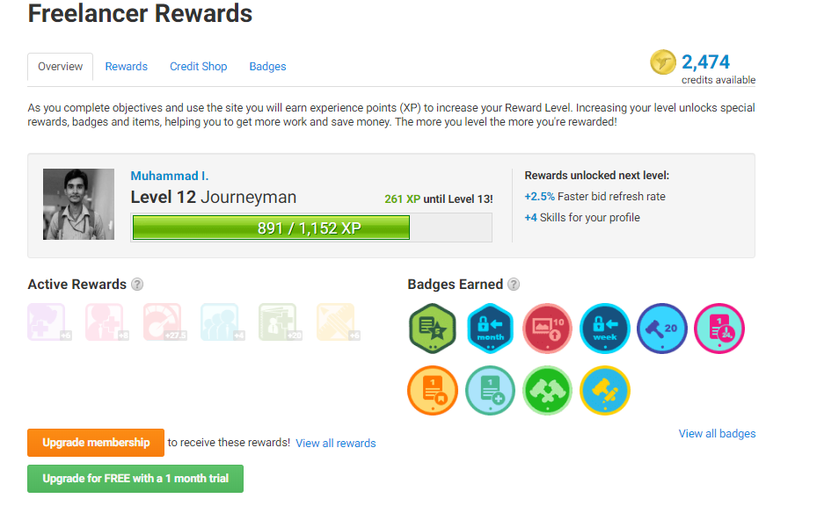
MEMBERSHIP AND REWARDS

Slide 6
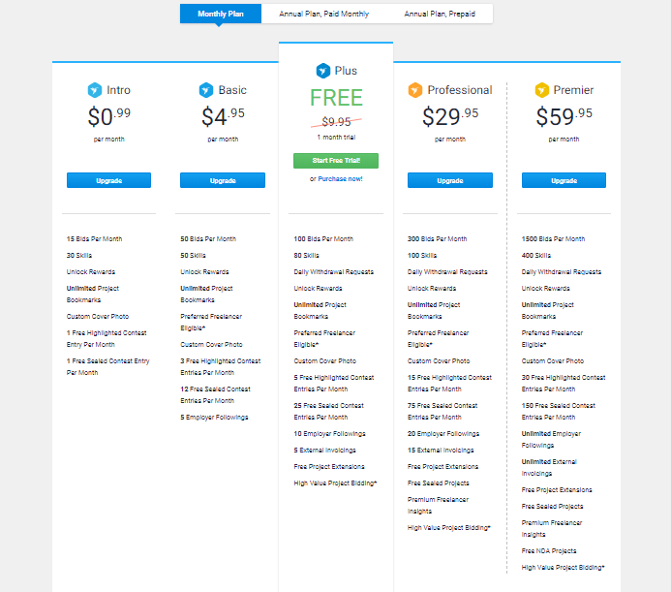
MEMBERSHIP

Slide 7
THANK YOU ☺

