Slide 1
Data structures
Prepared by
Ahmed Tarek

Slide 2
ASCII Table
1
ASCII was the first character set (encoding standard) used between computers on the Internet.

Slide 3
Definition
ASCII stands for the "American Standard Code for Information Interchange".
ASCII is a 7-bit character set containing 128 characters.
It contains the numbers from 0-9, the upper- and lower-case English letters from A to Z, and some special characters.

Slide 4
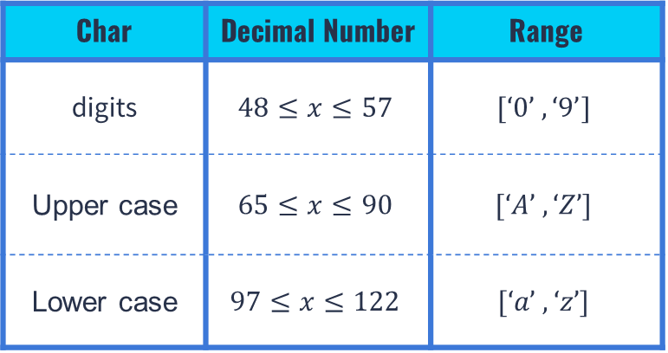
Representation
Char | Decimal Number | Range
digits | $$48≤x≤57$$ | $$[‘0’ , ‘9’]$$
Upper case | $$65≤x≤90$$ | $$[‘A’ , ‘Z’]$$
Lower case | $$97≤x≤122$$ | $$[‘a’ , ‘z’]$$

Slide 5
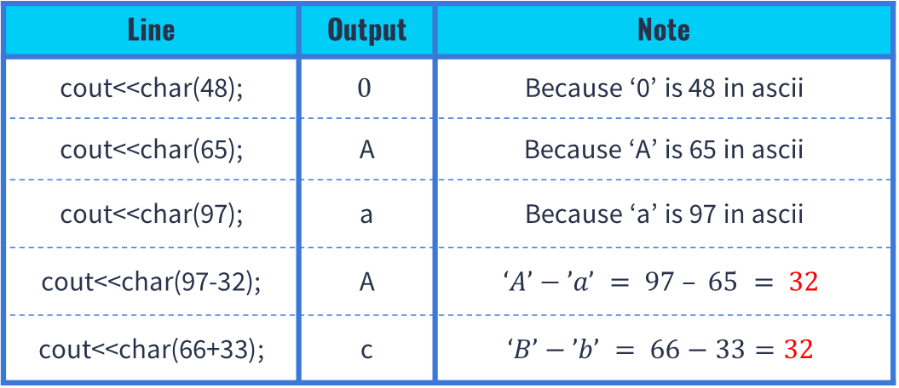
Representation In Decimal
Line | Output | Note
cout<<char(48); | $$0$$ | Because ‘0’ is 48 in ascii
cout<<char(65); | A | Because ‘A’ is 65 in ascii
cout<<char(97); | a | Because ‘a’ is 97 in ascii
cout<<char(97-32); | A | $$‘A’−’a’ = 97 – 65 = 32$$
cout<<char(66+33); | c | $$‘B’−’b’ = 66−33=32$$

Slide 6
Representation In Binary
value | In binary
‘A’ | 0100 0001
‘a’ | 0110 0001
32 | 0010 0000
The difference between ‘A’ and ‘a’ in binary is:
5th bit in binary representation in Upper is 0
5th bit in binary representation in Lower is 1
5th bit in 32 is 1
So, we can use And , Or , Xor to change character

Slide 7
Problems
https://www.codechef.com/problems/SHEC3
https://atcoder.jp/contests/abc218/tasks/abc218_b
7

Slide 8
STL (Standard template library)
2
A data structure is a particular way of organizing data in a computer so that it can be
used effectively.

Slide 9
Definition
The Standard Template Library (STL) : is a set of C++ template classes to provide common programming data structures and functions such as lists, stacks, arrays, etc.
STL has four components :
Containers : Containers or container classes store objects and data.
Functions : The STL includes classes that overload the function call operator.
Iterators : As the name suggests, iterators are used for working upon a sequence of values. They are the major feature that allow generality in STL.

Slide 10
Pair
Pair is used to combine two values that may be different in type.
Pair < data type 1 , data type 2 > name
Pair < int, string> p;
We call values of pair by using first and second
P . First ;
P . Second ;
We can use ( == , != >= , > , < ,<= , =), also we can $sort array of pairs$

Slide 11




Array of Pairs
Pair < int, string> arr[5];
Index | 0 | 1 | 2 | 3 | 4 | 5
Value_ First | 1 | 3 | 12 | 8 | 3 | 2
Value_Second | “Abc” | “Abcd” | “Abdd” | “Ams” | “Aop” | “Dpp”
$$Arr[2] . first = 12$$
$$Arr[2] . second =abdd$$
$$Arr[4] . first =3$$
$$Arr[4] . second =Aop$$

Slide 12
Practice
You will get point $(x , y)$, print index of two points that Euclidian distance between them is maximum .
6
1 0
0 1
2 5
-1 6
0 0
2 5
Input
0 3
Output

Slide 13
Vectors
Vectors are same as dynamic arrays with the ability to resize itself automatically when an element is inserted or deleted, with their storage being handled automatically by the container. Vector elements are placed in contiguous storage so that they can be accessed and traversed using iterators.
Vector<int> vec;
In run-time you can insert or delete element from vector because vector is dynamic array.
1
5
7
0
12
7
46
145

Slide 14
Iterator
Begin()
End()
Memory | 0ffx50 | 0ffx54 | 0ffx52 | 0fzx522 | 0ffo64 | 0ffxa5 | 0fyxa5
Index | 0 | 1 | 2 | 3 | 4 | 5
Value | 1 | 3 | 12 | 8 | 3 | 2

Slide 15
Functions
Function | Meaning
Sort(vec.begin , vec.end) | Sort vector data from first parameter to last parameter
vec.Push_back( 6 ) | It push 6 into a vector from the back
vec.pop_back() | It is used to remove elements from a vector from the back.
vec.insert(vec.begin() + 2 ,6 ) | It will put in index 2 value 6
vec.clear() | It is used to remove all the elements of the vector container
vec.size() | Returns the number of elements in the vector.
vec.Begin() , vec.End() | Returns an iterator pointing to the first element in the vector

Slide 16
Problems
https://cses.fi/problemset/task/1092
https://codeforces.com/contest/545/problem/A
16

Slide 17

THANKS!
Any questions?

