Slide 1
Graphs
Prepared by
Ahmed Tarek

Slide 2
BackTracking
1
Algorithm begins with an empty solution and extends the solution step by step.

Slide 3
Backtracking
A backtracking algorithm begins with an empty solution and extends the solution step by step. The search recursively goes through all different ways how a solution can be constructed.
Recursive Function structure
Base Case − There must be at least one base criteria or condition, such that, when this condition is met the function stops calling itself recursively.
Progressive approach − The recursive calls should progress in such a way that each time a recursive call is made it comes closer to the base criteria.

Slide 4


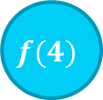







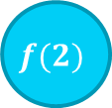


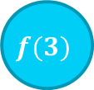


Factorial Tree
$$120$$
$$f(5)$$
?
F(4)
5
$$f(4)$$
$$24$$
?
$$f(2)$$
$$f(2)$$
$$f(2)$$
$$f(3)$$
4
$$f(3)$$
?
$$6$$
$$f(2)$$
$$f(4)$$
$$f(2)$$
$$2$$
3
?
$$f(2)$$
$$f(5)$$
2
$$1$$
Stack

Slide 5
?
-55
?
[1,8]
?
-22
-55
[1,4]
[5,8]
?
?
?
?
12
-22
18
-55
[1,2]
[3,4]
[5,6]
[7,8]
?
100
-22
-10
68
-55
12
?
?
?
?
?
?
?
18
14
12 | 100 | -22 | -10 | 68 | 18 | 14 | -55
1 | 2 | 3 | 4 | 5 | 6 | 7 | 8

Slide 6
Graph Representation
2
How to storing connectivity information between vertices

Slide 7
Unweighted Adjacency Matrix
 | 0 | 1 | 2 | 3 | 4 | 5 | 6
0 | 0 | 1 | 1 | 0 | 0 | 0 | 0
1 | 1 | 0 | 1 | 1 | 0 | 0 | 0
2 | 1 | 1 | 0 | 0 | 1 | 0 | 0
3 | 0 | 1 | 0 | 0 | 1 | 0 | 0
4 | 0 | 0 | 1 | 1 | 0 | 1 | 0
5 | 0 | 0 | 0 | 0 | 1 | 0 | 1
6 | 0 | 0 | 0 | 0 | 0 | 1 | 0
3
4
5
1
2
6
0

Slide 8
Weighted Adjacency Matrix
4
 | 0 | 1 | 2 | 3 | 4 | 5 | 6
0 | 0 | -2 | 9 | 0 | 0 | 0 | 0
1 | -2 | 0 | 2 | 7 | 0 | 0 | 0
2 | 9 | 2 | 0 | 0 | 3 | 0 | 0
3 | 0 | 7 | 0 | 0 | 12 | 0 | 0
4 | 0 | 0 | 3 | 12 | 0 | 4 | 0
5 | 0 | 0 | 0 | 0 | 4 | 0 | 8
6 | 0 | 0 | 0 | 0 | 0 | 8 | 0
3
12
4
5
7
3
8
1
2
2
6
-2
9
0

Slide 9
Directed Adjacency Matrix
 | 0 | 1 | 2 | 3 | 4 | 5 | 6
0 | 0 | 1 | 1 | 0 | 0 | 0 | 0
1 | 0 | 0 | 1 | 1 | 0 | 0 | 0
2 | 0 | 0 | 0 | 0 | 0 | 0 | 0
3 | 0 | 0 | 0 | 0 | 1 | 0 | 0
4 | 0 | 0 | 1 | 0 | 0 | 1 | 0
5 | 0 | 0 | 0 | 0 | 0 | 0 | 1
6 | 0 | 0 | 0 | 0 | 0 | 0 | 0
3
4
5
1
2
6
0

Slide 10
Unweighted Edge List
3
4
5
1
2
6
0
(0,1)
(0,2)
(1,0)
(2,0)
(1,2)
(2,1)
(1,3)
(3,1)
(2,4)
(4,2)
(4,5)
(5,4)
(6,5)
(5,6)

Slide 11
Unweighted Adjacency Matrix
0
1
2
3
4
5
6
1 | 2
3
4
5
2 | 3
4 | 1
1
2
6
1 | 4
2 | 3 | 5
0
4 | 6
5

Slide 12
Weighted Adjacency Matrix
4
0
1
2
3
4
5
6
(1,-2) | (2,9)
3
12
4
5
(2,2) | (3,7)
7
3
8
(4,3) | (1,2)
1
2
2
6
(1,7) | (4,12)
-2
9
(2,3) | (3,12) | (5,4)
0
(4,4) | (6,8)
(5,8)

Slide 13
Directed Adjacency Matrix
0
1
2
3
4
5
6
1 | 2
3
4
5
2 | 3
1
2
6
4
2 | 5
0
6

Slide 14
Graph Traversal
3
algorithm for traversing a graph. Starting from a distinguished source vertex

Slide 15
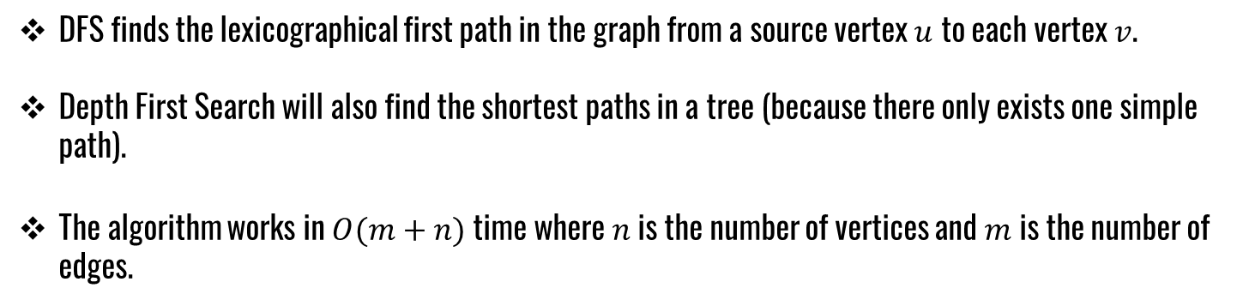
Depth First Search (DFS)
DFS finds the lexicographical first path in the graph from a source vertex $u$ to each vertex $v$.
Depth First Search will also find the shortest paths in a tree (because there only exists one simple path).
The algorithm works in $O(m+n)$time where $n$is the number of vertices and $m$ is the number of edges.

Slide 16


Depth First Search (DFS)
2
2
2
F(4)
1
1
1
8
8
8
$$f(2)$$
$$f(2)$$
$$f(2)$$
3
F(2)
3
7
3
F(9)
7
7
F(0)
$$f(2)$$
$$f(2)$$
$$f(2)$$
F(8)
F(4)
F(6)
9
$$f(2)$$
9
9
$$f(2)$$
$$f(2)$$
F(3)
F(7)
F(5)
0
$$f(2)$$
0
3
0
5
4
5
F(1)
4
4
6
6
6
1
1
1
0 | 0 | 0 | 0 | 0 | 0 | 0 | 0 | 0 | 0
0 | 1 | 2 | 3 | 4 | 5 | 6 | 7 | 8 | 9
1
1
1
1
1
1
1

Slide 17




Breadth First Search (BFS)
2
2
2
F(4)
1
1
1
8
$$f(2)$$
8
8
$$f(2)$$
F (1)
$$f(2)$$
F(3)
$$f(2)$$
F(2)
3
F(8)
3
7
3
7
7
F(9)
F(5)
F(6)
9
9
9
F(0)
F(7)
F(4)
0
0
5
0
5
4
5
4
4
6
6
6
0 | 0 | 0 | 0 | 0 | 0 | 0 | 0 | 0 | 0
0 | 1 | 2 | 3 | 4 | 5 | 6 | 7 | 8 | 9
1
1
1
1
1
1
1
1
1
1

Slide 18
THANKS!
Any questions?

