Slide 1
BitMasks

Slide 2







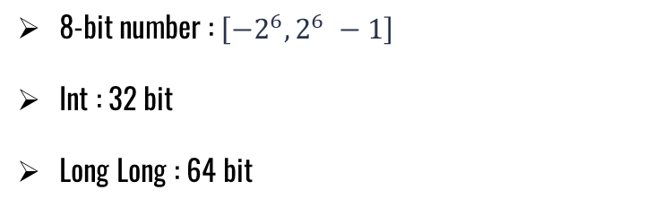
Binary Representation
$$2^{6}$$
$$2^{4}$$
$$2^{5}$$
$$2^{3}$$
$$2^{2}$$
$$2^{1}$$
$$2^{0}$$
0 1 0 1 1 0 0 1
Sign
Value
$$2^{6}+2^{4}+2^{3}+2^{0}=89$$
8-bit number : $\left[−2^{6},2^{6} −1\right]$
Int : 32 bit
Long Long : 64 bit

Slide 3
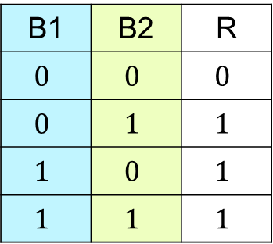

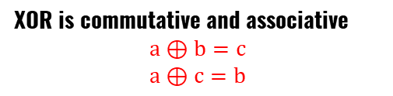


Bitwise Operations
AND &
OR |
XOR $⊕$
B1 | B2 | R
$$0$$ | $$0$$ | $$0$$
$$0$$ | $$1$$ | $$0$$
$$1$$ | $$0$$ | $$0$$
$$1$$ | $$1$$ | $$1$$
B1 | B2 | R
$$0$$ | $$0$$ | $$0$$
$$0$$ | $$1$$ | $$1$$
$$1$$ | $$0$$ | $$1$$
$$1$$ | $$1$$ | $$1$$
B1 | B2 | R
$$0$$ | $$0$$ | $$0$$
$$0$$ | $$1$$ | $$1$$
$$1$$ | $$0$$ | $$1$$
$$1$$ | $$1$$ | $$0$$
XOR is commutative and associative
$$a⊕b=c$$
$$a⊕c=b$$

Slide 4
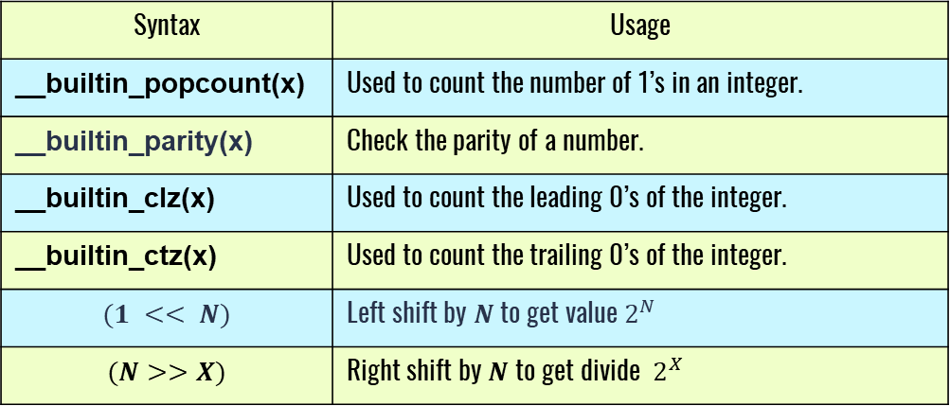
Built-in Functions and shifting
Syntax | Usage
__builtin_popcount(x) | Used to count the number of 1’s in an integer.
__builtin_parity(x) | Check the parity of a number.
__builtin_clz(x) | Used to count the leading 0’s of the integer.
__builtin_ctz(x) | Used to count the trailing 0’s of the integer.
$$(1 << N)$$ | Left shift by $N$ to get value $2^{N}$
$$(N>>X)$$ | Right shift by $N$ to get divide $2^{X}$

Slide 5



Tricks
Mod
$$\left(37\right)\%\left(32\right)=5$$
0 1 0 0 1 0 1
$$37$$
0 0 1 1 1 1 1
$$2^{5}−1=31$$
&
0 0 0 0 1 0 1
$$x \& \left(2^{m}−1\right)$$

Slide 6


Tricks
Form c to C and versa versa
1 0 0 0 0 0 1
$$A=65$$
1 1 0 0 0 0 1
$$a=97$$
OR 32
XOR 32
$$Small$$
$$Flip$$

Slide 7
THANKS!
Any questions?

