Slide 1

CSE 575: Statistical Machine Learning
Comparative Analysis of
Sarcasm Detection in Reddit Comments
Team:
Kovidnath Reddy Pyla
Tharun Kumar Veeralam Sreedhar
Sambhav Jain
Anh Nguyen
Vishal Tyagi
Notes:
Assigned to: Prajwal
@todo add ASU symbol on top-right
*

Slide 2
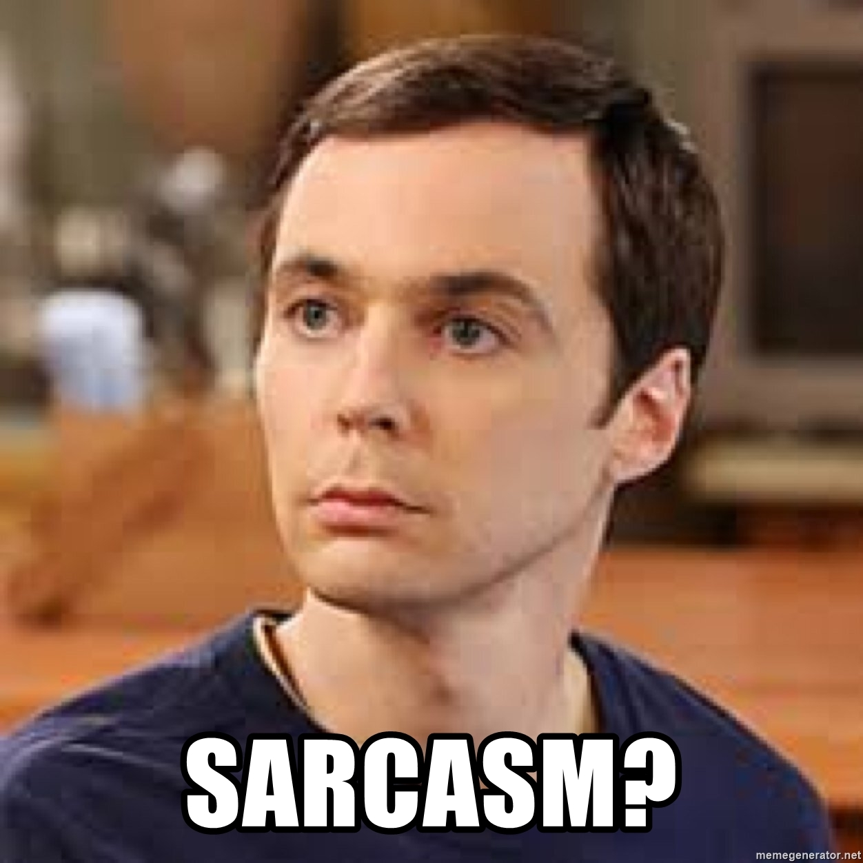
Notes:
*

Slide 3
Context in Sarcasm
Sarcasm is a conversational tool which uses irony to imply the exact opposite of the literal meaning of the sentence.
For example:
Context: …
Sentence: Thank you for the great news! You made my day!
Notes:
*

Slide 4
Context in Sarcasm
Sarcasm is a conversational tool which uses irony to imply the exact opposite of the literal meaning of the sentence.
For example:
Context: I’m sorry but after much deliberation we have rejected your application.
Sentence: Thank you for the great news! You made my day!
Notes:
*

Slide 5
The SARC dataset
Reddit has a unique parent and response structure.
Reddit as a social media platform is known to use extensive sarcasm and humor.
Each Sub Reddit has it’s own rules some of which are specifically know for sarcasm and humor.
Reddit allows the user to use sarcasm tags to identify his comment as sarcastic.
Reddit vocabular is generally clean and easy to process
Notes:
Prajwal: Spam and bot
*

Slide 6
Algorithms Implemented
SVM
Logistic Regression
LSTM
LSTM with Attention
Bi Directional RNN
LSTM cells have been used to integrate the parent sentence as context to the responses.
SVM and Logistic regression doesn’t use the context to show the importance of context in sarcasm.
Notes:
Prajwal: Spam and bot
*

Slide 7
Word Embeddings
GLOVE vectors: Pretrained glove vectors were used to convert each word into a 100 dimensional vector.
Word2Vec: We trained our own word embeddings using the CBOW Word2Vec model and this has provided slightly better results over the pretrained Glove vectors.
Notes:
Prajwal: Spam and bot
*

Slide 8
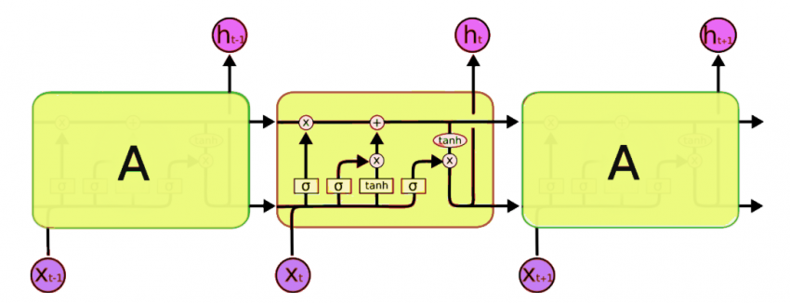
LSTM
Notes:
Add a ‘why’ slide for bot detection: election, product placement, spam messages with some examples
What is eugene? > sambhav. Hey that’s part of my presentation. Eugene is the algorithm emulating a 13yr old which passed the Turing test
I will explain this while presenting
*

Slide 9
LSTM vs LSTM with Attention
LSTM (Long short term memory) is a type of recurrent neural network.
The LSTM model takes in input from the previous states and retains information.
The Attention layer helps the LSTM model concentrate on required parts of the previous states.
Since the LSTM model has a problem with retaining information from distance words.
Notes:
Add a ‘why’ slide for bot detection: election, product placement, spam messages with some examples
What is eugene? > sambhav. Hey that’s part of my presentation. Eugene is the algorithm emulating a 13yr old which passed the Turing test
I will explain this while presenting
*

Slide 10
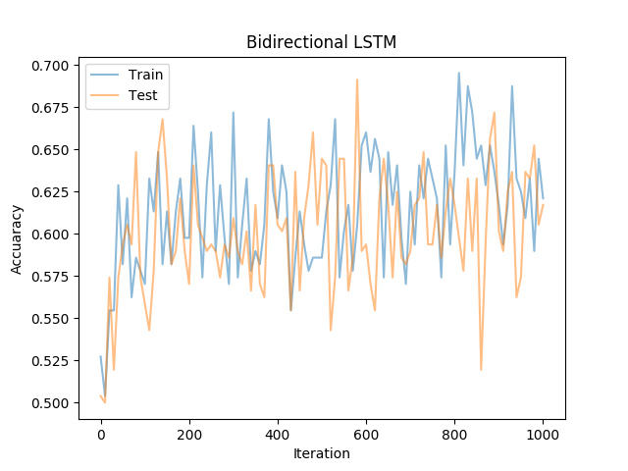
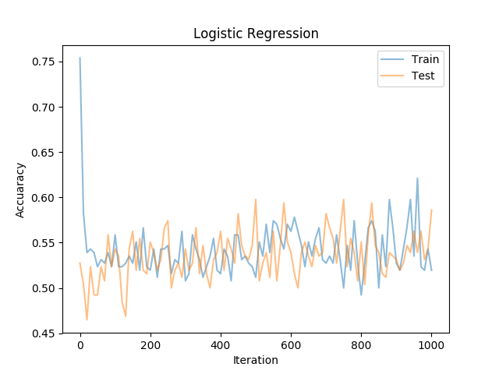
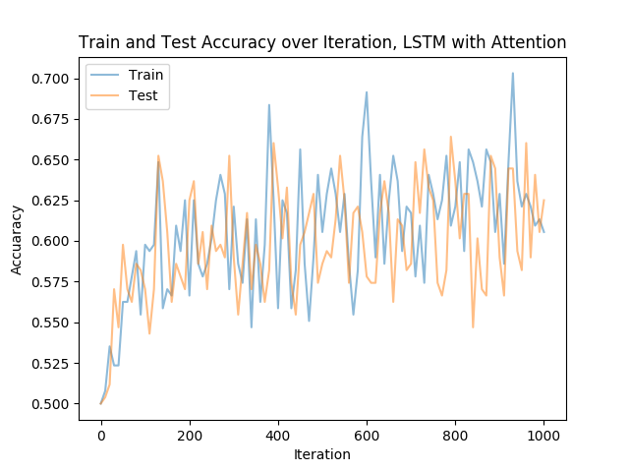
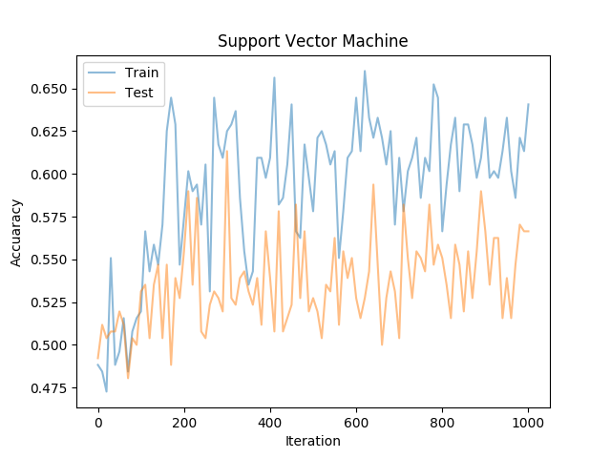
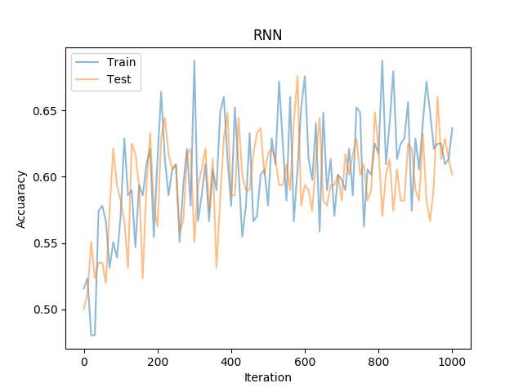
Accuracies
Notes:
*

Slide 11

Metrics
$$Precision=\frac{True Positive}{True Positive+False Positive}$$
$$Recall= \frac{True Positive}{True Positive+False Negatives}$$
Notes:
Prajwal: Spam and bot
*

Slide 12
Results
Algorithm | Glove | Word2Vec
LSTM Attention | 0.598 | 0.618
Bi LSTM | 0.595 | 0.614
LSTM | 0.584 | 0.607
SVM | 0.506 | 0.548
Logistic Regression | 0.517 | 0.541
Notes:
Prajwal: Spam and bot
*

Slide 13
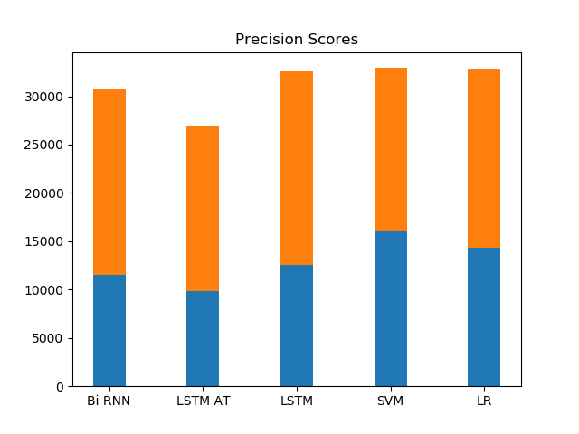
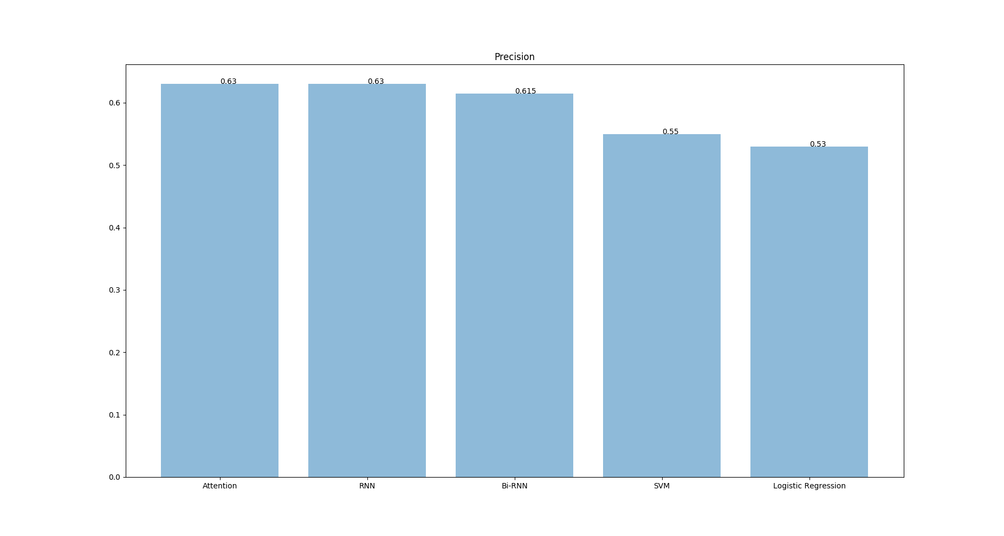
Results
Notes:
Prajwal: Spam and bot
*

Slide 14
Thank You!
Notes:
Prajwal: Spam and bot
*

