Slide 1

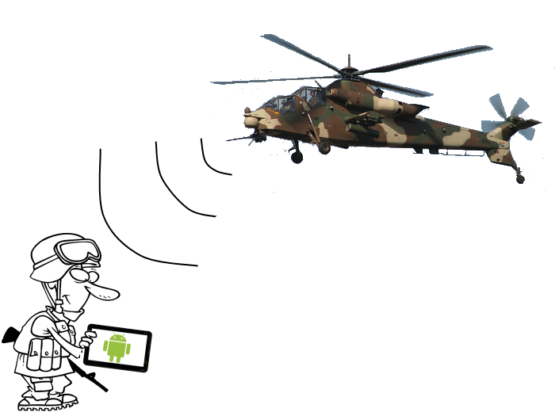
aytheon Senior Design Project Android Based Situational Awareness: Moving Map
Tom Atnip, Susi Cisneros,
Sam Kim, Seth Troisi
October 17, 2012

Slide 2
Problem Statement
Provides state-of-the-art electronics, mission systems integration and other capabilities for Government markets
Situational Awareness is being aware of and understanding the environmental elements around you
Need for a mobile system that is similar to currently existing solution
Notes:
Tom write

Slide 3
Requirements
Requirement | Type
The system shall let the user zoom using an on-screen button | Functional
The system shall display map tiles that are either stored on the device or provided by a local server | Functional
The system shall georeference the location of the device | Functional
The system shall let the user change default settings via a settings menu found in the menu bar | Functional
The system shall display a compass | Functional
The system shall let the user toggle heading/north up by clicking the compass | Functional
The system shall receive GPS data from a local server or the device | Non-Functional
The system shall display properly on either mobile phones or tablets | Non-Functional
Notes:
Key Needs

Slide 4
Process
Using a modified version of he waterfall model called Swift
Requirements will remain very static after requirements review
Project code and documentation hosted on GitHub
Client allows flexible coding process
Short sprints with deliverables at the end of each
Kanban board to track progress of code pieces
Notes:
Swift – modified waterfall
Schedule on next slide
Github for version control/ticket tracking
Plan to use a kanban board for features during coding

Slide 5
Project Schedule & Milestones
System Requirements Review: October 17th
Preliminary Design Review: October 31st
Alpha Release: December 19th
Beta Release: February 6th
Critical Design Review: February 6th
Test Readiness Review: March 20th
Final Release: April 17th
Expo/Out brief: May 22nd

Slide 6
Assumptions, Risks, & Opportunities
Risks
Find a mapping engine that supports Raytheon’s map format
Assumptions
There exists a mapping tool that provides the ability to perform basic functionality (e.g. panning, zooming)
Libraries for pulling mapping information from local server (e.g. Wifi, USB)
Opportunities
Google’s mapping engine may provide many required features
Notes:
Talk about solutions to risks
Copy things from docs

Slide 7
Key Features
View map of surrounding area
View points of interest on the map
View current location on the map
Map must not require internet access
Map must be Android based
Application must work on any size android device
Notes:
Common Mapping features plus no internet plus intranet

Slide 8
Project Status
System Requirements Review October 17th
Preliminary Design Development
Notes:
Requirements Review
Preliminary Design

Slide 9

Questions?

