Slide 1

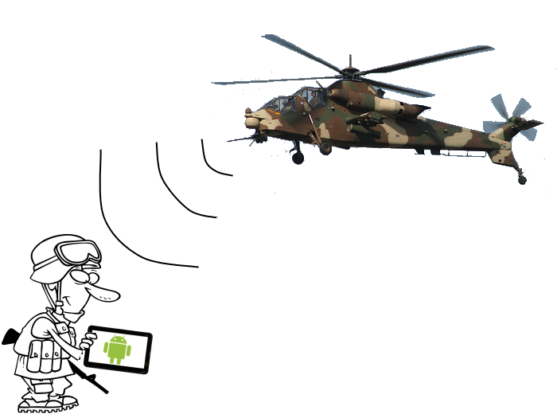
aytheon Senior Design Project Android Based Situational Awareness: Moving Map
Tom Atnip, Susi Cisneros,
Sam Kim, Seth Troisi
October 17, 2012

Slide 2
Problem Statement
Provides state-of-the-art electronics, mission systems integration and other capabilities for Government markets
Situational Awareness is being aware of and understanding the environmental elements around you
There exists a need for a mobile system that is similar to currently existing solution
Notes:
Tom write

Slide 3
Requirements
The system shall let the user zoom using an on-screen button
The system shall display map tiles that are either stored on the device or provided by a local server
The system shall georeference the location of the device
The system shall let the user change default settings via a settings menu found in the menu bar
The system shall display a compass
The system shall let the user toggle heading/north up by clicking the compass
The system shall receive GPS data from a local server or the device
The system shall display properly on both mobile phones or tablets
Notes:
Key Needs

Slide 4
Process
Using a modified version of the waterfall model called Swift
Project code and documentation hosted on GitHub
Client allows flexible coding process
Short sprints with deliverables at the end of each
Kanban board to track progress of code pieces
Notes:
Swift – modified waterfall
Schedule on next slide
Github for version control/ticket tracking
Plan to use a kanban board for features during coding

Slide 5
Project Schedule & Milestones
System Requirements Review: October 17th
Preliminary Design Review: October 31st
Alpha Release: December 19th
Beta Release: February 6th
Critical Design Review: February 6th
Test Readiness Review: March 20th
Final Release: April 17th
Expo/Out brief: May 22nd

Slide 6
Assumptions, Risks, & Opportunities
Assumptions
There exists an open source mapping engine for Android devices
The mapping engine does not require an internet connection to run
Android devices can connect to a local server
Risks
Performance of the system
Organizing data in the correct format in a timely manner
Opportunities
Finding a feature complete mapping engine
Notes:
Talk about solutions to risks
Copy things from docs

Slide 7
Key Features
View map of surrounding area
View points of interest on the map
View current location on the map
App must not require internet access
App must be Android based
App must work on any size android device
Notes:
Common Mapping features plus no internet plus intranet

Slide 8

Questions?

