Slide 1
Market Trend Analysis using news articles
CS-410 - Course Project
TeamAnand : atodkar2@illinois.edu

Slide 2
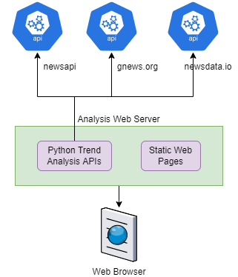
High level design
The idea of this project is to find trends in the market and business
Topic Modelling using LDA (Latent Dirichlet Analysis) is used to find trends
News data from various news sources over REST interface
Date wise trend analysis
Web based interface

Slide 3
Topic modelling using LDA algorithm
1. Convert sentences of news articles to words
2. Using bigram language model to extract phrases
3. Remove stopwords using ntlk
4. Lemmatize the nouns, adjectives verbs and adverbs
5. Prepare the LDA model on lemmatized data to model topics
6. Extract top trending topics from the algorithm

Slide 4
Python packages
1. gensim - For LDA and related functions implementation
2. spacy - For lemmatization of words
4. pattern - This is being used for mining patterns
5. nltk - Natural language toolkit. Helpful as natural language utility
3. flask - Python based webserver

Slide 5
Efforts
API layer preparation for all three sources - 4 hours
Prepare API on flask python webserver – 4 hours
Algorithm of LDA end to end implementation - 5 hours
Prepare React based UI - 5 hours
Documentation and presentation - 5 hours

Slide 6
demo

