Slide 1
EMAG
Aleksandar Todorov
Victor Mladenov

Slide 2
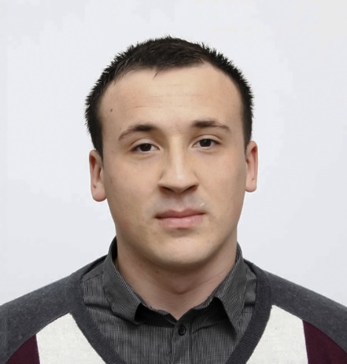

Who are we
Алексдандър Тод
Aleksandar Todorov
Victor
Mladenov
Architect
Student
27
y.o.
22
y.o.

Slide 3













Technologies, API’s and software

Slide 4

Main Functionality
User

Slide 5

Admin

Slide 6
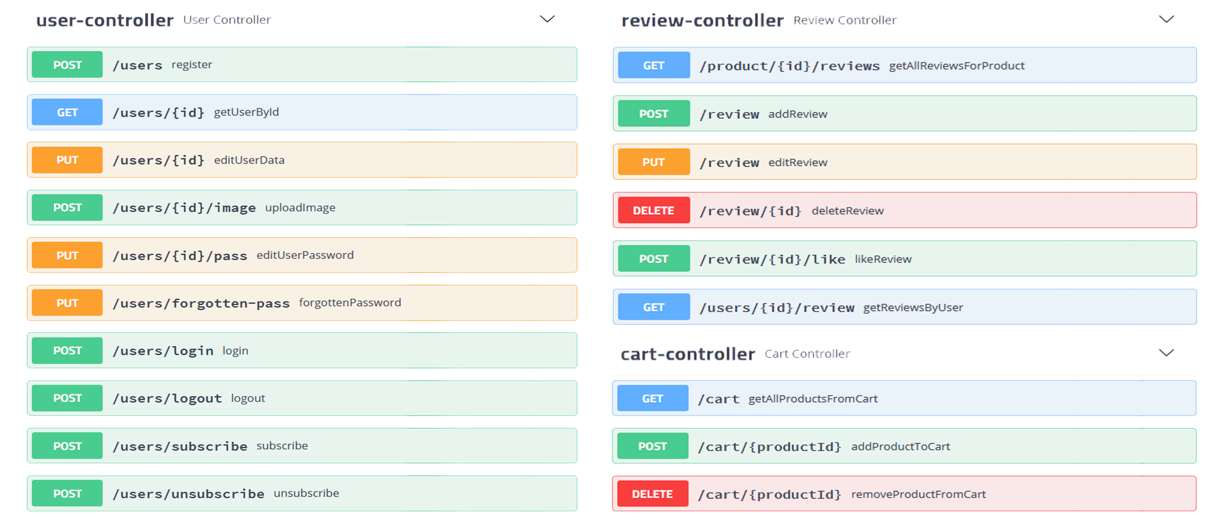

Slide 7
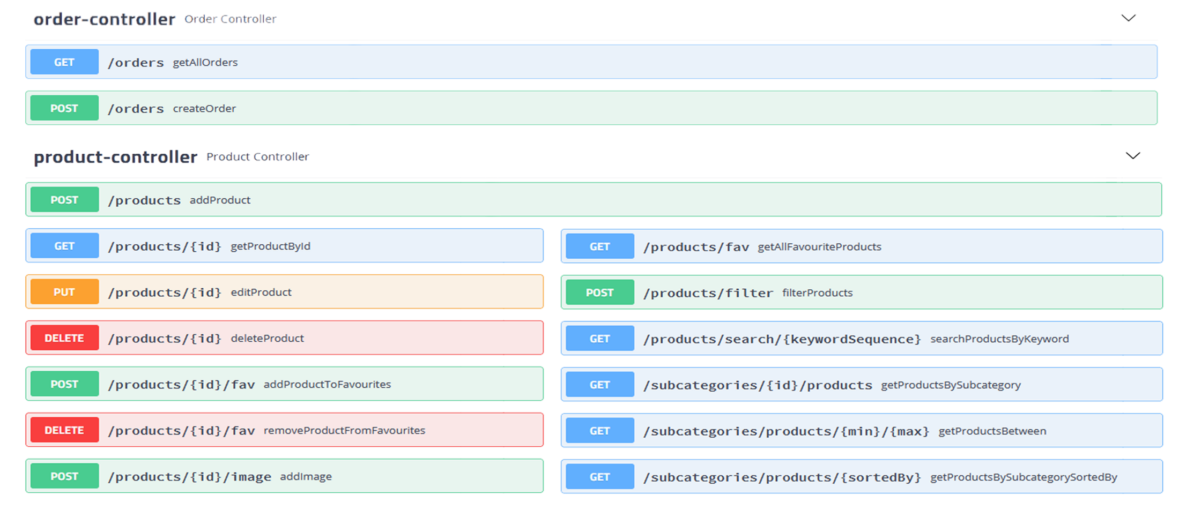

Slide 8
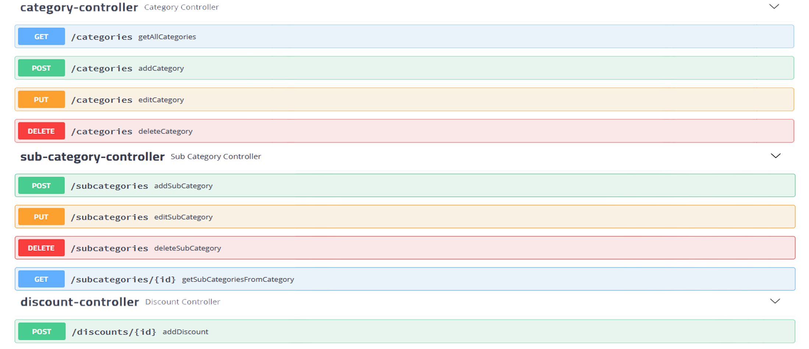

Slide 9
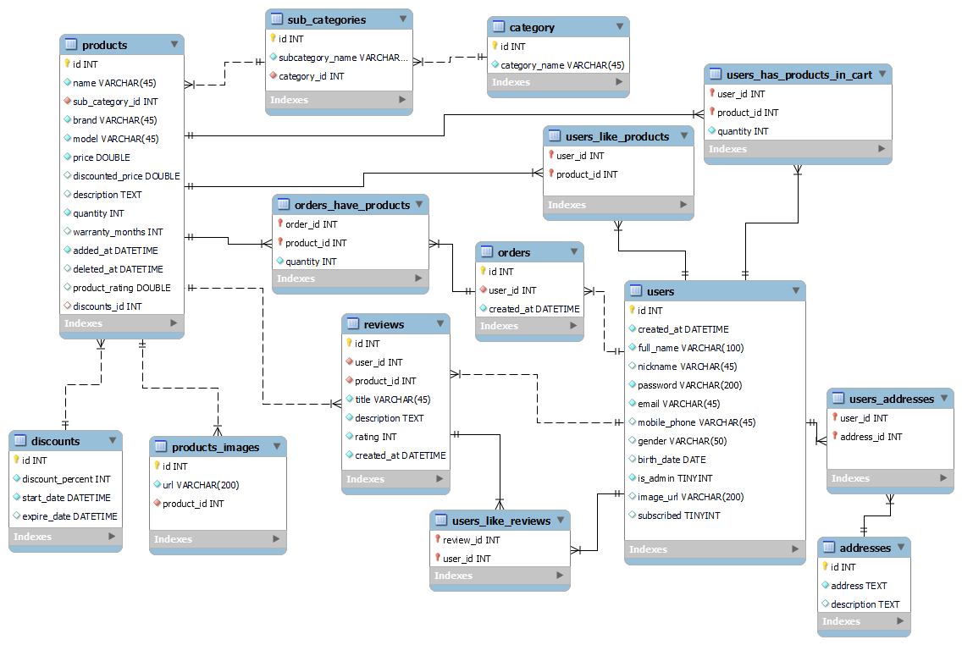
Database Diagram

Slide 10
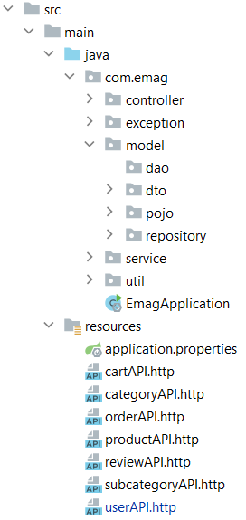
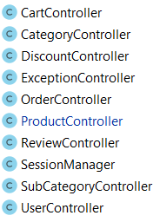
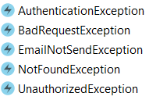
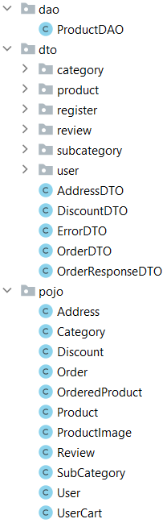
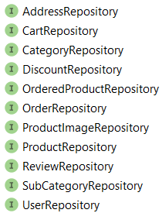
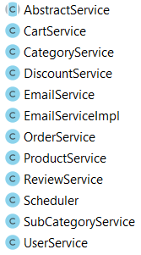


Slide 11
DEMO

Slide 12
Благодарим за вниманието!

