Slide 1
EMAG
Aleksandar Todorov
and Victor Mladenov

Slide 2













Technologies, API’s and software

Slide 3

Main Functionality
User

Slide 4
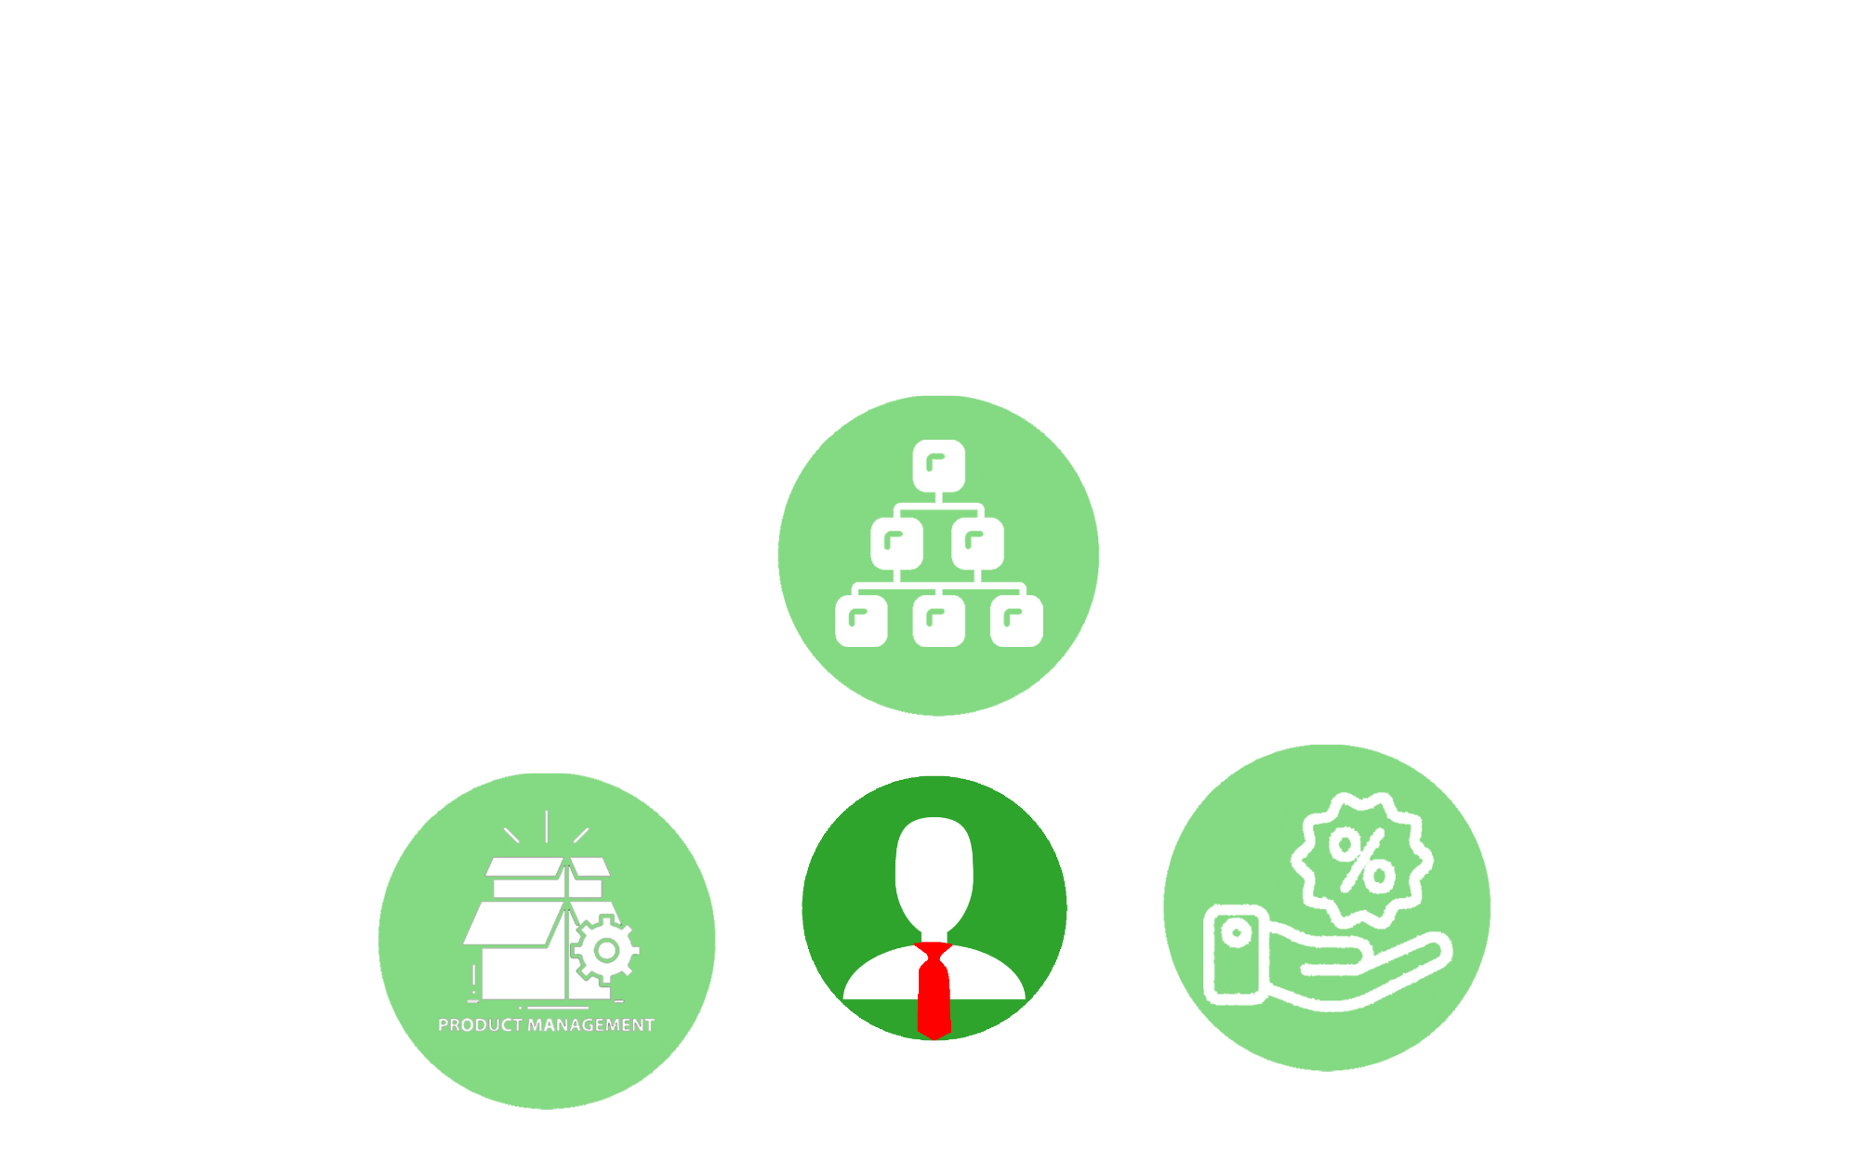
Admin

Slide 5
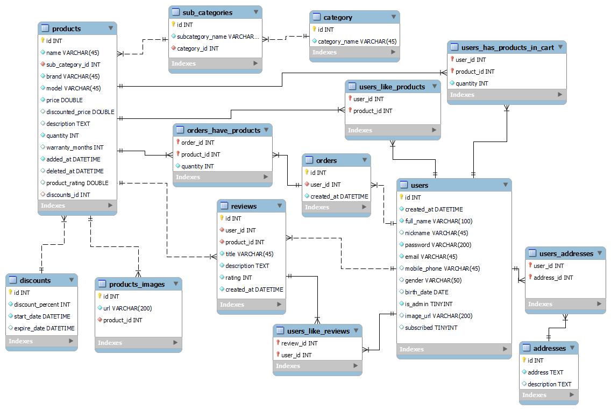
Database Diagram

Slide 6
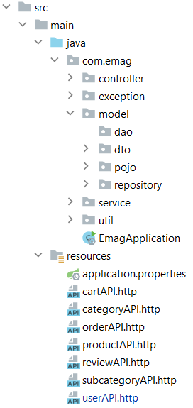
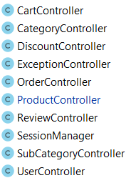
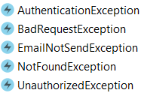
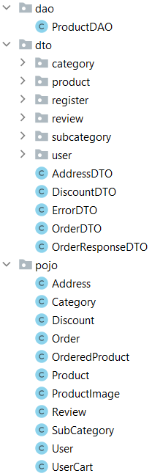
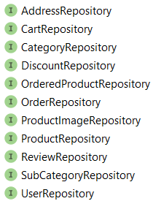
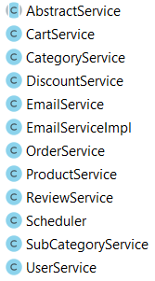


Slide 7
DEMO

Slide 8
Благодарим за вниманието!

