Slide 1
EMAG
Aleksandar Todorov
and Victor Mladenov

Slide 2

Main Functionality
User

Slide 3

Admin

Slide 4













Technologies, API’s and software

Slide 5
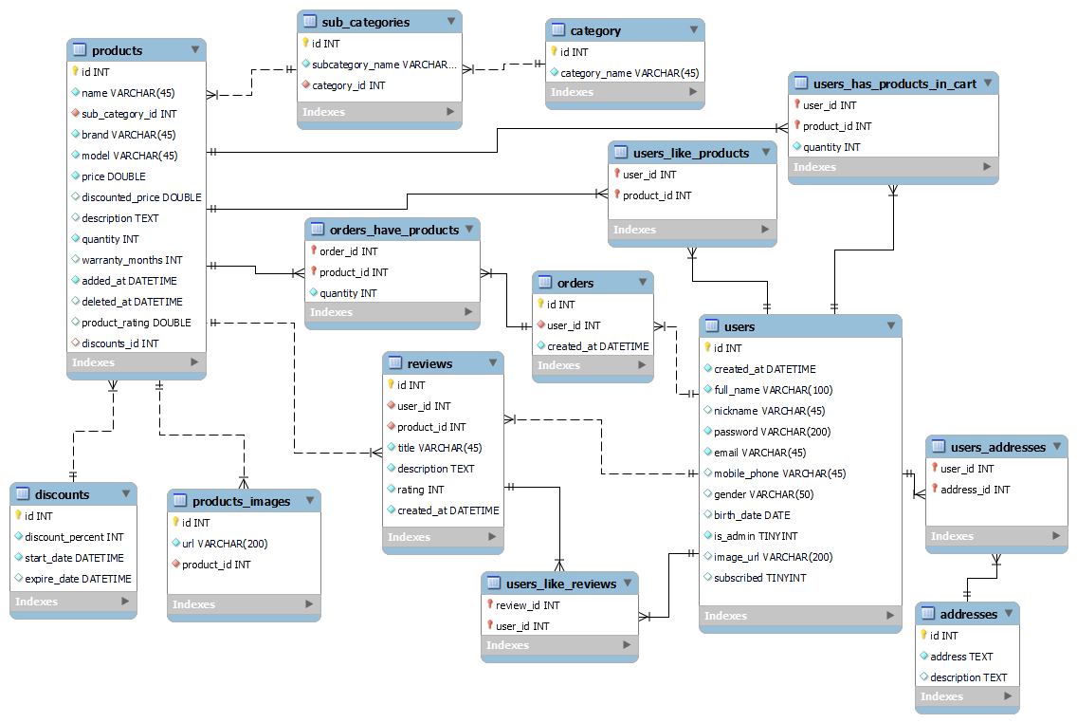
Database Diagram

Slide 6
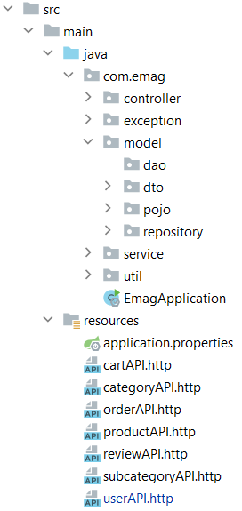
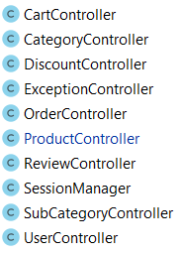
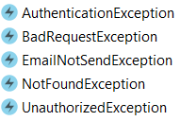
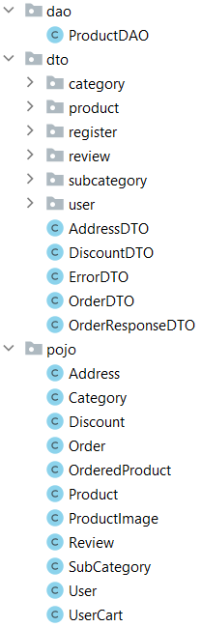
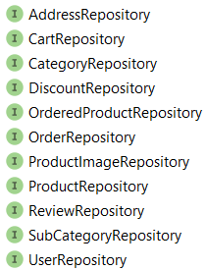
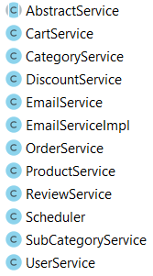


Slide 7
DEMO

Slide 8
Благодарим за вниманието!

