Slide 1
Phenotype OBT:000189
Bactéries
Habitat
“E. Coli and L. Lactis. are anaerobic bacterium that are commonly found in the lower-intestine of humans”
Figure 1: Détection d’entités

Slide 2
Phenotype OBT:000189
NCBI:562
Label: Escherichia Coli
NCBI:1246
Label: Lactobacillus Lactis
OBT:002810
Label : intestine
OBT:002488
Label: human
Bactéries
Habitat
“E. Coli and L. Lactis. are anaerobic bacterium that are commonly found in the lower-intestine of humans”

Slide 3
Phenotype OBT:000189
NCBI:562
Label: Escherichia Coli
NCBI:1358
Label: Lactococcus Lactis
OBT:002810
Label : intestine
OBT:002488
Label: human
Bactéries
Habitat
“E. Coli and L. Lactis. are anaerobic bacterium that are commonly found in the lower-intestine of humans”
Lives in

Slide 4
ID:000
“root concept”
ID:000
“Cell”
is_a
is_a
ID:002
ID:001
“Eukaryote”
“Prokaryote”
is_a
is_a
is_a
ID:004
ID:003
ID:005
“Yeast”
“Bacteria”
“Archea”
is_a
is_a
ID:006
ID:007
ID:008
“S.Cerevisiae”
“Escherichia coli”
“E.coli
“K9 strain”
is_a

Slide 5
is_a
is_a
ID:002
ID: 186826
“Bacteria”
“Lactobacilliales”
is_a
ID: 562
is_a
“Escherichia coli”
“E.coli”
ID: 1358
ID: 1005542
“Lactococcus lactis”
is_a
“Escherichia coli EC1847”
is_a
OBT:00001
OBT:00010
is_a
“living organism“
“microbial habitat”
is_a
OBT:02488
OBT:00014
“part of living organism”
“human”
is_a
is_a
is_a
OBT:03188
OBT:03245
OBT:02810
“child”
“adult human”
“intestine”
“gut”

Slide 6
Phenotype OBT:000189
NCBI:562
Label: Escherichia Coli
NCBI:1246
Label: Lactobacillus Lactis
Is
Lives in
Bactéries
“E. Coli and L. Lactis. are anaerobic bacterium that are commonly found in the lower-intestine of humans”
Habitat
OBT:002810
Label : intestine
OBT:002488
Label: human

Slide 7
Phenotype OBT:000189
NCBI:562
Label: Escherichia Coli
NCBI:1246
Label: Lactobacillus Lactis
Is
Lives in
Bactéries
“E. Coli and L. Lactis. are anaerobic bacterium that are commonly found in the lower-intestine of humans”
Habitat
OBT:002810
Label : intestine
OBT:002488
Label: human

Slide 8
Etiquette: “resistant to heat”
Vocabulaire
Vecteur
Mention
Proximité vectorielle
to
the
of
me
about
heat
drive
cat
resistant
1
0
0
0
0
1
0
0
1
“heat resistant”
++
“resistant to high temperature”
-
...
...
vert
0
0
font
0
0

Slide 9
Vocabulaire
Mention
Vecteur
“le chat noir”
lai
0
0
1
lat
1
la
.
0
.
.
0
.
.
.
.
.
.
che
0
0
cha
1
1
cho
0
0
noir
1
1
vert
0
0

Slide 10
Etiquette
Mention
Proximité vectorielle
a)
“le chat noir”
“le noir chat”
+++
b)
“le chaton noirâtre”
-
c)
“les chats noirs”
--
d)
“ce chat est assez noir”
-
“suspendu dans une solution”
“effectué dans une expérience”
“cultivé dans une boîte”
“cultivé sur boîte”

Slide 11
Etiquette :
“resistant to heat”
Mention
Proximité vectorielle
“heat resistant”
++
“resistant to high temperature”
-

Slide 12
Etiquette :
“resistant to heat”
Mention
Proximité vectorielle
a)
“heat resistant”
++
b)
“resistant to high temperature”
-

Slide 13
Etiquette :
“les chats ne font pas des chiens”
Mention
Proximité vectorielle
a)
“les chiens ne font pas des chats”
+++
b)
“les chats ne font pas des canidés”
-
c)
--
“le chat ne fait pas un chien”
d)
-
“les chats ne font pas souvent des chiens”

Slide 14
Etiquette
Mention
Proximité vectorielle
a)
“le cha t n oir”
“le noir chat”
+++
b)
“le chaton noirâtre”
-
c)
“les chats noirs”
--
d)
“ce chat est assez noir”
-

Slide 15
voiture
chaton
chat
chats
chien
manger
nourriture

Slide 16
Allium Porrum
Poireau
Pomme de terre
Carrotte
Voiture
Chat
Collier

Slide 17
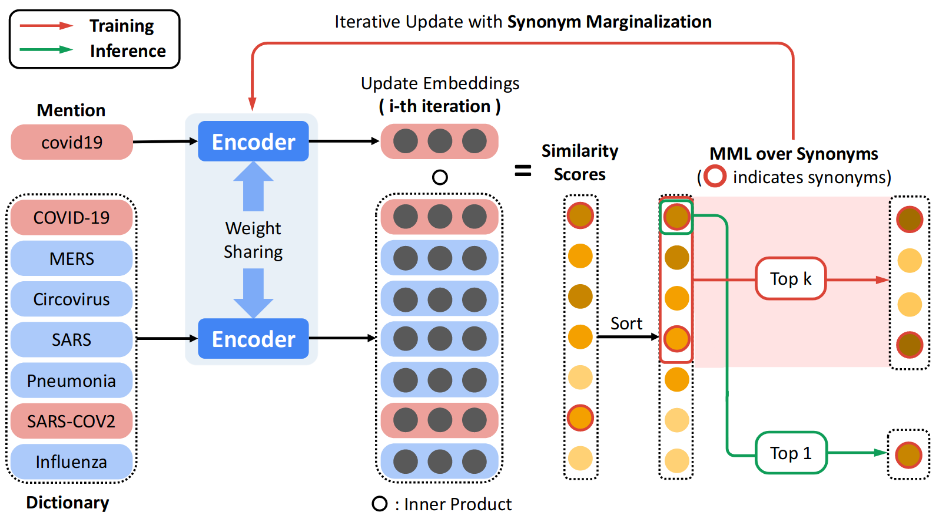


BioBERT
TF-IDF

Slide 18

Mention
“covid19”
Circovirus
Covid-19
SARS
...
Pneumonia
Dictionnary of labels
BioBERT
TF-IDF

Slide 19
Context
Coherence
Prior
a.
Mention
b.
c.
d.
e.
f.
Candidate
generation
Word
Embedding
Character
embedding
Alignment
feature
CNN
Output
layer
Similarity
Score
Candidate

Slide 20
Mention
Vecteur W2V
Similarité
Vecteur W2V
Etiquette
...
...
“type”
-0.1
“diabetes”
-0.1
2.3
2.0
1.0
-1.1
2.3
2.0
...
1.0
-1.1
...
“two”
0.12
-0.9
0.3
3.0
3.1
“mellitus”
3.1
4.1
0.2
...
4.6
-3.2
...
“diabetes”
3.1
“type”
-0.3
4.1
0.2
...
4.6
-3.2
-0.3
3.0
1.8
0.2
-0.3
0.2
“two”
-0.3
3.0
1.8
Meilleurs scores de similarité entre et

Slide 21
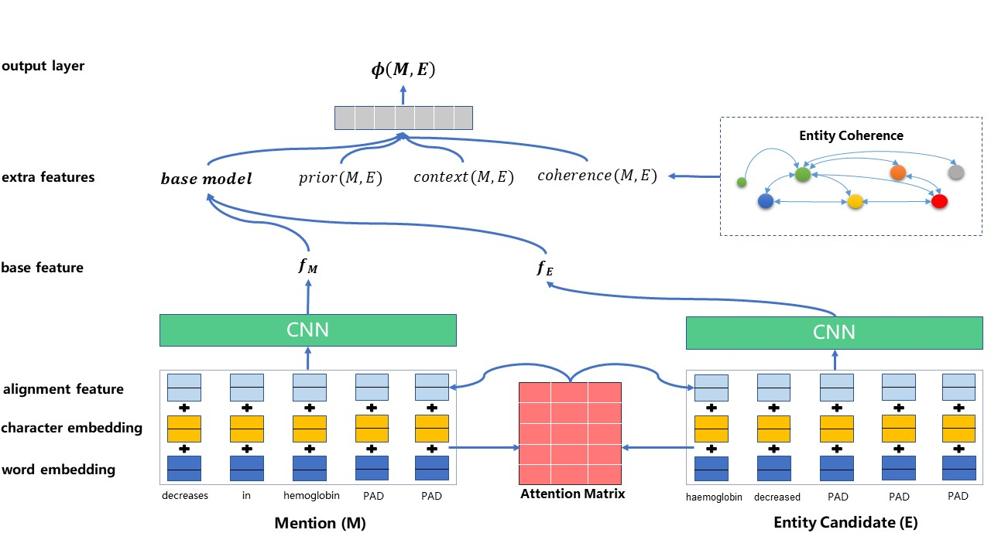
f)
e)
d)
c)
b)
a)

Slide 22
Bacteria
Biotope 4
train
header
NCBI Disease
Format standart
dev
data
test
Others

Slide 23
Raise issue generator
Test with as much mentions in both processed original data and custom preprocessed
Rapport – Refaire 3 schemas entity detection entity norm & relation extraction.
Launch on original data lightweight

