Slide 1

Agriculture in india
TEAM NUMBER: 19
TEAM NAME:

Slide 2

WHY AGRODEV?
Farmers require a one stop website where they can find all they need to get maximum output from their crops.
That is exactly what AGRODEV provides a one stop website to fulfil all the needs of the farmer.

Slide 3

What do we provide ?
CROP ROTATION PLANS:
Farmers in India, on an average plant only one crop in a year. Whereas if they exercise crop rotation they can on an average grow at least 3 crops in a single year.

Slide 4
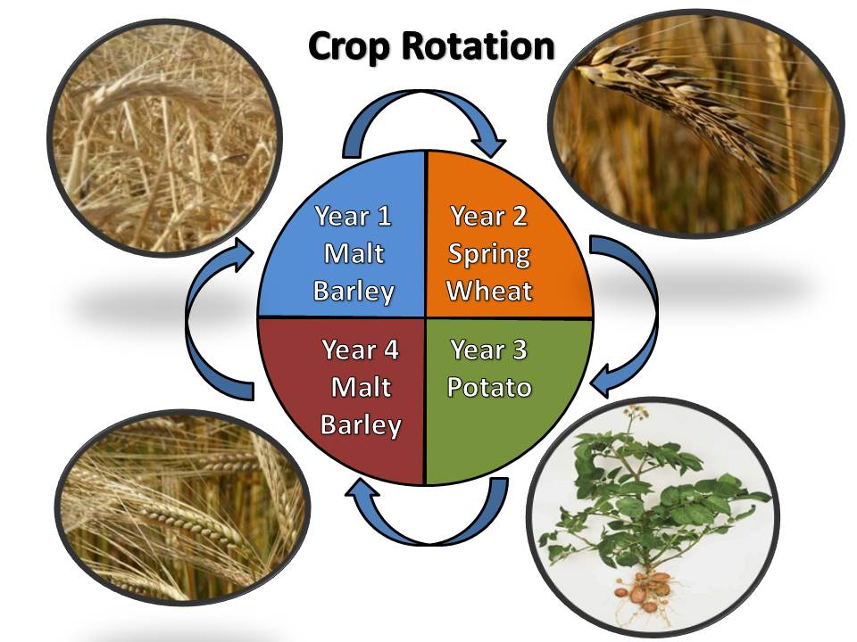
We will provide them with suggestion of which crop should they grow and when according the location of the farm

Slide 5

Broker free environment
Brokers are one of the major problems in the agricultural industry.
We will provide them a broker free environment where the farmer will directly be linked to the wholesale market .

Slide 6
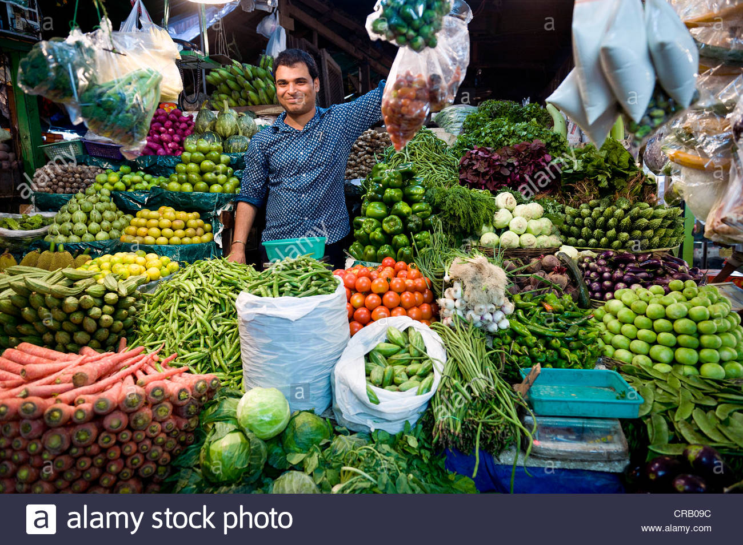
How will this help?
This will directly attach them to the nearby market, leading to direct selling without any intermediate commission taker.
This will help them a lot financially.

Slide 7

Update required!
The farmers in India are more into traditional form of farming i.e, hand cultivation, irrigation, winnowing, etc.

Slide 8
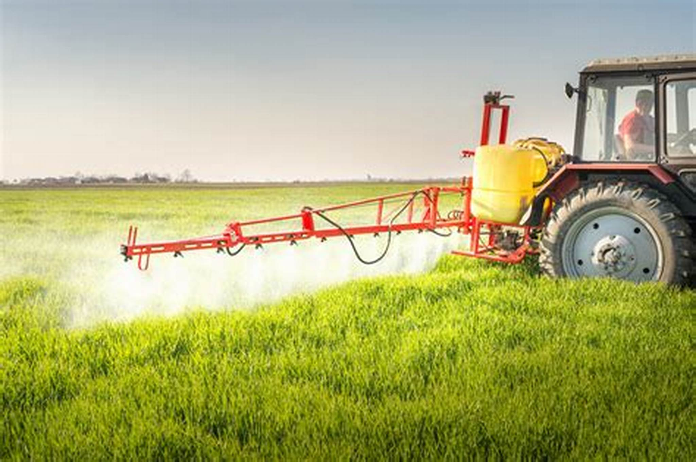
Tech updated!
We will suggest them the machine that will be suitable for them according to their land size and requirement by the crop….we will update them with better seeds and fertilizers to maximize their produce.

Slide 9


Investment and funding.
By this time we have already helped the farmers to maximize their return from the resources they already had.
But investing money is equally important for maximizing the gains even more.

Slide 10

What do we do about it?
We help them discuss about investment with experts that provide them with expertise and advice that would prove to be helpful to the farmer.
For ex: mutual funding.
We also inform them about the latest government schemes to help them further

Slide 11
Thank you!

