Slide 1


Test more and better with less friction

Slide 2

This talk
Introduction and theory
Managing external dependencies
Testcontainers
API-mocking
Contract testing
Why your unit tests are a mess (and how to fix it)
Notes:
This talk is all about reducing friction when it comes to automated tests. No matter where I’ve been I’ve found teams having friction with their tests, to the point where they don’t bother with tests at all. So let’s try to remedy some of that.
The first part of this talk is more or less about my philosophy related to testing.
The second part, aka the fun part, includes a few useful tools for dealing with external dependencies.
And then we’re going to talk about unit testing.

Slide 3

About me
Consultant @ bspoke
Tech Lead
Architect
Senior Developer
Subject Manager
Focus on developer processes
Notes:
I’m Mikael, and I’m a consultant at bspoke where I generally work as tech lead, architect, and so forth. I’m also the JVM subject manager at bspoke.
I care deeply about developer processes and experiences and how we create software. And the reason I care about this is because…

Slide 4
About me
Consultant @ bspoke
Tech Lead
Architect
Senior Developer
Subject Manager
Focus on developer processes
Lazy
Notes:
I’m lazy!
However, not all lazy are equal. There are different types of lazy.

Slide 5
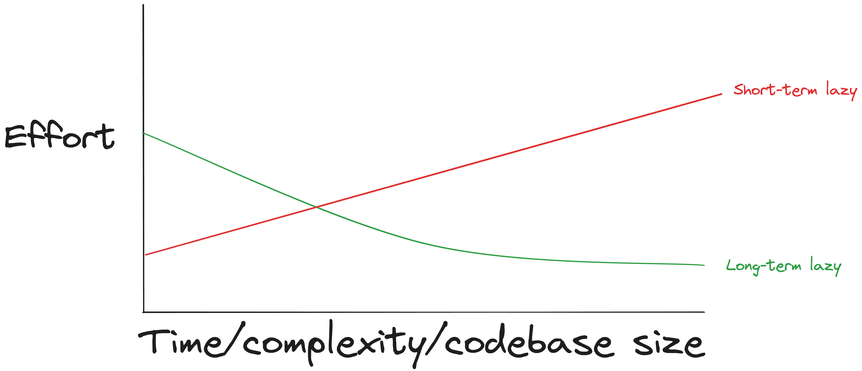
Short-term lazy vs Long-term lazy
Notes:
We have what I refer to as short-term laziness and long-term laziness. I am long-term lazy. I aim to do my job with the least amount of effort in the long term. As it happens, this also coincides with good developer practices!
Short-term laziness is very concerned with completing their current task. They will take shortcuts to achieve that task, even though the next task takes longer and requires more effort. As a long-term lazy person, I try to mitigate that. I’m more than happy to put in some extra effort and thought if that means I can do less in the future.
This graph is also not just for fun, it is actually based on real theories. We have Martin Fowler’s excellent post called “Is quality worth it?” where he points out that quality is free, as the investment in quality pays for itself due to the codebase being easier to work with.
It is also worth mentioning the broken window theory from the book Pragmatic Programmer which asserts that a house with a broken window, which is left unfixed, will soon find itself with more broken windows. Software are much like that when it comes to bad practices and technical debt. Once anti-patterns and technical debt gets to live in the codebase, then they’ll spread and developers will write more code using them, resulting in them being harder to remove later.
Overall, good automated testing is a core part of delivering and mainting systems.
I want to do work which doesn’t come back to bite me later
A core part of this is having good automated tests
https://martinfowler.com/articles/is-quality-worth-cost.html
Broken windows theory popularized by pragmatic programmer

Slide 6
Costs more to discover issues in production.
Faster deliveries.
Enables automation.
Creates a safer environment for developers.
Notes:
Automated tests allow us to find issues earlier – hopefully, before they reach production. Seeing as multiple studies point out that there’s a significant cost related to finding problems later in the development process, especially in production.
Automated tests also enable us to deliver software faster in a safe way. We can’t reliably do CI/CD with rapid releases to production without automated tests. And the more we trust that our systems work, the more we can automate around them. As we heard in the excellent talk from Sparebanken 1 yesterday where, they no longer found much value in test environments, code reviews and so forth, and much of that is thanks to tests that they trust.

Slide 7
Developers should not test manually.
Notes:
Developers should not test manually – this statement might offend some. And it comes with some caveats. For example, if you’re doing some embedded stuff on some novel hardware, then it might be difficult to find a proper way to test it in a way where you’re reasonably sure that it’ll work, but for the vast majority of developers the statement remains true. Developers should not test manually.

Slide 8
Developers should not test manually.
And if you have to, your test strategy isn’t good enough.
Notes:
And if you have to, then your test strategy isn’t good enough.
Now, when I say ”test strategy” , I don’t mean a formal test document; I just mean that the team has an idea of what kinds of tests they have, why they have them and when to write them. This is something teams should have written down somewhere, not as a several paged document, but a short list.

Slide 9

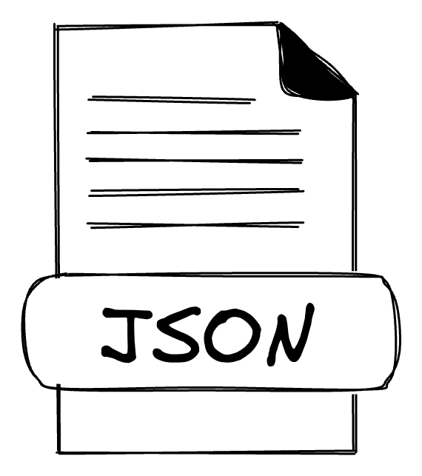
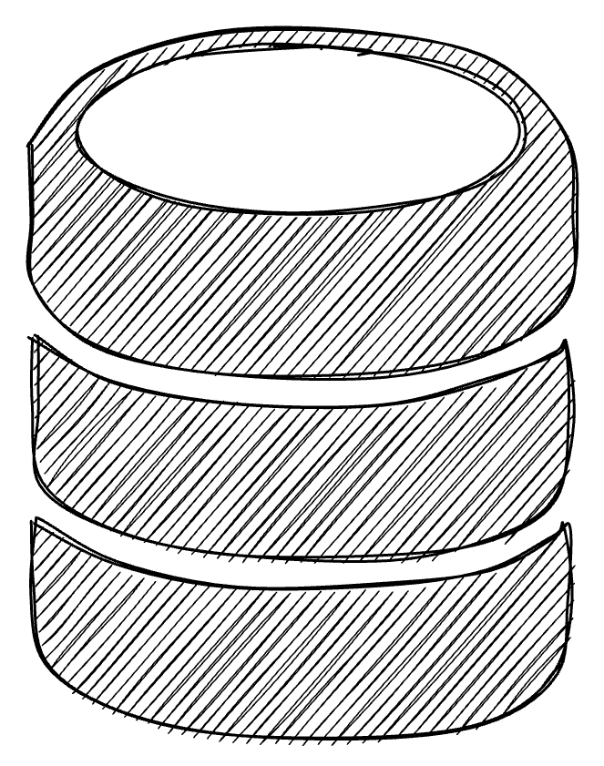
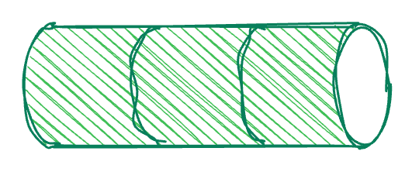
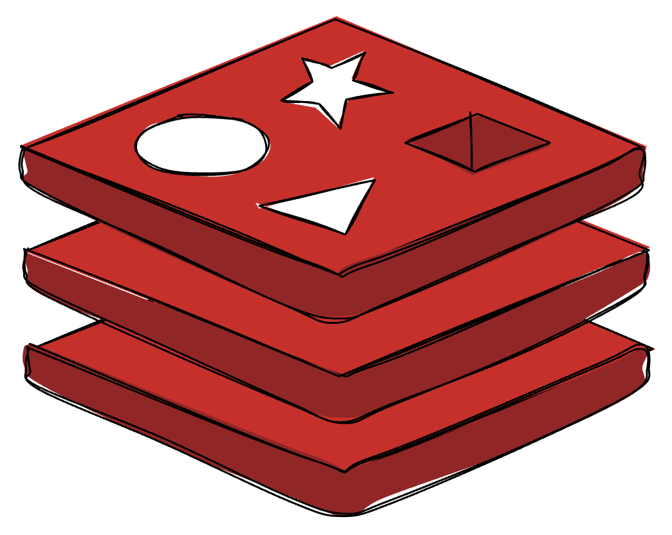
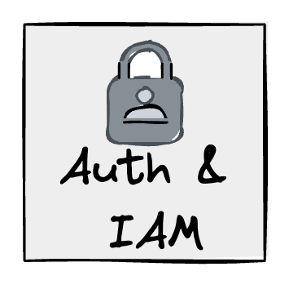
System
Notes:
Let’s talk about what kinds of tests that would be suitable for most kinds of systems. Here we have a typical system. It has some input, could be from a queue, the web, or whatever. And it sends data to somewhere, like a database, a queue, maybe an API, and so forth.

Slide 10
System
Test our code
Notes:
The first thing we want to test, is our code – obviously.

Slide 11
System
Test integrations
Test our code
Notes:
The second thing we want to test is that our system can talk to these other systems. Aka integration tests.

Slide 12
System
Verify we don’t break callers
Test integrations
Test our code
Notes:
The third kind, which I find a lot of teams forgetting, is some kind of test or verification that any changes hasn’t broken any consumers of our APIs.

Slide 13
System
Test the system as a whole
Verify we don’t break callers
Test integrations
Test our code
Notes:
And lastly, we want a sanity check that verifies the system as a whole. These are often a little more complicated, so I like to call this a 90% test, where we only verify how 90% of the requests will look like. We avoid edge cases or error handling but only focus on the most common scenario.
If you have tests that cover the above, and you can easily execute them locally, then you’re in a pretty good spot.

Slide 14


Slide 15
No manual setup required – just works
Test runs execute the same on local machine and pipeline
Easy to match version for dependency with
version in production
Notes:
- Docker-API compatible runtime

Slide 16
No manual setup required – just works
Test runs execute the same on local machine and pipeline
Easy to match version for dependency with
version in production
Demo time!
Notes:
Readme
:Peek
Gradle test
lzd
BookRepositoryTest
BaseDatabaseIntegrationTest
PersistenceTestConfig

Slide 17


API mocking

Slide 18
API mocking
System
Mocked service
Demo time!
Notes:
BestReadsServiceIntegrationTest
InventoryServiceIntegrationTest (with openAPI)

Slide 19
API mocking
System
Mocked service
Real service
?
?
=
?
?
?

Slide 20

Contract
testing

Slide 21



The problem with broad integration/E2E tests
Mocked system
Execute

Slide 22
The problem with broad integration/E2E tests
Mocked system
Execute

Slide 23

The problem with broad integration/E2E tests
Mocked system
Execute

Slide 24
The problem with broad integration/E2E tests
Mocked system
Execute

Slide 25
The problem with broad integration/E2E tests
Mocked system
Execute

Slide 26
External environments
Dev machine
System
Integration test
Some environment
Other system

Slide 27
External environments
Dev machine
System
Integration test
Some environment
Pipeline
System
Integration test
Other system

Slide 28
External environments
Dev machine
System
Integration test
Some environment
Pipeline
System
Integration test
Other system
Other devs machines
Integration test
System

Slide 29
External environments
Dev machine
System
Integration test
Some environment
Pipeline
System
Other system
Devs making changes
Integration test
Other devs machines
Integration test
System
Ops making changes

Slide 30
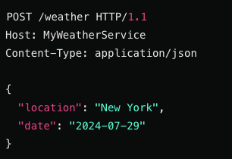
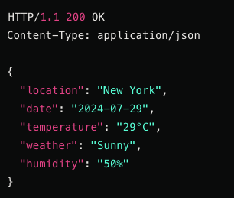
System A
System B
Request
Response

Slide 31
Contract
Expected request
Request from contract
System A
Request
System B
Response
Expected response
Response from contract

Slide 32



Contract
Expected request
Request from contract
System A
Request
System B
Response
Expected response
Response from contract
Cloud contract
Demo time!
Notes:
listing_books.groovy
<leader> 1
OrderServiceIntegrationTest
<leader 2>
<leader 3>

Slide 33





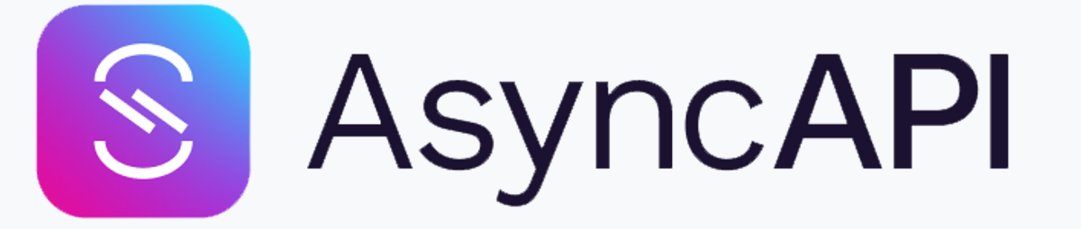

Contract testing vs schema
Notes:
Contract testing verifies that the actual implementation, which hopefully adheres to the schema.
Consumers may use our services in different ways, and a schema does not guarantee that a change won’t impact consumers even if it follows the schema.

Slide 34
Unit testing
What is a ”unit” anyway?
Notes:
Challenge audience: What is a unit?
Talk about testing behaviours (unit of behaviour)
First
Fast, Isolated, Repeatable, Self-verifying, Timely

Slide 35
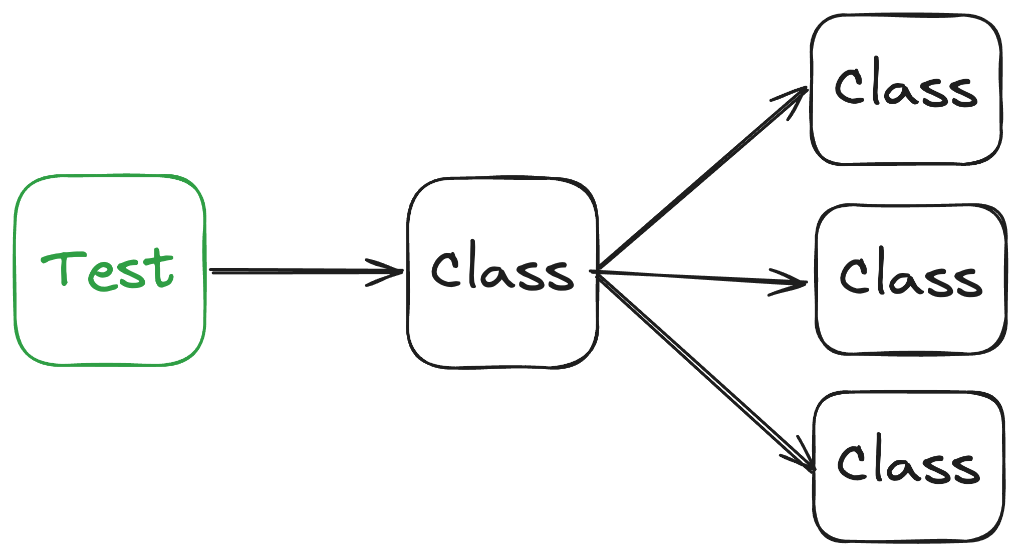
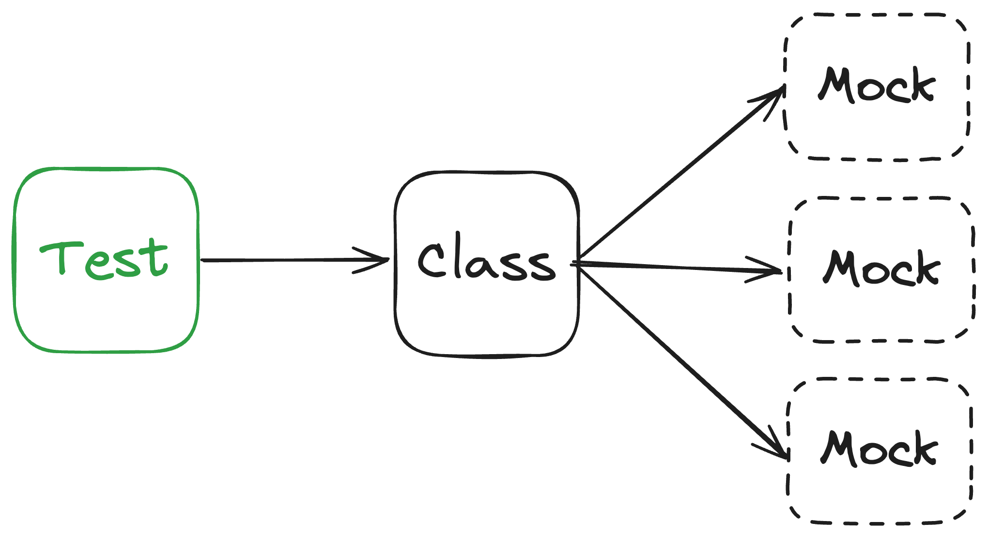
Unit testing
Sociable unit tests
Solitary unit tests
Focused on testing behavior
Focused on testing interactions

Slide 36
API
Input
Service
Business logic
Integration
DB/Kafka/External calls/etc

Slide 39
Solitary unit testing
Mock
Mock
Mock
Notes:
A lot of code related to tests will be focused on setting up mocks.
More mocks than tests.
Ties tests to implementation.

Slide 40
Sociable unit testing

Slide 41
Sociable unit testing
Interface
Interface
Interface

Slide 42
Sociable unit testing
Interface
Interface
Interface

Slide 43
Sociable unit testing
Interface
Interface
Interface
Interface
Interface
Interface
Interface
Interface
Interface

Slide 44
Sociable unit testing
Interface
Interface
Interface
Interface
Interface
Interface
Interface
Interface
Interface
Repository
Repository
Repository
Repository

Slide 45
Sociable unit testing
Interface
Interface
Interface
Interface
Interface
Interface
Interface
Interface
Interface
Interface
Repository
Repository
Repository
Repository
Repository

Slide 46
Sociable unit testing
Interface
Interface
Interface
Interface
Interface
Sociable unit tests
Solitary unit tests
Interface
Interface
6 class instances
5 mocks/tables
1 class instance 3 mocks
Interface
Interface
Interface
Repository
Repository
Repository
Repository
Repository

Slide 47
Responsible for everything related to transactions
Create transaction
TransactionService

Slide 48
Responsible for everything related to transactions
Create transaction
TransactionService
TransactionRepository

Slide 49
Responsible for everything related to transactions
Create transaction
TransactionService
TransactionRepository
Update account
AccountService
AccountRepository

Slide 50
Responsible for everything related to transactions
Create transaction
TransactionService
TransactionRepository
Update account
AccountService
AccountRepository
BonusService
BonusRepository

Slide 51

Responsible for everything related to transactions
Create transaction
TransactionService
TransactionRepository
Update account
AccountService
AccountRepository
Create transaction
BonusService
Bonus payout
BonusRepository

Slide 52
Responsible for everything related to transactions
Create transaction
TransactionService
TransactionRepository
Create transaction
Update account
AccountService
AccountRepository
BonusPayoutService
Get bonus
BonusService
BonusRepository
Bonus payout

Slide 53
Application layer
Create transaction
CreateTransactionUseCase
Bonus payout
BonusPayoutUseCase

Slide 54
Application layer
Create transaction
CreateTransactionUseCase
Bonus payout
BonusPayoutUseCase
Database layer
TransactionRepository
AccountRepository
BonusRepository

Slide 55
Application layer
Create transaction
CreateTransactionUseCase
Bonus payout
BonusPayoutUseCase
Database layer
Domain layer
TransactionRepository
TransactionRootAggregate
Account
AccountRepository
BonusRootAggregate
BonusRepository

Slide 56
Input
API
Application logic Business logic
Service
DB/Kafka/External calls/etc
Integration

Slide 57
Input
API
Business logic
Application logic
Service
Domain
No database calls
No web calls
No dependencies
DB/Kafka/External calls/etc
Integration

Slide 58
High-level test to verify that system is put together
correctly
Unit test this
Input
API
Business logic
Application logic
Service
Domain
No database calls
No web calls
No dependencies
DB/Kafka/External calls/etc
Integration

Slide 59
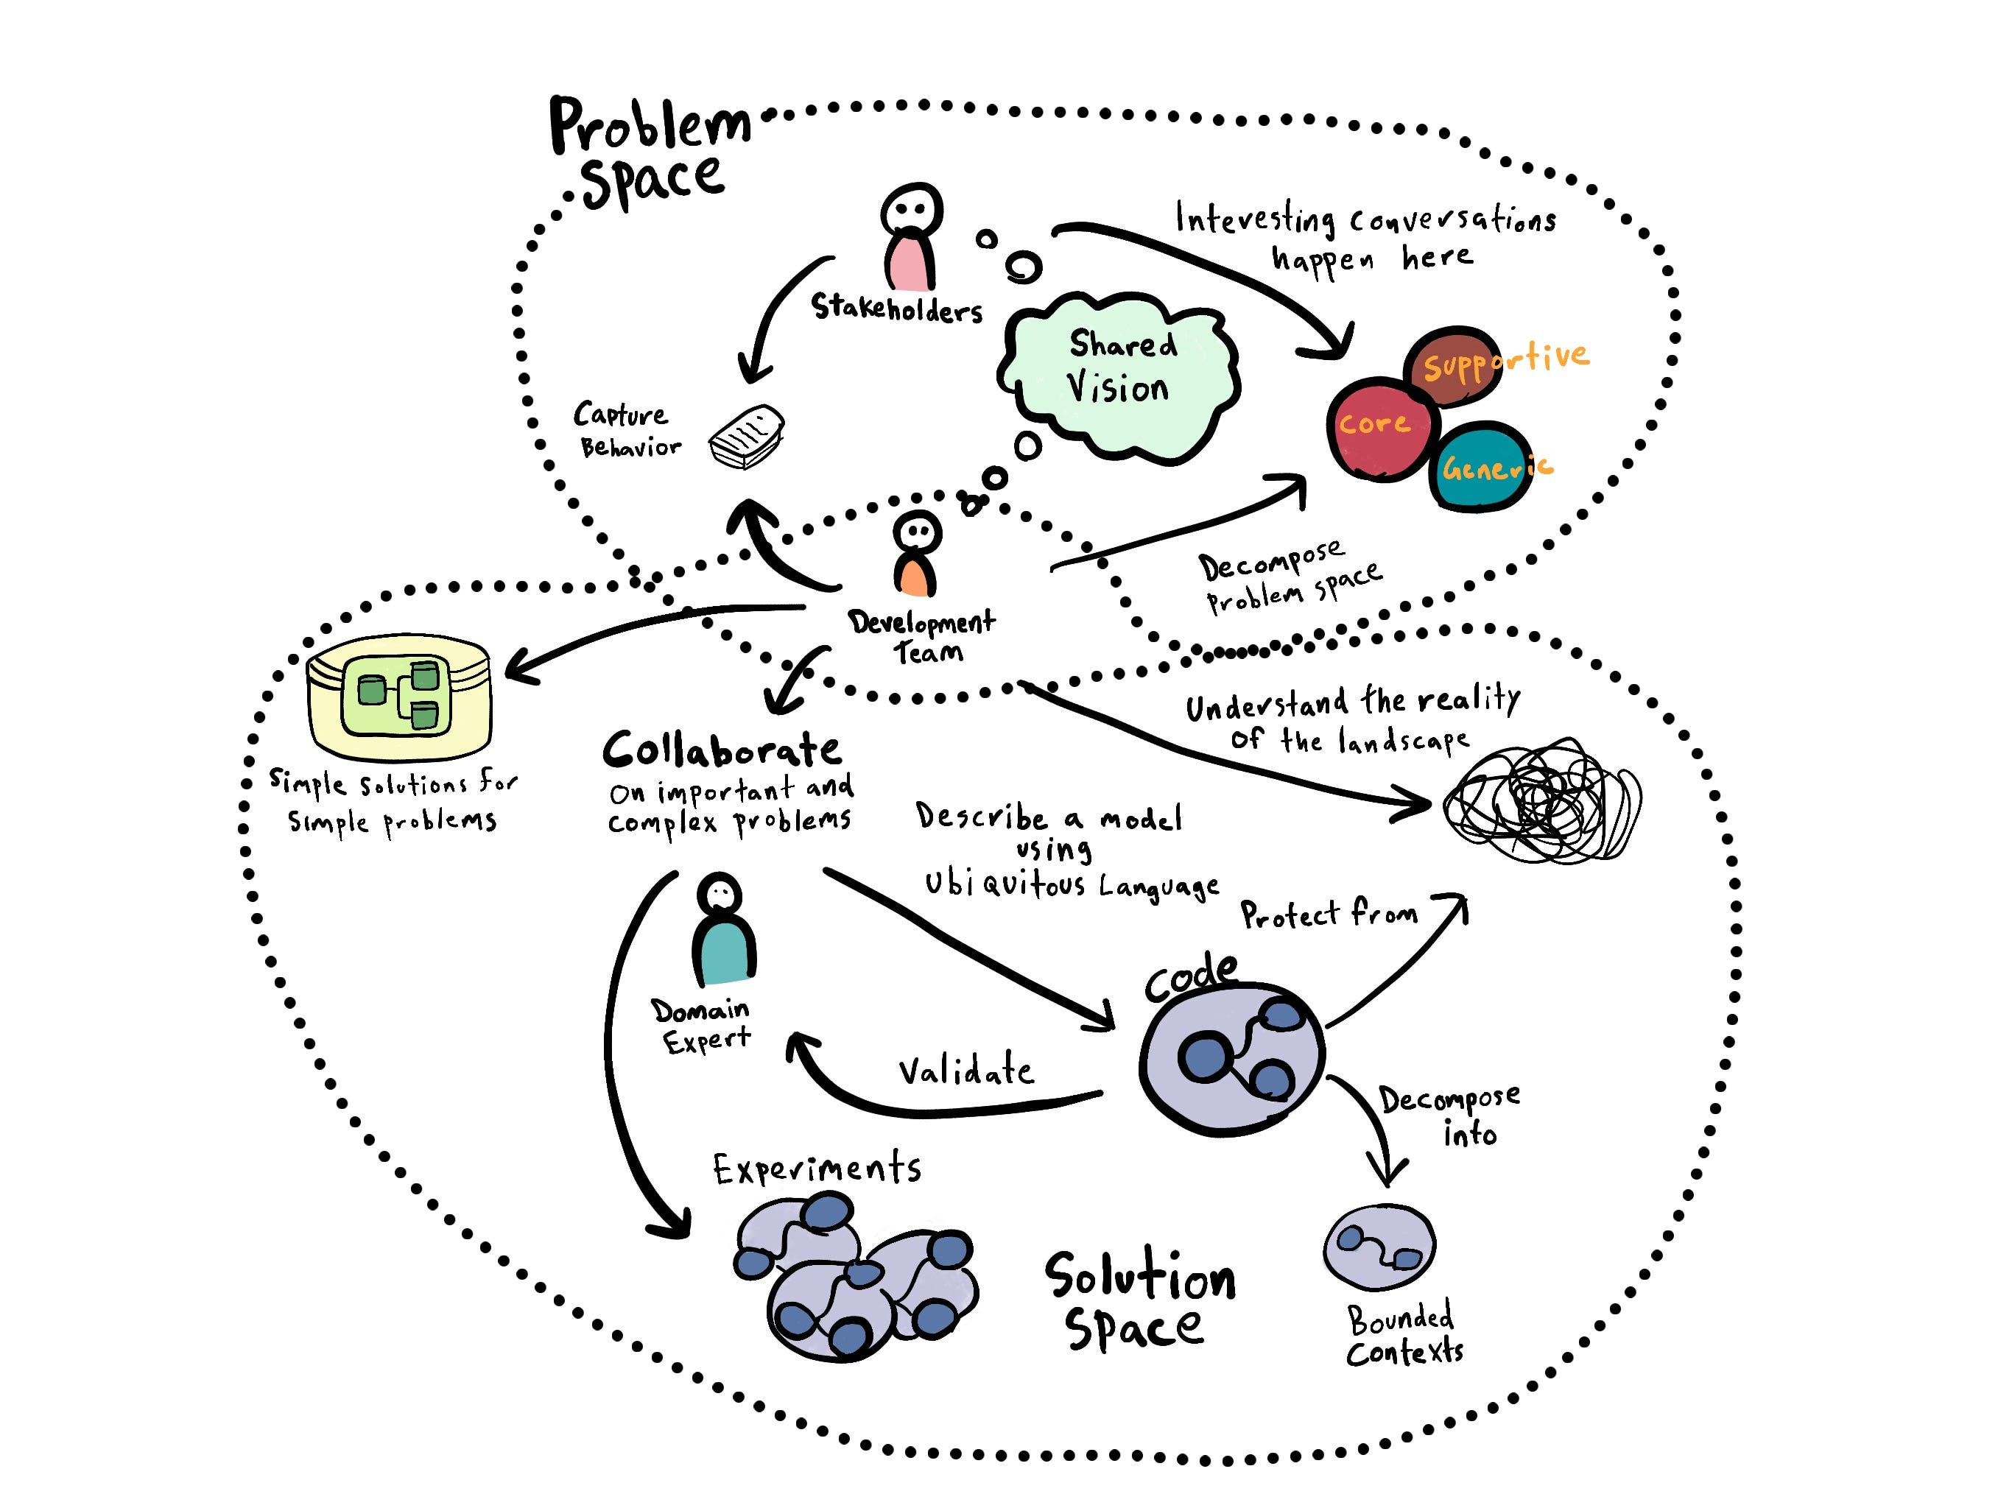
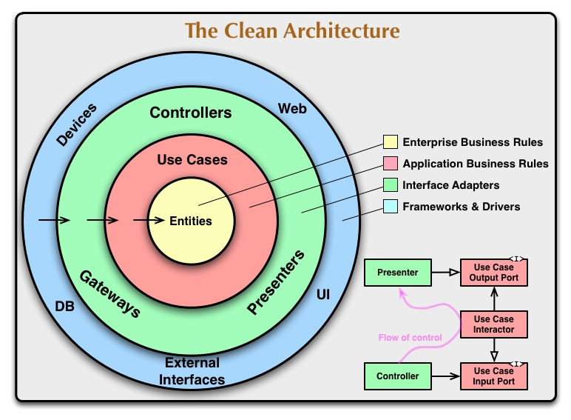
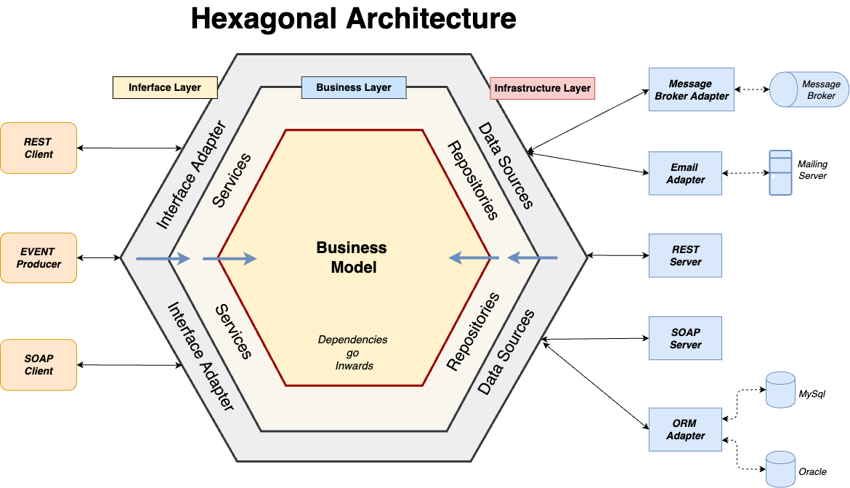

Slide 60
Acknowledgement
Practical test pyramid (Ham Vocke): https://martinfowler.com/articles/practical-test-pyramid.html
TDD, where did it all go wrong? (Ian Cooper): https://www.youtube.com/watch?v=EZ05e7EMOLM
BUILD STUFF'13: Ian Cooper - TDD, where did it all go wrong: https://www.youtube.com/watch?v=HNjlJpuA5kQ
Unit Test (Martin Fowler): https://martinfowler.com/bliki/UnitTest.html

Slide 61
The end
Website: lindbakk.com
Email: contact@lindbakk.com
bspoke: bspoke.no/kontakt-oss
Code: https://github.com/atomfinger/JavaZone-2024

