Slide 1
CS145: Intro to Databases
Lecture 1: Course Overview

Slide 2
The world is increasingly driven by data…
This class teaches the basics of how to use & manage data.

Slide 3
Key Questions We Will Answer
How can we collect and store large amounts of data?
By building tools and data structures to efficiently index and serve data
How can we efficiently query data?
By compiling high-level declarative queries into efficient low-level plans
How can we safely update data?
By managing concurrent access to state as it is read and written
How do different database systems manage design trade-offs?
e.g., at scale, in a distributed environment?

Slide 4
When you’ll use this material
Building almost any software application
e.g., mobile, cloud, consumer, enterprise, analytics, machine learning
Corollary: every application you use uses a database
Bonus: every program consumes data (even if only the program text!)
Performing data analytics
Business intelligence, data science, predictive modeling
(Even if you’re using Pandas, you’re using relational algebra!)
Building data-intensive tools and applications
Many core concepts power deep learning frameworks to self-driving cars

Slide 5
Today’s Lecture
Introduction, admin & setup
ACTIVITY: Jupyter “Hello World!”
Overview of the relational data model
ACTIVITY: SQL in Jupyter
Overview of DBMS topics: Key concepts & challenges

Slide 6
1. Introduction, admin & setup
Section 1

Slide 7
What you will learn about in this section
Section 1
Motivation for studying DBs
Administrative structure
Course logistics
Overview of lecture coverage
ACTIVITY: Jupyter “Hello World!”

Slide 8
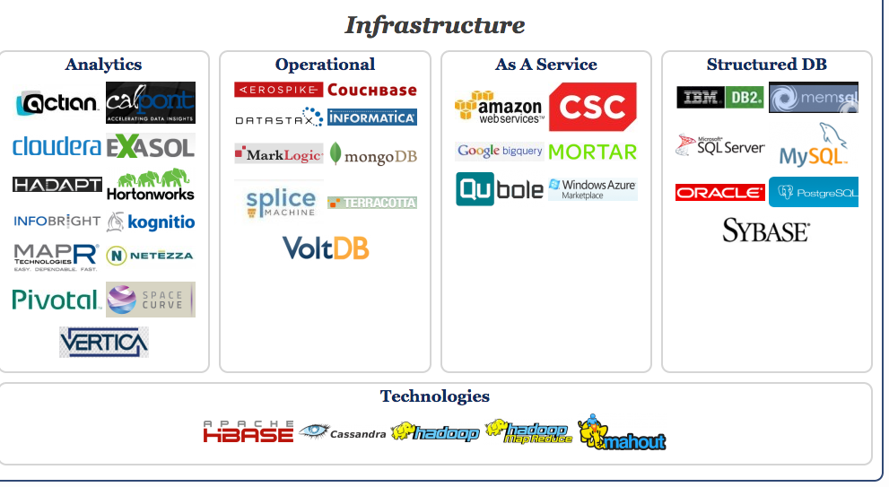
Big Data Landscape… Infrastructure is Changing
Section 1 > Introduction
New tech. Same Principles.
http://www.bigdatalandscape.com/

Slide 9


Why should you study databases?
Section 1 > Introduction
Mercenary- make more $$$:
Startups need DB talent right away = low employee #
Massive industry…
Intellectual:
Science: data poor to data rich
No idea how to handle the data!
Fundamental ideas to/from all of CS:
Systems, theory, AI, logic, stats, analysis….
Many great computer systems ideas started in DB.

Slide 10
What this course is (and is not)
Section 1 > Introduction
Discuss fundamentals of data management
How to design databases, query databases, build applications with them.
How to debug them when they go wrong!
Not how to be a DBA or how to tune Oracle 12g.
We’ll cover how database management systems work
And some (but not all of) the principles of how to build them
see 245, 345, and 346.

Slide 11
Who we are…
Section 1 > Administrative > Course Staff
Instructor (me) Peter Bailis
Faculty in the InfoLab
Second year at Stanford, first time teaching CS145!
Research: tools + systems for large-scale data analytics
Office hours: T/Th 4:30-5:30, Gates 410

Slide 12
Course Assistants (CAs)
Section 1 > Administrative > Course Staff

Slide 13
Section 1 > Administrative > Course Staff
Dev Bhargava
William Chen
Soroosh Hemmati
Woncheol Jeong
Lingtong Sun
Stephanie Tang
Amelia Vu

Slide 14
Section 1 > Administrative > Course Staff
Tara
Head CA

Slide 15
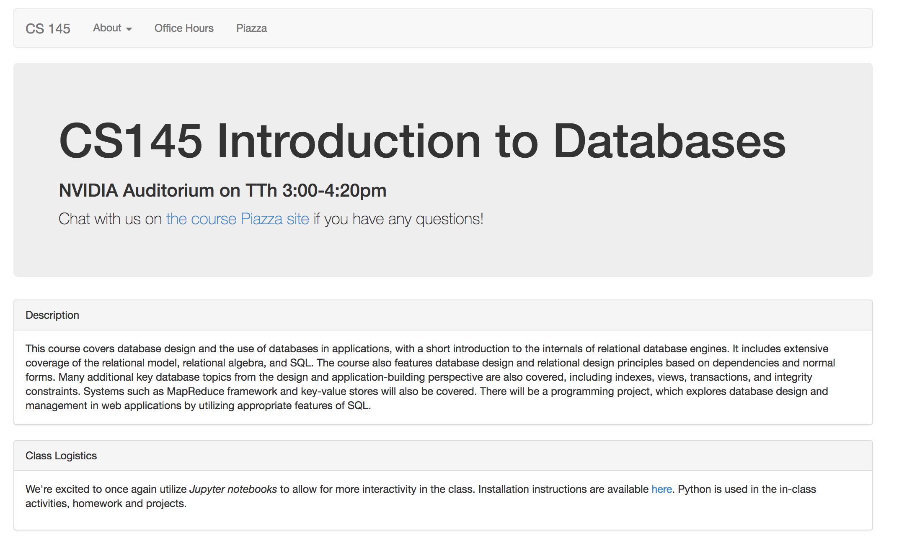
CS145.stanford.edu

Slide 16
Communication w/ Course Staff
Section 1 > Administrative
Piazza
Office hours
By appointment!
OHs are listed on the course website!

Slide 17
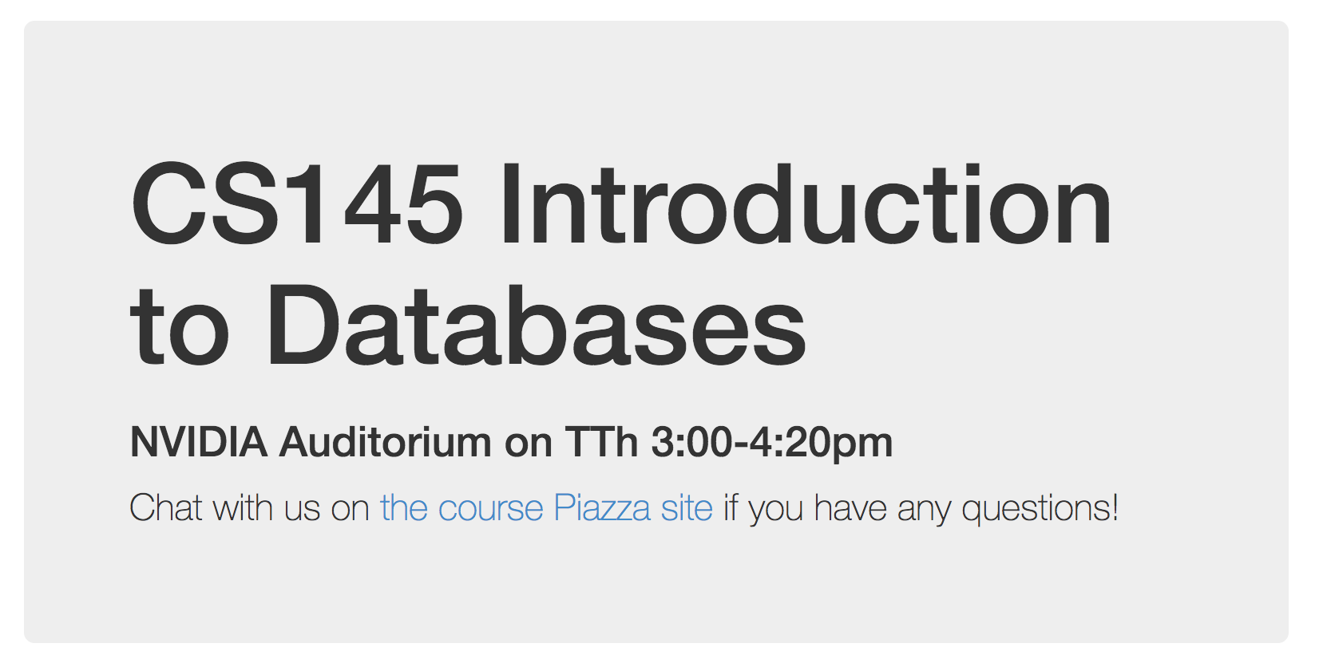
Piazza
Section 1 > Administrative
The goal is to get you to answer each other’s questions so you can benefit and learn from each other.

Slide 18
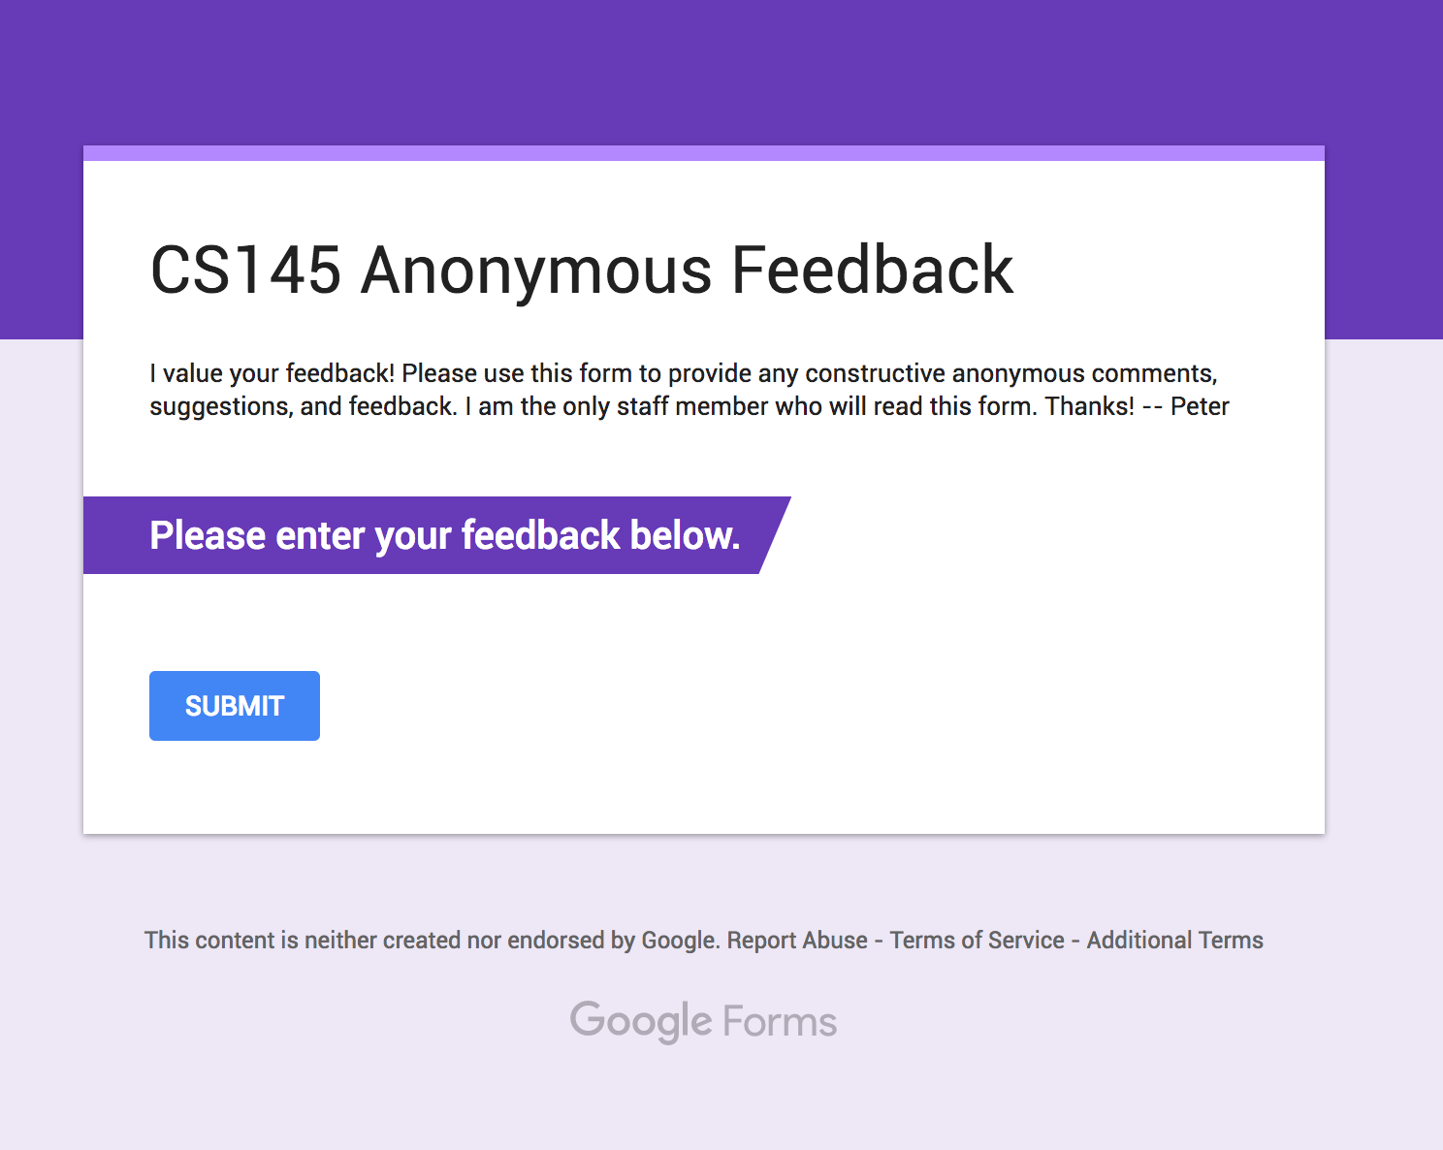
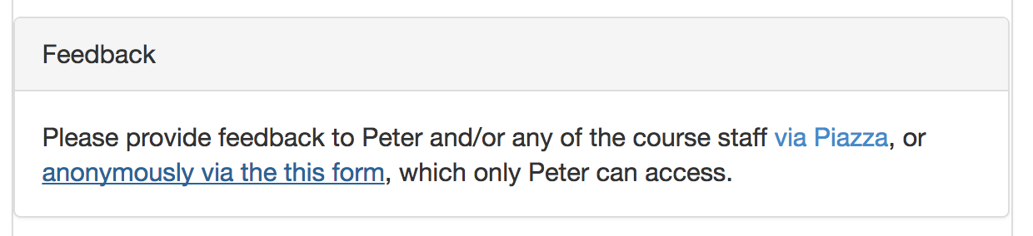

Slide 19
Important!
Section 1 > Administrative
Students with documented disabilities should send in their accommodation letter from O.A.E. (Office of Accessible Education) by the end of this week to Tara Balakrishnan (Head CA) & cc’ me.

Slide 20
Course Website: cs145.stanford.edu
Section 1 > Administrative

Slide 21
Lectures
Section 1 > Logistics
Lecture slides cover essential material
This is your best reference.
We are trying to get away from book, but do have pointers
Try to cover same thing in many ways: Lecture, lecture notes, homework, exams (no shock)
Attendance makes your life easier…

Slide 22
Attendance
Section 1 > Logistics
I dislike mandatory attendance… but in the past we noticed…
People who did not attend did worse ☹
People who did not attend used more course resources ☹
People who did not attend were less happy with the course ☹
Last year: mandatory attendance
This year: voluntary (to start!) -- reserve right to change

Slide 23
Graded Elements
Section 1 > Logistics
Assignments are typically due Tuesday before class, typically 2 weeks to complete
Problem Sets (25%)
Programming project (25%)
Midterm (20%)
Final exam (30%)

Slide 24
Un-Graded Elements
Section 1 > Logistics
Readings provided to help you!
Only items in lecture, homework, or project are fair game.
Activities are again mainly to help / be fun!
Will occur during class- not graded, but count as part of lecture material (fair game as well)
Jupyter Notebooks provided
These are optional but hopefully helpful.
Redesigned so that you can ‘interactively replay’ parts of lecture

Slide 25
What is expected from you
Section 1 > Logistics
Attend lectures
If you don’t, it’s at your own peril
Be active and think critically
Ask questions, post comments on forums
Do programming and homework projects
Start early and be honest
Study for tests and exams

Slide 26
Lectures: 1st half - from a user’s perspective
Section 1 > Lectures
Foundations: Relational data models & SQL
Lectures 2-3
How to manipulate data with SQL, a declarative language
reduced expressive power but the system can do more for you
Database Design: Design theory and constraints
Lectures 4-6
Designing relational schema to keep your data from getting corrupted
Transactions: Syntax & supporting systems
Lectures 7-8
A programmer’s abstraction for data consistency

Slide 27
Lectures: 2nd half - understanding how it works
Section 1 > Lectures
4. Introduction to database systems
Lectures 12-16
Indexing
External Memory Algorithms (IO model) for sorting, joins, etc.
Basics of query optimization (Cost Estimates)
Relational algebra
5. Specialized and New Data Processing Systems
Lectures 17-19
Key-Value Stores
Hadoop and its 10 year anniversary
SparkSQL. The re-rise of SQL
Next-gen analytics systems & current intersections with ML & AI

Slide 28
Lectures: A note about format of notes
Section 1 > Lectures
Take note!!
These are asides / notes (still need to know these in general!)
Definitions in blue with concept being defined bold & underlined
Main point of slide / key takeaway at bottom
Warnings- pay attention here!

Slide 29

Jupyter Notebook “Hello World”
Section 1 > ACTIVITY
Jupyter notebooks are interactive shells which save output in a nice notebook format
They also can display markdown, LaTeX, HTML, js…
You’ll use these for
in-class activities
interactive lecture supplements/recaps
homeworks, projects, etc.- if helpful!
FYI: “Jupyter Notebook” are also called iPython notebooks but they handle other languages too.
Note: you do need to know or learn python for this course!

Slide 30
Jupyter Notebook Setup
Section 1 > ACTIVITY
HIGHLY RECOMMENDED. Install on your laptop via the instructions on the next slide / Piazza
Other options running via one of the alternative methods:
Ubuntu VM.
Corn
Come to our Installation Office Hours after this class and tomorrow!
Please help out your peers by posting issues / solutions on Piazza!
As a general policy in upper-level CS courses, Windows is not officially supported. However we are making a best-effort attempt to provide some solutions here!

Slide 31
Jupyter Notebook Setup
Section 1 > ACTIVITY
https://github.com/stanford-futuredata/cs145-2017/blob/master/jupyter_install.md
CAs will be coming around to help with setup & installation

Slide 32
Activity-1-1.ipynb
Section 1 > ACTIVITY

Slide 33
2. Overview of the relational data model
Section 2

Slide 34
What you will learn about in this section
Section 2
Definition of DBMS
Data models & the relational data model
Schemas & data independence
ACTIVITY: Jupyter + SQL

Slide 35
What is a DBMS?
Section 2 > DBMS
A large, integrated collection of data
Models a real-world enterprise
Entities (e.g., Students, Courses)
Relationships (e.g., Alice is enrolled in 145)
A Database Management System (DBMS) is a piece of software designed to store and manage databases

Slide 36
A Motivating, Running Example
Section 2 > Data models
Consider building a course management system (CMS):
Students
Courses
Professors
Who takes what
Who teaches what
Entities
Relationships

Slide 37
Data models
Section 2 > Data models
A data model is a collection of concepts for describing data
The relational model of data is the most widely used model today
Main Concept: the relation- essentially, a table
A schema is a description of a particular collection of data, using the given data model
E.g. every relation in a relational data model has a schema describing types, etc.

Slide 38
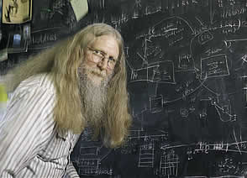
“Relational databases form the bedrock of western civilization”
Section 2 > Data models
- Bruce Lindsay, IBM Research

Slide 39
Modeling the CMS
Section 2 > Data models
Logical Schema
Students(sid: string, name: string, gpa: float)
Courses(cid: string, cname: string, credits: int)
Enrolled(sid: string, cid: string, grade: string)
sid | Name | Gpa
101 | Bob | 3.2
123 | Mary | 3.8
Relations
cid | cname | credits
564 | 564-2 | 4
308 | 417 | 2
Students
sid | cid | Grade
123 | 564 | A
Courses
Enrolled

Slide 40
Modeling the CMS
Section 2 > Data models
Logical Schema
Students(sid: string, name: string, gpa: float)
Courses(cid: string, cname: string, credits: int)
Enrolled(sid: string, cid: string, grade: string)
sid | Name | Gpa
101 | Bob | 3.2
123 | Mary | 3.8
Corresponding keys
cid | cname | credits
564 | 564-2 | 4
308 | 417 | 2
Students
sid | cid | Grade
123 | 564 | A
Courses
Enrolled

Slide 41
Other Schemata…
Section 2 > Schemata
Physical Schema: describes data layout
Relations as unordered files
Some data in sorted order (index)
Logical Schema: Previous slide
External Schema: (Views)
Course_info(cid: string, enrollment: integer)
Derived from other tables
Administrators
Applications

Slide 42
Data independence
Section 2 > Schemata
Concept: Applications do not need to worry about how the data is structured and stored
Logical data independence: protection from changes in the logical structure of the data
I.e. should not need to ask: can we add a new entity or attribute without rewriting the application?
Physical data independence: protection from physical layout changes
I.e. should not need to ask: which disks are the data stored on? Is the data indexed?
One of the most important reasons to use a DBMS

Slide 43
Activity-1-2.ipynb
Section 2 > ACTIVITY

Slide 44
3. Overview of DBMS topics
Section 3
Key concepts & challenges

Slide 45
What you will learn about in this section
Section 3
Transactions
Concurrency & locking
Atomicity & logging
Summary

Slide 46
Challenges with Many Users
Section 3 > DBMS Challenges
Suppose that our CMS application serves 1000’s of users or more- what are some challenges?
Security: Different users, different roles
Performance: Need to provide concurrent access
Consistency: Concurrency can lead to update problems
We won’t look at too much in this course, but is extremely important
Disk/SSD access is slow, DBMS hide the latency by doing more CPU work concurrently
DBMS allows user to write programs
as if they were the only user

Slide 47
Transactions
Section 3 > DBMS Challenges
A key concept is the transaction (TXN): an atomic sequence of db actions (reads/writes)
Atomicity: An action either completes entirely or not at all
Acct | Balance
a10 | 20,000
a20 | 15,000
Transfer $3k from a10 to a20:
Debit $3k from a10
Credit $3k to a20
Acct | Balance
a10 | 17,000
a20 | 18,000
Written naively, in which states is atomicity preserved?
Crash before 1,
After 1 but before 2,
After 2.
DB Always preserves atomicity!

Slide 48
Transactions
Section 3 > DBMS Challenges
A key concept is the transaction (TXN): an atomic sequence of db actions (reads/writes)
If a user cancels a TXN, it should be as if nothing happened!
Transactions leave the DB in a consistent state
Users may write integrity constraints, e.g., ‘each course is assigned to exactly one room’
Atomicity: An action either completes entirely or not at all
Consistency: An action results in a state which conforms to all integrity constraints
However, note that the DBMS does not understand the real meaning of the constraints– consistency burden is still on the user!

Slide 49
Challenge: Scheduling Concurrent Transactions
Section 3 > DBMS Challenges
The DBMS ensures that the execution of {T₁,…,T_{n}} is equivalent to some serial execution
One way to accomplish this: Locking
Before reading or writing, transaction requires a lock from DBMS, holds until the end
Key Idea: If T_{i} wants to write to an item x and T_{j} wants to read x, then T_{i}, T_{j} conflict. Solution via locking:
only one winner gets the lock
loser is blocked (waits) until winner finishes
A set of TXNs is isolated if their effect is as if all were executed serially
What if T_{i} and T_{j} need X and Y, and T_{i} asks for X before T_{j,} and T_{j} asks for Y before T_{i}?
-> Deadlock! One is aborted…
All concurrency issues handled by the DBMS…

Slide 50
Ensuring Atomicity & Durability
Section 3 > DBMS Challenges
DBMS ensures atomicity even if a TXN crashes!
One way to accomplish this: Write-ahead logging (WAL)
Key Idea: Keep a log of all the writes done.
After a crash, the partially executed TXNs are undone using the log
Write-ahead Logging (WAL): Before any action is finalized, a corresponding log entry is forced to disk
We assume that the log is on “stable” storage
All atomicity issues also handled by the DBMS…

Slide 51
A Well-Designed DBMS makes many people happy!
Section 3 > Summary
End users and DBMS vendors
Reduces cost and makes money
DB application programmers
Can handle more users, faster, for cheaper, and with better reliability / security guarantees!
Database administrators (DBA)
Easier time of designing logical/physical schema, handling security/authorization, tuning, crash recovery, and more…
Must still understand
DB internals

Slide 52
Summary of DBMS
Section 3 > Summary
DBMS are used to maintain, query, and manage large datasets.
Provide concurrency, recovery from crashes, quick application development, integrity, and security
Key abstractions give data independence
DBMS R&D is one of the broadest, most exciting fields in CS. Fact!

